Slide 1
Higher Physical Education Exam 2018 Question by Question Self Regulation

Slide 2
What do you see when you see the question…

Slide 3
Aspects to consider when approaching questions…
The factor (s) named within the question – The features you then known most about for that factor
The topic area most closely linked to the question – Naming these next to the topic area comes in handy too
The number of marks for the question – E.g., 4 marks for describe means you are required to provide 4 points of description

Slide 4
Annotate the question… Eventually you will train yourself to do this in your head!
Use arrows
Use highlighters
Make connections with your answer

Slide 7
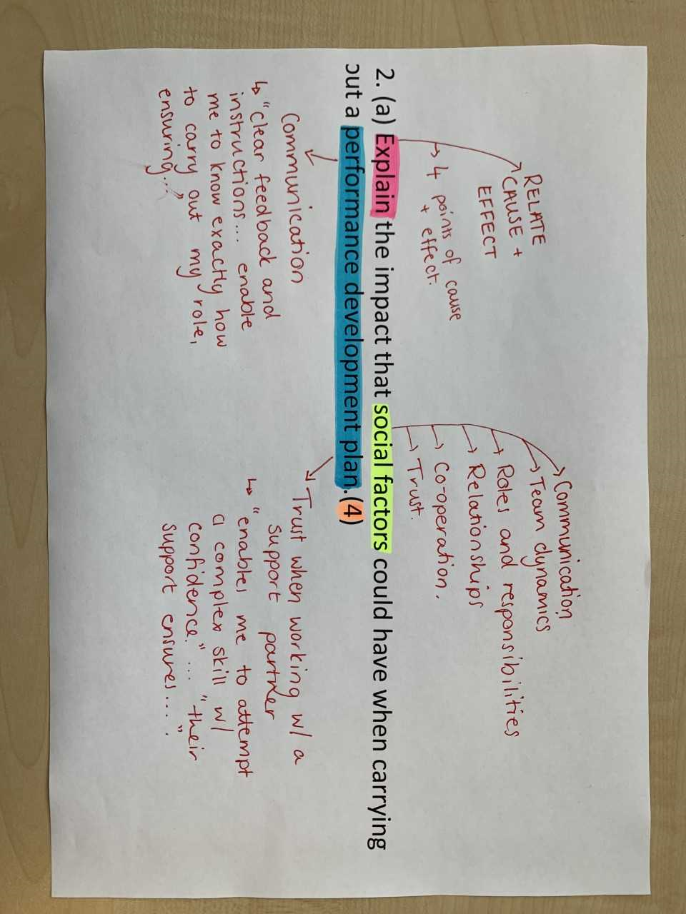

Slide 10
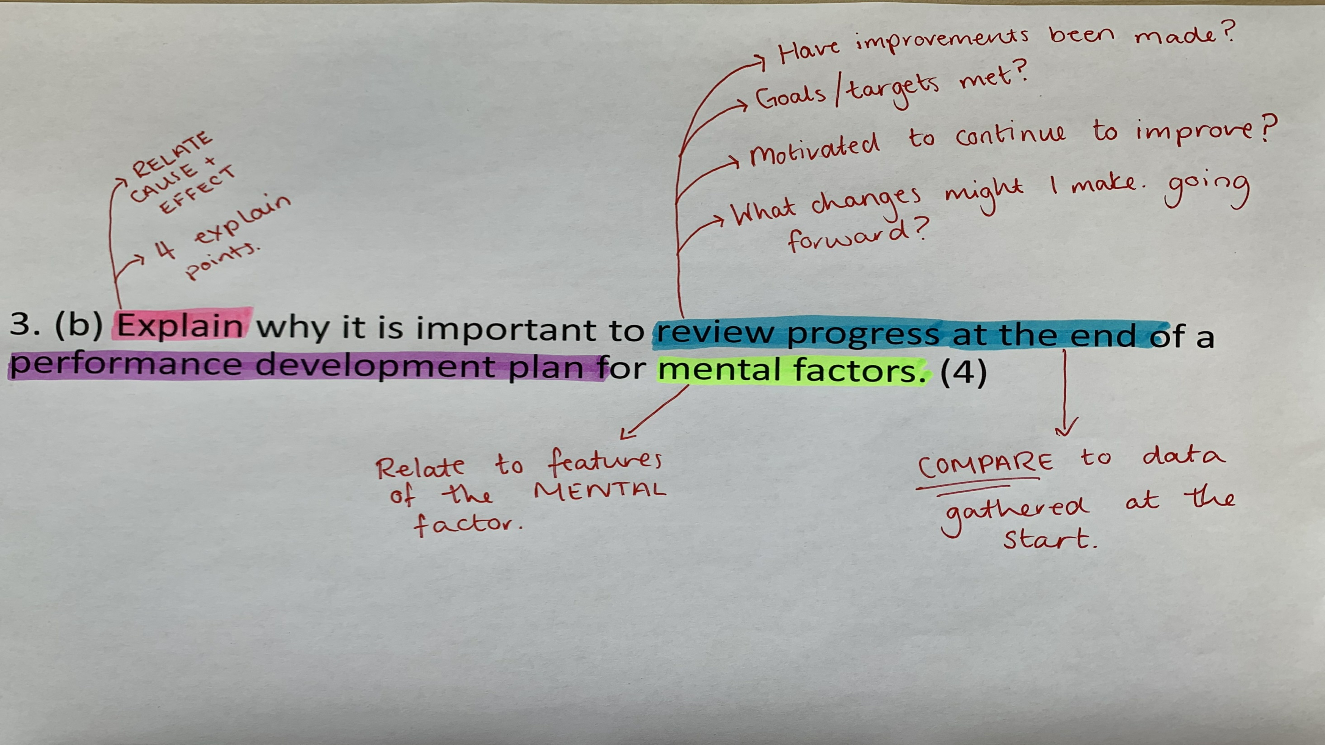

Slide 11
