Slide 1
Advanced Higher physical education

Slide 2
Entry
Higher Physical Education @ A/B Level
Higher English @ A/B/C Level
High Level Performer

Slide 3
What can you make use of
Online Sources
The Library at the back of the PE Classroom
Online Journals
Google Scholar
Glasgow University Library (to be finalised)

Slide 4
Wikipedia
NOT ACCEPTABLE

Slide 5
Initial task
Approximately 10 hours (the duration of time you would be in class)
Time to complete – 2 Weeks
Method of submission -> Email / Printed / USB
gw14gemmilljohn3@glow.sch.uk

Slide 6
Initial task
Carry out, and explain, 4 methods of gathering information on all 4 Factors.
The 4 methods you will start with are:
A Self Reflective Questionnaire
Performance Profiling
Interviewing
One Standardised Test (does not need to be carried out quite yet as you have done these during your two year course)

Slide 7
Self Reflective Questionnaire
Carefully take your time to work your way through the self-reflective questionnaire provided, all in relation to your own performance, in the activity you will be carrying out your investigation on.

Slide 8
Performance Profile
Carefully take your time to complete the 4 performance profile wheels provided, all in relation to your own performance, in the activity you will be carrying out your investigation on.
The MORE you SHADE, the MORE you perceive that to be an identified STRENGTH

Slide 9
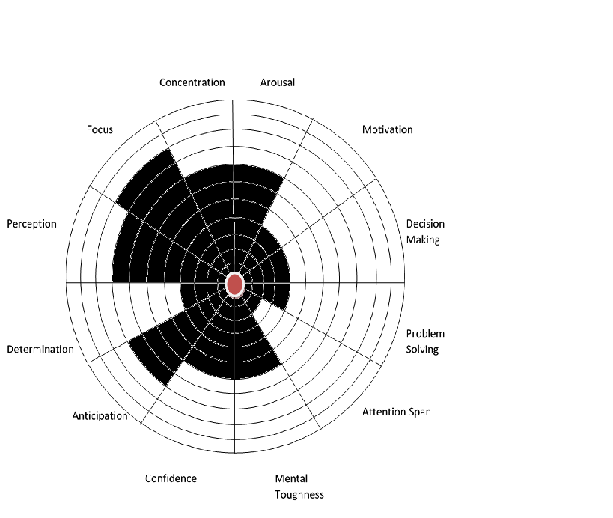

Slide 10
Interview
Carry out an interview with a peer or teacher who is knowledgeable about your chosen activity.
The interview should be approximately 5-10 minutes long and you should create open ended questions that will allow the interviewee to provide an in-depth evaluation of your performance (ALL FACTORS)
You should record the interview on a mobile device and transcribe fully (replay the audio file and type up the responses).
Alternatively you can take detailed notes (LESS VALID FOR ANALYSIS PURPOSES WHICH WILL COME LATER).

Slide 11
Interview availability / Minor Drop in periods
Mr Gemmill -> M1, M4, T2, W1, W4, W5, T2, T5, F1, F2, F3, F4
Mr Richardson -> M1, M4, T1, W3, W4, T2, F1, F2, F3
(Requests to interview a member of the PE staff must be done in week 1)

Slide 12
One standardised Test
E.g., Bleep Test, Cooper Run, Illinois Agility Run, 1 Rep Max
You do not have to carry this test out at the moment but you may choose to do so, which will help your answer. You will have completed these during your two year course and will possibly re visit in Task 2.
This particular part of the task is MORE about your ability to explain why you would use one of the standardised tests, referencing literature..

Slide 13
Explaining each of the four methods
For this part of the task you have to reflect on the methods of data gathering you have carried out and explain the benefits of the method and why you used them, referencing literature….

Slide 14
Example
“I carried out an interview with a teacher who is knowledgeable about my performance and the activity I am investigating, golf. Carrying out an interview provided me with an in-depth evaluation of my performance and detailed qualitative information. As indicated by Madziwa (2016), interviews “are mainly useful in cases where there is need to attain highly personalized data”, which is exactly what I needed in order to analyse my performance. This enabled me to access high quality feedback in relation my strengths and areas for development for all four factors.”
https://www.linkedin.com/pulse/interviewing-data-collection-method-munyaradzi-madziwa

Slide 15
For each explanation of each method
You should have 6 reasons that are referenced
6 for self reflective questionnaires
6 for performance profiles
6 for interviews
6 for your selected standardised test
IN OTHER WORDS, YOU SHOULD HAVE 24 EXAMPLES that meet the standard of the previous slide

Slide 16
What should I have evidence of in 2 weeks
gw14gemmilljohn3@glow.sch.uk
The three methods of data gathering you have carried out for all 4 Factors Impacting on Performance
A hard copy of the questionnaire
A hard copy of each completed performance profile wheel
The audio file and transcription from the interview you have carried out
An EXPLANATION, with evidence from literature, explaining the reasons for the particular methods selected (6 reasons for each method) (including the standardised tests)

Slide 17
Advanced Higher Task 2
Due for Tuesday 26th September
Analyse the impact the 4 Factors have on your performance, based on the information you have gathered.
This should be the information from:
The questionnaire
The performance profile
The interview
EXCLUDE THE STANDARDISED TEST AS YOU HAVE NOT ACTUALLY CARRIED THIS OUT

Slide 18
Structure
POSITIVE & NEGATIVE IMPACT FOR ALL 4 FACTORS
MINIMUM OF 2 POSITIVES and 2 NEGATIVES
Features like decision making and anxiety maybe POSITIVE and NEGATIVE, depending on the context… E.g., Sometimes decision making has a positive impact on my performance in basketball… Sometimes decision making has a negative impact on my performance in basketball…

Slide 19
Information
Cause & Effect
IMPACT

Slide 20
Extrapolating information from your interview

Slide 21
Example
From the information I gathered in my questionnaire I answered the self reflective statement ‘I get nervous before I play’ as a 10, strongly agree. This was also consistent with my performance profile shading and comments made by my coach, who said that I ‘appear nervous before I tee-off’. This relates directly to my performance during competition and medal play heavily increasing my nerves and anxiety. The NHS define anxiety as a ‘feeling of unease, such as worry or fear, that can be mild or severe’ (NHS 2017)1. As an amateur player who plays two to three times per week transferring my performance in bounce games to competitions is something I find very challenging. After playing two or three practice rounds with confidence, consistency and close to handicap I invariably still feel anxious when stepping on the first tee for a medal round. This regularly leads to a drive that lands in a position dissimilar to what I would in a social or bounce game, sometimes further from the hole or in a difficult position to get the green in regulation. When then faced with a challenging second shot, failure to hit an effective recovery shot to lead to, at worst bogey, can then turn into a downwards spiral of frustration and anger after only one hole.

Slide 23
Task 3 - Project Proposal
COME UP WITH A PROJECT PROPOSAL BASED ON THE INFORMATION YOU HAVE GATHERED – This is where the negative factors impacting on performance will become very important!
Example:
“In this project I aim to improve the consistency of my driving off the tee in golf so that I always have a second shot to either, the green, or in a safe position to be on the green in 3 shots. I collected information on my performance using a questionnaire, an interview with an experienced coach and performance profiling.”
Start by simply saying… “In this project I am to…” (KEEP THINGS SIMPLE)

Slide 24
Task 3 - Carrying out a literature review to gather information about the research focus
For this task you must FIND OUT as much as possible about your research proposal. You must holistically review the identified negative factor impacting on performance, making reference to research.
As part of this review you will want to:
EXPAND on the NEGATIVE Factor Impacting on Performance. You can explore and justify the need for ensuring YOUR NEGATIVE is a POSITIVE, and the POSITIVE impact this has on model performers.
REVIEW and INTRODUCE, with EVIDENCE, approaches to develop performance that will turn this NEGATIVE into a POSITIVE.

