Slide 1
S5 and S6
Parental Information Evening
Please turn off your camera and mute your microphone
we will be starting shortly

Slide 2
Agenda
Where are we now?
SQA Alternative Certification Model
How will this look in Hillhead High School?
Further information for pupils and parents
Next steps

Slide 3
Where are we now?
7th October 2020, The Deputy First Minister announces that there will be no external assessment for National 5 courses.
8th December 2020, The Deputy First Minister announces that there will be no external assessments for Higher and Advanced Higher courses.
These announcements meant that on this basis the 2021 SQA National Qualification Examination Diet was cancelled.
Alternative certification model produced (more on that a little later!) to take into account the period of remote learning.

Slide 4
Where are we now? Positive position!
2 year curriculum model in S4/5 means that in many subjects the course content has been covered.
Assessment period between October and December allowed us to capture evidence.
We have time/opportunities ahead for all pupils to consolidate or improve.
Teamwork!

Slide 5
SQA Alternative Certification Model
Created in partnership with the National Qualifications 2021 Group which includes representatives from across the education system including the National Parent Forum and the Scottish Youth Parliament.

Slide 6
Hillhead High School ACM
We have created an infographic to show how the stages of the SQA's alternative certification model will look, in reality, at Hillhead High.
An A4 copy of this will be made available after the information evening.

Slide 7
Behind the Scenes...
Staff across the school are working on quality assurance and moderation activities to ensure that provisional results are realistic, fair and at the national standard.
Robust procedures are in place for internal, external, city-wide and national quality assurance.
This ensures that pupils who are awarded results in our school are marked to the same standard as pupils in other parts of the country.

Slide 8
Behind the Scenes...
The quality assurance process includes:
All staff engaging with question papers and marking schemes.
All staff reading, discussing and working through all SQA documentation.
All staff blind marking and moderating pupils' work within departments and across our allocated 'quad' schools in the North West.
PTs/FHs from Hillhead will participate in city-wide moderation.
Samples of marking will be selected by SQA for national quality assurance.

Slide 9
Focus on Learning and Teaching Up to APRIL 2021
Focus on Learning and Teaching throughout remote learning period.
In school sessions for essential practical subject work.
Phased return – pupils accessing all of their SQA qualification subjects in some format.
Class teachers continue to focus on learning and teaching up to the Easter Holidays.

Slide 10
Focus on Consolidation of Learning Practical Evidence Opportunities APRIL 2021
Time to revisit areas covered in remote learning/revision of topics.
Practical evidence may be gathered – folio pieces, assignments, projects etc. where these are still components of the course.
Learner conversations with class teachers will let pupils know how they are progressing in subjects and will focus on what is needed to progress. Pupils will receive a tracking report with current levels.

Slide 11
Evidence Opportunities MAY 2021
Pupils will have opportunities to catch evidence across their subjects.
Evidence used to for provisional results must be robust – under timed conditions in a secure setting. It is important for all pupils to adhere to SQA conditions in this respect – we will go over expectations with pupils.
Remember – courses for this year were already amended to reduce the amount of evidence required whilst maintaining the validity and credibility of the course.

Slide 12
Evidence Opportunities MAY 2021
Opportunities for gathering evidence will be specific to each subject and level based on the requirements of the course. All evidence will be of demonstrated attainment.
Additional assessment arrangements (AAR) will be in place for pupils who are entitled to these when evidence gathering is taking place. This will also be the case for any timed practice.
We want to give pupils the best possible chance to succeed!

Slide 13
Provisional Results Finalised JUNE 2021
Evidence gathering opportunities will draw to a close
Final Quality assurance at departmental level
Whole school quality assurance will take place and checks made across the school
Provisional results will be submitted to the SQA

Slide 14
POST RESULTS AUGUST 2021
Results will be confirmed to pupils by SQA on August 10th 2021.
SQA have confirmed they will not adjust provisional results after they have been submitted.
There will be a post results appeal service – this is currently being developed by SQA and they are consulting with all stakeholders. You can be part of the consultation process here: https://www.sqa.org.uk/sqa/96506.html. Please take part if you can – it's important for all voices to be heard.

Slide 15
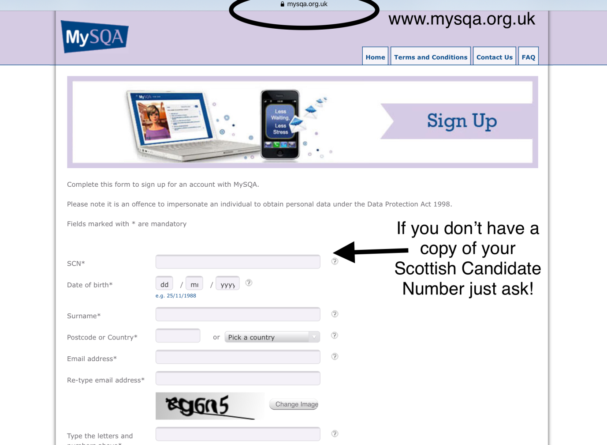
Sign up to MySQA
Check your address is correct for receiving your certificate in August
Check all your subjects and levels are correct
You can also receive your SQA results here (this is not an official transcript)
https://www.mysqa.org.uk/cs8/content/signup_input.action

Slide 16
SQA Learner Booklet
SQA have sent a booklet to the home address of all candidates held by the SQA.
If you have not received the booklet by the end of March please check the address on MySQA. Any changes to address should be passed on to Leanne Black – gw15blackleanne@glow.sch.uk
Can be accessed online:
https://www.sqa.org.uk/sqa/files_ccc/NQ-2021-what-you-need-to-know.pdf

Slide 17
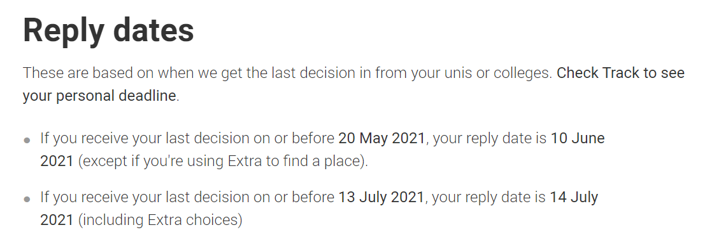
UCAS Applications
https://www.ucas.com/undergraduate/after-you-apply/types-offer/replying-your-ucas-undergraduate-offers

Slide 18
The SQA exam results achieved by pupils in the 2020-2021 session will not only display their attainment levels, but their strength of character, commitment to learning , resilience and ambition as individuals.

Slide 19
Expectations
Full engagement.
Communicate.
Take control.
Work to the best of your ability at all times.

Slide 20
Next Steps
Study packs issued to pupils with materials that can be used at home
Route maps from all subjects collated into a booklet

