Slide 1
S1 Parents’ Information Evening 6.00pm to 6.45
Please mute your mic
Please switch your camera off
The meeting will start in a few minutes...
Welcome Online Learning Support Options Choice Update Expectations Support for your Child's Learning Additional Support for Wellbeing Questions

Slide 2
Itinerary
How the DHT is engaging with the S1 pupils
Feedback for the Pupil Survey on Remote Learning
Examples of pupils’ work
Examples of how Faculties across the school are supporting Remote Learning
How we are supporting pupils with their digital skills
How the school, SFL and Pastoral care are supporting pupils’ health and wellbeing during this time
Looking to the future
Questions

Slide 3
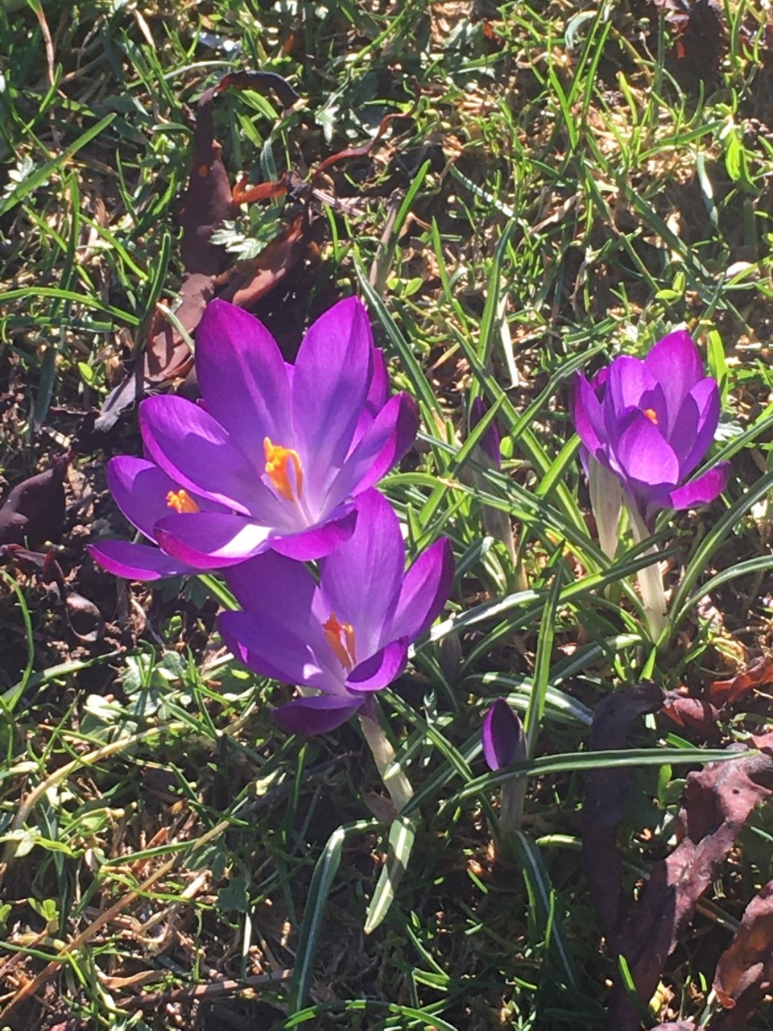
How the DHT is engaging with the S1 pupils
Every morning around 9.00am a Morning Message is sent out through Year Group
Teams Page. Every week a new theme:
Mindfulness Activities
Kindness Week
Riddle Week
Poem and Flower Week
Sharing important information and promoting engagement across the school
It is really important that the Pupils log into this Teams Page in the morning and give me a
Pupils can contact me at any time and I will get back to them as soon as possible
Virtual Office – After Friday Assembly for S1 pupils
Contacting parents by phone

Slide 4
Survey Information
Pupil Survey on Remote Learning
503 pupils completed the survey. Below you can see how many pupils did so in each year group.

Slide 5
Q3: Overall, across the whole school what was your view of the amount of work issued by the school over the past fortnight and whether it can all be completed within the school day while also allowing you time for breaks. You will be able to give feedback on specific subjects in later questions.
https://blogs.glowscotland.org.uk/gc/hillheadhigh/2021/02/01/supporting-your-child-with-online-learning/

Slide 6
Science Pupil and Parent Voice
You said… | We did…
It can be difficult to learn Science from a PowerPoint. | Every lesson will either include a pre-recorded audio or the teacher will host a weekly live check-in lesson for their class.
The instructions can be long and confusing. | Broken down large assignments into three separate ones (one for each lesson) and kept written instructions to a minimum.
It can be difficult to finish all my work in 3 hours. | Reduce the number of tasks issued per lesson.

Slide 7
Feedback to Maths classes
All of your comments have been read and discussed by the department and the main things to share are as follow:
You asked for a balance between live lessons, videos and independent working.
There is now a weekly live lesson for all of S1 as well as individual class lessons.
Tasks will be posted as assignments (rather than on the feed) on Teams to make work easier to find.
A reminder that, as is the case normally in class, teachers do not expect every single question to be done from an exercise.
The popularity of weekly quizzes means they will continue. However, in the BGE they will be shorter

Slide 8
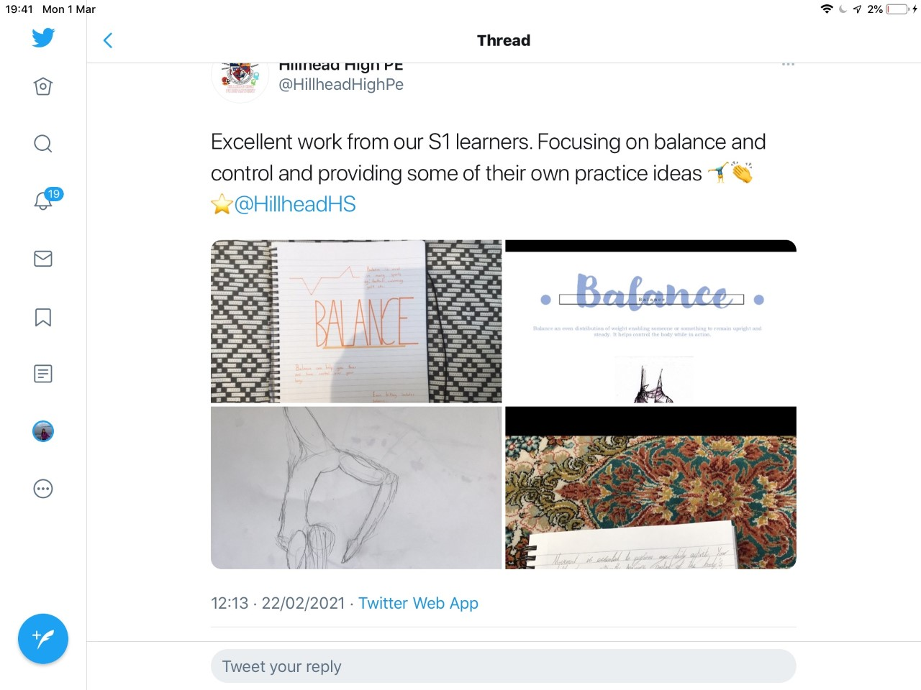
Examples of Pupils’ Work

Slide 9
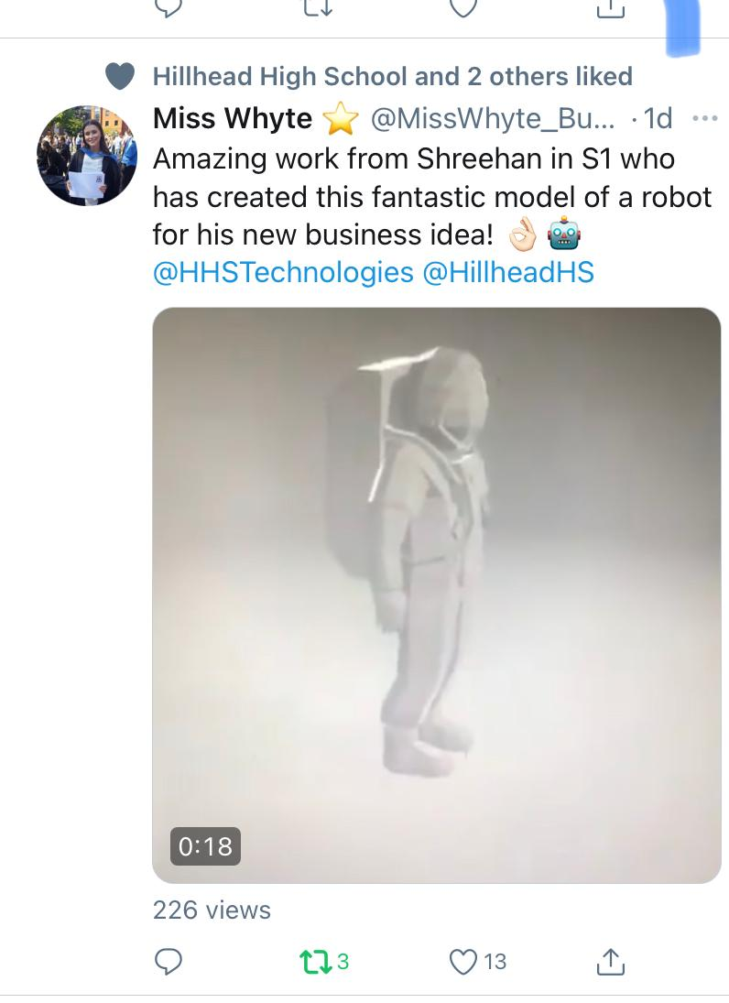
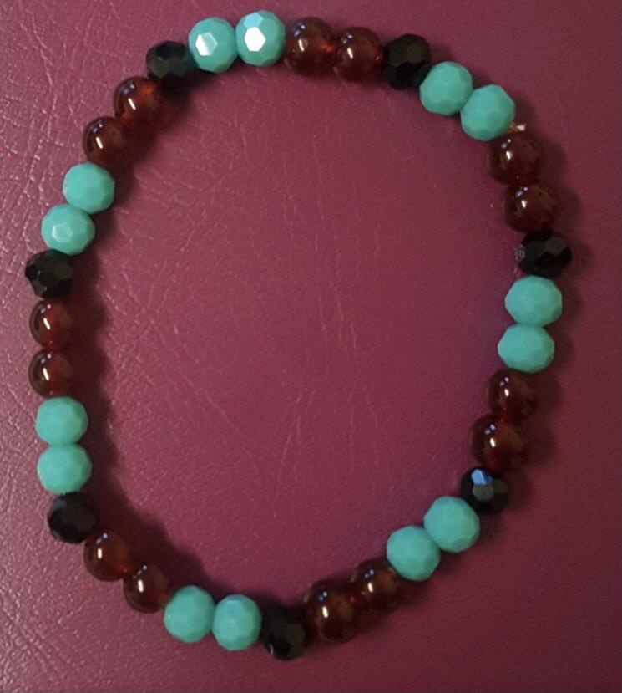
Technologies
Examples of Pupils’ Work
Taherah 1D

Slide 10
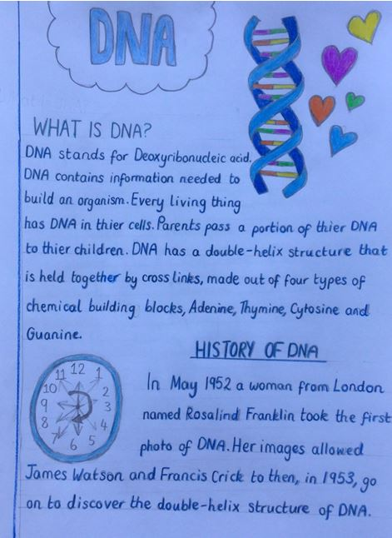
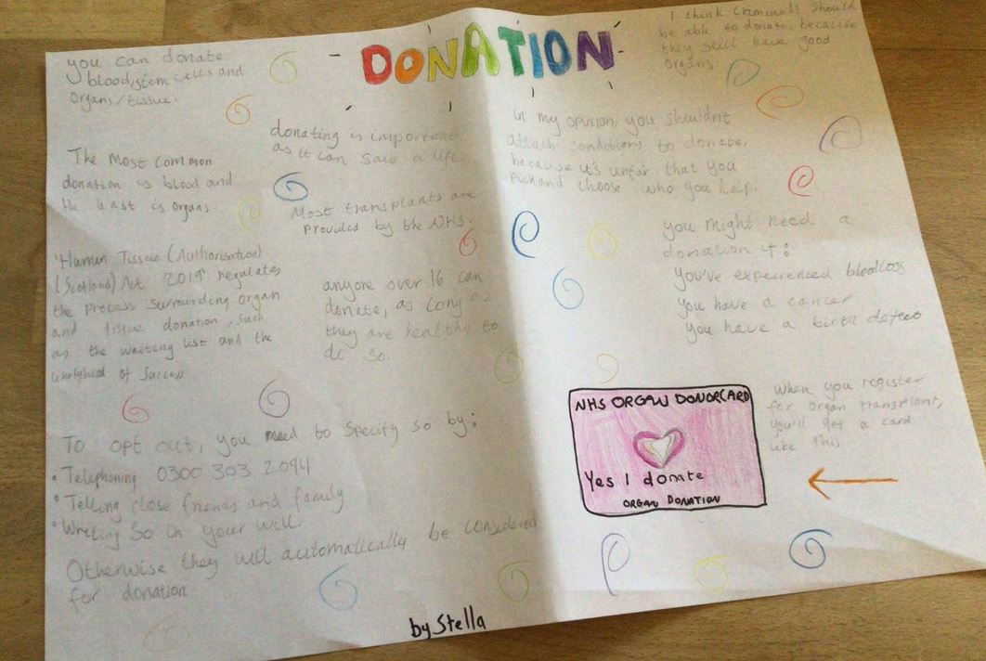
Examples of Pupils’ Work
Science

Slide 11
Examples of Pupils’ Work
Roddy Clark 1B
Humanities

Slide 12
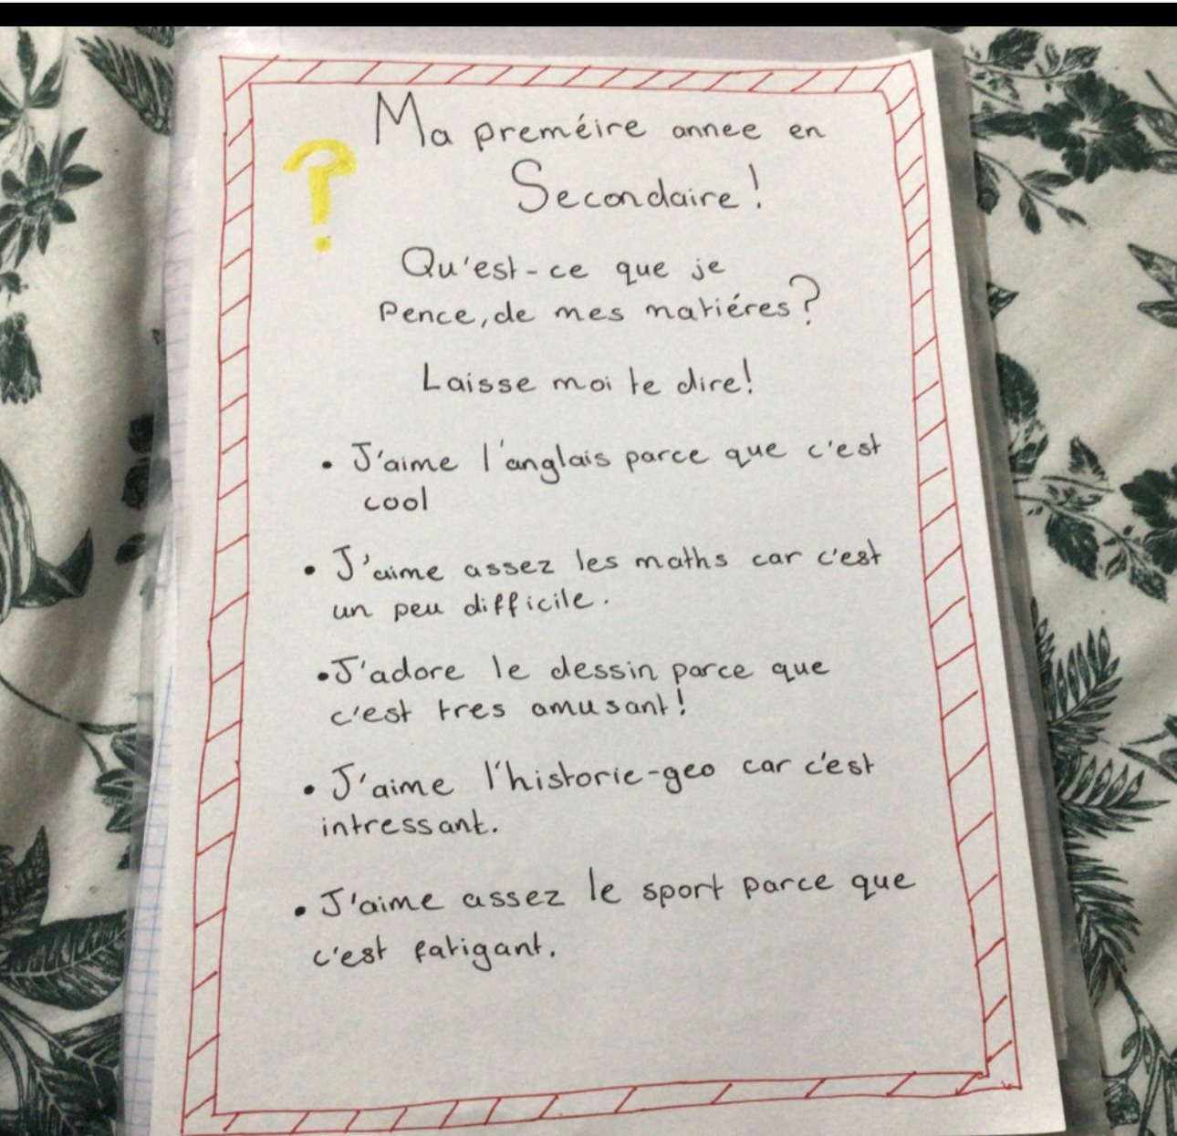
Examples of Pupils’ Work
French

Slide 13
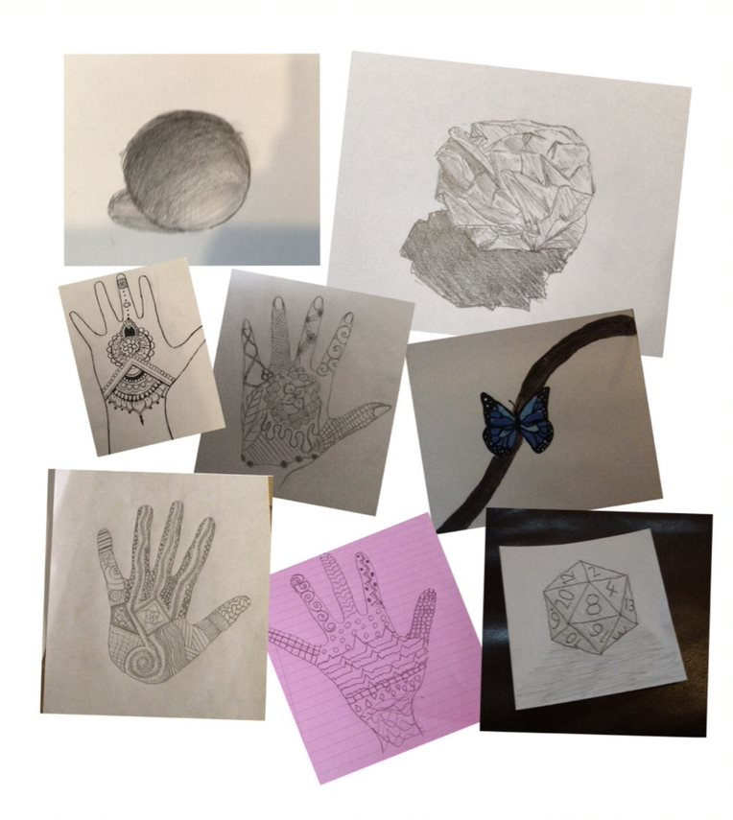
Examples of Pupils’ Work
Art

Slide 14
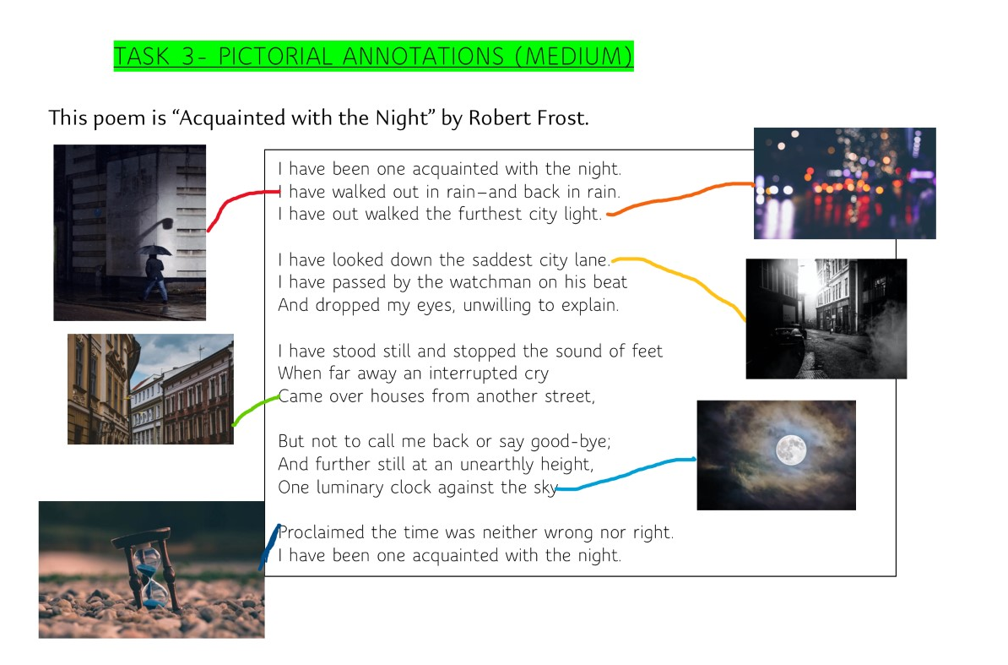
Manon 1C
Arundhati 1C
English

Slide 15
English

Slide 16
How Faculties are Supporting Remote Learning
Physical Education

Slide 17
How Faculties are Supporting Remote Learning

Slide 18
How is home learning working in Science?
3 assignments are uploaded to class Teams on a Monday morning.
Powerpoints will contain a pre-recorded audio recorded by Miss Visovan.
Teachers will schedule live check-ins as required.
There will be work to be submitted for each assignment (lesson), these will be clearly detailed in the presentation.
The deadline for submissions is Friday at 3pm to allow pupils flexibility over when to complete their work.
Class teachers are available on Teams during normal timetabled lessons.
Teachers review work the following week and use praise cards and our Twitter to celebrate pupil success @HillheadScience

Slide 19
The week beginning 8th March we will be celebrating British Science week in all S1-3 classes with some special lessons. Pupils will be given the opportunity to:
Discover and research the diversity of STEM careers.
Take part in online quizzes to see which STEM career suits their skills, personality and likes.
Choose an investigation to complete at home and submit a Science report on it.
Examples of investigations include:
Investigating Epsom salts
Making hot ice
Conscious consumers
Building a working waterwheel
Investigating the best coloured light for photosynthesis

Slide 20
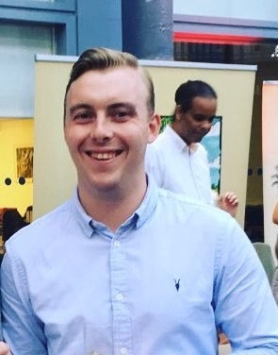
Mr Tait
PT of Digital Literacy
Other examples of how Faculties are supporting
pupils’ in their Remote Learning
Give examples of how he is supporting pupils
with their Digital Literacy

Slide 21
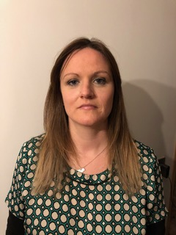
How the School is Providing Support for Pupils
Support for Learning
Regular phone calls with families
check-ins with pupils with ASN: via email and live through Teams
Live Teams learning support sessions
Provision of individualised timetables/study planners for pupils
Provision of individualised SfL resource packs for pupils
Advice to class teachers on how to differentiate materials and support individual pupils
Providing regular updates to class teachers about pupils and families
Sign posting families to learning materials and outside agency supports
Contact Miss McGuire: gw17mcguiresiobhan@glow.sch.uk

Slide 22
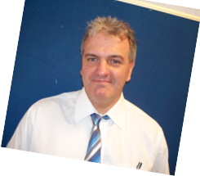
How the School is Providing Support for Pupils
Pastoral Care Support During Lockdown
Pastoral Care offer:
1. A point of contact for pupils, parents and carers.
2. Provide a link to the class teacher.
3. Check-in on the pupil's level of engagement with on-line learning.
4. Act as an advocate for the pupils in matter arising.
5. Allow access to outside agencies.

Slide 23
How the School is Providing Support for Pupils
Health and Wellbeing
Emotional First Aid (L Black )
Mental Health Support Pack (M Docherty)
Screen Time (N Higgins)
Sleep (L Robinson)
Remote support overview (L Black)
https://blogs.glowscotland.org.uk/gc/hillheadhigh/

Slide 24
Looking to the Future
S1 Tracking Reports
Reports will be issued the week
beginning
22nd March

Slide 25
Looking to the Future
What Pupils will Study in S2
English 4
Maths 4
Modern Language 2
Science 3
Social Subjects 3
Physical Education 3
Art 1
Music 1
Drama 1
Technologies 2
Religious Education 1
Personal and Social
Education 1

Slide 28
Question
Time?

