Slide 1
Supporting Your Child With Online Learning The meeting will start in a few minutes......
Please mute your microphone
Please turn your camera off

Slide 2
Itinerary
Online Learning Support Mr Brown
Expectations Mr Neil
Supporting Your Child's Learning Mr Neil
Wellbeing Support Miss Higgins

Slide 3
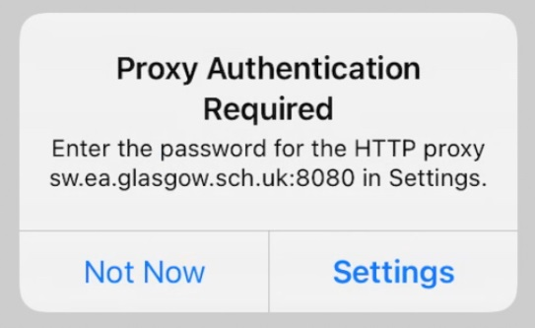
Online Learning Support
Frequent Problems
How they are frequently solved ✅

Slide 4
Online Learning Support
😫
No Internet other than Outlook/Teams/Glow etc.

Slide 5
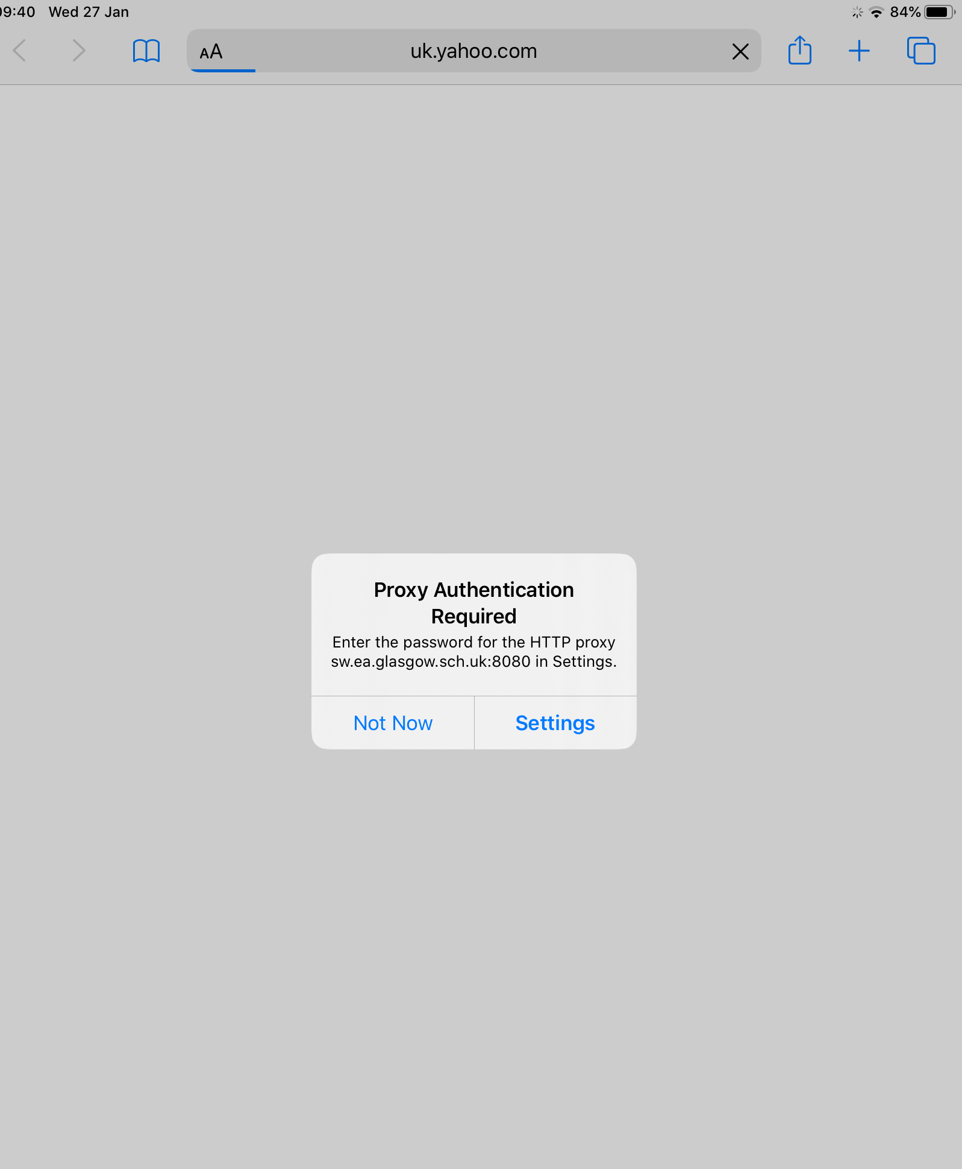
Online Learning Support
No Internet other than Outlook/Teams/Glow etc.
Proxy Authentication must be active:

Slide 6
Online Learning Support
No Internet other than Outlook/Teams/Glow etc.
Always Press 'Settings' NEVER 'Not Now'
Pressing 'Not Now' will disable the external web connectivity

Slide 7
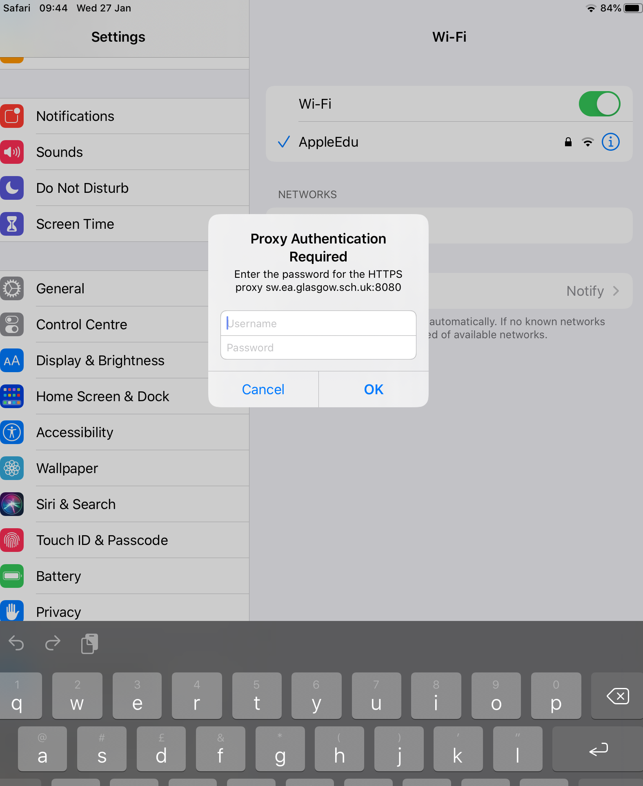
Online Learning Support
No Internet other than Outlook/Teams/Glow etc.
Enter School Computers Username/Password (GSN Username)
Pressing 'Not Now' will disable the external web connectivity
You can stil use Teams/Outlook/
Glow services if disabled

Slide 8
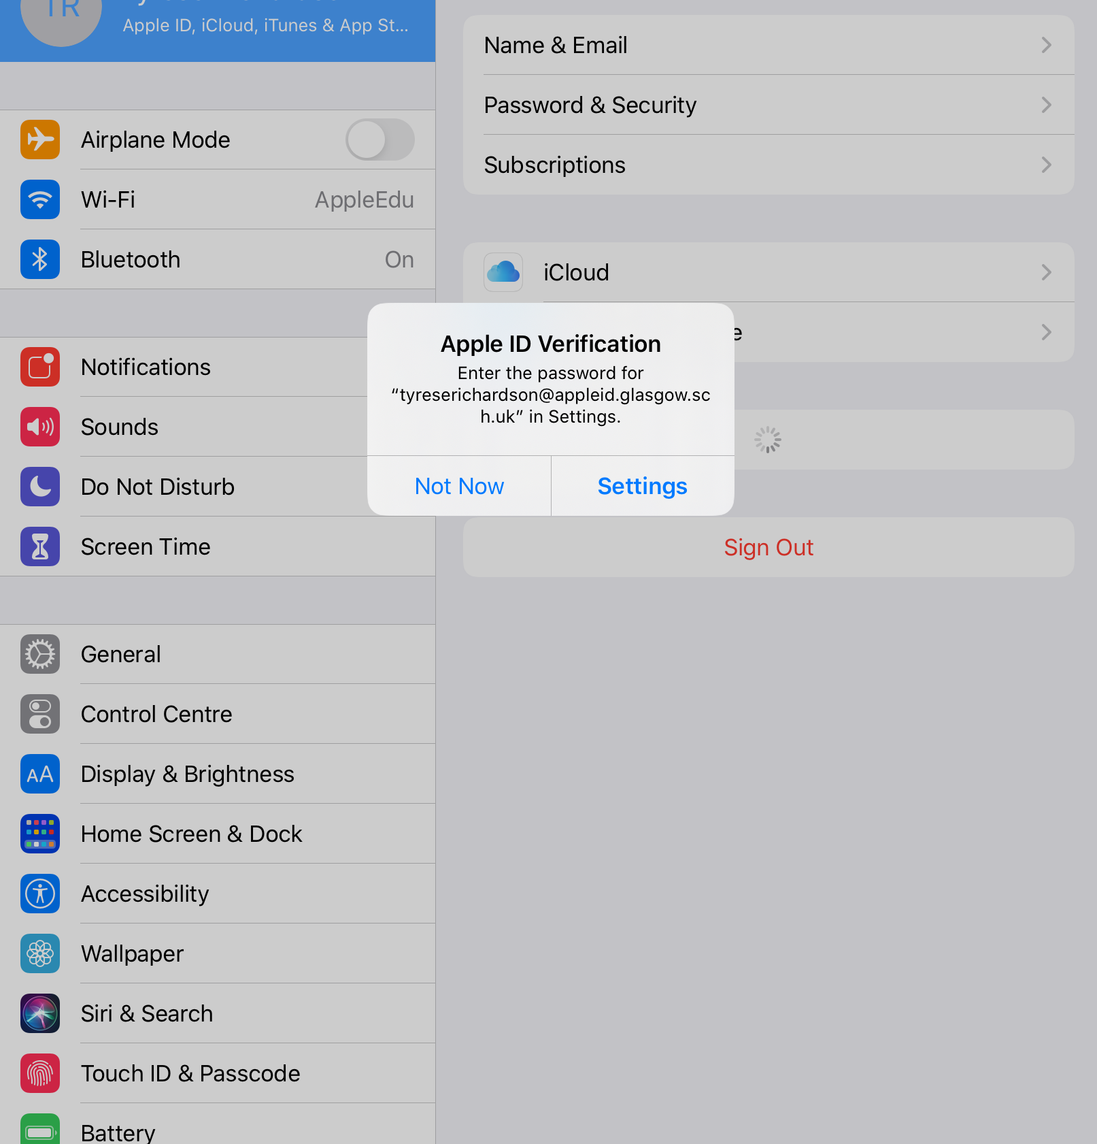
Online Learning Support
Apple ID Notifications
Annoying but useful to sort out
When Apple ID is working it means files on the device are backed up to iCloud
Work/Files on Teams is not affected

Slide 9
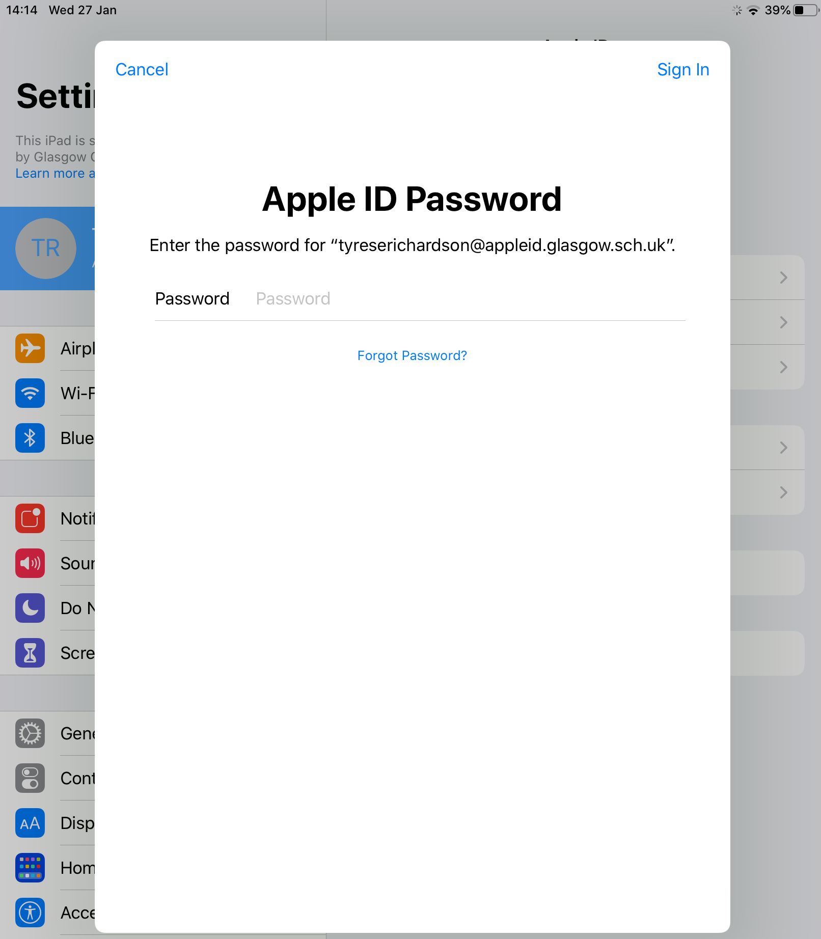
Online Learning Support
Apple ID Notifications
The password/passcode is a number – we advise pupils to make this the same as their device passcode

Slide 10
Online Learning Support
Apps not working
For example work not uploading on Teams
Sometimes the installation of Apps has gone wrong right back at the start.
The best thing to do is delete any app you are having trouble with and reinstalling it.

Slide 11
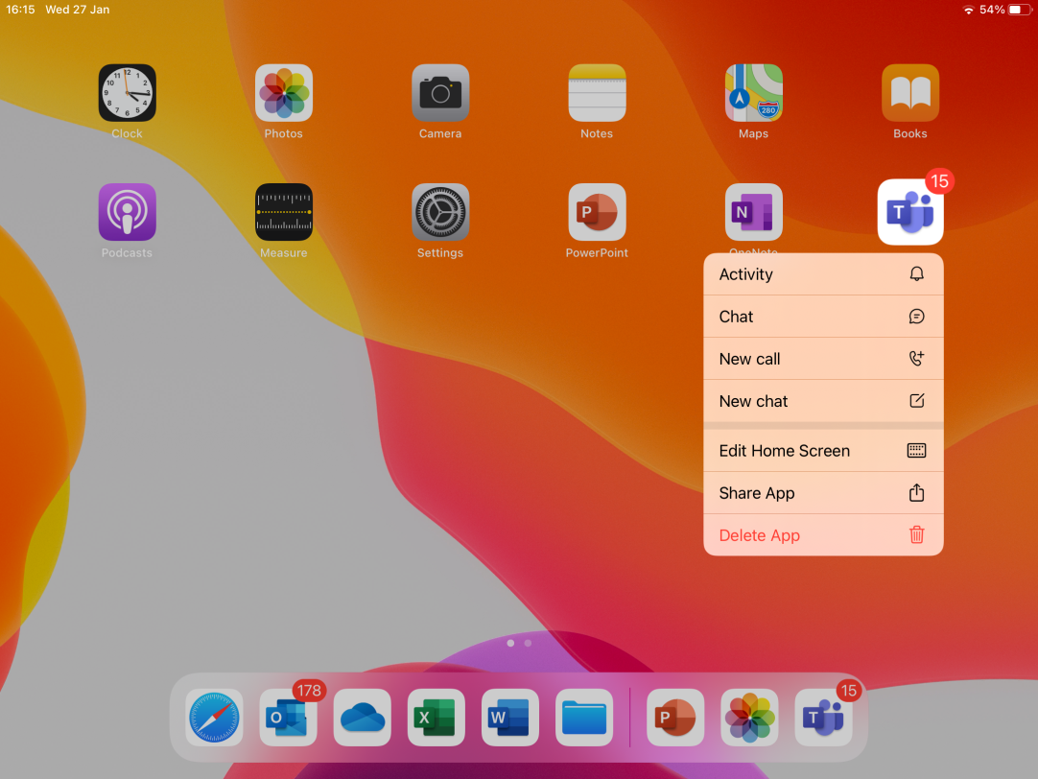
Online Learning Support
Apps not working
Delete & Reinstall the App
Long press on the App and ‘Delete App’

Slide 12
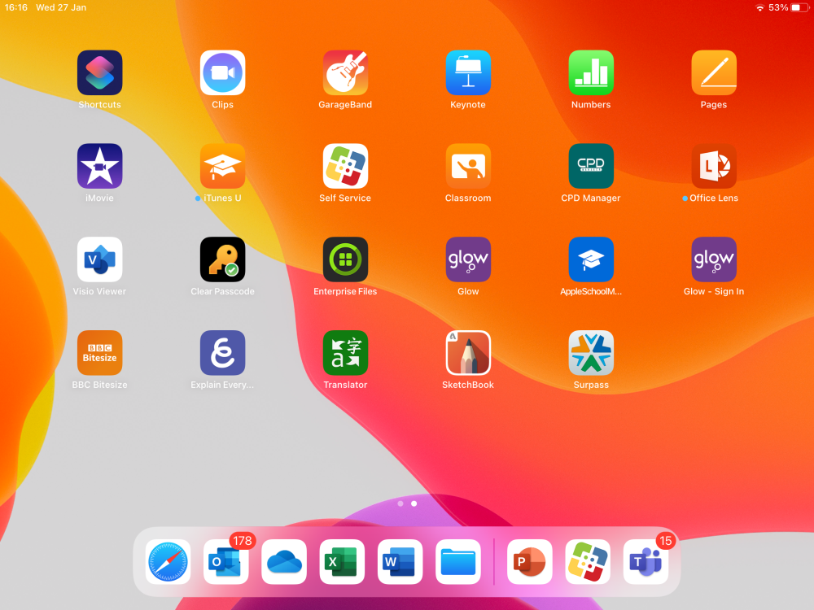
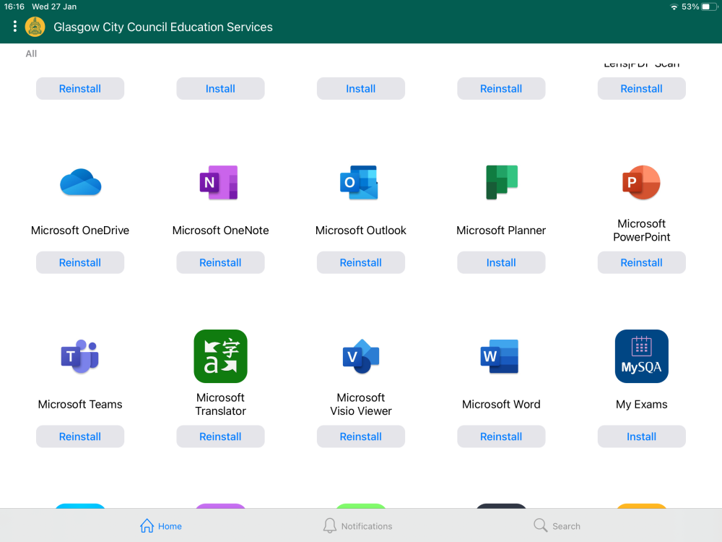
Online Learning Support
Apps not working
Reinstall the offending App!
All the Apps can be reinstalled this way
Use the Self Service App to reinstall the App

Slide 13
Online Learning Support
Not signed into Glow in an App
Might mean work cannot be opened/saved uploaded
Don’t ignore!
For office 365 apps all accounts end @glow.sch.uk
Sign in with Glow account

Slide 14
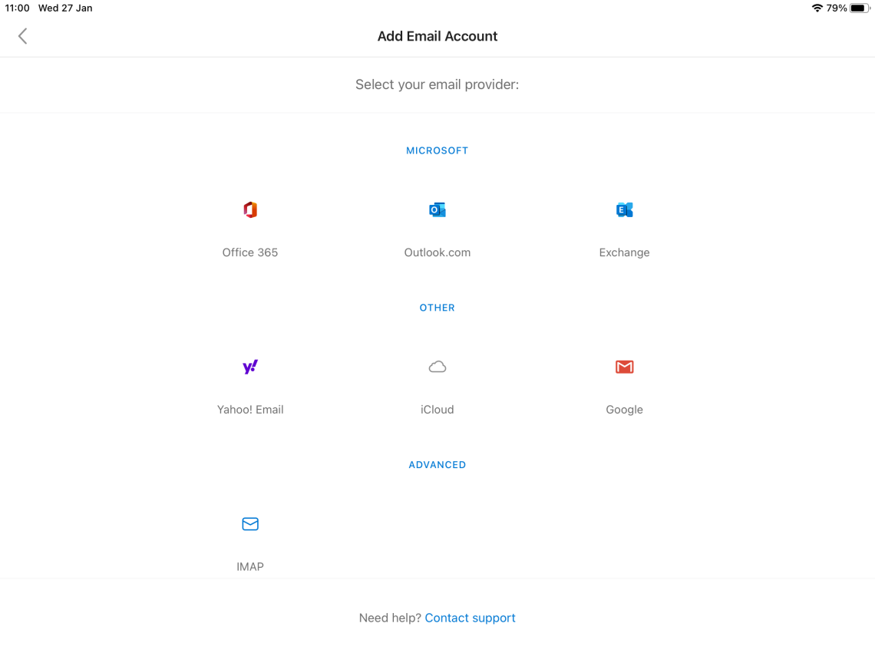
Online Learning Support
Signing in to an office 365 App
Making it sign into all of them at the same time!
When signing into any Office 365 App choose this option when you see it.
This means you will be ‘signed in’ in any of the other Apps on your device

Slide 15
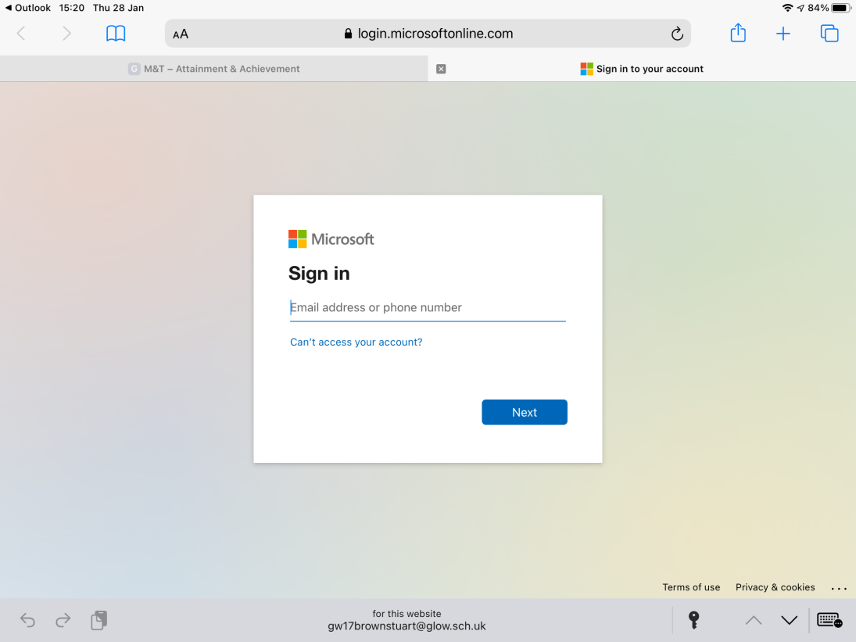
Online Learning Support
Can’t open a link hosted on Office 365/Glow
Pupil has to sign into Glow in browser
Any teacher can change a pupil’s glow password
Sign in with your Glow EMAIL ending in @glow.sch.uk

Slide 16
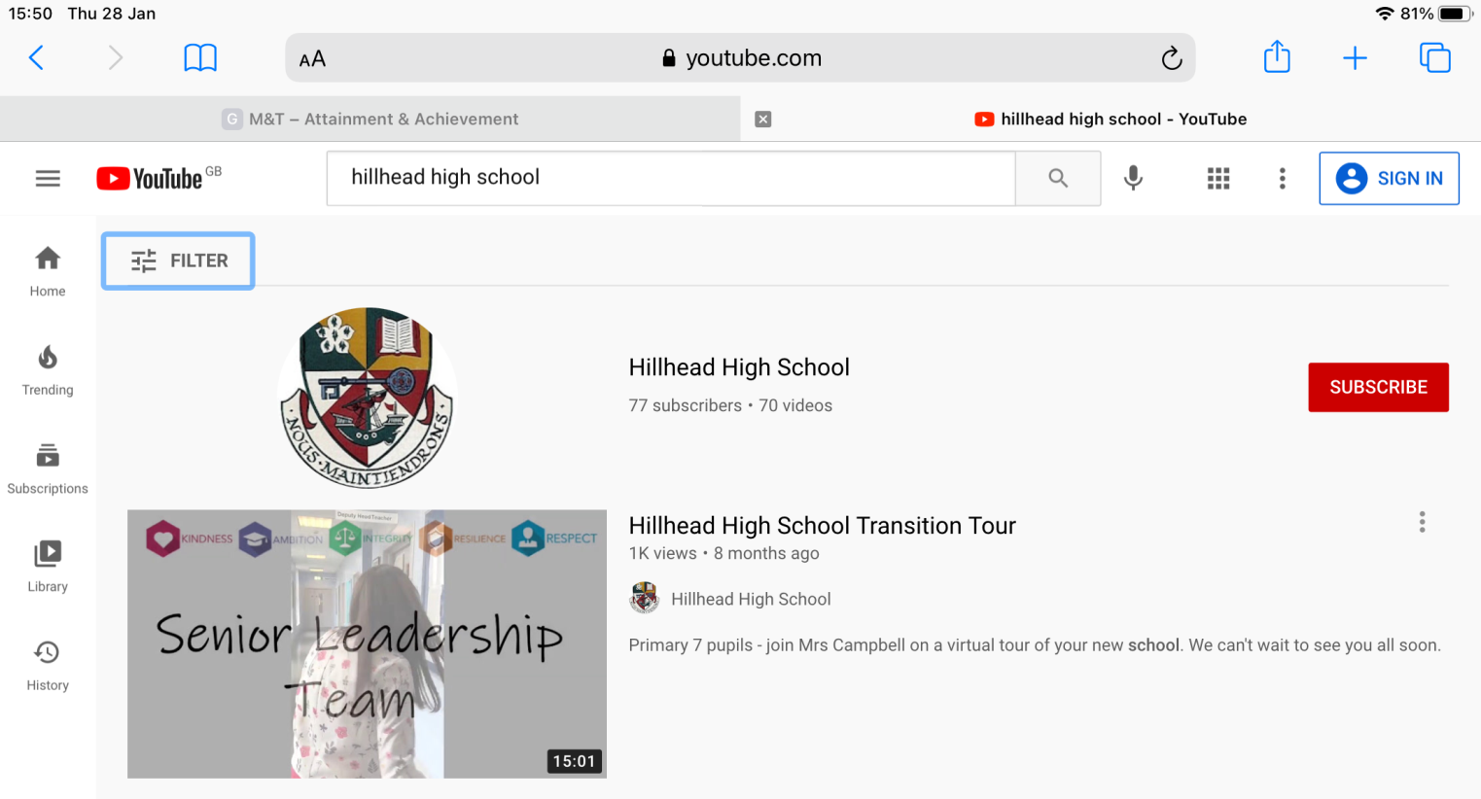
Online Learning Support
Everything is working
How can myself or my child gain in confidence?
There are videos showing all of the different skills and processes used to access and complete learning online
Search for ‘Hillhead High School’ on YouTube

Slide 17
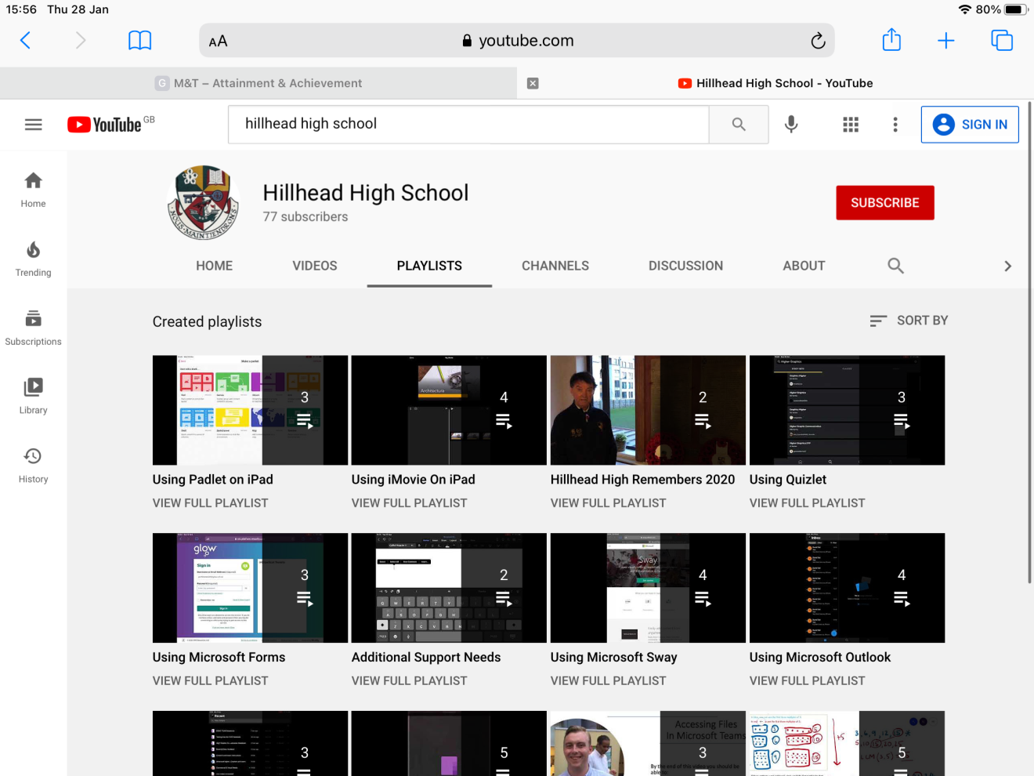
Online Learning Support
Everything is working
How can myself or my child gain in confidence?
There are ‘playlists’ on all different topics for example ‘Teams’
Search for ‘Hillhead High School’ on YouTube

Slide 18
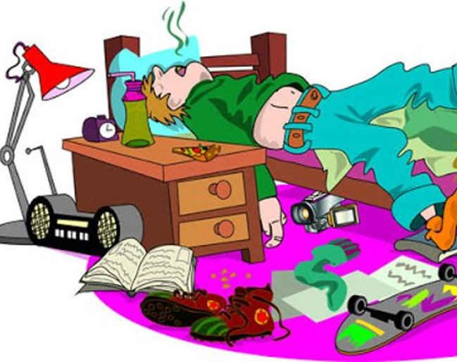
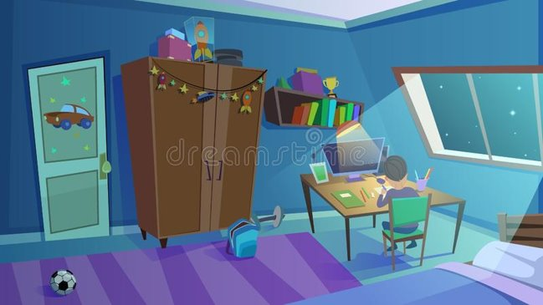
Sometimes the Reality v A Dream Scenario

Slide 19
A day in remote learning......
What we would like pupils to try to do.
Log on to their year group Teams page in the morning and read any important messages and give it a
Follow their timetable as much as possible, logging into their subject Teams page period by period
Attend any live lessons scheduled for the week
Complete tasks and assignments issued via class teams pages
Message their teachers via Teams or email if they have any questions/worries
Attend Year Group assemblies on a Friday

Slide 20
A Successful School Day
Set alarm and get up and get dressed
Have breakfast
Have a plan for the day – look at timetable for the day, when are live lessons? what is due to be handed in today?
Log on to their ipad and check year group Teams page and
Attend any live lessons
Complete any tasks and/or assignments
Get in contact with teacher if needed
Take regular breaks
Make sure they take time to relax, get fresh air and exercise.

Slide 21
Supporting Your Child’s Learning
Ms Black created a document with some general advice on supporting your child with remote learning.
This has been shared with parents and carers and it has also been shared on all Year Group Teams pages.
You will find the full document via the link below:
https://blogs.glowscotland.org.uk/gc/public/hillheadhigh/uploads/sites/7656/2021/02/01104548/Remote-Learning-Support-Guide-Jan-2021.pdf

Slide 22
Supporting Your Child's Learning
As far as possible separate home life from school life. For children physical markers are one of the best ways of doing this. They might need your support to model this with your own work and home life.

Slide 23
Supporting Your Child's Learning
Where possible talk to your child about goals for their day or week and check in with them where you can, particularly in the mornings and evenings. This can act as a grounding technique which supports pupils to process instructions from teachers and encourages self-management and reflection.

Slide 24
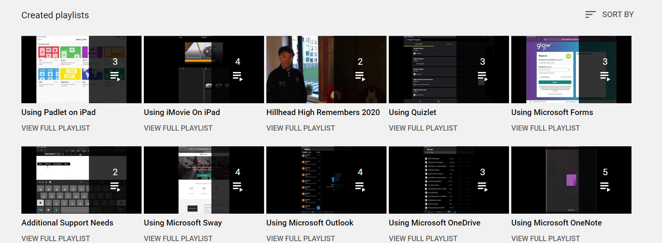
Supporting Your Child's Learning
Ask your child to show you how their Teams pages work so that you can be involved in their learning.

Slide 25
Supporting Your Child's Learning
We know that families are finding remote learning a real challenge – we are here for you.

Slide 26
Supporting Your Child's Learning
If you have a child who doesn't like to talk, often it can be counterproductive to sit down to focus on a chat. Instead, try talking to them when you are both engaged in a parallel activity. Walking often seems to let children open up and express feelings. You could try commenting/noticing feelings instead of asking about them.

Slide 27
Support Available - Virtual Office
What is the virtual office?
How exactly will it work?
When?
S4 - Monday, 3pm – 4pm
S5 - Wednesday, 9am - 10am
S6 - Monday, 11am - 12pm

Slide 28
Weekly Assemblies
It is very important that pupils attend weekly assemblies. S4 – Miss Higgins - Friday, period 5 (2 – 2:30pm) S5 and S6 – Mr Neil – Friday, period 5 (2 – 2:30pm and 2:30 – 3pm). Alternating weeks for S5 and S6.

Slide 29
Phone Calls Home
Pupil Support staff and Depute Head Teachers may phone home if your child has not been engaging with a particular subject.
The main purpose of this call is to see what we can do to support your child and you.

Slide 30
SQA Survey for Parents/Carers
The SQA Research, Insight and Analysis team is setting up panels of key stakeholders so they can get ‘quick pictures’ of what these groups think about important issues. For this to work effectively, the SQA need to get as many people to sign up as they possibly can.
They are looking for parents and carers of school learners to take part in these surveys and the time commitment would be minimal for participants. You can sign up through the following link:
https://bit.ly/2V3KNAV
The pupil version of the survey has been shared on all year group Teams pages.

Slide 31
Support for Wellbeing – who else can pupils speak to?
Support for Learning/English an Additional Language
Pastoral Care Teacher
Depute Head
School Counsellor

Slide 32
Sleep Routine
Sleep Scotland
https://www.sleepscotland.org/
Young Scot
https://young.scot/search-results?q=Sleep
NHS
https://www.nhs.uk/live-well/sleep-and-tiredness/sleep-tips-for-teenagers/

Slide 33
Support for Wellbeing

Slide 34
Support for Wellbeing
Coming soon....
We will be running a Wellbeing Information Evening
More details to follow

Slide 35
Mental Health Support
Please visit our school website
https://blogs.glowscotland.org.uk/gc/hillheadhigh/
Parents and Families section - Mental Health resources/contacts
https://blogs.glowscotland.org.uk/gc/hillheadhigh/parent-zone/advice-and-support/mental-health/
Wellbeing Support Pack – this has been shared on all year group Teams pages and will be shared on the school website
Young Scot website
https://young.scot/get-informed/national/who-to-contact-for-mental-health-support

Slide 37
Well Done and Thank You!

Slide 38
Questions
If you have any questions please put them in the chat function on the Teams page

