Slide 1
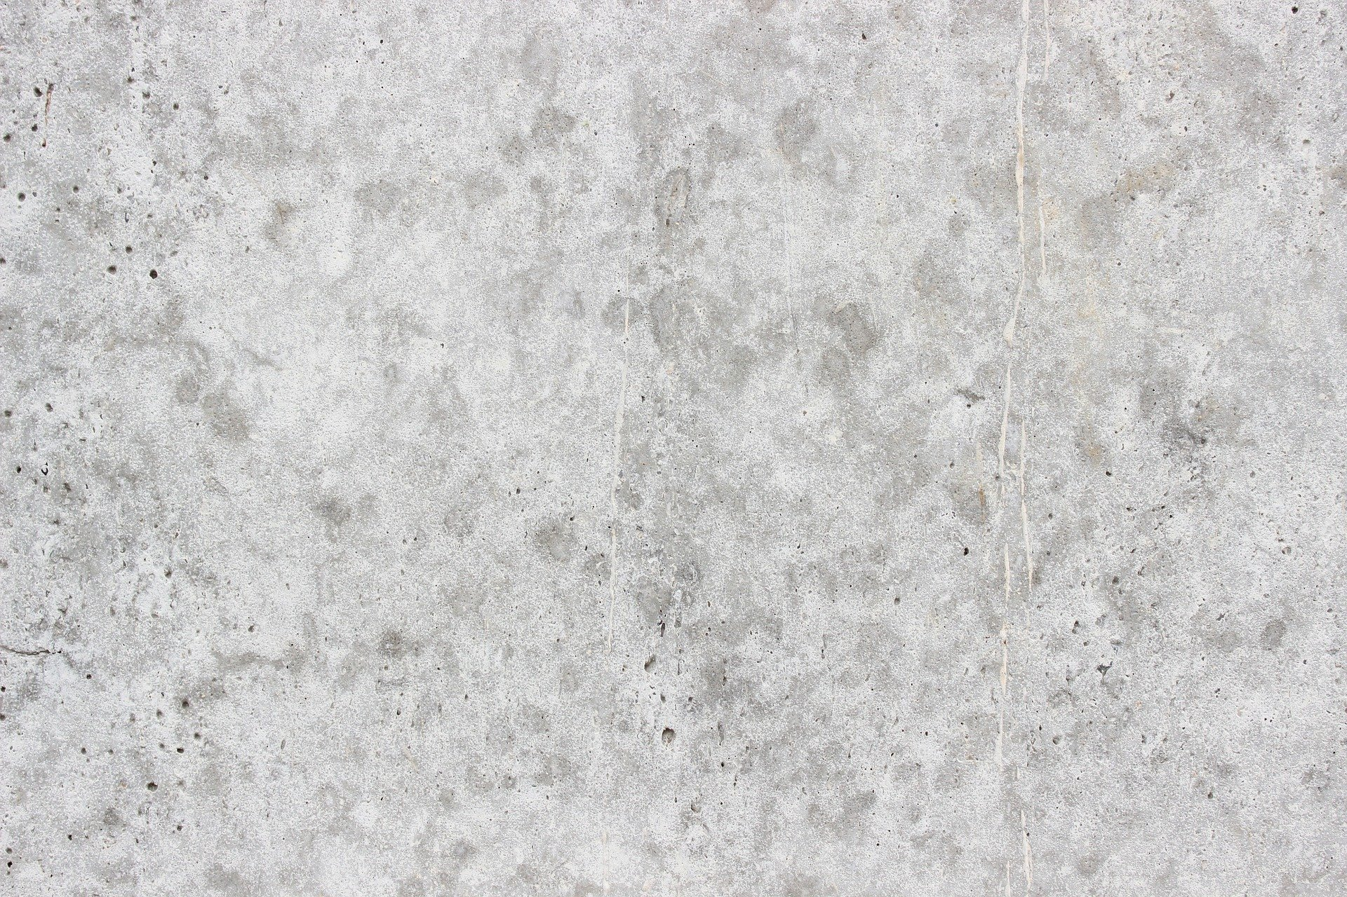
Welcome to the Art Museum!
Click On Each Of The Following Rooms To Explore The Museum
Click On The Exit If You Have Finished Viewing The museum
ROOM TWO
EXIT
ROOM THREE
ROOM ONE
ROOM FOUR

Slide 2
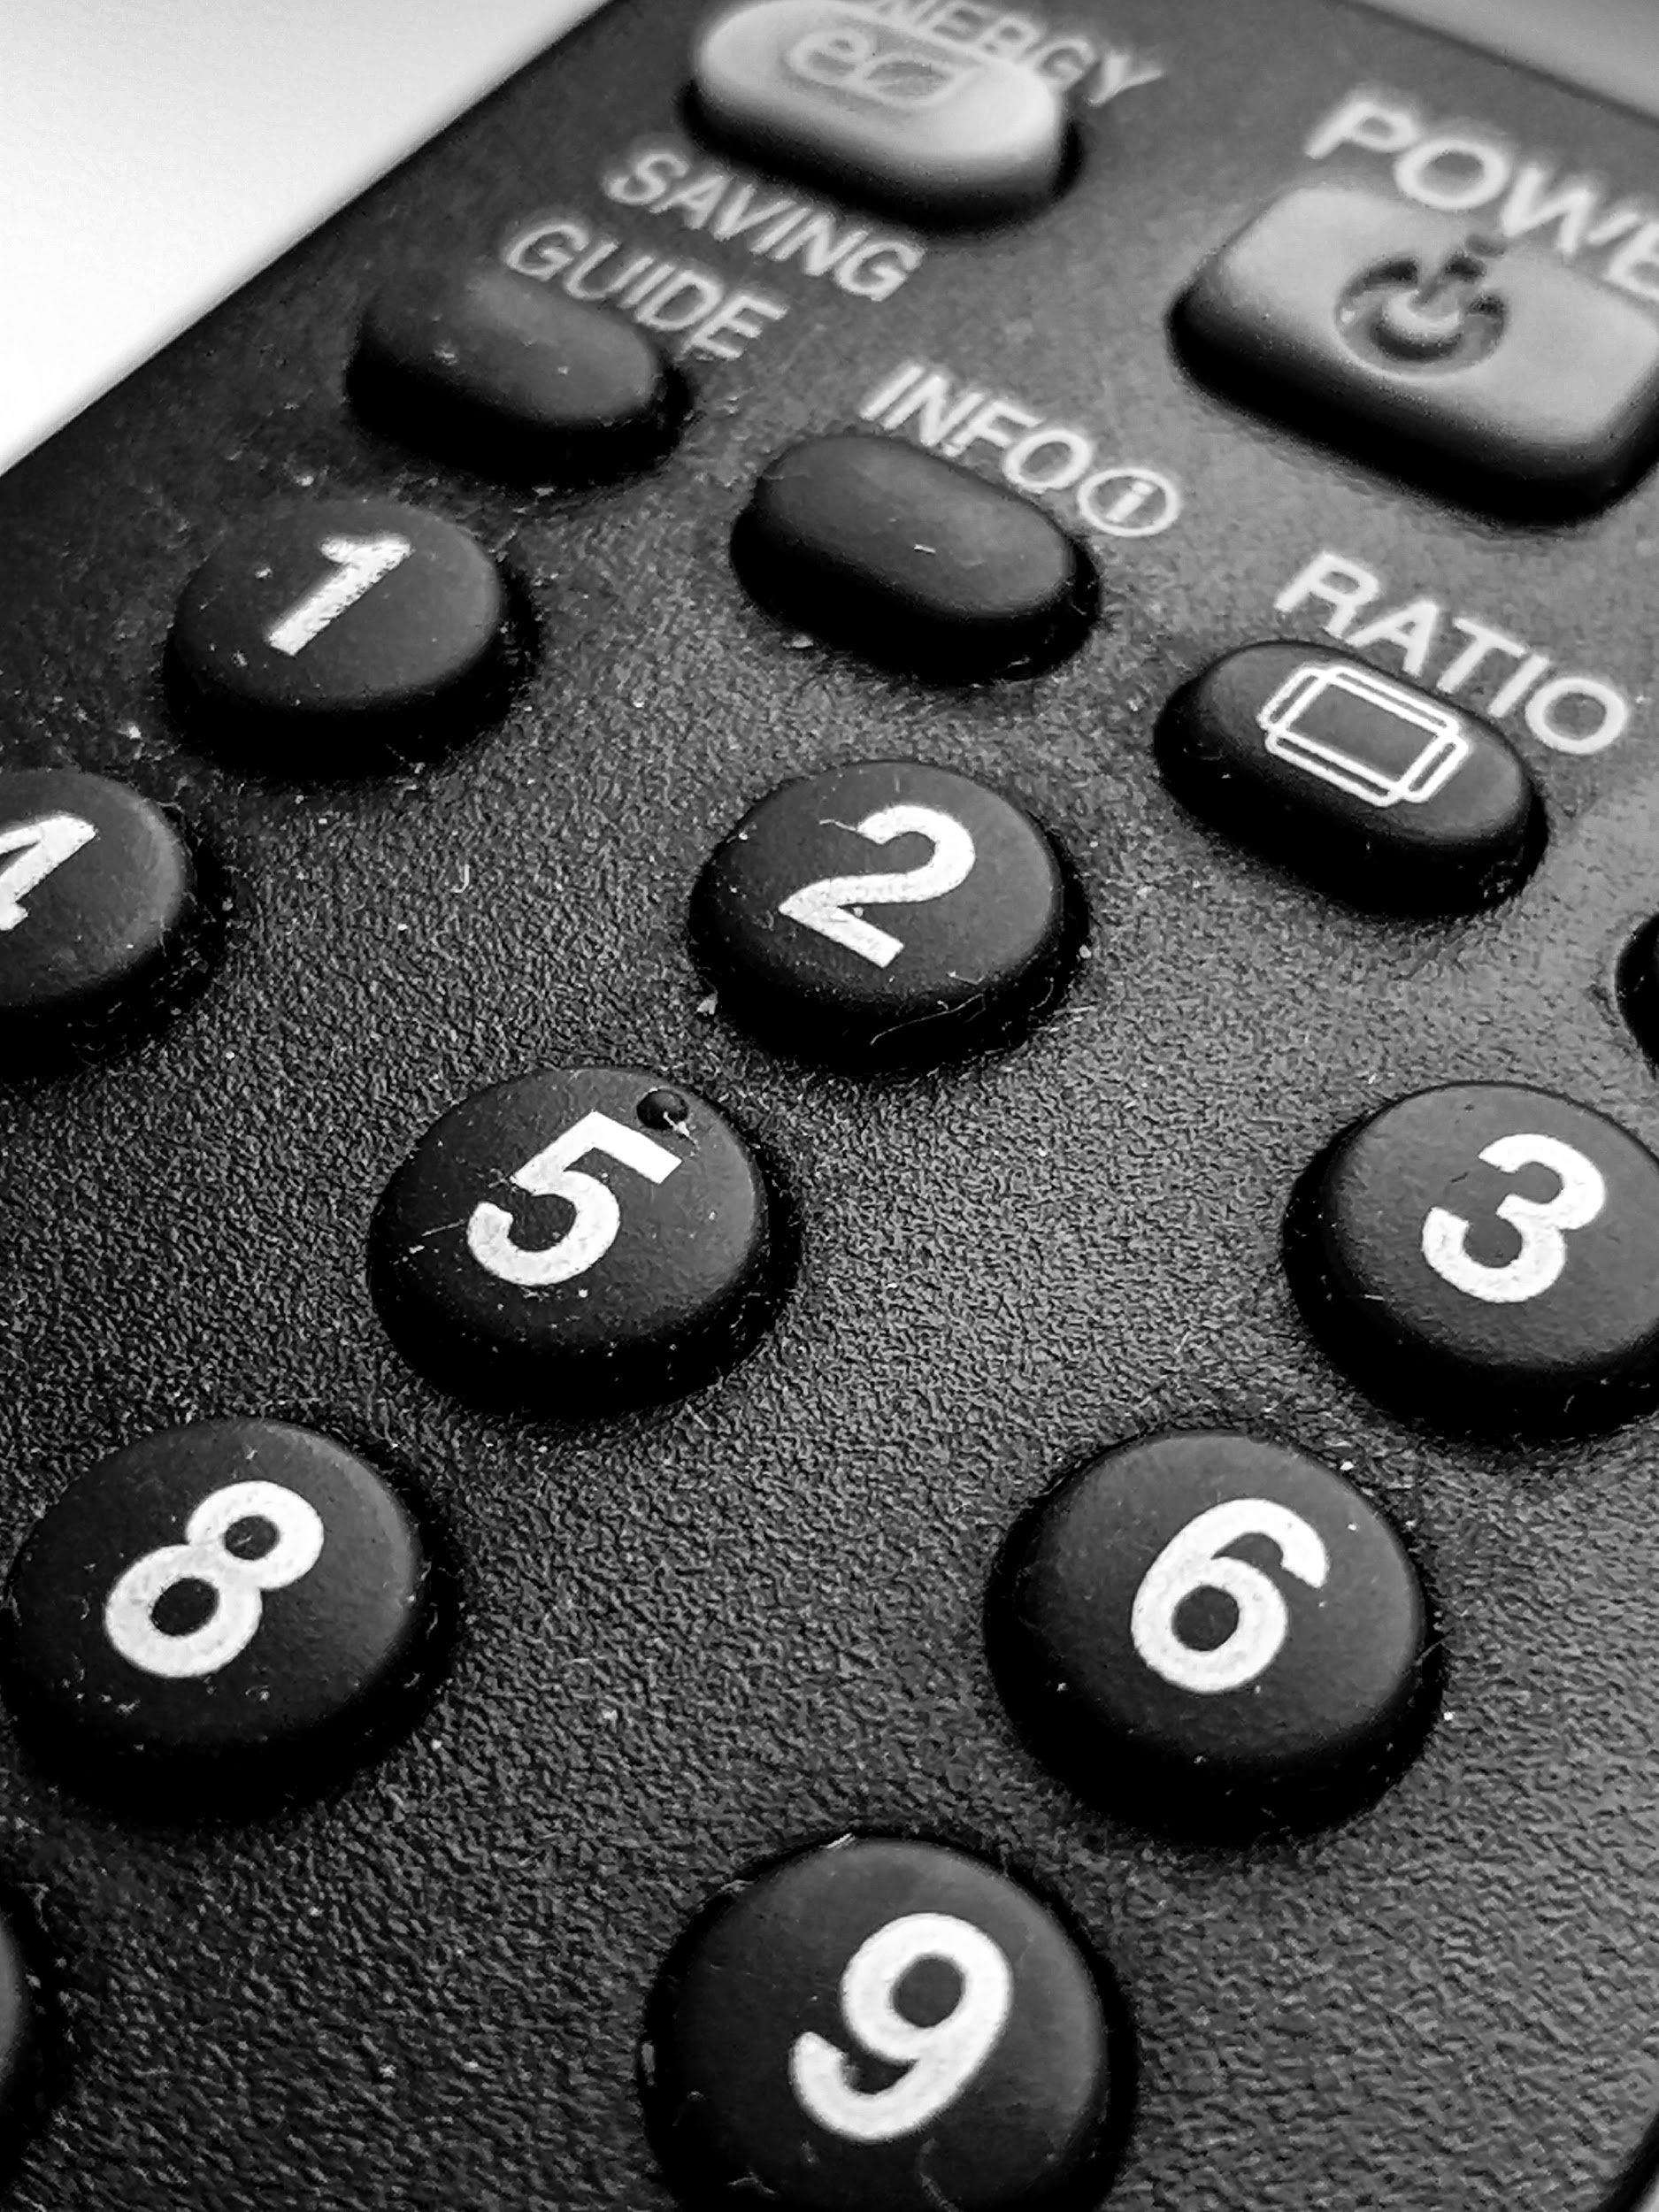
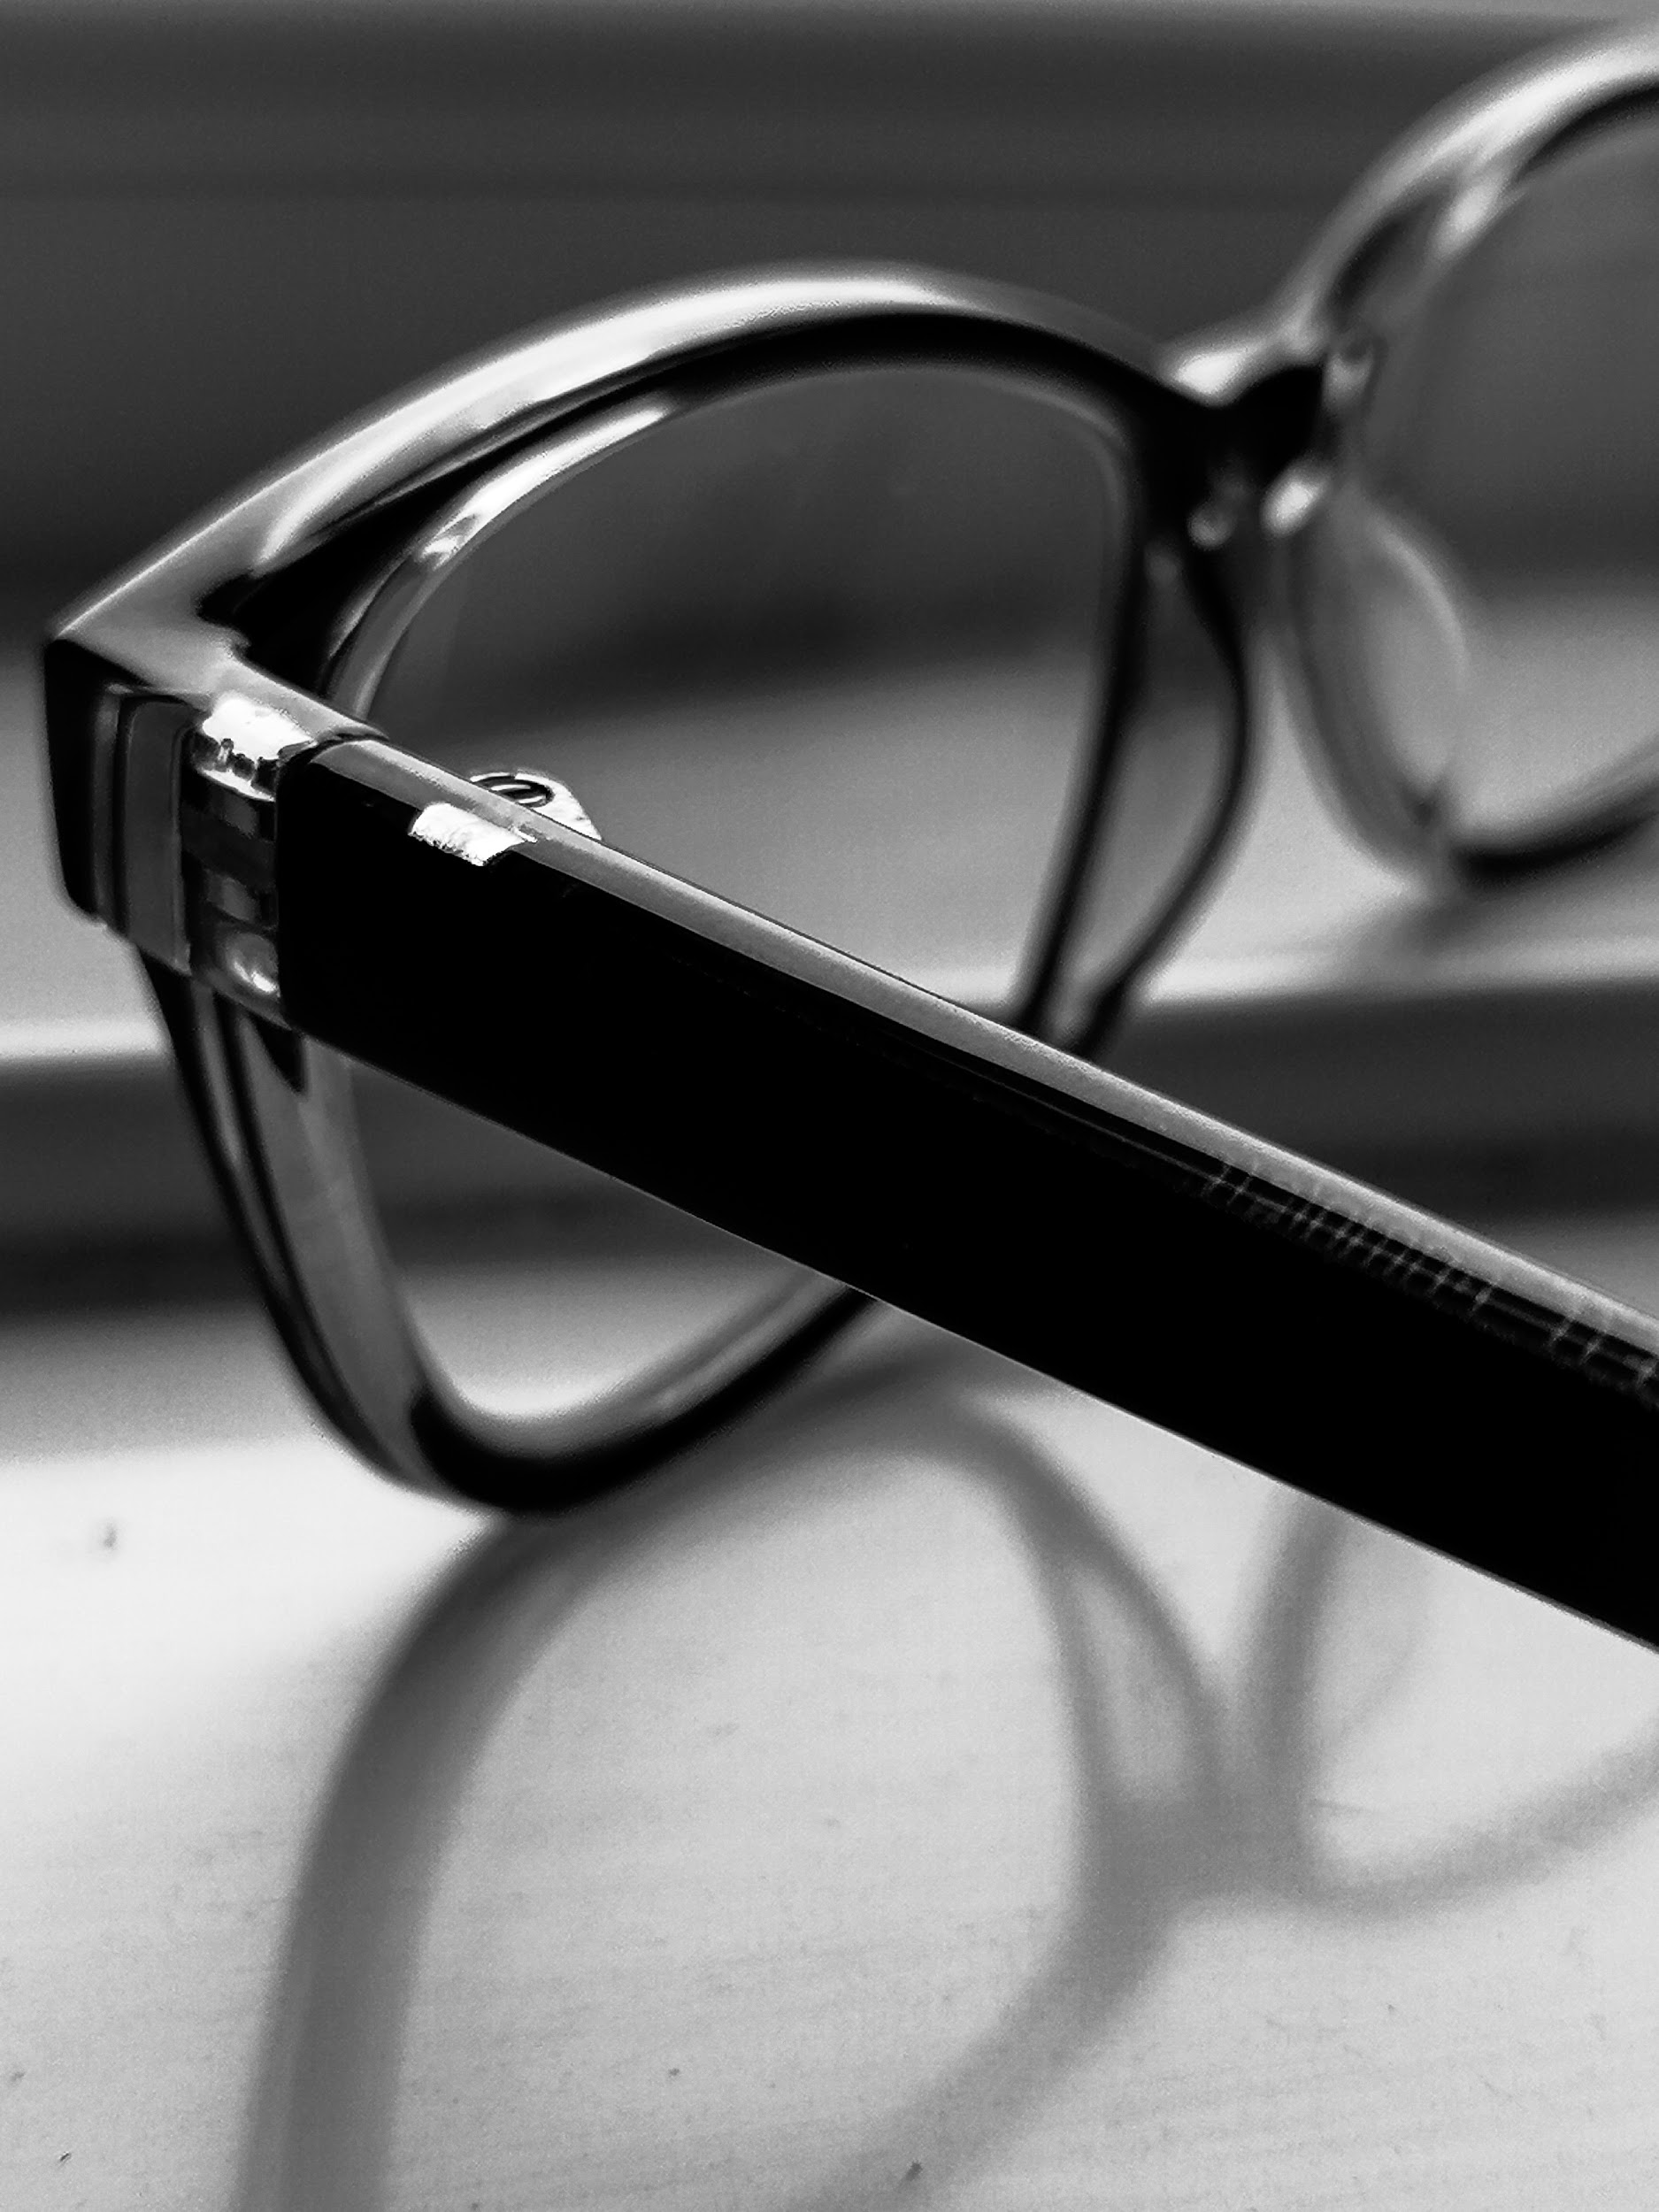
ROOM ONE
Click On The Pictures To Examine Them Closer
Return To Museum

Slide 3
Artifact 1
This is an artifact from the macro photography project which I had to take on. The task given was to capture a close up of everyday objects and their details that we can’t usually see with our naked eye. One of the objects that I chose to work with is a TV remote. I thought that this would be an interesting object to focus on as it has many cool textures and details that you won’t usually notice. I had choose my lighting carefully for this photograph, to make sure to capture every single feature of the remote. I think the B&W filter makes it stand out even more.
Return To Room

Slide 4
Artifact 2
For the next artifact of the macro photography project I have chosen a book to work with. I tried to find the thickest book I have in my room, to capture the most of its details. I thought it would be an amazing idea to take a close up of the pages of a book as they have an interesting texture. This has to be one of my favourite photographs I’ve taken for the project as the lighting creates a really nice shadow, which gives a contrast to both sides of the book.
Return To Room

Slide 5
Artifact 3
This is the last artifact from the macro photography project. I was struggling to think of another object to take a close up of, and then I started to experiment with my own glasses! It was quite hard to get the correct angle, so I could capture every detail of the object. Fortunately, I found an angle with not only great lighting, but also one which creates cool shadows. I think I’ve made the right choice by applying the B&W filter and deciding to choose these specific objects.
Return To Room

Slide 6
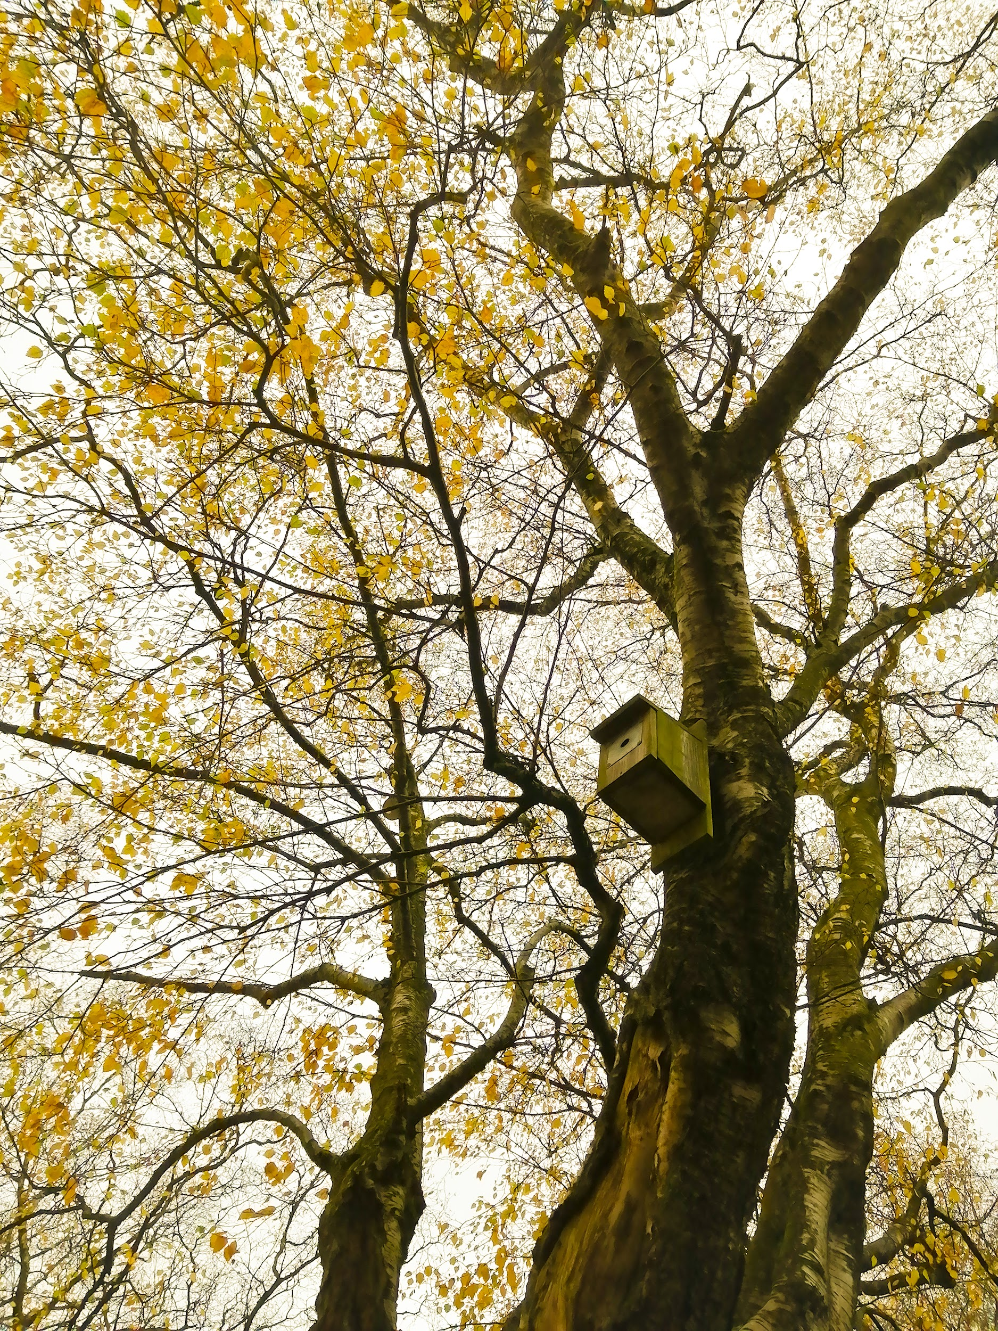
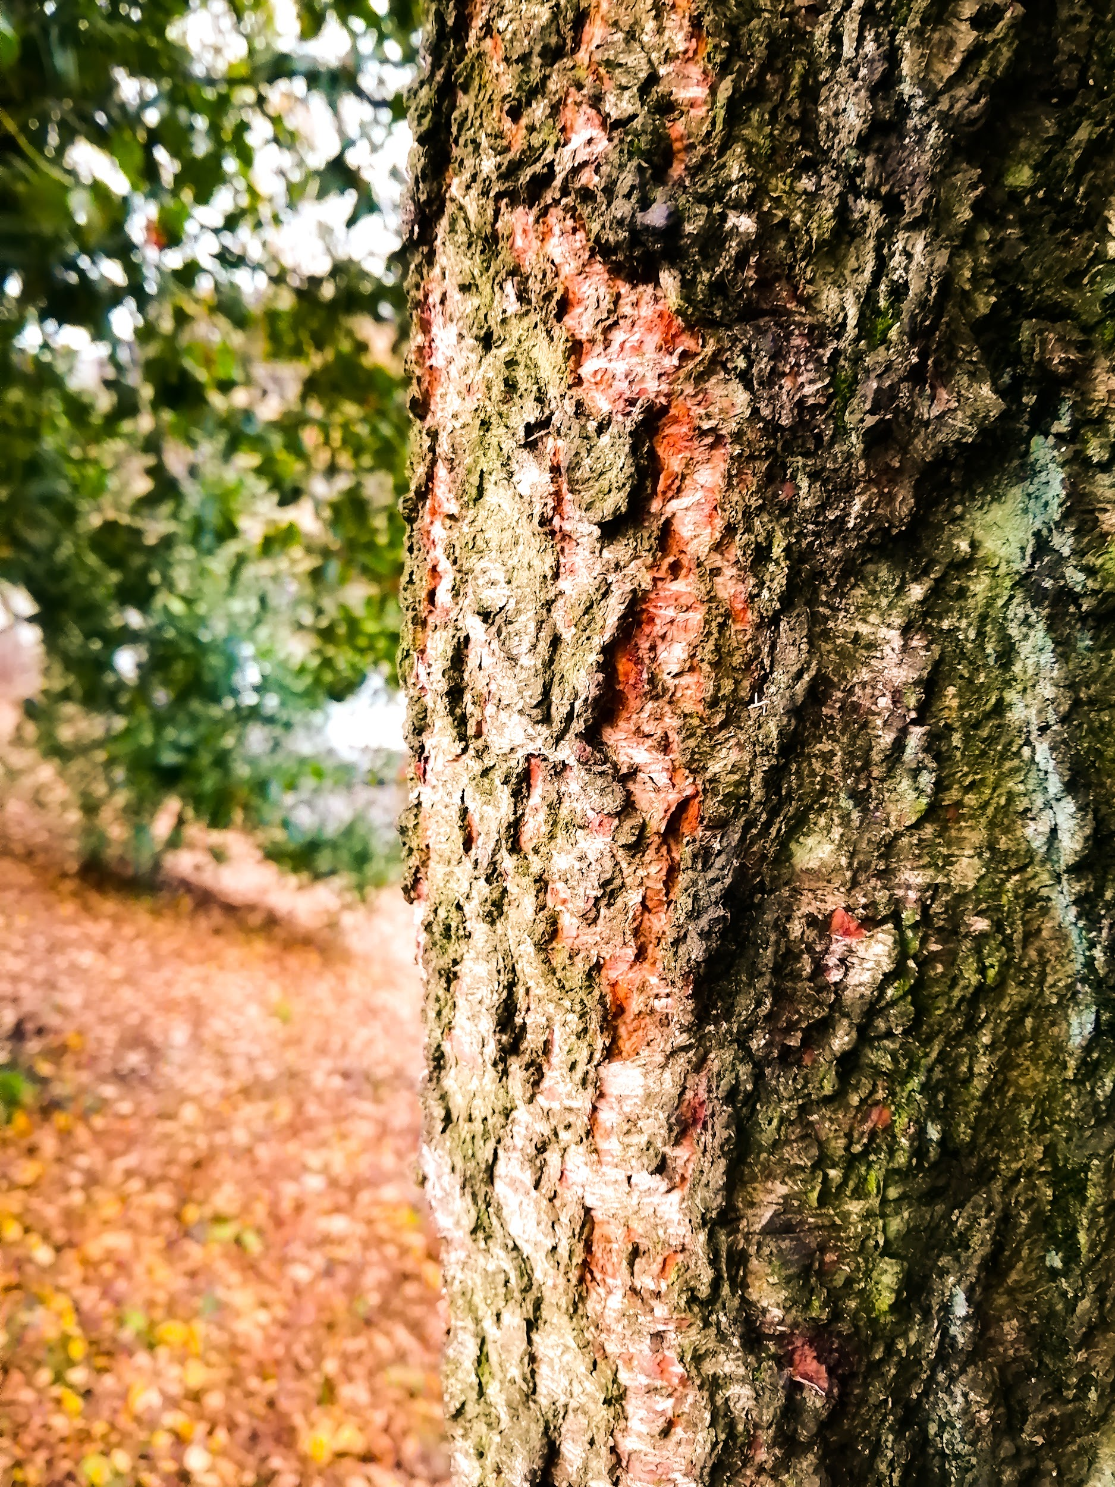
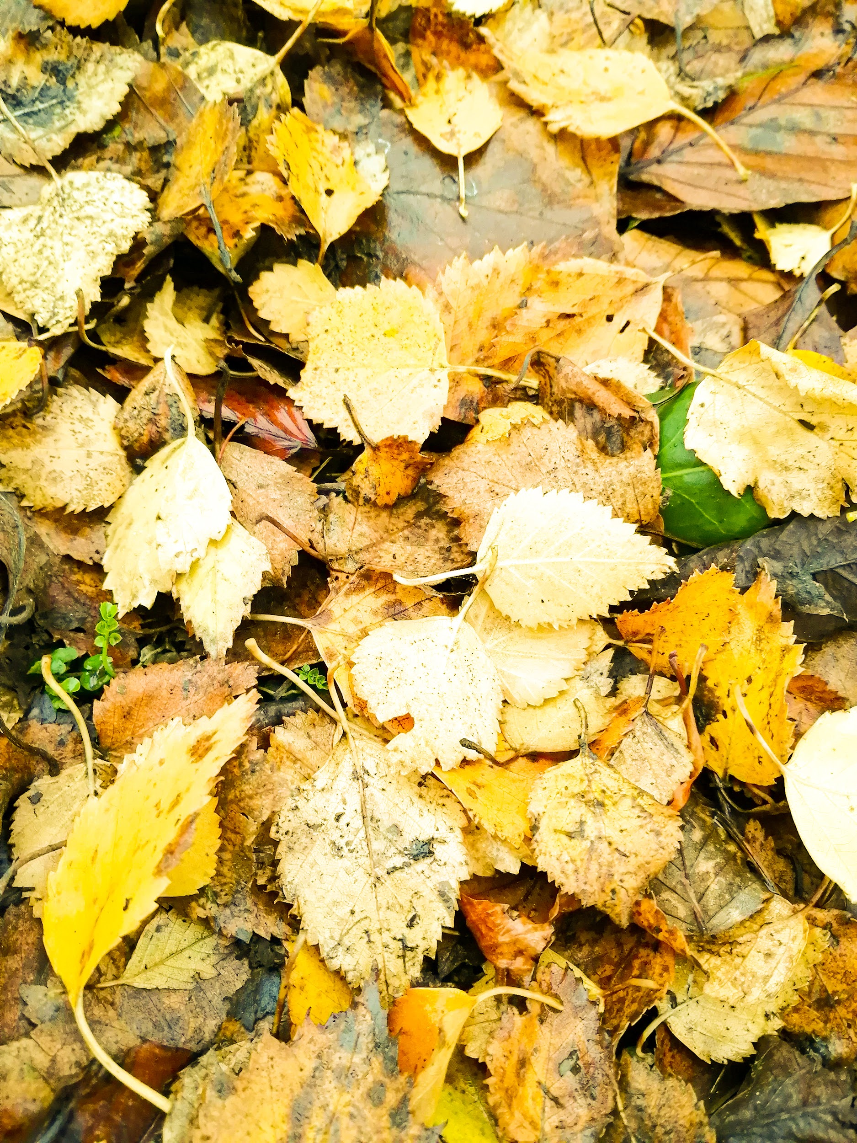
ROOM TWO
Return To Museum

Slide 7
Artifact 1
This is the first artifact from a mood board project. At first we had to create a moodboard for the inspiration of photos we were planning to take in the school grounds. I decided to choose the theme of autumn. As it was the near end of autumn, it was a bit tricky to find certain places I could take pictures of which still had golden leaves remaining. Luckily, I managed to capture some trees which still had some golden leaves. I really like the photo I’ve taken because the leaves remind me of golden stardust, which makes the picture really pretty.
Return To Room

Slide 8
Artifact 2
This is the second artifact from the autumn collection. In this photograph I wanted to capture the autumn atmosphere in our school. I thought it would be quite cool to take a picture of some tree bark against an autumn background. This could also potentially count as macro photography because it’s a close up of the tree bark. I really like this photograph as it manages to capture all of the colours of autumn perfectly.
Return To Room

Slide 9
Artifact 3
This is the last artifact from the autumn mood board inspiration. Autumn leaves are one of my favourite things about autumn, so I wanted to try to take a picture of some of them. Thankfully I managed to find a pile of them in the school grounds. They may not be the the golden orange leaves like on my moodboard, however these leaves still contain different pretty shades of yellow which I love.
Return To Room

Slide 10
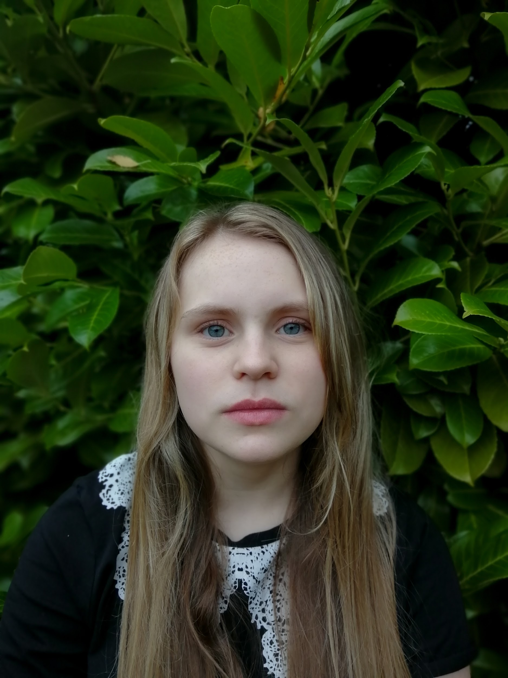
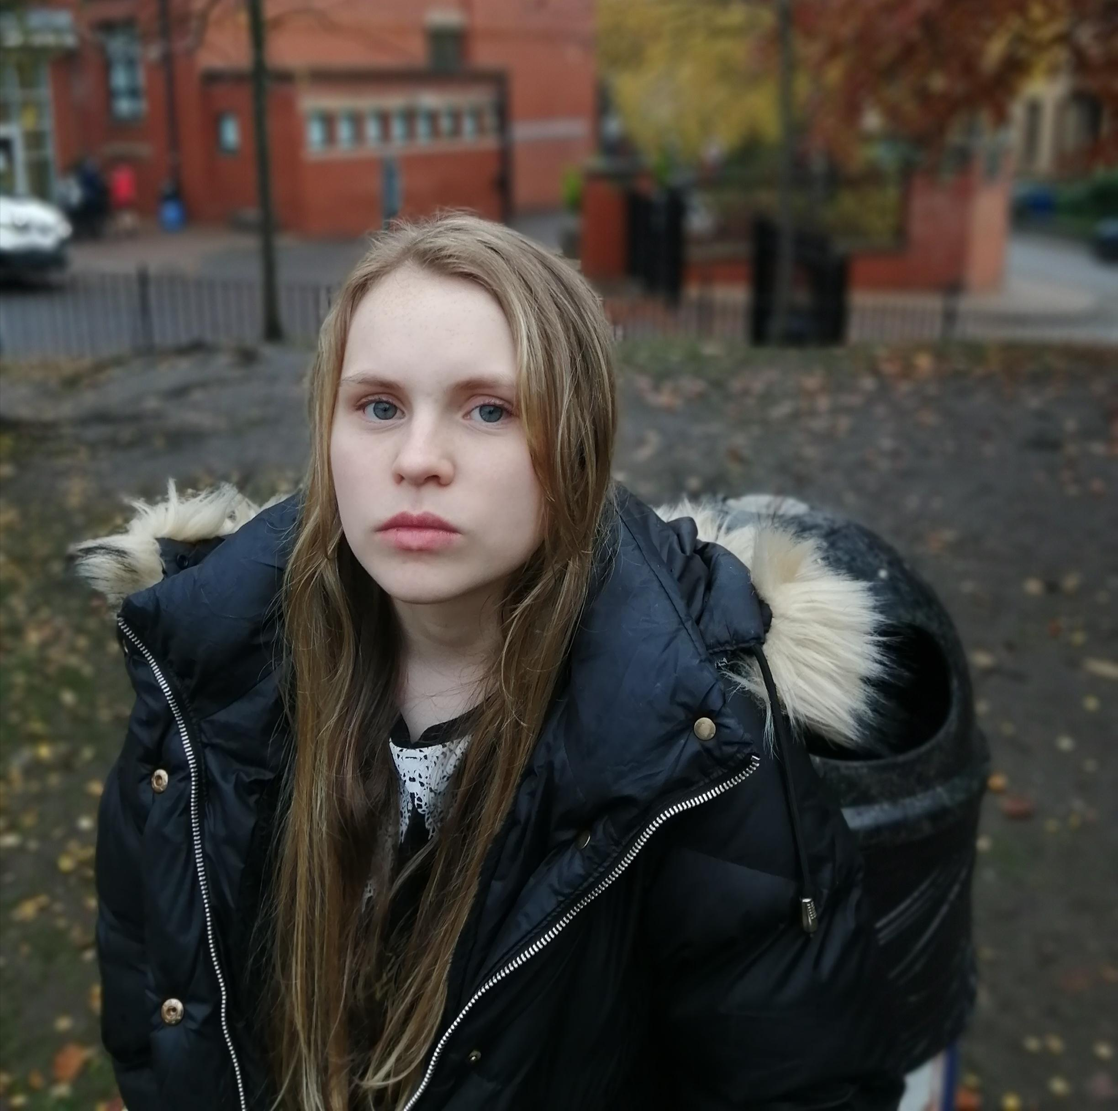
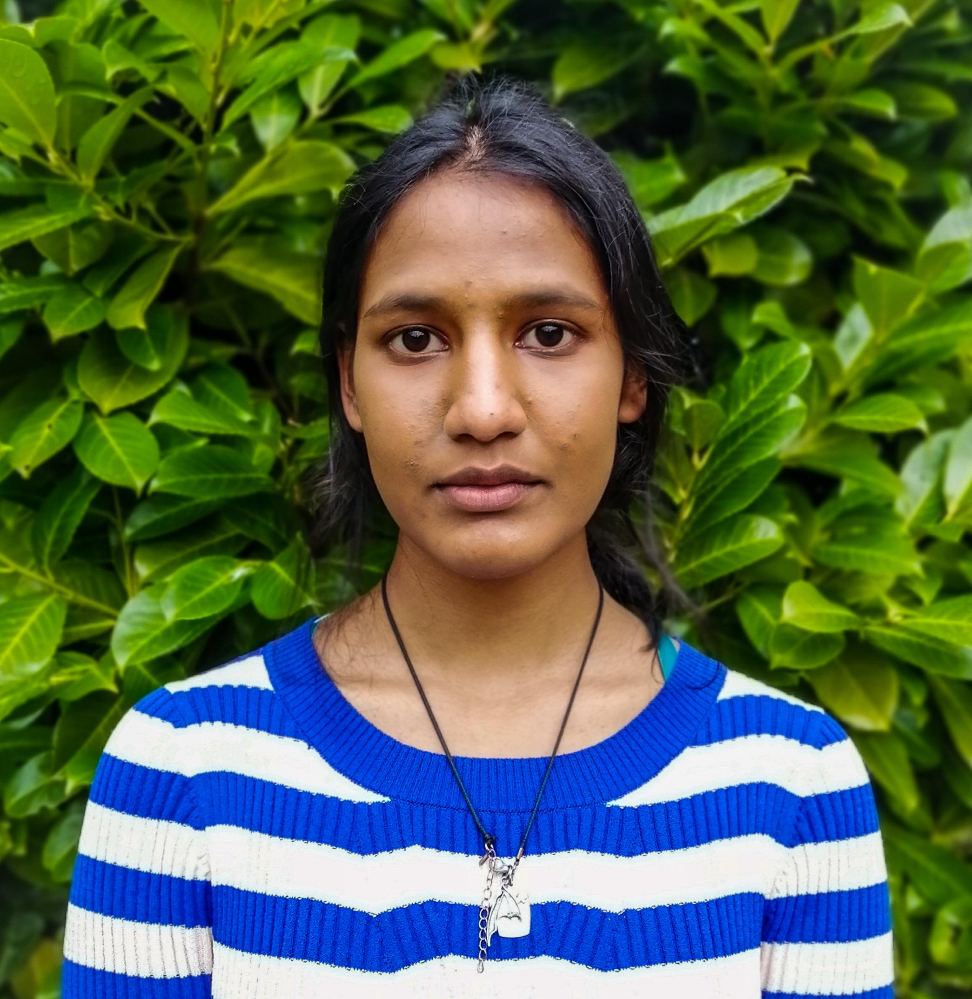
ROOM THREE
Return To Museum

Slide 11
Artifact 1
This is an artifact from a CV headshot project I had to undertake. Before coming up with headshots, we had to learn the differences between good and bad headshots and what makes them good or bad. This would be an example of a good headshot because of the background and the angle at which the photograph is taken. It is important to find the most effective angle and a one-colour background, so it doesn’t look like too much is going on.
Return To Room

Slide 12
Artifact 2
This is another artifact from the CV headshot project. This would be another good example of a good headshot because of the same reasons as the previous one. The background is not too distracting, however it is certainly eye-catching. Not only is it important to have an amazing CV, it is also important to have a great headshot as this will represent you in the best light when applying for a job.
Return To Room

Slide 13
Artifact 3
This is the last artifact of the headshots and is an example of a bad headshot. The angle in this photograph is not proportional and there are many things wrong with the background, such as the very visible bin. This isn’t a good feature for a CV headshot and will be found distracting. The background can also be seen as quite busy as there are many things going on. This type of photograph should definitely not be used as a headshot for a CV!
Return To Room

Slide 14
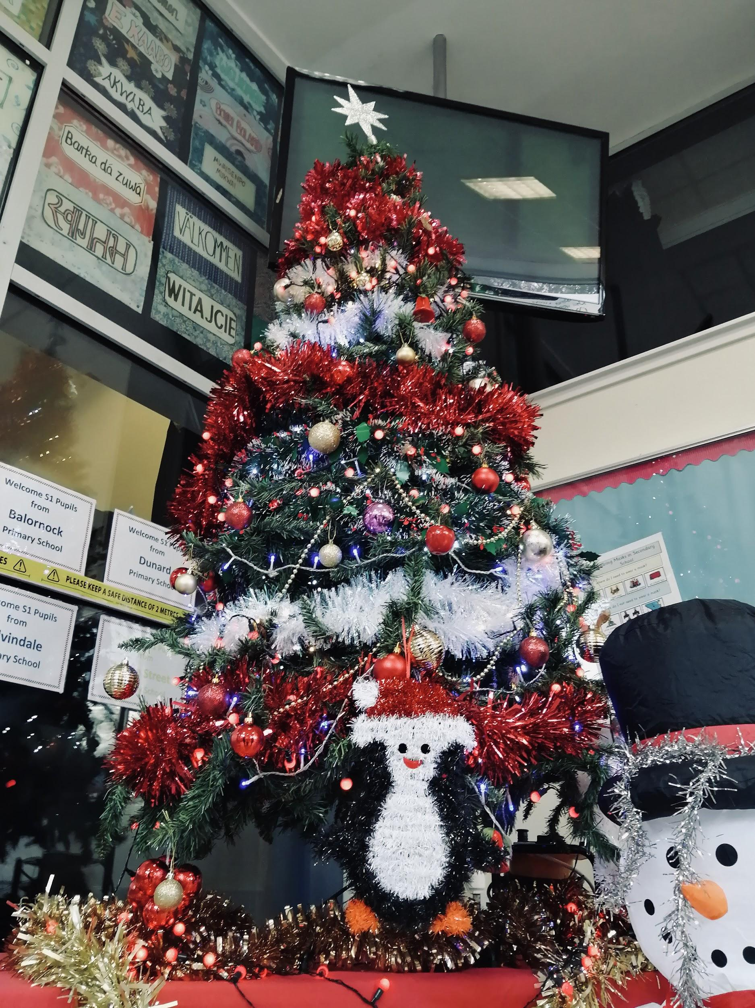
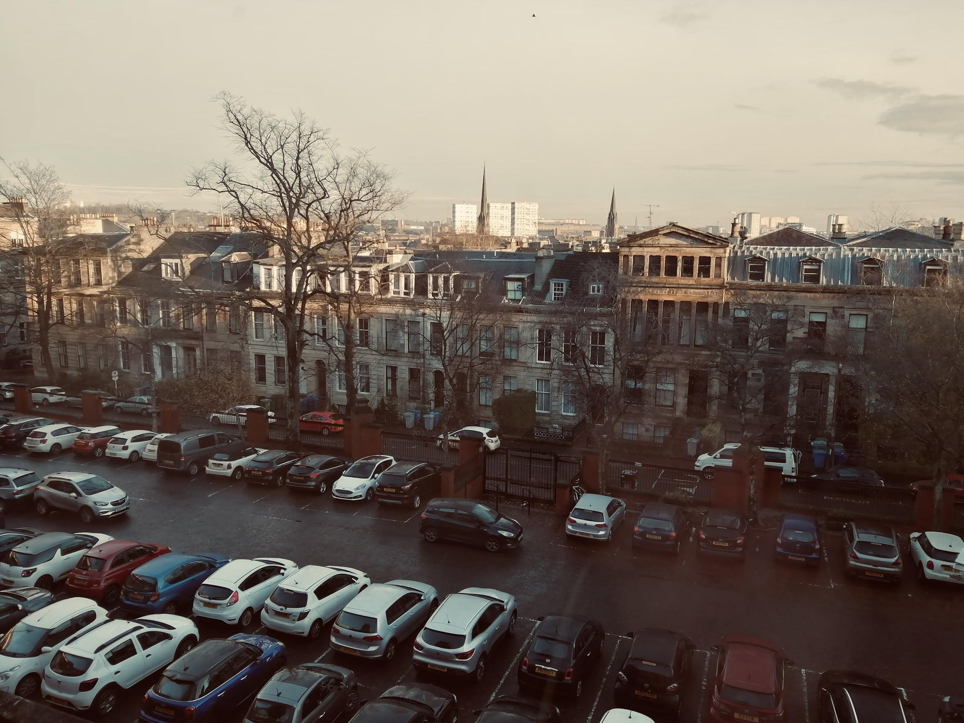
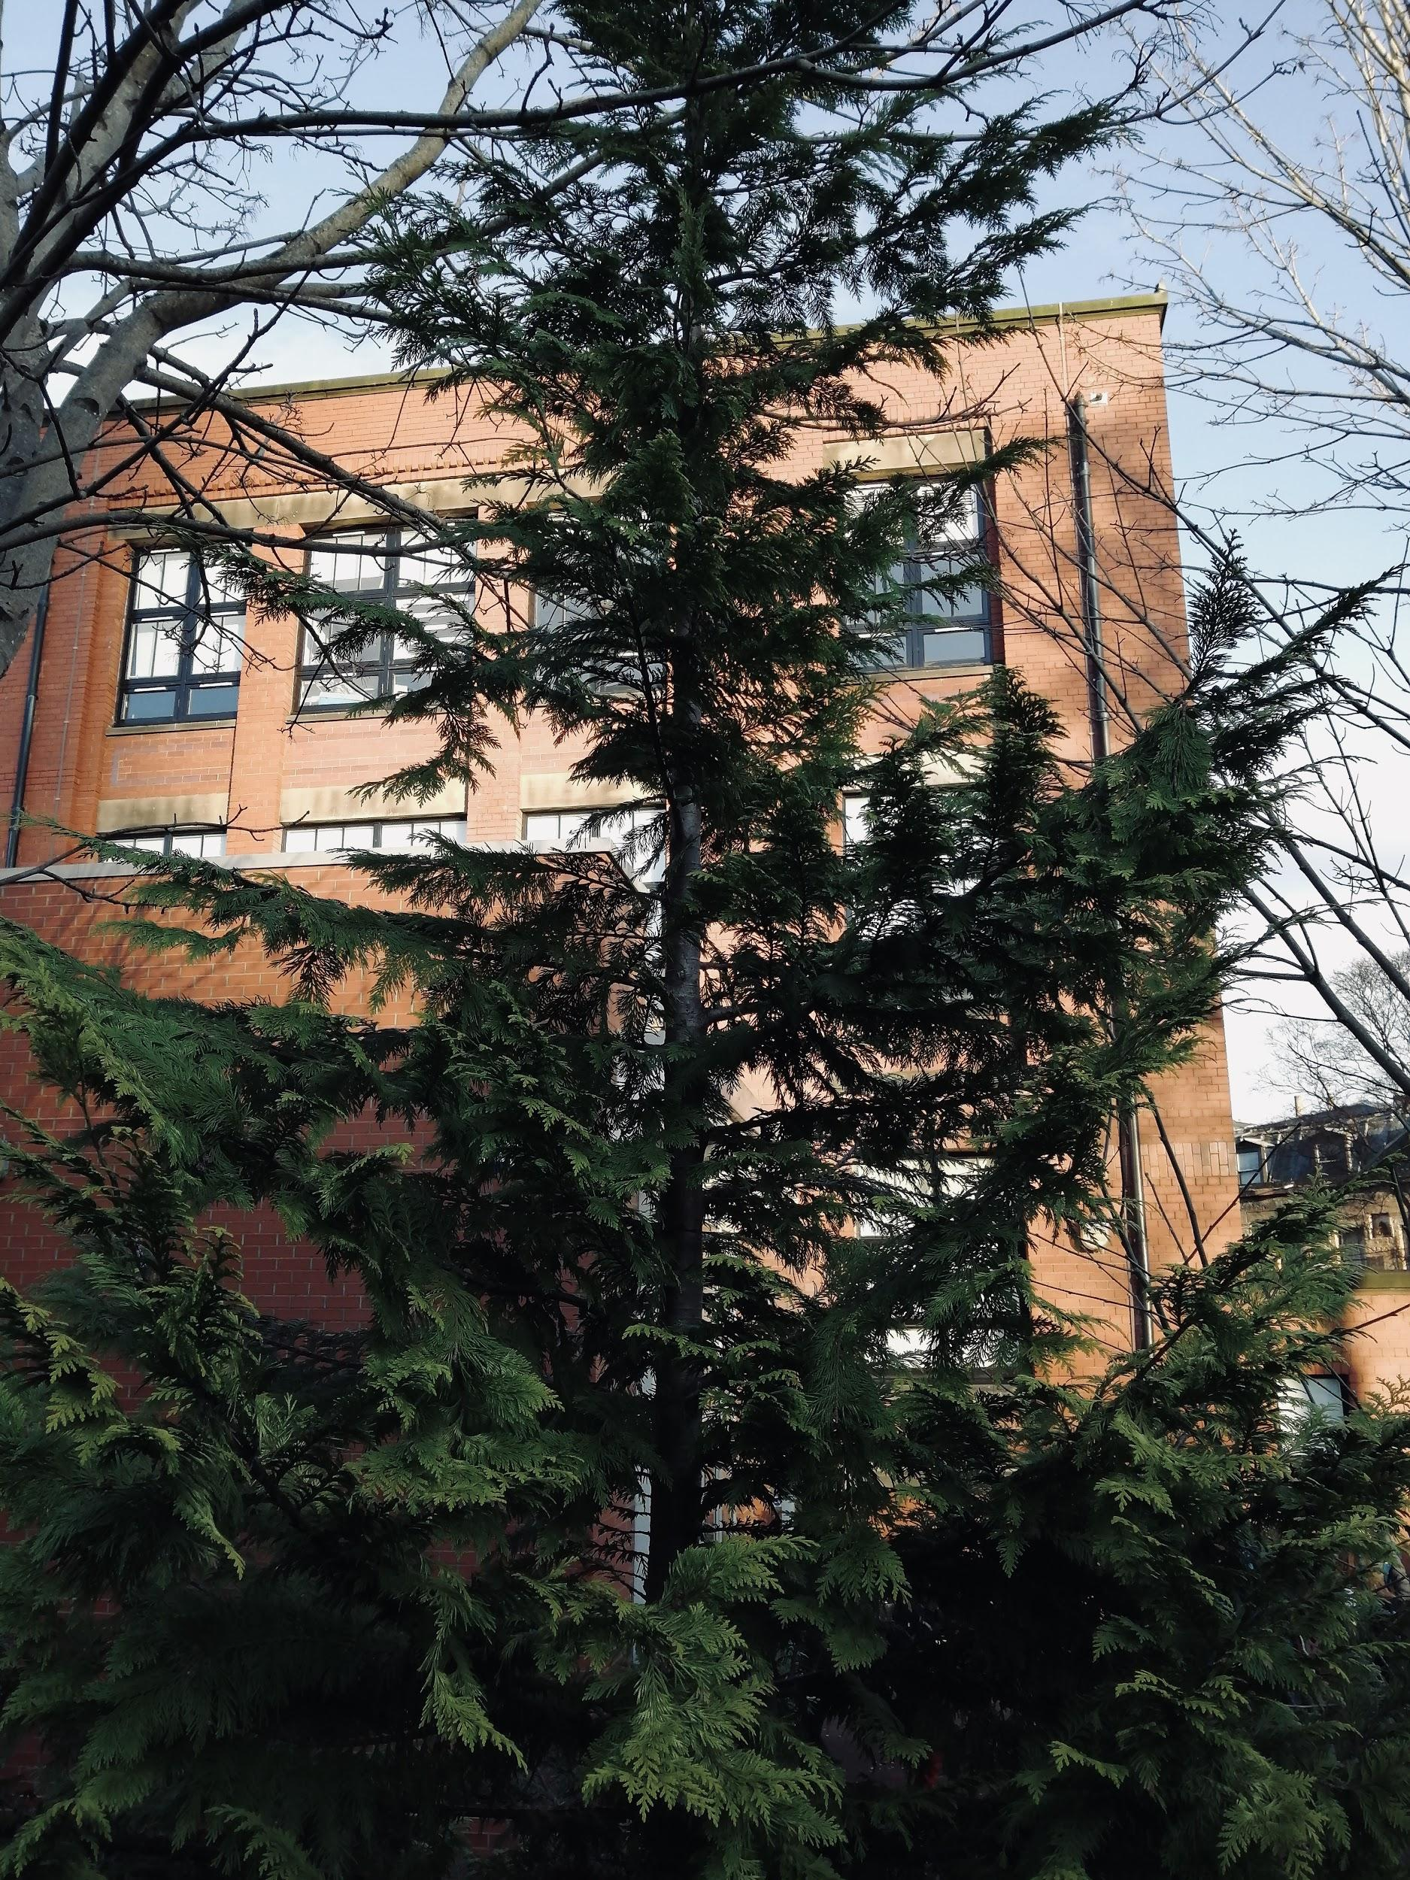
ROOM FOUR
Return To Museum

Slide 15
Artifact 1
This is an artifact from a Christmas card project that some of my friends and I did before the Christmas holidays. The task was to take some photographs which represent the Christmas season. As this task was set to be complete in the school grounds, it was a bit hard to find some “Christmassy” places. Inside of the school there were a few Christmas decorations and this was a great opportunity to take a photo of them.
Return To Room

Slide 16
Artifact 2
This is another photo from my many school Christmas photos. It may not give off the same Christmas vibes as the other photo, but I thought that this is quite a nice picture as it looks out onto the view that we get from the school classroom. I have also decided to put a filter onto the photo and the colours remind me a bit of Christmas.
Return To Room

Slide 17
Artifact 3
This is the last artifact of the museum and the last Christmas photo that I have. This is my favourite picture that I’ve taken for the Christmas card project and this is the photo I decided to use when making my cards. What I like about this photo is that there is a Christmas-like tree in front of the school building. This perfectly represents the school and Christmas. To enhance the photo, I’ve also added a filter which makes it look even better.
Return To Room

Slide 18
Thank you for visiting!

