Slide 1
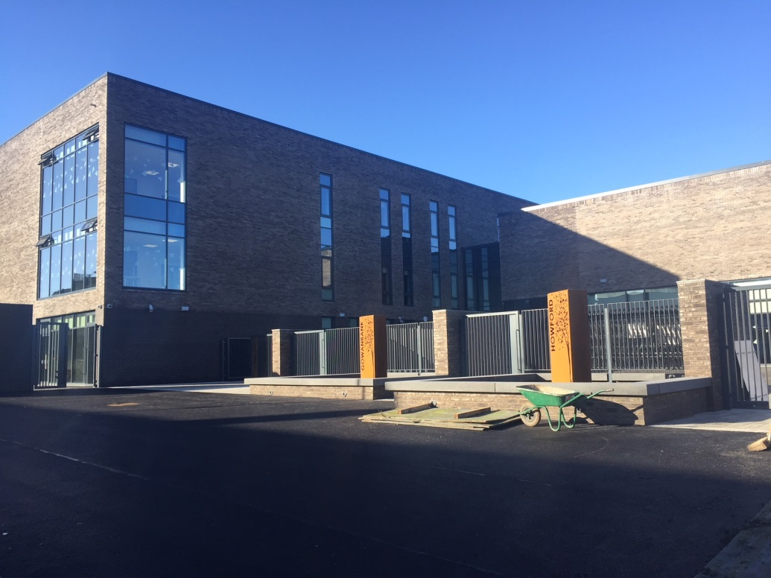
Gowanbank Primary School & LCR
When you
Enter this
Loving school
Consider yourself
One of the special
Members of an
Extraordinary team!
Helpful Hints and Information for the Parents of our New Children

Slide 2

The Gowanbank Team
Amanda Clubley– Head Teacher
Debbie McEwan– Depute Head Teacher
Scott Millar – Acting Depute Head Teacher
Jenna Harris- Acting Depute Head Teacher
11 mainstream classes, 6 LCR classes and 1 nurture class.
Mrs Hepburn is our CDO.
Miss Jackson, Mrs Tedcastle and a new member of teaching staff are the Primary 1 teachers.
Miss Johnstone is the LCR Primary 1 teacher.

Slide 3
School Values
Respect
Relationships
Inclusion
Fairness
Achievement
Notes:
Scott

Slide 4
Important
Dates & Times
School Starts:
Wednesday 17th August 2022 - 10am – 2pm
Thursday 18th August 2022 - 9.30am – 2.30pm
Friday 19th August 2022 - 9.30am – 2.30pm
From Mon 22nd August 2022 onwards - 8.50am – 2.50pm
LCR may have enhanced transition period.
Notes:
Need to discuss

Slide 5
Soft Start
In Primary 1 we use the Soft Start approach which helps our children to adapt to the school environment each morning.
Children in Primary 1 can arrive at school each morning between 8.50am and 9am. They should be dropped at the Primary 1 gate on Craigbank Drive where there will always be an adult there to greet them.
Notes:
Need to discuss

Slide 6
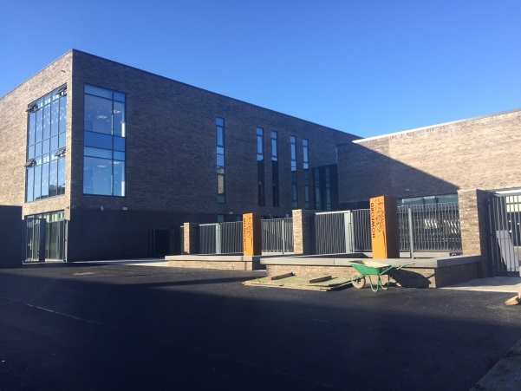
Lining Up and Collection
on the First Day
Children should enter via the side gate on Craigbank Drive (opposite the shops). Parents/carers should bring the children in the door closest to this gate (first day only).
A maximum of 2 parents/carers can enter the class, our staff will be there to welcome you and your child however we kindly ask you only stay a few minutes to take some photographs as this will allow us to settle all of the children and avoids overcrowding which can be overwhelming.
Notes:
I am thinking maybe flexible soft start might be easiest to manage?

Slide 7
Lining Up and Collection
(after the first day)
Children should enter via the side gate on Craigbank Drive (opposite the shops).
Parents are not permitted in the playground at any time.
P1 children dismissed from the side gate on Craigbank Drive (opposite the shops) and will be handed directly to parent/carer at 2.50pm.
Please inform school if someone different is collecting your child.
Children will be escorted from their classroom to you.
Notes:
Should we put markers in the infant playground for parents to stand on for the first few days? Teacher or SfLW could hand over from the classroom door? I reckon it will be easier to space from the infant playground

Slide 8

School Lunches
School lunches are free for all
Primary 1-5 children.
Parent Pay is the platform used to order school lunch.
(please note although the app is called parent pay – lunch is free)
Notes:
Alison

Slide 9
Parent Pay
Ordering School Lunch
Log-in information will be issues to all families to support the use of parent pay.
Lunch can be selected with your child in advance and all selections will be photographed.
Don’t panic – if you forget to pre-order at home, class teachers will support your child in making their selection.

Slide 10
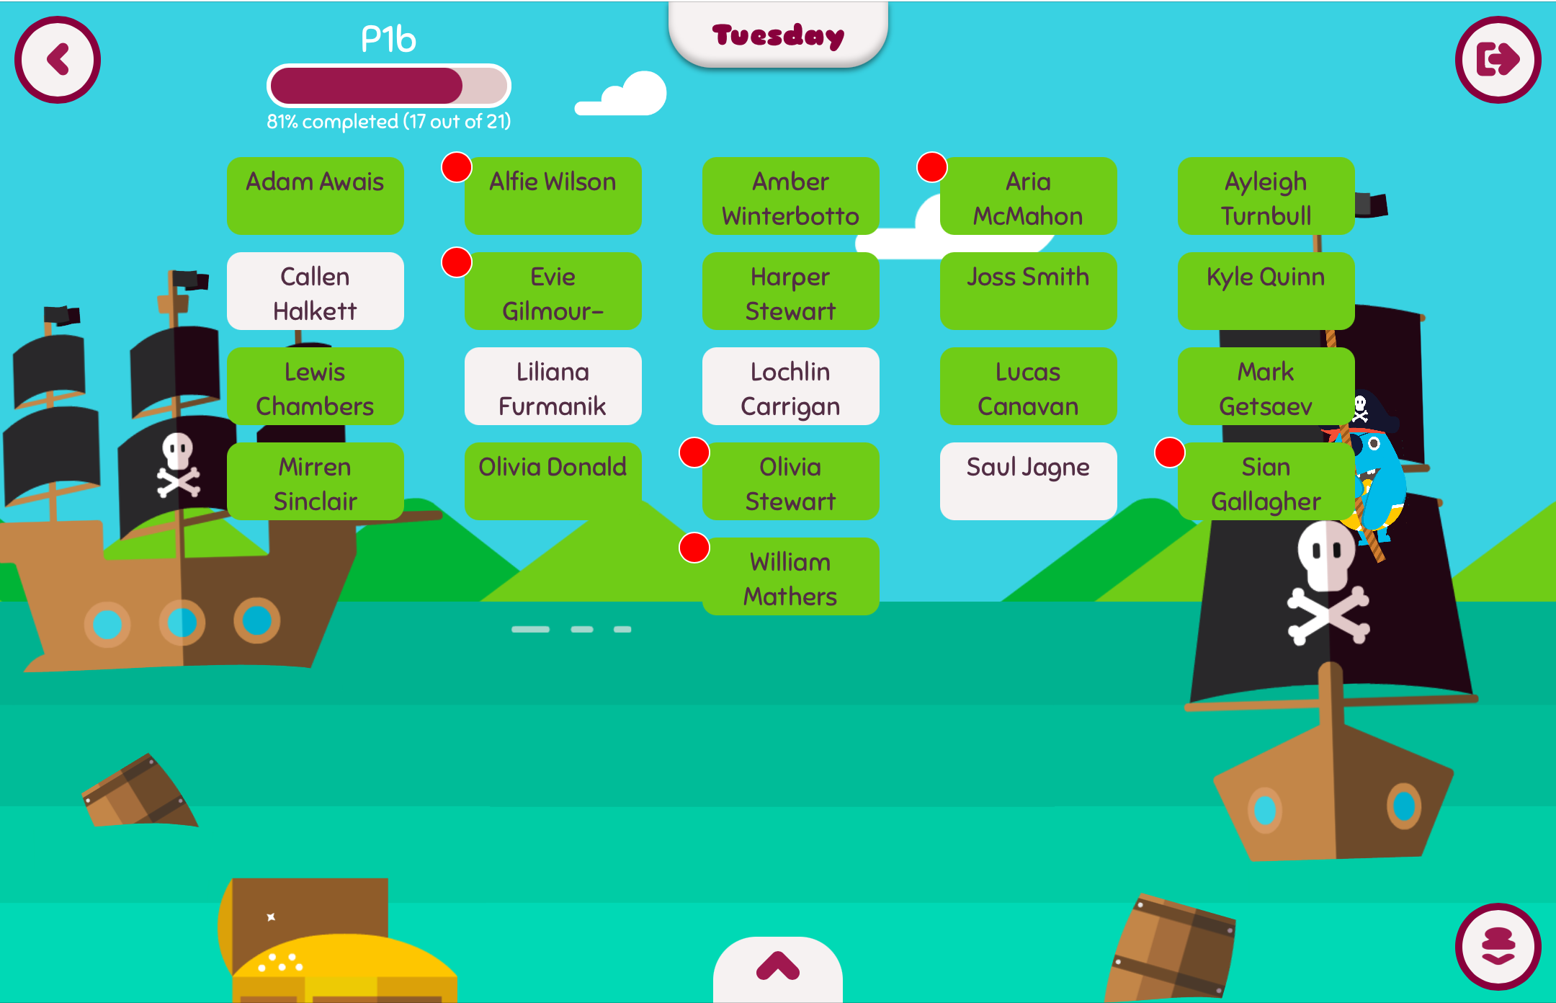
Parent Pay
Ordering School Lunch
Select your child’s name

Slide 11
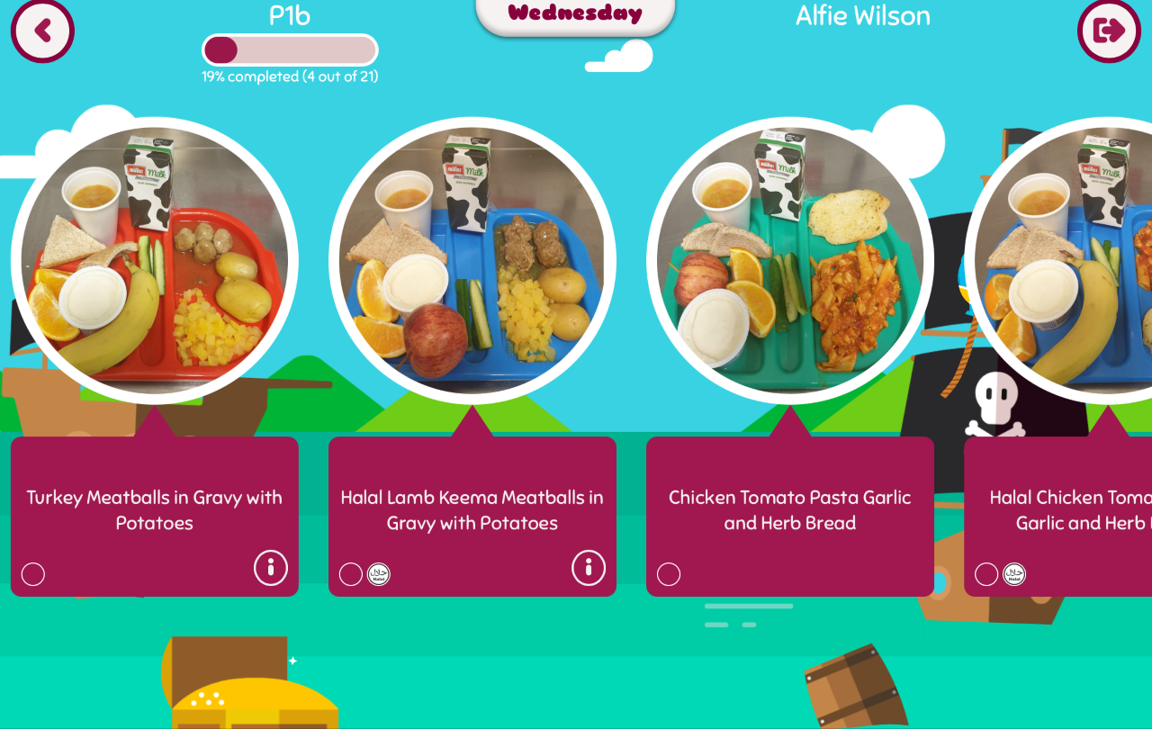
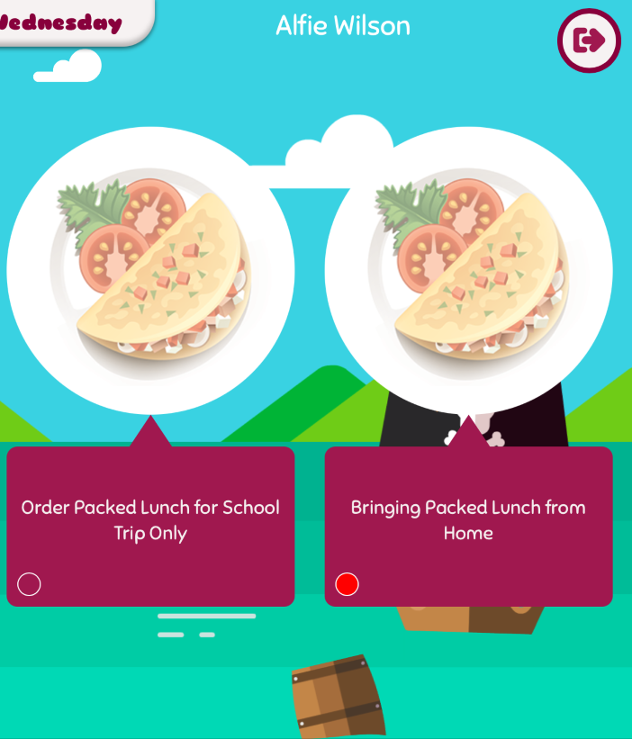
Parent Pay
Ordering School Lunch
Select your child’s choice from the options listed each day or choose the packed lunch option.

Slide 12

Notes:
Lunch video
http://www.fuelzoneprimary.co.uk/index.php

Slide 13

We are a
Health Promoting School!
Snack time: healthy snacks encouraged, i.e. fruit, healthy crisps & water. Large unhealthy snacks will not be permitted.
Lunch time: Free school meal P1-5. For packed lunches, as above, healthy food and snacks only please.
Notes:
1 piece of fruit e.g. apple, banana, orange etc.
Alison

Slide 14

NUT FREE ZONE
Please ensure your child brings nothing to school which contains nuts or pulses. This includes certain chocolates and crisps.
Notes:
Alison

Slide 15
Breakfast Club
Cordia run a Breakfast Club from
8.00am – 8.45am each morning
£2 per day (free for Free School Meal children)
cereal / toast / butter & jam / milk
Notes:
If you think you may be entitled to a school uniform clothing grant or free school meal please alert Mrs Miliken in the office who will be happy to advise you and help you fill out the forms. Breakfast club is free to children who receive free school meals via this
Alison

Slide 16
Appointments
If your child has a Doctor / Dentist / Hospital appointment please send a note to the school indicating the date and time of the appointment.
Please report the above to the office to ensure the correct code it put on the register.
Medicines must be labelled and consent forms signed at school office.
Notes:
Scott

Slide 17


Attendance
Attendance at school is vital to ensure your child achieves their best in learning.
Being at school everyday also develops good social and emotional skills and skills for work.
The Council request us to take action against attendance below 94%.
Notes:
Scott
We have a legal duty from the Council and Government to take legal action against poor attendance.

Slide 18
Attendance
90% = a day off every two weeks
Around 20 days off per school year
4 full school weeks
80% = a day off every week
Around 40 days off per school year
8 full school weeks
70% = two days off every week
Around 60 days off per school year
16 full school weeks
“Attending and taking part in learning – wherever learning takes place – is fundamental to making sure that our young people become successful learners, confident individuals, effective contributors and responsible citizens.”
Scottish Government
Notes:
Scott

Slide 19

Family Holidays
PLEASE AVOID ARRANGING ANY HOLIDAYS DURING SCHOOL TIME – holidays taken during school time are marked as unauthorised absences on your child’s attendance record.
Notes:
Scott

Slide 20
Absences
In the interest of safety if your child is
going to be absent from school for any
reason please phone the absence
reporting line everyday on 0141 287 0039
before 9.30am and send a letter
to your child’s class teacher on their
return to school.
This can be done online now, too!
Notes:
Scott

Slide 21
What Your Child Needs
Refillable water bottle (soft plastic)
School bag
Indoor shoes
P.E. kit – although children may not initially change for gym.
LCR – Home-school diary should be returned every day.
Notes:
Alison

Slide 22
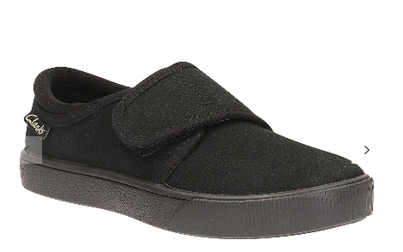

School Uniform
Grey/black/navy skirt / pinafore / trousers
Navy school sweatshirt / jumper / cardigan
White shirt and tie (tucked in) / white polo shirt
Blue & white summer dress
Black shoes (no white trainers)
Navy blazer
Indoor soft shoes
Notes:
Alison

Slide 23

School Uniform
Fashion Show
Notes:
Ask parents for pictures

Slide 24

The Jumper Monster…
Please remember to label everything. In a class of 25 there are can be more than 200 items which could be lost on a daily basis!
Notes:
Scott

Slide 25

Practise with your child…
Opening/closing bags and lunch boxes
Putting on/taking off school trousers,
jumpers, jackets, etc.
Fastening shoes
Washing hands
Notes:
Alison

Slide 26
Please Remember…
Avoid belts – children find them very difficult to
manage!
Send gym kits on gym days (or leave in school to be washed termly) - you will be given these days in August. This changes termly.
Sensible shoes/avoid laces and no jewellery to
be worn on gym days. Child must take our earrings on their own.
Indoor shoes should be worn.
Notes:
Alison

Slide 27


Playful Pedagogy
Our primary 1 classrooms are play based.
The room is divided into areas
Each area has a variety of stimulating and challenging resources to extend children’s learning, provoke thought and support the development of their imagination.
Notes:
Alison

Slide 28

Curriculum for Excellence
8 Curricular Areas: Literacy & English, Numeracy & Maths, Health & Wellbeing (PE), RME, Social Studies, Technologies (ICT), Expressive Arts (Drama, Music, Art, Dance), Sciences
4 Capacities: Successful Learners, Responsible Citizens, Effective Contributors, Confident Individuals

Slide 29
Parent Curriculum Workshops
Workshops will provide opportunities to see how your child learns and support their development.
Stay, Play & Learn
Read, Write, Count
Playing with Sounds
Play along maths
Family, Food & Fun
Get Shopping, Get Cooking
And much more!
Research shows the more you engage
with your child's learning in school, the
better your child will do.
How can I help?
Notes:
Including Stay, Play and Learn, Playing with Sounds, Play Along Maths, Bookbug, Monster’s Bookclub
Most of these workshops take part during the school day, we understand that for working parents this may not be suitable however we are happy to welcome grandparents, aunts, uncles etc.
Scott

Slide 30


ASN Parent Network
An opportunity to meet with other parents whose children have an ASN.
Dates for 2022-23 TBC.
Notes:
Scott

Slide 31
Parent Council Group
Our parent council can make a real difference to the school. The
Parent Council are very eager to welcome new members in Aug 2022!
Notes:
Scott

Slide 32

Communication
We all want the same… the best for your child!
It’s important that the school and parents have good communication to allow us work together to get the best for your child.
If an issue does arise, please contact a member of the
leadership team via the school office and we will
get back to you as soon as we can. This is not
always immediately.
Please keep in mind, social media is not a good
forum to share school business.
Notes:
Scott

Slide 33

See Saw
In August, you will be issued with information on how to download and log-into SeeSaw.
SeeSaw is a platform which allows you to see your child’s learning in class through photograph and video updates.
Teachers will also share homework and general class messages via SeeSaw.
The chat function will be available for you to make contact with the class teacher. We kindly ask however that you be mindful to the time and content of messages via this app.

Slide 34
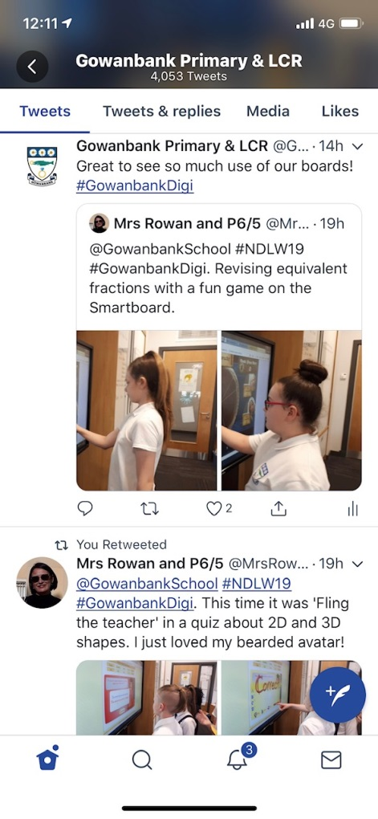
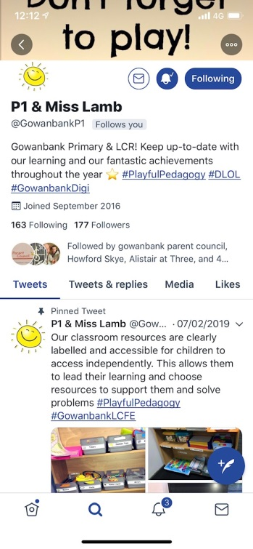
Twitter
Twitter @GowanbankSchool
Individual class twitter
Notes:
Scott

Slide 35
School Website
Please check our school website over the coming weeks for any updated information.
https://blogs.glowscotland.org.uk/gc/gowanbank/

Slide 36

Challenge…
Download the Twitter app and follow our school… We have 1941 followers!
Notes:
Scott

Slide 37

Other Communication
Most of our communication with you will be via email. If you have not already, please email headteacher@gowanbank-pri.glasgow.sch.uk with your current contact details including your email address.
You will receive:
Weekly Update Newsletters which are emailed
Texts
Emails (no reply)
School Website
Important letters (check bags)
Notes:
Scott

Slide 38
Contacting the School
At Gowanbank Primary and LCR we have an open door policy. We welcome your feedback and encourage parents to come and discuss any issues that may arise with us.
We ask that if you would like to speak to a member of the school team please contact the office in the first instant who will pass on your message to the appropriate member of the school team. We aim to get back to parents within 48 hours.
We appreciate your cooperation with this as at times, things can be particularly busy across the school.
Notes:
Have added this slide in, thoughts?

Slide 39

The Campus
What is an Language & Communication Resource (LCR)?
Howford Primary School
Craigbank Nursery
Parking/Drop off – car free zone!
LFCE/Makaton
Play and lunch times
Notes:
Scott

Slide 40
Car Free Zone
Our school operates a Car Free Zone between the hours:
08:30 - 09:15
14:30 - 15:15
The Following Streets are closed to traffic during this time:
Craigbank Drive, Drumbeg Drive and Prestwick Street
Please note: Taxis and Buses from Gowanbank LCR and Howford PS will still be in operation during this time.

Slide 41
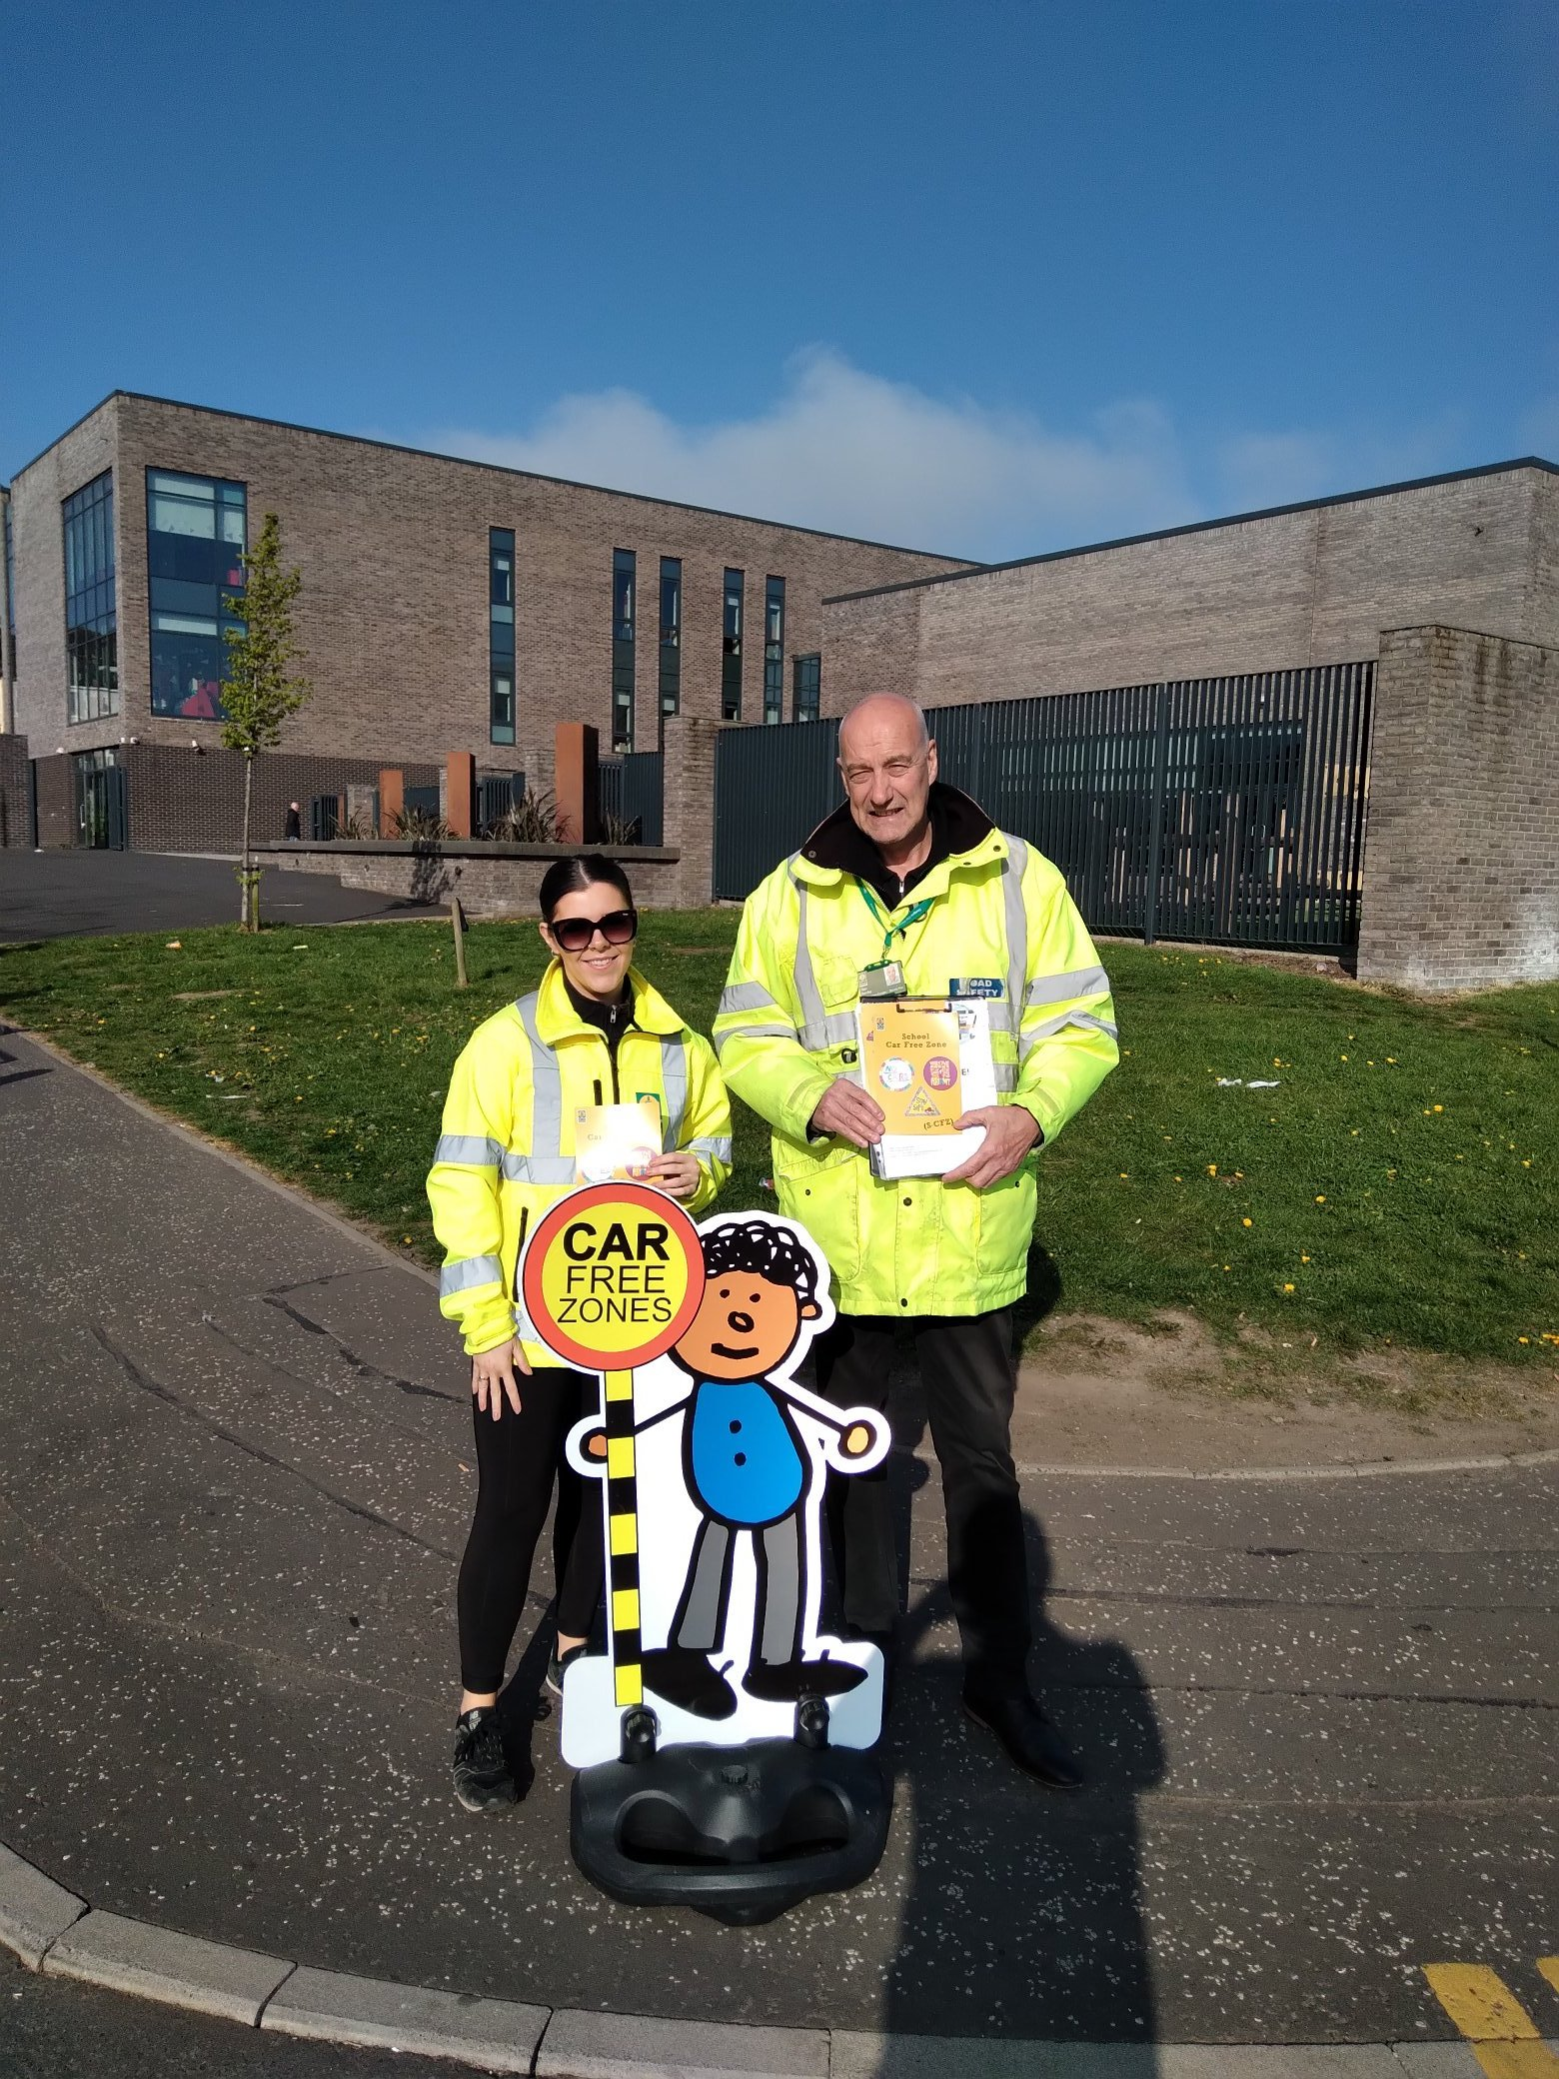
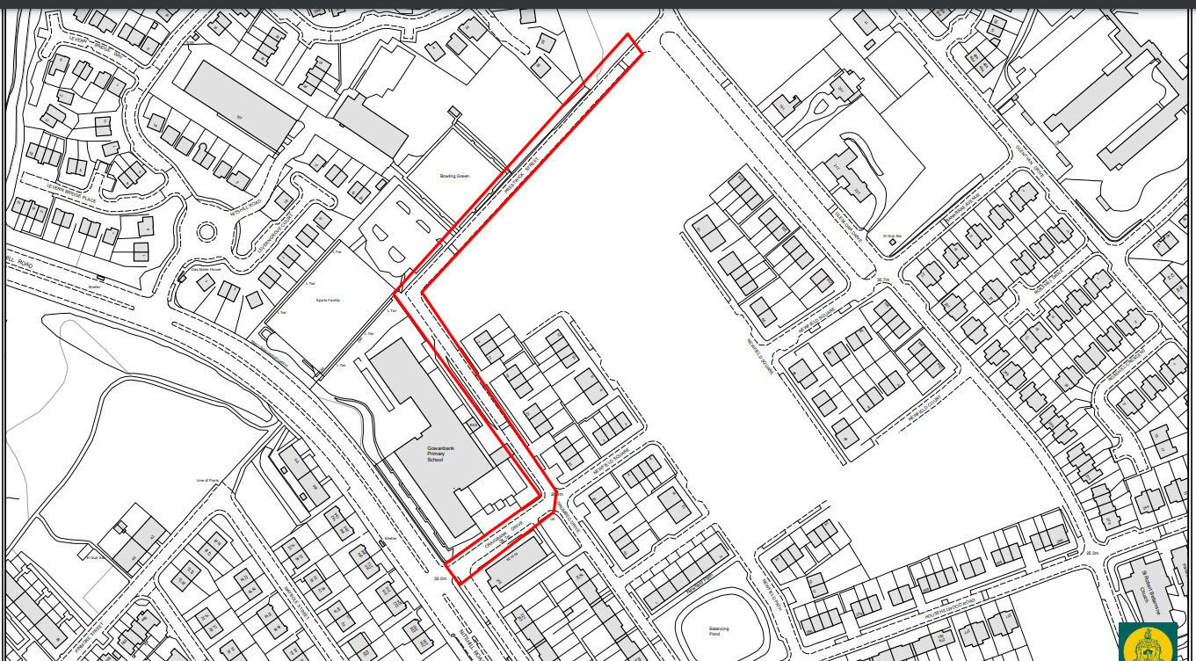
Car Free Zone
Craigbank Drive, Drumbeg Drive and Prestwick Street

Slide 42

Over the summer………….
Talk to your child and encourage your child to talk to you
Read to your child (encourage a love of books!)
Read /teach them nursery rhymes
Draw and mark make together
Colour in (encourage to stay in the lines)
Letter formation / sounds not names:
“b not B” “e not E”
Notes:
We can’t stress enough the importance of talking to your child. Use opportunities to point out things like colours, numbers, letters etc. Encourage familiarity with spoken and written language as much as possible. Joly Phonics online.
Alison

Slide 43
Additional Support Needs (ASN)
What is an Additional Support Need?
Who do I speak to if I have an ASN concern?
How do we support ASN?
Medical or Educational?
Transitions

Slide 44

Speech and Language Therapist

Slide 45

Outside Agencies
We have a councillor in school on a Tuesday and Wednesday each week. Pupils may be signposted to Lisa or can sign themselves up for a drop-in session.
Notes:
Ryan and Claire to film

Slide 46

Outside Agencies
We have a family support worker Claire Marshall. Claire is from HomeStart and has worked with the school for a number of years. As well as supporting families out in the local community, Claire hosts weekly parent support groups.

Slide 47

Outside Agencies
In session 22-23, Lee Davidson from Potential in Me will host monthly wellbeing workshops. Sessions will focus on the development of new skills such as candle making and flower arranging and will also give parents the chance to discuss a range of topics which support wellbeing.

Slide 48
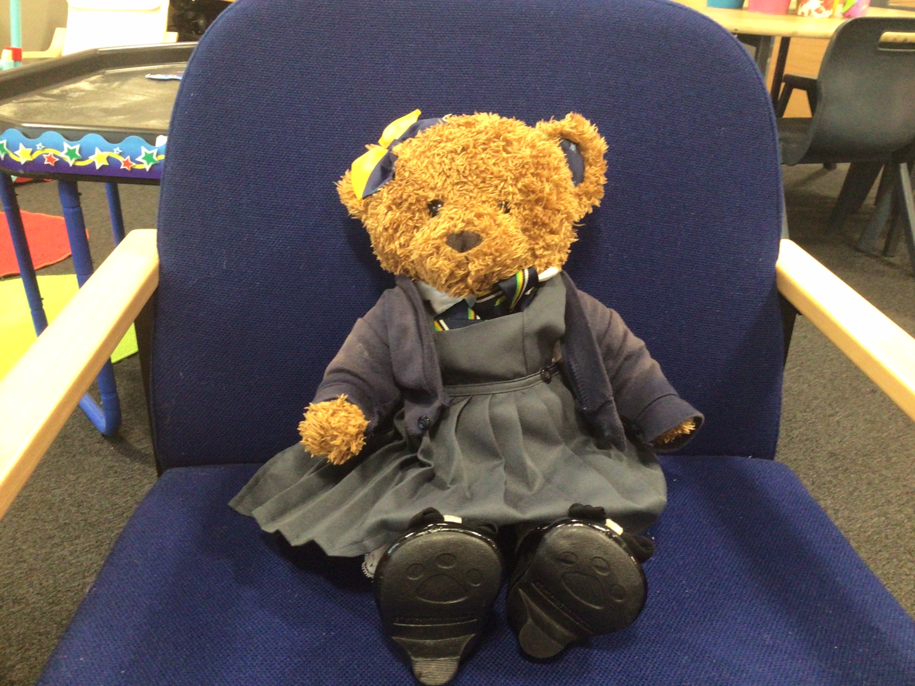
Look out for Gowanbank Gertie
Coming to your e-mail soon!

Slide 49

Coffee and Questions
Next week when the children visit their class teachers on 15th June between 1.30pm and 2.30pm, the SLT will be holding a coffee and questions session.
We hope to see you then.

Slide 50
Question Time
Any Questions?
If you have any questions please don’t hesitate to call the school office on 01418812424 or email
Jharris@Gowanbank-pri.glasgow.sch.uk headteacher@gowanbank-pri.glasgow.sch.uk
Welcome to the Gowanbank Family, we are looking forward to working with you.

Slide 51

Thank You For Listening

