Slide 1

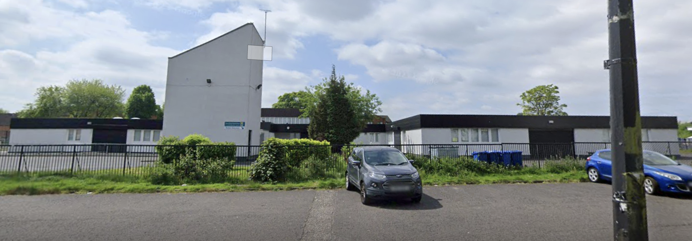
Fàilte gu Seisean Fiosrachaidh
Bun-Sgoil Ghàidhlig Bhaile a’ Ghobhainn
Primary 1 Induction
22.04.26

Slide 2
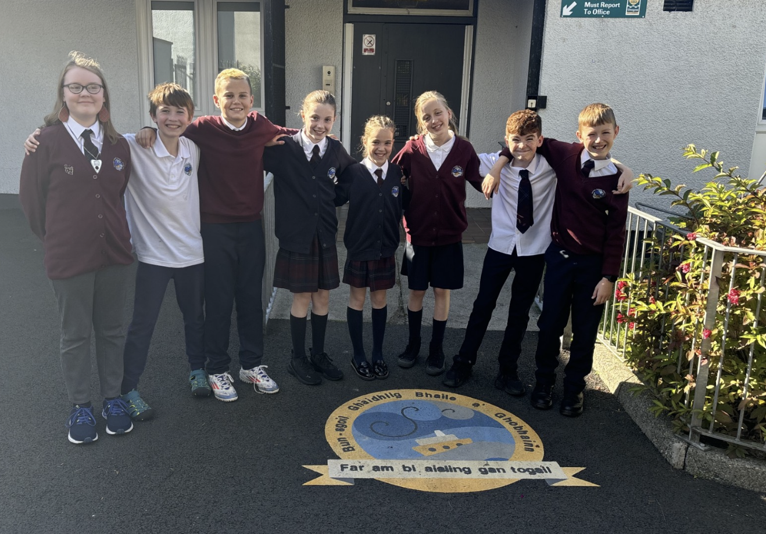
Cruth / Format
  Brief Information session
  Tour of the School / Captains & Vice Captains
  Form completion

Slide 3
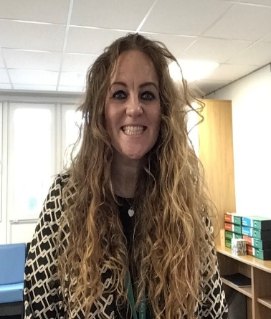
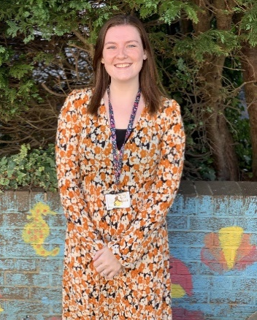
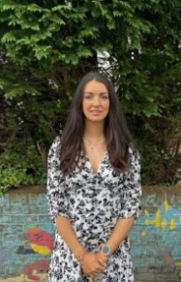
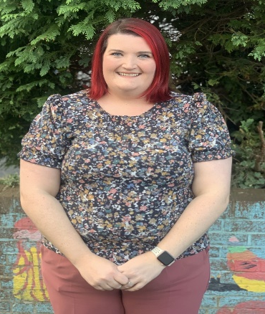
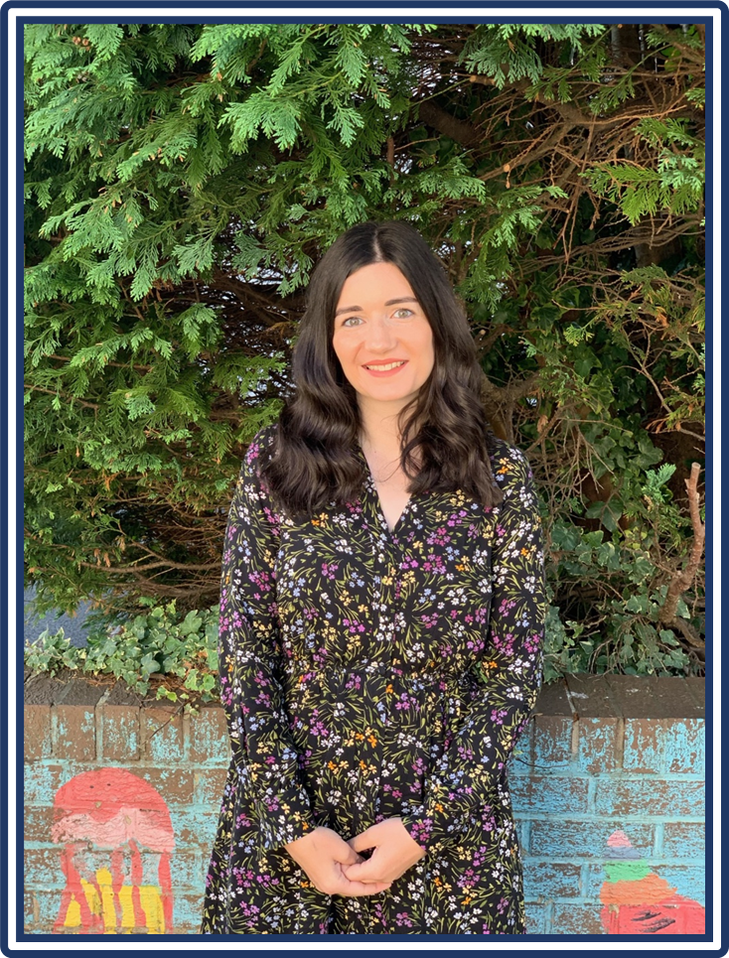
Meet the Leadership Team
Miss Dillon
Acting Head Teacher
Mrs Roisin Geddes
Acting Depute Head Teacher
Mrs Ann Quinn
Acting Principal Teacher
Mrs Charlotte Meney
Principal Teacher
Mrs Katy Smith
Acting Principal Teacher

Slide 4
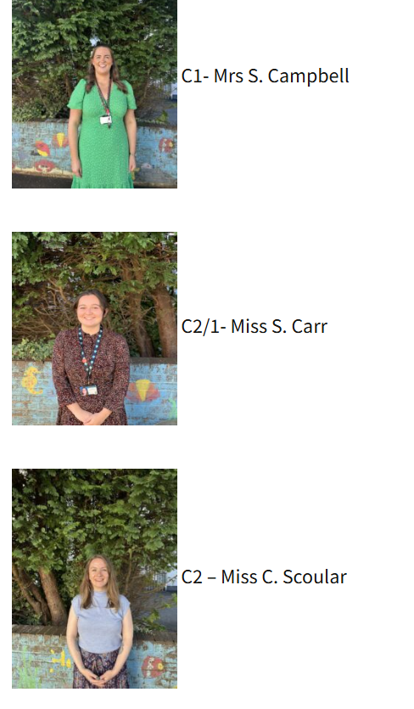
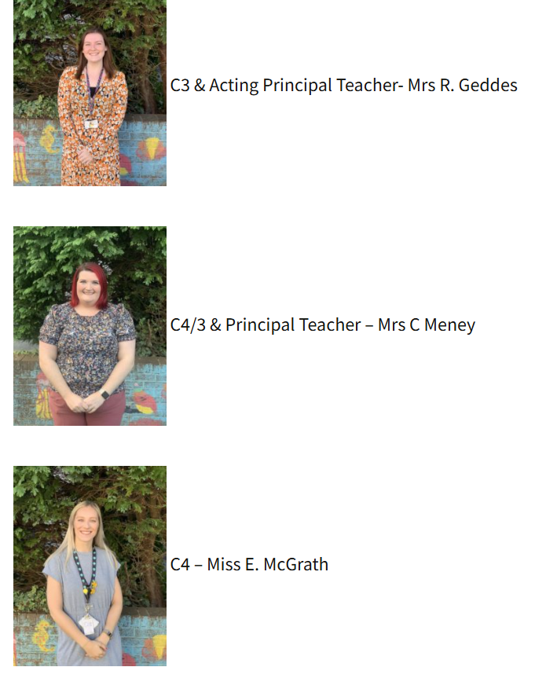
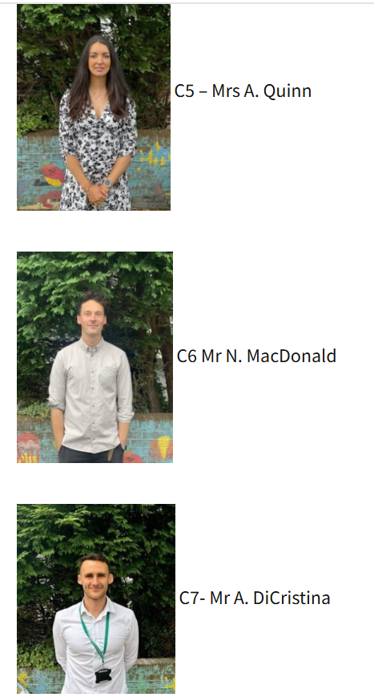
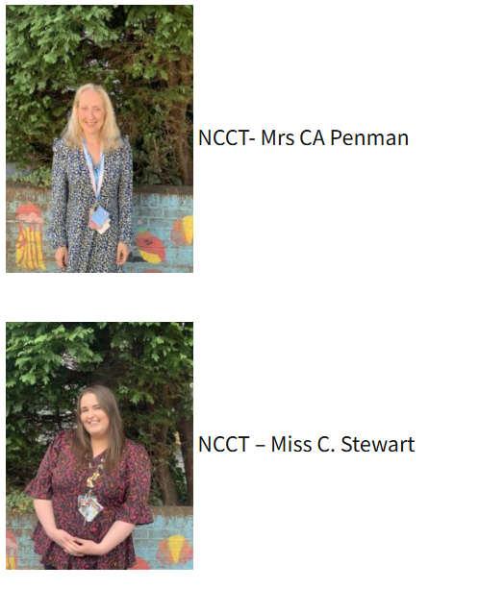
Meet our Teachers

Slide 5
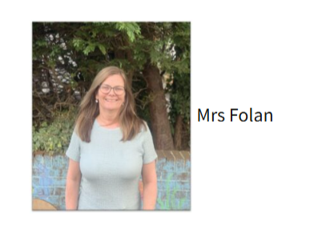
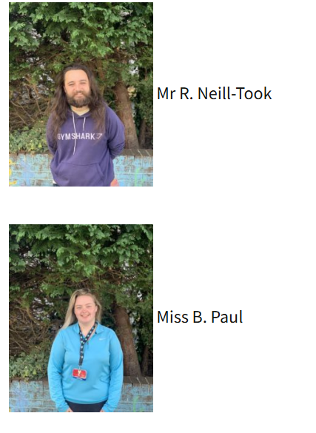
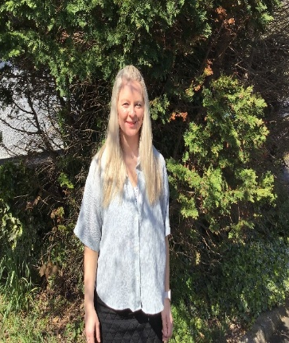
Meet the Support for Learning Workers
Mrs Lynsey

Slide 6
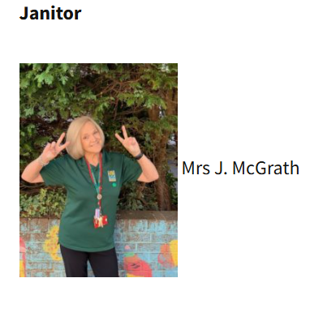
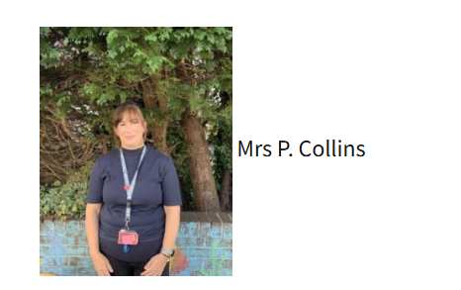
Meet our Clerical Assistants and our Janitor
Clerical

Slide 7
Ar Sgoil / Our School
Our school was first established in August 2018 (with a roll of just 50 pupils!).
We moved from the Glasgow Gaelic School in 2018 to an annexe in Whiteinch.
In 2019, we moved to our permanent, refurbished home in Govan.
In 2020, Bun-sgoil Ghàidhlig Bhaile a' Ghobhainn formally became a standalone school.
We now have 9 classes and 243 pupils.

Slide 8
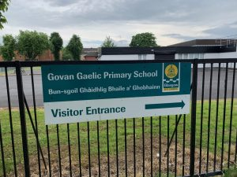
Ar Lèirsinn/Our Vision
“At Bun-sgoil Ghàidhlig Bhaile a’ Ghobhainn our vision is to provide a safe, caring and happy learning environment, centred in the Gaelic language and culture. We will support our learners to develop the qualities, knowledge and skills to enable them to form positive relationships, display kindness, experience success and participate meaningfully in society.”

Slide 9
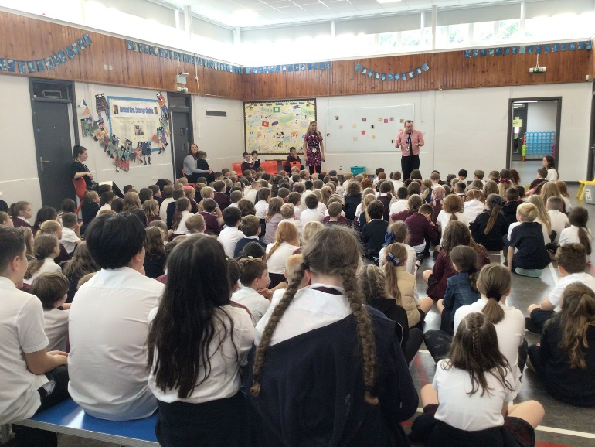
Luachan/School Values
Urramach/Respectful
Àrachadh/Nurturing
Càirdeil/Friendly
Taiceil/Supportive
Brosnachail/Encouraging

Slide 10
Iomadachd / Equalities & Diversity
At Bun-sgoil Ghàidhlig Bhaile a’ Ghobhainn we believe that all children should receive equal access to the full school curriculum and wider school experience regardless of first language, disability, race, gender, cultural or socio-economic background
We believe that every child has the right to equality of outcome and to achieve their full potential
We aim to create a diverse curriculum which reflects the diversity of our pupils, our local and wider community

Slide 11

Our School Logo
The logo below was designed by pupils in our school to symbolise the rich history of the Govan shipyard and the Glasgow Clyde. The badge has been adapted slightly for the uniform, to ensure that it is clear and simple.
However, the original design is used on correspondence.

Slide 12
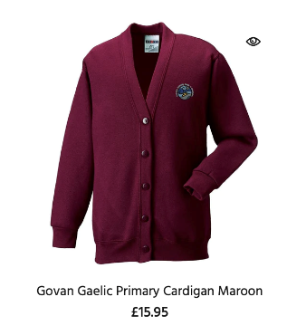
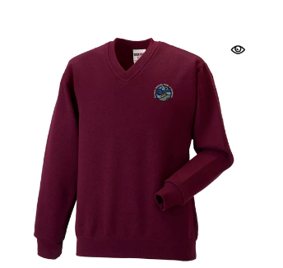

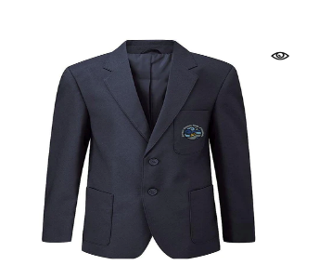

Èideadh Sgoile / Uniform
Maroon tartan for skirt, kilt, pinafore and tie
Navy and Maroon jumpers/cardigans (crew neck or v-neck)
White polo-shirt
Navy trousers / shorts
A navy badged blazer
Badged items are not compulsory, but the school colours must be worn
The badged and tartan items for our school are available to order online from Schoolwear Made Easy: Govan Gaelic Primary School
They also sell P.E. packs.

Slide 13
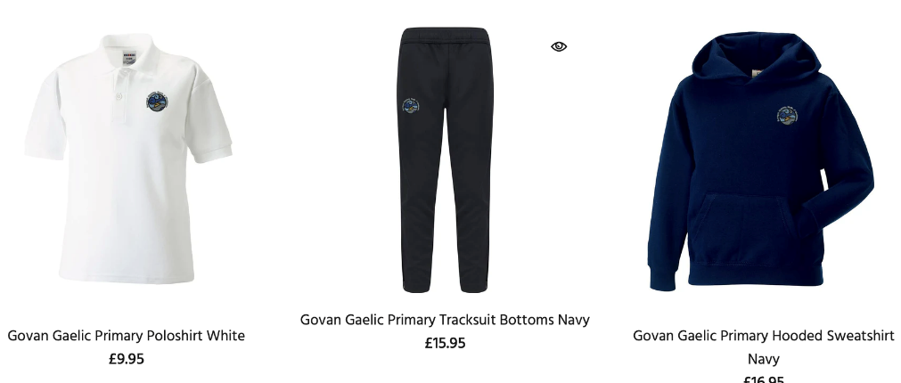
Leubailean/ Label
PLEASE LABEL ALL ITEMS OF CLOTHING (school uniform, jackets, water bottles, lunchboxes)
On P. E. days – which will be confirmed in August – children should come to school in their P. E. kit
P.E. Kit should comprise of:
Navy / Maroon Joggers / leggings / shorts
A white, navy t-shirt / school polo shirt

Slide 14
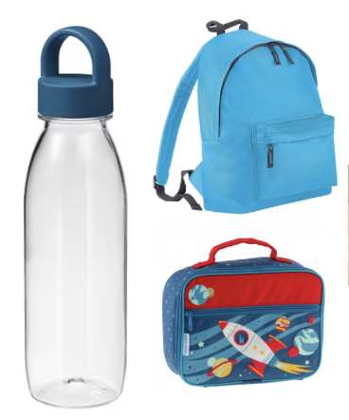

Stuthan Eile / Other Essentials
Filled water bottle
Small school bag
The children can visit the toilet regularly and when required. There is a toilet at the back of their class
However, we would appreciate if you would pack a spare pair of pants in your child’s school bag in case of any accidents

Slide 15
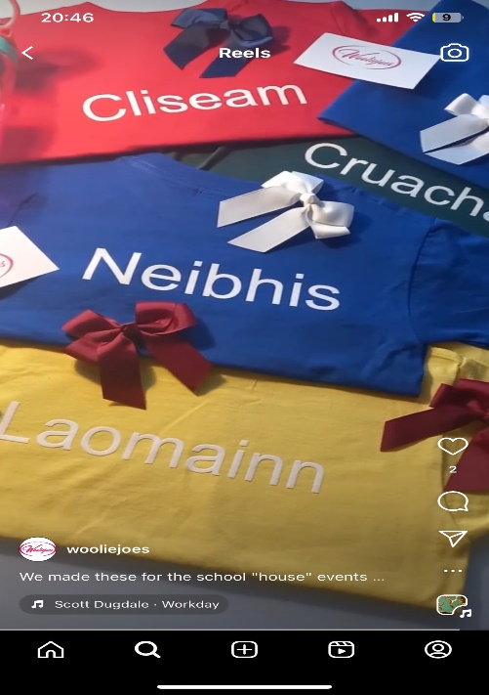
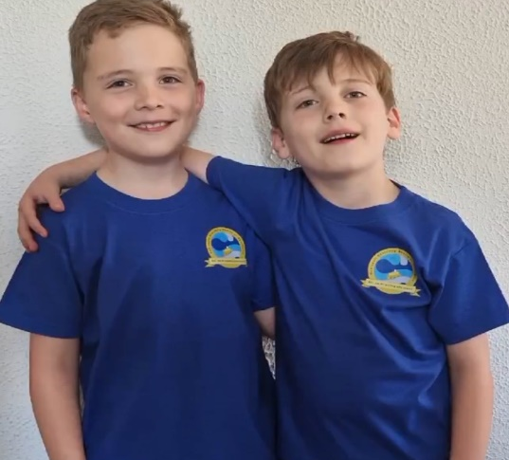
Na Taighean/ House System
Laomainn
Neibhis
Cruachan
Cliseam
Parent Council kindly gift all our new P1 children a house colour t-shirt
Angela Wooliejoes for merchandise

Slide 16

Why choose GME for your child?
Role of the Parent/Carer/
Extended Family
Gaelic embedded in the home
Child at the Centre

Slide 17
Foghlam Tron Ghàidhlig/
Gaelic Medium Education
  Total Immersion phase: from the first day of P1 until the end of P3, with a clear emphasis on developing oral fluency and a secure foundation in the Gaelic language. During this phase, all subjects will be exclusively taught through the medium of Gaelic.
  Immersion phase: from end of P3/start of P4 and this continues to the end of P7.
  The curriculum in its entirety continues to be taught through the medium of Gaelic.
  However, at this stage English is gradually introduced as a subject (e.g. English phonics, English spelling rules) but all teaching and learning is still taught through Gaelic

Slide 18
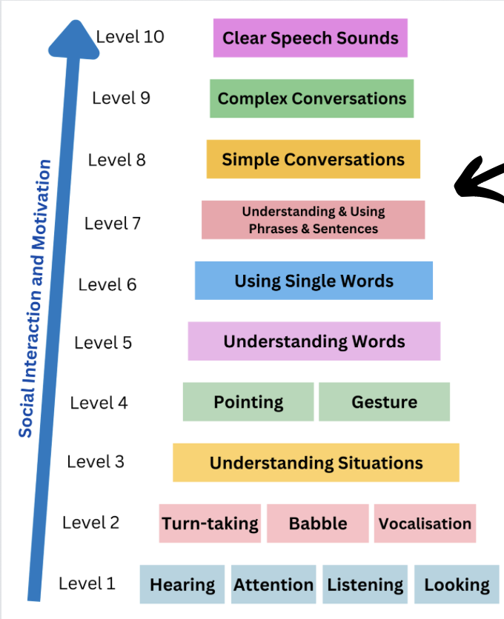
Building Blocks of Language

Slide 19
Parental Engagement & Involvement
Home support is crucial for your child's development in Gaelic Medium Education.
Commit to your own language journey to aid your child's acquisition of Gaelic.
Get involved!
Take Gaelic classes, assist with homework, attend school workshops
Normalise Gaelic at home:
Create a language-rich environment by watching, listening to, and reading Gaelic stories.
Valuing Gaelic language and culture at home will greatly enhance your child's passion for the language.

Slide 20
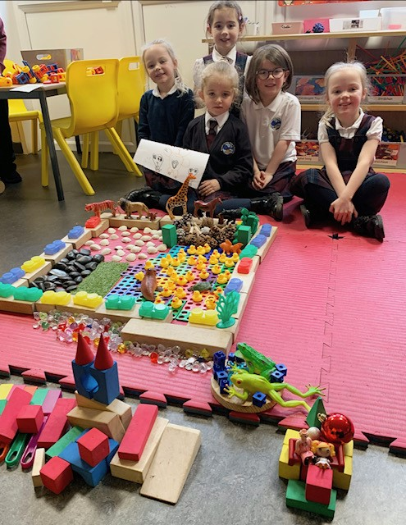
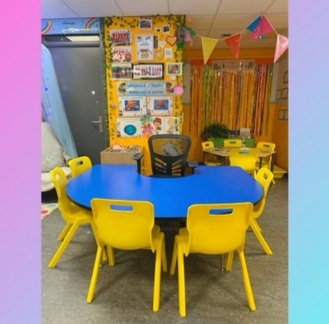
Ionnsachadh tro Chluich /
Play-based Learning
The children have opportunities to engage in a range of play experiences, including child-led free play, adult initiated play, and more structured adult directed tasks. It is important that the children receive this balance in order to ensure they are progressing throughout the curriculum as well as supporting their own interests.
Teachers plan engaging areas together for Literacy, Numeracy and STEAM (Science, Technologies, Engineering, Art and Maths)
Pupils' complete daily targets in class
Teachers provide Gaelic input - emphasis on songs, rhymes, stories and repetition of language
Smooth transition
Mrs Geddes

Slide 21
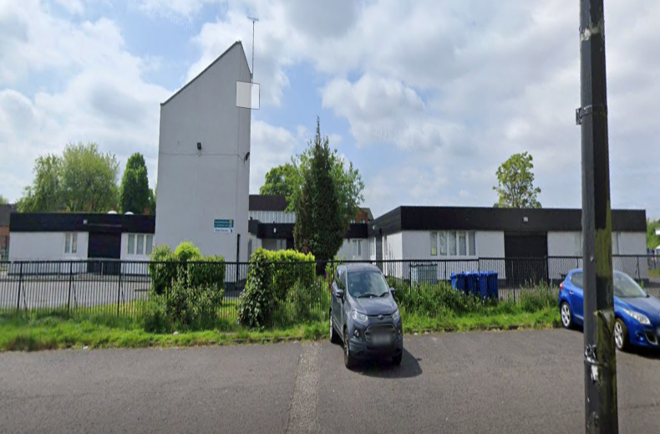
August 2026
Week 1
Day 1 - Wednesday 12/08/2026 – 9.30am - 2.30pm
Day 2 - Thursday 13/08/2026 - 9.30am – 2.30pm
Day 3 – Friday 14/08/2026 - 9am – 3pm

Slide 22


Deisealachd airson na Sgoile/
Leading up to school
Talk positively about school
Independent skills
Recognise their own belongings
Fasten their own shoes / put on and take off their own jacket and jumper or cardigan
Open snacks and eat meals using appropriate cutlery and utensils
Learning
Talk about colours and shapes/ count to 10
Share a story with an adult
Help them recognise/ begin to write their own name
Practise holding and using a pencil

Slide 23

Frithealadh / Attendance
Please contact 0141 287 0039, before 09:30am and provide details to the Pupil Absence Reporting Line.
https://www.glasgow.gov.uk/pupilabsence
If you do not contact the school by 9.30am you will receive a text message from the school office
Inform After School Care of absences

Slide 24


Leigheasan/ Medicines
Parents should inform the school of any medical requirements relating to their child.
If a child requires medication during the school day, parents must complete the appropriate medical form at the school office
Only medicines prescribed by a doctor can be administered during the school day. These must all be clearly labelled by the pharmacy with name of child clearly stated.

Slide 25



Break Time
We encourage children to make healthy choices at snack times and for lunch
15-minute interval (class time)
We are a NUT-FREE school
Please do not send any nuts or food containing nuts to school. This includes popular brands of chocolate spreads
We also ask that children do not bring lollipops or fizzy drinks as part of their snack or lunch

Slide 26
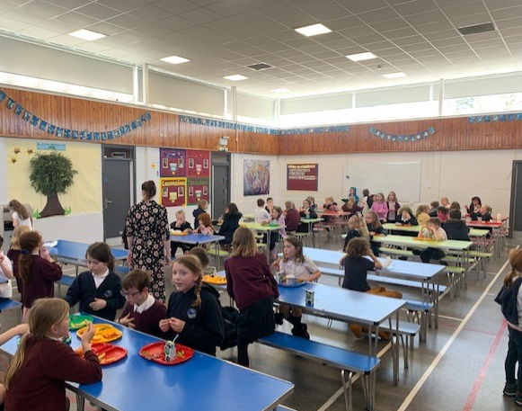
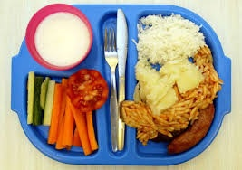
Lunch Time
45-minute lunch break
All P1-5 pupils are currently entitled to a Free School Lunch from the Fuel Zone
Please check the website for the menu
Halal, Vegetarian options are available
Meals for children with food allergies can be prepared when supported by a letter from a GP
Supervision
Parent Pay (select your child’s food)
Packed lunches also eat in the dinner hall

Slide 27
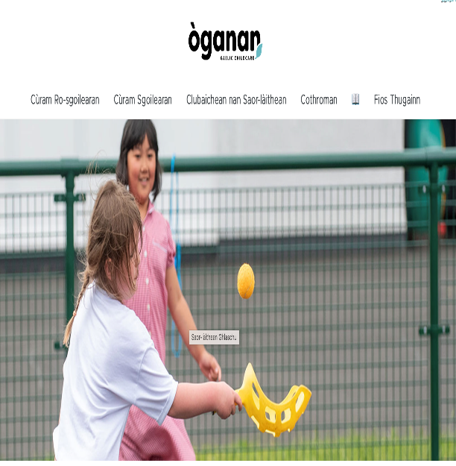
Cobhair Chloinne / Breakfast Club & After School Care
Breakfast Club is available from 8:00am-8:45am- serving toast, cereal and juice - £2 per day (additional children £1)
The after-school club is run by Òganan, a Gaelic organisation, situated within the school premises
They also run holiday clubs during the Summer holidays, October holidays and Easter holidays
Please see Oganan’s website for more details

Slide 28

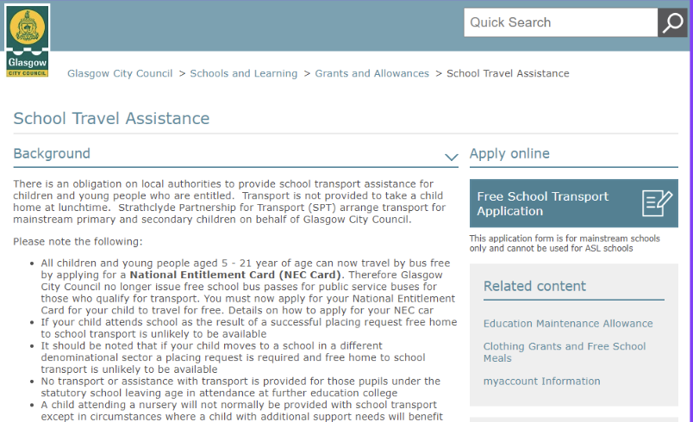
Còmhdail / Transport
Parents’ responsibility to formally apply for transport (if you are 1.2 miles from the school (Google Maps) using the Free School Transport form at https://www.glasgow.gov.uk/article/5505/School-Travel-Assistance
If transport is granted, a pickup point will be assigned, as well as information about pick up/drop off times
Code of Conduct policy for School Transport
On arrival at school:
Pupils are met by school staff
Staff supervision in the playground from 8:45am
Pupils are escorted to the bus/taxi at the end of the school day by teachers/SMT

Slide 29
Tabhartasan / Clothing Grants &
Free School Meals
While all P1-5 pupils are currently entitled to a Free School Meal, you should still apply for a Clothing Grant and Free School Meals grant if this is something you are entitled to
Clothing Grant Applications for the new school session 2026/2027 will open in June 2026
Information and application forms can be found at: https://www.glasgow.gov.uk/schoolsandlearning

Slide 30



Conaltradh / Communication
Phone the school office 0141 445 1767
Email via the Headteacher Inbox: headteacher@govangaelic-pri.glasgow.sch.uk
Showbie
Newsletters / Letters
Xpressions/ Groupcall– almost all communication from school is sent via Xpressions – both parents can sign up – allow notifications or check regularly.
ParentPay – school meals selection and pay for trips etc

Slide 31

Booklets
Please engage with the resources provided in the booklet. It is important that, between now and your child’s upcoming stay and play sessions, they begin to engage with the language, if they are not already doing so.
The transition booklet should be completed and returned during the first stay and play session.

Slide 32
Moran taing/ Thank you!
Thank you for attending!
We Look forward to meeting your child at the planned stay and play sessions!

