Slide 1

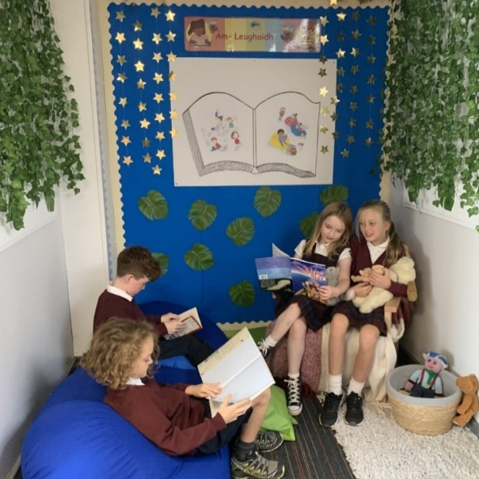
Fàilte gu Bun-Sgoil
Ghàidhlig Bhaile a’ Ghobhainn

Slide 2
Cruth / Format
  Information session
  Tour of the School
  Information Session GME
  Q/A with Captains and Vice Captains

Slide 3
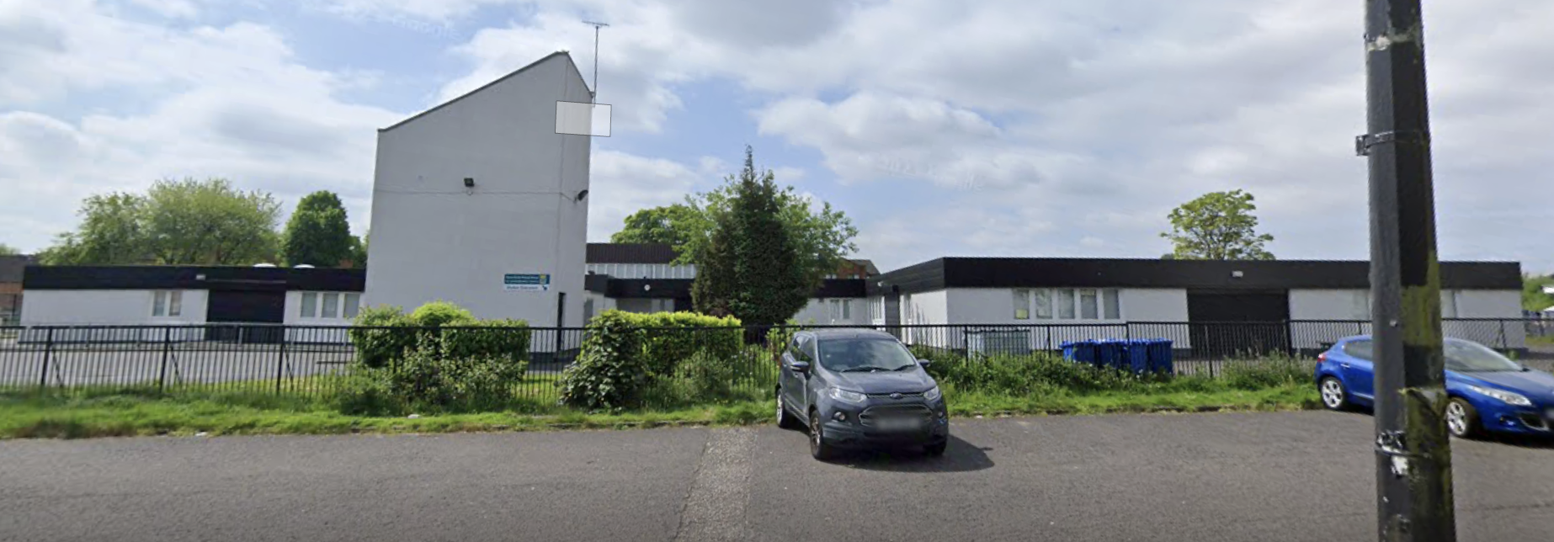
Ar Sgoil / Our School
Our school was first established in 2018 (with a roll of just 60 pupils!) as an annexe of the Glasgow Gaelic School.
We then moved to our permanent re-furbished home in Govan in 2019.
In 2020, Bun-sgoil Ghàidhlig Bhaile a' Ghobhainn formally became a standalone school.
We now have 9 classes with a school role of 240 pupils.

Slide 4
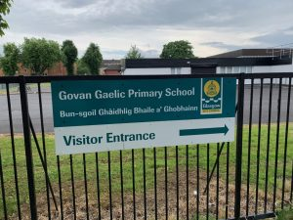
Ar Lèirsinn/Our Vision
“At Bun-sgoil Ghàidhlig Bhaile a’ Ghobhainn our vision is to provide a safe, caring and happy learning environment, centred in the Gaelic language and culture. We will support our learners to develop the qualities, knowledge and skills to enable them to form positive relationships, display kindness, experience success and participate meaningfully in society.”

Slide 5
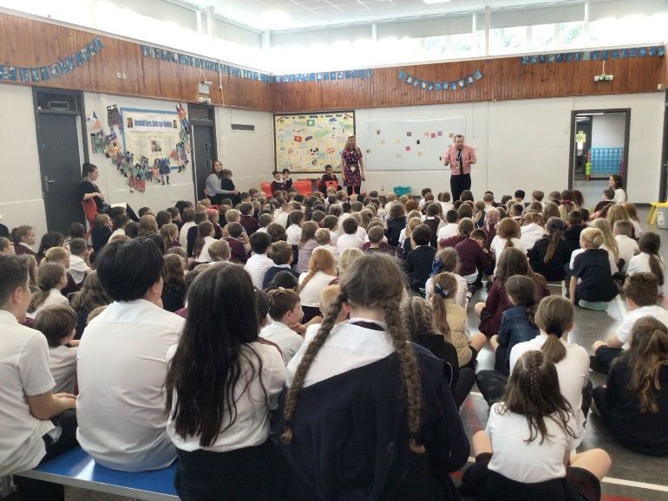
Luachan/School Values
Urramach/Respectful
Àrachadh/Nurturing
Càirdeil/Friendly
Taiceil/Supportive
Brosnachail/Encouraging

Slide 6

Our School Logo
The logo below was designed by pupils in our school to symbolise the rich history of the Govan shipyard and the Glasgow Clyde. The badge has been adapted slightly for the uniform, to ensure that it is clear and simple. However, the original design is used on correspondence.

Slide 7
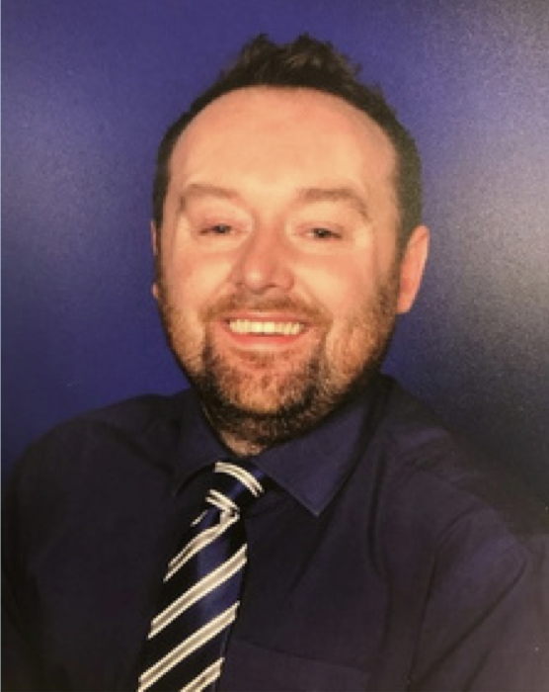
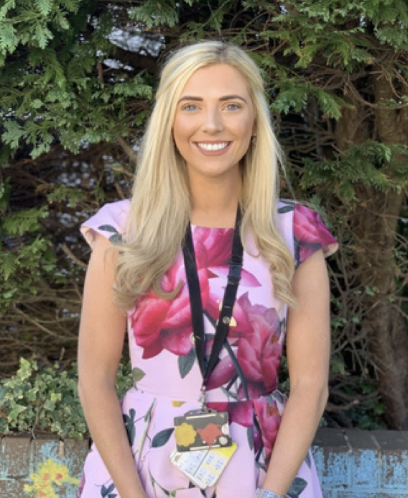
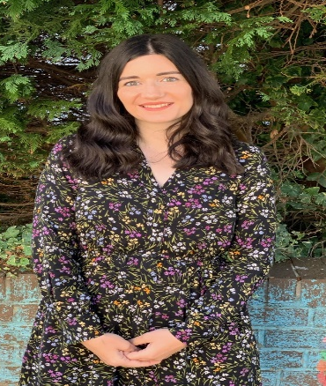
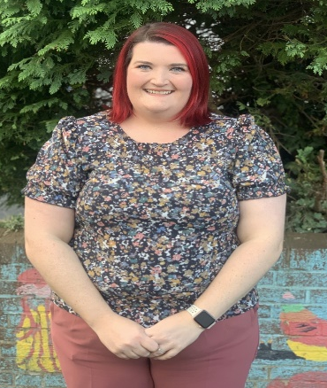
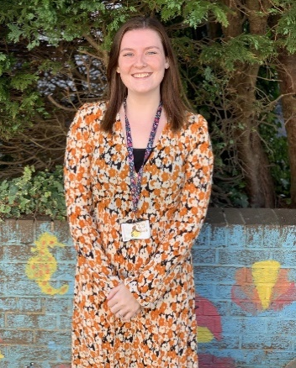
Meet the Leadership Team
Mgr Paul Cassidy
Executive Head Teacher
Mrs Kristina Urquhart
Head of School
Mrs Katy Smith
Acting Principal Teacher
Mrs Charlotte Meney
Principal Teacher
Mrs Roisin Geddes
Acting Principal Teacher

Slide 8
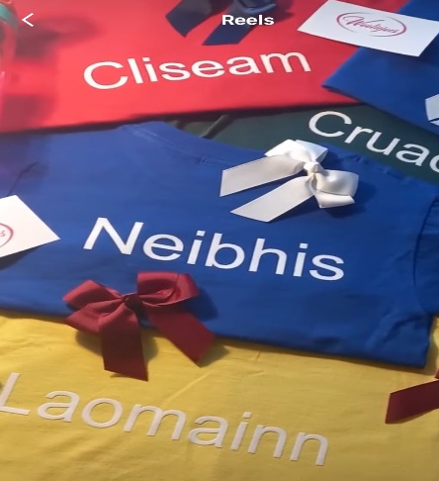
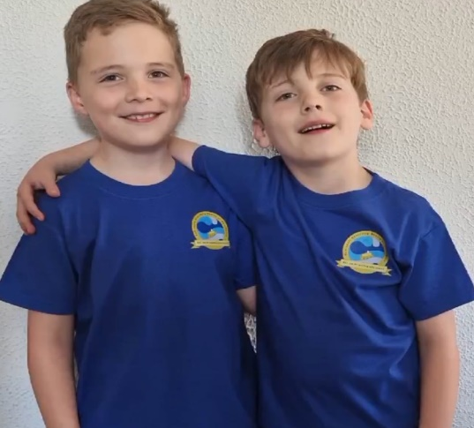
Na Taighean/ House System
Laomainn
Neibhis
Cruachan
Cliseam

Slide 9
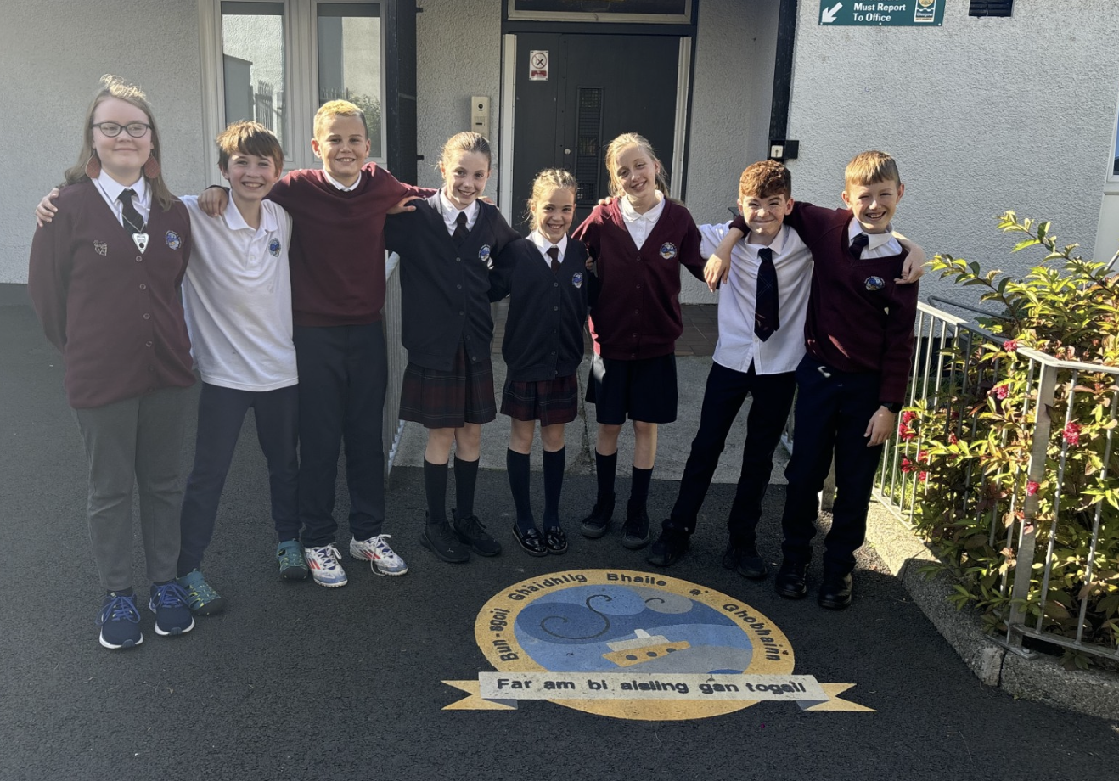
Cuairt timcheall na sgoile

Slide 10
Foghlam Tron Ghàidhlig/
Gaelic Medium Education
  Total Immersion phase: from the first day of P1 until the end of P3, with a clear emphasis on developing oral fluency and a secure foundation in the Gaelic language. During this phase, all subjects will be exclusively taught through the medium of Gaelic.
  Immersion phase: from end of P3/start of P4 and this continues to the end of P7.
  The curriculum in its entirety continues to be taught through the medium of Gaelic.
  However, at this stage English is gradually introduced as a subject (e.g. English phonics, English spelling rules) but all teaching and learning is still taught through Gaelic

Slide 11



Why choose GME for your child?
Role of the Parent/Carer/
Extended Family
Gaelic embedded in the home
Child at the Centre

Slide 12
Parental Engagement & Involvement
Support from home is essential for your child’s progression and development within Gaelic Medium Education.
Commitment to supporting your child’s language acquisition through developing your own language journey.
Parents are encouraged to learn Gaelic (classes, homework support, attending school workshops) and also by ‘normalising’ Gaelic in the home - creating a language-rich environment (watch, listen and read Gaelic at home)
A home environment which values the Gaelic language and culture will have the biggest effect on your child’s development and your child’s love for the language.

Slide 13
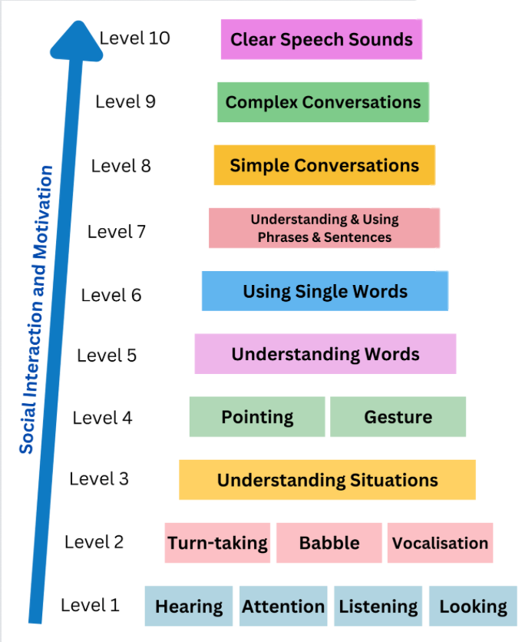
Building Blocks of Language

Slide 14
Enrolment for new P1 parents
  Submit an application for your child to their GME Catchment School on the ‘Schools and Learning’ section on the Glasgow City Council website at
  https://www.glasgow.gov.uk/P1Enrolment
  Put in a Placing Request if you would like them to attend another school
  Placing Requests trumps enrolment

Slide 15
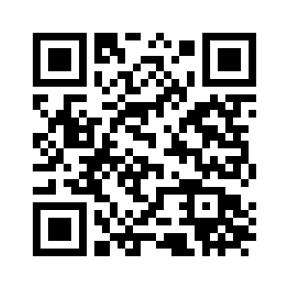
Enrolment for new P1 parents

Slide 16
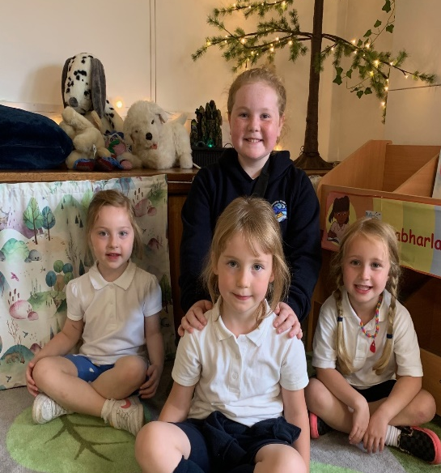
Transition Arrangements
  Once we are notified by the Council of our new P1 pupils, our transition processes will begin.
  We will liaise with the Early Years Establishments of children from non GME nurseries and Gaelic Medium Nurseries.
  In Term 4, we will have a number of ‘Stay and Play” sessions. The children and parents are invited in small groups to get to know the school environment and key staff.
We will also hold our Induction Days in late May/early June. Parents are also invited on these days to join us for a coffee and to hear about the things their child will be doing during their first year at school.

Slide 17
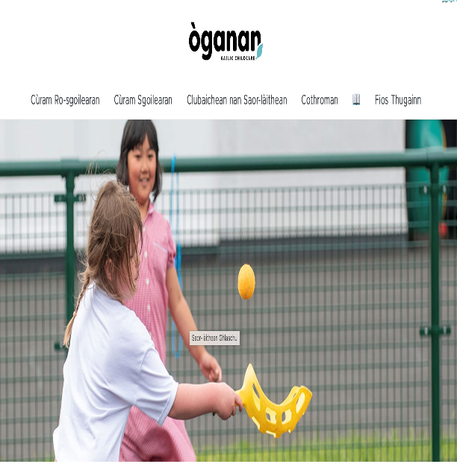
Cobhair Chloinne / Breakfast Club & After School Care
Breakfast Club is available from 8:00am-8:45am- serving toast, cereal and juice - £2 per day (additional children £1)
The after-school club is run by Òganan, a Gaelic organisation, situated within the school premises
They also run holiday clubs during the Summer holidays, October holidays and Easter holidays
Please see Oganan’s website for more details

Slide 18


Gaelic Resources
There are lots of resources available so please make time for reading Gaelic books, listening to the Gaelic radio, Gaelic music and watching cartoons on BBC ALBA.
Padlet Goireasan Gàidhlig airson Pàrantan
Comann Nam Pàrant
Gaelic 4 Parents Website
Orain Na Cloinne Bige
Gaidhlig.Scot
BBC Alba- Cartoons
Sgeulachdan.Scot
Miss MacDonald Youtube

Slide 19
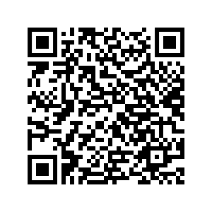
Gaelic Resources

Slide 20


Conaltradh / Communication
Phone the school office 0141 445 1767
Email via the Headteacher Inbox:
headteacher@govangaelic-pri.glasgow.sch.uk
School Website

Slide 21
Ceistean

