Slide 1

Developing Action Inquiry
Training Workshop
Laura Clark
Education Services

Slide 2
Aims
What is Action Research?
How can the Action Research framework benefit practitioners?
What are the steps involved in conducting Action Research?
Notes:
The basic aims of the training session are outlined here. Discussion with the HT/DHT pre-training may highlight specific areas to focus on in practice. Staff will conduct a template of AR throughout the training session to familiarise them with how AR works and its processes.
So aims are:
To provide you with an understanding of what Action Research is.
To demonstrate the usefulness of using the AR process as a framework for development.
To demonstrate the steps involved in AR to help you conduct your own AR.

Slide 3
Action Research is…
…a reflective process where practitioners look for ways to improve their practice.
…a way for practitioners to develop by making use of their own experiences.
…a way to incorporate the views of children and young people into teaching practice.
…a framework that allows practitioners to build their own evidenced-based practice.
…research which is conducted in a real-world context.
Notes:
It is very important to highlight that AR can be conducted as part of their daily practice. AR allows teachers/practitioners (T/P) to be accountable for their own professional development, implement strategies that they have demonstrated to be effective and be more systematic when it comes to (self-)evaluation. Also allows there to be consistency of practice across the establishment. AR framework allows T/P to make best use of the knowledge they gather, and what to do with it to implement change. Can be a collaborative project with all T/Ps or select T/P.
Through developing their own EBP, this means that these are not interventions that are being developed out of context, the interventions are developed in context, by the practitioners involved in its implementation – ultimately more invested in the efficiency and legacy of an intervention. Specific to their teaching and learning context, T/Ps will be able to monitor the progress and identify why (or maybe why not) an intervention has been successful by following the steps in the process.

Slide 4
Action Research Cycle
Reflect
Plan
Observe
Act
Observe
Notes:
Stages involved in AR:
Plan – decide a topic/issue to work on; formulate a research question
Observe – gather data about the current situation
Act – implement a change to improve situation
Observe – gather data about the new situation
New plan? … reformulate research question, gather data, act…
Reflection is important throughout the process, good practice to keep notes of observations/thoughts as the project develops.

Slide 5
Activity
In small groups, discuss areas of your work practice that you would like to improve upon.
Decide on one to focus on.
Reading Ability?
CfE?
Managing Conflict?
Nurture principles?
Notes:
Separate into groups to work on activities throughout the session. Give each group some paper and pens to jot down their ideas.
Discussions with HT/DHT may have highlighted a specific area that the staff are to focus on but this is not important at this stage, this is just an exercise to familiarise staff with the process involved so it can be about anything work-related. Not just about the pupils, could also be about increasing administration efficiency of the school for example.
This whole process should demonstrate that research doesn’t need to be complicated to be effective.
After the activity (10mins), might be an idea to have a whole group discussion about the ideas that they have come up with, and why each group has chosen to focus on that particular issue. This should help promote collaborative working, getting the viewpoints of colleagues and helping them justify the reason for doing a particular piece of research. Could write the ideas on a flipchart/white board to give a visual of all of the potential areas where AR could be effective.

Slide 6
Is it SMART enough?
Whatever topic you have chosen is it:
Specific
Manageable
Achievable
Realistic
Time-limited
Notes:
The topics that they have chosen will need to be:
Specific – managing conflict for example is a big topic, so they should be specific about what aspect they would like to improve, for example: less punishment exercises, less incidents of disruptive behaviour
Manageable – is this topic something that can become part of their daily practice?
Achievable – is it something that can actually be measured?
Realistic – keeping it simple is the best way forward
Time-limited – AR is about giving a framework for all of the information they are already gathering, so it should fit into a realistic, manageable, and achievable timescale

Slide 7
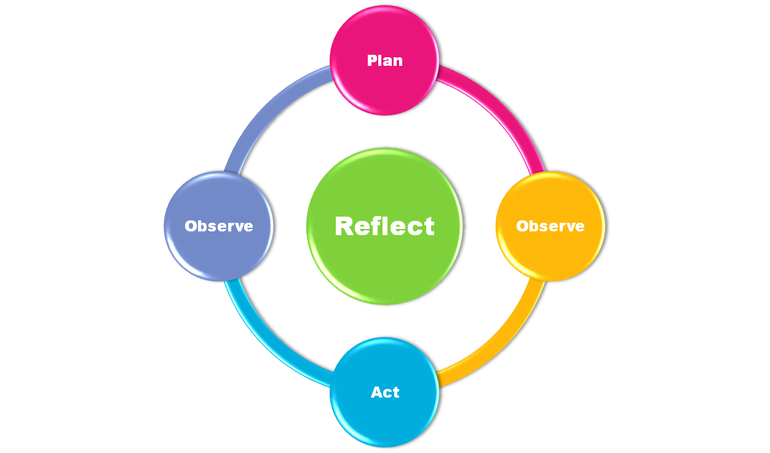
Plan
Decide on a research question for your topic.
  Your question should not already have an answer or have a yes/no answer…why would you need to research it?
  “How can I…?” is a good starting point for thinking about a SMART research question.
Notes:
The previous activity was to demonstrate how to do the first step in the AR process.
Now, it is helpful to formulate their issues into workable research questions.
Questions should not really have a yes/no answer
They should not already have an answer either – why would you need to research it?
‘How can I…’ is a good starting point for thinking about how to do research and formulate questions
If possible, it is better to let staff work on their RQ themselves so that they get into the practice of formulating workable questions, guiding if necessary.
Good to highlight that this is the basis of AR and so the question should be kept in mind throughout the process. Developing a strong RQ gives the research a clear focus and will give structure to the rest of the process.

Slide 8
Activity
What is happening in this situation now?
Thinking about evidence from your daily practice, how do you know that this is happening?
  Class/playroom observations?
  Talking to pupils?
  Assessment Information?
Are there any other methods that might be useful to you?
Notes:
This activity (10-15mins) is to demonstrate that the data collection stage is something that they are already doing as part of their daily practice. Highlights that they have a lot of evidence to hand anyway.
This should help staff get into the practice of justifying their views with evidence.
Again a whole group discussion of their collection methods would be useful, writing their ideas on the flipchart/board. This highlights the range of methods that can be adopted. Listening to other peoples’ views will lead to more collaborative working.
May want to discuss other research methods that might be useful (questionnaires, focus groups, interviews, video observations…). There are supplementary handouts to help them with these methods. Not important to go into full detail at this stage, this is just to demonstrate that there are lots of ways to gather evidence available already.

Slide 9
Observe
Drawing together evidence from different sources gives you a broader understanding of the issue.
It’s good practice to use three sources of evidence, what researchers call ‘triangulation’.
Staff
?
Pupils/Parents
Assessment/Information
Notes:
The previous activity was to demonstrate the first observation stage of the AR cycle
Highlight that it is best practice to have more than one point of view, from more than one source to get the best/fullest understanding of the situation.
Staff – could be from discussions with other staff (anecdotal evidence), maybe conducted a questionnaire, interview, focus group etc.
Assessment/information – this would be any documentation that may be relevant to gathering evidence on the issue (attendance records, class tests, homework assignments, worksheets, exclusion reports, map of the classroom layout, lesson plans...)
Pupils/parents – really important to elicit children and young peoples’ views, also any evidence that the parents may have given at parents’ evenings, talking to staff after school etc. May want to discuss ways of eliciting CYP/parents views that they have not considered before.
E.g. one high school were wanting to know how they could adapt nurture classes to be age appropriate for teenagers – seeking the views of teenagers would be particularly insightful for this project

Slide 10
Activity
What could be done to improve the current situation?
Discuss some possible solutions and decide on one realistic change that could be put in place.
How will you do this?
How will you know if there has been a change as a result of your actions?
Notes:
This is the ‘solution-focus’ or ‘problem-solving’ part of the training/AR process (15mins).
This is about getting staff to think about how to implement a change to improve the situation (capacity building). Ideally only one change should be planned for so that they know if any change in the situation is a result of their intervention.
It is better to let the staff come up with their own solutions. Can have a whole group discussion on each of their topics.
When they are conducting their own research post-training, EPs can help with this stage if necessary to help guide them towards a solution. They may also want to conduct their own independent literature review into the topic to see what other solutions are available.

Slide 11
Act
Implementing just one change will allow you to establish whether any changes in the situation are a result of your intervention.
Whatever change you plan to make, it should be realistic.
At this stage, you should identify some success criteria so that you are able to judge whether your action has been effective.
Notes:
The previous activity demonstrates the ‘action’ stage of action research. Highlight that the intervention has to be realistic in terms of resources, timescales, etc.
It is important that the effects of the intervention are measurable too.
Careful planning at this stage and focusing on the RQ will help guide the project in the right direction.

Slide 12
Observe
Once your change in practice has been put in place, gather new evidence relating to your research question. This means that you will be able to measure the effect of your intervention.
Again, it is good practice to ‘triangulate’ your data.
Notes:
A second round of observation means that pre and post interventions are able to be compared, which will demonstrate whether the intervention was successful or not. This may mean a lot of trial and error but at least they will have evidence of what has not worked, which can be just as insightful.

Slide 13
Reflect
Once you have collected and analysed your data, you will be in a position to evaluate your research.
  Has the research question been answered?
  How did you do this?
  Has practice changed as a result of your action?
  Has practice improved? Why?
  Has practice not improved? Why not?
  Is further action required?
Notes:
Reflection throughout the process is important but at this stage it’s about reflecting on the whole process, and determining how effective (or not) the intervention has been and what evidence they have for this. Reflection at this point will help them decide whether the intervention has been successful and can therefore remain in place, or whether the cycle can begin again, by tweaking and reformulating the research question.

Slide 14
Further Action
You can begin the process again, with a reformulated question in light of your new evidence.
Reflect
Plan
Observe
Act
Observe
Notes:
If more work is required the cycle can begin again, taking on board the evidence from the first time round. This means that new methodology can be used (perhaps different research methods would be more prudent to exploring the topic). Hindsight is a wonderful thing so staff can take advantage of it to explore the issue further and find an effective solution.
Action Research is a systematic and flexible process so many methods can be used depending on the topic.

Slide 15
Further Action
If you are satisfied that the question has been answered, you now have your own evidence base:
How will you communicate your findings?
  Staff twilights?
  Parents’ evenings?
  Pupil report cards?
  School Improvement Plans?
How can you make sure that the changes you have made continue?
Notes:
Staff may feel satisfied that their research has achieved what it set out to do, in which case they can think about what to do with their findings. The research can be communicated across learning communities (provided they have informed consent to do so!) and help with transitions or just generally building up a knowledge base of pupils/classes. This can also help with CPD and at staff training sessions because the action researchers can communicate their findings to other teachers, what methods they have tried, what worked, what didn’t work etc.
It may be a good idea to set up a database for other teachers to access – they may come across an issue in future that someone has already completed an action research project for.
Could even have a Glasgow-wide teachers database online? Could be separated into CfE levels/age groups. Database could also contain links to guidelines for different research methods that may be of benefit to staff wishing to conduct Action Research.

Slide 16
Things to Consider
Firstly, it’s important to set a timescale for your project. Your timescale should be realistic.
What resources are available to you?
Are there any particular ethical considerations you need to take into account?
It is also a good idea to think about roles. Will one person be leading the project or will it be a working party?
Notes:
Timescale is really important for each stage. It can be easy to get carried away and endlessly collect data. Some types of data collection may not be possible in a short time as there may be other factors to take into account (e.g. waiting for questionnaire returns, timetabling a focus group etc.). Timescale also needs to take on board whether the project needs to be completed in one term or one school year (e.g. finding out whether nurture groups increase attendance would require statistics across the school year).
Resources are also crucial to consider – for example, if you wanted to do a video observation, is a video recording device available at the time of the research?
Principles of informed consent, debriefing and confidentiality are important. Participants must know about the research and why they are taking part. If they do not want to take part or change their mind about it, then they must be allowed to do so. Anonymity of participants is crucial. How the information will be shared must also be in keeping with the participants consent. Also, participants should be told what research they were taking part in and why after participating (full debriefing). Issues of ethics are covered in more detail on the handouts with research methods.
Whatever roles are agreed upon, there must be full disclosure amongst members of the group. Communication amongst researchers is a key part of the process so that everyone knows where the research is going, how it’s being conducted etc.

Slide 17
Tips
Keep the research question in mind at all times.
Keep a notebook to jot down any ideas or reflections that you have as you go through the process.
The project needn’t be complicated – the simplest ideas are often the best.
Notes:
Having the research question at the forefront of your mind throughout the process will help keep the project on track and towards answering the question.
Keeping note of ideas as they come to you will make the whole project run smoother and will help with the analysis and reflection of the data. May pick up on things that may be of significance later (e.g. staff discussion about change in pupils’ behaviour, observation of behaviour change in the classroom)
Keep it simple. To conduct an effective project with meaningful results that lead to improved practice does not have to be a complicated process. One tiny change can make all the difference.

Slide 18
Benefits of Action Research
It allows:
  Practitioners to look for solutions to the everyday problems that they experience, in the context that they are experienced.
  Collaboration between practitioners to identify solutions, put them into practice and evaluate their success.
  Practitioners to gain deeper insight into their practice, their teaching and how their young people learn.
Notes:
Hopefully by conducting as many of the processes as possible throughout the training will have helped to clarify the benefits of conducting their own action research. Perhaps by now, they are already thinking of how to go about conducting their own research. If the HT or DHT has discussed what goals they want to work towards, this could be a good opportunity to discuss them and perhaps jot down a few ideas of how this project could be taken forward. SMT themselves may already have a few ideas about how to do so.

Slide 19
Further Information
There are numerous books and websites dedicated to conducting AR, which may be useful to you. There are also handouts to accompany this training pack which provide information about research methods.
The National Teachers’ Research Panel (www.ntrp.org.uk) has a range of AR projects that have been conducted by teaching staff across the UK.
Glasgow Psychological Service has a range of tools and checklists that can be made available to you that may help you gather and analyse the topic of interest to you.

