Slide 1
Family Centred Transitions February 2024
Welcome!
In partnership with the Family Learning Team, Leaders of Early Learning, Cleeves Primary/Burnbrae Children’s Centre, St Patrick’s Primary, Kings Park Learning Community
Notes:
Welcome Douglas

Slide 2
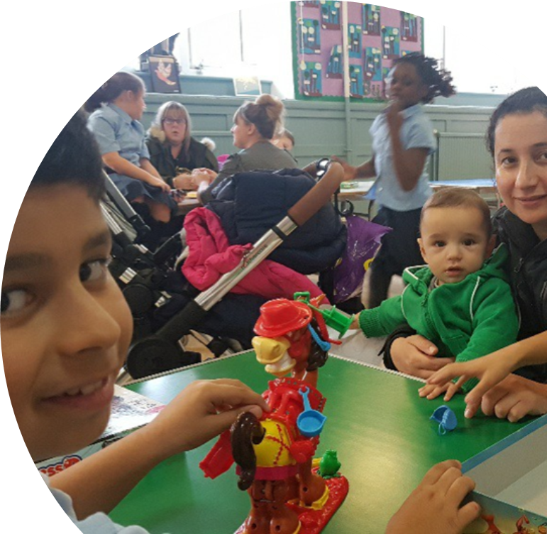
The Scottish Children and Families Transitions Position Statement (2019)
Recognises the value of working together with children and their families, positive relationships, positive continuity, learning, play and wellbeing.
Notes:
Slide Notes:
The Scottish Children and Families Transitions Statement (2019) has been developed by Education Scotland both as a call to action and as support for all those who place an importance on early childhood experiences. This includes educators, researchers, policy makers, families, associated professionals, educational systems and local and national government embracing the significance of transitions for children’s lives.
This could be a change in mindset for the ‘traditional’ transition programme where schools present information to parents.

Slide 3
The key messages through evidence and research:
A holistic approach recognises that the whole family is going through change, not just child; that it’s a process.
If parents expect transitions to be positive, then children are more likely to feel relaxed and happy too.
Provides opportunity to develop and deepen relationships with the whole family
Provides opportunity for parents to ‘build their social capital’ and support one another – make friends!
Parental participation in children’s education influences child’s outcomes positively.

Slide 4
Realising the Ambition: Being Me
“ A successful transition experience at this stage is likely to influence whether or not they can develop their full potential and their ability to cope with future transitions” OECD, 2017:13
“If I have learned anything about what makes a difference to making this rite of passage successful, it is strong, loving, caring relationships. It is mutual trust and the existence of an equal partnership between parents as the child’s first educator and staff. I regularly promote the need for authentic partnerships that are responsive to the needs of each child and their family.” (Burns 2019)
Notes:
Burns also states:
The child in transition from nursery to school is expected to navigate their way through physical changes in the environment they encounter and to the structure of their day (OECD, 2017:19). The child and his her or her family often have to adjust socially and culturally to a new set of routines and rules (Burns 2018: 36). Steps should be taken by practitioners to minimise the adverse impact that new routines and systems can have when starting school.

Slide 5
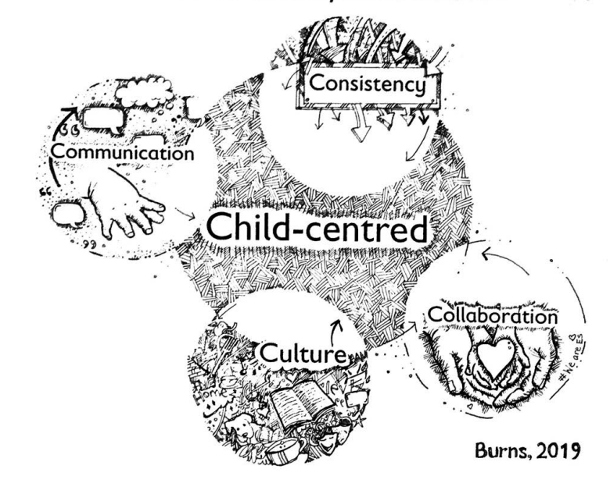
The 5 C’s that Contribute to a Positive Transition (Burns 2019)
Child-centred
Communication
Consistency
Collaboration
Culture
Notes:
Slide notes: The 5 C’s that contribute to a positive transition; this means being child-centred and collaborating meaningfully with others to realise consistently high-quality play pedagogy, thereby creating relevant progression in children’s learning within a supportive and empowering transitions culture. A culture which engages parents and others in open and transparent communications.

Slide 6
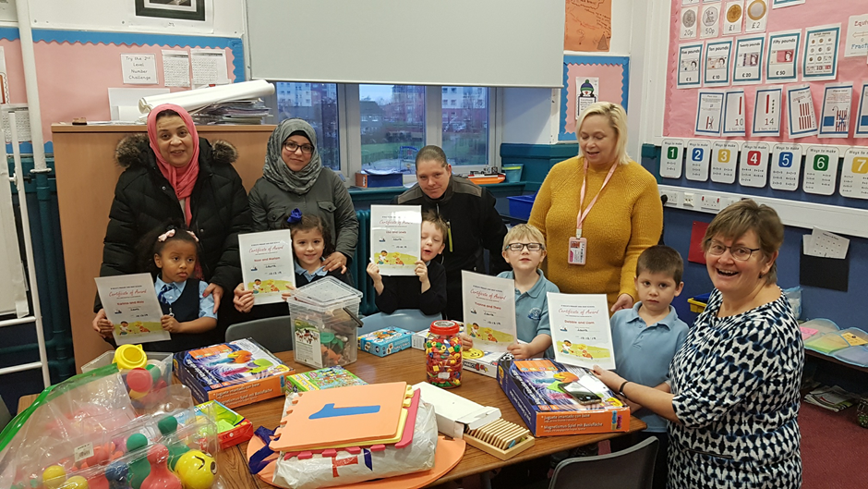
HGIOS 4 and HGIOELC QI 2.6 Transitions
Features of Highly Effective Practice:
‘Children, young people and their parents and carers are actively involved in planning transitions’.
Notes:
Finally, we all know this information.
KEY FEATURES OF POSITIVE TRANSITIONS
Induction programmes that value parents’ knowledge of their child and the learning children bring with them to school
Priming activities which promote parents’ active participation during the transition process rather than being viewed as passive recipients of information and rules to be followed

Slide 7
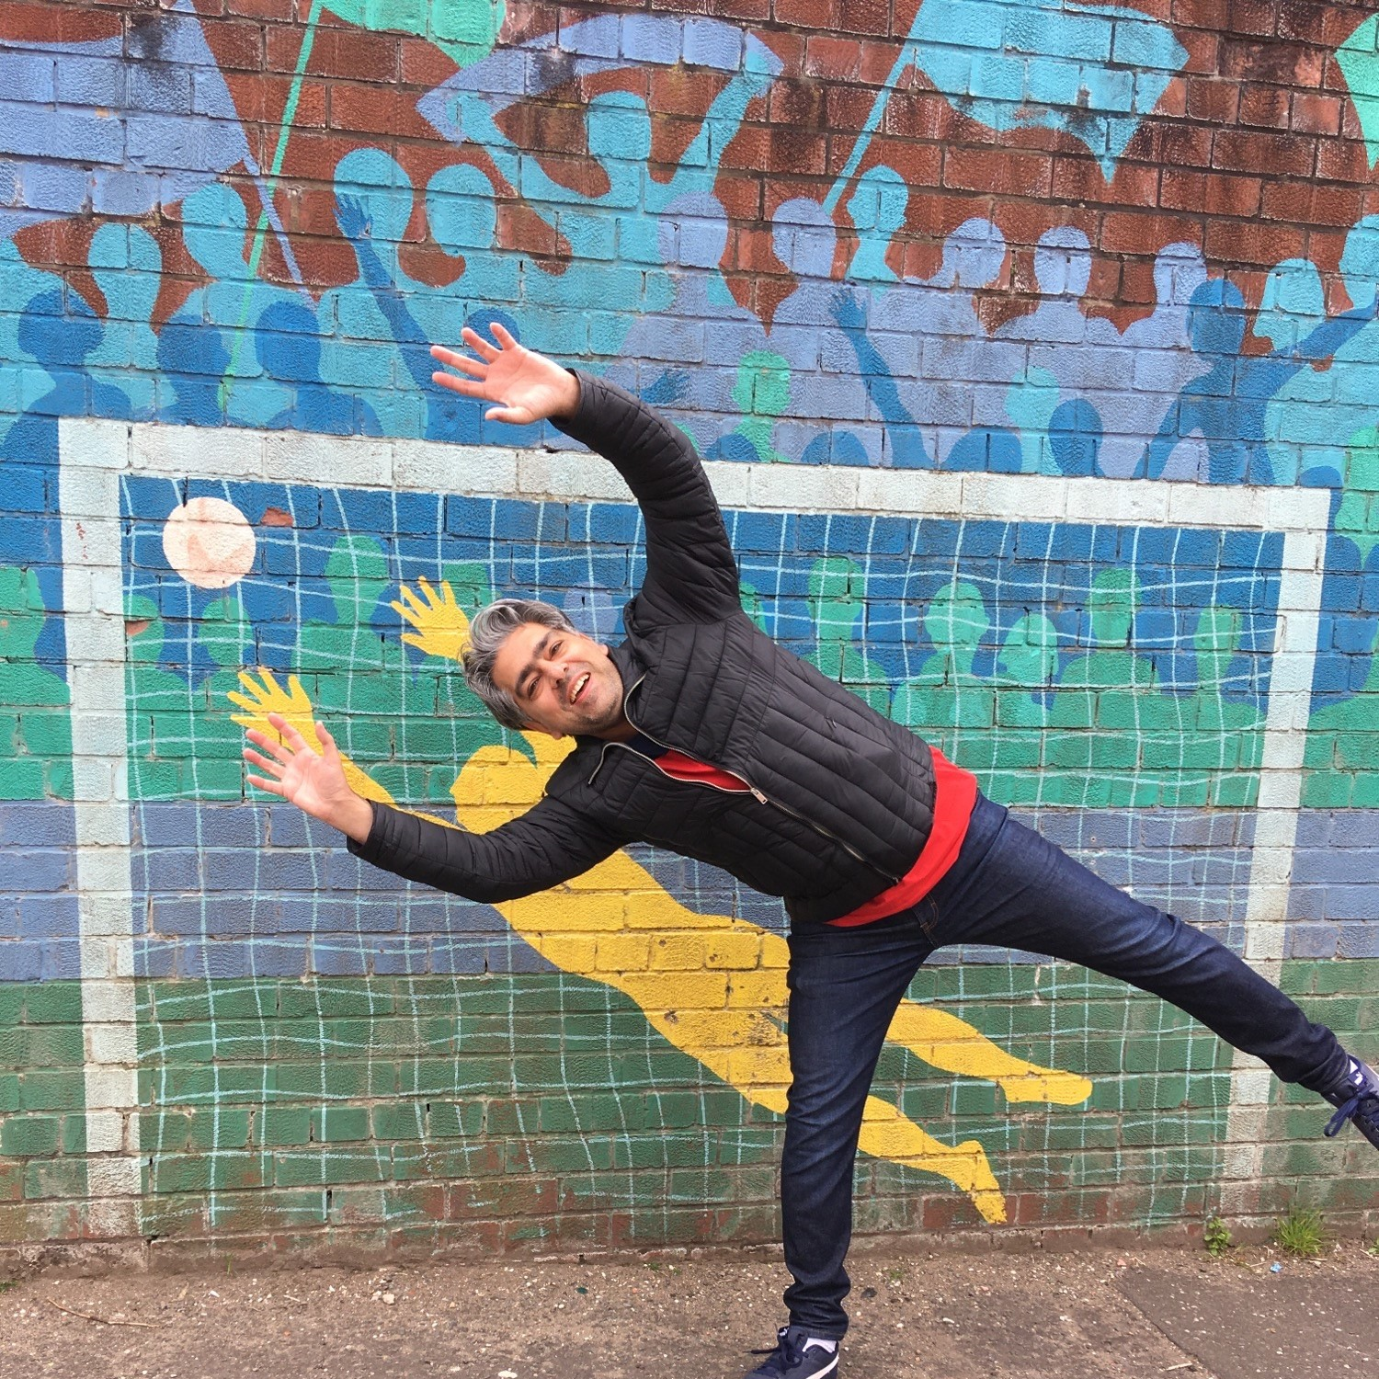
Programme for today:
9.15 Welcome and Registration
9.30 Introduction
9.45 Workshop
10.30 Workshop
11.15 Break
11.30 Workshop
12.15 Plenary and Evaluation
12.30 Lunch and Networking
1.15 Close
Notes:
Please check the number you were given – explain room allocation
Please have a look at our displays, we have resources available which you can access (e.g. Families in Partnership)
Before you leave please complete the QR Code evaluation which we will leave on the screen towards the end of the session.

Slide 8
Please scan and complete this evaluation
Download programme descriptors
Further Information: kathryn.farrow@glasgow.gov.uk or laura.kennedy@glasgowlife.org.uk

