Slide 1
Primary School Transitions
Feb 24
Only one chance to make a first impression!

Slide 2
Rationale – What’s our why?
Scottish Schools (Parental Involvement) Act 2006/2017
Better Relationships, Better Learning, Better Behaviour (2012)
National Improvement Framework 2016
Delivering Excellence and Equity in Scottish Education: A Delivery Plan for Scotland (2016)
Getting it Right for Every Child
Curriculum for Excellence
Scottish Attainment Challenge – GCC Improvement Challenge
How Good Is Our School 4
Learning Together – National Action Plan
Realising the Ambition

Slide 3
Aims
To establish a network for families in and out with the community.
To build and develop trusting relationships between children, their parents and carers as well as our staff.
For families to become familiar with the whole school environment.
For pupils to find a sense of belonging before they start in August.
To provide important information to parents and carers in a supportive environment.

Slide 4
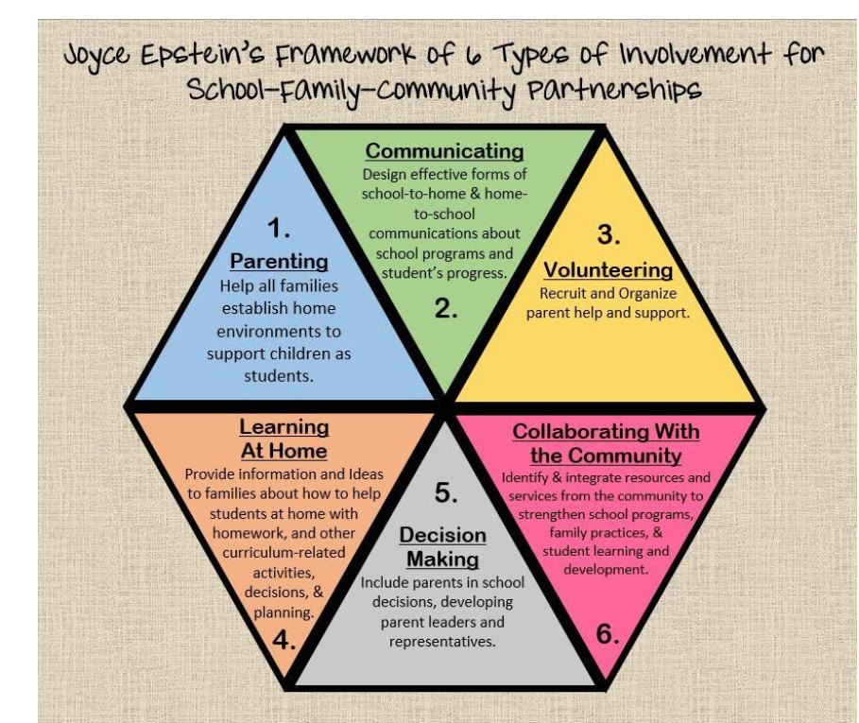
My influences and research based on the work of Dr Joyce Epstein “School-Family-Community Partnership Model”

Slide 5
Parental Involvement
While there are no universally recognised definitions of ‘parental involvement’ in Scottish education, the term most often focuses on parents getting involved in the life and work of the establishment.
chrome-extension://efaidnbmnnnibpcajpcglclefindmkaj/https://education.gov.scot/media/4w3lkhnd/strategic-framework-for-pi-pe-fl-lah-october-2022.pdf

Slide 6
Parental Involvement
Parental involvement includes parental representation in decision-making, collaboration between parents and educators in matters such as school improvement planning and communication between home and early learning and childcare setting and school. It is about the partnerships and links between home and school, and the opportunities for parents and families to get involved in activities in school or early learning and childcare setting. https://www.gov.scot/publications/learning-together-scotlands-national-action-plan-parental-involvement-parental-engagement/pages/5/

Slide 7
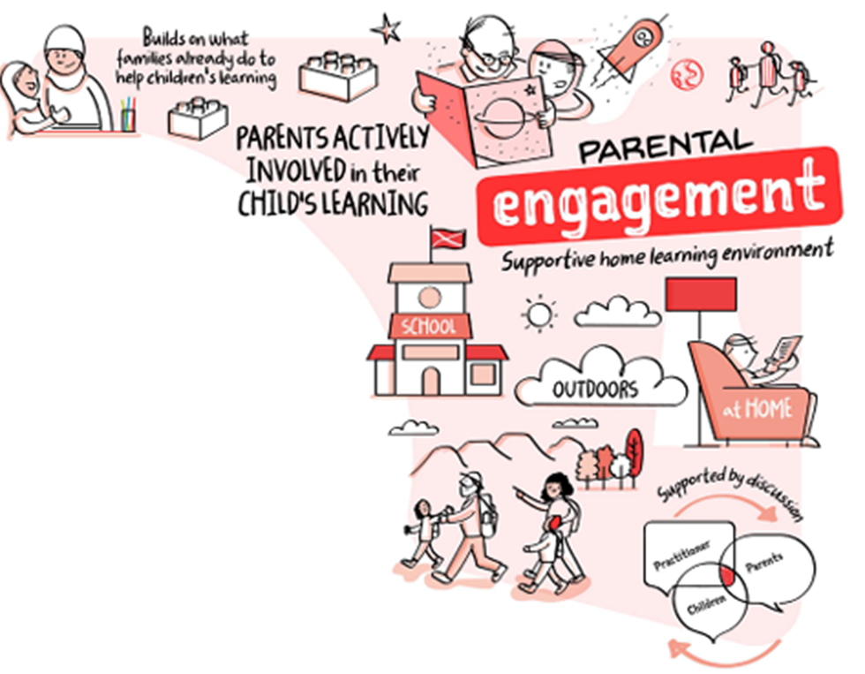
Parental Engagement A key driver for improvement (National Improvement Framework, 2015)
‘Parental engagement’ most often refers to parents actively and meaningfully engaging in their children’s learning (Harris and Goodall, 2007; Goodall and Montgomery, 2014). Such learning can take place in a variety of settings…
Parental engagement is supported by discussion between parents, teachers and practitioners.
It focuses on how families can build upon what they already do to help their children’s learning and provide a supportive home learning environment.
Parental engagement represents a greater ‘commitment, ownership of action’ than parental involvement within educational settings such as early learning and childcare and schools.

Slide 8
Parental Engagement
Parental engagement refers to teachers and schools involving parents in supporting their children’s academic learning. It includes:
approaches and programmes which aim to develop parental skills such as literacy or IT skills;
general approaches which encourage parents to support their children with, for example reading or homework;
the involvement of parents in their children’s learning activities; and
more intensive programmes for families in crisis.
https://educationendowmentfoundation.org.uk/education-evidence/teaching-learning-toolkit/parental-engagement
“When parental engagement is active,
it has a positive impact on attainment and achievement as well as positive attitudes to learning.
(Goodall et al, 2011)

Slide 9
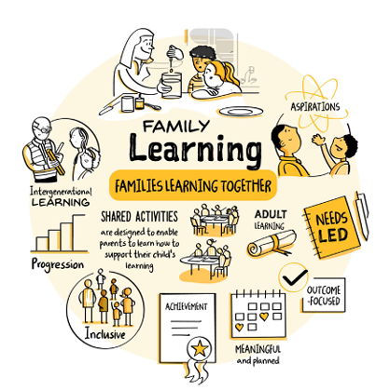
Family Learning
Family Learning encourages family members to learn together as and within a family, with a focus on intergenerational learning. Family learning activities can also be specifically designed to enable parents to learn how to support their children’s learning.
‘

Slide 10
Family Learning
2.5 FAMILY LEARNING
Themes:
Engaging families in learning
Early intervention and prevention
Quality of family learning programmes
This indicator focuses on increasing the positive impact of working with families to improve learning and achievement. The emphasis is on schools working in partnership with others in the community to support families to secure better outcomes through programmes which enable them to improve literacy, numeracy and health and wellbeing

Slide 11
We don’t know what we don’t know!
We differentiate so naturally for our children.
How do we differentiate for our families?

Slide 12
It’s simple…
Make time
Be visible
Get to know them
Be realistic
Build relationships strong enough that they learn to trust you.

Slide 13
Scottish Education Values
Wisdom Justice Compassion Integrity
Wisdom

Slide 14
People Wisdom
Get to know your people
See your learner’s faces
See who they are and what motivates them
See the families as they present themselves
See the support around you
See the faces of each of your colleagues as we learn with and from each other

Slide 15
Contextual Wisdom
Know your context & remember your why
What we are doing?
Why are we doing
Where are your families coming from?
Do you know anything about their countries, their faith, their culture?
What do they bring that enrich your school context?
Embrace each and every one
Be part of the transformational change in culture

Slide 16
Procedural Wisdom
Know your procedures
Collaborate with colleagues
Draw upon expertise
Plan your how, plan your when and plan your what.
Be committed, be courageous
&
be brave!

Slide 17
Method
Meet with local nurseries & complete transition paperwork
(Formal information gathering)
Call all parents/guardians and ask them about their son or daughter
(Informal Information gathering = building relationships =enables personalised, meaningful planning)

Slide 18
Method
All levels of staff contribute to planning and are involved in some capacity of delivery; Teacher/s, SFLw/s, EAL, CLOL, PT, DHT, HT
(Staff are empowered. They are valued. The have a voice = Genuine collaboration = High level of motivation)
Invite everyone to our 7 week Play Café
(A platform for building relationships with each other; parents, children and staff)

Slide 19
Planning & Set up
4 weeks of informal fun.
(Getting to know us and each other)
3 different activities across 3 different areas in school.
Each activity enables each group to get to know staff as individuals away from the crowd.
(Becoming familiar with our school environment and our people in a natural way)

Slide 20
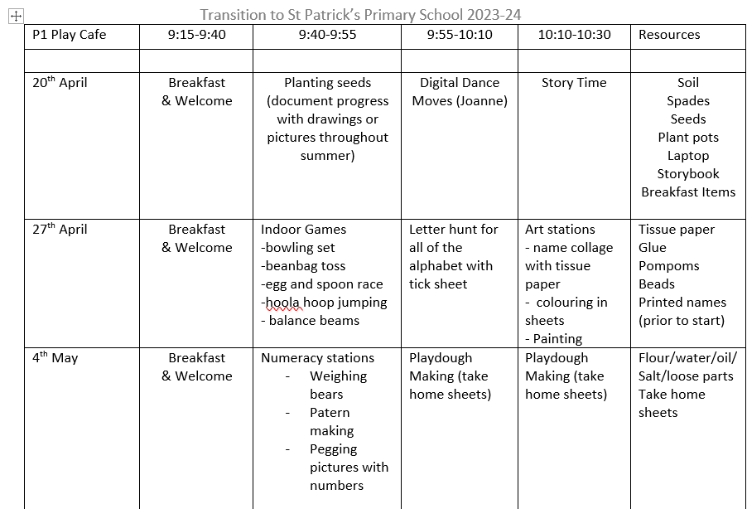

Slide 21
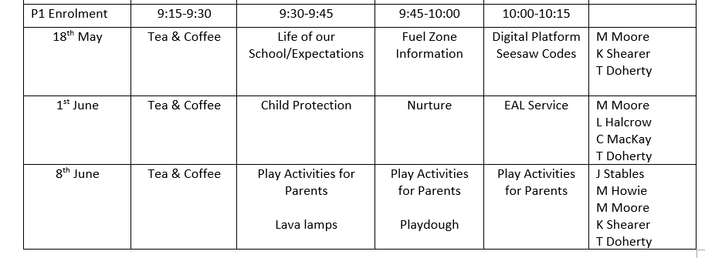
“I’m spending time with my class and my teacher now whilst my guardian listens to the information”

Slide 22
Results
And Impact
Families and pupil’s relaxed after first few visits and questions flowed reducing insecurities.
Some families became friends
Pupils excited to come in and greeted all staff members warmly.
Notable reduction of distress of parental/guardian separation.
Following a few weeks of Play Café, some parents/guardian met in the local park for their children to play.
Summer Play dates occurred
Parents/guardians know our school building well.
Parents/guardians relaxed enough to hear important information.
Continuous relationships with school staff
Children engaged in planned learning as activities are matched to personal preferences where possible.

Slide 23
What next?
Parental/Guardian audit
Gather data from the children – What’s going well? What do they like/dislike?
Staff reflect, evaluate and amend to suit
Always looking for ways to improve. Who doesn’t want to get better?
Removed Meet the teacher and replaced with personalised telephone phone calls

Slide 24
Children and their families are at the ‘heart’ of what we strive for. (Scottish Government, 2018)
No significant learning occurs without significant relationships

Slide 25
Thank You!

