Slide 1
Glasgow Framework for Digital Literacy & Computing Science – Early, First & Second Level

Slide 2
Guidance on using this framework
Experiences & Outcomes Overview (Early – Second Level)
Experiences & Outcomes Overview (Third – Fourth Level)
Early Level
Benchmarks Overview
First Level
Benchmarks Overview
Second Level
Benchmarks Overview
Second Level
Benchmarks Overview
Third Level
Benchmarks Overview
Fourth Level
Benchmarks Overview
(coming soon)
(coming soon)

Slide 3
Effective Learning and Teaching
in Digital Literacy and Computing Science
Glasgow’s Mission Statement:
Education Services, in collaboration with colleagues from across the city, have developed the Digital Learning Strategy, as part of Glasgow City Council’s Transformation Programme.
The three work-streams; Digital Leadership and Culture, Digital Services, Digital Foundations, clearly align with Education aims and priorities:
Raising attainment and achievement
Enhancing the leadership of staff
Supporting families to be better able to support their children’s learning and development
Make best use of resources
This progression framework aims to support this Digital Learning Strategy.
National Strategy
The Scottish Government launched a digital learning and teaching strategy for Scotland, Enhancing Learning and Teaching through the use of Digital Technology, in September 2016.
Scotland's refreshed digital strategy was launched in March 2017, setting out the vision for Scotland as a vibrant, inclusive, open and outward looking digital nation, Realising Scotland's full potential in a digital world: a digital strategy for Scotland.

Slide 4
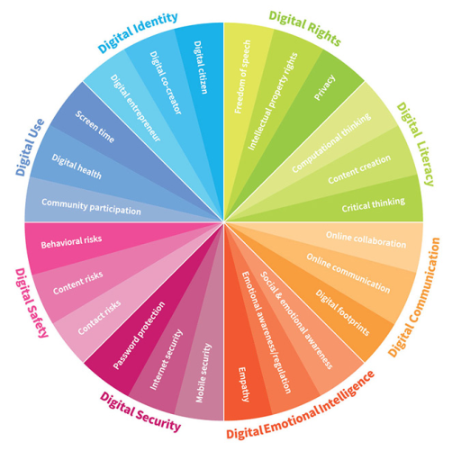
Effective Learning and Teaching
in Digital Literacy and Computing Science
Aims for Children and Young People:
Education Scotland have developed a set of digital vision diagrams exploring what digital means for Learners and Schools (as well as Teachers, Head Teachers and Local Authorities).
‘In order to prepare our children and young people for the social and economic impact of technology, we must support them to develop the social, emotional and cognitive abilities that enable individuals to face the challenges and adapt to the demands of the digital world’
(Glasgow City Council (2018) Digital Strategy)
‘Without a doubt, it is critical for us to equip them with digital intelligence. This is the set of social, emotional and cognitive abilities that enable individuals to face the challenges and adapt to the demands of digital life.’
(World Economic Forum, 2016)
These abilities can broadly be broken down into eight interconnected areas:
Digital identity
Digital use
Digital safety
Digital security
Digital emotional intelligence
Digital communication
Digital literacy
Digital rights
World Economic Forum: Digital Skills we must teach our children

Slide 5
Effective Learning and Teaching
in Digital Literacy and Computing Science
Advice for Practitioners:
This progression framework aims to help support the tracking and assessment of learners across and between levels. It has not been designed as a planning document, but it includes examples of teaching approaches and strategies that will help practitioners identify key areas of learning and track progress.
All establishments are expected to create a digital strategy of their own, which takes into account their individual context. The self-evaluation tools How Good Is Our School 4 or How good is our early learning and childcare can be used to evaluate current practice and to inform the development of your digital learning strategy. See the Glasgow Digital Learning Strategy for guidance.
It is an expectation that practitioners make themselves familiar with the framework, but please note that the progression trackers, along with the strategies & approaches and resources pages are not exclusive. We urge practitioners to seek out and develop learning experiences which will best support the learners in their own classrooms. Updates on digital learning can be accessed on the Digital Learning page of Glasgow Online.
Opportunities for professional learning are suggested throughout this framework, but please bear in mind there are also face to face opportunities offered through CPD Manager, which is updated regularly, and our online learning environment can be accessed from anywhere: Connected Learning Glasgow.
‘The experiences and outcomes are intended to tap into children’s and young people’s natural inventiveness and their desire to create and work in practical ways. They act as a motivation for progressively developing skills, knowledge, understanding and attitudes, and so maximise achievement. Effective learning and teaching will draw upon a wide variety of approaches to enrich the experience of children and young people, particularly through collaborative and independent learning.
‘Proficiency in ICT is an ideal vehicle for shared learning between and amongst children, young people and teachers. Many teachers may need to build their own knowledge and confidence, often learning with and from children and young people, in this area of continually evolving developments.’
(Technologies: Principles and Practice, Curriculum for Excellence, 2017)

Slide 6
Digital Literacy and Computing Science – Guidance for Organisers
Figure 1
Figure 2
Figure 1:
Not a useful approach to embedding digital literacy and computing science in learning and teaching. This approach is focused on taking specific organisers one at a time, at different stages across the year, perhaps in blocks. This model can make it harder to include elements of the technologies in an already busy timetable, as well as create gaps in the understanding of young learners, as to where links should be made.
Figure 2 :
In our suggested approach, organisers are bundled/grouped together where possible, in order to ensure breadth, challenge and application. Digital Literacy organisers are returned to repeatedly across the year, as multiple links can be made with other curriculum areas. This facilitates the development of a coherent understanding of the links within Digital Literacy. The Computing Science organisers overlap considerably, and you may find planning to take elements from the approaches and strategies for two or even three organisers at a time will be both efficient and beneficial. Some suggestions have been made of cross-curricular links for both Digital Literacy and Computing Science, but do not feel you have to limit your teaching to only those identified.

Slide 7
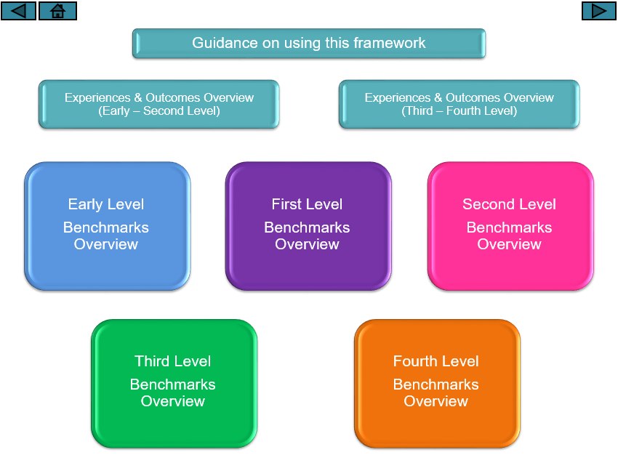
Digital Literacy and Computing Science – Navigation around Framework
From the initial landing page:
Go to beginning of guidance section
Return to last viewed page
Return to title page
Skip to next page
Click to go to overviews of the Experiences and Outcomes for Digital Literacy and Computing Science
Click each tile to go to an overview of the benchmarks for that level
To use the framework properly with working buttons and links, ensure you have it in 'play slide show' mode

Slide 8
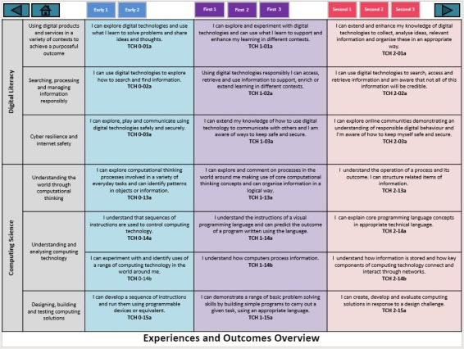
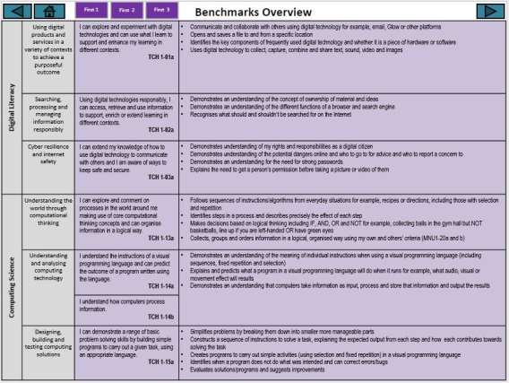
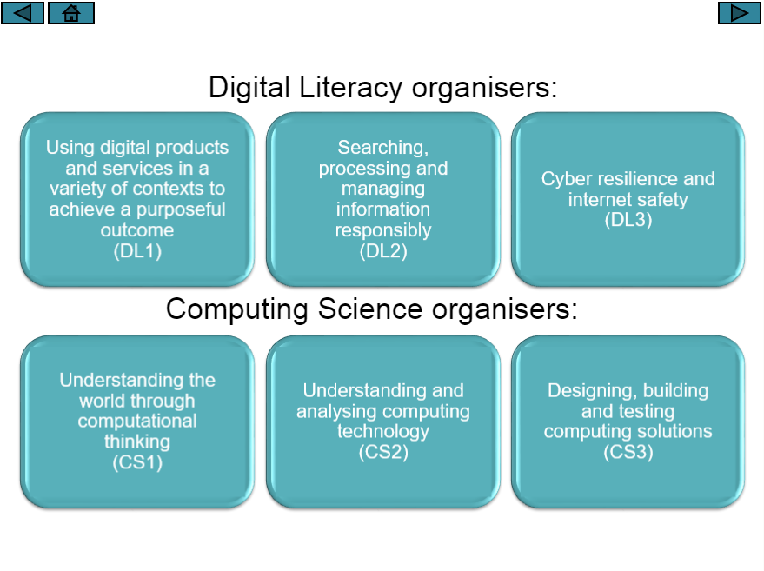
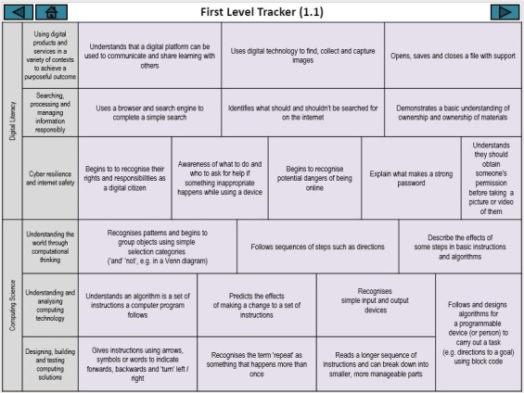
Digital Literacy and Computing Science – Guidance for use of Trackers
The Framework for Digital Literacy and Computing Science is arranged by Curriculum Organisers in line with the Curriculum for Excellence Experiences and Outcomes and Benchmarks.
For the purposes of the Framework, each of these organisers has been assigned a short code, e.g. DL1 is the first of the Digital Literacy organisers
The curriculum organisers are arranged down the left hand side of the overview and tracker pages

Slide 9
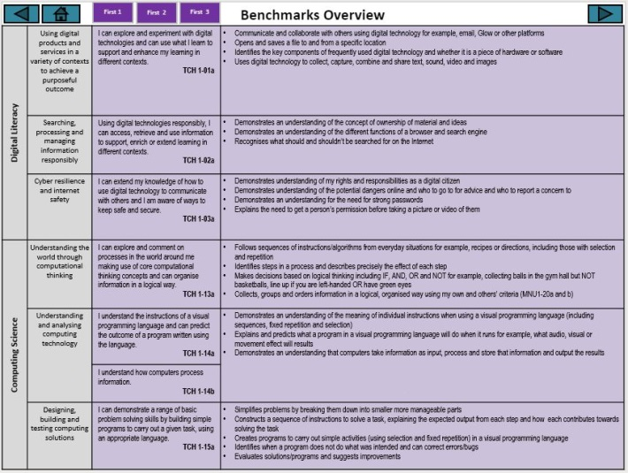
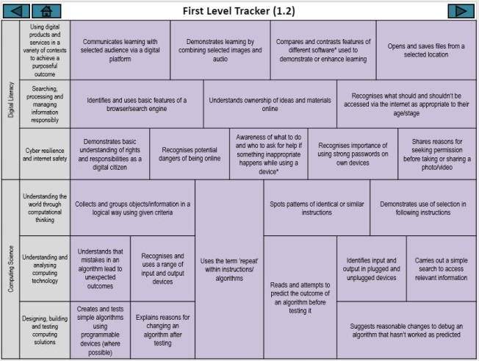
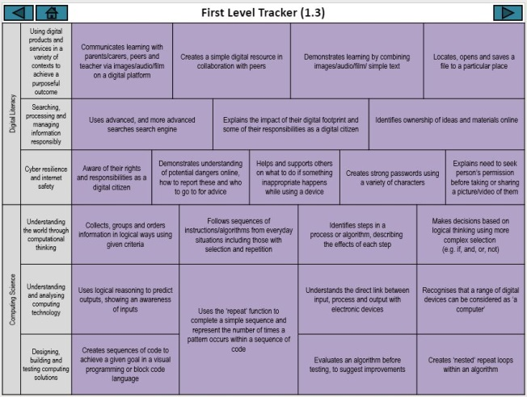
Digital Literacy and Computing Science – Guidance for use of Trackers
The trackers can be navigated to via the Experiences and Outcomes or Benchmarks overview pages at each level and are broken down into 2 at Early Level, 3 at First Level and 3 at Second Level
The trackers should help practitioners identify key learning within each level that builds towards helping children achieve the end of level benchmarks. These pages do not show a linear progression. As mentioned previously, aspects of each curriculum organiser can be bundled together across digital literacy, computing science and other areas of the curriculum.
These trackers can be used to pinpoint gaps in learning, which can then be compared with earlier trackers to look at strategies and approaches for building the knowledge, understanding and skills required to make progression.

Slide 10
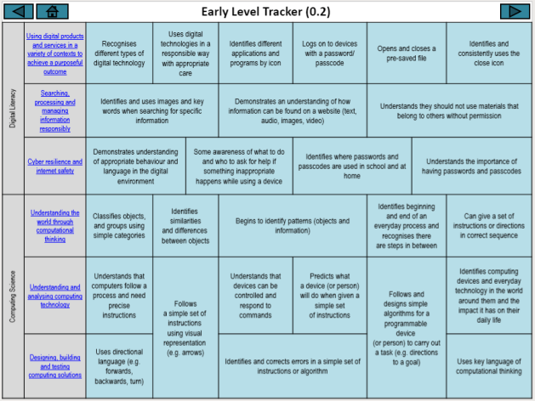
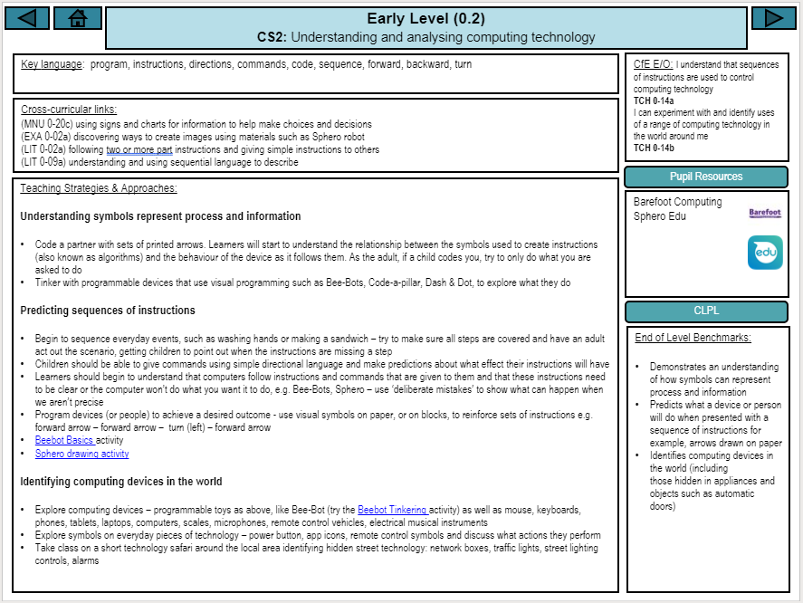
Digital Literacy and Computing Science – Guidance for use of Trackers
Clicking on the hyperlinked curriculum organiser on the tracker page will take you to the suggested teaching approaches and strategies page for that level
Pupil resources are hyperlinked in the Strategies and Approaches and outlined here. The hyperlinks will take you straight to the activity (online)*
Click the ‘Pupil Resources’ button to find out more information about the software or online resources
Key language and vocabulary children and practitioners should be aware of
Some suggested cross-curricular links are highlighted – these can be added to
To find out more about the required subject knowledge and skills for practitioners, click on ‘CLPL’. This will take you to suggested resources for Career Long Professional Learning
The Benchmarks are highlighted here – bear in mind these are the for the end of the level
Key teaching points are in bold
*As with all external links, be aware that these may change or stop working, and website/iPad app access will be dependent on Data Protection Impact Assessments (DPIA). Links to external sites and resources are provided by third parties. We have no control over the contents of these sites or resources and accept no responsibility for them or for any loss or damage that may arise from your use of them. We are not the owners of materials published on external sites This is a working document and will be updated regularly. Please be flexible in your approach and keep up-to-date with developments via your Digital Leader of Learning.

Slide 11
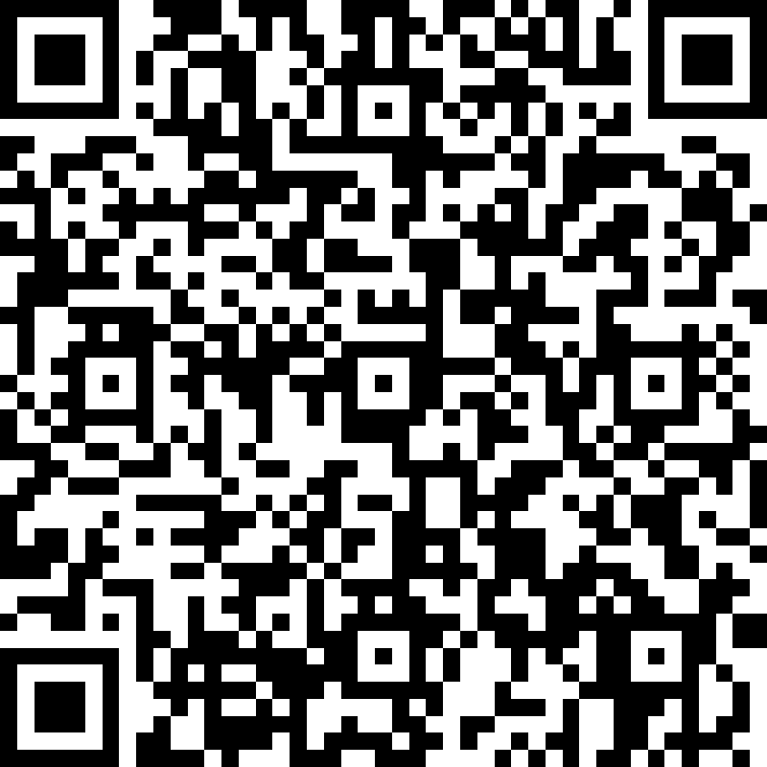
Digital Literacy and Computing Science Framework
This framework has been developed by practitioners for practitioners to support you in your establishment to provide progression in learning in Digital Literacy and Computing Science.
You can audit your own skills in Computing Science using the ‘Knowledge and Skills audit form’ in QuickStart Computing. Guidance towards subject knowledge is given within the audit, and professional learning opportunities are outlined at the end of this framework, accessible via the ‘CLPL’ button on each Teaching Approaches page.
At present, you may find that you are unable use some of the content due to a lack of hardware, software or other resources. Computational thinking is about solving problems, with or without a computer. We can engage in this without devices, and many ‘unplugged’ activities have been suggested to help you achieve the same outcomes – where possible – without digital equipment. However, to really embrace the ethos of the Technologies curriculum, children should have the opportunity to use digital technologies to support this learning.
This framework will be reviewed at the end of each session, with additional resources being developed for Early Level for use in Early Years establishments and 3rd and 4th level resources to complete the Broad General Education.
Feedback is welcome (including any errors, broken links or suggestions) here or via the QR code:
http://bit.ly/DLCSfeedback
Return to Overviews page

Slide 12
Technologies Overview:
Digital Literacy and Computing Science organisers
Return to Overviews page
Digital Literacy organisers:
Using digital products and services in a variety of contexts to achieve a purposeful outcome (DL1)
Searching, processing and managing information responsibly (DL2)
Cyber resilience and internet safety (DL3)
Computing Science organisers:
Understanding the world through computational thinking (CS1)
Understanding and analysing computing technology (CS2)
Designing, building and testing computing solutions (CS3)

Slide 13
First 1
First 2
First 3
Second 1
Second 2
Second 3
Digital Literacy | Using digital products and services in a variety of contexts to achieve a purposeful outcome | I can explore digital technologies and use what I learn to solve problems and share ideas and thoughts. TCH 0-01a | I can explore and experiment with digital technologies and can use what I learn to support and enhance my learning in different contexts. TCH 1-01a | I can extend and enhance my knowledge of digital technologies to collect, analyse ideas, relevant information and organise these in an appropriate way. TCH 2-01a
 | Searching, processing and managing information responsibly | I can use digital technologies to explore how to search and find information. TCH 0-02a | Using digital technologies responsibly I can access, retrieve and use information to support, enrich or extend learning in different contexts. TCH 1-02a | I can use digital technologies to search, access and retrieve information and am aware that not all of this information will be credible. TCH 2-02a
 | Cyber resilience and internet safety | I can explore, play and communicate using digital technologies safely and securely. TCH 0-03a | I can extend my knowledge of how to use digital technology to communicate with others and I am aware of ways to keep safe and secure. TCH 1-03a | I can explore online communities demonstrating an understanding of responsible digital behaviour and I’m aware of how to keep myself safe and secure. TCH 2-03a
Computing Science | Understanding the world through computational thinking | I can explore computational thinking processes involved in a variety of everyday tasks and can identify patterns in objects or information. TCH 0-13a | I can explore and comment on processes in the world around me making use of core computational thinking concepts and can organise information in a logical way. TCH 1-13a | I understand the operation of a process and its outcome. I can structure related items of information. TCH 2-13a
 | Understanding and analysing computing technology | I understand that sequences of instructions are used to control computing technology. TCH 0-14a | I understand the instructions of a visual programming language and can predict the outcome of a program written using the language. TCH 1-14a | I can explain core programming language concepts in appropriate technical language. TCH 2-14a
 |  | I can experiment with and identify uses of a range of computing technology in the world around me. TCH 0-14b | I understand how computers process information. TCH 1-14b | I understand how information is stored and how key components of computing technology connect and interact through networks. TCH 2-14b
 | Designing, building and testing computing solutions | I can develop a sequence of instructions and run them using programmable devices or equivalent. TCH 0-15a | I can demonstrate a range of basic problem solving skills by building simple programs to carry out a given task, using an appropriate language. TCH 1-15a | I can create, develop and evaluate computing solutions in response to a design challenge. TCH 2-15a
Experiences and Outcomes Overview

Slide 14
Benchmarks Overview: Early Level
Digital Literacy | Using digital products and services in a variety of contexts to achieve a purposeful outcome | I can explore digital technologies and use what I learn to solve problems and share ideas and thoughts TCH 0-01a | Recognises different types of digital technology Identifies the key components of different types of digital technology Logs on to a preferred device with a given password Identifies icons for different applications Opens and closes a pre-saved file Identifies and consistently uses the close icon Uses digital technologies in a responsible way and with appropriate care
 | Searching, processing and managing information responsibly | I can use digital technologies to explore how to search and find information. TCH 0-02a | Identifies and uses images and key words when searching for specific information Demonstrates an understanding of how information can be found on websites as text, audio, images and video Demonstrates an understanding of how they should not use materials owned by others without permission
 | Cyber resilience and internet safety | I can explore, play and communicate using digital technologies safely and securely. TCH 0-03a | Demonstrates an understanding of appropriate behaviour and language in the digital environment Demonstrates an understanding of the importance of passwords and passcodes for example access to a school building
Computing Science | Understanding the world through computational thinking | I can explore computational thinking processes involved in a variety of everyday tasks and can identify patterns in objects or information. TCH 0-13a | Identifies and sequences the main steps in an everyday task to create instructions/an algorithm for example, washing hands Classifies objects and groups them into simple categories for example, groups toy bricks according to colour Identifies patterns, similarities and differences in objects or information such as colour, size and temperature and simple relationships between them
 | Understanding and analysing computing technology | I understand that sequences of instructions are used to control computing technology. TCH 0-14a | Demonstrates an understanding of how symbols can represent process and information Predicts what a device or person will do when presented with a sequence of instructions for example, arrows drawn on paper Identifies computing devices in the world (including those hidden in appliances and objects such as automatic doors)
 |  | I can experiment with and identify uses of a range of computing technology in the world around me. TCH 0-14b
 | Designing, building and testing computing solutions | I can develop a sequence of instructions and run them using programmable devices or equivalent. TCH 0-15a | Designs a simple sequence of instructions/algorithm for programmable device to carry out a task for example, directional instructions: forwards/backwards Identifies and corrects errors in a set of instructions

Slide 15
First 1
First 2
First 3
Benchmarks Overview: First Level
Digital Literacy | Using digital products and services in a variety of contexts to achieve a purposeful outcome | I can explore and experiment with digital technologies and can use what I learn to support and enhance my learning in different contexts. TCH 1-01a | Communicate and collaborate with others using digital technology for example, email, Glow or other platforms Opens and saves a file to and from a specific location Identifies the key components of frequently used digital technology and whether it is a piece of hardware or software Uses digital technology to collect, capture, combine and share text, sound, video and images
 | Searching, processing and managing information responsibly | Using digital technologies responsibly, I can access, retrieve and use information to support, enrich or extend learning in different contexts. TCH 1-02a | Demonstrates an understanding of the concept of ownership of material and ideas Demonstrates an understanding of the different functions of a browser and search engine Recognises what should and shouldn’t be searched for on the Internet
 | Cyber resilience and internet safety | I can extend my knowledge of how to use digital technology to communicate with others and I am aware of ways to keep safe and secure. TCH 1-03a | Demonstrates understanding of my rights and responsibilities as a digital citizen Demonstrates understanding of the potential dangers online and who to go to for advice and who to report a concern to Demonstrates an understanding for the need for strong passwords Explains the need to get a person’s permission before taking a picture or video of them
Computing Science | Understanding the world through computational thinking | I can explore and comment on processes in the world around me making use of core computational thinking concepts and can organise information in a logical way. TCH 1-13a | Follows sequences of instructions/algorithms from everyday situations for example, recipes or directions, including those with selection and repetition Identifies steps in a process and describes precisely the effect of each step Makes decisions based on logical thinking including IF, AND, OR and NOT for example, collecting balls in the gym hall but NOT basketballs, line up if you are left-handed OR have green eyes Collects, groups and orders information in a logical, organised way using my own and others’ criteria (MNU1-20a and b)
 | Understanding and analysing computing technology | I understand the instructions of a visual programming language and can predict the outcome of a program written using the language. TCH 1-14a | Demonstrates an understanding of the meaning of individual instructions when using a visual programming language (including sequences, fixed repetition and selection) Explains and predicts what a program in a visual programming language will do when it runs for example, what audio, visual or movement effect will result Demonstrates an understanding that computers take information as input, process and store that information and output the results
 |  | I understand how computers process information. TCH 1-14b
 | Designing, building and testing computing solutions | I can demonstrate a range of basic problem solving skills by building simple programs to carry out a given task, using an appropriate language. TCH 1-15a | Simplifies problems by breaking them down into smaller more manageable parts Constructs a sequence of instructions to solve a task, explaining the expected output from each step and how each contributes towards solving the task Creates programs to carry out simple activities (using selection and fixed repetition) in a visual programming language Identifies when a program does not do what was intended and can correct errors/bugs Evaluates solutions/programs and suggests improvements

Slide 16
Second 1
Second 2
Second 3
Benchmarks Overview: Second Level
Digital Literacy | Using digital products and services in a variety of contexts to achieve a purposeful outcome | I can extend and enhance my knowledge of digital technologies to collect, analyse ideas, relevant information and organise these in an appropriate way. TCH 2-01a | Identifies and saves in a range of standard file formats Saves files using an organised filing system Stores, shares and collaborates using an online cloud-based service for example, Glow or other platforms Identifies the key features of input, output and storage devices Selects and use applications and software to capture, create and modify text, images, sound and video Selects the most appropriate digital software to perform a task
 | Searching, processing and managing information responsibly | I can use digital technologies to search, access and retrieve information and am aware that not all of this information will be credible. TCH 2-02a | Uses search engines to search the internet for specific or relevant information for example, using quotation marks to narrow the results Access websites and use navigation skills to retrieve information for a specific task Demonstrates an understanding of usage rights and can apply these within a search, for example Creative Commons
 | Cyber resilience and internet safety | I can explore online communities demonstrating an understanding of responsible digital behaviour and I’m aware of how to keep myself safe and secure. TCH 2-03a | Demonstrates an understanding of the content they should include in an online profile Discusses the importance of being a responsible digital citizen, giving examples of appropriate online behaviours and actions Identifies appropriate ways to report concerns Uses strong passwords Has an understanding of the law as it relates to inappropriate or illegal online behaviours, for example, the sharing of inappropriate images
Computing Science | Understanding the world through computational thinking | I understand the operation of a process and its outcome. I can structure related items of information. TCH 2-13a | Compares activities consisting of a single sequence of steps with those consisting of multiple parallel steps, for example, making tomato sauce and cooking pasta to be served at the same time Identifies algorithms/instructions that include repeated groups of instructions a fixed number of times and/or loops until a condition is met Identifies when a process is not predictable because it has a random element for example, a board game which uses dice Structures related items of information for example, a family tree (MNU 2- 20b). Uses a recognised set of instructions/ an algorithm to sort real worlds objects for examples, books in a library or trading cards
 | Understanding and analysing computing technology | I can explain core programming language concepts in appropriate technical language. TCH 2-14a | Explains the meaning of individual instructions (including variables and conditional repetition) in a visual programming language Predicts what a complete program in a visual programming language will do when it runs, including how the properties of objects for example, position, direction and appearance change as the program runs through each instruction. Explains and predicts how parallel activities interact Demonstrates an understanding that all computer data is represented in binary for example, numbers, text, black and white graphics. Describes the purpose of the processor, memory and storage and the relationship between them Demonstrates an understanding of how networks are connected and used to communicate and share information, for example the internet
 |  | I understand how information is stored and how key components of computing technology connect and interact through networks. TCH 2-14b
 | Designing, building and testing computing solutions | I can create, develop and evaluate computing solutions in response to a design challenge. TCH 2-15a | Creates programs in a visual programming language including variables and conditional repetition Identifies patterns in problem solving and reuses aspects of previous solutions appropriately for example, reuse code for a timer, score counter or controlling arrow keys Identifies any mismatches between the task description and the programmed solution, and indicates how to fix them

Slide 17
Early Level Tracker
Digital Literacy | Using digital products and services in a variety of contexts to achieve a purposeful outcome | Recognises different types of digital technology | Uses digital technologies in a responsible way with appropriate care |  | Identifies different applications and programs by icon | Logs on to devices with a password/ passcode | Opens and closes a pre-saved file |  | Identifies and consistently uses the close icon
 | Searching, processing and managing information responsibly | Identifies and uses images and key words when searching for specific information |  |  | Demonstrates an understanding of how information can be found on a website (text, audio, images, video) |  | Understands they should not use materials that belong to others without permission
 | Cyber resilience and internet safety | Demonstrates understanding of appropriate behaviour and language in the digital environment |  | Some awareness of what to do and who to ask for help if something inappropriate happens while using a device |  | Identifies where passwords and passcodes are used in school and at home |  | Understands the importance of having passwords and passcodes
Computing Science | Understanding the world through computational thinking | Classifies objects, and groups using simple categories | Identifies similarities and differences between objects |  | Begins to identify patterns (objects and information) |  | Identifies beginning and end of an everyday process and recognises there are steps in between |  | Can give a set of instructions or directions in correct sequence
 | Understanding and analysing computing technology | Understands that computers follow a process and need precise instructions | Follows a simple set of instructions using visual representation (e.g. arrows) |  | Understands that devices can be controlled and respond to commands | Predicts what a device (or person) will do when given a simple set of instructions | Follows and designs simple algorithms for a programmable device (or person) to carry out a task (e.g. directions to a goal) |  | Identifies computing devices and everyday technology in the world around them and the impact it has on their daily life
 | Designing, building and testing computing solutions | Uses directional language (e.g. forwards, backwards, turn) |  |  | Identifies and corrects errors in a simple set of instructions or algorithm |  |  |  | Uses key language of computational thinking

Slide 18
Early Level DL1: Using digital products and services in a variety of contexts to achieve a purposeful outcome
Key language: log on/in, mouse, touchpad, interactive screen, tablet, laptop, capture, image, audio, file, program, drag, drop
CfE E/O: I can explore digital technologies and use what I learn to solve problems and share ideas and thoughts.
TCH 0-01a
Cross-curricular links:
(TCH 0-13a) making links, noticing and discussing differences and similarities between types of technology
(TCH 0-14b) identifying devices in the world around them
(LIT 0-09b) exploring events and characters in stories, creating own stories and sharing these with others
(HWB 0-33a) looking at routines and sequencing of events, such as brushing teeth
Pupil Resources
Camera
Photos
Puppet Pals
ChatterPix Kids
PicCollage
Clips
BBC Learn
Teaching Strategies & Approaches:
Exploring and using different types of technology
Children learn to unlock or log on to devices using a password/passcode e.g. tablet or computer using letters, numbers, fingerprint or pattern (depending on device compatibility) [links to Digital Literacy ’cyber resilience and internet safety]
Learners explore and tinker with digital devices such as old cameras, old mobile phones, broken Bee-Bots, digital clocks, calculators, computers etc. to investigate the parts and components; discuss what they find and share it with peers (not necessary to know names of parts)
Learners explore different types of digital devices in their environment, discussing similarities between the devices and how to control each one, for example, controlling the mouse, the touchpad, interactive touch screen, calculator, scales, differences between a laptop, PC, tablet
Learners use an interactive display (e.g. tablet or interactive board) for play, choice, creativity and activities,
Learners are given opportunities to use technology to complete everyday tasks, e.g. navigating to and opening apps,
Learners use simple drag and drop pictograms to ‘vote’ e.g. for a favourite story, snack choice, an outing venue
With support children use basic apps such as Puppet Pals or ChatterPix to retell familiar stories
Teacher captures audio of learners reflecting on or explaining their captured images/videos taken previously
With support, capture images or audio to create or recreate stories e.g. retelling a familiar story with photographs, create a photograph slide show or video recording related to aspect of their learning for which they exhibit strong personal interest
With support learners collaborate to create a ‘how to video’ using video clips or photos (e.g. using Clips app) for everyday routines, for example brushing teeth, making a sandwich
Responsibility and care with digital technologies
Children learn how to handle and move around digital technologies carefully
Children know how to turn digital technologies off or to standby
Children can exit an app/program (home button or ‘x’), and close apps on iPad (double-tap home button, swipe away windows to close apps)
Children are learning to navigate the camera app, use the shutter button and find their photo in the camera roll, as well as how to delete
Children learn that photographs are taken for a specific reason: to share learning with parents, carers and other pupils
After learners have captured images, generate discussion about what the image will be used for and if they have permission to use the image, are there pictures of people in their image, have those people agreed to being photographed?
CLPL
End of Level Benchmarks:
Recognises different types of digital technology
Identifies key components of different types of technology
Logs on to a preferred device with a given password
Identifies icons of different applications
Opens and closes a pre-saved file
Identifies and consistently use the close icon
Uses digital technologies in a responsible way and with appropriate care

Slide 19
Early Level DL2: Searching, processing and managing information responsibly
Key language: search, audio, information, text, video, images, permission
CfE E/O: I can use digital technologies to explore how to search and find information.
TCH 0-02a
Cross-curricular links:
(LIT 0-01c) explore stories, characters and events and share thoughts in different ways
(LIT 0-09a) exploring real and imaginary situations through discussion and role-play to demonstrate understanding of ownership; linking learning of searching for information to find what they need and collecting information together e.g. in Book Creator
(TCH 0-14b) use of devices in the environment around them, including interacting with voice assistants (e.g. Alexa) to conduct a search of the internet
Pupil Resources
Camera
Photos
Book Creator
SeeSaw
Teaching Strategies & Approaches:
Searching for information
Game - What am I? Who am I? – Encouraging children to think about what questions they have to ask to find the information they require
Create links between children’s current interest / topics within their learning environment. Give children pictures and they have to begin to group them. e.g. pictures of animals and different habitats and they have to place them in their correct habitat
With support, search for interests on browser, asking child for key word to search, e.g. ‘dogs’
Demonstrating understanding of information as text, audio, images, video
As a class using a search engine search for something of interest to the children – look at the different types of results – text, audio, images and videos.
Using voice recognition search functions, such as Alexa or Siri children could carry out own search (with support and monitoring)
Let children create their own results to a search e.g. if children told that the search was ‘dog’ they could create pictures of dogs, audios of barking, create own videos of dog imitations and share any information they know about dogs
Use Book Creator to record children’s learning on searches
Time for a Story: listen to a story and answer/ask questions, create illustrations to go along with the story; share your learning on SeeSaw
Sharing materials and seeking permission
Have different characters from storybooks / programmes which the children are interested in. Have things which belong to them in the work area / on board. Through discussion work out who owns what items. Create a scenario where one character needs to borrow something from another - what would they have to do?
Link learning to the online world – ensuring that children understand that if taking something online (e.g. photo) people need to be asked as well
Role play – discuss with the children things that are precious to them and how they would feel if someone else took it without asking. Children to demonstrate how they would ask to play with someone else’s toy.
CLPL
End of Level Benchmarks:
Identifies and uses images and key words when searching for specific information.
Demonstrates an understanding of how information can be found on websites as text, audio, images and video.
Demonstrates an understanding of how they should not use materials owned by others without permission.

Slide 20
Early Level DL3: Cyber resilience and internet safety
Key language: online, safety, internet, password, security, report, concerns, permission, image, video, privacy, security, identify
CfE E/O: I can explore, play and communicate using digital technologies safely and securely.
TCH 0-03a
Cross-curricular links:
(LIT 0-04a) listening and watching for useful information to make choices
(HWB 0-03a) recognising those who can offer practical and emotional support
(HWB 0-49a) learning respect for own body (and mind) and what behaviour is right and wrong; who to talk to if they are worried
(TCH 0-14b) recognising technology both obvious and hidden, in their surrounding environment
Pupil Resources
Thinkuknow
Childnet
Teaching Strategies & Approaches:
Demonstrating appropriate behaviour and language
Children learn that they can go to exciting places online, but they need to follow certain rules to remain safe - Smartie the Penguin activity
Identify safe places to play, what it feels like to be safe, who to turn to when they are worried, use of an emotional barometer to share own feelings. Discuss Personal Safety, School Safety, House Safety & Community Safety.
Important that to recognise that, we are kind and careful when we use the computer to talk to people as we would be in person. Even if we can’t see or hear them when we’re online, the things we say, write or share can still upset others
​Identify safe places to play, what it feels like to be safe, use of the emotional barometer
Think about who children can turn to when they come across something inappropriate on a device. A good set of rules for these are:
1. Don’t show or share it with anyone else
2. Turn off the screen on the device you’re using
3. Immediately speak to a trusted adult, who will deal with it for you
From the Jessie and Friends pack (Thinkuknow): ‘Watching videos’ animation (available with subtitles and BSL) which discusses what it feels like to see something you don’t like online and what to do)
Advice for practitioners on what to do and what to say to young children in these circumstances can be found on Thinkuknow website. Also bear in mind safeguarding and child protection training.
Demonstrating importance of passwords and passcodes
Take class on a short safari around the local environment identifying technology that might use passwords, e.g. school entry system (fob is a shortcut to entering a passcode – computer does it for you!), phones, tablets, computers, doors
Every time you introduce new digital technology to a class, have a discussion about passwords and passcodes (banking, phone login etc) and the importance of having an individual login; why passwords should be kept safe and not shared with others (and why it’s ok for a teacher to know your password at this stage)
Discuss the school entry system, padlocks, bike locks, ID badges, smoke detectors, the fire alarm, burglar alarms, and why we are careful to protect the things that belong to us
CLPL
End of Level Benchmarks:
Demonstrates an understanding of appropriate behaviour and language in the digital environment
Demonstrates an understanding of the importance of passwords and passcodes for example access to a school building

Slide 21
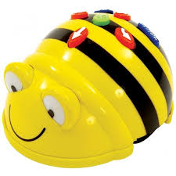
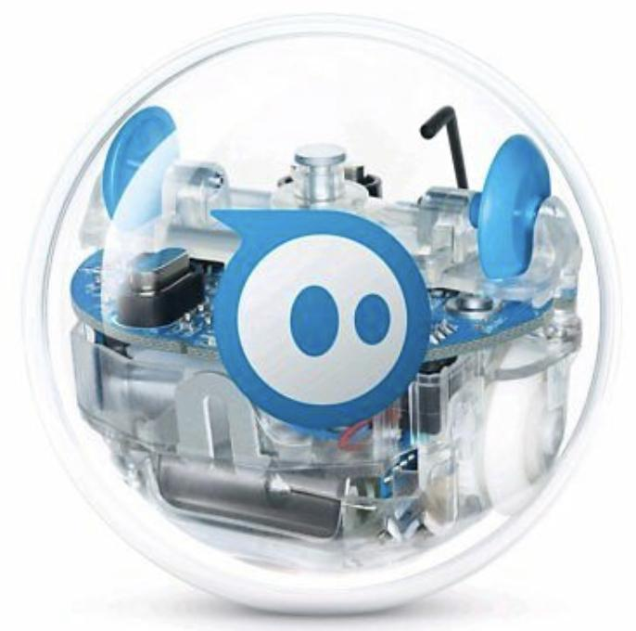
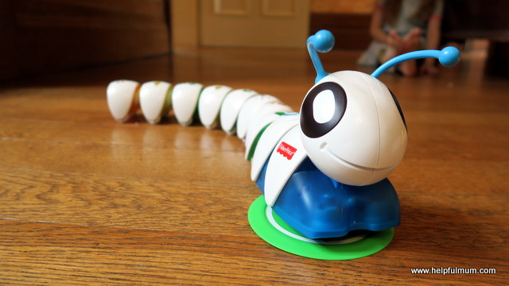
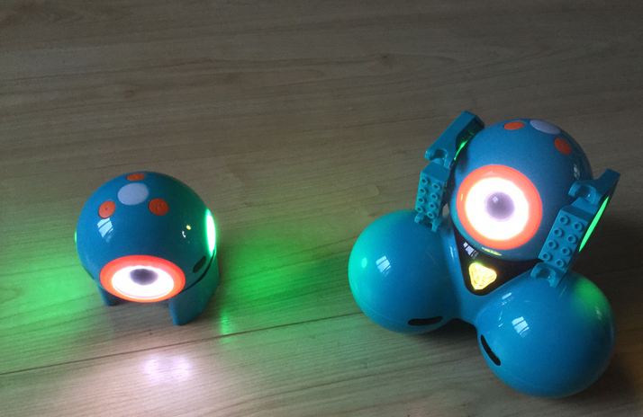
Early Level CS1: Understanding the world through computational thinking
Key language: instructions, directions, commands, sequence, group, sort, organise, share, size, colour, tinker
CfE E/O: I can explore computational thinking processes involved in a variety of everyday tasks and can identify patterns in objects or information TCH 0-13a
Cross-curricular links:
(MNU 0-13a) spotting and exploring patterns; copying, continuing and creating own patterns
(MNU 0-20a) collecting and organising objects
(MNU 0-20b) matching objects, sorting using own and others’ criteria
Pupil Resources
Topmarks
Bee-Bot
Sphero
Code-a-pillar
Dash & Dot
Teaching Strategies & Approaches:
Unplugged
Learners can identify the beginning and end of a process, when given all of the steps. Spend time thinking of familiar routines and identifying the first and last steps – can use visual cards with routines and sequence these
Begin grouping together found objects or maths concrete resources, with categories that are chosen for the learners, such as grouping by colour, by size, by type, by purpose, by qualities and move on to simple categories chosen by the learner (they may come up with some you hadn’t considered)
When grouping and sharing in maths, you may also group by number of ‘things’ e.g. sharing eight things into four groups of two.
Identify repeating visual patterns, using the same categories and groups for sorting, e.g. red-yellow-red-yellow and try to vary the method of pattern. Ask children to create repeating patterns of their own and ask a partner to try to identify the pattern.
Look at overlapping qualities, e.g. in a Venn diagram (you can make these with two hula hoops) to discuss similarities and differences, for example ‘this teddy is red AND soft but this truck is red and not soft’
Complete the Pattern activity (online, but download activity for unplugged use)
Plugged
Tinker with programmable devices to find out what they do; especially robots that follow patterns of instructions
Code short routes for programmable devices to follow (e.g. Bee-Bot, Code-a-pillar, Dash & Dot) and start to recognise that the instructions given are the same as the route the device follows
CLPL
End of Level Benchmarks:
Identifies and sequences the main steps in an everyday task to create instructions/an algorithm for example, washing hands
Classifies objects and groups them into simple categories for example, groups toy bricks according to colour
Identifies patterns, similarities and differences in objects or information such as colour, size and temperature and simple relationships between them

Slide 22
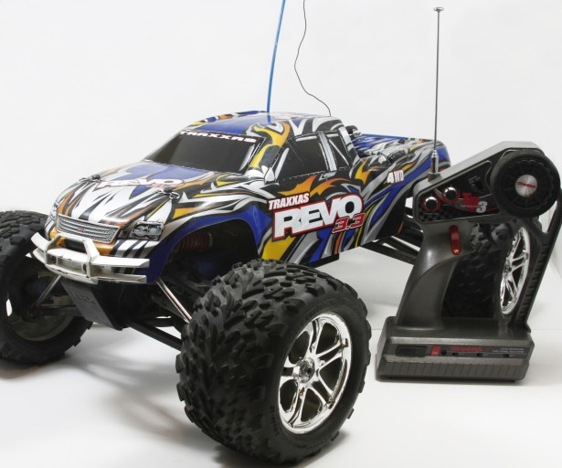
Early Level CS2: Understanding and analysing computing technology
Key language: program, instructions, directions, commands, code, sequence, forward, backward, turn
CfE E/O: I understand that sequences of instructions are used to control computing technology
TCH 0-14a
I can experiment with and identify uses of a range of computing technology in the world around me
TCH 0-14b
Cross-curricular links:
(MTH 0-17a) using simple directions and describing positions using technology
(MNU 0-20c) using signs and charts for information to help make choices and decisions
(TCH 0-01a) exploring and identifying computing devices in the world around us, and how they are used
Pupil Resources
Teaching Strategies & Approaches:
Unplugged
Take class on a short technology safari around the local area identifying hidden street technology: network boxes, traffic lights, street lighting controls, alarms
Begin to sequence everyday events, such as washing hands – try to make sure all steps are covered and have an adult act out the scenario, getting children to point out when the instructions are missing a step
Code a partner with sets of printed arrows. Learners will start to understand the relationship between the symbols used to create instructions (also known as algorithms) and the behaviour of the device as it follows them. As the adult, if a child codes you, try to only do what you are asked to do
Children should be able to give commands using simple directional language and make predictions about what effect their instructions will have
Plugged
Explore computing devices – programmable toys as above, like Bee-Bot (try the Beebot Tinkering activity) as well as mouse, keyboards, phones, tablets, laptops, computers, scales, microphones, remote control vehicles, electrical musical instruments
Use remote controlled objects (e.g. cars) to explore how the controls affect the movement and direction of the object – compare this instant response of remote controlled object to programmable devices that you code first, then hit ‘go’ – note that Sphero offers both options!
Learners should begin to understand that computers follow instructions and commands that are given to them and that these instructions need to be clear or the computer won’t do what you want it to do, e.g. Bee-Bots, Sphero – use ‘deliberate mistakes’ to show what can happen when we aren’t precise
Program devices (or people) to achieve a desired outcome - use visual symbols on paper, or on blocks, to reinforce sets of instructions e.g. forward arrow – forward arrow – turn (left) – forward arrow
Beebot Basics activity
Sphero drawing activity
Explore symbols on everyday pieces of technology – power button, app icons, remote control symbols and discuss what actions they perform
Tinker with programmable devices that use visual programming such as Bee-Bots, Code-a-pillar, Dash & Dot, to explore what they do
Bee-Bot
Sphero
Sphero Edu
Barefoot Computing
Code-a-pillar
Dash & Dot
Remote control
objects
CLPL
End of Level Benchmarks:
Demonstrates an understanding of how symbols can represent process and information
Predicts what a device or person will do when presented with a sequence of instructions for example, arrows drawn on paper
Identifies computing devices in the world (including those hidden in appliances and objects such as automatic doors)

Slide 23
Early Level CS3: Designing, building and testing computing solutions
Key language: program, instructions, directions, commands, code, sequence, symbols, predict
CfE E/O: I can develop a sequence of instructions and run them using programmable devices or equivalent. TCH 0-15a
Cross-curricular links:
(MTH 0-13a) Creating and identifying patterns in code (TCH 0-14a) using sequences to control movement of people/devices
(MTH 0-17a) Movement and directions using technology and games
(MTH 0-20b) Sorting/sequencing
(HWB 0-22a) developing movement skills, following sequences of instructions in dance/movement
Pupil Resources
Code.org
Bee-Bot app
Kodable
Bee-Bot
Sphero
Code-a-pillar
Dash & Dot
Teaching Strategies & Approaches:
Learners will start to understand the relationship between symbols used to create instructions (algorithms) and behaviour of device as it follows these. They should be able to sequence commands using simple symbolic language and make predictions about what effect their instructions will have.
Unplugged
Code a partner to move using verbal instructions (e.g. move forwards three times and then turn left/right – if unable to use left/right they could use ‘turn’ to mean a quarter turn in one direction, and to go in the opposite direction will take three ‘turn’ instructions)
Code a partner to move using visual directions (e.g. a sequence of arrows on the floor)
Read a sequence of arrows and predict what the outcome would be or where the subject would get to if they followed the arrows
Use arrows to create, or read a sequence of arrows to identify, a pattern (e.g. forward-forward-turn-right-turn-right-forward-forward)
Create a dance routine using visual stimulus (e.g. sequencing pictures or photos of different actions to make up a routine) – have a child follow the sequence using the photos and ask children to feedback any errors. Ask children to deliberately change one move and see if others can find the ‘error’
Use pictures to sequence instructions for everyday tasks using only the ‘main’ steps, such as making a sandwich, and encourage children to work out the missing steps – the more detail, the better
Plugged
Using programmable devices to ‘draw’ or ‘map out’ a pattern (e.g. a triangle, a staircase or zigzag design) – you could use masking tape on the floor and see if children can get the device to follow the pattern using trial and error (children will start to identify errors and correct these as they improve their algorithm)
Move it move it activity: sequencing arrows to move a character – relating this back to the unplugged activities (note: this program uses compass points NSEW to describe arrows)
Using programmable devices, such as Bee-Bots, to input commands with a desired outcome – pair this with the visual direction cards to plan out a route for the Bee-Bot
Once familiar with movement of programmable devices, you can also use the Bee-Bot or Kodable apps to practice following pathways using directions/arrows (note slight difference in approach to each)
CLPL
End of Level Benchmarks:
Designs a simple sequence of instructions/algorithm for programmable device to carry out a task for example, directional instructions: forwards/backwards
Identifies and corrects errors in a set of instructions

Slide 24
First Level Tracker (1.1)
Digital Literacy | Using digital products and services in a variety of contexts to achieve a purposeful outcome | Understands that a digital platform can be used to communicate and share learning with others |  |  | Uses digital technology to find, collect and capture images |  |  |  |  | Opens, saves and closes a file with support
 | Searching, processing and managing information responsibly | Uses a browser and search engine to complete a simple search |  |  | Identifies what should and shouldn't be searched for on the internet |  |  |  |  | Demonstrates a basic understanding of ownership and ownership of materials
 | Cyber resilience and internet safety | Begins to to recognise their rights and responsibilities as a digital citizen | Awareness of what to do and who to ask for help if something inappropriate happens while using a device |  |  |  | Begins to recognise potential dangers of being online |  | Explain what makes a strong password |  |  |  | Understands they should obtain someone's permission before taking a picture or video of them
Computing Science | Understanding the world through computational thinking | Recognises patterns and begins to group objects using simple selection categories ('and' 'not’, e.g. in a Venn diagram) |  |  |  | Follows sequences of steps such as directions |  |  |  |  | Describe the effects of some steps in basic instructions and algorithms
 | Understanding and analysing computing technology | Understands an algorithm is a set of instructions a computer program follows |  | Predicts the effects of making a change to a set of instructions |  |  |  | Recognises simple input and output devices |  |  |  | Follows and designs algorithms for a programmable device (or person) to carry out a task (e.g. directions to a goal) using block code
 | Designing, building and testing computing solutions | Gives instructions using arrows, symbols or words to indicate forwards, backwards and 'turn' left / right |  | Recognises the term 'repeat' as something that happens more than once |  |  |  | Reads a longer sequence of instructions and can break down into smaller, more manageable parts

Slide 25
First Level (1.1) DL1: Using digital products and services in a variety of contexts to achieve a purposeful outcome
Key language: log on/in, mouse, touchpad, interactive screen, tablet, laptop, capture, image, audio, file, program, drag, drop
CfE E/O: I can explore and experiment with digital technologies and can use what I learn to support and enhance my learning in different contexts.
TCH 1-01a
Cross-curricular links:
(TCH 1-13a) making links, noticing and discussing differences and similarities between types of technology
(TCH 1-14b) identifying devices in the world around them
(LIT 1-10a) Collaborate and create texts using digital resources
(ENG 1-31a) children use apps to retell familiar stories and to create texts of their own
Pupil Resources
Camera
Photos
Puppet Pals
ChatterPix Kids
Clips
Seesaw
Pages
Book Creator
BBC Learn
Teaching Strategies & Approaches:
Communicate and collaborate with others
Learners begin to use technology to communicate with others. With support learners select photographs of learning to share with parents or carers in digital learning logs, such as through Seesaw. This is a simple means of helping them understand the concepts of a learning outcome and success criteria and scaffolds their ability to self-evaluate through use of higher order questions which require the children to justify their choice.
With support learners collaborate to create a class information book to demonstrate their understanding of classroom or outdoor learning routines, e.g. each child can add one page to the book using Pages or Book Creator. This could be shared with other classes or parents/carers to reinforce that they are using technology to create a digital resource
Learners independently use camera to record each other and collaborate in retelling familiar stories using characters/puppets, or basic apps such Puppet Pals to retell familiar stories, or ChatterPix to create their own stories
Opening and saving files
Learners can independently navigate to and open apps/programs, and open saved files with teacher support
Learners know how to exit an app/program using the home button (tablet) or – usually – ‘x’ (laptop/PC), and how to close apps (e.g. on iPad via double-tap on home button, then swiping away open windows)
Capturing, combining and sharing text, sound, video and image
Learners begin to understand that capturing images or audio can be used to demonstrate their learning. Use an app like Clips to link together images and video of children’s learning, and record audio descriptions of the learning.
Children take and share selected photos for a purpose, with each other and class teacher via Airdrop on iPad
After photographs have been taken, generate discussion about what the image will be used for and if they have permission to use the image, are there pictures of people in their image, have those people agreed to being photographed?
Time for a Story: listen to a story and answer/create questions, create illustrations to go along with the story, continue the story in your own book, share your learning on SeeSaw
CLPL
End of Level Benchmarks:
Communicate and collaborate with others using digital technology for example, email, Glow or other platforms
Opens and saves files to and from a specific location
Identifies the key components of frequently used digital technology and whether it is a piece of hardware or software
Uses digital technology to collect, capture, combine and share text, sound, video and images

Slide 26
First Level (1.1) DL2: Searching, processing and managing information responsibly
Key language: search, audio, information, text, video, images, permission, search engine, homepage, features, owner, copyright, ownership, browsers, digital citizen
CfE E/O: Using digital technologies responsibly, I can access, retrieve and use information to support, enrich or extend learning in different contexts
TCH 1-02a
Cross-curricular links:
(LIT 1-25a) link ownership back to looking at types of writing to understand ideas belong to people
(TCH 1-03a) cyber resilience and internet safety linked to searches on the internet
Pupil Resources
Camera
Photos
Book Creator
Green Screen
Swiggle
Teaching Strategies & Approaches:
Understanding of ownership
Discussion about the term ‘ownership’. How do we know who owns something? Link to literacy looking at different books – people who contribute to them, and the ownership of ideas.
Create link between people owning things in the physical world and online. Could introduce through familiar films e.g. Disney recreating old fairy-tales, ownership of music – do you own the music that’s on your iPod/computer? How about your bed?
Great opportunity to link to children’s philosophy – Who owns the sky? (BBC)
Understanding functions of a browser and search engine
Use child safe educational search engines like Swiggle to look up information for topics, or to practise safe searching
Pupils should be able to open a browser and use the search engine to search for given information. Pupils search for pictures online via a search engine like Google/Bing
Children learn that directory sites with alphabetical listings (much like a dictionary) offer one way to find things on the Internet, but that most searches come up with the most popular suggestions, or suggestions that companies have paid to come up
Children are learning navigate a simple webpage to get to information they need (e.g. home, forward, back buttons; links, tabs and sections)
Responsibility with Internet searches
Discuss with children what they usually search for online and whether someone monitors their searches (be clear that all activity on school computers and tablets is monitored, and that a majority of what they do online at home is also monitored in different ways).
Begin to explore keeping safe online – one aspect of being a good digital citizen. Look at different searches and discuss with children what kind of searches are ok, and how they shouldn’t ever search for things that might upset or worry them. If anyone asks them to look at, or search for, something that does, they should tell a trusted adult. Clicking on unknown sites or links can sometimes lead to nasty viruses
Create a class safety promo film for staying safe around the school. You could use a Green Screen to create a safety promo film for other places such as the local park, the city centre, the library etc. Link going to somewhere in physical world and online world and talk about why it might be useful to use a virtual experience like green screen to improve your films.
CLPL
End of Level Benchmarks:
Demonstrates an understanding of the concept of ownership of material and ideas
Demonstrates an understanding of the different functions of a browser and search engine
Recognises what should and shouldn’t be searched for on the Internet

Slide 27
First Level (1.1) DL3: Cyber resilience and Internet safety
Key language: online, safety, Internet, password, security, digital citizen, report concerns, permission, image, video, live stream, similarities, differences, privacy, in/appropriate
CfE E/O: I can extend my knowledge of how to use digital technology to communicate with others and I am aware of ways to keep safe and secure.
TCH 1-03a
Cross-curricular links:
(HWB 1-03a) recognising those who can offer practical and emotional support
(HWB 1-09a) exploring rights and responsibilities; showing respect for others
(HWB 1-49a) learning respect for own body (and mind) and what behaviour is right and wrong; who to talk to if they are worried
(TCH 1-02a) safe searching online
Pupil Resources
Thinkuknow
Childnet
Clips
iMovie
Teaching Strategies & Approaches:
Understanding of rights and responsibilities, and dangers online
Discuss what makes a good friend and classmate, linking this discussion to rights and responsibilities as a digital citizen. Children complete a ‘Learner Licence’ towards Digital Citizenship, while learning about what each of the agreements means
Make a poster or video (use iMovie or Clips) with 5/10 points of what makes a great digital citizen
Play & compare online/offline games , discussing rules, rights & responsibilities ​
Watch age-appropriate online safety videos and follow up discussion including who to talk to when you have concerns or see something upsetting​
Understanding of passwords
Discuss the consequences of everyone having the same password – teacher can create individual simple passwords for pupils to use on Glow via the management console (e.g. each child has a different colour and a number, such as blue17, red9) – children can have a sticker/laminate card that they keep somewhere safe, but try to remember their password when possible
Children create a passcode for their iPad login, and passwords (or use their Glow one as above) when using online profiles, such as Sumdog
Seeking permission for photos/videos
From the Jessie and Friends pack (Thinkuknow): ‘Sharing pictures’ animation (available with subtitles and BSL) which discusses using a device to take and share pictures and the unintended consequences (teacher guidance included in pack)
Digiduck’s Big Decision – book about sharing pictures without permission; generate discussion about passing on pictures without permission, how other people feel when you laugh at their pictures
CLPL
End of Level Benchmarks:
Demonstrates understanding of my rights and responsibilities as a digital citizen
Demonstrates understanding of the potential dangers online and who to go to for advice and who to report a concern to
Demonstrates an understanding for the need for strong passwords
Explains the need to get a person’s permission before taking a picture or video of them

Slide 28
First Level (1.1) CS1: Understanding the world through computational thinking
Key language: algorithm, patterns, tinkering, bug, debug, motion, looks, sounds, instructions, directions, commands, steps, sequence, group, sort, organise, share, size, colour, tinker
CfE E/O: I can explore and comment on processes in the world around me making use of core computational thinking concepts and can organise information in a logical way.
TCH 1-13a
Cross-curricular links:
(MNU 1-07b) grouping and sharing items equally
(MNU 1-20a, 1-20b) Ask and answer questions about collected data; conduct class surveys; organise information into graphs
(MTH 1-17a) describe, follow and record routes using signs and words associated with direction and turning
(MTH 1-21a) using technology, display data simply, clearly and accurately using tables, charts and diagrams
Pupil Resources
Teaching Strategies & Approaches:
Learners will be able to follow simple instructions and be aware that this is the same as algorithms being given to computers. They will follow and create simple sequences. They can spot patterns in groups of objects and will collect information and group based on their own and given criteria. They will classify based on multiple categories, using logic to sort objects depending on conditions. Learners will follow instructions and make decisions based on logical thinking, including the conditionals AND/OR/NOT. They will be able to describe the effects of some steps in basic instructions/algorithms.
Unplugged
Discuss computers: what do they know about them? What do computers do? Are computers smart? Computers might seem smart, but actually they can’t do anything by themselves – they must be given instructions (algorithms) in order to work properly. This is the job of a programmer – we can get computers to carry out tasks if we give them steps to follow.
Learners can identify the beginning and end of a process, and some of the steps in between. Spend time thinking of familiar routines and put the steps in order can use visual cards with routines and sequence these (e.g. making a jam sandwich, bedtime routine, coming into school routine)
Describe the effects of steps in a sequence, e.g. if given a route to somewhere in the school, they should be beginning to predict where they will end up; or if told the steps in a familiar dance, some should be able to identify it (encourage to act out some steps to help)
Review grouping together found objects or maths concrete resources, with categories that are chosen for the learners, such as grouping by colour, by size, by type, by purpose, by qualities and move on to simple categories chosen by the learner (they may come up with some you hadn’t considered). Try this Grouping and Sorting activity (online, but download activity for unplugged use)
When grouping and sharing in maths, link to simple division e.g. sharing into equal groups, such as 16 objects into 4 groups 4
Look at overlapping qualities, e.g. in a Venn diagram (you can make these with two hula hoops) to discuss similarities and differences, for example ‘this teddy is red AND soft but this truck is red and not soft’
Plugged
Use programmable devices to follow simple instructions, e.g. from one spot to another using trial and error
Introduce the concept of a ‘bug’ as a problem with the algorithm/instructions given to the device and that when we try to fix the problem, this is called debugging; if we program our Bee-Bot/Sphero to go forward for long enough, it will eventually bump into something – can we help it?
Code short planned routes for programmable devices to follow, e.g. using a grid mat with points of interest on it, or a tape shape on the floor
Create tables using data from surveys of class/school, with support input numbers into an electronic table which teacher can use to turn into a graph (use Numbers/Sheets which automatically generate graphs) and discuss what the visual graph tells us about the information collected
Use the Bee-Bot or Kodable apps to reinforce following pathways using directions/arrows and to practice directional language
Bee-Bot
Sphero
Numbers
Sheets
Kodable
Bee-Bot app
CLPL
End of Level Benchmarks:
Follows sequences of instructions/algorithms from everyday situations for example, recipes or directions, including those with selection and repetition
Identifies steps in a process and describes precisely the effect of each step
Makes decisions based on logical thinking including IF, AND, OR and NOT for example, collecting balls in the gym hall but NOT basketballs, line up if you are left-handed OR have green eyes
Collects, groups and orders information in a logical, organised way using my own and others’ criteria (MNU1-20a and b)

Slide 29
First Level (1.1) CS2: Understanding and analysing computing technology
Key language: program, instructions, algorithm, code, block code, sequence, input, process, output, bug (problem) debug (find and fix problems), repeat, pattern
CfE E/O: I understand the instructions of a visual programming language and can predict the outcome of a program written using the language.
TCH 1-14a
I understand how computers process information.
TCH 1-14b
Cross-curricular links:
(MTH 1-13a) repeating patterns
(MNU 1-20a & MNU 1-20b) data analysis
(TCH 1-13a) describing and predicting effects of steps in a sequence
Teaching Strategies & Approaches:
Learners will be able to follow simple instructions and be aware that this is the same as algorithms being given to computers. They will improve their understanding of simple coding and sequences. They will be able to explain the effects of steps in some programs. Learners will understand that computers take in inputs, process them, then output the results. Learners show some understanding of the function of a search engine.
Unplugged
Relate own bodies in terms of input, output and storage device
Discuss everyday objects and their inputs and outputs, e.g. bread into a toaster (input) > heating (process) > toast (output); traffic lights
Label parts of a computer that we know on a diagram or 3D model. Discuss that computers have no intelligence and can do nothing unless a human writes an algorithm (set of instructions), which the computer program follows
What is the Internet? Draw what you think it is - pupils to share their ideas and understanding (what do they already know?)
Come up with a set of instructions for a familiar process. Change one of the steps in the process and ask children to predict what would happen? Use visual cards, for example if making a sandwich, what happens if you pick up the knife and put down the knife before putting the jam on it?
Follow directions from the teacher, e.g. Simon Says
Plugged
Plan a program using a Bee-Bot and discuss/predict what will happen when it runs with classmates – run the program to check
Code.org Course A and resources, starting with a very simple ‘click the block’, learn to click/drag, and move on to using visual programming to complete activities.
Work in pairs: Scratch Jr to show and get the sprite to follow sequence of instructions (Bee-Bot app for those new to concept of coding)
Children identify and rectify their mistakes (bugs) as they code
Use Sphero ‘draw’ function to create numbers for Sphero to follow – what’s input/process/output? Try simple functions, e.g. change light colour
Carry out simple internet searches as a class, to find information. What is the input? What is the process? What is the output?
BBC Bitesize – what are the main parts of a computer?
Questions to enable HOTS:
Can you tell me what makes certain items a computing device and some not….? -Can you predict what will happen?
Can you explain why it’s important for symbols to be the same across different devices?
What do you think would happen if symbols were not the same?
Pupil Resources
Code.org
Scratch Jr
Bee-Bot app
Bee-Bot
Sphero
CLPL
End of Level Benchmarks:
Demonstrates an understanding of the meaning of individual instructions when using a visual programming language (including sequences, fixed repetition and selection)
Explains and predicts what a program in a visual programming language will do when it runs for example, what audio, visual or movement effect will result
Demonstrates an understanding that computers take information as input, process and store that information and output the results

Slide 30
First Level (1.1) CS3: Designing, building and testing computing solutions
Key language: program, instructions, commands, code, sequence, input, output, bug (problem), debug / debugging (identifying / fixing problems), repeat, pattern
CfE E/O: I can demonstrate a range of basic problem solving skills by building simple programs to carry out a given task, using an appropriate language.
TCH 1-15a
Cross-curricular links:
(MTH 1-13a) repeating patterns (TCH 1-13a, 1-14a, 1-14b) sequencing instructions, using visual programming
(MTH 1-17a) direction and turning (MNU 1-20b) sorting information
(MTH 1-18a) co-ordinates (if using Scratch)
Pupil Resources
Teaching Strategies & Approaches:
Learners will start to understand the relationship between the symbols used to create instructions (algorithms) and the behaviour of the device as it follows them. They should be able to sequence commands using simple symbolic language and make predictions about what effect their instructions will have, beginning to debug any issues that arise. Leaners should understand that computers follow instructions. Learners will start to recognise and use ‘repeats’ instead of using the same arrow/instruction multiple times.
Unplugged
Code a partner/teacher to perform a sequence of actions or routine using written or other visual means using verbal commands and/or visual instructions including basic repetition (e.g. walk forwards 5 times).
Using directional language, accurately sequence commands to navigate from one point in the classroom to another (moving on to making attempts to use the word ‘repetition’ to describe the process)
Give learners long list of instructions that they will have to break down into smaller, more manageable chunks (e.g. daily timetable broken down into ‘now and next’, or use stories like ‘We’re Going on a Bear Hunt’ and create visual stimuli to remember the route for all to join in repeating)
Using written or visual instructions (trying to include repetition), describe a well-known routine
Read written or visual instructions and identify any errors (teachers should make deliberate mistakes to see if pupils can point these out)
Identify a pattern in a set of instructions (e.g. a dance or when playing music/clapping games) and pinpoint where it starts to repeat. Lay visual cards/ draw the single sequence from beginning to end and use the verbal instruction ‘and repeat’
Plugged
Code.org Course A and resources, starting with a very simple ‘click the block’, learn to click/drag, and move on to using visual programming to complete activities
Play and create simple games/animations using Scratch Jr, such as moving a car from one side of the screen to another, by sequencing simple commands (and repeat loops where appropriate, if ready)
Plan a route for a programmable device and try to find any errors (bugs) before hitting ‘run’ (share code with a partner/group to check)
Coding a programmable device (e.g. Bee-Bot / Sphero) to achieve a desired outcome using repeated patterns, such as following the route of a shape outlined on the floor, e.g zig-zag, square
Questions to enable HOTS:
Code.org
Bee-Bot
Sphero
Scratch Jr
CLPL
End of Level Benchmarks:
Simplifies problems by breaking them down into smaller more manageable parts
Constructs a sequence of instructions to solve a task, explaining the expected output from each step and how each contributes towards solving the task
Creates programs to carry out activities (using selection and fixed repetition) in a visual programming language
Identifies when a program does not do what was intended and can correct errors/bugs
Evaluates solutions/programs and suggests improvements
How can you make your code better? | Is there another way that you could code this that works?
Can you tell me what will happen if you add…? Can you show me a block that shouldn’t be in your program? | Is there a way that you could finish this using fewer/more arrows?

Slide 31
First Level Tracker (1.2)
Digital Literacy | Using digital products and services in a variety of contexts to achieve a purposeful outcome | Communicates learning with selected audience via a digital platform |  |  | Demonstrates learning by combining selected images and audio |  |  |  |  | Compares and contrasts features of different software* used to demonstrate or enhance learning |  |  |  | Opens and saves files from a selected location
 | Searching, processing and managing information responsibly | Identifies and uses basic features of a browser/search engine |  |  |  |  | Understands ownership of ideas and materials online |  |  |  |  | Recognises what should and shouldn’t be accessed via the internet as appropriate to their age/stage
 | Cyber resilience and internet safety | Demonstrates basic understanding of rights and responsibilities as a digital citizen |  | Recognises potential dangers of being online |  |  |  | Awareness of what to do and who to ask for help if something inappropriate happens while using a device* |  |  | Recognises importance of using strong passwords on own devices |  |  |  | Shares reasons for seeking permission before taking or sharing a photo/video
Computing Science | Understanding the world through computational thinking | Collects and groups objects/information in a logical way using given criteria |  |  |  | Uses the term ‘repeat’ within instructions/ algorithms |  |  | Spots patterns of identical or similar instructions |  |  |  | Demonstrates use of selection in following instructions
 | Understanding and analysing computing technology | Understands that mistakes in an algorithm lead to unexpected outcomes | Recognises and uses a range of input and output devices |  |  |  |  |  | Reads and attempts to predict the outcome of an algorithm before testing it |  |  | Identifies input and output in plugged and unplugged devices |  |  |  | Carries out a simple search to access relevant information
 | Designing, building and testing computing solutions | Creates and tests simple algorithms using programmable devices (where possible) | Explains reasons for changing an algorithm after testing |  |  |  |  |  |  |  |  | Suggests reasonable changes to debug an algorithm that hasn’t worked as predicted

Slide 32
First Level (1.2) DL1: Using digital products and services in a variety of contexts to achieve a purposeful outcome
Key language: e-book, digital learning log, open , save, stored, files, internet connection, demonstrate, collaborate, justify, create, present
CfE E/O: I can explore and experiment with digital technologies and can use what I learn to support and enhance my learning in different contexts.
TCH 1-01a
Cross-curricular links:
(LIT 1-01a) creating texts within eBooks to demonstrate learning in curricular areas
(MLAN 1-08a / 1-08b) sharing what children have learnt in modern languages, organising images, text, group together topics like ‘family’, ‘colours’
(HWB 1-11a) managing own learning, using captured images, film or audio to reflect on learning
(MNU 1-03a) children create audio or films to explain their thinking (encourage ‘maths talk’) and show the strategies and approaches they are using
Pupil Resources
Camera
Photos
ChatterPix Kids
Clips
Seesaw
Pages
Book Creator
Explain Everything
BBC Learn
Teaching Strategies & Approaches:
Communicate and collaborate with others
Learners take or choose photographs/videos of learning to share with parents or carers in digital learning logs, such as through Seesaw. This is a simple means of helping them understand the concepts of a learning outcome and success criteria and scaffolds their ability to self-evaluate through use of higher order questions which require the children to justify their choice.
Learners collaborate to create an eBook to share an aspect of their learning e.g. in maths, literacy or IDL. This could be shared with other classes or parents/carers to reinforce that they are using technology to create a digital resource with a purpose
Children can present their eBooks to peers in another classroom or at home via digital learning logs so that they are beginning to understand that what they have created is stored and can be accessed anywhere with internet connection
Use one of the ideas from 50 Ways to Use Book Creator in your classroom
Opening and saving files
Learners can independently navigate to and open apps/programs, and open/save files in a specific location (may need support in locating)
Learners know how to exit an app/program using the home button (tablet) or – usually – ‘x’ (laptop/PC), and how to close apps (e.g. on iPad via double-tap on home button, then swiping away open windows) and the importance of saving before doing so (if necessary)
Capturing, combining and sharing text, sound, video and image
Learners could take a variety of photos during an outdoor or STEM learning activity and afterwards use Pic Collage to select four photos from those they took which they feel best demonstrates their learning. Teachers ask learners to justify why they photographed a particular image or piece of work, or why they deleted some and kept others.
Children share work with each other and teacher via Airdrop on iPad – they can begin to peer assess with Mark Up using clear success criteria
With support children collaborate to combine images, audio and text in order to demonstrate learning across curricular areas, using apps such as Book Creator, Clips or ChatterPix to show e.g. ‘French colours’
Use the camera with concrete materials or whiteboard (pictorial) or Explain Everything (pictorial/abstract) to capture children’s thinking, e.g. when solving maths problems – they can press record then draw directly into the page and explain their thinking while they work
Time for a Story: listen to a story and answer/create questions, create illustrations or animations to go along with the story, continue the story in your own book, share your learning on SeeSaw
CLPL
End of Level Benchmarks:
Communicate and collaborate with others using digital technology for example, email, Glow or other platforms
Opens and saves files to and from a specific location
Identifies the key components of frequently used digital technology and whether it is a piece of hardware or software
Uses digital technology to collect, capture, combine and share text, sound, video and images

Slide 33
First Level (1.2) DL2: Searching, processing and managing information responsibly
Key language: search, audio, information, text, video, images, permission, search engine, homepage, features, owner, copyright, ownership, browsers, digital citizen
CfE E/O: Using digital technologies responsibly, I can access, retrieve and use information to support, enrich or extend learning in different contexts
TCH 1-02a
Cross-curricular links:
(LIT 1-25a) link ownership back to looking at types of writing to understand ideas belong to people
(LIT 1-28a) conveying information, sharing opinions to persuade
(TCH 1-03a) cyber resilience and internet safety linked to searches
Pupil Resources
Thinkuknow
Childnet
Swiggle
Teaching Strategies & Approaches:
Understanding of ownership
Pupils are introduced to the concept of having ownership over creative work. They practice putting their name and date on something they produce: Budd:e Stay Smart Online (online learning activities, rewards and interactive tool)
Collaboratively create a class blog on Glow blogs, or a class page on the school website to update families on what you get up to in class
Play the Band Runner game, which asks questions about sharing photos and chatting online
Understanding functions of a browser and search engine
With guidance pupils perform a basic search on the internet for a specific purpose e.g. topic related, knowledge or image search and use it in their work (what is trustworthy / not trustworthy?)
Watch and discuss animation: What is Reliable? (The Adventures of Kara, Winston and the SMART Crew)
Swiggle (safe search engine): Discuss the features and results of searches which have been identified by teacher. Children should be able to identify how these would be useful when they are searching for information relating to different topics.
Children should be made aware of different option tabs when searching e.g. only showing results that are images, videos etc.
Set Top Trumps task which will encourage children to make use of these features
Responsibility with Internet searches
Discuss what we use search engines for and how they are used in school
Have information / pictures which are the results of different searches – children have to decide whether they think people should have carried out these searches / whether they are safe / unsafe
Link to how we behave online and how to be good digital citizens.
Pupils explore what it means to be responsible to and respectful of their offline and online communities as a way to learn how to be good digital citizens
CLPL
End of Level Benchmarks:
Demonstrates an understanding of the concept of ownership of material and ideas
Demonstrates an understanding of the different functions of a browser and search engine
Recognises what should and shouldn’t be searched for on the Internet

Slide 34
First Level (1.2) DL3: Cyber resilience and Internet safety
Key language: online, safety, Internet, password, security, digital citizen, report concerns, permission, image, video, live stream, similarities, differences, privacy, in/appropriate
CfE E/O: I can extend my knowledge of how to use digital technology to communicate with others and I am aware of ways to keep safe and secure.
TCH 1-03a
Cross-curricular links:
(HWB 1-03a) recognising those who can offer practical and emotional support
(HWB 1-09a) exploring rights and responsibilities; showing respect for others
(HWB 1-49a) learning respect for own body (and mind) and what behaviour is right and wrong; who to talk to if they are worried
(TCH 1-02a) safe searching online
Pupil Resources
Thinkuknow
Childnet
NSPCC
Teaching Strategies & Approaches:
Understanding of rights and responsibilities, and dangers online
Discuss what makes a good friend and classmate, linking this discussion to rights and responsibilities as a digital citizen. Children complete a ‘Learner Licence’ towards Digital Citizenship, and create a class charter for communication based on positive rules
Use this lesson plan with the NSPCC ‘Lucy and the Boy’ Share Aware (NSPCC) video (available via Alex and Lucy slides)
Follow up discussion including who to talk to when you have concerns or see something upsetting​;
Learners explore the similarities/differences between in-person and online communications, and then learn how to write clear and respectful messages
Zap and Zoom: A Space Race – a 360 degree film (children can watch on a tablet and move around on the spot to look around) - about keeping safe when gaming online
Watch and discuss animation: What should you keep safe? (The Adventures of Kara, Winston and the SMART Crew)
Try the ‘Are you smart online?’ quiz
Think about Screen Time and how we use our devices at school and at home. How can we strike a healthy balance?
Understanding of passwords
Children create a passcode for their iPad login, and passwords (or use their Glow one as above) when using online profiles, such as Sumdog
Play‘ Yes/No’ game to find out why animals are a bad example for passwords. Discuss easily guessed passwords, and the consequences; discuss the responsibility each person has as a digital citizen, not to try to ‘hack’ someone else’s password
How Secure Is My Password? - children can check their own password, or give them a fictional character or celebrity with a weak password, and ask them to choose a stronger one, e.g. ‘Ariana Grande has set her password to ‘ponytail’ but a stronger option might be ‘ponytail26’ and an even stronger one would be ’26-p0nyt4il’ – can they come up with new passwords that would take more than 1000 years to crack?
Seeking permission for photos/videos
Use this lesson plan with the NSPCC ‘I saw your willy’ Share Aware (NSPCC) video (available via Alex and Lucy slides); follow up discussion of what to do if something like this happens to you – focus on how to get help and who to go to, even if it means being honest about doing something they regret/are embarrassed by
CLPL
End of Level Benchmarks:
Demonstrates understanding of my rights and responsibilities as a digital citizen
Demonstrates understanding of the potential dangers online and who to go to for advice and who to report a concern to
Demonstrates an understanding for the need for strong passwords
Explains the need to get a person’s permission before taking a picture or video of them

Slide 35
First Level (1.2) CS1: Understanding the world through computational thinking
Key language: algorithm, patterns, tinkering, bug, debug, motion, looks, sounds, instructions, directions, commands, steps, sequence, group, sort, organise, tinker, repeat, sprite
CfE E/O: I can explore and comment on processes in the world around me making use of core computational thinking concepts and can organise information in a logical way.
TCH 1-13a
Cross-curricular links:
(MNU 1-07b) grouping and sharing items equally
(MNU 1-20a, 1-20b) Ask and answer questions about collected data; conduct class surveys; organise information into graphs
(MTH 1-21a) using technology, display data simply, clearly and accurately using tables, charts and diagrams
Pupil Resources
Teaching Strategies & Approaches:
Learners will be able to follow simple instructions and be aware that this is the same as algorithms being given to computers. They will follow and create simple sequences, including those using fixed repetition. Learners can spot patterns in objects and sequences. They will collect information and group based on their own and given criteria. They will classify based on multiple categories, using logic to sort objects depending on conditions. Learners will follow instructions and make decisions based on logical thinking, including the conditionals AND/OR/NOT. They will be able to describe the effects of steps in given instructions/algorithms.
Unplugged
Review computers: Where can you find them? What do they do? Are computers smart? Remember, they can’t do anything by themselves – they must be given instructions (algorithms) to follow. This is the job of a programmer – create precise steps for computers to complete a task
Learners can identify the beginning and end of a process, and the steps in between. Using a variety of routines, ask children to put the steps in order. Use sequences that are out of order and ask children to ‘debug’ (fix the errors)
Learners in a circle each act out an action to add on to a sequence; children have to repeat the whole sequence before adding their own action
Describe the effects of steps in a sequence, e.g. if given arrows ‘forward, right turn, forward, right turn, forward, right turn’ can they identify that they end up where they started? Can they look at a visual program that shows an ‘event’ and identify what will happen?
Review categorising by overlapping qualities, e.g. in a Venn diagram to discuss similarities and differences, for example ‘this teddy is red AND soft; this truck is red and NOT soft, this truck is blue and NOT soft’ and move on to putting information into tables with headings
Use Lego bricks, or similar resources with more than one distinguishing feature to introduce AND, OR, NOT statements, such as ‘group all of the Lego bricks that are blue AND sized 2x2’, ‘group all of the Lego bricks that are blue OR red’, ‘group all of the Lego bricks that are blue but NOT sized 2x2’
Use printable logical thinking puzzles to get children to organise information they are given (online, but download activity for unplugged use)
When grouping and sharing in maths, link to simple division e.g. sharing into equal groups, such as 24 objects into 3 groups of 8
Plugged
Use programmable devices to follow more complex instructions, e.g. find its way through a maze
Code short planned routes for programmable devices to follow, e.g. using a grid mat with points of interest on it, or a tape shape on the floor – challenge using more complex shapes, for children who struggle use ‘draw’ on the Sphero Edu app
Children use Scratch Jr to get the character (sprite) to follow a set of instructions (e.g. move right, say ‘pop’, make ‘pop’ noise)
Code.org Course B will review some initial programming steps and introduces blockly code (includes videos to watch as class/individually)
Create tables using data from surveys of class/school, with support input numbers into an electronic table and show pupils how this becomes a graph (use Numbers/Sheets); discuss the visuals in the graph and why it might be useful to organise information in this way
Bee-Bot
Sphero
Numbers
Sheets
Sphero Edu
Scratch Jr.
Code.org
CLPL
End of Level Benchmarks:
Follows sequences of instructions/algorithms from everyday situations for example, recipes or directions, including those with selection and repetition
Identifies steps in a process and describes precisely the effect of each step
Makes decisions based on logical thinking including IF, AND, OR and NOT for example, collecting balls in the gym hall but NOT basketballs, line up if you are left-handed OR have green eyes
Collects, groups and orders information in a logical, organised way using my own and others’ criteria (MNU1-20a and b)

Slide 36
First Level (1.2) CS2: Understanding and analysing computing technology
Key language: program, instructions, algorithm, code, block code, sequence, input, process, output, bug (problem) debug (find and fix problems), repeat, pattern
CfE E/O: I understand the instructions of a visual programming language and can predict the outcome of a program written using the language.
TCH 1-14a
I understand how computers process information.
TCH 1-14b
Cross-curricular links:
(MTH 1-13a) repeating patterns (TCH 1-02a) using keywords with search engines
(MNU 1-20a & MNU 1-20b) data analysis
(TCH 1-13a) describing and predicting effects of steps in a sequence
Teaching Strategies & Approaches:
Learners will be able to follow simple instructions and be aware that this is the same as algorithms being given to computers. They will improve their understanding of simple coding and sequences. They will be able to explain the effects of steps in some programs. Learners will understand that computers take in inputs, process them, then output the results. Learners show some understanding of the function of a search engine.
Unplugged
Learners can withdraw information from a range of diagrams and charts and answer questions
Review what is a computer? and go on to discuss/review what is the Internet? (videos online, can be watched as a class)
Can recognise an increasing range of input devices – e.g. touch screens, calculator buttons, keyboards, mouse, microphone
Can recognise a range of output devices – e.g. monitors, speakers, motors, lights
Create 3D models or posters of a digital devices, identifying and labelling input, output, storage. Discuss the relationship between each.
Introduce children to Binary Numbers (offline activities)
Plugged
Plan a program using visual cards/blocks and discuss/predict what will happen when it runs with classmates
Create a program using Code.org or Scratch which shows the use of repetition
Plan a program using a Bee-Bot and discuss/predict what will happen when it runs with classmates – run the program to check
Code.org Course B will review some initial programming steps and introduces blockly code (includes videos to watch as class/individually)
Work in pairs: Scratch Jr to show and get the sprite to follow sequence of instructions
Children create a code and ask partner to change one part of it. Can they identify and rectify the bug (mistake)? Discuss how you can find and fix bugs before you ‘run’ the program – what strategies do you have?
Teacher asks pupils to navigate a course with programmable devices. Create simple block code for Sphero to follow – what’s input/process/output?
Investigate the effect of adding additional keywords to internet searches – does this make the input (instructions) more precise? How does it help us get the results we want?
Questions to enable HOTS:
Can you tell me what makes certain items a computing device and some not….? -
Can you predict what will happen?
Can you evaluate your code? How can you make it better?
Could you explain your code to someone else?
Pupil Resources
Code.org
Scratch Jr
Bee-Bot
Sphero
BBC Bitesize
CLPL
End of Level Benchmarks:
Demonstrates an understanding of the meaning of individual instructions when using a visual programming language (including sequences, fixed repetition and selection)
Explains and predicts what a program in a visual programming language will do when it runs for example, what audio, visual or movement effect will result
Demonstrates an understanding that computers take information as input, process and store that information and output the results

Slide 37
First Level (1.2) CS3: Designing, building and testing computing solutions
Key language: program, instructions, commands, code, sequence, input, output, bug (problem), debug / debugging (identifying / fixing problems), loop, repeat, pattern
CfE E/O: I can demonstrate a range of basic problem solving skills by building simple programs to carry out a given task, using an appropriate language.
TCH 1-15a
Cross-curricular links:
(MTH 1-13a) repeating patterns (TCH 1-13a, 1-14a, 1-14b) sequencing instructions, using visual programming
(MTH 1-17a) direction and turning (MNU 1-20b) sorting information
(MTH 1-18a) co-ordinates (if using Scratch)
Pupil Resources
Teaching Strategies & Approaches:
Learners will start to understand the relationship between the symbols used to create instructions/ algorithms and the behaviour of the device as it follows them. They should be able to sequence commands using simple symbolic/directional language and make predictions about what effect their instructions will have, beginning to debug any issues that arise. Learners will start to recognise and use ‘repeats’ instead of using the same arrow/instruction multiple times.
Unplugged
Code a partner/teacher to perform a sequence of actions or routine using written or other visual means using verbal commands and/or visual instructions including basic repetition (e.g. walk forward 3 times, turn left and repeat). Discuss how we’ll know which parts of the instructions are included in the repeat – when we use code, we can see the parts of code within the repeat block or within the brackets
Using directional language, accurately sequence commands to navigate from one point in the classroom to another. Attempt to simplify the number of steps by using repetition to describe the process
Using written or visual instructions that include repetition, describe a known routine
Read written or visual instructions and identify any errors
Identify a pattern in a short script of block code and simplify the code by using ‘repeat’
Plugged
Code.org Course B will review some initial programming steps and introduces blockly code (includes videos to watch as class/individually)
Work in pairs: Scratch Jr to show and get the sprite to follow sequence of instructions
Coding a programmable device (e.g. Bee-Bot / Sphero) to achieve a desired outcome using repeated patterns, such as making its way through a maze, Sphero golf (try to land on the ‘hole’), paint repeated patterns with Sphero (tip: put your paper, paint and Sphero inside a hoop/box)
When planning a route for a programmable device, try to find any errors (bugs) before hitting ‘run’ (share code with a partner/group to check)
After you’ve run your program, discuss and explain any bugs with your partner/teammates and offer suggestions on how to debug
Try Barefoot Goes Wild and take your programmable devices outside
Questions to enable HOTS:
Sphero
Bee-Bot
Scratch Jr
Code.org
Barefoot
CLPL
End of Level Benchmarks:
Simplifies problems by breaking them down into smaller more manageable parts
Constructs a sequence of instructions to solve a task, explaining the expected output from each step and how each contributes towards solving the task
Creates programs to carry out activities (using selection and fixed repetition) in a visual programming language
Identifies when a program does not do what was intended and can correct errors/bugs
Evaluates solutions/programs and suggests improvements
How can you make your code better? | Is there another way that you could code this that works?
Can you tell me what will happen if you add…? Can you show me a block that doesn’t need to be in your code? | Is there a way that you could finish this using fewer/more arrows? How can I do… using a repeat? Can you evaluate this code to find a pattern that could be repeated

Slide 38
First Level Tracker (1.3)
Digital Literacy | Using digital products and services in a variety of contexts to achieve a purposeful outcome | Communicates learning with parents/carers, peers and teacher via images/audio/film on a digital platform |  | Creates a simple digital resource in collaboration with peers |  |  |  | Demonstrates learning by combining images/audio/film/ simple text |  |  |  |  | Locates, opens and saves a file to a particular place
 | Searching, processing and managing information responsibly | Uses advanced, and more advanced searches search engine |  |  |  | Explains the impact of their digital footprint and some of their responsibilities as a digital citizen |  |  |  |  | Identifies ownership of ideas and materials online
 | Cyber resilience and internet safety | Aware of their rights and responsibilities as a digital citizen | Demonstrates understanding of potential dangers online, how to report these and who to go to for advice |  |  |  | Helps and supports others on what to do if something inappropriate happens while using a device |  |  | Creates strong passwords using a variety of characters |  |  |  | Explains need to seek person’s permission before taking or sharing a picture/video of them
Computing Science | Understanding the world through computational thinking | Collects, groups and orders information in logical ways using given criteria |  |  | Follows sequences of instructions/algorithms from everyday situations including those with selection and repetition |  |  |  | Identifies steps in a process or algorithm, describing the effects of each step |  |  | Makes decisions based on logical thinking using more complex selection (e.g. if, and, or, not)
 | Understanding and analysing computing technology | Uses logical reasoning to predict outputs, showing an awareness of inputs |  |  | Uses the ‘repeat’ function to complete a simple sequence and represent the number of times a pattern occurs within a sequence of code |  |  |  | Understands the direct link between input, process and output with electronic devices |  |  | Recognises that a range of digital devices can be considered as ‘a computer’
 | Designing, building and testing computing solutions | Creates sequences of code to achieve a given goal in a visual programming or block code language |  |  |  |  |  |  | Evaluates an algorithm before testing, to suggest improvements |  |  | Creates loops within an algorithm

Slide 39
First Level (1.3) DL1: Using digital products and services in a variety of contexts to achieve a purposeful outcome
Key language: e-book, digital learning log, open , save, stored, files, internet connection, create, present, justify, demonstrate, respond, access
CfE E/O: I can explore and experiment with digital technologies and can use what I learn to support and enhance my learning in different contexts.
TCH 1-01a
Cross-curricular links:
(LIT 1-01a) creating texts within eBooks to demonstrate learning in curricular areas
(MLAN 1-08a / 1-08b) sharing what children have learned in modern languages, organising images and text
(HWB 1-11a) managing own learning, using captured images, film or audio to reflect on learning
(MNU 1-03a) children create audio or films to explain their thinking (encourage ‘maths talk’) and show the strategies and approaches they are using
Pupil Resources
Seesaw
Pages
Book Creator
Explain Everything
Google Classroom
Class Notebook
Powerpoint
Word
Slides
Docs
Forms
Kiddle (Kpedia)
BBC Learn
Teaching Strategies & Approaches:
Communicate and collaborate with others
Learners begin to use technology to communicate with others, including collaboratively sharing documents (G-Suite Docs or O365 Word), set up by a teacher, inserting text, images, sound and video to share aspects of their learning e.g. reciprocal reading roles in collaborative groups
Learners independently access and respond to simple learning tasks created by the teacher on Google Classroom or shared through Class Notebook, such as Slides/Powerpoint presentations which require the pupils to add images or basic text to slides, e.g. adding photographs from iPad albums related to curricular contexts, e.g. minibeasts. This provides opportunity for children to use technology to apply their knowledge and understanding from other curricular areas
Use one of the ideas from 50 Ways to Use Book Creator in your classroom
Children can independently access and respond to home learning tasks on Seesaw, Google Classroom, or shared OneNote via their OneDrive, e.g. they could create or respond to quizzes (made with Forms) related to specific curricular areas
Opening and saving files
Teachers engage learners in discussion about cloud storage to reinforce knowledge that resources they have created can be accessed anywhere there is internet connection
Learners can independently open and save files from a specific location
Key components of technology
Investigate the differences between hardware and software (use a Kiddle Kpedia search for hardware and one for software) or watch this video
Learners investigate the difference between hardware and software and pull together this content knowledge and present their learning, e.g. using apps they are familiar with, like Powerpoint/Keynote/Slides/Clips/Sway/OneNote
Capturing, combining and sharing text, sound, video and image
Children share work with each other and teacher via Airdrop on iPad – they can begin to peer assess with Mark Up using clear success criteria
Learners can independently share learning with parents or peers on Seesaw
Use Explain Everything to combine audio of children reflecting on their learning with images, videos and text
Time for a Story: listen to a story and user your reciprocal reading roles, or answer/create questions, create illustrations or animations to go along with the story, continue the story/write a sequel or write something similar in your own book on Book Creator/Pages
CLPL
End of Level Benchmarks:
Communicate and collaborate with others using digital technology for example, email, Glow or other platforms
Opens and saves files to and from a specific location
Identifies the key components of frequently used digital technology and whether it is a piece of hardware or software
Uses digital technology to collect, capture, combine and share text, sound, video and images

Slide 40
First Level (1.3) DL2: Searching, processing and managing information responsibly
Key language: search engine, homepage, features, owner, copyright, browsers, functions, history, bookmarks, zoom, favourites, tabs, netiquette, digital footprint, digital citizen
CfE E/O: Using digital technologies responsibly, I can access, retrieve and use information to support, enrich or extend learning in different contexts
TCH 1-02a
Cross-curricular links:
(LIT 1-25a) link ownership back to looking at types of writing to understand ideas belong to people
(TCH 1-03a) cyber resilience and internet safety linked to searches
Pupil Resources
Thinkuknow
Childnet
Swiggle
Kiddle
Teaching Strategies & Approaches:
Understanding of ownership
Introduce idea of copyright – ideas, materials, images etc. Look at copyright logo – can you identify this on different images etc.
Carry out searches using different search engines – can you identify images / materials which can be copied?
Lead children to use search engines which have images etc. which can be copied (Swiggle, Kiddle)
Understanding functions of a browser and search engine
As a class explore features of a browser e.g. history, favourites, bookmarks, zoom and tabs. Discuss what the purpose of each feature would be. Encourage children to use these when using the internet / searching online
Choosing a search site activities (links to teacher’s lesson plan with activities and resource sheets)
Children should be able to identify and use a variety of different search engines, stating which they prefer and why
Responsibility with Internet searches
Discuss what we use search engines for and how they are used in school
Recap with children what should / shouldn’t be searched for online
Introduce idea of a digital footprint. Pupils learn that the information they put online leaves a digital footprint or ‘trail’: Watch this video on digital footprints. This trail can be big or small, helpful or hurtful, depending on how they manage it – consider that if information is online other people can search for it and that even content that is deleted still exists somewhere on the Internet. What do children think their digital footprint looks like at this stage?
Watch and discuss animation: What should you keep safe? (The Adventures of Kara, Winston and the SMART Crew)
What is personal information? Activity (with teacher lesson plan)
Watch Hector’s World cartoon Welcome to the Carnival about keeping your personal information safe and discuss at various points in the film where the children might be going wrong – an accessible introduction to and mention of data protection, terms and conditions which could be talked about further.
CLPL
End of Level Benchmarks:
Demonstrates an understanding of the concept of ownership of material and ideas
Demonstrates an understanding of the different functions of a browser and search engine
Recognises what should and shouldn’t be searched for on the Internet

Slide 41
First Level (1.3) DL3: Cyber resilience and Internet safety
Key language: online, safety, play, internet, password, password strength, security, digital citizen, report concerns, permission, image, video, live stream, netiquette, similarities, differences, privacy, in/appropriate
CfE E/O: I can extend my knowledge of how to use digital technology to communicate with others and I am aware of ways to keep safe and secure.
TCH 1-03a
Cross-curricular links:
(HWB 1-03a) recognising those who can offer practical and emotional support
(HWB 1-09a) exploring rights and responsibilities; showing respect for others
(HWB 1-49a) learning respect for own body (and mind) and what behaviour is right and wrong; who to talk to if they are worried
(TCH 1-02a) safe searching online
Pupil Resources
Thinkuknow
Childnet
Pixabay
Pages
Keynote Be Internet Legends
Teaching Strategies & Approaches:
Understanding of rights and responsibilities, and dangers online
Explore what it means to be responsible and respectful of their offline and online communities as a way to learn how to be good digital citizens
Debate your rights and responsibilities as a digital citizen – who’s at fault when things go wrong?
Use Skype to link up with another class in the school, another school in the world, or someone you want to learn more from (experts in their field, people with interesting jobs, authors) – come up with questions to ask beforehand
Who can help when a child is worried? (Links, advice, contact details)
Save images of famous faces, then insert into Pages with a made up ‘rumour’ about this person. Put them up around the classroom, or in a corridor. Ask children to describe what effects this could have on someone they knew and link to discussion on similar images/statements being shared via social media or messages. How could this affect children’s classmates?
Use Pages/Keynote to create and perform a role-play/drama about sending and sharing messages through social media/Airdrop and in real life
Explore the online game from Google’s Be Internet Legends, focusing on Kindness (includes blocking/reporting abusive users)
Watch the animation ‘Block Him Right Good Alfie’ (or all 3); discusses blocking and cyberbullying via ‘liking’ someone else’s mean comment
Consider that children (even though underage for social media) can receive online messages from others that will make them feel angry, hurt, sad or fearful. Learners should identify actions they can take, including keeping things private/between friends, blocking, reporting and telling a trusted adult.
Understanding of passwords
Explore the online game from Google’s Be Internet Legends, focusing on being secure
How Secure Is My Password? - children can check their own passwords and seek to make these stronger
Seeking permission for photos/videos
Explore how to use copyright approved images (e.g. creative commons or no copyright) in Sway/PowerPoint/Slides: use sites like Pixabay (copyright and royalty free images)
Think carefully about the kind of things you comment on/like when online, and what you choose to share with others (especially if it’s something that doesn’t belong to you): what should you share and who with?
CLPL
End of Level Benchmarks:
Demonstrates understanding of my rights and responsibilities as a digital citizen
Demonstrates understanding of the potential dangers online and who to go to for advice and who to report a concern to
Demonstrates an understanding for the need for strong passwords
Explains the need to get a person’s permission before taking a picture or video of them

Slide 42
First Level (1.3) CS1: Understanding the world through computational thinking
Key language: algorithm, patterns, tinkering, bug, debug, motion, looks, sounds, instructions, directions, commands, sequence, group, sort, organise, share, size, colour, tinker
CfE E/O: I can explore and comment on processes in the world around me making use of core computational thinking concepts and can organise information in a logical way.
TCH 1-13a
Cross-curricular links:
(EXA 1-02a) choose and explore a range of technologies to create images and objects
(EXA 1-06a) using exploration and imagination to solve design problems
(MTH 1-13a) continue and devise more involved repeating patterns using a variety of media
(MNU 1-20a, 1-20b) Ask and answer questions about collected data; conduct class surveys; organise information into graph
Pupil Resources
Forms
Barefoot
Bee-Bot
Sphero
Sphero Edu
Hour of Code
Scratch
Micro:bit
Teaching Strategies & Approaches:
Learners will be able to follow instructions and be aware that this is the same as algorithms being given to computers. They will follow and create sequences, including those using fixed repetition. Learners can spot patterns, collect, then group and order information based on their own and given criteria. They will classify based on multiple categories, using logic to sort objects depending on conditions. Learners will follow instructions and make decisions based on logical thinking, including the conditionals IF/AND/OR/NOT. They will be able to describe the effects of steps in given instructions/algorithms.
Unplugged
Use logical reasoning to debug an algorithm with 2D Shape Drawing Activity (online, but download activity for unplugged use)
Collect, interpret and display data gathered through surveys (using e.g. Forms) – group together information using pupil-chosen categories and in sharing their findings, justify their use of these categories. Ask and answer questions , describe data using IF/AND/OR/NOT
Focus on spotting patterns in lines of code, or instructions for completing a physical task, and how to use fixed repetition to reduce number of steps
Learners should be able to piece together block code to achieve a purpose without testing and begin to debug – use laminated block code, or (if learners are able) written Python code – and simplify algorithms, including the use of fixed repetition, to reduce the number of blocks used
Plugged
If your children have a quiet space/headphones, they can follow these courses, which involve watching videos that detail instructions and using sequencing, conditionals and debugging: Animate a Name (Google and Scratch); An Unusual Discovery (Google and Scratch)
If you have access to Micro:bits: learn to code a Micro:bit to do Rock, Paper, Scissors or Flip a Coin
Children work collaboratively in small groups and use decomposition to split a complex course between the class
Children should be using Scratch Online at this stage on creating their own projects. Try setting open success criteria that allows children to create different types of games. Follow a game tutorial, e.g. Make a Clicker Game or Chase Game
Try working with younger or older children in the school on some of the one hour activities from the Scratch Educator Guides, which have a step by step workshop guide – children up the school or young Digital Leaders could support children in trying these out (there are Coding Cards to go with these)
Use Hour of Code to review using block code: introduce learners to coding with Minecraft or coding with Star Wars
If your children are ready to move on from dragging block code to reading simple Python code and creating the process, try becoming the computer with Compute It
Learners can investigate how to create and change backgrounds, e.g. to show the passing of time in an animation
CLPL
End of Level Benchmarks:
Follows sequences of instructions/algorithms from everyday situations for example, recipes or directions, including those with selection and repetition
Identifies steps in a process and describes precisely the effect of each step
Makes decisions based on logical thinking including IF, AND, OR and NOT for example, collecting balls in the gym hall but NOT basketballs, line up if you are left-handed OR have green eyes
Collects, groups and orders information in a logical, organised way using my own and others’ criteria (MNU1-20a and b)

Slide 43
First Level (1.3) CS2: Understanding and analysing computing technology
Key language: program, instructions, algorithm, code, block code, sequence, input, process, output, bug (problem) debug (find and fix problems), loop, repeat, pattern, condition, logic, tinker, commands
CfE E/O: I understand the instructions of a visual programming language and can predict the outcome of a program written using the language.
TCH 1-14a
I understand how computers process information.
TCH 1-14b
Cross-curricular links:
(MTH 1-13a) repeating patterns (of code)
(TCH 1-13a) describing and predicting effects of steps in a sequence
Teaching Strategies & Approaches:
Learners will be able to use logical reasoning to predict outputs, showing an awareness of inputs, and can explain the link between input, process and output. They will be able to use the repeat function to complete simple sequences and show how to repeat a fixed number of times within a sequence or until a condition is met. Learners recognise that a range of digital devices can be considered a ‘computer’.
Unplugged
Learners can withdraw information from a range of diagrams and charts and answer questions
Can recognise and talk with confidence about a range of input devices – e.g. touch screens, calculator buttons, keyboards, mouse, microphone
Can recognise and talk with confidence about a range of output devices – e.g. monitors, speakers, motors, lights
Watch What are computers? (to review how computers work)
Come up with a list of devices that could be considered a ‘computer’ – where can you find these?
Understand the relationships between the main features of a computer
Learners discuss ‘conditions’ verbally using ‘if statements,’ showing that when certain conditions are met an alternative sequence of steps occurs, e.g. ‘if you are age 7 you can line up at the door… if you have green socks on, stand up’
Learners can discuss the relationship between sources of input and output and make links between information and processing, i.e. what goes on inside computing technology
Review binary numbers (video) and how they are used -- link to place value (decimals)
Plugged
Discuss the benefits of bugs (what are compuer bugs?) in helping us to improve our code and providing challenge
Plan and create a program, discussing and predicting what will happen when it runs with classmates, using the language of computing science: tinkering, creating, debugging, persevering & collaborating
Create a programme using Code.org or Scratch which shows the use of sequencing, repeat and selection blocks.
Discuss how to isolate and identify bugs (debugging) in a program as you create an animation or a game (Use Hour of Code, Code.org or Scratch)
Code.org Course C and resources, beginning with dragging and dropping code using blockly, fixed repetition, debugging ‘bad’ code
Program your Sphero to run in a chariot race against other Spheros: Chariot Challenge (teacher lesson plan)
Questions to enable HOTS:
Can you tell me what makes certain items a computing device and some not….?
Can you predict what will happen?
Can you evaluate your code? How can you make it better? Could it be simplified?
Could you explain your code to someone else?
Pupil Resources
Code.org
Sphero
BBC Bitesize
CLPL
End of Level Benchmarks:
Demonstrates an understanding of the meaning of individual instructions when using a visual programming language (including sequences, fixed repetition and selection)
Explains and predicts what a program in a visual programming language will do when it runs for example, what audio, visual or movement effect will result
Demonstrates an understanding that computers take information as input, process and store that information and output the results

Slide 44
First Level (1.3) CS3: Designing, building and testing computing solutions
Key language: program, instructions, commands, code, sequence, input, output, bug (problem), debug / debugging (identifying / fixing problems), loop, repeat, pattern
CfE E/O: I can demonstrate a range of basic problem solving skills by building simple programs to carry out a given task, using an appropriate language.
TCH 1-15a
Cross-curricular links:
(MTH 1-13a) Repeating patterns (TCH 1-13a, 1-14a, 1-14b) sequencing instructions, using visual programming
(MTH 1-17a) Direction and turning (MNU 1-20b) Sorting information
(SCN 1-07a) investigating forces on toys/other objects predict the effect on the shape or motion of objects
Pupil Resources
Teaching Strategies & Approaches:
Learners understand the relationship between the blocks/code used to create algorithms and the behaviour of a device/program as it follows them. They should be able to sequence commands using simple programming language and make predictions about what effect their algorithms will have, making suggestions to debug any issues that arise. Learners are using decomposition (to break code down into manageable parts), and use repeats and loops instead of using the same step multiple times.
Unplugged
Code a partner/teacher to perform a sequence of actions or routine using written or other visual means using conditional (if something happens e.g. if touching table), variable (e.g. score/time) and fixed repetition (e.g. repeat x number of times)
Using directional language, accurately sequence commands to navigate from one point in the classroom to another using correct terminology to describe instructions (conditional, variable, iteration (loops))
Using written or visual instructions that include conditionals, variables and loops, describe a well-known routine
Read written or visual instructions and identify then try to debug errors
Identify patterns in a large series of code and use loops and nested loops (loops within loops – e.g. [repeat 5 times (repeat three times move forward, turn left)] to repeat these patterns – similar to using brackets in multiplication, you do all instructions within the inner brackets first and repeat the number of times outside of the brackets
Plugged
Code.org Course C and resources, beginning with dragging and dropping code using blockly, fixed repetition, debugging ‘bad’ code
When planning a route for a programmable device, try to find any errors (bugs) before hitting ‘run’ (share code with a partner/group to check)
After you’ve run your program, discuss and explain any bugs with your partner/teammates and offer each other suggestions on how to debug
Use Sphero to move objects on different textures of land or through water to achieve a goal (e.g. hit switches, land on shapes, collect floating objects); move up ramps to investigate gravity, speed and distance; create paintings (tip: put your paper, paint and Sphero inside a hoop/box)
Using other available coding software (e.g. Scratch online, Swift Playgrounds, Minecraft Education), create and debug scripts of block code that using the simple conditionals and variables children are confident with
Use Micro:bit to learn about iteration and looping (teacher lesson plan)
Follow a Scratch game tutorial e.g. Make a Clicker Game (practice forever loops), then create own version
Questions to enable HOTS:
Sphero
Code.org
Micro:bit
Scratch
Swift Playgrounds
Minecraft Education
CLPL
End of Level Benchmarks:
Simplifies problems by breaking them down into smaller more manageable parts
Constructs a sequence of instructions to solve a task, explaining the expected output from each step and how each contributes towards solving the task
Creates programs to carry out activities (using selection and fixed repetition) in a visual programming language
Identifies when a program does not do what was intended and can correct errors/bugs
Evaluates solutions/programs and suggests improvements
How can you make your code better? Can you tell me what will happen if you add…? | Is there another way that you could code this that works? How can I do… using a loop? Can you evaluate this code to find a line of code that could be looped?

Slide 45
Second Level Tracker (2.1)
Digital Literacy | Using digital products and services in a variety of contexts to achieve a purposeful outcome | Begins to identify an increasing range of file formats | Understands to some level the structure of file storage |  | Contributes to simple collaborative tasks set by teacher on a chosen cloud-based platform | Explains and uses basic digital editing tools | Uses and describes the features of an increasing range of digital software
 | Searching, processing and managing information responsibly | Uses a search engine independently to find information |  | Accesses a variety of websites to retrieve specific information |  | Shows an understanding of ownership, usage and rights
 | Cyber resilience and internet safety | Understands appropriate content to share in an online profile | Understands what makes a digital citizen, citing examples of appropriate online behaviours and actions |  | Recognises appropriate ways to report concerns online and in class | Consistently uses strong passwords using a variety of characters and explains why this is important | Recognises legal age for social media sites and awareness that actions online can be deemed illegal or inappropriate
Computing Science | Understanding the world through computational thinking | Identifies and discusses an activity with single steps | Compares activity with single steps and parallel steps |  | Recognises an algorithm with repeated steps and the predicted effect | Identifies predictable outcomes and compares with elements of random outcome | Categorises sets of instructions to sort items/objects based on different characteristics
 | Understanding and analysing computing technology | Understands the meaning of individual instructions in a visual programming language | Predicts the outcome of an algorithm when it runs using a visual programming language |  | Understands that computers interact via networks | Demonstrates a basic understanding of all computer data being represented as binary | Describes the interactions between the different parts of a computer
 | Designing, building and testing computing solutions | Creates simple programs that use repeated patterns using a programming language
 |  |  |  |  | Recognises and begins to use conditionals ‘if’ and ‘then’ and can relate these to everyday activities | Recognises simple variables within a program and describes their function | Uses different scripts initiated by ‘when’ events to control different aspects of a program

Slide 46
Second Level (2.1) DL1: Using digital products and services in a variety of contexts to achieve a purposeful outcome
Key language: editing tools, .jpg, .txt, .csv, .mp3, .mp4, .mov, capture relevant content, video editing tools, digital tools, justify
CfE E/O: I can extend and enhance my knowledge of digital technologies to collect, analyse ideas, relevant information and organise these in an appropriate way.
TCH 2-01a
Cross-curricular links:
(LIT 2-07a) show understanding of stories or multimodal texts, such as music videos, by responding to literal, inferential, evaluative (etc) questions
(LIT 2-01a) select and listen to texts, create texts of own choice (LIT 2-26a) creating storyboards when planning film projects
(EXA 2-02a) choosing and exploring range of media and technologies to create images and objects
(MNU 2-03a) children create audio or films to explain their thinking (encourage ‘maths talk’) and show the strategies and approaches they are using
Pupil Resources
Teaching Strategies & Approaches:
Identifying, saving and organising files
Learners are beginning to explore different files and how a device recognises each file type, e.g. pictures can be stored as .jpg, word documents as .txt, spreadsheets as .csv, movies as .mov or .mp4 and music as .mp3 (see BBC Bitesize Media types)
Learners can create and use simple folder structures to store and navigate their files, either on a shared network or own device
Storing, sharing and collaborating via the Cloud
With support learners can access folder structure in Glow using OneDrive (Office 365) or Google Drive (G-Suite)
They understand that by using cloud systems files can be shared and accessed easily (OneDrive/G-Drive) e.g. home learning – contribute to learning tasks set by the class teacher using One Drive or G Drive, for example teacher can create Kahoot quizzes based on an aspect of learning taking place in class or ‘flipped classroom’ videos, where children watch teacher-led content at home in preparation for the next day
Learners routinely share their learning at home with families via work saved to their Glow account or SeeSaw
Key features of devices
Learners recognise key features of input and output (BBC Bitesize Input v Output)
Create an input/output quiz for pupils, or ask them to create one for each other using Kahoot
Selecting and using software
Learners are becoming more independent when capturing content (video/sound/text/images) relevant to a lesson or curricular area
Learners are confident in using Mark Up tool to edit images on their iPad, and can use images within apps like Pages to present their learning
They are being introduced to an increasing variety of video editing tools, e.g. iMovie, Clips, Green Screen by DoInk
Learners are becoming more independent in selecting the most appropriate digital tools to present and share their learning (e.g. Powerpoint/Keynote/Slides/Clips/Sway/OneNote/iMovie) and can confidently justify their choice
Combining digital media available online, using new music and literacy, children could analyse music videos (as a multimodal text) to develop comprehension skills, understanding of inference, effects of literary devices such as similes, metaphors, alliteration
Time for a Story: listen to a story and user your reciprocal reading roles, or answer/create questions, create illustrations or animations to go along with the story, continue the story/write a sequel or write something similar in your own book on Book Creator/Pages
Clips
iMovie
Seesaw
Pages
Kahoot
Office 365
OneDrive
G Suite
Google Drive
Green Screen
BBC Learn
CLPL
End of Level Benchmarks:
Identifies & saves in a range of standard file formats
Saves files in an organised filing system
Stores, shares & collaborates using an online cloud based service for example, Glow or other platforms
Identifies the key features of input, output & storage devices
Selects and uses applications and software to capture, create and modify text, images , sound and video
Selects the most appropriate digital software to perform a task

Slide 47
Second Level (2.1) DL2: Searching, processing and managing information responsibly
Key language: search, audio, information, text, video, images, permission, search engine, homepage, features, owner, ownership, browsers, digital citizen, quick search, narrowing results, navigate, key words, copyright laws
CfE E/O: I can use digital technologies to search, access and retrieve information and am aware that not all of this information will be credible.
TCH 2-02a
Cross-curricular links:
(SOC 2-01a) using primary and secondary sources to research events in the past
(SOC 2-15a) use evidence selectively to research current social, political or economic issues
(LIT 2-08a) distinguishing fact from opinion and recognizing when sources try to influence opinion
(LIT 2-25a) recognising the need to acknowledge sources
Pupil Resources
KidSmart
iMovie
Teaching Strategies & Approaches:
Search engines
With children discuss how we find or look up information that we want via books, Internet, people etc. Talk about which is most effective for different situations and why
A Google a Day asks children to put their search skills to use to find the answer to a question
Find out how Google search works – discuss what sort of factors pull out the ‘top results’ when searching?
Is information we find online reliable? Have kids use the KidSmart site to find reasons why not – they could create their own poster/presentation using some of their familiar apps: share what they learn with children in the class below to teach them more about this
Access and navigate websites
Recap on searching online – assess children’s prior knowledge and understanding. Provide range of activities to encourage children to use different features of searching online: set a quiz where the answers can be found by browser search (e.g. similar to this quiz, but could be related to your IDL themes, or age/stage appropriate general knowledge). Discuss the benefits of committing some information to memory, and when and why we don’t need to do so!
Set scavenger hunt / relay task – children have to navigate their way around a website to find answers to given questions – could use QR codes (click here for teacher guide to creating QR codes) around the environment that gives them a question to find an answer to
Discuss what websites they used, which were effective, how they found the websites, how they found the information on them and how reliable they find that information. What did they cross-reference against?
Demonstrating an understanding of usage rights
Teacher explores with class the term 'copyright' and what that means to different groups of people, e.g. musicians, artists, authors, businesses etc, and what that means to individuals who are using copyright material, and the consequences if copyright rules are ignored - Whose Is It, Anyway?
Children create their own logo/tag to use on videos they make (as Vloggers use), which can be superimposed using iMovie (picture in picture mode), to identify content they’ve created
CLPL
End of Level Benchmarks:
Uses search engines to search the internet for specific or relevant information for example, using quotation marks to narrow the results.
Access websites and use navigation skills to retrieve information for a specific task.
Demonstrates an understanding of usage rights and can apply these within a search for example creative commons

Slide 48
Second Level (2.1) DL3: Cyber resilience and Internet safety
Key language: online, content, profile, safety, digital citizen, in/appropriate, report concerns, permission, password strength, two step verification, image, video, live stream, privacy, security, identify, report, block
CfE E/O: I can explore online communities demonstrating an understanding of responsible digital behaviour and I’m aware of how to keep myself safe and secure.
TCH 2-03a
Cross-curricular links:
(HWB 2-05a) Friendship, caring, sharing, fairness, equality and love; building positive relationships online as well as in person
(HWB 2-08a) Cyberbullying is another form of bullying, and is just as hurtful and damaging to our mental health – children should be aware of available support and how to support others
(HWB 2-17a) Assessing and managing risk, including reducing potential for harm online
(LIT 2-08a) distinguishing fact from opinion and recognizing when sources try to influence opinion
Pupil Resources
Thinkuknow
Childnet
YouTube
Teaching Strategies & Approaches:
Sharing content including online profiles, keeping private information safe and reporting concerns
Review what children know about staying safe online with this Netsmartz powerpoint
Watch Film 2: Who’s Magnus?
Ask children to write a personal recount, giving as much detail as possible, or a plan they’ve made for the holidays/weekend. Spend some time highlighting the parts of it you’d consider safe to post publicly online.
Cut up magazines/newspapers; make fake/profile posters for a range of ages groups and include age appropriate and/or inappropriate information – can pupils identify what should and shouldn’t be shared?
We all have a responsibility to keep ourselves safe and this includes not clicking around on websites when we don’t know where those links might take us. Watch Horrible Histories: Surfing the Web Safely and remind learners about their options when they see something upsetting or worrying online, including the option to block and report other users. Discuss the need to report to a trusted adult if something they’ve shared online or sent to someone is worrying them. Check the safety features available on various social media and identify positives/negatives.
Remember the social media restrictions, including age and advise parents of this with guidance from the Safer Internet Centre
Watch Who should you tell? (The Adventures of Kara, Winston and the SMART Crew) and discuss how using someone’s photos against them
Watch Film 3: They Have Fans, But We Have Friends and discuss the implications of what happened in the film; what are the rules for accepting friend requests and meeting up with people you’ve met online?
Sometimes people can be mean online and they can say or do things that are unacceptable. We shouldn’t always believe everything we see or hear online, and we shouldn’t put up with bullying behaviour. Support is available for children to access on Childnet
Review how to create secure passwords using a mix of character, in order to protect their private information and accounts online then check how secure their passwords are
Digital Citizenship
Pupils and students work together to outline common expectations in order to build a strong digital citizenship community. Each member of the class signs a We the Digital Citizens Pledge.
Review and Create a class, then a whole school ‘Acceptable User Policy’
Use Book Creator App to create ‘Fake News’ and real news reports about a chosen topic and investigate how you can spot the difference
CLPL
End of Level Benchmarks:
Demonstrates an understanding of the content they should include in an online profile.
Discusses the importance of being a responsible digital citizen, giving examples of appropriate online behaviours and actions.
Identifies appropriate ways to report concerns.
Uses strong passwords.
Has an understanding of the law as it relates to inappropriate or illegal online behaviours, for example, the sharing of inappropriate images

Slide 49
Second Level (2.1) CS1: Understanding the world through computational thinking
Key language: conditional, logic, algorithm, decomposition, patterns, abstraction, evaluation, tinkering, creating, debugging, persevering, collaboration, sounds, events, control, operators, variables, input, process, output
CfE E/O: I understand the operation of a process and its outcome. I can structure related items of information.
TCH 2-13a
Cross-curricular links:
(LIT 2-20a) selecting subject, purpose, format, resources to create texts (ENG 2-31a) Creating stories, with setting, characters, actions, dialogue
(LIT 2-06a) select ideas and relevant information, organising these in appropriate way for purpose
(HWB 2-21a) Demonstrating ability to select, adapt and apply movements skills and strategies, accurately
Pupil Resources
Barefoot
Code.org
Micro:bit
Scratch
CS First
Numbers
Sheets
Excel
Hour of Code
Teaching Strategies & Approaches:
Learners are beginning to identify when a process is a single sequence or multiple parallel steps. They predict possible outcomes of a process or identify when it’s non-predictable due to random elements. Learners identify fixed repetition and can use this to repeat a set of steps. Learners are beginning to use patterns in problem solving and algorithms to identify shortcuts.
Unplugged
Video to watch as a class: Solving Problems at Google using Computational Thinking (reviewing key concepts) – think about everyday problems that might be solved with computational thinking
Carry out an activity where groups of 3/4/5 have to work together in order to produce a successful outcome (it could be a game or a task). Sort responsibilities into parts that each learner needs to contribute.
Set up a series of circuit stations in PE and when target time/score is met move to the next station. Create a gymnastics/dance routine. Write a list for successfully completing tasks /jobs in school (e.g. heads, shoulders, knees and toes. Test it out by giving the algorithm to someone else to try out. Are there bugs in the code? Debug!
Learn about Variables by keeping score for a game. In doing so pupils learn why variables are needed, how they are created, how they store data, and how this data may be used by a computer program as it runs (online, but download activity for unplugged use)
Sort countries in the world by location, population, land size, temperature, GDP, etc and display information in a chart or graph (use Numbers/Sheets/Excel)
Write an algorithm for classification of similar a range of different objects, items, things from the same type of family e.g. flags from the same continent
Think about making a roast dinner. How do you ensure that it’s all ready for 6pm? Create a task where learners split into groups but collaborate to ensure everyone is ready at the same time. How is this related to computational thinking? (Decomposition, single vs parallel steps)
Plugged
Review Route Decomposition: control a single Bee-Bot, Sphero, or similar floor robot, around a complex course. The pupils achieve this by working collaboratively, decomposing the route into sections, creating the algorithm in smaller steps and then programming the device. Share learning with younger pupils – identify the key ideas of computing science they might need to know first, then introduce them to Bee-Bots / Spheros
Make up a code for a dance routine which is continuous (such as Floss or Scottish country dancing routine) and use repeats, loops and forever statements
Create an algorithm using the MakeCode editor in Micro:bit for the card game or one of the other games
Create a sorting game using Scratch with ‘if’ statements so that objects can be sorted in to types, sizes, colours – e.g. Imagine if…
Learn to tell a story through coding (CS First)
CLPL
End of Level Benchmarks:
Compares activities consisting of a single sequence of steps with those consisting of multiple parallel steps, for example, making tomato sauce and cooking pasta to be served at the same time
Identifies algorithms/instructions that include repeated groups of instructions a fixed number of times and/or loops until a condition is met
Identifies when a process is not predictable because it has a random element for example, a board game which uses dice
Structures related items of information for example, a family tree
Uses a recognised set of instructions/ an algorithm to sort real worlds objects for examples, books in a library or trading cards

Slide 50
Second Level (2.1) CS2: Understanding and analysing computing technology
Key language: program, instructions, algorithm, code, block code, sequence, input, process, output, bug, debug, loop, repeat, pattern, condition, logic, tinker, commands, iteration, variable, script
CfE E/O: I can explain core programming language concepts in appropriate technical language.
TCH 2-14a
I understand how information is stored and how key components of computing technology connect and interact through networks.
TCH 2-14b
Cross-curricular links:
(MTH 2-13a) explain rules used to generate sequences and apply to extend number patterns
(SCN 2-05a) processes involved in the water cycle
(TCH 2-13a) operations of processes and their outcomes (EXA 2-17a) use music technology to experiment with sounds, pitch, melody, rhythm
Teaching Strategies & Approaches:
Learners can explain the meaning of more complex programs that include selection and repetition. They understand that variables can change as the program runs through each instruction block. They will be able to predict what a complete program will do when it runs. They are adept at detecting and persisting with debugging errors in their own/others’ code. Learners understand that computers can communicate over networks.
Unplugged
Modelling the Internet - pupils will role play different digital devices, learn how the Internet provides access to world wide web and how data is accessed
Network Hunt Activity – find and map the networks in your school
The Orange Game – find out what can slow down information being passed across networks
Review binary numbers (video) and how they are used -- link to place value (decimals)
Learners are able to look at lines of visual/block code and make accurate predictions about the effects of steps and overall program
Learners are beginning to recognise some of the features and explore additional coding languages, such as Python, Swift, HTML
Using Logical Number Sequences in maths (recognising number patterns) to ‘crack the safe’
Plugged
Design algorithms using Scratch featuring looping repeat commands and conditionals including if / when / else / until
Using logical reasoning to detect, isolate and debug errors, such as in Bug in the Water Cycle
Try some of the starter projects using Lego WeDo and Scratch
Code.org Course D and resources (for those who have done Courses A-C) covers debugging, looking at individual steps to find bugs, introducing loops, nested loops, conditionals, binary
Learners use simple programming (Scratch/Python) to show awareness of simple programming concepts they’ve learned so far, such as sequencing, repetition, variables and selection
Hour of Code: solve musical puzzles in Play That Tune and go on to make own tunes
Try Swift Playgrounds: Learn to Code 1, which introduces the programming language of Swift
Questions to enable HOTS:
Can you predict what will happen if / when…?
Can you evaluate your code? How can you make it better? Could it be simplified?
Could you explain your code to someone else?
What would happen if we changed the order of [chosen] commands?
How can you isolate the bug in your program?
Pupil Resources
Barefoot
Lego WeDo
Scratch
Code.org
Swift Playgrounds
CS Unplugged
CLPL
End of Level Benchmarks:
Explains the meaning of individual instructions (including variables and conditional repetition) in a visual programming language
Predicts what a complete program in a visual programming language will do when it runs, including how the properties of objects for example, position, direction and appearance change as the program runs through each instruction.
Explains and predicts how parallel activities interact
Demonstrates an understanding that all computer data is represented in binary for example, numbers, text, black and white graphics.
Describes the purpose of the processor, memory and storage and the relationship between them
Demonstrates an understanding of how networks are connected and used to communicate and share information, for example the internet.

Slide 51
First Level (2.1) CS3: Designing, building and testing computing solutions
Key language: program, instructions, commands, code, selection, sequence, input, output, bug, debug / debugging, loop, repeat, pattern, perseverance, iteration, variable, script, events
CfE E/O: I can create, develop and evaluate computing solutions in response to a design challenge.
TCH 2-15a
Cross-curricular links:
(MTH 2-17c) using technology, develop understanding of compass points and angles; describe, follow and record directions, routes
(TCH 2-02b) investigating the use and development of renewable and sustainable energy
(TCH 2-13a, 2-14a) understanding process, outcome, core programming concepts
Pupil Resources
Sphero
Code.org
Micro:bit
Scratch
Swift Playgrounds
Minecraft Education
Tynker
Lego WeDo
CS First
Teaching Strategies & Approaches:
Learners can explain the meaning of more complex programs that include selection, repetition, variables and loops. They will be able to predict what a complete program will do when it runs, identifying and fixing bugs before and during. They should be aware that software development often includes coming back to tricky bugs and that this requires perserverance.
Unplugged
Code a partner/teacher to perform a sequence of actions or routine using written or other visual means using conditionals (if something happens e.g. if touching table, then…), variable (e.g. score/time), fixed repetition (e.g. repeat X number of times) and events (e.g. when bell rings)
Using directional language, accurately sequence commands to navigate from one point in the classroom to another using correct terminology to describe instructions (conditional, variable, iteration (loops))
Using written or visual instructions that include conditionals, variables and loops, describe a well-known routine
Begin to recognise when written or visual instructions can be used and modified to create other outcomes – remix a classmate’s code
Identify patterns in a large series of code and use loops and nested loops (loops within loops – e.g. [repeat 5 times (repeat three times move forward turn left)] to repeat these patterns – similar to using brackets in multiplication, you do all instructions within the inner brackets first and repeat the number of times outside of the brackets
Plugged
Code.org Course D and resources (for those who have done Courses A-C) covers debugging, looking at individual steps to find bugs, introducing loops, nested loops, conditionals, binary
Code Sphero to move objects on different textures of land or through water to achieve a goal (e.g. hit switches, land on shapes, collect floating objects); move up ramps to investigate gravity, speed and distance; create paintings (tip: put your paper, paint and Sphero inside a hoop/box)
Use Sphero to investigate compass points and angles outdoors or in the hall (taping out or chalk drawing lines that intersect might be useful)
Using other available coding software (e.g. Scratch, Swift Playgrounds, Minecraft Education, Tynker, Hour of Code), create and debug scripts of block code using conditionals, variables, iteration (loop/repeat), events
If learners have been using Micro:bit previously, they might be ready to take on the Micro:bit mini-project (otherwise try intro activities)
Use Sphero/Lego WeDo or similar to create models of renewable energy – (possible link back to SCN 2-04b and SOC 2-08a)
Create your own Google logo using Scratch
Questions to enable HOTS:
CLPL
End of Level Benchmarks:
Creates programs in a visual programming language including variables and conditional repetition
Identifies patterns in problem solving and reuses aspects of previous solutions appropriately for example, reuse code for a timer, score counter or controlling arrow keys
Identifies any mismatches between the task description and the programmed solution, and indicates how to fix them
How can you make your code better? Can you tell me what will happen if you add…? | Is there another way that you could code this that works? How can I do… using a loop? Can you evaluate this code to find a line of code that could be looped?

Slide 52
Second Level Tracker (2.2)
Digital Literacy | Using digital products and services in a variety of contexts to achieve a purposeful outcome | Saves to an increasing range of formats |  | Beginning to use and share content on a cloud-based system |  |  |  |  |  |  | Collaborates with peers to complete tasks using a shared online platform (e.g. Glow) |  |  |  | Independently uses an increasing range of digital editing tools
 | Searching, processing and managing information responsibly | Uses search engines and key words to locate specific information |  |  |  |  | Identifies main navigation features on websites and uses these to retrieve specific information |  |  |  |  |  |  |  | Applies understanding of copyright when searching online, using suitable sites
 | Cyber resilience and internet safety | Differentiates between appropriate and inappropriate apps/ sites/content for their age |  |  |  | Analyses examples of appropriate and inappropriate online behaviours and actions |  |  |  | Selects appropriate ways of reporting concerns based on type of incident |  |  |  | Consistently uses strong passwords, using a variety of characters and explains why this is important |  |  |  | Discusses the law as it relates to inappropriate or illegal online behaviours
Computing Science | Understanding the world through computational thinking | Recognises activities with single vs parallel steps | Makes up activities with single steps and parallel steps combined |  |  |  |  | Creates algorithms that will loop until target condition is achieved |  |  |  | Identifies algorithms with repeated steps which continually produce the same outcome |  |  |  | Predicts outcomes based on unpredictable / random inputs |  |  | Refines categorisation of items/objects based on similar characteristics
 | Understanding and analysing computing technology | Explains the meaning of variables in a visual programming language |  |  | Predicts what an algorithm will do when it runs using a visual programming language |  |  |  | Describes the purpose of a computer’s processor, memory and storage and the relationship between them |  |  |  | Demonstrates a basic understanding that all computer data is represented in binary |  |  |  | Understands data is shared between devices and computers via networks
 | Designing, building and testing computing solutions | Creates more complicated programs using different repeated patterns using a visual programming language |  |  |  |  |  | Recognises and uses simple conditionals and variables in a visual programming language |  |  |  |  |  |  |  | Creates and reuses custom blocks (or functions) in a visual coding language

Slide 53
Second Level (2.2) DL1: Using digital products and services in a variety of contexts to achieve a purposeful outcome
Key language: editing tools, .jpg, .txt, .csv, .mp3, .mp4, .mov, capture relevant content, video editing tools, digital tools, justify
CfE E/O: I can extend and enhance my knowledge of digital technologies to collect, analyse ideas, relevant information and organise these in an appropriate way.
TCH 2-01a
Cross-curricular links:
(LIT 2-07a) show understanding of multimodal texts, such as films and TV clips through film literacy techniques and approaches
(LIT 2-26a) creating storyboards when planning film projects
(EXA 2-02a) choosing and exploring range of media and technologies to create images and objects
Pupil Resources
Teaching Strategies & Approaches:
Identifying, saving and organising files, storing, sharing and collaborating via the Cloud
Learners know and use recognises each file type, e.g. pictures can be stored as .jpg, word documents as .txt, spreadsheets as .csv, movies as .mov or .mp4 and music as .mp3 (see BBC Bitesize Media types)
Learners can create and use simple folder structures to store and navigate files, either on a shared network or their OneDrive / Google Drive
Learners independently access and navigate cloud-based file storage on Glow using OneDrive (Office 365) or Google Drive (G-Suite)
They understand that by using cloud systems files can be shared and accessed easily (OneDrive/G-Drive) e.g. home learning – contribute to learning tasks set by the class teacher using One Drive or G Drive, for example teacher can create Kahoot quizzes based on an aspect of learning taking place in class or ‘flipped classroom’ videos, where children watch teacher-led content at home in preparation for the next day
Learners routinely share their learning at home with families via work saved to their Glow account or SeeSaw
Key features of devices
Learners recognise key features of input and output (BBC Bitesize Input v Output)
Learners can manipulate their own devices to suit their needs, e.g. accessibility settings, screen time limits
Selecting and using software
Learners can independently capture content (video/sound/text/images) relevant to a lesson or curricular area and use this in their learning
Learners are confident in using Mark Up tool to edit images on their iPad, and can use images within apps like Pages to present their learning
They can select and use an increasing variety of video creation and editing tools for their purpose, e.g. StopMotion Studio, iMovie, Clips, Green Screen by DoInk
Learners are becoming more independent in selecting the most appropriate digital tools to present and share their learning (e.g. Powerpoint/Keynote/Slides/Clips/Sway/OneNote/iMovie), can confidently justify their choice and use more complex features of the software to improve their presentations
Children create assessments and quizzes for their peers using Kahoot
Combining digital media available online, using films, TV clips, YouTube clips (as a multimodal texts) to develop comprehension skills, understanding of inference, effects of literary devices such as similes, metaphors, alliteration
Time for a Story: listen to a story and user your reciprocal reading roles, or answer/create questions, create illustrations or animations (e.g. using Stop Motion or Keynote) to go along with the story, continue the story, summarise the key points
Clips
iMovie
Seesaw
Pages
Kahoot
Keynote
Stop Motion Studio
Office 365
OneDrive
G Suite
Google Drive
Green Screen
BBC Learn
CLPL
End of Level Benchmarks:
Identifies & saves in a range of standard file formats
Saves files in an organised filing system
Stores, shares & collaborates using an online cloud based service for example, Glow or other platforms
Identifies the key features of input, output & storage devices
Selects and uses applications and software to capture, create and modify text, images , sound and video
Selects the most appropriate digital software to perform a task

Slide 54
Second Level (2.2) DL2: Searching, processing and managing information responsibly
Key language: search, audio, information, text, video, images, permission, search engine, homepage, features, owner, ownership, browsers, digital citizen, quick search, narrowing results, navigate, key words, copyright laws, domain, URL, hyperlink, tab, cite
CfE E/O: I can use digital technologies to search, access and retrieve information and am aware that not all of this information will be credible.
TCH 2-02a
Cross-curricular links:
(SOC 2-01a) using primary and secondary sources to research events in the past (LIT – 2-25a) recognising the need to acknowledge sources
(SOC 2-15a) use evidence selectively to research current social, political or economic issues
(LIT 2-08a) distinguishing fact from opinion and recognizing when sources try to influence opinion
Pupil Resources
YouTube
Popplet
Padlet
Teaching Strategies & Approaches:
Search engines
Teacher-led input on how to search online linking to an IDL topic and providing learners with information on chosen topic. Discuss how to get more specific results – keywords and domains etc. When searching use search engines but also make use of Encyclopaedia (resources).
Watch The Internet: How Search Works to find out more how search engines work, how algorithms play into what it returns, and how to get more accurate results
Lesson plan for keyword searching
Introduce additional characters used in online searches to limit, expand or determine the search results returned by a search engine. Sometimes referred to as Boolean operators e.g. +, AND, “ ” , NOT, *
Create a collaborative piece of writing linked to a current curriculum focus. Include appropriate links to source information. You could use a wiki tool or a thought map tool like Popplet, or Padlet on the iPad, to create and present the information.
Access and navigate websites
Introduce concept / language of ‘navigating’ through websites. Use a website which links to what children have been learning in class and consider the following questions. Do we click on ads? Why? Why Not? How do you go back on the Internet? How can you tell if a website opens in a new tab? How do you open a new tab? How do you delete a tab? Where is the main navigation on this site? How do you know that? Why has the colour changed in the hyperlink? If you found a website useful how could you add it to favourite?
What are the consequences and intention of pop-ups and spam? Watch Horrible Histories: Lady Jane Grey Online Spam
Visit a website that is commonly used in lessons – give children time to browse the website. Diagram the structure of the website as a class.
Watch What is the Internet? You could look at the impact and changes the Internet has had on society since the 1970s; how is their childhood different to that of their grandparents?
Demonstrating an understanding of usage rights
Explore how copyright rules apply to internet sites, and how pupils as good digital citizens should consider copyright issues.
Working in pairs students find resources (Pictures, Videos, Music, Text ) online and practice acknowledging the owner of the work when they use the resource. This should then be part of every piece of work they produce in school. They should also know that they can protect their own work: How to Cite a Site (can be a tricky concept, but usually a link to the site and when they accessed it is enough at this stage; for books it would be name of author and name of book)
CLPL
End of Level Benchmarks:
Uses search engines to search the internet for specific or relevant information for example, using quotation marks to narrow the results.
Access websites and use navigation skills to retrieve information for a specific task.
Demonstrates an understanding of usage rights and can apply these within a search for example creative commons

Slide 55
Second Level (2.2) DL3: Cyber resilience and Internet safety
Key language: online, content, profile, safety, digital citizen, in/appropriate, report concerns, permission, password strength, two step verification, image, video, live stream, privacy, security, identify, report, block
CfE E/O: I can explore online communities demonstrating an understanding of responsible digital behaviour and I’m aware of how to keep myself safe and secure.
TCH 2-03a
Cross-curricular links:
(HWB 2-05a) Friendship, caring, sharing, fairness, equality and love; building positive relationships online as well as in person
(HWB 2-08a) Cyberbullying is another form of bullying, and is just as hurtful and damaging to our mental health – children should be aware of available support and how to support others
(HWB 2-17a) Assessing and managing risk, including reducing potential for harm online
Pupil Resources
Teaching Strategies & Approaches:
Sharing content including online profiles, secure information and passwords
Sometimes people can be mean online and they can say or do things that are unacceptable. We shouldn’t always believe everything we see or hear online, and we shouldn’t put up with bullying behaviour. Support is available for children to access on Childnet
Read profile pages of internet users and discuss the appropriateness of the information they have shared based on their actual age
Review how to create secure passwords using a mix of character, in order to protect their private information and accounts online then check how secure their passwords are
Explore the online game from Google’s Be Internet Legends, focusing on Sharing
Digital Citizenship
Pupils and students work together to outline common expectations in order to build a strong digital citizenship community. Each member of the class signs a We the Digital Citizens Pledge
Create comic strips to show a digital superhero who witnesses an act of poor digital citizenship
Create posters with Augmented Reality (AR) using HP Reveal or your own videos about cyber resilience
Reporting concerns
Produce a child-friendly multimedia advert or presentation based on key persuasive points about ways to report concerns including blocking & reporting
Behaviours online and the law
Make a rap or song using Garageband loops or instruments, about: 10 Top Tips to stay safe online, the dangers
Guidance for teachers on social media networks including risk factors and on sexting and how to address it if needed
As we’ve seen already, photos can be altered digitally. Learners will also consider the creative upsides of photo alteration, as well as its power to distort and impact health and wellbeing: link to body image and the kind of adverts that are targeted at young people.
Discuss images and photos, and what might be appropriate. Help children understand how photographs can give people a sense of your personality, and that sharing the wrong kind of image can give the wrong impression. More information for teachers/parents.
Thinkuknow
Childnet
YouTube
HP Reveal
Garageband
Be Internet Legends
CLPL
End of Level Benchmarks:
Demonstrates an understanding of the content they should include in an online profile.
Discusses the importance of being a responsible digital citizen, giving examples of appropriate online behaviours and actions.
Identifies appropriate ways to report concerns.
Uses strong passwords.
Has an understanding of the law as it relates to inappropriate or illegal online behaviours, for example, the sharing of inappropriate images

Slide 56
Second Level (2.2) CS1: Understanding the world through computational thinking
Key language: conditional, logic, algorithm, decomposition, patterns, abstraction, evaluation, tinkering, creating, debugging, persevering, collaboration, loops, events, control, sensing, operators, variables, input, process, output, parallel
CfE E/O: I understand the operation of a process and its outcome. I can structure related items of information.
TCH 2-13a
Cross-curricular links:
(LIT 2-20a) selecting subject, purpose, format, resources to create texts (ENG 2-31a) Creating stories, with setting, characters, actions, dialogue
(LIT 2-06a) select ideas and relevant information, organising these in appropriate way for purpose
Pupil Resources
Teaching Strategies & Approaches:
Learners can identify when a process is a single sequence or multiple parallel steps. They predict outcomes of a process or identify when it’s non-predictable due to random elements. Learners identify loops as fixed repetition or conditional and can use this to repeat a set of steps. Learners can see patterns in problem solving and evaluate them in terms of efficiency (smallest number of steps). They are aware information can be sorted using algorithms.
Unplugged
Describe the properties of simple systems involving a parallel process. Learners could play a part in a physical process (such as in a playground game) in which multiple activities are carried out at the same time (parallel) in order to achieve an output. It could also be a creating a story or creating a game with multiple processes (links to Make a Game in plugged section)
Guess the weather for tomorrow and give evidence for your predictions. Explain why weather is random and why flights require you to have a maximum baggage allowance
Learn about loops with Getting Loopy on code.org (online, but download activity for unplugged use)
Try using loops to create Music (Everyone Can Create: Music) and discuss the similarities between use of loops in music and code
Create written code (e.g. Python) for a route to give to a partner and ask them to predict or draw the route (e.g. repeat (3) {right (4) left (2)} )
Review/learn how search engines ranks results
Learn about conditionals: define circumstances when certain parts of programs should run and when they shouldn’t - determine whether a conditional is met based on criteria. Try Conditionals with Cards (online, but download activity for unplugged use)
Arrange classroom books/films/files into genres/type and by a second conditional, e.g. alphabetical order
Write an algorithm for sorting or classifying items which have some similarities e.g. physical characteristics, types of apes, bears, chewy sweets
Introduce abstraction e.g. a school timetable shows that you have literacy at 9.30am and maths at 11am, but not the content of those lessons; a storyboard shows just the key points of a story and none of the detail
Plugged
Create a ‘choose your own ending’ story in Keynote with multiple branches through creating hyperlinks to jump to a different page
Review fixed repetition and nested loops with Shapes & Crystal Flowers Repetition activity
Review variables and use these in the Scratch Maths Quiz activity
Investigate programming input devices using Scratch
Investigate outputs with Lego WeDo
Create a classroom sound monitor using input (e.g. microphone) and output (e.g. warning sound from computer)
Make a Game – set parameters for the game that learners need to fulfil e.g. loops/variables/fixed repetition/conditionals
Learners who are moving on to Python language can play or create a game using Code Combat on Hour of Code
Introduce learners to Javascript language using Micro:bit
Learn how to use code for storytelling, and use a piece of imaginative writing you’ve created: Storytelling with Computing Science (CS First) (introduces random elements)
Barefoot
Code.org
Micro:bit
Everyone Can Create
Scratch
CS First
Hour of Code
Lego WeDo
CLPL
End of Level Benchmarks:
Compares activities consisting of a single sequence of steps with those consisting of multiple parallel steps, for example, making tomato sauce and cooking pasta to be served at the same time
Identifies algorithms/instructions that include repeated groups of instructions a fixed number of times and/or loops until a condition is met
Identifies when a process is not predictable because it has a random element for example, a board game which uses dice
Structures related items of information for example, a family tree
Uses a recognised set of instructions/ an algorithm to sort real worlds objects for examples, books in a library or trading cards

Slide 57
Second Level (2.2) CS2: Understanding and analysing computing technology
Key language: program, instructions, algorithm, code, block code, sequence, input, process, output, bug, debug, loop, repeat, pattern, condition, logic, tinker, commands, iteration, variable, script
CfE E/O: I can explain core programming language concepts in appropriate technical language.
TCH 2-14a
I understand how information is stored and how key components of computing technology connect and interact through networks.
TCH 2-14b
Cross-curricular links:
(MTH 2-13a) explain rules used to generate sequences and apply to extend number patterns (TCH 2-03a) communicating online safely
(SCN 2-05a) processes involved in the water cycle
(TCH 2-13a) operations of processes and their outcomes
Teaching Strategies & Approaches:
Learners can explain the meaning of more complex programs that include selection and repetition. They understand that variables can change as the program runs through each instruction block. They will be able to predict what a complete program will do when it runs. They are adept at detecting and persisting with debugging errors in their own/others’ code. Learners understand that computers can communicate over networks.
Unplugged
Learners can read lines of code (in familiar coding languages like blockly, some Python or Swift) and make accurate predictions about the effects of steps and overall program
Learners are beginning to recognise some of the features of, and explore additional coding languages, such as Python, Swift, HTML
Review using Logical Number Sequences in maths (recognising number patterns) to ‘crack the safe’
How do we communicate online? Different ways to communicate online
Can messages being sent across the Internet get lost? Find out how with Network Communication Protocols
How do digital images work? What are digital images? How are they transferred across the Internet?
Watch this vide on Binary Images and create a picture by colouring in blocks on squared paper (e.g. 12x12). Use binary code (1 or 0) to communicate your image to a partner sitting across the table from you. How is this similar to how images are transferred across the Internet?
Plugged
Design algorithms using Scratch featuring looping repeat commands and conditionals including if / when / else / until
Create a program that has (at least) two parallel activities interacting (e. g. two commands beginning with ‘when flag clicked’ run simultaneously)
Use logical reasoning to detect and debug errors in problems; could be in code, mistakes in a sentence, misused language in MFL, or in maths
Code.org Course E and resources (for those who have done Courses A-D) covers algorithms, loops, conditionals, events and functions
Learners use simple programming (Scratch/Python) to show awareness of programming concepts they’ve learned so far, such as sequencing, repetition, variables and selection
Try Swift Playgrounds: Learn to Code 2, which uses the programming language of Swift
Practice or get to know JavaScript using Sphero: start with Text 1: Hello World to introduce text code and use loops
Questions to enable HOTS:
Can you predict what will happen if / when…?
Can you evaluate your code? How can you make it better? Could it be simplified?
Could you explain your code to someone else?
What would happen if we changed the order of [chosen] commands?
How can you isolate the bug in your program? What would you propose to debug it?
Pupil Resources
Scratch
Code.org
Swift
CS Unplugged
BBC Bitesize
Sphero
CLPL
End of Level Benchmarks:
Explains the meaning of individual instructions (including variables and conditional repetition) in a visual programming language
Predicts what a complete program in a visual programming language will do when it runs, including how the properties of objects for example, position, direction and appearance change as the program runs through each instruction.
Explains and predicts how parallel activities interact
Demonstrates an understanding that all computer data is represented in binary for example, numbers, text, black and white graphics.
Describes the purpose of the processor, memory and storage and the relationship between them
Demonstrates an understanding of how networks are connected and used to communicate and share information, for example the internet.

Slide 58
Second Level (2.2) CS3: Designing, building and testing computing solutions
Key language: program, instructions, commands, code, selection, sequence, input, output, bug, debug / debugging, loop, repeat, pattern, perseverance, iteration, variable, script, events
CfE E/O: I can create, develop and evaluate computing solutions in response to a design challenge.
TCH 2-15a
Cross-curricular links:
(TCH 2-13a, 2-14a) understanding process, outcome, core programming concepts (MTH 2-18a) use knowledge of coordinate system
(MTH 2-17c) using technology, develop understanding of compass points and angles; describe, follow and record directions, routes
(SCN 2-12a) investigating body systems/disease/infection
Pupil Resources
Sphero
Code.org
Micro:bit
Scratch
Swift Playgrounds
Minecraft Education
Tynker
Lego WeDo
Teaching Strategies & Approaches:
Learners can explain the meaning of more complex programs that include selection, repetition, variables and loops. They will be able to predict what a complete program will do when it runs, identifying and fixing bugs before and during. They should be aware that software development often includes coming back to tricky bugs and that this requires perseverance.
Unplugged
Code a partner/teacher to perform a sequence of actions or routine using written or other visual means using conditionals (if something happens e.g. if touching table, then…), variable (e.g. score/time), fixed repetition (e.g. repeat X number of times) and events (e.g. when bell rings)
Remind pupils about the concept of Events through teacher-led code.org unplugged activities
Using written or visual instructions that include conditionals, variables, iteration and events, code a dance routine for a group to follow
Recognise when written or visual instructions can be used and modified to create other outcomes – propose a remix for a classmate’s code
Review using patterns in a large series of code to create loops and nested loops (loops within loops – e.g. [repeat 5 times (repeat three times move forward turn left)] to repeat these patterns
Learn about Functions (this unplugged activity is part of code.org Course E below) through song
Plugged
Code.org Course E and resources (for those who have done Courses A-D) covers algorithms, loops, conditionals, events and functions
Use Sphero to investigate compass points, plotting coordinates and angles outdoors
Using other available coding software (e.g. Scratch, Swift Playgrounds, Minecraft Education, Tynker, Hour of Code), create and debug scripts of block code using conditionals, variables, iteration (loop/repeat), events
Create your own Flappy Bird game to practice using multiple events with block code (you can also view text code via button)
Practice using coordinates with Micro:bit
While looking at how otherwise healthy body systems can be interfered with, try the Infection Simulation with Micro:bit
Questions to enable HOTS:
CLPL
End of Level Benchmarks:
Creates programs in a visual programming language including variables and conditional repetition
Identifies patterns in problem solving and reuses aspects of previous solutions appropriately for example, reuse code for a timer, score counter or controlling arrow keys
Identifies any mismatches between the task description and the programmed solution, and indicates how to fix them
How can you make your code better? Can you tell me what will happen if you add…? | Is there another way that you could code this that works? How can I do… using a loop? Can you evaluate this code to find a line of code that could be looped?

Slide 59
Second Level Tracker (2.3)
Digital Literacy | Using digital products and services in a variety of contexts to achieve a purposeful outcome | Identifies and saves in a range of standard file formats​ | Saves files using an organised filing system (including via the cloud)​ |  |  | Stores, shares and collaborates using online cloud based service (e.g. Glow)​ |  |  | Identifies the key features of input, output and storage devices​ |  |  | Selects and uses applications and software to capture, create and modify text, images, sound and video​ |  |  | Selects the most appropriate digital software to perform a task​
 | Searching, processing and managing information responsibly | Uses search engines to search the Internet for specific or relevant information |  |  |  | Accesses websites and uses navigation skills to retrieve information for a specific task |  |  |  |  |  | Demonstrates an understanding of usage rights and can apply these within a search and when using materials
 | Cyber resilience and internet safety | Demonstrates an understanding of the content they should include in an online profile |  |  | Discusses the importance of being a responsible digital citizen, giving examples of appropriate online behaviours and actions |  |  | Identifies the appropriate way to report concerns |  |  | Uses strong passwords effectively |  |  | Understands the law as it relates to inappropriate or illegal online behaviours (e.g. sharing of images)
Computing Science | Understanding the world through computational thinking | Compares activities consisting of a single sequence of steps with those consisting of multiple parallel steps |  |  | Identifies algorithms/instructions that include repeated groups of instructions a fixed number of times and/or loops until a condition is met |  |  | Identifies when a process is not predictable because it has a random element and predicts possible outcomes |  |  | Structures related items of information within own selected categories |  |  | Uses a recognised set of instructions/an algorithm to sort real world objects
 | Understanding and analysing computing technology | Explains the meaning of individual instructions in a visual programming language |  | Predicts what a complete program in a visual programming language will do when it runs |  |  | Explains and predicts how parallel activities interact |  |  | Demonstrates an understanding that all computer data is represented in binary |  |  | Describes the purpose of the processor, memory and storage and the relationship between them |  |  | Demonstrates an understanding of how networks are connected and used to communicate and share information
 | Designing, building and testing computing solutions | Creates programs in a visual programming language including variables and conditional repetition |  |  |  |  | Identifies patterns in problem solving and reuses aspects of previous solutions appropriately |  |  |  |  |  | Identifies any mismatches between the task description and the programmed solution, and indicates how to fix them

Slide 60
Second Level (2.3) DL1: Using digital products and services in a variety of contexts to achieve a purposeful outcome
Key language: editing tools, .jpg, .txt, .csv, .mp3, .mp4, .mov, capture relevant content, video editing tools, digital tools, justify
CfE E/O: I can extend and enhance my knowledge of digital technologies to collect, analyse ideas, relevant information and organise these in an appropriate way.
TCH 2-01a
Cross-curricular links:
(LIT 2-07a) show understanding of of multimodal texts, such as films and TV clips through film literacy techniques and approaches
(LIT 2-26a) creating storyboards when planning film projects
(EXA 2-02a) choosing and exploring range of media and technologies to create images and objects
Pupil Resources
Teaching Strategies & Approaches:
Identifying, saving and organising files, storing, sharing and collaborating via the Cloud
Learners can independently save in a range of standard file formats on their devices and on OneDrive or Google Drive via Glow. They can export to different file types depending on their requirements. They recognise that some file types are specific to the device used, and the use of file types like PDF, which is accessible across devices (see BBC Bitesize Media types)
Learners can create and use simple folder structures to store and navigate files, either on a shared network or their OneDrive / Google Drive
Learners independently access and navigate cloud-based file storage on Glow using OneDrive (Office 365) or Google Drive (G-Suite)
They understand that by using cloud systems files can be shared and accessed easily (OneDrive/G-Drive) e.g. home learning – contribute to learning tasks set by the class teacher using One Drive or G Drive, ‘flipped classroom’ videos, where children watch teacher-led content at home in preparation for the next day
Learners routinely share their learning at home with families via work saved to their Glow account, Class Notebook, or SeeSaw
Key features of devices
Review: learners recognise key features of input, output (BBC Bitesize Input v Output) and storage devices
Learners can manipulate their own devices to suit their needs, e.g. accessibility settings, screen time limits
Selecting and using software
Learners can independently capture content (video/sound/text/images) relevant to a lesson or curricular area and use this in their learning
Learners are confident in using Mark Up tool to edit images on their iPad, and can use images within apps like Pages to present their learning
They can select and use a variety of video creation and editing tools appropriate for their purpose, e.g. Stop Motion Studio, iMovie, Clips, Green Screen by DoInk, Windows Moviemaker, Keynote, Book Creator (presentations can be exported as video), combined with Creating Film approaches
Learners are becoming more independent in selecting the most appropriate digital tools to present and share their learning (e.g. Powerpoint/Keynote/Slides/Clips/Sway/OneNote/iMovie), can confidently justify their choice and use more complex features of the software to improve their presentations
Children create assessments, quizzes and feedback for their peers using Forms
Combining digital media available online for comprehension: using films, TV clips, music videos, YouTube clips (as multimodal texts) through film literacy approaches and techniques
Clips
iMovie
Seesaw
Pages
Forms
Keynote
Stop Motion Studio
Office 365
OneDrive
G Suite
Google Drive
Green Screen
CLPL
End of Level Benchmarks:
Identifies & saves in a range of standard file formats
Saves files in an organised filing system
Stores, shares & collaborates using an online cloud based service for example, Glow or other platforms
Identifies the key features of input, output & storage devices
Selects and uses applications and software to capture, create and modify text, images , sound and video
Selects the most appropriate digital software to perform a task

Slide 61
Second Level (2.3) DL2: Searching, processing and managing information responsibly
Key language: search, information, permission, homepage, features, ownership, browsers, digital citizen, quick search, narrowing results, navigate, key words, copyright laws, domain, URL, hyperlink, tab, cite, creative commons, Boolean operators
CfE E/O: I can use digital technologies to search, access and retrieve information and am aware that not all of this information will be credible.
TCH 2-02a
Cross-curricular links:
(SOC 2-01a) using primary and secondary sources to research events in the past (LIT – 2-06a) select relevant information, organise and present
(SOC 2-15a) use evidence selectively to research current social, political or economic issues
(LIT 2-08a) distinguishing fact from opinion and recognizing when sources try to influence opinion
(MTH 2-21a) display data clearly choosing appropriately from tables, charts, diagrams, graphs, making effective use of technology
Pupil Resources
YouTube
Popplet
Padlet
Keynote
Pages
Numbers
iMovie
Clips
Teaching Strategies & Approaches:
Search engines
Review how search engines work
Together teachers and learners explore and record the use of : “ ” , +, - , * in Google searches and note the number of web sites found. Have discussion / record effect of operator
Explore same searches in a different search engine (e.g. Bing or Safari) and record if any changes were required to the search string, if any differences in number of results found. Explain any differences. Create graphs/tables (Excel/Sheets/Numbers) to compare findings.
Gather together information linked to a current curriculum focus, and include appropriate links to source information. You could use a wiki tool or a thought map tool like Popplet, or Padlet on the iPad, to create and present the information
Access and navigate websites
Create a guide to navigating around websites – children identify a website of particular interest to them, or one they find useful and would like to share with their peers, and create a poster/presentation using Pages/Word/Docs/Keynote/Powerpoint/Slides/Sway which showcases their understanding of navigating
Using Keynote, children begin to consider navigation creating presentations with linking slides, main menu, hyperlinks, back buttons etc.
Create a blog using Glow Blogs to share what happens in your school and put learners in charge of updating it each week/month – you could link to this from your current website, or create a page on the website if you have access
Demonstrating an understanding of usage rights
Discuss with children how best to use online information without breaking copyright laws . Revisit how copyright rules apply to internet sites, and how pupils as good digital citizens should consider copyright issues.
Review: protecting their own work with copyright, logos
Watch this video on Creative Commons and make your own video (on iMovie/Clips) to explain how to use images correctly – make sure you only use creative commons images in your film!
Work independently/in pairs to produce a factual/balanced/persuasive report using Pages (or other) that has citations for the information children have included
CLPL
End of Level Benchmarks:
Uses search engines to search the internet for specific or relevant information for example, using quotation marks to narrow the results.
Access websites and use navigation skills to retrieve information for a specific task.
Demonstrates an understanding of usage rights and can apply these within a search for example creative commons

Slide 62
Second Level (2.3) DL3: Cyber resilience and Internet safety
Key language: online, content, profile, safety, digital citizen, in/appropriate, report concerns, permission, password strength, two step verification, image, video, live stream, privacy, security, identify, report, block
CfE E/O: I can explore online communities demonstrating an understanding of responsible digital behaviour and I’m aware of how to keep myself safe and secure.
TCH 2-03a
Cross-curricular links:
(HWB 2-05a) Friendship, caring, sharing, fairness, equality and love; building positive relationships online as well as in person
(HWB 2-08a) Cyberbullying is hurtful and damaging to our mental health – awareness of available support and how to support others
(HWB 2-17a) Assessing and managing risk, including reducing potential for harm online
Pupil Resources
Teaching Strategies & Approaches:
Sharing content including online profiles, secure information and passwords
Investigate steps and strategies to stay secure online, including safeguarding against identity theft and scams that try to access children’s private information online. Include long passwords, different passwords for different sites, touch ID and two-step authentication
Explore the online game from Google’s Be Internet Legends, focusing on Reality (of what you see/what is shared online)
Create a Password Generator: review how to create secure passwords using a mix of character, in order to protect their private information and accounts online
Ensure children keep passwords secret. Don’t share with siblings or friends. If you think someone has found out your password, change it. You can’t change a thumb print – it’s unique. Sharing passwords can lead to people posing as others online
Create an ‘Escape Room’ where pupils have to crack a code to ‘escape’ – use IDL/topics they’ve been covering as a stimulus. You can use ciphers for creating a code.
Digital Citizenship
Explore how it feels to be cyber-bullied, how cyber-bullying is similar to or different than in-person bullying, and learn strategies for handling cyberbullying when it arises. Make children aware of how to step in and support someone who is being cyber-bullied (block/report online but also report to a trusted adult) – being a bystander can be a complicit role in bullying
Lead an assembly for younger pupils on the impacts of cyber-bullying and who to talk to if you think you are being cyber-bullied or have been a cyber-bullying (impression should be that even if it’s online, it’s still as damaging and often goes unseen)
Behaviours online, reporting concerns and the law
Guidance for teachers on social media networks including risk factors and on sexting and how to address it if needed
We shouldn’t always believe everything we see or hear online, and we shouldn’t put up with bullying behaviour. Support is available for children to access on Childnet
Discuss images and photos: what’s appropriate to share online? Link to HWB, including sex education lessons. Outline the law as it concerns children under 16 and that it’s breaking the law if they share indecent images of themselves or others. More information for teachers/parents.
Consider different types of issues that will concern children at this age/stage that don’t necessarily fall under the category of cyber-bullying e.g. chatting online, gaming, live streaming, peer pressure, sexting, imaginary, media
Lesson plan for addressing cyber-bullying and homophobic language to use alongside your Health and Wellbeing plans (content is mature, includes a PG video, discussion of LGBT+ issues and should be checked before using in Primary 7) – relevant for children at this age/stage
Thinkuknow
Childnet
YouTube
HP Reveal
Garageband
Be Internet Legends
CLPL
End of Level Benchmarks:
Demonstrates an understanding of the content they should include in an online profile.
Discusses the importance of being a responsible digital citizen, giving examples of appropriate online behaviours and actions.
Identifies appropriate ways to report concerns.
Uses strong passwords.
Has an understanding of the law as it relates to inappropriate or illegal online behaviours, for example, the sharing of inappropriate images

Slide 63
Second Level (2.3) CS1: Understanding the world through computational thinking
Key language: conditional, logic, algorithm, decomposition, patterns, abstraction, evaluation, tinkering, creating, debugging, persevering, collaboration, motion, loops, sounds, events, control, sensing, operators, variables, input, process, output, parallel, predictable, non-predicable
CfE E/O: I understand the operation of a process and its outcome. I can structure related items of information.
TCH 2-13a
Cross-curricular links:
(TCH 2-02a) use digital technologies to search access and retrieve information (SCN 2-01a) classify examples of living things
(MTH 2-17b) measure and draw angles, applying skills to problems in context
(LIT 2-06a) select ideas and relevant information, organising these in appropriate way for purpose
Pupil Resources
Barefoot
Code.org
Micro:bit
Scratch
Sphero
Hour of Code
Raspberry Pi
Makey Makey
Teaching Strategies & Approaches:
Learners can identify when a process is a single sequence or multiple parallel steps. They predict outcomes of a process or identify when it’s non-predictable due to random elements. Learners identify loops as fixed repetition or conditional and can use this to repeat a set of steps. Learners can see patterns in problem solving and evaluate them in terms of efficiency (smallest number of steps). They are aware information can be sorted using algorithms.
Unplugged
Create set of instructions for tidying the classroom at the end of the day, with different desk/groups of pupils given different responsibilities (multiple parallel steps to achieve ‘tidy’)
Use variables to make a scoring system for a quiz e.g. 1 point for an easy question, 2 points for a harder question, bonus questions earn 10. When point total met it’s ‘game over’. Then try creating a Brain Game (quiz) using Scratch.
Play a traditional game (such as snakes and ladders, 21s, or rock, paper, scissors) and identify when it is possible to predict what will happen in a process and the circumstances under which it will end. Solve the traditional River Crossing problem of a farmer trying to get a chicken, fox and corn across a river (you could even act it out)
Gather data on a classmate and arrange their family members into a family tree; survey, collate, organise and communicate findings via digitech
Classify animals in a chart according to species and create a flowchart using true/false statement e.g. invertebrates & vertebrates
Write an algorithm for classification on objects with a refine feature on a website so items can be filtered to obtain the lowest common denominator
Plugged
Create a step counter using Micro:bit, with a conditional output for when the target input is met e.g. display “well done”, when 100 steps have been taken
Learners use what they know about parallel sequences, random elements, fixed and conditional repetition to collaborate in a group of 4/5 to create a game using Scratch – host or join in with a local GameJam, where children compete to create their own games using original ideas
Try the Homework Excuse Generator and, as a group or class, create a remix of the existing version, using Javascript (recognise that some steps in algorithm can be recycled and amended to create different outcomes)
Create code that will read the temperature on earth or in space, and display this on the Astro Pi* on the International Space Station: Mission Zero
Hour of code: in Code Combat, use parameters, strings, loops and variables to create a game where enemies and other characters can have an impact on the game
Use Sphero to demonstrate understanding of angles in the environment and code using block/Python code to accurately move
Learners requiring challenge can explore using Raspberry Pi, Makey Makey, Micro:bit to manipulate software and create programs to achieve tasks *An Astro Pi is a Raspberry Pi computer encased by a housing specially designed for conditions in space
CLPL
End of Level Benchmarks:
Compares activities consisting of a single sequence of steps with those consisting of multiple parallel steps, for example, making tomato sauce and cooking pasta to be served at the same time
Identifies algorithms/instructions that include repeated groups of instructions a fixed number of times and/or loops until a condition is met
Identifies when a process is not predictable because it has a random element for example, a board game which uses dice
Structures related items of information for example, a family tree
Uses a recognised set of instructions/ an algorithm to sort real worlds objects for examples, books in a library or trading cards

Slide 64
Second Level (2.3) CS2: Understanding and analysing computing technology
Key language: program, instructions, algorithm, code, sequence, input, process, output, bug, debug, loop, repeat, pattern, conditional, logic, tinker, commands, iteration, variable, script, parallel, network, binary, blockly, Python, Javascript, HTML, Swift
CfE E/O: I can explain core programming language concepts in appropriate technical language.
TCH 2-14a
I understand how information is stored and how key components of computing technology connect and interact through networks.
TCH 2-14b
Cross-curricular links:
(MTH 2-13a) explain rules used to generate sequences and apply to extend number patterns
(TCH 2-13a) operations of processes and their outcomes
Teaching Strategies & Approaches:
Learners can explain the meaning of more complex programs that include variables and conditional repetition. They will be able to predict what a complete program will do when it runs, including how parallel activities interact. They recognise computer data is represented in binary and that computers communicate over networks.
Unplugged
Learners can read lines of code (in familiar coding languages like blockly, some Python or Swift) and make accurate predictions about the effects of steps and overall program. They are beginning to recognise some of the features of coding languages, such as Python, Swift, HTML
Tell a story about binary with Computational Fairy Tales
Review Binary Numbers and how information is stored on computers
Create Binary Bracelets to encode your name or a secret message into your jewellery (video for teachers)
Show and then teach your learners how to do this Magic Trick (Error Detection)
Try the Muddy City problem – ask children to work together to solve this problem
Plugged
Create a program that has (at least) two parallel activities interacting (e. g. two commands beginning with ‘when flag clicked’ run simultaneously)
Use logical reasoning to detect and debug errors in problems; could be in code, mistakes in a sentence, misused language in MFL, or in maths
Code.org Course F and resources (for those who have done Courses A-E) covers different kinds of loops, events, functions, variables and conditionals, and goes on to show learners how to create their own game
Learners use simple programming (Scratch/Python) to show awareness of programming concepts they’ve learned so far, such as sequencing, repetition, variables and selection
Use Swift Playgrounds to learn about functions with Hello, Byte (Require challenge? create own photo editor, or create own arcade games)
Practice or get to know Javascript using Sphero: start with Text 1: Hello World to introduce text code and use loops if you haven’t used it before, and go on to Text 2 etc.
Look at Introduction to HTML (Hyper Text Mark-up Language) and remix any page on the web using Mozilla X-Ray Goggles (great idea to introduce this lesson by teacher changing web page such as Newsround, e.g. editing children’s names into the headlines, or to something silly)
Hour of Code: Toxicode - follow complex written code using arrow keys (challenging)
Learn what makes a good app and create your own design in Keynote or on paper
Questions to enable HOTS:
Pupil Resources
Sphero
Code.org
Scratch
Swift Playgrounds
CS Unplugged
Barefoot
Keynote
Hour of Code
CLPL
End of Level Benchmarks:
Explains the meaning of individual instructions (including variables and conditional repetition) in a visual programming language
Predicts what a complete program in a visual programming language will do when it runs, including how the properties of objects for example, position, direction and appearance change as the program runs through each instruction.
Explains and predicts how parallel activities interact
Demonstrates an understanding that all computer data is represented in binary for example, numbers, text, black and white graphics.
Describes the purpose of the processor, memory and storage and the relationship between them
Demonstrates an understanding of how networks are connected and used to communicate and share information, for example the internet.
Can you predict what will happen if / when…? Could you explain your code to someone else? How can you isolate the bug in your program? What would you propose to debug it? | Can you evaluate your code? How can you make it better? Could it be simplified? What would happen if we changed the order of [chosen] commands?

Slide 65
First Level (2.3) CS3: Designing, building and testing computing solutions
Key language: program, instructions, commands, code, selection, sequence, input, output, bug, debug / debugging, loop, repeat, pattern, perseverance, iteration, variable, script, events
CfE E/O: I can create, develop and evaluate computing solutions in response to a design challenge.
TCH 2-15a
Cross-curricular links:
(TCH 2-13a, 2-14a) understanding process, outcome, core programming concepts
(SOC 2-06a) if covering WWII, look at how computers were code-cracking devices, and Alan Turing as a significant person from a time in the past
(SCN 2-06a) use simple models to communicate size, scale, time and relative motion within our solar system
Pupil Resources
Barefoot
Hour of Code
Sphero
Code.org
Scratch
Micro:bit
Swift Playgrounds
Tynker
Minecraft Education
Lego WeDo
Teaching Strategies & Approaches:
Learners can explain the meaning of more complex programs that include selection, repetition, variables and loops. They will be able to predict what a complete program will do when it runs, identifying and fixing bugs before and during. They should be aware that software development often includes coming back to tricky bugs and that this requires perseverance.
Unplugged
Code a partner/group to perform a sequence of actions or routine using written or other visual programming language, using variables and conditional repetition
Using written or visual code that include conditionals, variables, iteration and events, create code for school/classroom routines
Recognise when written or visual instructions can be used and modified to create other outcomes – propose a remix for a classmate’s code
Plugged
Code.org Course F and resources (for those who have done Courses A-E) covers different kinds of loops, events, functions, variables and conditionals, and goes on to show learners how to create their own game
Using other available coding software (e.g. Scratch, Swift Playgrounds, Minecraft Education, Tynker, Hour of Code), create and debug scripts of block code using conditionals, variables, iteration (loop/repeat), events
Learners create, develop and evaluate their own code with a partner/small group, through any of the Micro:bit projects
Individually or in programming pairs, create a code to achieve a purpose, and switch with a partner/group, to identify any bugs and offer debugging solutions – if you have access to Raspberry Pi, try some of the activities from their curriculum
Hour of code: get to know or practice JavaScript, using functions to Code the News
Complete Barefoot’s Make a Game Project
From what children have researched about the solar system, use a set of Spheros to recreate the orbit of the planets around the sun (outdoor / large hall required) – use decomposition so that small groups work on each planet, but collaborate to ensure synchronicity with others’ solutions
Discover the importance of computers in World War II, and the work of Alan Turing, in Barefoot’s Code Cracking
Questions to enable HOTS:
CLPL
End of Level Benchmarks:
Creates programs in a visual programming language including variables and conditional repetition
Identifies patterns in problem solving and reuses aspects of previous solutions appropriately for example, reuse code for a timer, score counter or controlling arrow keys
Identifies any mismatches between the task description and the programmed solution, and indicates how to fix them
How can you make your code better? Can you tell me what will happen if you add…? | Is there another way that you could code this that works? How can I do… using a loop? Can you evaluate this code to find a line of code that could be looped?

Slide 66
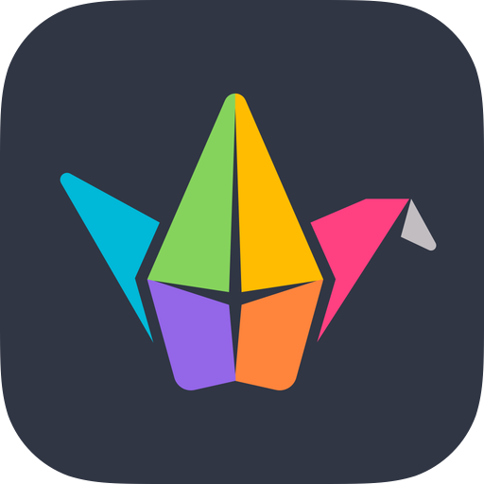
Pupil Resources: apps
more apps
 | Camera (iPad) Take photographs, videos, time-lapse or slow-motion recordings with the camera app. |  | Book Creator: Create and design your own digital books using text, drawing, photographs, videos, voice clips and more.
 | Photos (iPad): View photos and videos stored. Built in edit features, including crop, filter, change colour balance, trim video length. Use Mark Up tool to edit photographs with set of drawing tools. |  | Kodable: Create Activities to encourage computational thinking and code from the very basics through to creating JavaScript. Paid version also includes lesson plans (American).
 | PicCollage: For editing photos and creating collages of photos/video. Pupils learn editing process of photography - this demonstrates that photography has a purpose and that their photographs are seen by other people. |  | Bee-Bot: Based on the programmable robot Bee-Bots, the app replicates the controls of a Bee-Bot, with the aim being to input sets of instructions for the bee to follow.
 | Puppet Pals HD: easy to use cartoon creator app that allows you to create your own animations using a variety of themes and characters. Puppet Pals is a really fun and engaging app which can be used in many ways. Choose a puppet and background to tell a story. |  | Padlet: Collect together information and create mind maps with image, text, audio and links. Work collaboratively with others on a shared space.
 | Clips (iPad): app for making videos with text, effects, graphics and more. Easily record clips in the app, or add photos and clips together to make a video. Use pre-made frames, filters, animated graphics, annotate with text and add live subtitles using automatic voice recognition. Great for creating short clips to share learning. |  | Seesaw: app or web-based, this is a digital learning log for pupils, to keep a record of learning through text, image, video and audio. It empowers pupils of all ages to create, reflect and collaborate, as well as share their learning to a private feed for their families to see (optional) and engage with through the family app.
 | ChatterPix Kids: Bring photos of objects/characters to life. Take a photo, use stickers, frames and filters, then give your picture a mouth and record your voice talking. |  | Swift Playgrounds (iPad): app that makes learning Swift (a programming language) interactive and fun. Solve puzzles to master the basics using Swift is used by pros to build today’s most popular apps

Slide 67
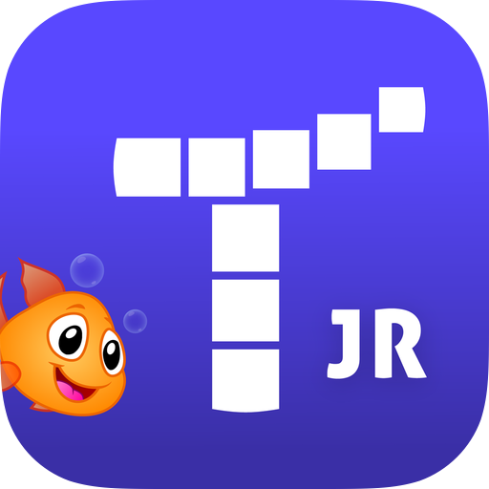
apps
Pupil Resources: apps
more apps
 | Tynker: A community space with iPad-friendly coding games, including Hour of Code and Swift. Uses block or Swift coding to introduce learners to simple movement of a character, and simple debugging/improving routines |  | Stop Motion Studio: create stop motion animations using this software with simple interface
 | Tynker Junior: Suitable for early years/pre-readers, learn to code through solving puzzles and games using picture-based block coding before moving onto block coding. |  | Plickers: formative assessment tool, which can be used with one device and a set of Plicker cards to gather multiple choice responses from large groups
 | Kahoot: Used for formative assessment; find and create quizzes and games for pupils to play via their device. |  | iMovie (iPad): movie-making and editing software on iPad. Use your own images, videos, audio and text to create movies or trailers using simple drag and drop interface.
 | Green Screen by DoInk: create videos using a green screen effect – insert your own background images/videos to a film, or create interesting effects using green objects. |  | Podcasts (Apple): Access podcasts from creators around the world – this is a catalogue of existing podcasts (caution: not always child-friendly content, please review any proposed podcasts before giving to pupils)
 | Scratch Jr: Learn to code with this introduction to visual programming and block coding. Use sample projects or create your own to make scenes with backgrounds, objects and characters. Focuses on creating movement; make changes to what’s seen on the screen using visual blocks. |  | HP Reveal: Making augmented reality easy and accessible to everyone. Upload assets, assemble Auras and share or insert into your work. Find out more.
 | Explain Everything: virtual whiteboard, use as a whiteboard through Apple TV, or for children as a canvas to work upon. Use text, image, video, hyperlinks all in one place. Can record mark making and play it back, also records audio. |  | Garageband (iPad): this app has a range of touch instruments and a recording studio for children to create music or DJ with provided songs.

Slide 68
apps
Pupil Resources: apps
online
 | Office 365 apps include: Word, Powerpoint, Excel, Sharepoint, OneDrive, Teams, OneNote, Forms, Sway This suite of apps and ideas for use across the curriculum are explained further in the Microsoft Innovative Educator community (links via CLPL section) |  | Pages (Apple) Docs (Google) Word (Microsoft) Word processing, allowing learners to create, edit and collaborate on documents and templates. Supports text, image, drawings (+ audio in Pages)
 |  |  | Numbers (A) Sheets (G) Excel (M) Spreadsheets, allowing learners to work with numbers, collaborate and create tables, graphs and charts
 | G-Suite apps include: Docs, Slides, Sheets, Drive, Classroom, Forms, Sites, Expeditions. This suite of apps and ideas for use across the curriculum are explained further in the Google for Education community (more links via CLPL section)
 |  |  | Keynote (A) Slides (G) Powerpoint (M) Presentation software, allowing learners to create, edit and collaborate on presentations. Supports text, image, video, drawings (A), audio and more
 | Classroom (Apple): This is your control centre in the classroom – monitor and control pupil iPads, set and receive work and make sure everyone is on task. There is a teacher’s guide to Classroom available.
 |  |  | iCloud (A) Drive (G) OneDrive (M) Cloud storage, used to store files and backups. iCloud (when turned on) will automatically store files and settings from user iPad (connected to unique Apple ID); Drive and OneDrive are accessible via Glow and use Glow login. Both have capability of storing all types of files, but each option works best with their own software.
 | Google Classroom: Google Classroom's purpose is to facilitate paperless communication between teachers and students and streamline educational workflow. Classroom is an online space, allowing teachers to create classes, post assignments, organise folders, and view work in real-time. Not to be confused with (Apple) Classroom
 |  |  | More useful Microsoft O365 software/apps: Outlook: pupil and staff email via Glow email address OneNote: pupil notebook software, can be viewed by teacher and notebooks can shared with class/groups of other pupils for collaboration Forms: create surveys/forms/quizzes
 | Microsoft Teams: a hub for team collaboration in Office 365 that integrates the people, content, and tools your classroom needs. Create classes/teams, post assignments, mark work, have an overview of shared Class Notebooks, view work in real-time
 |  |  | More useful Google software/apps: YouTube: access to YouTube, video-sharing site (caution: not always child-friendly content, please review any proposed videos and potential adverts before giving to pupils) Sites: create your own websites Forms: create surveys/forms/quizzes

Slide 69
apps
Pupil Resources: online
more online
 | Thinkuknow (via Glow): Resources for online safety (should be adult-directed) |  | Topmarks: A site with online resources and activities for across the curriculum, including game-based learning.
 | Childnet.com: Resources for online safety (should be adult-directed) |  | CodeClub: projects are free and open to all. Easy-to-follow, step-by-step guides that young people use to make their own games, animations, and websites with coding languages such as Scratch, HTML/CSS, and Python.
 | Barefoot Computing (via Glow): Resources and activities for building computing science literate pupils, including ‘unplugged’ activities for learning computational thinking without devices or internet |  | Micro:bit: use Micro:bit hardware in the classroom to code via laptop/PC/iPad (teacher resources and ‘how to’ accessed via site)
 | Sphero Edu: A community with resources and activities for using Sphero across the curriculum. Sphero have also created a curriculum aligned to aspects of Curriculum for Excellence, for some topics based on First/Second Level experiences and outcomes. |  | Minecraft Education: an open-world game that promotes creativity, collaboration, and problem-solving in an immersive environment
 | Code.org: A site with resources and activities for using coding in the classroom. |  | Lightbot: (requires Flash player; use with laptop/computer/tablets that are not iPad): games and puzzles to introduce visual directional programming
 | Hour of Code: A site that gathers together resources and activities for using coding in the classroom or at home, grouped by age/stage. |  | CS Unplugged: site with resources and activities for teaching computing science without computers or devices – there are lesson plans and cross-curricular links. Note: activities are identified by suggested age group in brackets, usually (5-7), (8-10) and (11-14).

Slide 70
online
Pupil Resources: online
programmable devices
 | Scratch: With Scratch, children can program their own interactive stories, games, and animations — and share their creations with others. Scratch helps young people learn to think creatively, reason systematically, and work collaboratively — essential skills for life in the 21st century. Introduction to visual programming language. |  | Office 365 (via Glow) software includes: Word, Powerpoint, Excel, Sharepoint, OneDrive, Teams, OneNote, Forms, Sway, Skype. This suite off software (with equivalent iPad apps) and ideas for use across the curriculum are explained further in the Microsoft Innovative Educator community (links via CLPL section)
 | NSPCC: Resources and guidance for keeping children safe from abuse, cyberbullying and grooming online – children should not be left to browse website as it also contains some age-dependent explicit content related to safeguarding children |  | G-Suite (via Glow) apps include: Docs, Slides, Sheets, Drive, Classroom, Forms, Expeditions, Sites, Hangouts. This suite off apps and ideas for use across the curriculum are explained further in the Google for Education community (more links via CLPL section)
 | Google Classroom: Google Classroom's purpose is to facilitate paperless communication between teachers and students and streamline educational workflow. Classroom allows teachers to create classes, post assignments, organise folders, and view work in real-time |  | Pixabay: royalty and copyright free images Unsplash: royalty and copyright free photos
 | Kiddle: offers a child-friendly search engine, but also a children’s encyclopedia (Kpedia) |  | Popplet: mind-mapping and note-taking software
 | Swiggle: offers a child-friendly search engine |  | CS First: computing science curriculum with activities and resources from Google.
 | Be Internet Legends: cyber-resilience and internet safety resources from Google, focusing on aspects of digital citizenship and safety through games. See the Be Internet Awesome Curriculum |  | BBC Bitesize: The BBC provide free resources on digital literacy and computing science (search by CfE levels) Learn at BBC Scotland: free resources including videos, sound clips, radio shows, stories and activities for use across the curriculum

Slide 71
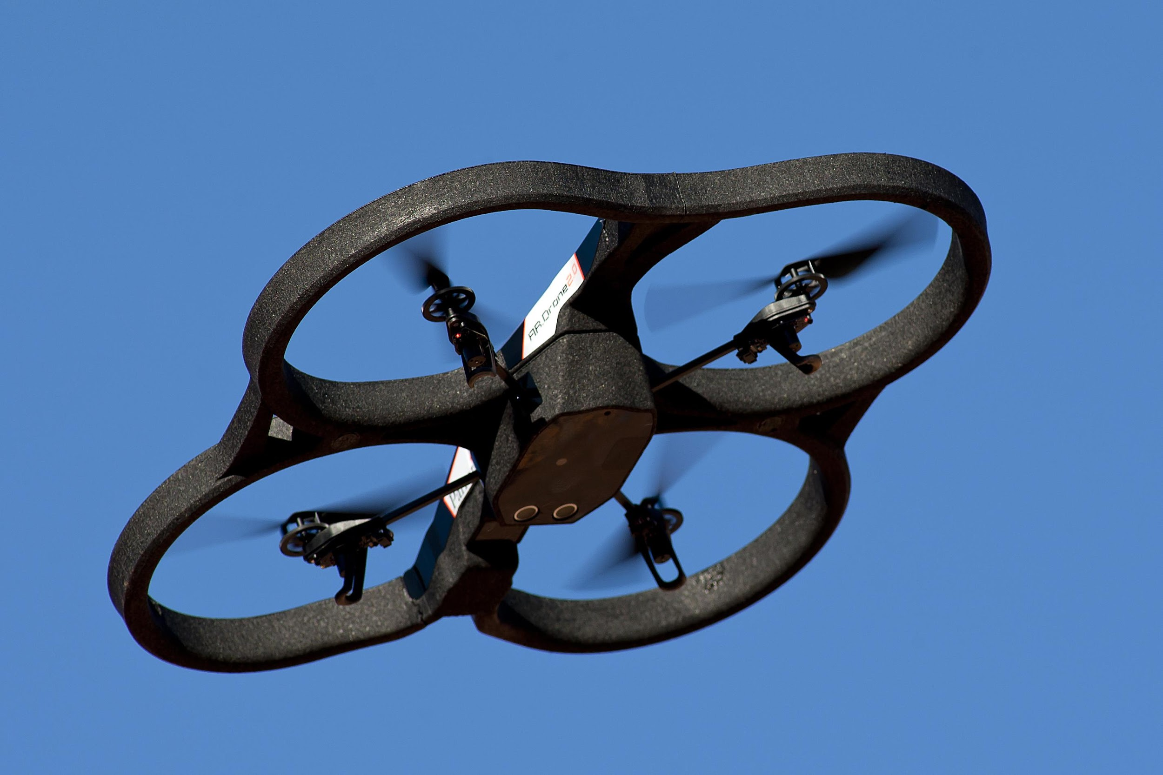
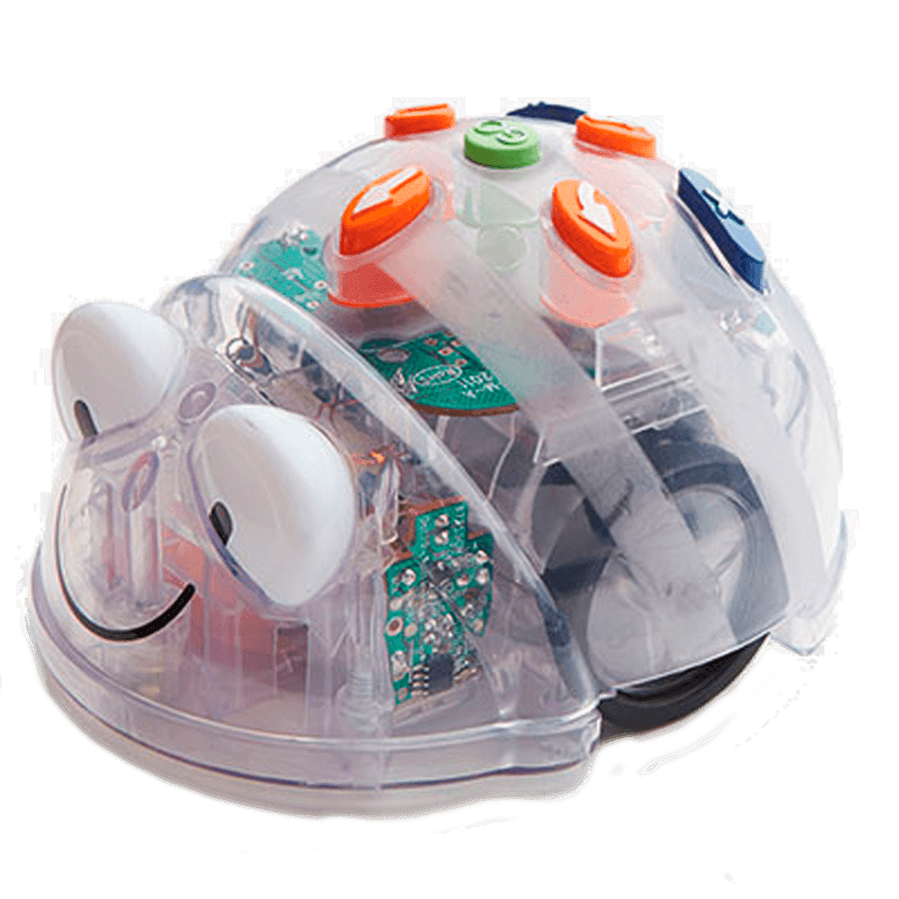
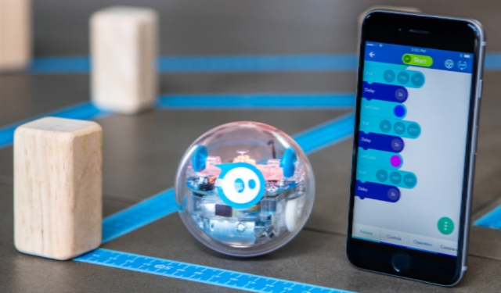
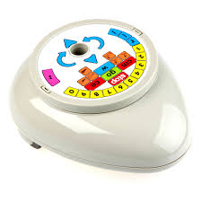
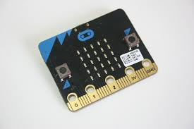
online
Pupil Resources: programmable devices
more
programmable devices
 | BeeBot: programmable ‘robot’ focusing on direction, movement and sequencing short code using arrows |  | Drone: often programmable via an app, or ’driven’ with directional joystick
 | Sphero: programmable robot ball – use ‘drive’ for movement, ‘draw’ for visual programming and ’block’ coding elements all within the Sphero Edu app. Also interacts with Swift Playgrounds on iPad. Watch this video to find out more. |  | Roamer-Too: programmable roaming robot, with changeable keypad for increasing challenge
 | Code-a-pillar: programmable caterpillar device, where the body parts make up the ‘code’ – these click together and light up as they perform the code created so that children can follow the effects of what they input |  | Remote-controlled objects: not usually a programmable device, as it responds immediately to movement, but useful as a stepping stone and comparison; for learning about movement and direction (instructions given to the remote are followed by the object)
 | Dash & Dot: programmable robots, come with their own apps for creating visual and block code |  | Micro:bit: open-source hardware, ARM Cortex-M0 processor, accelerometer and magnetometer sensors, Bluetooth and USB connectivity, display consisting of 25 LEDs, two programmable buttons, and can be powered by either USB or an external battery pack; inputs and outputs through five ring connectors that form part of a larger 25-pin edge connector

Slide 72
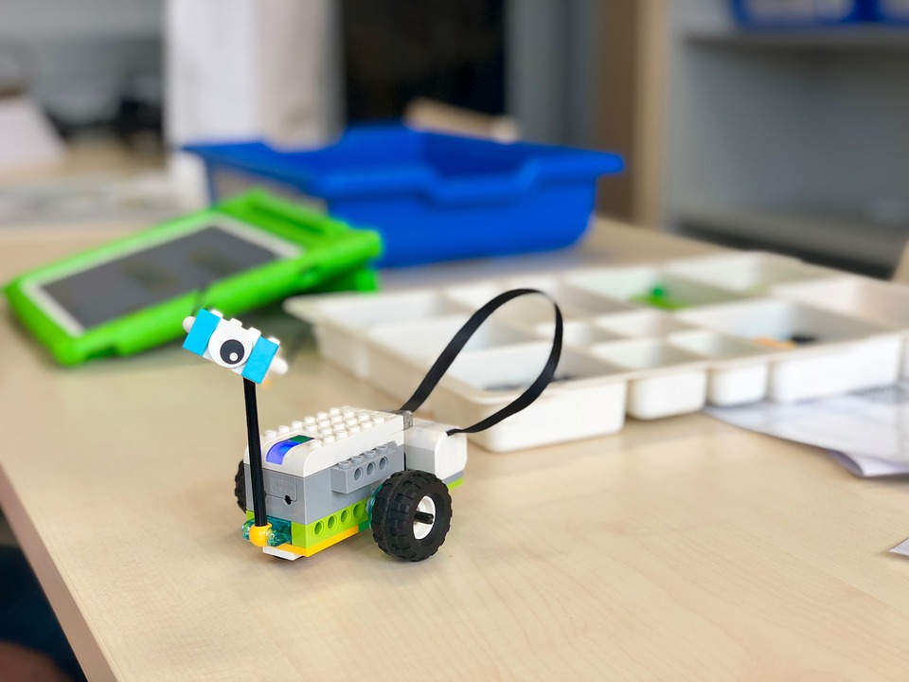
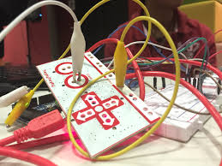
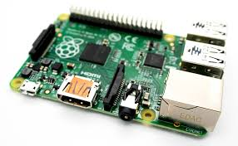
programmable devices
Pupil Resources: programmable devices
 | Lego WeDo: set of Lego aimed as an ’introduction to control technology and programming using robotics’ – should work via Scratch or Micro:bit online/app as a plug-in
 | Makey Makey: ‘First set up takes seconds. Start out easy with a banana piano. Then create game controllers, invent musical instruments, make voting machines, and light up paper circuits. Connect Makey Makey to the world and the possibilities are endless!’
 | Raspberry Pi: mini computer, attaches to a monitor, keyboard and mouse to run programs

Slide 73
Early Level: DL1 Using digital products and services in a variety of contexts to achieve a purposeful outcome
Suggested Professional Learning: Early Level
Early Level: CS1 Understanding the world through computational thinking
Enabling Environments: iPads in the Early Years by Mark Faulder (download via Books) – preview this section on photos
Teachable:
Getting to Know Your iPad 1 / 2 / 3
Using Clips for Learning Logs and Parental Engagement
Developing Literacy – Gathering Resources
Developing Literacy – Digital Story Telling (iMovie)
Picture books to support e-safety (list provided by primary school)
Teachable:
LfA Reading Strategies (Book Creator)
New professional learning courses coming soon specifically for Early Years
South West Grid for Learning (SWGfL) lesson plans and resources
General information on cyber resilience and internet safety for teachers and parents via Parent Info - Thinkuknow - Internet Matters and Childnet as well as useful resources for learning by age and stage
The Early Years – 7 section of Education for a Connected World
Digital Schools Award Cyber Resilience Internet Safety (CRIS) badge resources available when you register your school to participate
Early Level: CS2 Understanding and analysing computing technology
Barefoot Computing: concepts and approaches for teachers
Quickstart Computing Scotland – Subject Knowledge for Primary Teachers (pdf that can be saved to Books)
Teach Computing Science: A Guide for Primary and Early Years Practitioners (pdf that can be saved to Books)
Bee-Bot Teacher Guide
Code.org: Lesson plans for teaching and resources for pupils
Kodable: lesson plans for teaching and and self-led activities for pupils (free version)
Teachable: (http://connected-learning-glasgow.teachable.com) accessible via Glow tile – short courses created by colleagues across Glasgow and XMA
CPD Manager – for face to face sessions and conferences
Apple Teacher programme
Microsoft Innovative Educator programme
Google for Education programme
Today at Apple – workshops at Buchanan Street Apple Store and Braehead Apple Store – check their calendar for events and book in online to one of their sessions
Early Level: CS3 Designing, building and testing computing solutions
Early Level: DL2 Searching, processing and managing information responsibly
Early Level: DL3 Cyber resilience and internet safety
Additional professional learning opportunities

Slide 74
First Level: DL1 Using digital products and services in a variety of contexts to achieve a purposeful outcome
Suggested Professional Learning: First Level
First Level: CS1 Understanding the world through computational thinking
Enabling Environments: iPads in the Early Years by Mark Faulder (download via Books) – preview this section on photos
Teachable:
Getting to Know Your iPad 1 / 2 / 3
Using Clips for Learning Logs and Parental Engagement
Developing Literacy – Gathering Resources
Developing Literacy – Digital Story Telling (iMovie)
Apple: Everyone Can Create (link for info, but Teacher Guide and pupil books available via Book Catalogue on managed iPads)
Picture books to support e-safety (list provided by primary school, suitable for younger or beginning of first level learners)
Teachable:
LfA Reading Strategies (Book Creator)
South West Grid for Learning (SWGfL) lesson plans and resources
General information on cyber resilience and internet safety for teachers and parents via Parent Info - Thinkuknow - Internet Matters and Childnet as well as useful resources for learning by age and stage
Password guidance (Glow)
Appropriate sections (Early Years – 7 and first column of 7-11) of Education for a Connected World)
Digital Schools Award Cyber Resilience Internet Safety (CRIS) badge resources available when you register your school to participate
NSPCC (Share Aware campaign)
Google’s Be Internet Legends programme (available via Glow) with Teacher Guide takes children through games with positive messages. On completing each section, children get a certificate
First Level: CS2 Understanding and analysing computing technology
Barefoot Computing: concepts and approaches for teachers
Quickstart Computing Scotland – Subject Knowledge for Primary Teachers (pdf that can be saved to Books)
Teach Computing Science: A Guide for Primary and Early Years Practitioners (pdf that can be saved to Books)
Bee-Bot Teacher Guide
Code.org: Lesson plans for teaching and resources for pupils
Kodable: lesson plans for teaching and and self-led activities for pupils (free version)
Teachable: (http://connected-learning-glasgow.teachable.com) accessible via Glow tile – short courses created by colleagues across Glasgow and XMA
CPD Manager – for face to face sessions and conferences
Apple Teacher programme
Microsoft Innovative Educator programme
Google for Education programme
Today at Apple – workshops at Buchanan Street Apple Store and Braehead Apple Store – check their calendar for events and book in online to one of their sessions
Apps for Good – learn how to teach creation of apps
Sphero Edu Teacher Resource Guide (linked to Curriculum for Excellence)
First Level: CS3 Designing, building and testing computing solutions
First Level: DL2 Searching, processing and managing information responsibly
First Level: DL3 Cyber resilience and internet safety
Additional professional learning opportunities

Slide 75
Second Level: DL1 Using digital products and services in a variety of contexts to achieve a purposeful outcome
Suggested Professional Learning: Second Level
Second Level: CS1 Understanding the world through computational thinking
Teachable:
Getting to Know Your iPad 1 / 2 / 3
Using Clips for Learning Logs and Parental Engagement
Developing Literacy – Gathering Resources
Developing Literacy – Digital Story Telling (iMovie)
LfA Creating Film (Green Screen)
Apple: Everyone Can Create (link for info, but Teacher Guide and pupil books available via Book Catalogue on managed iPads)
Teachable:
LfA Reading Strategies (Book Creator)
Creating Authentic Online Assessments (Forms)
Developing Numeracy – Digital Spreadsheets
South West Grid for Learning (SWGfL) lesson plans and resources
General information on cyber resilience and internet safety for teachers and parents via Parent Info - Thinkuknow - Internet Matters and Childnet as well as useful resources for learning by age and stage
Appropriate sections (7-11 columns) of Education for a Connected World)
Digital Schools Award Cyber Resilience Internet Safety (CRIS) badge resources available when you register your school to participate
NSPCC staff training (Share Aware campaign)
Google’s Be Internet Legends programme (available via Glow) with Teacher Guide takes children through games with positive messages. On completing each section, children get a certificate
Second Level: CS2 Understanding and analysing computing technology
Barefoot Computing: concepts and approaches for teachers
Quickstart Computing Scotland – Subject Knowledge for Primary Teachers (pdf that can be saved to Books)
Teach Computing Science: A Guide for Primary and Early Years Practitioners (pdf that can be saved to Books)
Code.org: Lesson plans for teaching and resources for pupils
Kodable: lesson plans for teaching and and self-led activities for pupils (free version)
Google CS curriculum has lesson plans and activities for 9-14 year olds
Teachable: (http://connected-learning-glasgow.teachable.com) accessible via Glow tile – short courses created by colleagues across Glasgow and XMA
CPD Manager – for face to face sessions and conferences
Apple Teacher programme
Microsoft Innovative Educator programme
Google for Education programme
Today at Apple – workshops at Buchanan Street Apple Store and Braehead Apple Store – check their calendar for events and book in online to one of their sessions
Apps for Good – learn how to teach creation of apps
Sphero Edu Teacher Resource Guide (linked to Curriculum for Excellence)
Second Level: CS3 Designing, building and testing computing solutions
Second Level: DL2 Searching, processing and managing information responsibly
Second Level: DL3 Cyber resilience and internet safety
Additional professional learning opportunities

