Slide 1
Calculating and Problem Solving
Twilight 23-24
4:30-6:00pm

Slide 2


Aims
To build knowledge and understanding of Estimating and Rounding.
To look at the skills and knowledge that underpin Early Addition and Subtraction.
Comparison
Ordering
Partitioning
Notes:
Throughout the presentation remember the key message re maths talk. All the strategies we suggest require adult modelling maths talk and using interactions to move learning forward.

Slide 3
Early Level Tracker 1
Estimation & Rounding |  | Knows they can check estimates by counting within 0-10 |  |  |  | Can apply subitising skills to estimate the number of items in a set |  |  |  |  | Uses the language of estimation, including more than, less than, fewer than and the same
Awareness of Number – Counting, Quantities & Number Structure | No. word sequences | Say short forward and backward number word sequences within 0-10 |  |  |  | Uses ordinal numbers in real life contexts e.g. I am first/second/third in the line’ |  |  |  |  | Recalls the number sequence forwards and backwards within 0-10
 | Numerals | Recognise numerals e.g. points to the number from 0-10 |  | Identify (name) numerals e.g. can respond to question ‘what is that number?’ from 0-10 |  | Explains zero is represented as 0 |  | Orders numerals forwards and backwards within 0-10 |  |  | Identifies number before, after and missing numbers in a sequence within 0-10; beginning to use the language before, after and in-between
 | Subitising | Identifies ‘how many?’ in regular dot patterns e.g. dot arrangement/on fingers/five frames/10 frames/dice without counting up to 6 |  |  |  | Identifies ‘how many?’ in irregular dot patterns e.g. dot arrangement/on fingers/five frames/10 frames/dice without counting up to 6 |  |  |  |  | Represents amounts in different arrangements e.g.dot arrangement/on fingers/five frames/ 10 frames/dice without counting up to 6
 | Counting | When counting objects understands the order in which we say the numbers is always the same (stable order) |  | Touch counts one item when each number word is said (1-to-1 correspondence) |  | When counting objects understands that the number name of the last object counted is the name given to the total number of objects in a set (cardinal principle) |  | When counting objects understands that the number of objects is not affected by position (order irrelevance) |  |  | Counts objects in a set recognising that the appearance of the objects has no effect on the overall total within 0-10 (conservation) |  | Counts anything e.g. objects at a distance/in a book/sounds/claps within 0-10 (abstract principle)
 | Place Value | Explains that zero means there is none of a particular quantity |  |  |  |  |  | Partitions quantities to 10 into 2 or more parts and recognises that this does not affect the total e.g. 6 as 3 and 3/2 and 2 and 2
Addition and Subtraction |  | Sorts & classifies objects using quantity as an attribute e.g. sets of 1, 2 within 0-10 | Compares 2 sets to decide which has the fewest/most within 0-10 |  | Finds the total when 1,2 or 3 is added to an existing amount e.g. a number line or height chart (augmentation) |  | Finds the total when 2 sets are added together within 0-10 (aggregation) |  | Finds out how many are left when 1 or 2 are taken away within 0-10 |  |  | Compares to find the difference between sets as a quantity within 0-10 | Beginning to count on and back in ones to add and subtract with objects or number line within 0-10
Multiplication and Division |  | Shares out a group of items into 2 equal sets within 0-10. Groups objects into matching or natural sets of 2 e.g. shoes within 0-10 |  |  |  |  |  | Begin to identify halves and doubles using concrete materials within 0-10
Fractions, Decimals and % |  | Identifies wholes and halves in a social context and uses appropriate language e.g. ‘I have eaten half of my banana’ |  |  |  | Splits a whole into smaller parts and explains that equal parts are the same size |  |  |  | Understands that a whole can be shared equally and unequally
Notes:
Highlight where this is evident in the tracker

Slide 4
Early Level Estimating and Rounding
“Good estimators are flexible in their thinking and they use a variety of strategies. They demonstrate a deep understanding of numbers and operations and they continually draw upon that understanding” (Sowder, 1992 P.381)
Notes:
Estimating is a concept children find difficult to do as they are pre-programmed to believe in maths there is a right and a wrong answer. Estimating skills enrich children’s understanding of maths and good estimating skills go hand in hand with good number sense and mathematical thinking. We use estimating in every day e.g. when we are doing the shopping we roughly add up the price we think the total bill be, it is important children are given opportunities to estimate as we want them to develop in a way that they can determine the reasonableness of their answer.

Slide 5
Early Level Tracker 1
Estimation & Rounding |  | Knows they can check estimates by counting within 0-10 |  |  |  | Can apply subitising skills to estimate the number of items in a set |  |  |  |  | Uses the language of estimation, including more than, less than, fewer than and the same
Awareness of Number – Counting, Quantities & Number Structure | No. word sequences | Say short forward and backward number word sequences within 0-10 |  |  |  | Uses ordinal numbers in real life contexts e.g. I am first/second/third in the line’ |  |  |  |  | Recalls the number sequence forwards and backwards within 0-10
 | Numerals | Recognise numerals e.g. points to the number from 0-10 |  | Identify (name) numerals e.g. can respond to question ‘what is that number?’ from 0-10 |  | Explains zero is represented as 0 |  | Orders numerals forwards and backwards within 0-10 |  |  | Identifies number before, after and missing numbers in a sequence within 0-10; beginning to use the language before, after and in-between
 | Subitising | Identifies ‘how many?’ in regular dot patterns e.g. dot arrangement/on fingers/five frames/10 frames/dice without counting up to 6 |  |  |  | Identifies ‘how many?’ in irregular dot patterns e.g. dot arrangement/on fingers/five frames/10 frames/dice without counting up to 6 |  |  |  |  | Represents amounts in different arrangements e.g.dot arrangement/on fingers/five frames/ 10 frames/dice without counting up to 6
 | Counting | When counting objects understands the order in which we say the numbers is always the same (stable order) |  | Touch counts one item when each number word is said (1-to-1 correspondence) |  | When counting objects understands that the number name of the last object counted is the name given to the total number of objects in a set (cardinal principle) |  | When counting objects understands that the number of objects is not affected by position (order irrelevance) |  |  | Counts objects in a set recognising that the appearance of the objects has no effect on the overall total within 0-10 (conservation) |  | Counts anything e.g. objects at a distance/in a book/sounds/claps within 0-10 (abstract principle)
 | Place Value | Explains that zero means there is none of a particular quantity |  |  |  |  |  | Partitions quantities to 10 into 2 or more parts and recognises that this does not affect the total e.g. 6 as 3 and 3/2 and 2 and 2
Addition and Subtraction |  | Sorts & classifies objects using quantity as an attribute e.g. sets of 1, 2 within 0-10 | Compares 2 sets to decide which has the fewest/most within 0-10 |  | Finds the total when 1,2 or 3 is added to an existing amount e.g. a number line or height chart (augmentation) |  | Finds the total when 2 sets are added together within 0-10 (aggregation) |  | Finds out how many are left when 1 or 2 are taken away within 0-10 |  |  | Compares to find the difference between sets as a quantity within 0-10 | Beginning to count on and back in ones to add and subtract with objects or number line within 0-10
Multiplication and Division |  | Shares out a group of items into 2 equal sets within 0-10. Groups objects into matching or natural sets of 2 e.g. shoes within 0-10 |  |  |  |  |  | Begin to identify halves and doubles using concrete materials within 0-10
Fractions, Decimals and % |  | Identifies wholes and halves in a social context and uses appropriate language e.g. ‘I have eaten half of my banana’ |  |  |  | Splits a whole into smaller parts and explains that equal parts are the same size |  |  |  | Understands that a whole can be shared equally and unequally
Notes:
Highlight where this is evident in the tracker

Slide 6
Early Level Estimating and Rounding
Early Level Tracker 1
Notes:
EL tracker 1
The next 5 slides are examples of estimating games you can play with the children – they are based on estimating games I have used before created by Steve Wyborney (https://stevewyborney.com/).
Basically you show the first image, or use concrete resources the same as the images, as the children to estimate how many they think there are. You then reveal the correct amount to them and show them the second image/objects and ask them again to estimate, this time they have the knowledge of the first image/objects to refer back to e.g. the first jar had 5 figures and this one looks like it has more than five. They can then make their estimation based on this knowledge. This continues until 4 images/objects have been shown.

Slide 7
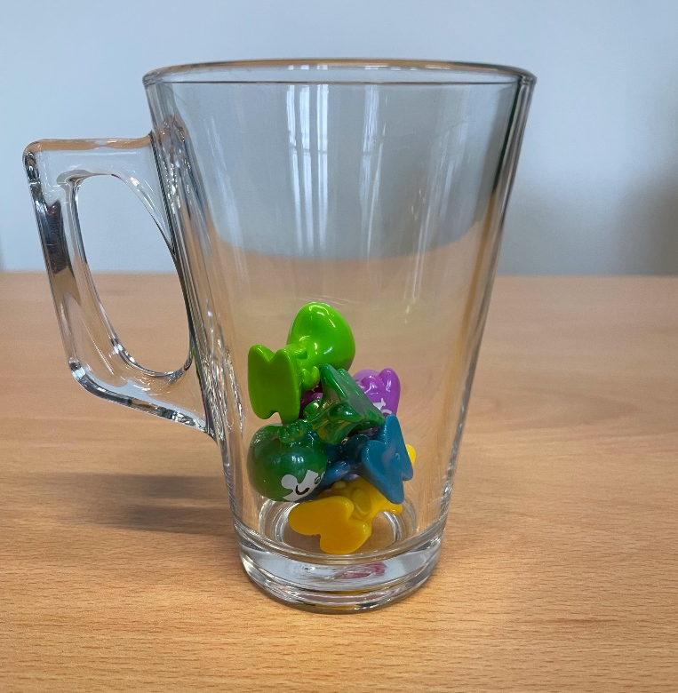
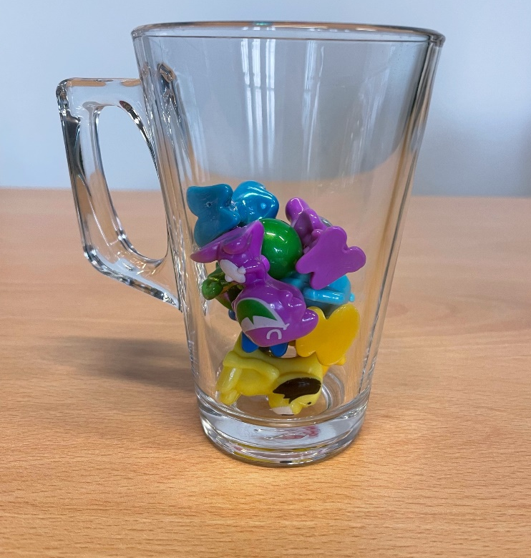
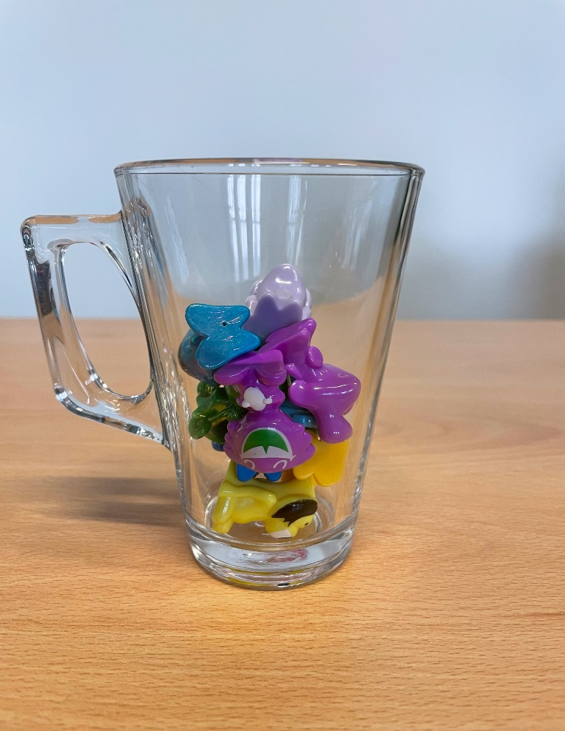
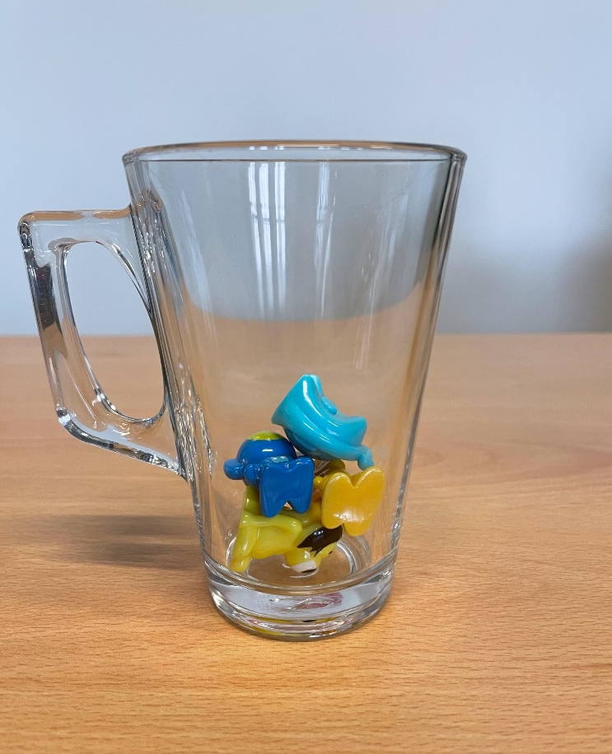
How many figures are in the cup?
Estimate
Estimate
5
7
8
4
Estimate
Estimate

Slide 8
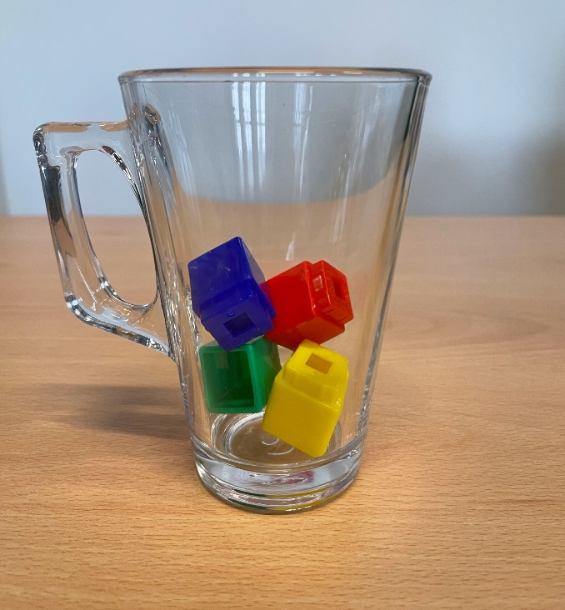
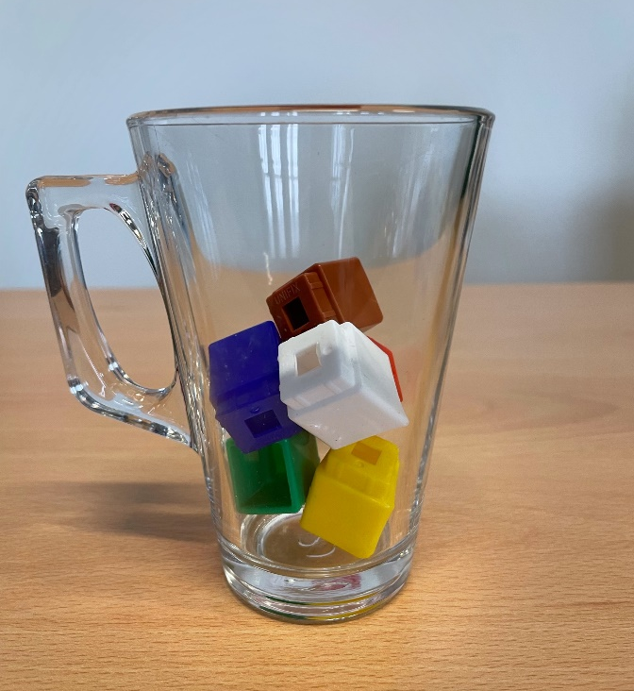
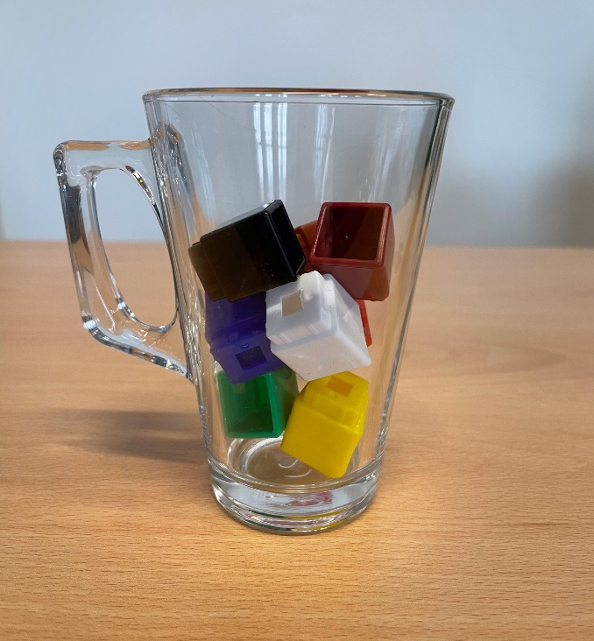
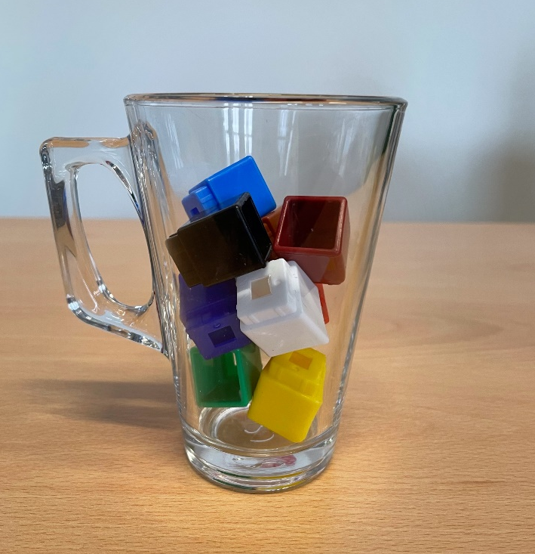
How many cubes are in the cup?
4
Estimate
Estimate
6
7
Estimate
Estimate
9

Slide 9
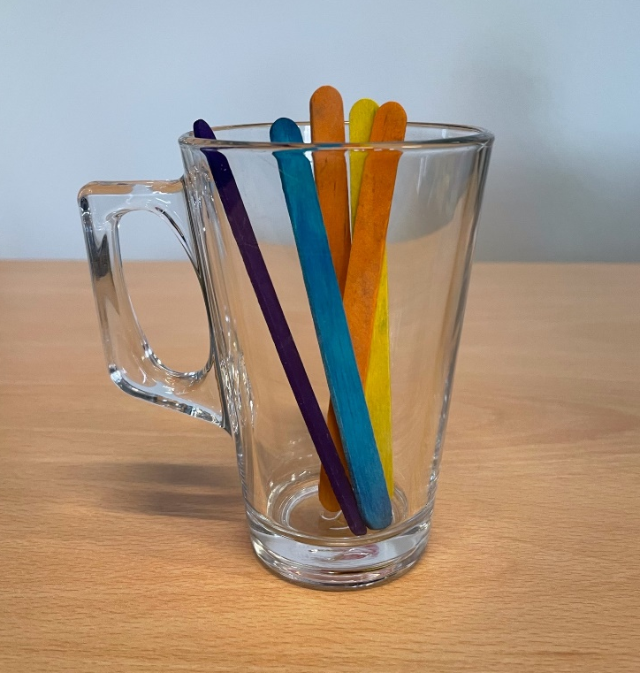
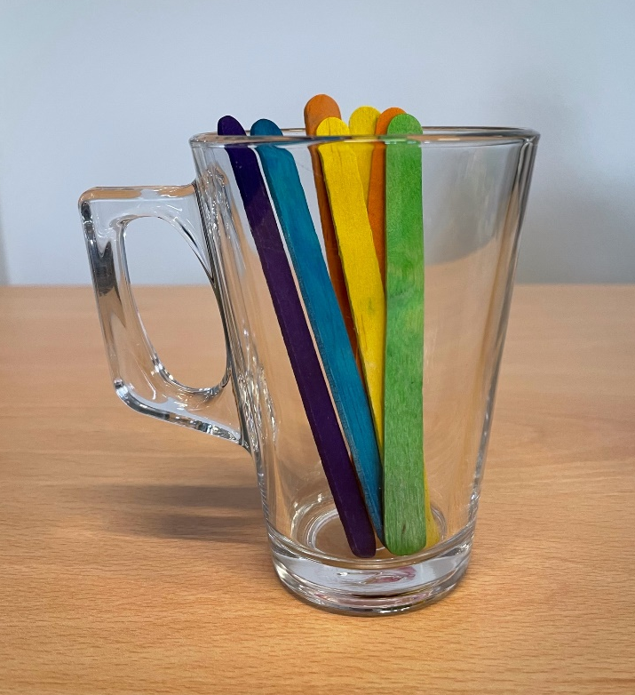
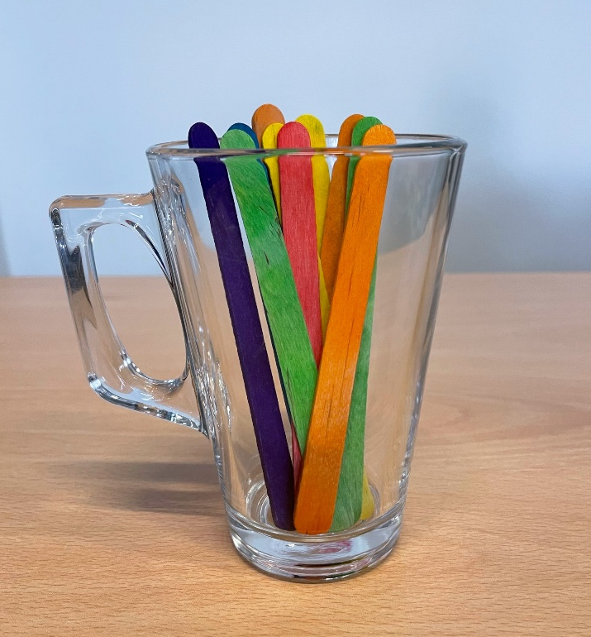
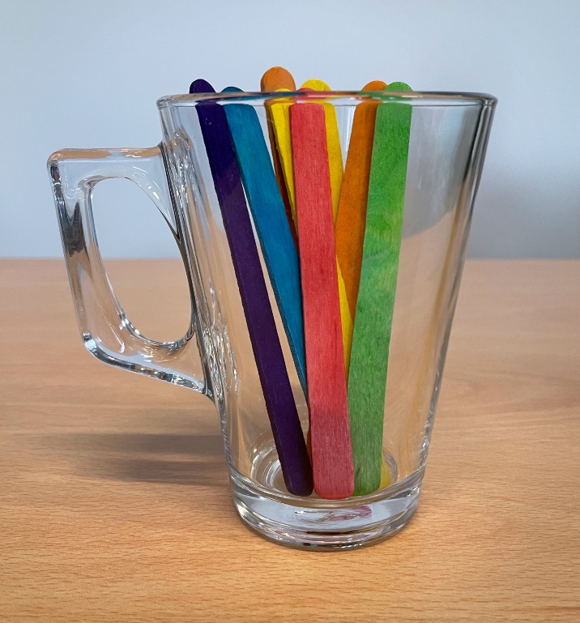
How many sticks are in the cup?
5
Estimate
Estimate
7
10
8
Estimate
Estimate

Slide 10
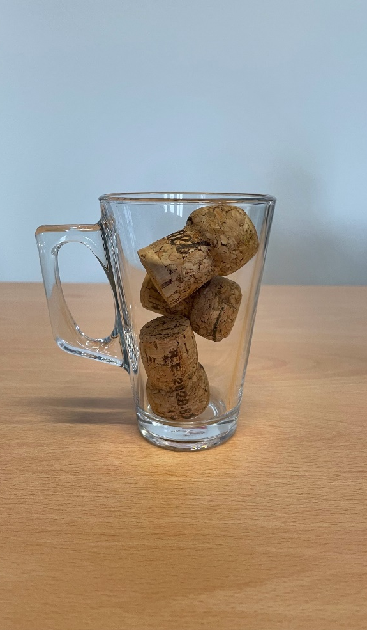
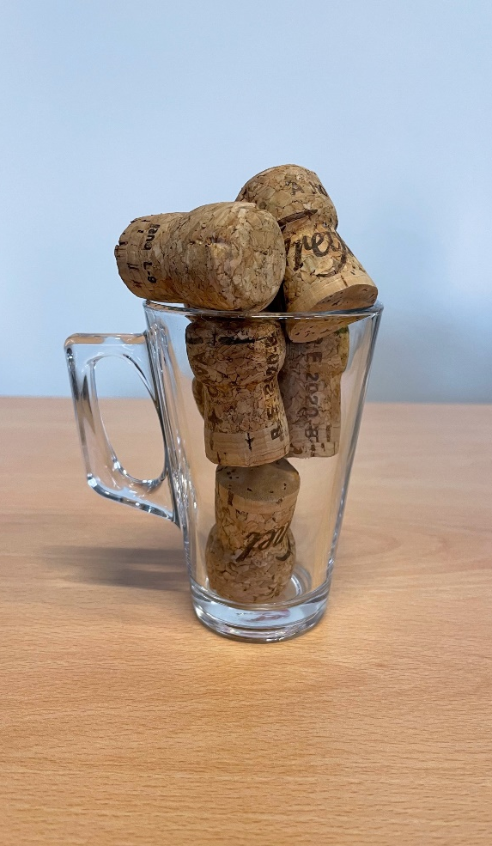
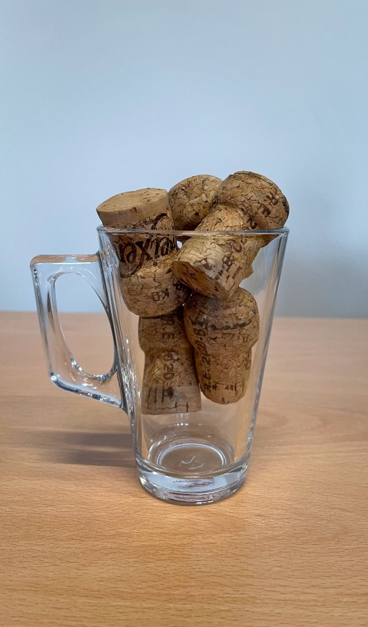
How many corks are in the cup?
3
6
5
Estimate
Estimate
Estimate

Slide 11
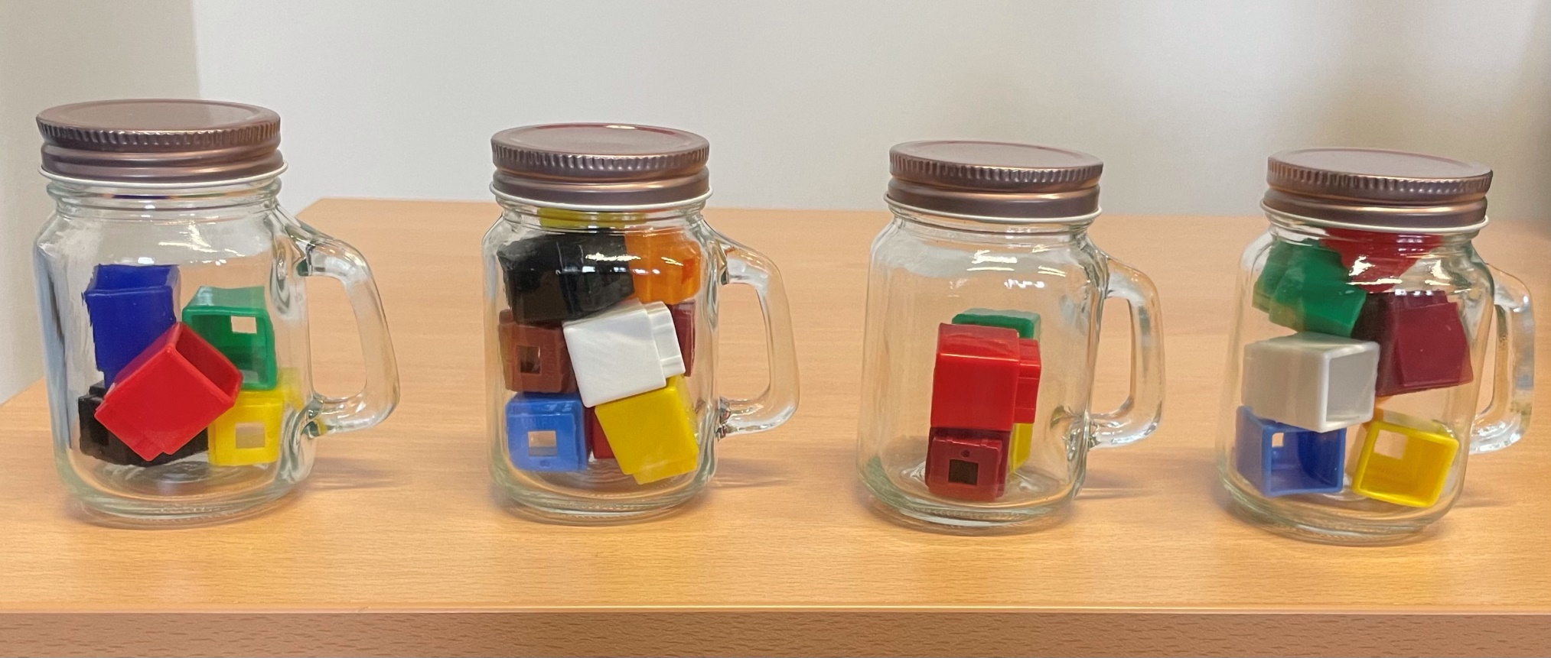
Can you recognise smallest to largest amounts and estimate the number of cubes in each jar?
Estimate
Estimate
Estimate
6
5
9
4
Estimate

Slide 12
In order to calculate children need…
..to know the relationship between numbers
  comparison E.g., 5 and 7
  ordering E.g., 3, 4, 5 and 5, 4, 3
  partitioning E.g., 4 can be 2 and 2

Slide 13
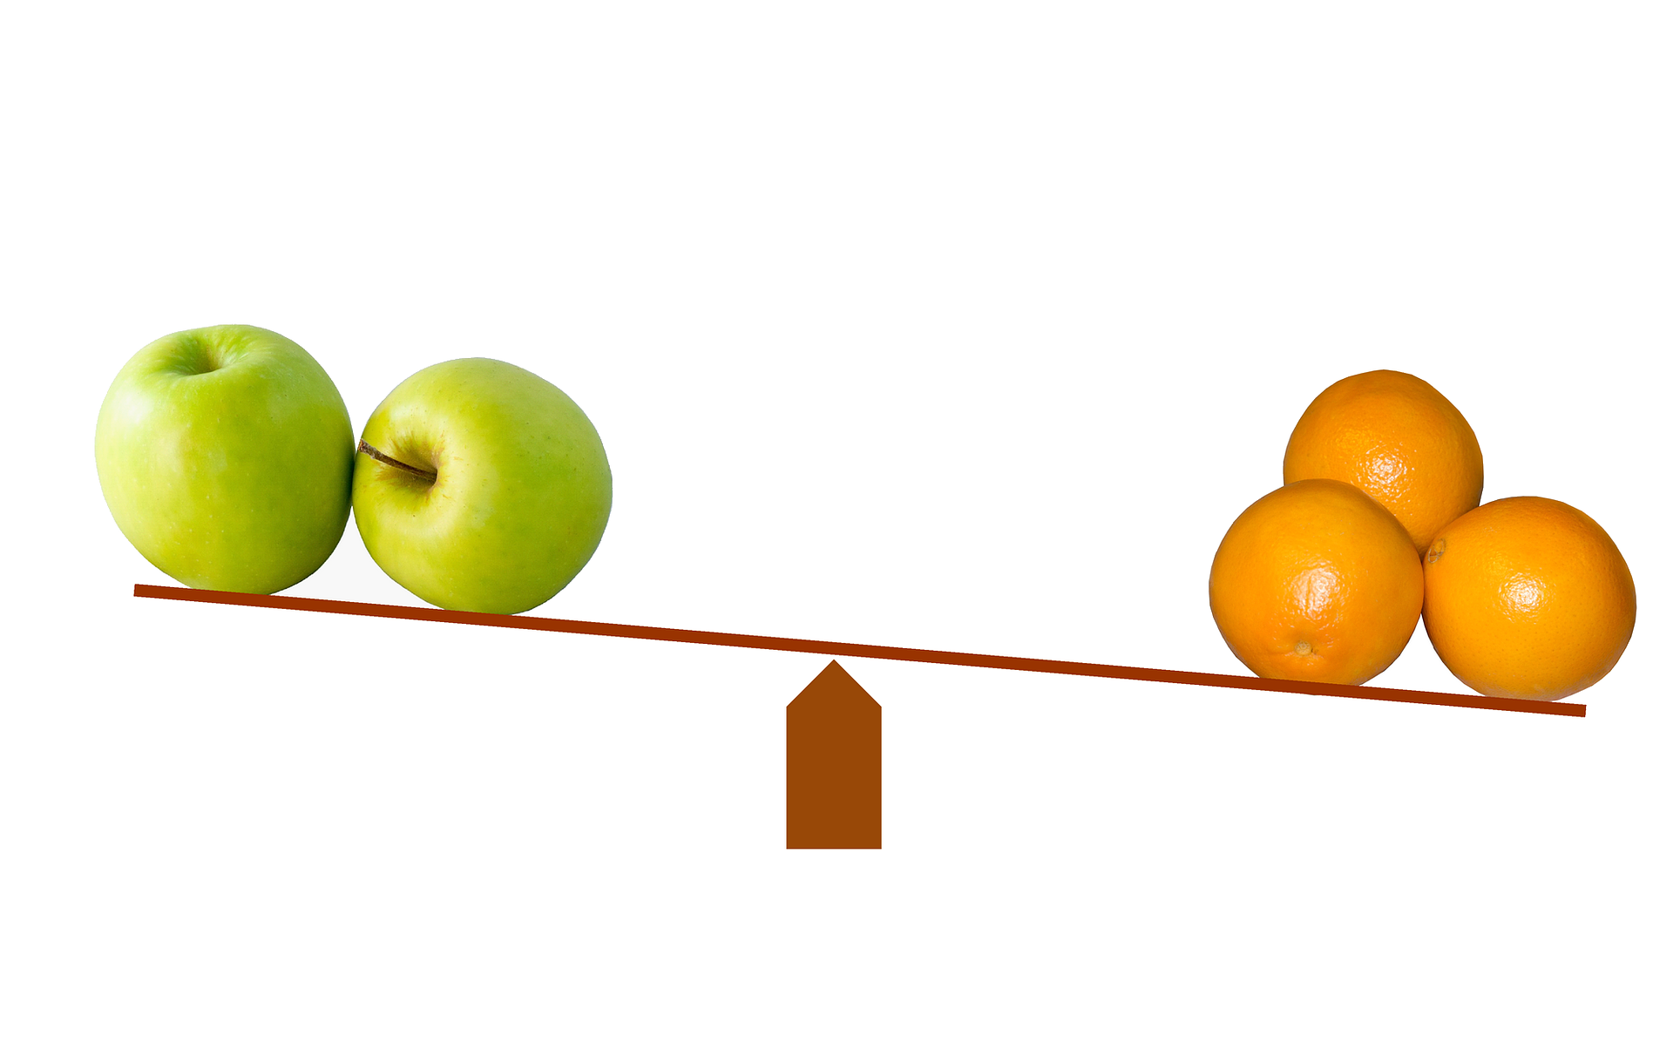
Comparison
Notes:
** Add picture

Slide 14
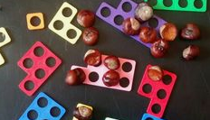

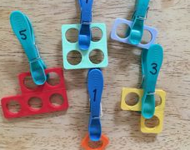
Comparison
In order to compare, children need an understanding that items are counted as sets and quantity is an attribute of the set
Notes:
As children learn to count they will begin to compare sets of objects. The children may subitise the sets, line up objects to compare them or count them to determine which has more. Through these experiences they will develop an understanding of equivalence and non equivalence.
Comparative language can be explored when making comparisons between sets in the context of play such as a lot, few, too many, more fewer.
As well as helping children to understand addition and subtraction, early work on partitioning been found to help understanding of place value, being able to partition large numbers into tens and units (Fischer, 1990)

Slide 15
Early Level Tracker 1
Estimation & Rounding |  | Knows they can check estimates by counting within 0-10 |  |  |  | Can apply subitising skills to estimate the number of items in a set |  |  |  |  | Uses the language of estimation, including more than, less than, fewer than and the same
Awareness of Number – Counting, Quantities & Number Structure | No. word sequences | Say short forward and backward number word sequences within 0-10 |  |  |  | Uses ordinal numbers in real life contexts e.g. I am first/second/third in the line’ |  |  |  |  | Recalls the number sequence forwards and backwards within 0-10
 | Numerals | Recognise numerals e.g. points to the number from 0-10 |  | Identify (name) numerals e.g. can respond to question ‘what is that number?’ from 0-10 |  | Explains zero is represented as 0 |  | Orders numerals forwards and backwards within 0-10 |  |  | Identifies number before, after and missing numbers in a sequence within 0-10; beginning to use the language before, after and in-between
 | Subitising | Identifies ‘how many?’ in regular dot patterns e.g. dot arrangement/on fingers/five frames/10 frames/dice without counting up to 6 |  |  |  | Identifies ‘how many?’ in irregular dot patterns e.g. dot arrangement/on fingers/five frames/10 frames/dice without counting up to 6 |  |  |  |  | Represents amounts in different arrangements e.g.dot arrangement/on fingers/five frames/ 10 frames/dice without counting up to 6
 | Counting | When counting objects understands the order in which we say the numbers is always the same (stable order) |  | Touch counts one item when each number word is said (1-to-1 correspondence) |  | When counting objects understands that the number name of the last object counted is the name given to the total number of objects in a set (cardinal principle) |  | When counting objects understands that the number of objects is not affected by position (order irrelevance) |  |  | Counts objects in a set recognising that the appearance of the objects has no effect on the overall total within 0-10 (conservation) |  | Counts anything e.g. objects at a distance/in a book/sounds/claps within 0-10 (abstract principle)
 | Place Value | Explains that zero means there is none of a particular quantity |  |  |  |  |  | Partitions quantities to 10 into 2 or more parts and recognises that this does not affect the total e.g. 6 as 3 and 3/2 and 2 and 2
Addition and Subtraction |  | Sorts & classifies objects using quantity as an attribute e.g. sets of 1, 2 within 0-10 | Compares 2 sets to decide which has the fewest/most within 0-10 |  | Finds the total when 1,2 or 3 is added to an existing amount e.g. a number line or height chart (augmentation) |  | Finds the total when 2 sets are added together within 0-10 (aggregation) |  | Finds out how many are left when 1 or 2 are taken away within 0-10 |  |  | Compares to find the difference between sets as a quantity within 0-10 | Beginning to count on and back in ones to add and subtract with objects or number line within 0-10
Multiplication and Division |  | Shares out a group of items into 2 equal sets within 0-10. Groups objects into matching or natural sets of 2 e.g. shoes within 0-10 |  |  |  |  |  | Begin to identify halves and doubles using concrete materials within 0-10
Fractions, Decimals and % |  | Identifies wholes and halves in a social context and uses appropriate language e.g. ‘I have eaten half of my banana’ |  |  |  | Splits a whole into smaller parts and explains that equal parts are the same size |  |  |  | Understands that a whole can be shared equally and unequally
Notes:
This is where it is explicit in the tracker, however, it relies on Counting and Subitising being well embedded.

Slide 16

The power of sets
What sets could we provide that would provoke and sustain curiosity and communication?
Notes:
What opportunities do you have within your setting for children to count groups of objects/ abstract to allow them to develop and utilise the five principles of counting?

Slide 17
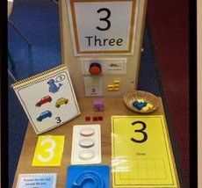
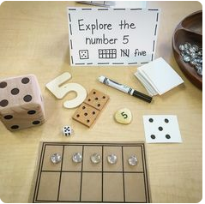
The power of sets
Children need to have a firm foundation in the ‘threeness of three, the fiveness of five’ – think number, quantity, counting
Notes:
Examples of how different representations of number can be included into the environment to reinforce cardinality and the link between numeral and quantity.

Slide 18
Comparison
Key questions and language
  Who has more/Who has fewer?
  Who has the most/Who has the fewest?
  How do you know?
  How many more?
Notes:
Children sensitive to situations that matter to them e.g. child having more than them. When comparing sets adults tend to draw attention to the larger one e.g. who has the most rather than who has the fewest…stating there are more cups than plates rather than there are fewer plates than cups.
EAL children tend to struggle with the language of comparison – need to be consistent, clear modelling and scaffolding

Slide 19
  Confusing terms…
  Try to make sure the language used is clear and consistent across the playroom.
  “Few and fewer” when things can be counted.
  “Less” when measuring or comparing.
I need a few more….
There are a lot less….
Notes:
Remember!
Few and fewer for cardinal number (things that can be counted)
Less refers to things that are measured
‘A few more…a lot less’… be careful about language so as not to confuse the children.
Your own awareness

Slide 20
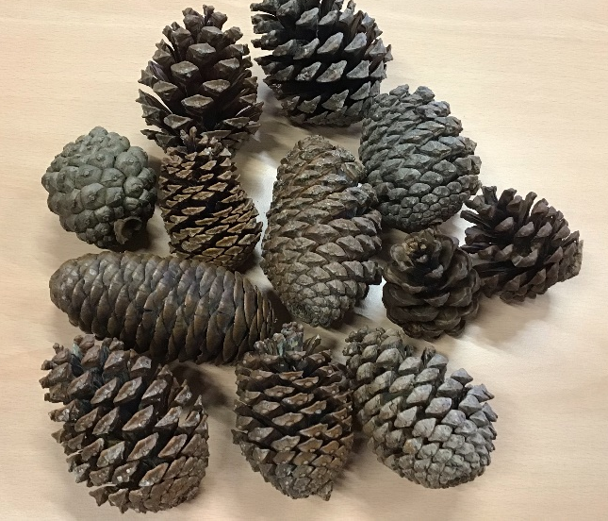
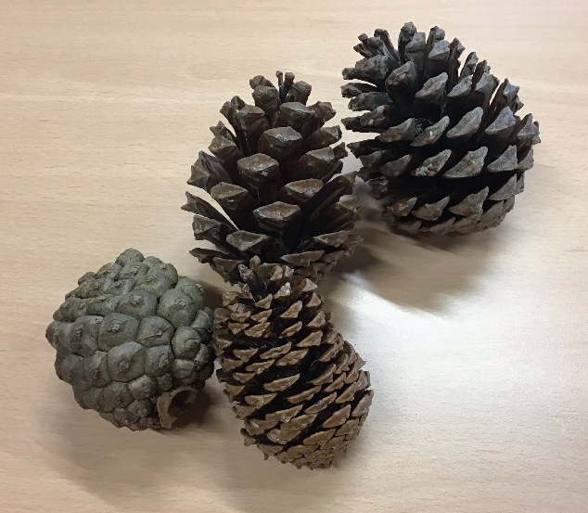
Language of Comparison
We tend to always draw attention to more.
Look for opportunities to use the term few or fewer (less).
Notes:
**Add example- picture
When comparing sets adults tend to draw attention to the larger one e.g. who has the most rather than who has the fewest…stating there are more cups than plates rather than there are fewer plates than cups.

Slide 21
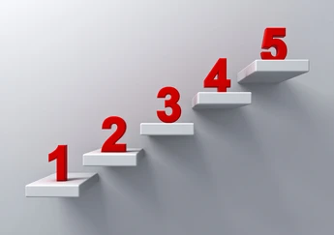
Ordering

Slide 22
Early Level Tracker 1
Estimation & Rounding |  | Knows they can check estimates by counting within 0-10 |  |  |  | Can apply subitising skills to estimate the number of items in a set |  |  |  |  | Uses the language of estimation, including more than, less than, fewer than and the same
Awareness of Number – Counting, Quantities & Number Structure | No. word sequences | Say short forward and backward number word sequences within 0-10 |  |  |  | Uses ordinal numbers in real life contexts e.g. I am first/second/third in the line’ |  |  |  |  | Recalls the number sequence forwards and backwards within 0-10
 | Numerals | Recognise numerals e.g. points to the number from 0-10 |  | Identify (name) numerals e.g. can respond to question ‘what is that number?’ from 0-10 |  | Explains zero is represented as 0 |  | Orders numerals forwards and backwards within 0-10 |  |  | Identifies number before, after and missing numbers in a sequence within 0-10; beginning to use the language before, after and in-between
 | Subitising | Identifies ‘how many?’ in regular dot patterns e.g. dot arrangement/on fingers/five frames/10 frames/dice without counting up to 6 |  |  |  | Identifies ‘how many?’ in irregular dot patterns e.g. dot arrangement/on fingers/five frames/10 frames/dice without counting up to 6 |  |  |  |  | Represents amounts in different arrangements e.g.dot arrangement/on fingers/five frames/ 10 frames/dice without counting up to 6
 | Counting | When counting objects understands the order in which we say the numbers is always the same (stable order) |  | Touch counts one item when each number word is said (1-to-1 correspondence) |  | When counting objects understands that the number name of the last object counted is the name given to the total number of objects in a set (cardinal principle) |  | When counting objects understands that the number of objects is not affected by position (order irrelevance) |  |  | Counts objects in a set recognising that the appearance of the objects has no effect on the overall total within 0-10 (conservation) |  | Counts anything e.g. objects at a distance/in a book/sounds/claps within 0-10 (abstract principle)
 | Place Value | Explains that zero means there is none of a particular quantity |  |  |  |  |  | Partitions quantities to 10 into 2 or more parts and recognises that this does not affect the total e.g. 6 as 3 and 3/2 and 2 and 2
Addition and Subtraction |  | Sorts & classifies objects using quantity as an attribute e.g. sets of 1, 2 within 0-10 | Compares 2 sets to decide which has the fewest/most within 0-10 |  | Finds the total when 1,2 or 3 is added to an existing amount e.g. a number line or height chart (augmentation) |  | Finds the total when 2 sets are added together within 0-10 (aggregation) |  | Finds out how many are left when 1 or 2 are taken away within 0-10 |  |  | Compares to find the difference between sets as a quantity within 0-10 | Beginning to count on and back in ones to add and subtract with objects or number line within 0-10
Multiplication and Division |  | Shares out a group of items into 2 equal sets within 0-10. Groups objects into matching or natural sets of 2 e.g. shoes within 0-10 |  |  |  |  |  | Begin to identify halves and doubles using concrete materials within 0-10
Fractions, Decimals and % |  | Identifies wholes and halves in a social context and uses appropriate language e.g. ‘I have eaten half of my banana’ |  |  |  | Splits a whole into smaller parts and explains that equal parts are the same size |  |  |  | Understands that a whole can be shared equally and unequally
Notes:
Highlight where this is evident in the tracker

Slide 23

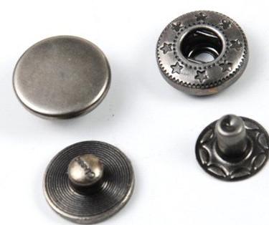
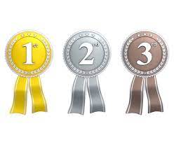
Ordering
Children need an understanding of…
  Cardinal Number says how many of something there are in a set.
  Ordinal Number tells the position e.g. pages in a book, houses in a street, number line.
Notes:
Remember, children have to understand both cardinal and ordinal number, developing an understanding of these alongside each other (as well as nominal numbers)

Slide 24
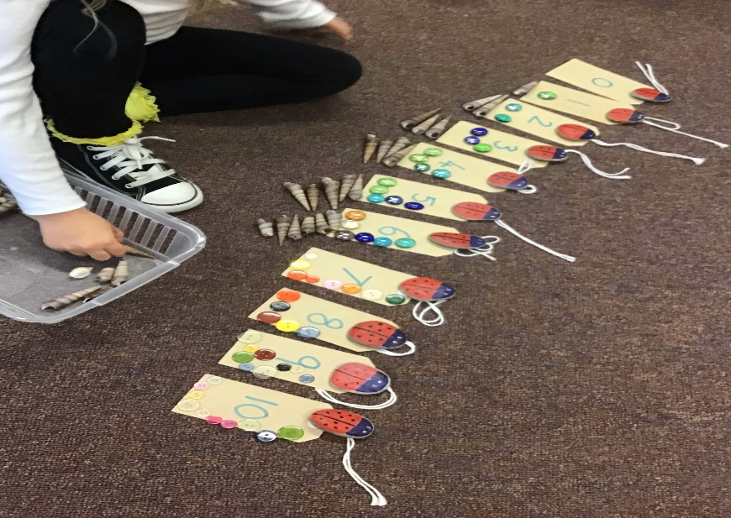
Ordering
As children understand the stable order principle, they can be encouraged to think of the next number as one more or one less.
Not just the next number in an order, but ‘one more’ or ‘one less’ than the last number.
Notes:
Explore items to demonstrate the skill of quantity increasing.
Remember the value of maths talk and quality interactions.

Slide 25
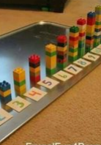
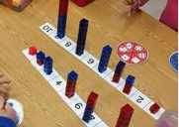
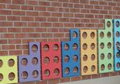

Slide 26
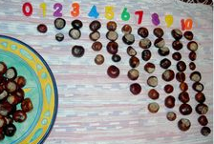
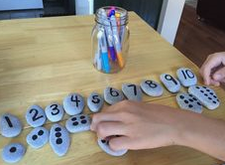
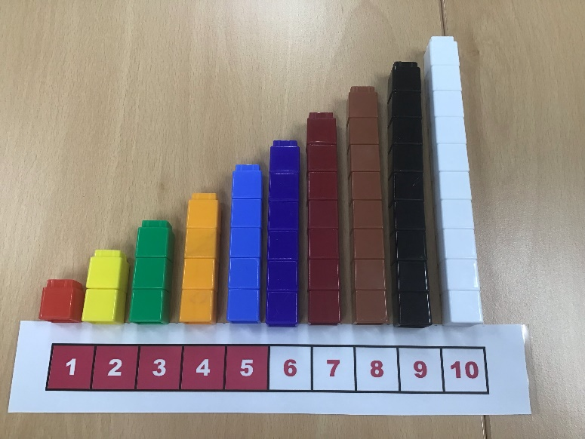

Slide 27
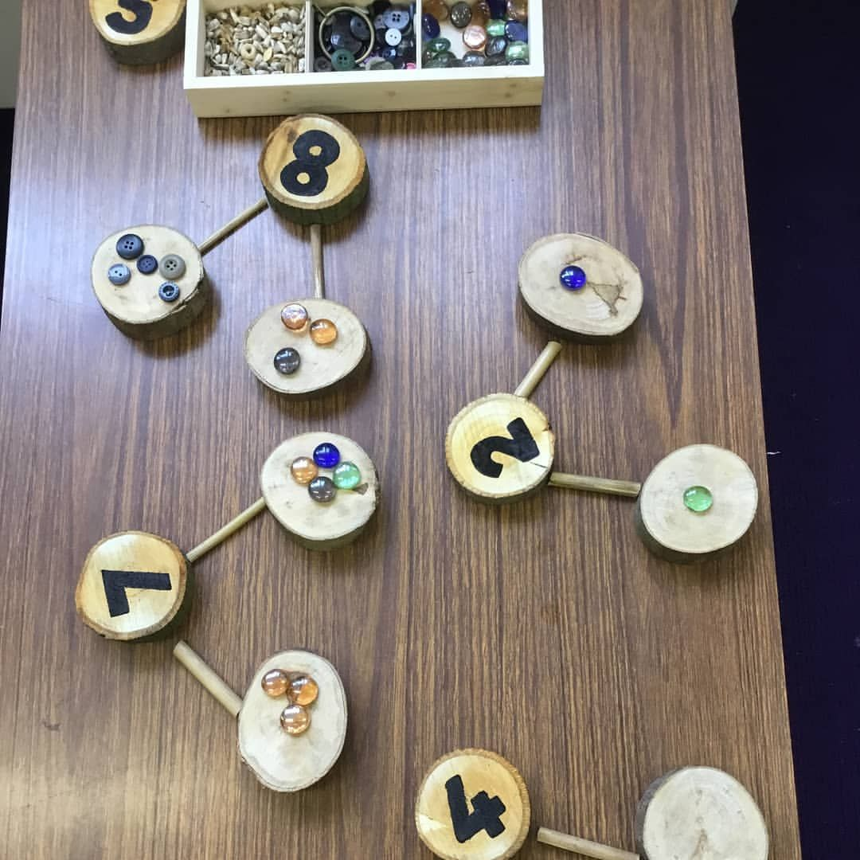
Partitioning

Slide 28
Partitioning readiness:
Children are ready to partition within 5 when they:
can count sets within 5
can recognise numerals to 5
have conservation of number to 5
Notes:
Model and discuss conservation of number.

Slide 29
Early Level Tracker 1
Estimation & Rounding |  | Knows they can check estimates by counting within 0-10 |  |  |  | Can apply subitising skills to estimate the number of items in a set |  |  |  |  | Uses the language of estimation, including more than, less than, fewer than and the same
Awareness of Number – Counting, Quantities & Number Structure | No. word sequences | Say short forward and backward number word sequences within 0-10 |  |  |  | Uses ordinal numbers in real life contexts e.g. I am first/second/third in the line’ |  |  |  |  | Recalls the number sequence forwards and backwards within 0-10
 | Numerals | Recognise numerals e.g. points to the number from 0-10 |  | Identify (name) numerals e.g. can respond to question ‘what is that number?’ from 0-10 |  | Explains zero is represented as 0 |  | Orders numerals forwards and backwards within 0-10 |  |  | Identifies number before, after and missing numbers in a sequence within 0-10; beginning to use the language before, after and in-between
 | Subitising | Identifies ‘how many?’ in regular dot patterns e.g. dot arrangement/on fingers/five frames/10 frames/dice without counting up to 6 |  |  |  | Identifies ‘how many?’ in irregular dot patterns e.g. dot arrangement/on fingers/five frames/10 frames/dice without counting up to 6 |  |  |  |  | Represents amounts in different arrangements e.g.dot arrangement/on fingers/five frames/ 10 frames/dice without counting up to 6
 | Counting | When counting objects understands the order in which we say the numbers is always the same (stable order) |  | Touch counts one item when each number word is said (1-to-1 correspondence) |  | When counting objects understands that the number name of the last object counted is the name given to the total number of objects in a set (cardinal principle) |  | When counting objects understands that the number of objects is not affected by position (order irrelevance) |  |  | Counts objects in a set recognising that the appearance of the objects has no effect on the overall total within 0-10 (conservation) |  | Counts anything e.g. objects at a distance/in a book/sounds/claps within 0-10 (abstract principle)
 | Place Value | Explains that zero means there is none of a particular quantity |  |  |  |  |  | Partitions quantities to 10 into 2 or more parts and recognises that this does not affect the total e.g. 6 as 3 and 3/2 and 2 and 2
Addition and Subtraction |  | Sorts & classifies objects using quantity as an attribute e.g. sets of 1, 2 within 0-10 | Compares 2 sets to decide which has the fewest/most within 0-10 |  | Finds the total when 1,2 or 3 is added to an existing amount e.g. a number line or height chart (augmentation) |  | Finds the total when 2 sets are added together within 0-10 (aggregation) |  | Finds out how many are left when 1 or 2 are taken away within 0-10 |  |  | Compares to find the difference between sets as a quantity within 0-10 | Beginning to count on and back in ones to add and subtract with objects or number line within 0-10
Multiplication and Division |  | Shares out a group of items into 2 equal sets within 0-10. Groups objects into matching or natural sets of 2 e.g. shoes within 0-10 |  |  |  |  |  | Begin to identify halves and doubles using concrete materials within 0-10
Fractions, Decimals and % |  | Identifies wholes and halves in a social context and uses appropriate language e.g. ‘I have eaten half of my banana’ |  |  |  | Splits a whole into smaller parts and explains that equal parts are the same size |  |  |  | Understands that a whole can be shared equally and unequally
Notes:
Highlight where this is evident in the tracker

Slide 30
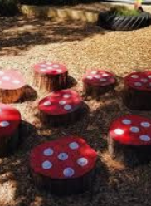
Subitising and Partitioning
How can being a super subitiser help me with partitioning?
Notes:
How do you see?
What do you see?
Progressing to splitting dots up eg 5 and two dots is 7 conceptual subitising (partitioning)

Slide 31
Partitioning
Partitioning offers the opportunity to talk about the changes involved in addition and subtraction
Subtraction - Taking away from the whole
Addition - Recombining the whole
  At this stage the formal words (addition, subtraction, equals) and especially the symbols ( = - + )are not important
Notes:
Activity with cakes and counters

Slide 32
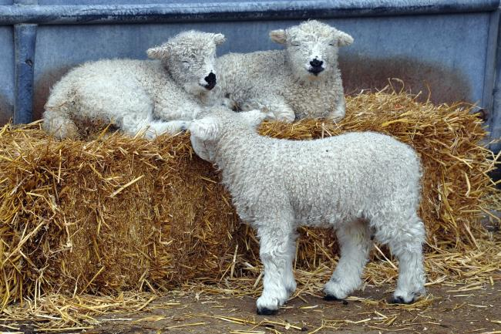
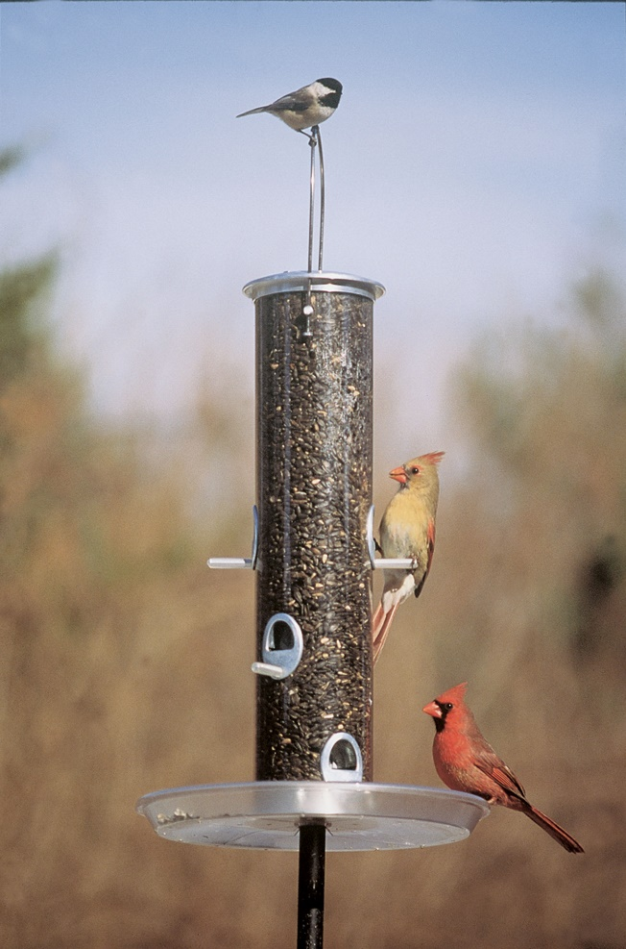
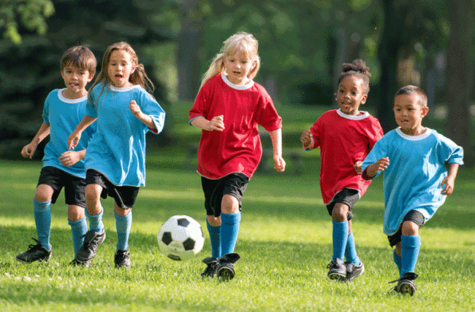
Partitioning
Notes:
Partitioning through interactions:
3 Lambs- two on the hay, 1 on the ground
5 footballers, 3 in blue and 2 in red
3 birds, 1 on the handle and 2 on the feeder

Slide 33
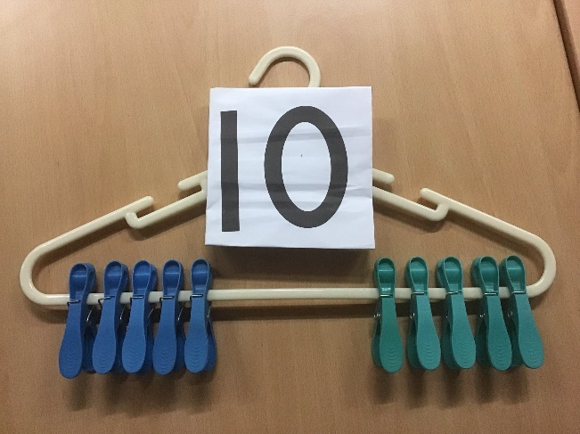
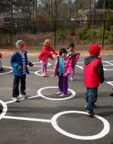
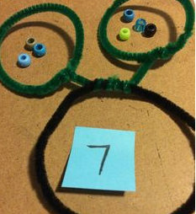
Part Part Whole Modelling

Slide 34
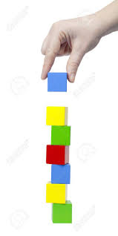
Early addition - Augmentation
There are 6 blocks.
Let’s add 1 more
Notes:
Augmentation – the action or process of making or becoming greater in size or amount
Need ‘real world’ experience of both
Are we using number tracks in nursery? How? What context?

Slide 35
Early Level Tracker 1
Estimation & Rounding |  | Knows they can check estimates by counting within 0-10 |  |  |  | Can apply subitising skills to estimate the number of items in a set |  |  |  |  | Uses the language of estimation, including more than, less than, fewer than and the same
Awareness of Number – Counting, Quantities & Number Structure | No. word sequences | Say short forward and backward number word sequences within 0-10 |  |  |  | Uses ordinal numbers in real life contexts e.g. I am first/second/third in the line’ |  |  |  |  | Recalls the number sequence forwards and backwards within 0-10
 | Numerals | Recognise numerals e.g. points to the number from 0-10 |  | Identify (name) numerals e.g. can respond to question ‘what is that number?’ from 0-10 |  | Explains zero is represented as 0 |  | Orders numerals forwards and backwards within 0-10 |  |  | Identifies number before, after and missing numbers in a sequence within 0-10; beginning to use the language before, after and in-between
 | Subitising | Identifies ‘how many?’ in regular dot patterns e.g. dot arrangement/on fingers/five frames/10 frames/dice without counting up to 6 |  |  |  | Identifies ‘how many?’ in irregular dot patterns e.g. dot arrangement/on fingers/five frames/10 frames/dice without counting up to 6 |  |  |  |  | Represents amounts in different arrangements e.g.dot arrangement/on fingers/five frames/ 10 frames/dice without counting up to 6
 | Counting | When counting objects understands the order in which we say the numbers is always the same (stable order) |  | Touch counts one item when each number word is said (1-to-1 correspondence) |  | When counting objects understands that the number name of the last object counted is the name given to the total number of objects in a set (cardinal principle) |  | When counting objects understands that the number of objects is not affected by position (order irrelevance) |  |  | Counts objects in a set recognising that the appearance of the objects has no effect on the overall total within 0-10 (conservation) |  | Counts anything e.g. objects at a distance/in a book/sounds/claps within 0-10 (abstract principle)
 | Place Value | Explains that zero means there is none of a particular quantity |  |  |  |  |  | Partitions quantities to 10 into 2 or more parts and recognises that this does not affect the total e.g. 6 as 3 and 3/2 and 2 and 2
Addition and Subtraction |  | Sorts & classifies objects using quantity as an attribute e.g. sets of 1, 2 within 0-10 | Compares 2 sets to decide which has the fewest/most within 0-10 |  | Finds the total when 1,2 or 3 is added to an existing amount e.g. a number line or height chart (augmentation) |  | Finds the total when 2 sets are added together within 0-10 (aggregation) |  | Finds out how many are left when 1 or 2 are taken away within 0-10 |  |  | Compares to find the difference between sets as a quantity within 0-10 | Beginning to count on and back in ones to add and subtract with objects or number line within 0-10
Multiplication and Division |  | Shares out a group of items into 2 equal sets within 0-10. Groups objects into matching or natural sets of 2 e.g. shoes within 0-10 |  |  |  |  |  | Begin to identify halves and doubles using concrete materials within 0-10
Fractions, Decimals and % |  | Identifies wholes and halves in a social context and uses appropriate language e.g. ‘I have eaten half of my banana’ |  |  |  | Splits a whole into smaller parts and explains that equal parts are the same size |  |  |  | Understands that a whole can be shared equally and unequally
Notes:
Highlight where this is evident in the tracker

Slide 36

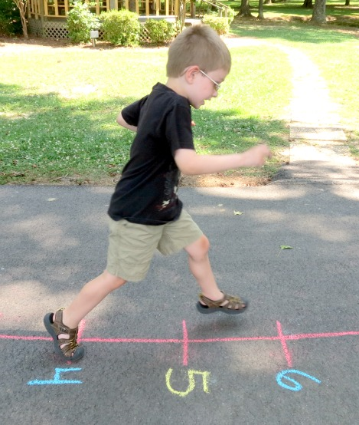
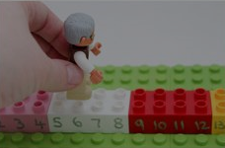
Early addition - Augmentation
  Increasing the amount of a set.
  Relies on cardinality.
  Counting on from a set number.
Notes:
Augmentation – the action or process of making or becoming greater in size or amount
Need ‘real world’ experience of both
Are we using number tracks in nursery? How? What context?

Slide 37
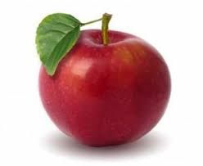

Early addition - Aggregation
  Bringing together or combining sets of objects
Notes:
Very physical for the children.
What key questions could we be asking the children?
Lets put these sets together, how many do you have now???

Slide 38
Early Level Tracker 1
Estimation & Rounding |  | Knows they can check estimates by counting within 0-10 |  |  |  | Can apply subitising skills to estimate the number of items in a set |  |  |  |  | Uses the language of estimation, including more than, less than, fewer than and the same
Awareness of Number – Counting, Quantities & Number Structure | No. word sequences | Say short forward and backward number word sequences within 0-10 |  |  |  | Uses ordinal numbers in real life contexts e.g. I am first/second/third in the line’ |  |  |  |  | Recalls the number sequence forwards and backwards within 0-10
 | Numerals | Recognise numerals e.g. points to the number from 0-10 |  | Identify (name) numerals e.g. can respond to question ‘what is that number?’ from 0-10 |  | Explains zero is represented as 0 |  | Orders numerals forwards and backwards within 0-10 |  |  | Identifies number before, after and missing numbers in a sequence within 0-10; beginning to use the language before, after and in-between
 | Subitising | Identifies ‘how many?’ in regular dot patterns e.g. dot arrangement/on fingers/five frames/10 frames/dice without counting up to 6 |  |  |  | Identifies ‘how many?’ in irregular dot patterns e.g. dot arrangement/on fingers/five frames/10 frames/dice without counting up to 6 |  |  |  |  | Represents amounts in different arrangements e.g.dot arrangement/on fingers/five frames/ 10 frames/dice without counting up to 6
 | Counting | When counting objects understands the order in which we say the numbers is always the same (stable order) |  | Touch counts one item when each number word is said (1-to-1 correspondence) |  | When counting objects understands that the number name of the last object counted is the name given to the total number of objects in a set (cardinal principle) |  | When counting objects understands that the number of objects is not affected by position (order irrelevance) |  |  | Counts objects in a set recognising that the appearance of the objects has no effect on the overall total within 0-10 (conservation) |  | Counts anything e.g. objects at a distance/in a book/sounds/claps within 0-10 (abstract principle)
 | Place Value | Explains that zero means there is none of a particular quantity |  |  |  |  |  | Partitions quantities to 10 into 2 or more parts and recognises that this does not affect the total e.g. 6 as 3 and 3/2 and 2 and 2
Addition and Subtraction |  | Sorts & classifies objects using quantity as an attribute e.g. sets of 1, 2 within 0-10 | Compares 2 sets to decide which has the fewest/most within 0-10 |  | Finds the total when 1,2 or 3 is added to an existing amount e.g. a number line or height chart (augmentation) |  | Finds the total when 2 sets are added together within 0-10 (aggregation) |  | Finds out how many are left when 1 or 2 are taken away within 0-10 |  |  | Compares to find the difference between sets as a quantity within 0-10 | Beginning to count on and back in ones to add and subtract with objects or number line within 0-10
Multiplication and Division |  | Shares out a group of items into 2 equal sets within 0-10. Groups objects into matching or natural sets of 2 e.g. shoes within 0-10 |  |  |  |  |  | Begin to identify halves and doubles using concrete materials within 0-10
Fractions, Decimals and % |  | Identifies wholes and halves in a social context and uses appropriate language e.g. ‘I have eaten half of my banana’ |  |  |  | Splits a whole into smaller parts and explains that equal parts are the same size |  |  |  | Understands that a whole can be shared equally and unequally
Notes:
Highlight where this is evident in the tracker

Slide 39
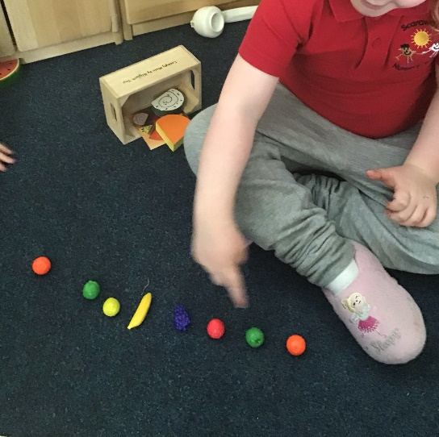
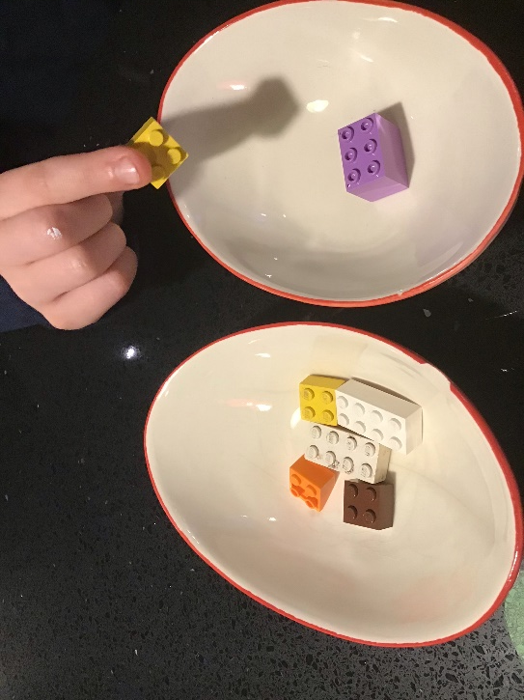
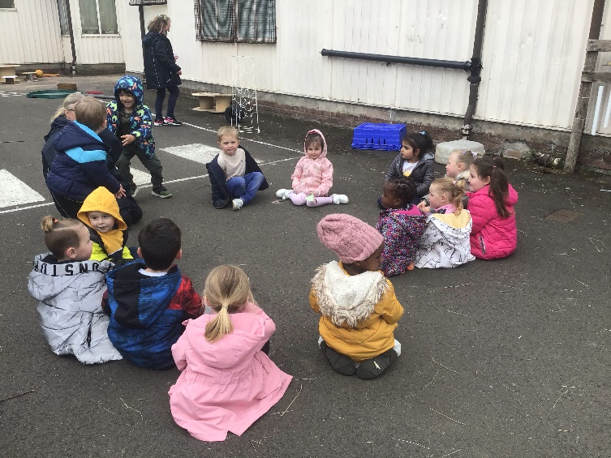
Aggregation
Look for real life opportunities to bring groups of objects (and people) together.

Slide 40
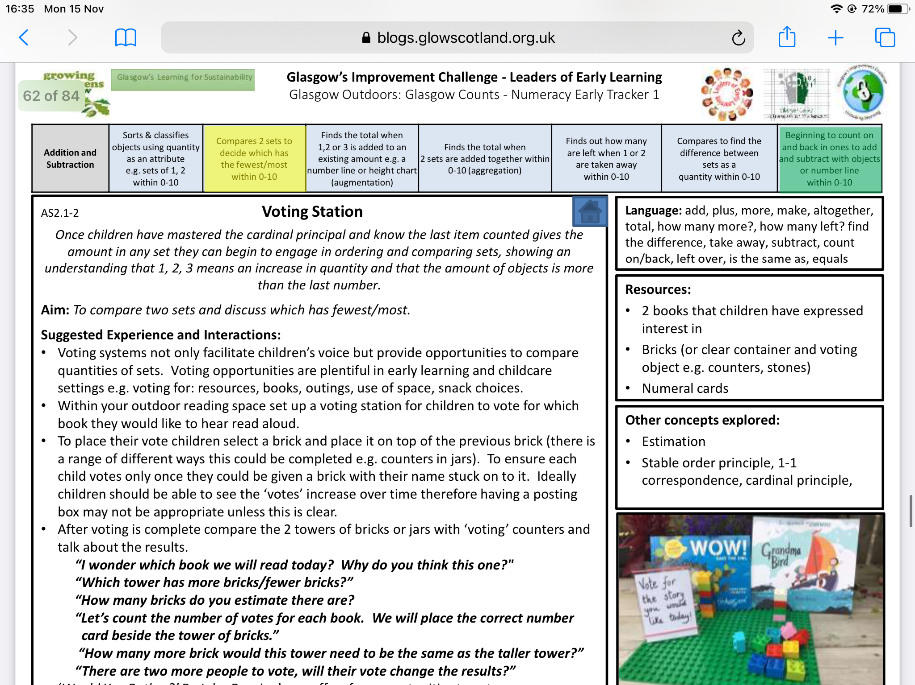

Slide 41
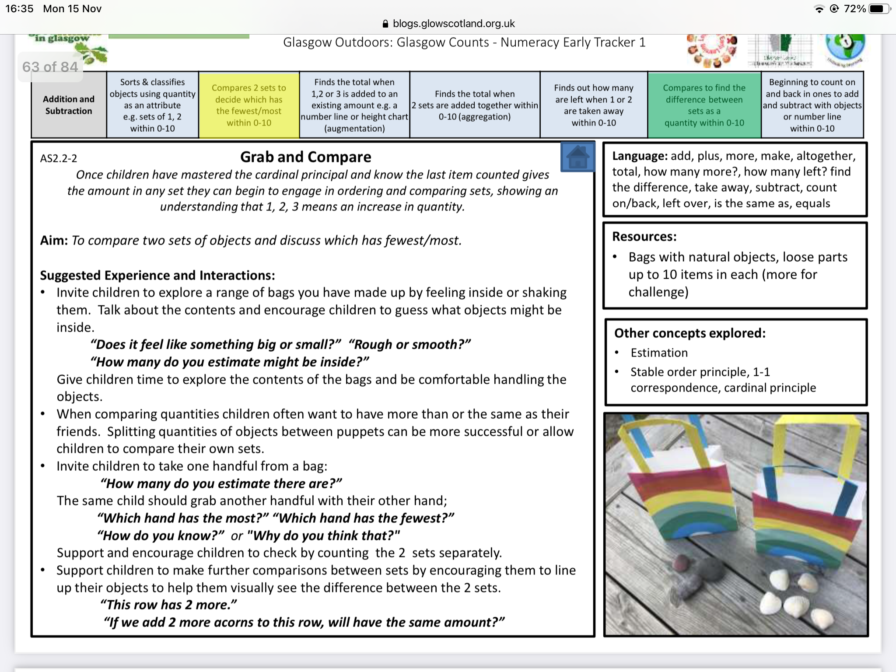

Slide 42


Slide 43


Slide 44


Slide 45
Addition and Subtraction: Early Level
Mathematical Language :
CfE MNU 0-02a
MNU0-03a “”
add, more, make, altogether, total, how many more? How many left?, find the difference, take away, subtract, leave, count on, count back, number sentence, plus, sum, left over, is the same as, equal to.
Strategies and Approaches
Once children have mastered the cardinal principle and know the last item counted gives the amount in any set, they can begin engage in ordering sets showing an understanding that 1,2,3 or 3,2,1 means an increase or decrease in quantity. They can begin to engage in early addition and subtraction as a concrete activity by exploring:
Early Addition
ways a set can be broken into smaller sets e.g. 6 can be 4 and 2 - partitioning
adding to an existing amount to find a new total – augmentation
combining two sets together to find a new total – aggregation
Early Subtraction
two sets to think about which has most/fewest - comparison
two sets to think about which has more items as a quantity – find the difference
taking away items from a set and find a new total – take away
Small World: children may be working with farm animals as sets. Sheep or cows may arrive in the field or leave the field so this gives the possibility of working out a new total. Children might work out how many animals are on the farm altogether by aggregating 2 or more sets together
Board games: games that involve building up a set of items lend themselves to discussion about how many is their set, how many they have now, who has most/fewest.
Outdoors: children might add to existing sets of conkers, twigs, leaves. They may compare their sets with a friend to work out who has fewest and by how many. They might be building and decide they need more or fewer bricks. They can compare against their own prediction. They might be monitoring the bird feeder for different types of bird and compare the amounts of each type within the day and over time. They might start to think about this in terms of why certain birds come is it certain food that they like? Children have to see early number processes as purposeful and meaningful for them.
Questions to Enable Higher Order Thinking Skills
What would happen if 2 more cows came into the field? How many would there be?
How many grapes do you have on your plate? How many will you have when you eat one?
Who has the fewest grapes left on their plate?
Can you show me different ways to make 6 with your fingers? What if you added one more finger – how many would you have then?
The birds have all left the bird feeder – how many are there now? How many starlings do you think will come tomorrow?
Which is the most popular fruit for snack? How many more like apples than grapes?
If I take away 2 cartons of milk how many will we have? Will we have enough for everyone?
If all the people in these 2 cars got on the bus, how many people would be on the bus?
How many different ways can you show me 6 using these items in the circles?
Barriers to Learning and Misconceptions
Not fully confident in number recognition and counting.
Children will require modelling to build their organizational skills e.g. working in rows, combining sets carefully
Unclear language e.g. a few more, a lot less
Children may be asked to state ‘the most’ very frequently; they need to also be asked about ‘the fewest’ to build understanding.
Children need to have meaningful ways to work with sets or they will not have a motivation to work things out.
On Track at Transition Statement
Beginning to compare and find the difference between sets as a quantity within 0-10
Beginning to count on and back in ones to add and subtract with objects or number line within 0-10
Digital Learning:
Resources

Slide 46

Concrete, real life examples!
At this stage the formal words (addition, subtraction, equals) and especially the symbols ( = - + )are not important.
Children might be aware of these symbols but there should not be the expectation that they use them.

Slide 47


Slide 48
Aims
To increase our knowledge and understanding of the 4 operations: + - x ÷
To explore social fractions
To develop our understanding of mathematical mark making.

Slide 49

Problem Solving
Notes:
This is not a separate aim as it should not be thought of as separate. Problem Solving is at the heart of early mathematics and a development of mathematical skills enhances children's problem solving capabilities.

Slide 50
Early Level Tracker 1
Estimation & Rounding |  | Knows they can check estimates by counting within 0-10 |  |  |  | Can apply subitising skills to estimate the number of items in a set |  |  |  |  | Uses the language of estimation, including more than, less than, fewer than and the same
Awareness of Number – Counting, Quantities & Number Structure | No. word sequences | Say short forward and backward number word sequences within 0-10 |  |  |  | Uses ordinal numbers in real life contexts e.g. I am first/second/third in the line’ |  |  |  |  | Recalls the number sequence forwards and backwards within 0-10
 | Numerals | Recognise numerals e.g. points to the number from 0-10 |  | Identify (name) numerals e.g. can respond to question ‘what is that number?’ from 0-10 |  | Explains zero is represented as 0 |  | Orders numerals forwards and backwards within 0-10 |  |  | Identifies number before, after and missing numbers in a sequence within 0-10; beginning to use the language before, after and in-between
 | Subitising | Identifies ‘how many?’ in regular dot patterns e.g. dot arrangement/on fingers/five frames/10 frames/dice without counting up to 6 |  |  |  | Identifies ‘how many?’ in irregular dot patterns e.g. dot arrangement/on fingers/five frames/10 frames/dice without counting up to 6 |  |  |  |  | Represents amounts in different arrangements e.g.dot arrangement/on fingers/five frames/ 10 frames/dice without counting up to 6
 | Counting | When counting objects understands the order in which we say the numbers is always the same (stable order) |  | Touch counts one item when each number word is said (1-to-1 correspondence) |  | When counting objects understands that the number name of the last object counted is the name given to the total number of objects in a set (cardinal principle) |  | When counting objects understands that the number of objects is not affected by position (order irrelevance) |  |  | Counts objects in a set recognising that the appearance of the objects has no effect on the overall total within 0-10 (conservation) |  | Counts anything e.g. objects at a distance/in a book/sounds/claps within 0-10 (abstract principle)
 | Place Value | Explains that zero means there is none of a particular quantity |  |  |  |  |  | Partitions quantities to 10 into 2 or more parts and recognises that this does not affect the total e.g. 6 as 3 and 3/2 and 2 and 2
Addition and Subtraction |  | Sorts & classifies objects using quantity as an attribute e.g. sets of 1, 2 within 0-10 | Compares 2 sets to decide which has the fewest/most within 0-10 |  | Finds the total when 1,2 or 3 is added to an existing amount e.g. a number line or height chart (augmentation) |  | Finds the total when 2 sets are added together within 0-10 (aggregation) |  | Finds out how many are left when 1 or 2 are taken away within 0-10 |  |  | Compares to find the difference between sets as a quantity within 0-10 | Beginning to count on and back in ones to add and subtract with objects or number line within 0-10
Multiplication and Division |  | Shares out a group of items into 2 equal sets within 0-10. Groups objects into matching or natural sets of 2 e.g. shoes within 0-10 |  |  |  |  |  | Begin to identify halves and doubles using concrete materials within 0-10
Fractions, Decimals and % |  | Identifies wholes and halves in a social context and uses appropriate language e.g. ‘I have eaten half of my banana’ |  |  |  | Splits a whole into smaller parts and explains that equal parts are the same size |  |  |  | Understands that a whole can be shared equally and unequally

Slide 51

The CPA Approach
What is the CPA approach:
CPA stands for concrete, pictorial, abstract. This approach to teaching maths is based on the work of Jerome Bruner in 1980. Children’s conceptual understanding of a skill will develop from being actively engaged in their learning progressing through these three stages.

Slide 52
Early Addition and Subtraction

Slide 53


Slide 54









Resources – Addition and Subtraction
Common Learning Resources
Online Resources
Five and Ten Frames
Board games
Height charts and
number lines
Stories
The Country Bunny and the Little Gold Shoes by Rick Walton
The Crayon Counting Book by Pam Munoz Ryan and Jerry Pallotta
Fat Frogs On a Skinny Log by Sara Riches
The Icky Bug Counting Book by Jerry Pallotta
Ten Terrible Dinosaurs by Paul Stickland
Ten Sly Piranhas by William Wise
Five Little Ducks by Pam Paparone
Construction Countdown by K.C. Olsen
The Very Hungry Caterpillar by Eric Carle
Five little monkeys go shopping by Eileen Christelow
Ten Little Beasties by Rebecca Emberley
Wibbly Pig has 10 balloons by Mick Inkpen
One less fish by Kim Michelle Toft
Magic Numbers by Patrick George
Sets to bring together
Sets of manmade and
natural objects
to add to and
take away from

Slide 55





Early Addition
Aggregation - Bringing 2 sets together
Augmentation – Adding more to an existing amount
You have increased from number 5 to number 7 on the height chart.
Early Subtraction
Finding the difference
Reduction - Take away

Slide 56
Early addition - Augmentation
  Increasing the amount of a set.
  Relies on cardinality.
  Counting on from a set number.

Slide 57
Early addition - Aggregation
  Bringing together or combining sets of objects

Slide 58
Early subtraction
Take away
  Common understanding of early subtraction as ‘take away’
  Easy to model by physically taking away objects from a set
  Counting back

Slide 59
Early subtraction
Finding the difference
  Subtraction is also used to find the difference between two numbers or sets of objects
  The two sets are compared to find the difference; nothing is taken away
  Key aspect is introducing the children to the language – ‘finding the difference’
  Links to comparison of sets
Notes:
Comparison is crucial. Food, block towers, lego etc

Slide 60
Early addition/subtraction
What materials would be helpful for children to build an understanding of addition/subtraction?
Measuring tape
Height Chart
Number line/number track
Sets of objects
5 frame/10 frame
Part, part, whole models

Slide 61


Early addition
Addition and Subtraction | Sorts & classifies objects using quantity as an attribute e.g. sets of 1, 2 within 0-10 | Compares 2 sets to decide which has the fewest/most within 0-10 | Finds the total when 1,2 or 3 is added to an existing amount e.g. a number line or height chart (augmentation) | Finds the total when 2 sets are added together within 0-10 (aggregation) | Finds out how many are left when 1 or 2 are taken away within 0-10 | Compares to find the difference between sets as a quantity within 0-10 | Beginning to count on and back in ones to add and subtract with objects or number line within 0-10

Slide 62




Early addition
Addition and Subtraction | Sorts & classifies objects using quantity as an attribute e.g. sets of 1, 2 within 0-10 | Compares 2 sets to decide which has the fewest/most within 0-10 | Finds the total when 1,2 or 3 is added to an existing amount e.g. a number line or height chart (augmentation) | Finds the total when 2 sets are added together within 0-10 (aggregation) | Finds out how many are left when 1 or 2 are taken away within 0-10 | Compares to find the difference between sets as a quantity within 0-10 | Beginning to count on and back in ones to add and subtract with objects or number line within 0-10

Slide 63


Slide 64


Early addition
Addition and Subtraction | Sorts & classifies objects using quantity as an attribute e.g. sets of 1, 2 within 0-10 | Compares 2 sets to decide which has the fewest/most within 0-10 | Finds the total when 1,2 or 3 is added to an existing amount e.g. a number line or height chart (augmentation) | Finds the total when 2 sets are added together within 0-10 (aggregation) | Finds out how many are left when 1 or 2 are taken away within 0-10 | Compares to find the difference between sets as a quantity within 0-10 | Beginning to count on and back in ones to add and subtract with objects or number line within 0-10

Slide 65


Slide 66




Early addition/subtraction
Addition and Subtraction | Sorts & classifies objects using quantity as an attribute e.g. sets of 1, 2 within 0-10 | Compares 2 sets to decide which has the fewest/most within 0-10 | Finds the total when 1,2 or 3 is added to an existing amount e.g. a number line or height chart (augmentation) | Finds the total when 2 sets are added together within 0-10 (aggregation) | Finds out how many are left when 1 or 2 are taken away within 0-10 | Compares to find the difference between sets as a quantity within 0-10 | Beginning to count on and back in ones to add and subtract with objects or number line within 0-10
First
Then
Now
3
1
4

Slide 67

Early addition/subtraction
Addition and Subtraction | Sorts & classifies objects using quantity as an attribute e.g. sets of 1, 2 within 0-10 | Compares 2 sets to decide which has the fewest/most within 0-10 | Finds the total when 1,2 or 3 is added to an existing amount e.g. a number line or height chart (augmentation) | Finds the total when 2 sets are added together within 0-10 (aggregation) | Finds out how many are left when 1 or 2 are taken away within 0-10 | Compares to find the difference between sets as a quantity within 0-10 | Beginning to count on and back in ones to add and subtract with objects or number line within 0-10
First
Then
Now
5
2
3

Slide 68


Early addition/subtraction
Addition and Subtraction | Sorts & classifies objects using quantity as an attribute e.g. sets of 1, 2 within 0-10 | Compares 2 sets to decide which has the fewest/most within 0-10 | Finds the total when 1,2 or 3 is added to an existing amount e.g. a number line or height chart (augmentation) | Finds the total when 2 sets are added together within 0-10 (aggregation) | Finds out how many are left when 1 or 2 are taken away within 0-10 | Compares to find the difference between sets as a quantity within 0-10 | Beginning to count on and back in ones to add and subtract with objects or number line within 0-10
First
Then
Now
3
2
5

Slide 69


Early addition/subtraction
Addition and Subtraction | Sorts & classifies objects using quantity as an attribute e.g. sets of 1, 2 within 0-10 | Compares 2 sets to decide which has the fewest/most within 0-10 | Finds the total when 1,2 or 3 is added to an existing amount e.g. a number line or height chart (augmentation) | Finds the total when 2 sets are added together within 0-10 (aggregation) | Finds out how many are left when 1 or 2 are taken away within 0-10 | Compares to find the difference between sets as a quantity within 0-10 | Beginning to count on and back in ones to add and subtract with objects or number line within 0-10
First
Then
Now
3
2
5
First
Then
Now
5
2
3

Slide 70
Early addition/subtraction
Addition and Subtraction | Sorts & classifies objects using quantity as an attribute e.g. sets of 1, 2 within 0-10 | Compares 2 sets to decide which has the fewest/most within 0-10 | Finds the total when 1,2 or 3 is added to an existing amount e.g. a number line or height chart (augmentation) | Finds the total when 2 sets are added together within 0-10 (aggregation) | Finds out how many are left when 1 or 2 are taken away within 0-10 | Compares to find the difference between sets as a quantity within 0-10 | Beginning to count on and back in ones to add and subtract with objects or number line within 0-10
First
Then
Now
4
2
6

Slide 71
Early addition/subtraction
Addition and Subtraction | Sorts & classifies objects using quantity as an attribute e.g. sets of 1, 2 within 0-10 | Compares 2 sets to decide which has the fewest/most within 0-10 | Finds the total when 1,2 or 3 is added to an existing amount e.g. a number line or height chart (augmentation) | Finds the total when 2 sets are added together within 0-10 (aggregation) | Finds out how many are left when 1 or 2 are taken away within 0-10 | Compares to find the difference between sets as a quantity within 0-10 | Beginning to count on and back in ones to add and subtract with objects or number line within 0-10
First
Then
Now
6
2
4

Slide 72


Slide 73


Slide 74


Slide 75

Early addition/subtraction
Addition and Subtraction | Sorts & classifies objects using quantity as an attribute e.g. sets of 1, 2 within 0-10 | Compares 2 sets to decide which has the fewest/most within 0-10 | Finds the total when 1,2 or 3 is added to an existing amount e.g. a number line or height chart (augmentation) | Finds the total when 2 sets are added together within 0-10 (aggregation) | Finds out how many are left when 1 or 2 are taken away within 0-10 | Compares to find the difference between sets as a quantity within 0-10 | Beginning to count on and back in ones to add and subtract with objects or number line within 0-10
4
3
7

Slide 76
Early addition/subtraction
Addition and Subtraction | Sorts & classifies objects using quantity as an attribute e.g. sets of 1, 2 within 0-10 | Compares 2 sets to decide which has the fewest/most within 0-10 | Finds the total when 1,2 or 3 is added to an existing amount e.g. a number line or height chart (augmentation) | Finds the total when 2 sets are added together within 0-10 (aggregation) | Finds out how many are left when 1 or 2 are taken away within 0-10 | Compares to find the difference between sets as a quantity within 0-10 | Beginning to count on and back in ones to add and subtract with objects or number line within 0-10
4
7
3

Slide 77


Early addition/subtraction
Addition and Subtraction | Sorts & classifies objects using quantity as an attribute e.g. sets of 1, 2 within 0-10 | Compares 2 sets to decide which has the fewest/most within 0-10 | Finds the total when 1,2 or 3 is added to an existing amount e.g. a number line or height chart (augmentation) | Finds the total when 2 sets are added together within 0-10 (aggregation) | Finds out how many are left when 1 or 2 are taken away within 0-10 | Compares to find the difference between sets as a quantity within 0-10 | Beginning to count on and back in ones to add and subtract with objects or number line within 0-10
4
3
7

Slide 78


Slide 79


Early addition/subtraction
Addition and Subtraction | Sorts & classifies objects using quantity as an attribute e.g. sets of 1, 2 within 0-10 | Compares 2 sets to decide which has the fewest/most within 0-10 | Finds the total when 1,2 or 3 is added to an existing amount e.g. a number line or height chart (augmentation) | Finds the total when 2 sets are added together within 0-10 (aggregation) | Finds out how many are left when 1 or 2 are taken away within 0-10 | Compares to find the difference between sets as a quantity within 0-10 | Beginning to count on and back in ones to add and subtract with objects or number line within 0-10
7
3
4

Slide 80
Early addition/subtraction
Addition and Subtraction | Sorts & classifies objects using quantity as an attribute e.g. sets of 1, 2 within 0-10 | Compares 2 sets to decide which has the fewest/most within 0-10 | Finds the total when 1,2 or 3 is added to an existing amount e.g. a number line or height chart (augmentation) | Finds the total when 2 sets are added together within 0-10 (aggregation) | Finds out how many are left when 1 or 2 are taken away within 0-10 | Compares to find the difference between sets as a quantity within 0-10 | Beginning to count on and back in ones to add and subtract with objects or number line within 0-10
4
3

Slide 81
Early addition/subtraction
Addition and Subtraction | Sorts & classifies objects using quantity as an attribute e.g. sets of 1, 2 within 0-10 | Compares 2 sets to decide which has the fewest/most within 0-10 | Finds the total when 1,2 or 3 is added to an existing amount e.g. a number line or height chart (augmentation) | Finds the total when 2 sets are added together within 0-10 (aggregation) | Finds out how many are left when 1 or 2 are taken away within 0-10 | Compares to find the difference between sets as a quantity within 0-10 | Beginning to count on and back in ones to add and subtract with objects or number line within 0-10
5
8

Slide 82


Slide 83
Early addition/subtraction
Addition and Subtraction | Sorts & classifies objects using quantity as an attribute e.g. sets of 1, 2 within 0-10 | Compares 2 sets to decide which has the fewest/most within 0-10 | Finds the total when 1,2 or 3 is added to an existing amount e.g. a number line or height chart (augmentation) | Finds the total when 2 sets are added together within 0-10 (aggregation) | Finds out how many are left when 1 or 2 are taken away within 0-10 | Compares to find the difference between sets as a quantity within 0-10 | Beginning to count on and back in ones to add and subtract with objects or number line within 0-10
0
1
2
3
4
5
6

Slide 84

Early addition/subtraction
Addition and Subtraction | Sorts & classifies objects using quantity as an attribute e.g. sets of 1, 2 within 0-10 | Compares 2 sets to decide which has the fewest/most within 0-10 | Finds the total when 1,2 or 3 is added to an existing amount e.g. a number line or height chart (augmentation) | Finds the total when 2 sets are added together within 0-10 (aggregation) | Finds out how many are left when 1 or 2 are taken away within 0-10 | Compares to find the difference between sets as a quantity within 0-10 | Beginning to count on and back in ones to add and subtract with objects or number line within 0-10

Slide 85
Early addition/subtraction
Addition and Subtraction | Sorts & classifies objects using quantity as an attribute e.g. sets of 1, 2 within 0-10 | Compares 2 sets to decide which has the fewest/most within 0-10 | Finds the total when 1,2 or 3 is added to an existing amount e.g. a number line or height chart (augmentation) | Finds the total when 2 sets are added together within 0-10 (aggregation) | Finds out how many are left when 1 or 2 are taken away within 0-10 | Compares to find the difference between sets as a quantity within 0-10 | Beginning to count on and back in ones to add and subtract with objects or number line within 0-10

Slide 86
Early addition/subtraction
Addition and Subtraction | Sorts & classifies objects using quantity as an attribute e.g. sets of 1, 2 within 0-10 | Compares 2 sets to decide which has the fewest/most within 0-10 | Finds the total when 1,2 or 3 is added to an existing amount e.g. a number line or height chart (augmentation) | Finds the total when 2 sets are added together within 0-10 (aggregation) | Finds out how many are left when 1 or 2 are taken away within 0-10 | Compares to find the difference between sets as a quantity within 0-10 | Beginning to count on and back in ones to add and subtract with objects or number line within 0-10
0
1
2
3
4
5
6
7
8
9
10

Slide 87


Slide 88


Slide 89


Slide 90
Early Multiplication and Division

Slide 91
Early Multiplication and Division
What opportunities have you engaged children with to either share or group items?
What aspects of your environment allow children to explore sharing or grouping items?

Slide 92
Multiplication and Division: Early Level
Mathematical Language :
CfE MNU 0-02a
MNU0-03a “”
Share(s), group(s), pairs, twos, threes, fours, etc. odd, even, array.
Strategies and Approaches
Once children have mastered the cardinal principle and know the last item counted gives the amount in any set, they can begin to engage in early division as a concrete activity by exploring sharing and grouping. Children can observe halves and doubles naturally as part of the sharing and grouping process. Early multiplication may also be explored as skip counting e.g. I say number 1 quietly, number 2 loudly, number 3 quietly, number 4 loudly etc.
Sharing - dividing a set between 2 or more people
strawberries, grapes or tangerine pieces at snack time
toys equally with a partner
cookies equally between 2 teddies
playing cards
playdoh
Grouping - creating groups of items from a bigger existing set
Pairs of shoes
Pairs of socks – have a box of socks, washing line and pegs
Finding matching items e.g. ties
Grouping colours together from a bag of sweets
Putting animals into 2s or 3s
Lining up in 2s or 3s
Playing games outside where we get into groups of 2, 3, 4
Grouping objects found e.g. conkers into groups of 3
Questions to Enable Higher Order Thinking Skills
How many groups of strawberries can you make?
How can you share these between you and Katie?
How many plates are there? How many cookies are there on each plate?
Here is some fruit. Can you sort the fruit for me? What can you tell me about the number of each type of fruit?
Can you share out these crayons with your partner. How many do you have each?
Can you share these cookies between the teddies? How many cookies do they get each?
Lets line up with a partner.
Can you find all the matching socks in the box?
Barriers to Learning and Misconceptions
It is essential that children are given sufficient thinking time and time to reflect.
Learners might distribute one item to each group in turn. Alternatively they might use a less systematic sharing strategy, for example, distributing more than one item at a time, to one or more groups.
Pay close attention to what the child says and does in order to determine the strategy used. Learners may have to count the number in each group from one or be able to subitise. It is important that children can identify that each group has the same number.
On Track at Transition Statement
Shares out a group of items into 2 equal sets within 0-10.
Groups objects into matching or natural sets of 2 e.g. shoes within 0-10
Begin to identify halves and doubles using concrete materials within 0-10
Digital Learning:
Resources

Slide 93



Grouping
Grouping
“Can we line up in lines of 2…3….4?”
Grouping
“15 biscuits are to be put into 3 packets. How many will there be in each packet?”
Grouping
“How many groups of 2 or pairs can we make from this pile of wellies

Slide 94




Sharing
Sharing
“We have 6 bananas how can we share them equally between 2 monkeys?”
Sharing
“We can give the monkeys 3 bananas each - this way it is fair and they have the same to eat”

Slide 95






Resources – Multiplication and Division
Common Learning Resources
Online Resources
Snack/lunch time food that
can be grouped and shared
Box of socks and
a washing line for sorting
Everyday objects that can
be sorted into groups
Stories
The Doorbell Rang by Pat Hutchins
Equal Shmequal by Virginia Croll
A Fair Bear Share by Stuart J Murphy
One Hundred Angry Ants By Elinor J Pinczes
One Thing by Lauren Child
Each Orange had 8 Slices by Paul Giganti
Where’s The Pair? by Britta Teckentrup
Toys that can be
grouped and shared
e.g. animals

Slide 96
Early Multiplication and Division
Sharing
  Sharing a set out so each have smaller amounts
  Sharing can be equal and unequal
  There may be a social reason to be unequal
  Children will be quite interested in equal shares
  Links to partitioning of a set

Slide 97
Early Multiplication and Division
Grouping or repeated subtraction
  Less common in early years than sharing as there are fewer natural opportunities
  Wellies, socks, games in groups of 2 or 3
  10 fat sausages; one goes pop and one goes bang
  Links to partitioning of a set and ordering

Slide 98
Early Multiplication and Division
Multiplication and Division | Shares out a group of items into 2 equal sets within 0-10. Groups objects into matching or natural sets of 2 e.g. shoes within 0-10 | Begin to identify halves and doubles using concrete materials within 0-10
3
3

Slide 99

Early Multiplication and Division
Multiplication and Division | Shares out a group of items into 2 equal sets within 0-10. Groups objects into matching or natural sets of 2 e.g. shoes within 0-10 | Begin to identify halves and doubles using concrete materials within 0-10
4
4

Slide 100

Early Multiplication and Division
Multiplication and Division | Shares out a group of items into 2 equal sets within 0-10. Groups objects into matching or natural sets of 2 e.g. shoes within 0-10 | Begin to identify halves and doubles using concrete materials within 0-10
5
5

Slide 101



Early Multiplication and Division
Multiplication and Division | Shares out a group of items into 2 equal sets within 0-10. Groups objects into matching or natural sets of 2 e.g. shoes within 0-10 | Begin to identify halves and doubles using concrete materials within 0-10

Slide 102
Early Multiplication and Division
Multiplication and Division | Shares out a group of items into 2 equal sets within 0-10. Groups objects into matching or natural sets of 2 e.g. shoes within 0-10 | Begin to identify halves and doubles using concrete materials within 0-10
4
4

Slide 103






Early Multiplication and Division
Multiplication and Division | Shares out a group of items into 2 equal sets within 0-10. Groups objects into matching or natural sets of 2 e.g. shoes within 0-10 | Begin to identify halves and doubles using concrete materials within 0-10

Slide 104
Early Multiplication and Division
Multiplication and Division | Shares out a group of items into 2 equal sets within 0-10. Groups objects into matching or natural sets of 2 e.g. shoes within 0-10 | Begin to identify halves and doubles using concrete materials within 0-10

Slide 105


Slide 106


Slide 107


Slide 108


Slide 109


Early (Social) Fractions

Slide 110
Early Fractions
What opportunities have you engaged children with to recognise fractions?

Slide 111
Fractions, Decimals and % : Early Level
Mathematical Language :
CfE MNU 0-02a
MNU0-03a “”
Half, quarter, share, equally, part, part, whole, amount, shape, object, number, one half, one quarter
Strategies and Approaches
Questions to Enable Higher Order Thinking Skills
Can you cut your sandwich in half?
If we share these grapes between 2 how many will each person get?
Can we cut your cake into 2 equal pieces?
Lets pour in some milk so that the cup is half full
Can you fold your paper in half?
How many pieces do you have if you fold it again?
I wonder how many pieces I will have when I fold it again?
It is only appropriate to work with fractions in social and naturally occurring contexts in early years. Children should explore equal and unequal sharing and what it means to have a ‘fair share’ e.g. my dad might get more sausages than me because he is bigger and needs to eat more food for energy.
Snack time: Children will have opportunities to half whole items e.g. apples, sandwiches, cakes into equal parts. They should observe with the adult that the 2 halves make a whole. Similarly when having water, the jug could be full or half full and allow for discussion. Half full could be marked on the jug for the children to work with. Children should also have opportunities to half a set e.g. grapes, strawberries between themselves and a partner. Snack could therefore be given out to 2 children who must work out how to share it equally between themselves.
Playdough: Children will have opportunities to cut the playdough into halves and share it with others for example making playdoh cakes etc.
Origami: working creatively with paper allows the child to work with halves as they fold and see the ‘whole’ shape. Children should have access to
shapes, card , paper and objects to allow exploration.
Water and sand: when playing, children should be encouraged to notice if containers and jugs are full, half full, empty.
Baking and cooking: filling bowls half way, pouring in half the mixture then the other half, making half the cakes pink and the other half green.
Lacing beads, peg boards: Showing half of the beads, making one half a different colour.
Barriers to Learning
Children do not have a sound understanding of grouping and sharing
Children need to explore many representations and uses over a period of time.
Open up opportunities for pupils to find fractions of objects, shapes and amounts in equal measures.
Children are unsure of what ‘equal’ means
On Track at Transition Statement
Splits a whole into smaller parts and explains that equal parts are the same size
Understands that a whole can be shared equally and unequally
Digital Learning:
Resources

Slide 112






Resources – Fractions, Decimals and %
Common Learning Resources
Online Resources
A variety of shaped paper including 2D shapes
What ways can you fold these?
Abacus
“Can you show me half of four?”
Blocks
Can you split these into halves/quarters?
Stories
The Doorbell Rang by Pat Hutchins
Equal Shmequal by Virginia Croll
A Fair Bear Share by Stuart J Murphy
One Hundred Angry Ants By Elinor J Pinczes
One Thing by Lauren Child
Each Orange had 8 Slices By Paul Giganti
Play-dough
Can you cut your ball in half to
make us both a cake?

Slide 113


Folding and cutting activities to
allow children to see that the shape can be halved in
different ways; creating different
shapes, but the size stays the same.
How many different ways can you cut/fold these shapes to make two or four equal parts?
Learning about quarters by halving and halving again
Extending to other shapes/objects.

Slide 114
Early Fractions
It is only appropriate to work with fractions in a social context in early years.
Fractions, Decimals and % | Identifies wholes and halves in a social context and uses appropriate language e.g. ‘I have eaten half of my banana’ | Splits a whole into smaller parts and explains that equal parts are the same size | Understands that a whole can be shared equally and unequally

Slide 115


A whole, halves, quarters
Early Fractions

Slide 116



Whole set, half a set, quarter of a set

Slide 117


Early Fractions
Fractions, Decimals and % | Identifies wholes and halves in a social context and uses appropriate language e.g. ‘I have eaten half of my banana’ | Splits a whole into smaller parts and explains that equal parts are the same size | Understands that a whole can be shared equally and unequally

Slide 118


Early Fractions
Fractions, Decimals and % | Identifies wholes and halves in a social context and uses appropriate language e.g. ‘I have eaten half of my banana’ | Splits a whole into smaller parts and explains that equal parts are the same size | Understands that a whole can be shared equally and unequally
$$\frac{1}{2}$$
$$\frac{1}{2}$$

Slide 119




Early Fractions
Fractions, Decimals and % | Identifies wholes and halves in a social context and uses appropriate language e.g. ‘I have eaten half of my banana’ | Splits a whole into smaller parts and explains that equal parts are the same size | Understands that a whole can be shared equally and unequally
$$\frac{1}{2}$$
$$\frac{1}{2}$$

Slide 120
Early Fractions
Fractions, Decimals and % | Identifies wholes and halves in a social context and uses appropriate language e.g. ‘I have eaten half of my banana’ | Splits a whole into smaller parts and explains that equal parts are the same size | Understands that a whole can be shared equally and unequally
6
4

Slide 121


Slide 122


Slide 123


Slide 124

Early Problem Solving

Slide 125
Problem solving
Young children need problems:
• which they understand – in familiar contexts
• where the outcomes matter to them - even if imaginary
• where they have control of the process
• involving mathematics with which they are confident.

Slide 126
Problem solving
What is the child’s role when problem solving?
What is the adult’s role in the child’s problem solving?
How can the environment support problem solving?

Slide 127
Some Practical Tips for Problem Solving....
Model and talk through your own thinking.
Make problem solving part of everyday routines.
Provide open questions:
I think....
I see.....
I wonder.....

Slide 128

Problem solving
“Very young children are natural problem solvers. They learn to walk and talk by having a desire to attain their goal, by mimicking others, by trying things out, by making lots of mistakes and adjusting strategies accordingly, and by gradually gaining in confidence”
(www.nrich.co.uk, 2018).
Notes:
At the heart of mathematical experiences.

Slide 129
Calculating and Problem Solving
Twilight 23-24

