Slide 1


Assessment and Moderation
Roadmap and Self-Evaluation Toolkit
Shona McArthur
@WPshonamcarthur

Slide 2

Aims
Introduce the Assessment and Moderation Roadmap and Self-Evaluation toolkit
QAMSOs, Middle Leadership Teams and Senior Leadership Teams confident in how to make use of the resources

Slide 3
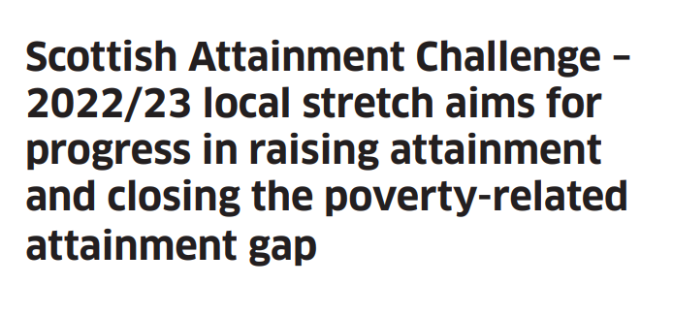
Assessment and Moderation
Improving attainment is a regular feature in School Improvement Plans, and is a key stretch aim across the RIC, and therefore improving our assessment and moderation practice is vital in achieving this.

Slide 4
Why have we introduced this?
From delivering training, hosting moderation events and developing materials across the RIC it is clear there is a need for establishments to begin identifying their key strengths and areas for development in regards to assessment and moderation in order to continue to drive forward improvement.

Slide 5
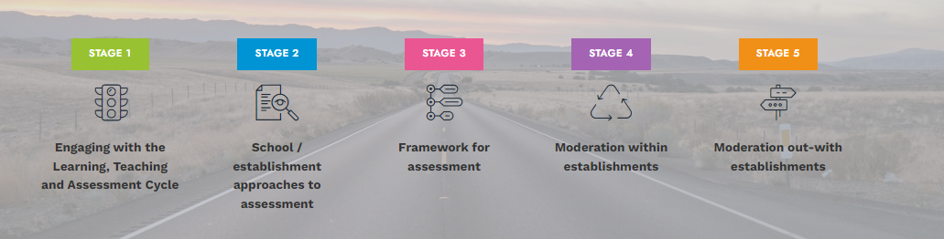
The Journey
South Lanarkshire QAMSO group and West Partnership collaborated to create the Assessment and Moderation Roadmap.
This was to allow establishments to identify where they are, and where they want to be. Included in the roadmap were key challenge questions and resources.

Slide 6
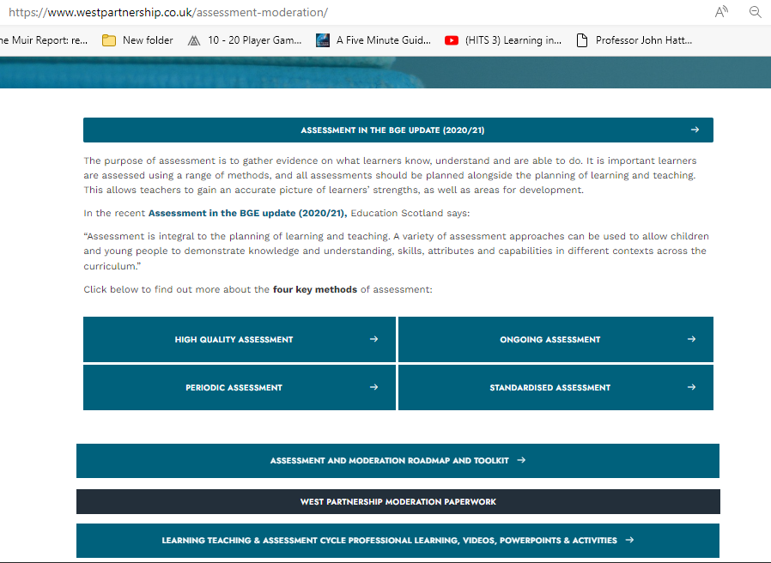
Notes:
Assessment and Moderation Roadmap and Toolkit – The West Partnership

Slide 7
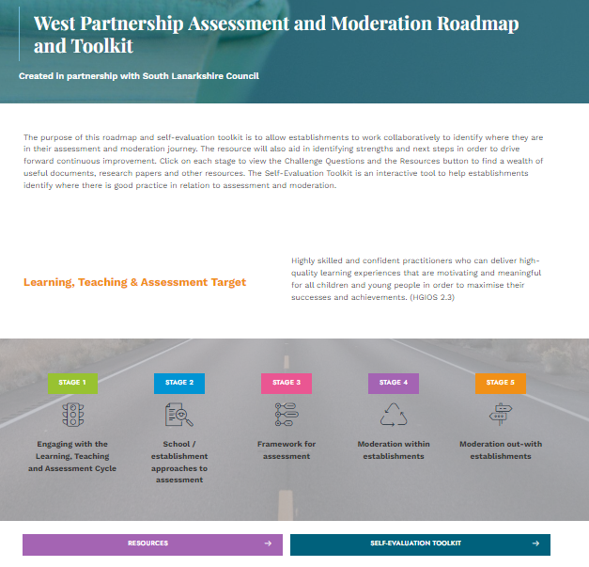
Notes:
Assessment & Moderation Resources – The West Partnership

Slide 8
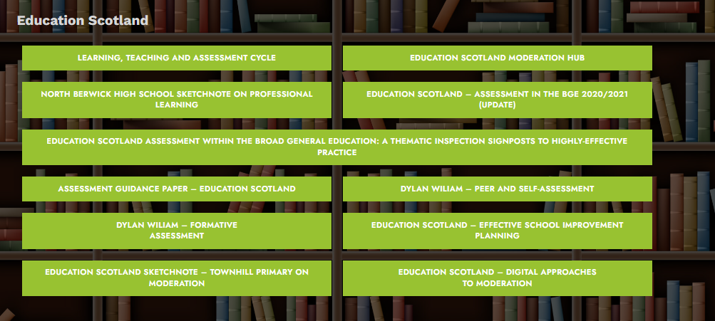
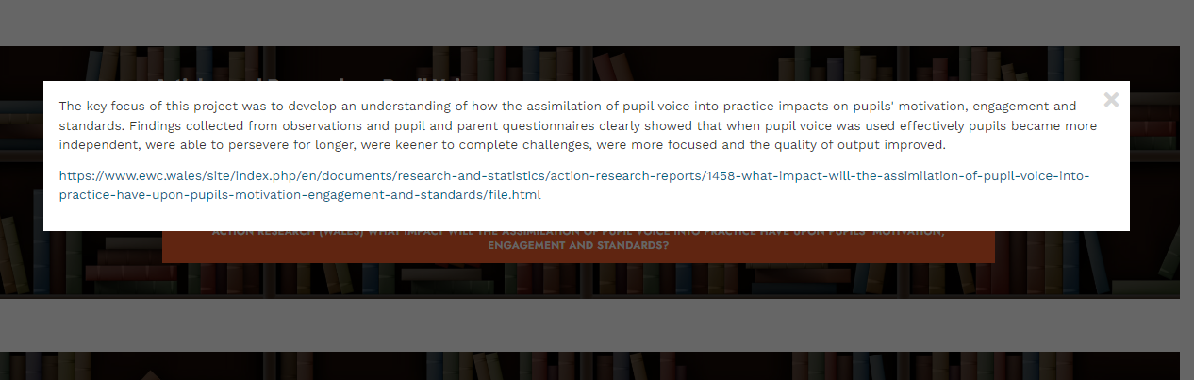
Resources
Notes:
Assessment & Moderation Resources – The West Partnership – take 5 minutes to explore this page and it’s resources. Is there anything here that interests you/you’d like to read or your staff to read?

Slide 9
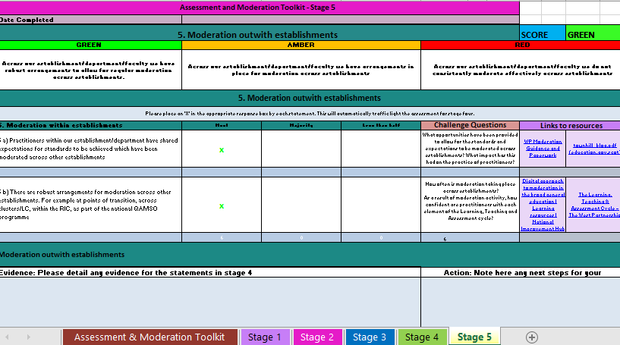
Self-Evaluation Toolkit
Forth Valley and West Lothian RIC created a fantastic Self-Evaluation Toolkit on Attendance – ThingLink
We used the formula to create a toolkit on Assessment and Moderation

Slide 10
How it works
Like the roadmap there are 5 key stages
The first sheet has information on how the toolkit works.
Each stage is on a separate sheet, and has statements down the left hand side
Each statement should be evaluated using this key
Once all statements have been evaluated the toolkit will then identify if you are ‘Red’, ‘Amber’ or ‘Green’ for each stage, both within the stage and also on the front page
Whilst the toolkit will be filled out by one practitioner, this should be used collaboratively
Key | Percentage
Most | 75%+
Majority | 50-74%
Less than Half | 0-49%

Slide 11
Notes:
Assessment and Moderation Roadmap and Toolkit – The West Partnership

Slide 12
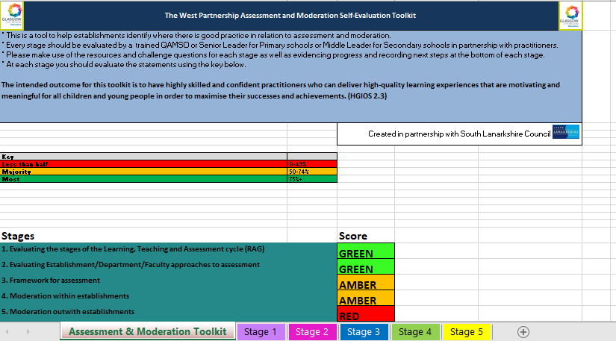

Slide 13
Stage 1 – Engaging with the Learning, Teaching and Assessment Cycle
I would envisage this stage is done first and on an annual basis, perhaps at the start of the new term/on an Inset Day
It would begin with an audit of the L, T and A cycle
In Primary establishments the SLT or QAMSO member would RAG where they feel the school is for each stage of the cycle.
In Secondary establishments this would be done at Department/Faculty level

Slide 14
Stage 1 – Engaging with the Learning, Teaching and Assessment Cycle
After this, each individual practitioner would RAG the cycle with where they feel they are as an individual.
This information can then be collated – did the original judgement mirror the general results? Are there specific gaps that need to be addressed?
Does this create a CLPL plan for practitioners, as groups or as individuals for the year ahead?
Greens could also match with Reds to collaborate or lead CLPL

Slide 15
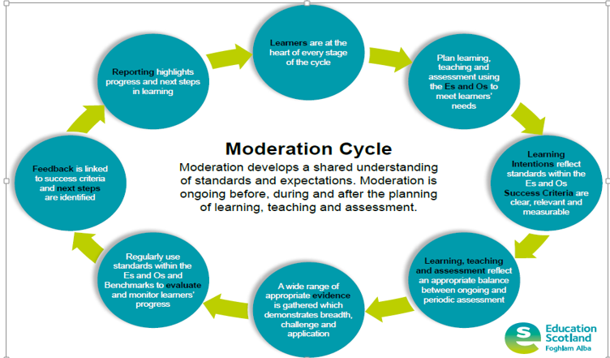
Stage 1 – Engaging with the Learning, Teaching and Assessment Cycle
There is an expectation that practitioners engage with the cycle when planning, both as an individual and collaboratively.
The cycle should also be used as a basis for observations, tracking conversations etc

Slide 16
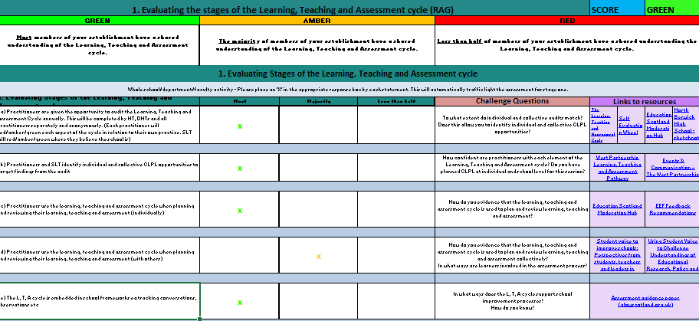
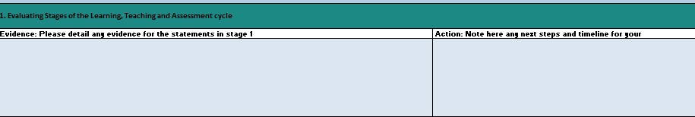
Screenshot stage 1

Slide 17
Stage 2 – Evaluating Approaches to Assessment
This stage focusses on the range of assessments being used across the establishment/faculty/department to ensure learners are being assessed in a variety of ways to demonstrate their knowledge and understanding, skills, attributes and capabilities

Slide 18
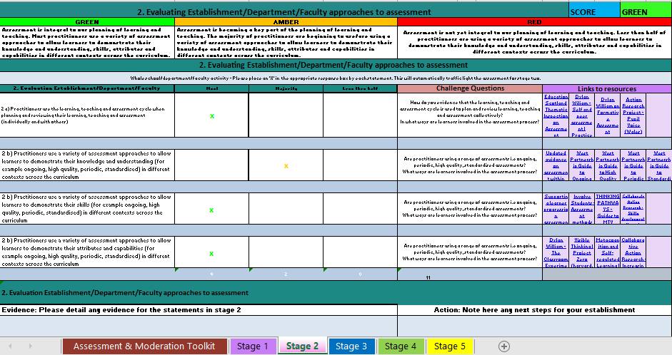

Slide 19
Stage 3 – Framework for Assessment
Stage 3 builds on Stage 2.
Stage 2 focusses on that range of assessment, and Stage 3 brings attention to an assessment framework.
Are there key check points showing a range of assessments? Are those assessments providing reliable data? Can we use that data to report to parents and carers?

Slide 20
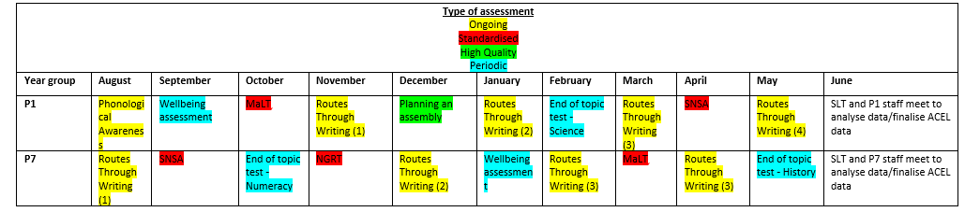
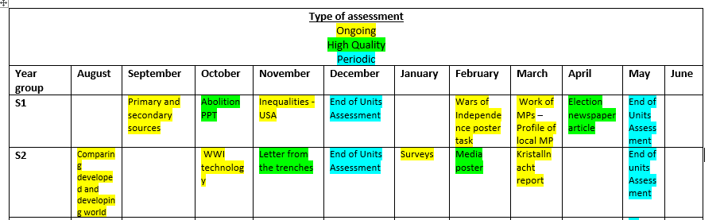
Stage 3 – Framework for Assessment

Slide 21
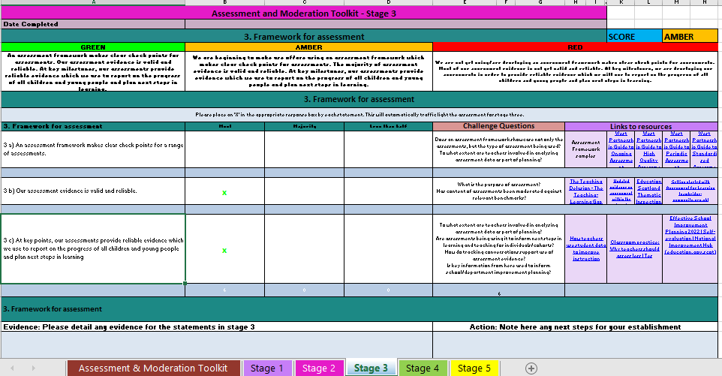

Slide 22
Stage 4 – Moderation within Establishments
This stage allows the establishment/faculty/department to reflect on whether there are shared expectations for standards to be achieved, and if there are robust arrangements for moderation across stages and across the curriculum.
This may not only mean moderating Literacy and Numeracy, but moderating a range of curricular areas.
It could also mean moderating progression

Slide 23
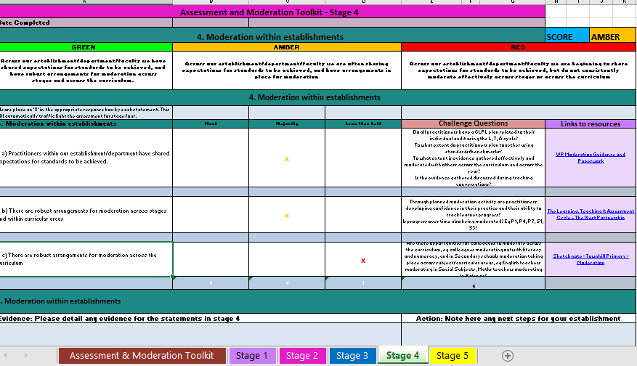

Slide 24
Stage 5 – Moderation across Establishments
This stage allows the establishment/faculty/department to reflect on moderation practice with other establishments.
This could be in learning communities, their local authority, the RIC or nationally.
This doesn’t have to be done in person – Education Scotland have a video showing how to do this on Teams using the PLC notebook
Looking inward, looking outward, looking forward

Slide 25
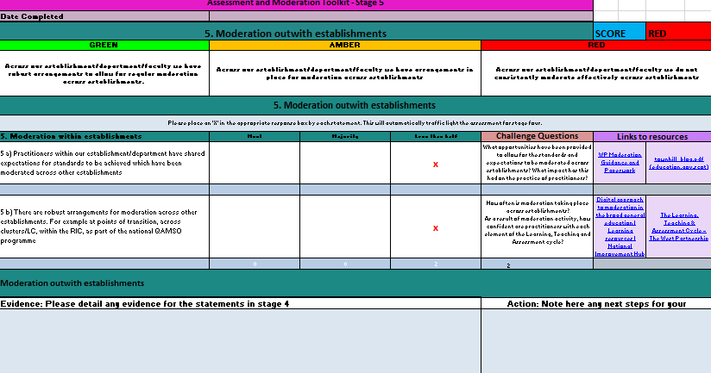

Slide 26
Recap
All resources can be found here – Assessment and Moderation Roadmap and Toolkit – The West Partnership
The purpose of this is to continue to drive improvement of Learning, Teaching and Assessment (HGIOS 2.3)

Slide 27
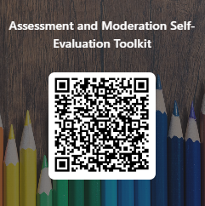
Feedback
Notes:
https://forms.office.com/e/nHujqdPbVp

Slide 28
Thank you!
Any Questions?
@WPshonamcarthur
Shona.mcarthur@eastrenfrewshire.gov.uk

