Slide 1
Our
John Muir
Award

Slide 2
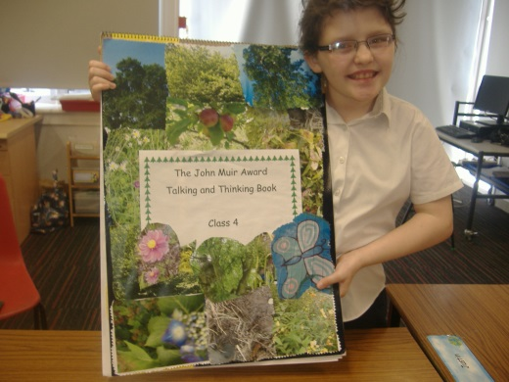
Discover a wild place
We were discovering what John Muir did.
He travelled around the world with his dog, Sticking.
John Muir went up high mountains to see what kind of nature he could find.
We added pictures of places around our school to our Talking and Thinking book. We wrote down our thoughts and questions about John Muir. We took pictures of the school and how we could fix it up.

Slide 3
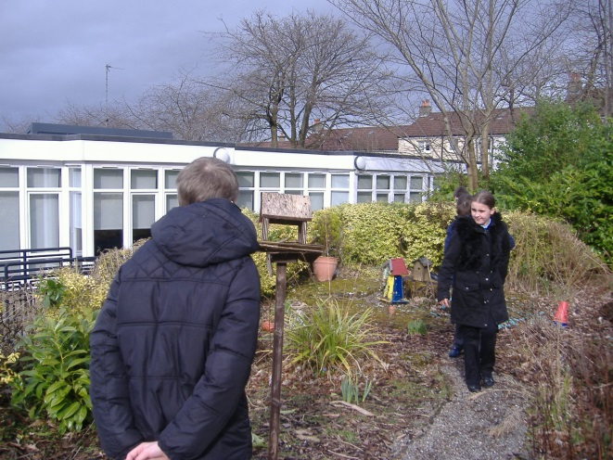
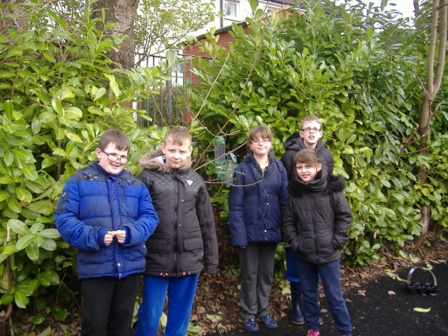
Discover
We were finding places in the school where we could put food for birds.
Once we found the places, we put bird feeders there to help the birds in winter.

Slide 4
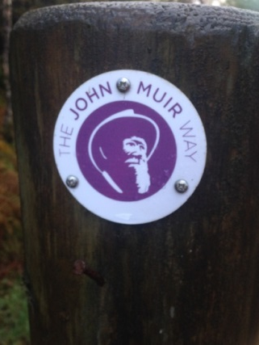
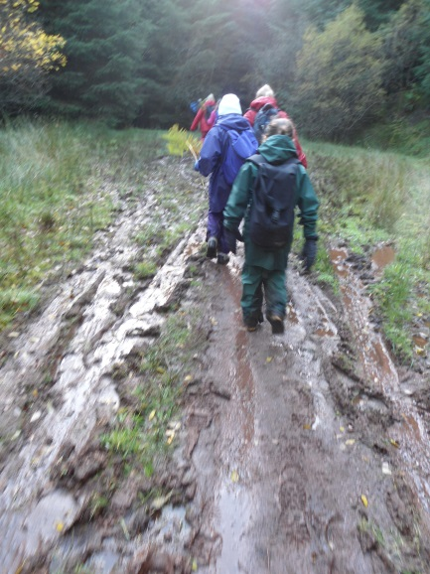
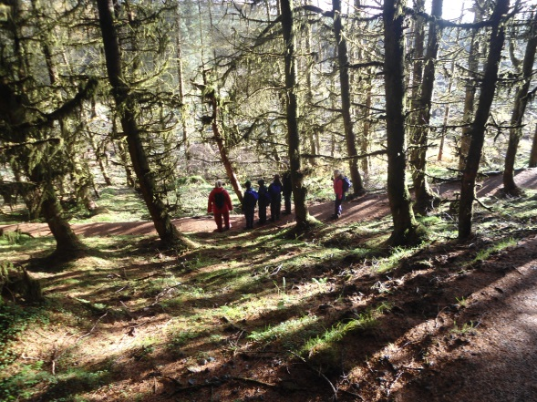
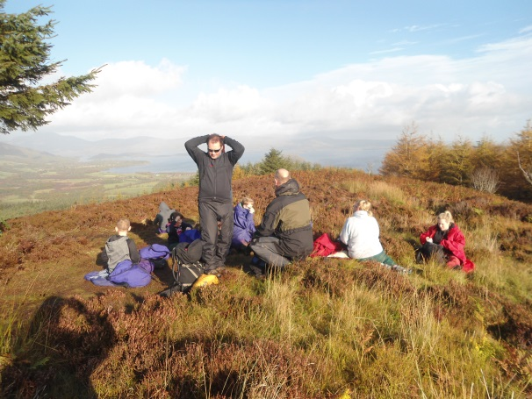
Explore its wildness
We saw lots of trees getting cut down – that’s not good for our air supply.
Blairvadach
We were walking in the woods along the trail that John Muir walked.
There was lots of mud! Kylie lost her wellie boot.
We went up a high mountain and then when we were at the top we had a lunch break and some hot chocolate.

Slide 5
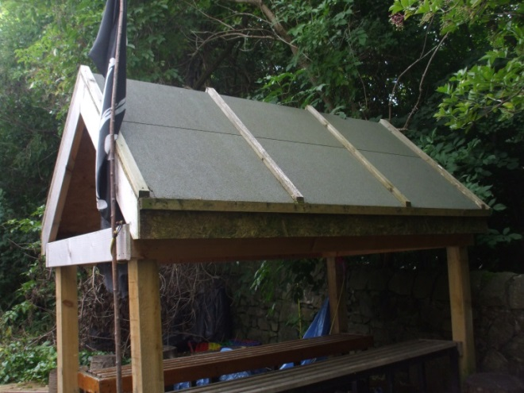
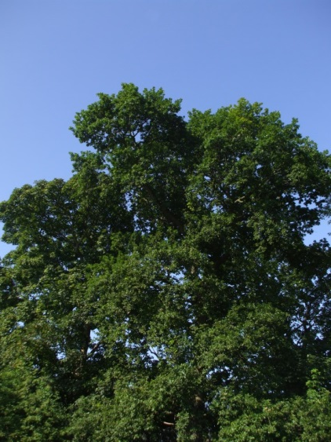
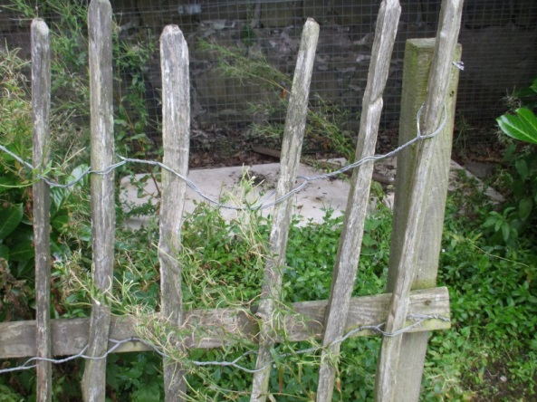
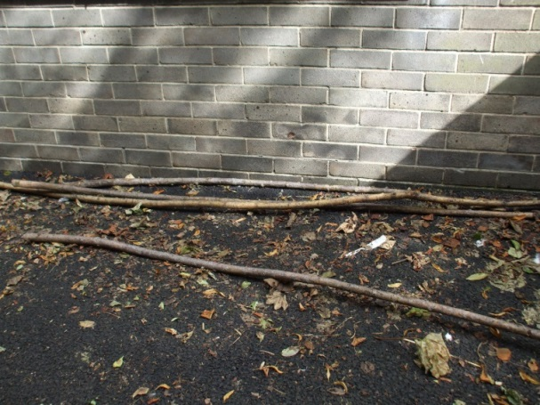
Explore
Our school grounds
We took photos of different things around the school and planned what we were going to do tidy the mess up.

Slide 6
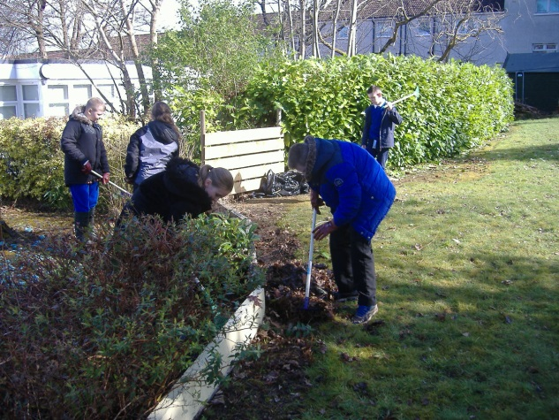
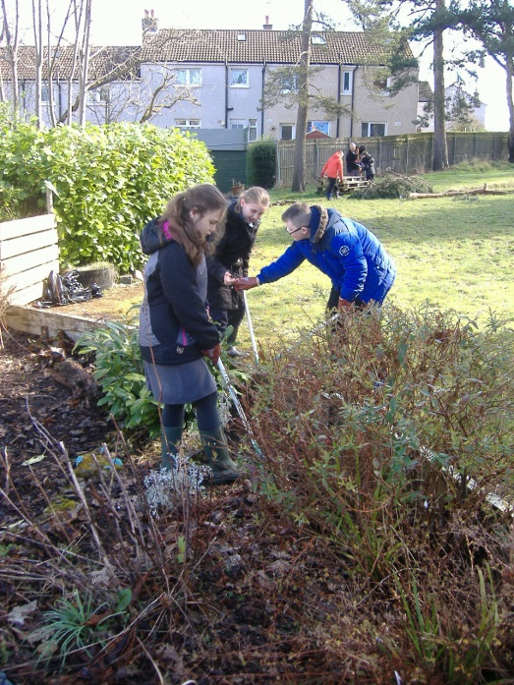
Conserve a wild place
We were raking up the leaves in the sensory garden so we could plant flowers. We tidied the leaves to let the new plants pop up through the ground.

Slide 7
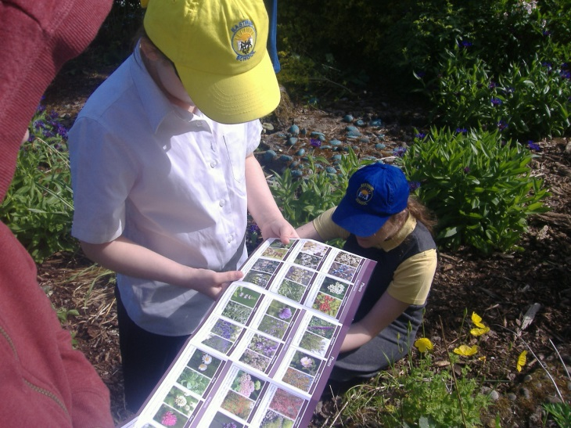
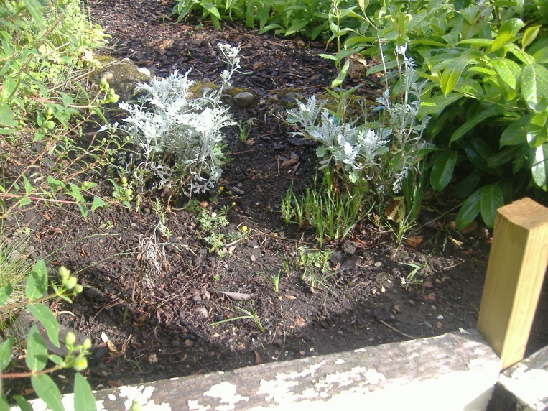
Conserve
We were doing a survey. We were looking at the different types of flowers and insects. We wrote down what we found and it will be used next year to see if there are more.
We all planted some wild flowers and they are just starting to grow. We watered them so they can grow even in the hot sunshine.

Slide 8
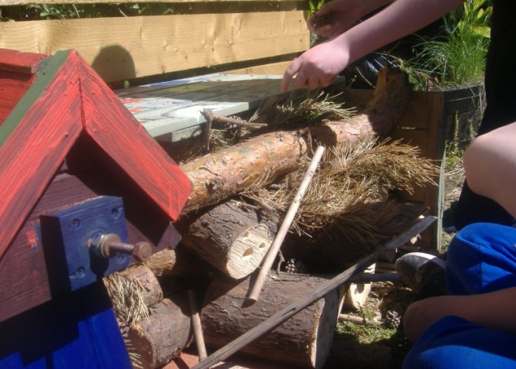
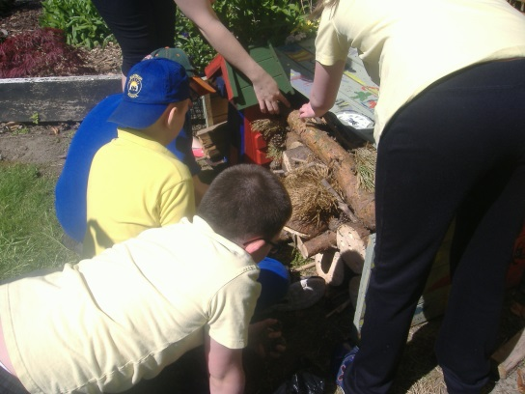
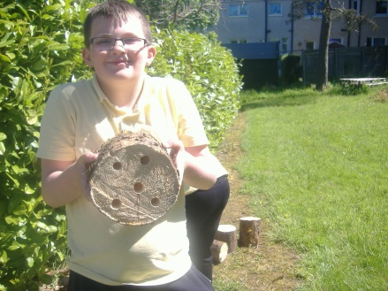
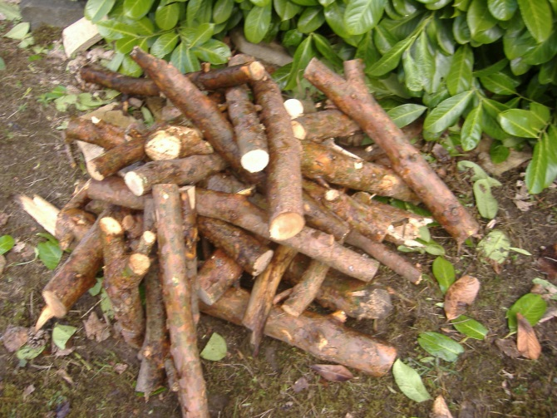
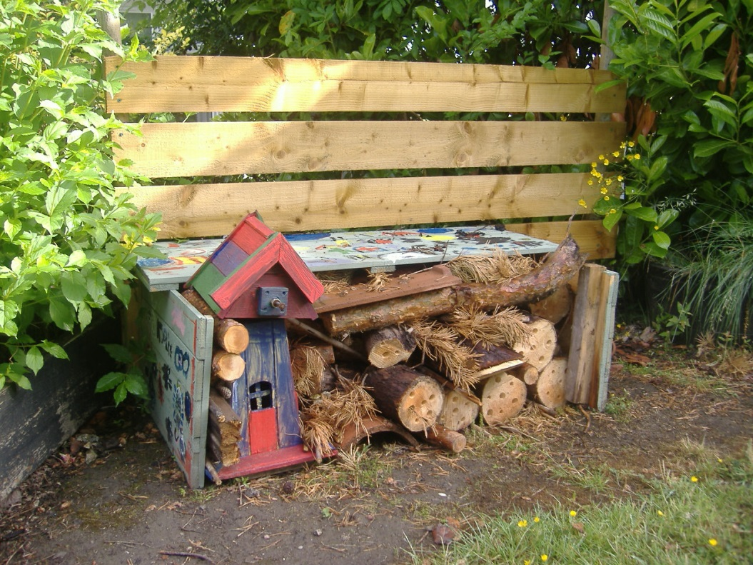
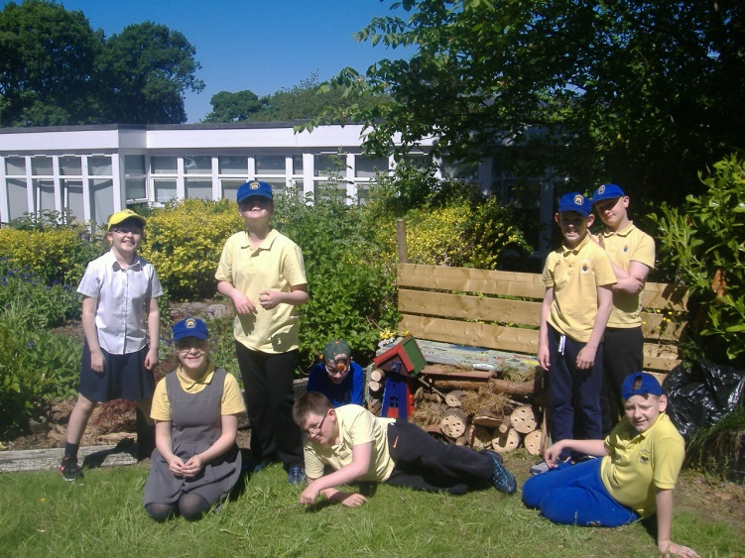
Conserve
This is our mini-beast hotel!
We sawed logs and drilled holes to make homes for the bugs. We added the newly painted windmill for the spiders, and we made a wee space for the hedgehogs next to the windmill. We worked together and are really proud of what we have made!

Slide 9
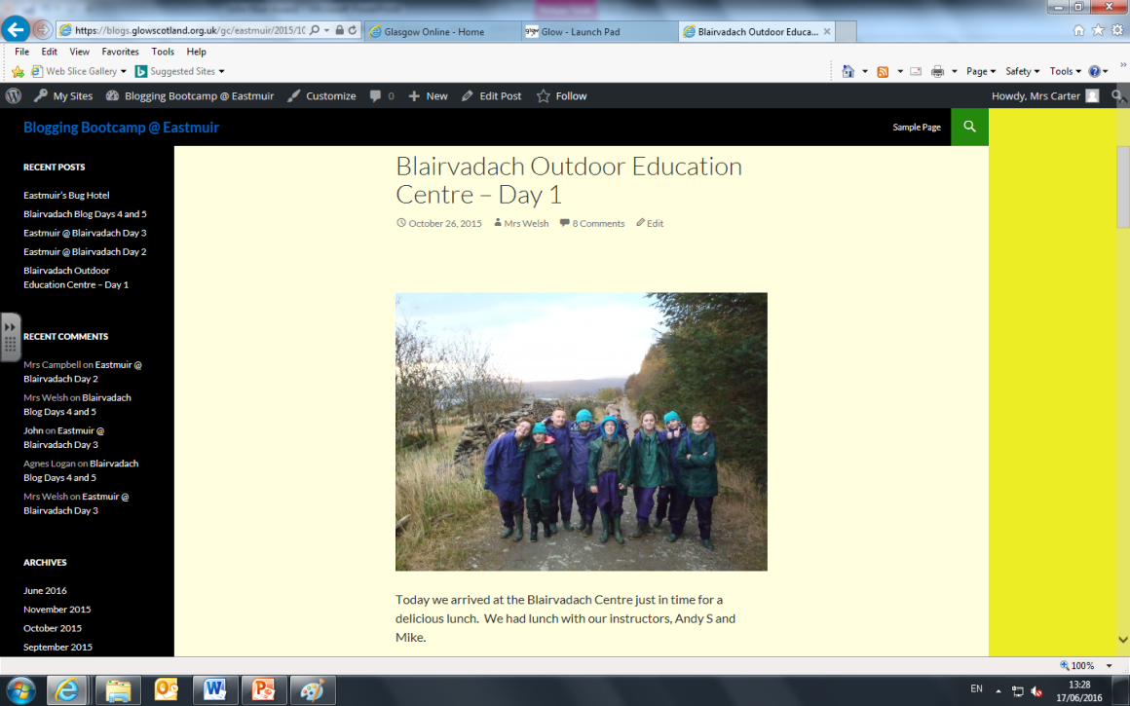
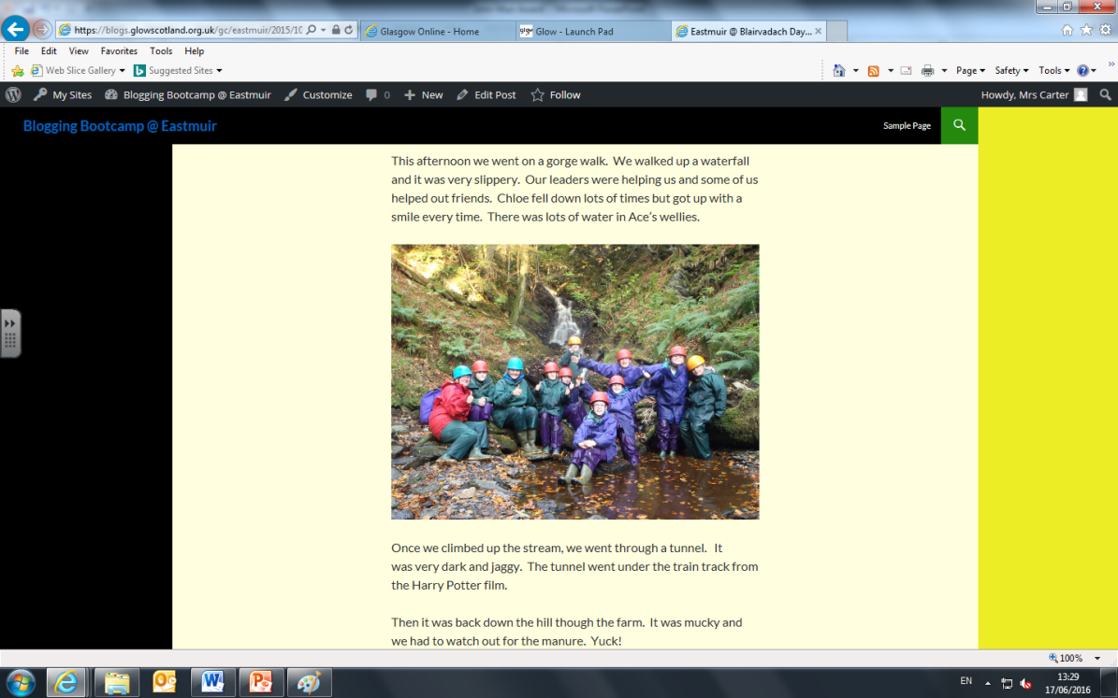
Share your experiences
We created a blog so we can put our pictures on it and share what we have been doing.
Some of us went into the freezing cold water.
We got loads of comments about our posts.

Slide 10
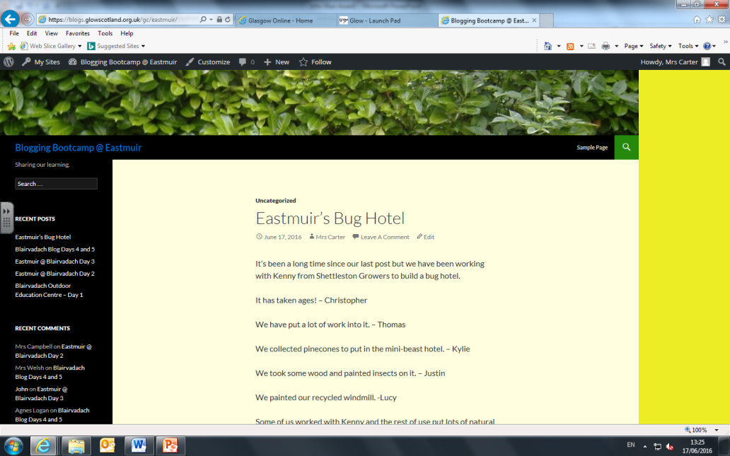
Share
We wanted to share about our mini-beast hotel because we wanted people to see what we had been doing with the materials which came from nature.

