Slide 1

Senior Phase
Information
Evening
Monday 31st august 2026

Slide 2


Message from the Head Teacher
The work here at DHS is excellent in terms of supporting learners into positive destinations and developing young people who will successfully contribute to society.
Ambition is one of our School Values and we work very hard to ensure that all young people have ambition for their future.
We work to ensure the highest level of achievement and attainment for all learners.
We work with partners and universities to support learners into the next stage of their lives.
We are extremely proud of the young people who leave DHS and of their success after leaving school.

Slide 3
Dhs expectations
Phone free school
Attendance matters
Living our values

Slide 4
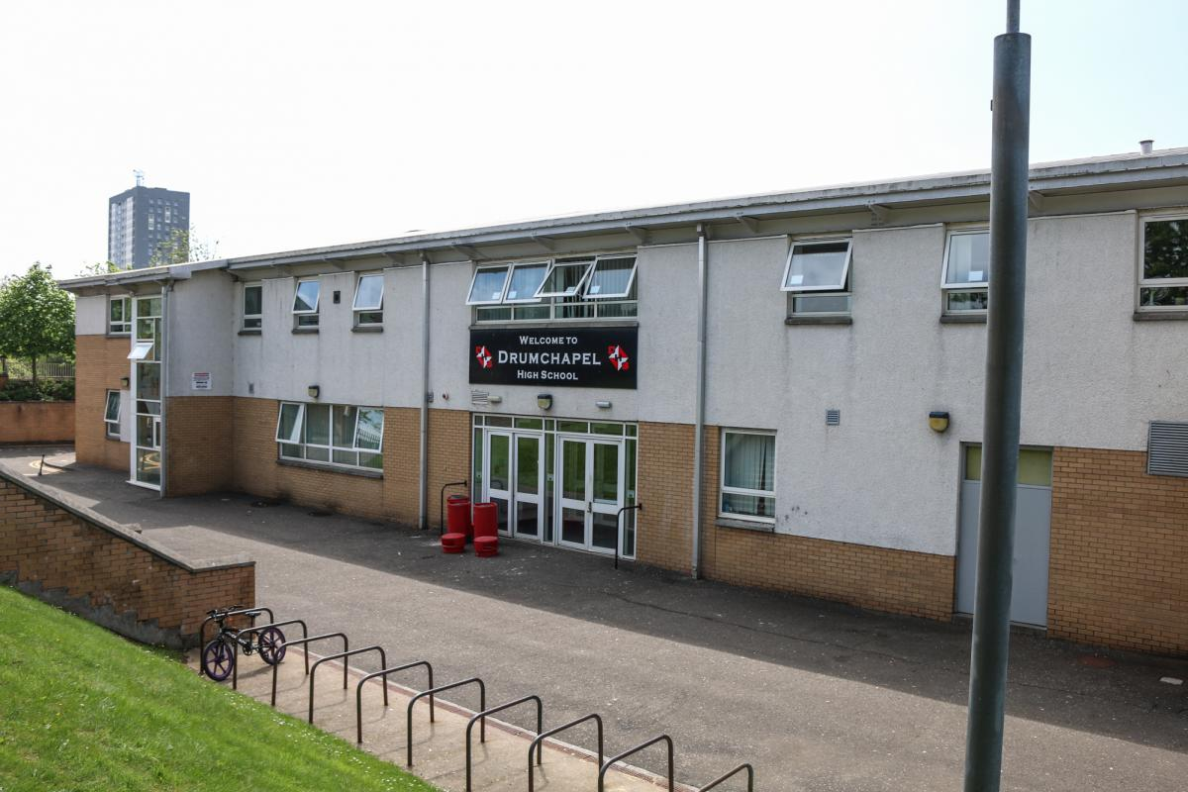
Welcome to the senior phase
Moving into the Senior Phase we are working to prepare our young people for the world outside of school and the opportunities that await.
Equipping them with Qualifications and Skills for Learning Life and Work to enable them to progress to sustained, positive destinations.
These sustained positive destinations change the lives of our young people for the better and positively impact them allowing for a successful future
Resilience Opportunity Ambition Respect

Slide 5

Positive Destinations
For the Session 2025-26
We have achieved a figure of 92.6% of our pupils, in positive and sustained destinations.
Pupils go on to either employment, further or higher education

Slide 6
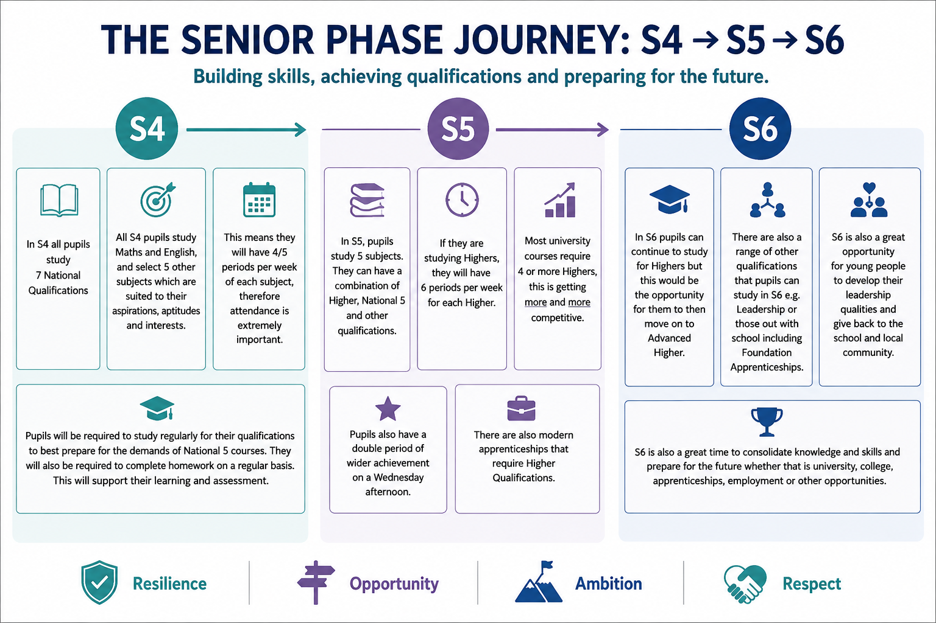

Slide 7

Communication
Communication about your learner’s progress will take place in a variety of ways, including contact from PT Pastoral Care, Faculty Head of Subject, DHT or HT.
You will have the opportunity to come into our progress evenings in person and you will receive tracking as well as full school report.
Feel free to contact us regarding progress if you are concerned. In most instances you would ask to speak to their Pastoral Care teacher who will find out the information you require.
Resilience Opportunity Ambition Respect

Slide 8

Qualifications Scotland
Prelim exams this year will take place in DECEMBER. This allows time for post prelim interventions to support in preparation for final exams.
QS exam diet will begin in April 2027 and last for approximately 5/6 weeks. The timetable will be issued soon and we will alert you to this.
Most subjects have internally and externally assessed coursework elements that pupils need to complete in order to sit the final exam.
Pupils will receive an assessment calendar to help them prepare.
Resilience Opportunity Ambition Respect

Slide 9


Slide 10
PT of Learning & Teaching
Miss Gibb
Notes:
https://www.mentimeter.com/app/presentation/alitryosrxyur5b7xeu7inx8bid9vrom/edit?question=5ojun11jgoda
Osiris Teaching Intervention - Osiris Educational

Slide 11
Our School Focus 2026-27
Improving Learning & Teaching
Raising Attainment

Slide 12
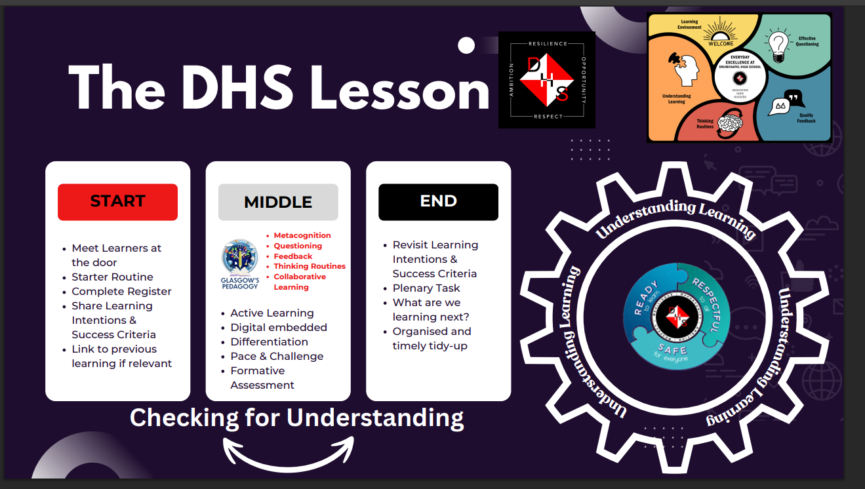

Slide 13
Main Areas of Focus in Senior Phase
Increasing Pupil Voice & Metacognition
Enhancing Retrieval Practise & Exam Skills
Living Our School Values to improving Learning & Teaching

Slide 14
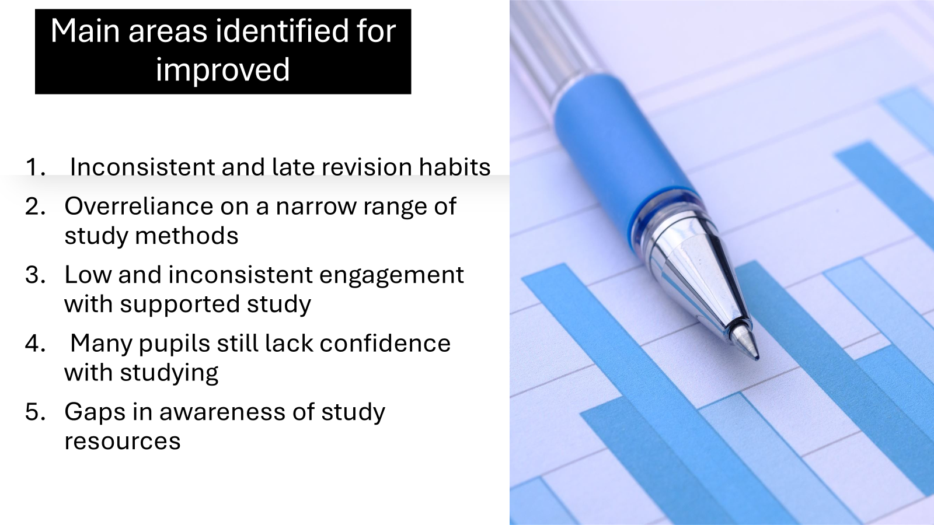
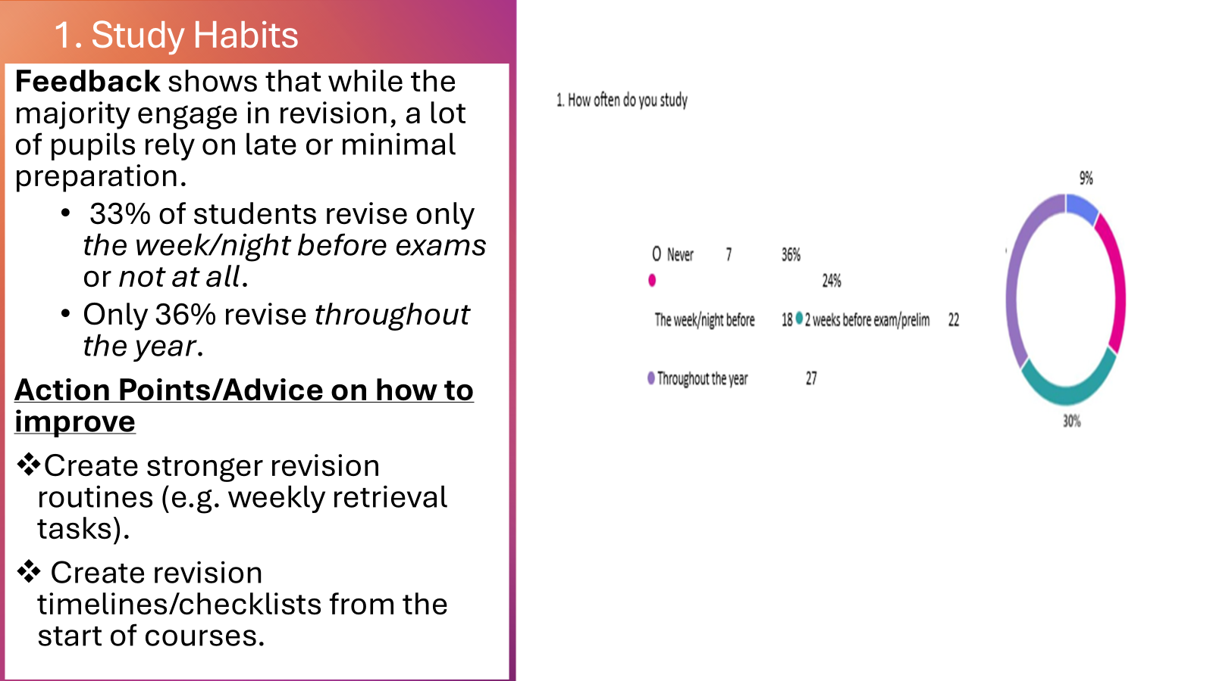
1. Increasing Pupil Voice & Metacognition
Helping pupils to better understand how they learn so they can become more reflective and effective learners.
Steps: Using pupil feedback to inform L&T
How you can better support with this at home
Having more conversations about learning – asking learners what they are studying, discussing what they have learned, and encouraging them to explain their thinking.

Slide 15

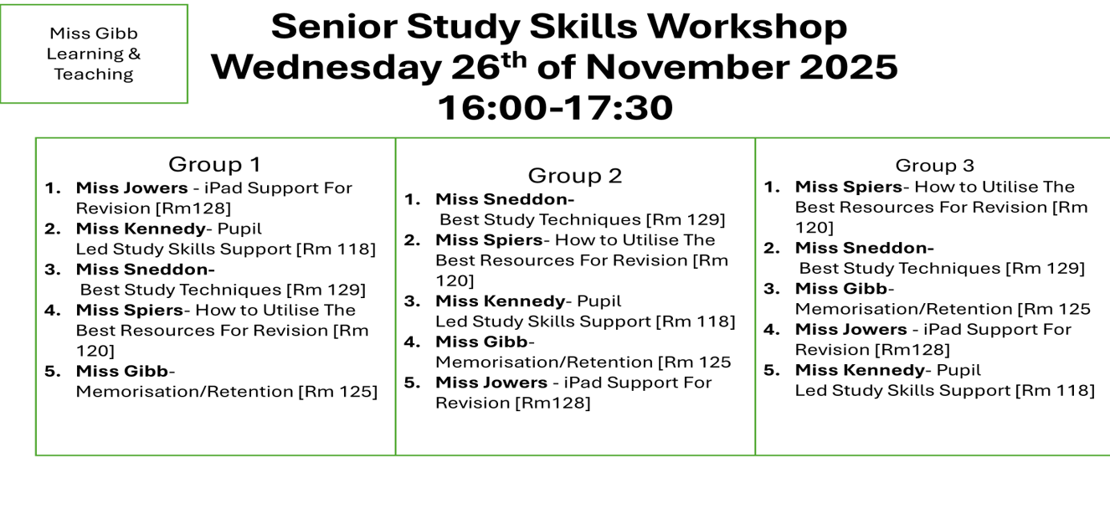
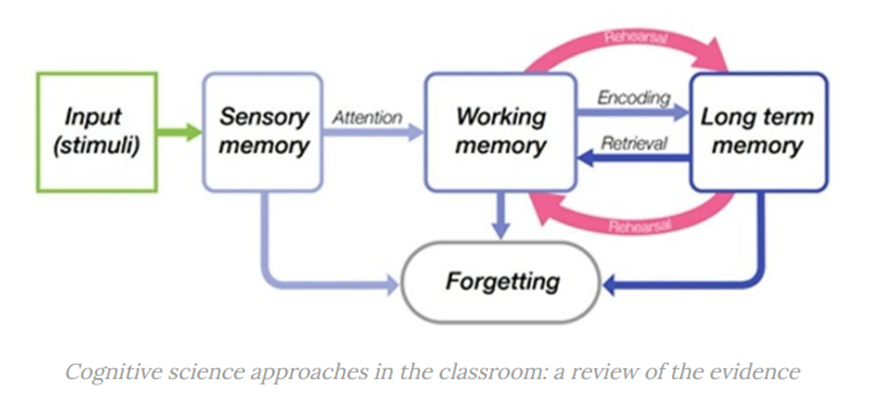
2. Enhancing Retrieval Practise & Study Skills
Training pupils on how to better access and retain information, build strong study habits and increase their confidence with exams.
Steps: Staff training, incorporating retrieval practise and teaching of study skills better in lessons. study skills workshops, supported study, study trips
How you can better support with this at home
Supporting independent learning – helping learners organise their time, plan assignments and solve problems on their own.
Testing their retrieval practise at home with low-stakes quizzes
Encouraging attendance & engagement -at supported study/ Study Skills workshops/making use of TEAMS & other online resources

Slide 16


3. Living Our School Values To Improve Learning & Teaching
Fostering a culture of learning shaped by our school values, enhancing pupil agency of their learning journey
Steps: Pupils outlining what each value means, merits, shared language of learning, Collaborative learning
Not just values for school but values for life
How you can better support with this at home
Setting high but realistic expectations – communicating belief in the learner’s ability and encouraging persistence, effort and ambition.
Creating a positive learning environment – encouraging regular study routines and showing that education is valued.

Slide 17
Other Ways We Can Better Help Our Young People Succeed
Knowing when exams assignments and encouraging study habits at home
Encouraging attendance
Communicating pupil needs to teachers/staff - sharing information and addressing difficulties early so that home and school can provide consistent support.

Slide 18
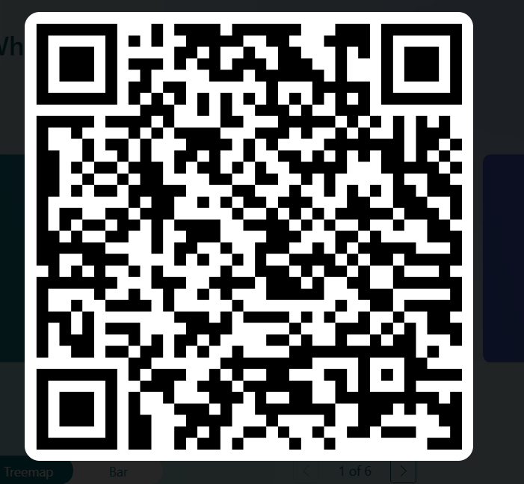
Thank you ☺ for all your support
Please complete feedback forms ☺
Notes:
https://forms.cloud.microsoft/e/WW7jM8MgJ1?origin=lprLink

Slide 20

DYW Support – Miss Baigent
Identify young people who would benefit from work based learning
Create opportunities and achieve sustainable, positive destinations for all
Work in conjunction with school partners to provide full and coherent support to every young person
Resilience Opportunity Ambition Respect

Slide 21

Role of PT Pastoral Care and Positive Destinations Ms Adamson
Support senior phase pupils in their subject choices appropriate for their pathways.
Offering integrated college courses (senior phase college)
Research and review choices for post-school alongside pupils.
Work with partners e.g. FocusWEST, Glasgow Caledonian University, IntoUniversity to provide opportunities for campus visits, taster-sessions and mentoring.
Oversee and support with personal statements and UCAS applications.
Resilience Opportunity Ambition Respect

Slide 22
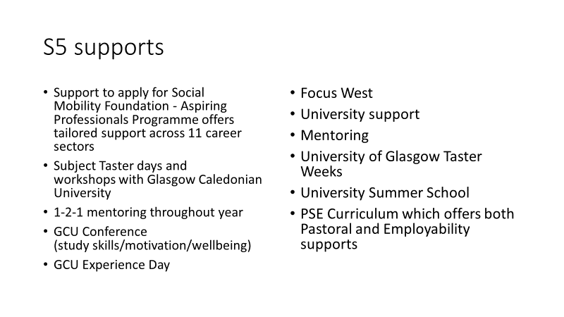
Resilience Opportunity Ambition Respect

Slide 23
S6 Supports
S6 PSE – weekly support to complete UCAS/College support
S6 GCU Mentoring and Supported Study
Personal statement support
Extensive support and mentoring from Focus West
Top Up completed during PSE/Wider Achievement
Routes for All – College support
Apprenticeship support
SAAS Support (Tuition Fees)
Support to apply for scholarships
Resilience Opportunity Ambition Respect

Slide 24
S5/S6 Universal Supports
PSE – Employability workshops from a range of industries
Careers Advisor 1-2-1 interviews
Visit to Skill Scotland Event (SEC) - opportunity to meet and network with regional and national employers, training providers, colleges, universities and industry specific organisations.
Work Experience
College workshops – Pupils will apply to college with support from Destinations Team
Senior Phase College Courses (Tues/Thurs) – part-time alongside school timetable
Resilience Opportunity Ambition Respect

Slide 25
Research shows that those with higher attendance levels:
feel more connected to their school
are more likely to overcome / be supported to overcome any issues they may have
Attain more/ higher level qualifications
are more likely to complete homework
Resilience Opportunity Ambition Respect

Slide 26
Each week, if I attend:
90% = ½ day absent
80% = 1 day absent
70% = 1 ½ days absent
60% = 2 days absent
Resilience Opportunity Ambition Respect

Slide 27
By June, if I attend:
90% = approx. 4 weeks absent
80% = approx.8 weeks absent
70% = approx. 12 weeks absent
60% = approx. 16 weeks absent
Resilience Opportunity Ambition Respect

Slide 28
Parents & Carers
What can you expect from us?
- Text messages in the morning and afternoon if they are not at school
- Letters to update you on attendance percentage
- Phone calls from, HSSW, FH or PTPC to discuss attendance percentage or patterns
What do we need from you?
- Updates on illness or appointments
- Be aware of upcoming assessments / prelims to ensure attendance
- Encourage attendance everyday
- Ask for support from us to improve attendance if needed

Slide 29

Any questions?
Resilience Opportunity Ambition Respect

