Slide 1

S4- S5 and S5-S6 options evening
Wednesday 28th January 2026

Slide 2

Message from the Head Teacher
The work here at DHS is excellent in terms of supporting learners into positive destinations and developing young people who will successfully contribute to society.
Ambition is one of our School Values and we work very hard to ensure that all young people have ambition for their future.
We work to ensure the highest level of achievement and attainment for all learners.
We work with partners and universities to support learners into the next stage of their lives.
We are extremely proud of the young people who leave DHS and of their success after leaving school.

Slide 3
Overview of this evening
Overview of S5/S6 curriculum
Timeline for S5-6 options
Positive destinations
Supporting young people in their option choices

Slide 4
Our aim
Moving into S5/S6 we are building upon National Qualifications gained at the previous level and working to prepare our young people for the world outside of school and the opportunities that await.
Equipping them with Skills for Learning Life and Work to enable them to progress to sustained, positive destinations.
These sustained positive destinations change the lives of our young people for the better and positively impact them allowing for a successful future

Slide 5


The S5/S6 curriculum
In S5, young people will build upon their National qualifications attained at the previous level. They will continue studying 5 subjects from a curricular pathway in line with their current 6 subjects
In S6, young people will continue to build upon their qualifications gained in S5, choosing 5 subjects .

Slide 6
The S5/6 curriculum at DHS
Subject | Number of periods
Choice subject 1-5 (to include English and Maths in S5) | 6
Wider Achievement | 2
PSE | 1

Slide 7
Timeline for S5/S6 options
January 2026 – prelim and working grades issued.
2nd-13th February course choice interviews with DHT/PTPC
W/B 16th Feb - Full written report issued.

Slide 8
How do I support my child with their options choices?
Consider your child’s recent prelim and working grades. Which subjects are their strongest? These are the subjects they are most likely to achieve best in.
What subjects does your child enjoy studying within school?
What are your child’s career aspirations beyond school? Do they need certain qualifications?

Slide 9
Tracking levels explained
National 3/4 | National 5 | Higher
on track/off track | 1,2 = A | 1,2 = A
 | 3,4 = B | 3,4 = B
 | 5,6 = C | 5,6 = C
 | 7 = D | 7 = D
 | 8,9 = fail | 8,9 = fail

Slide 10
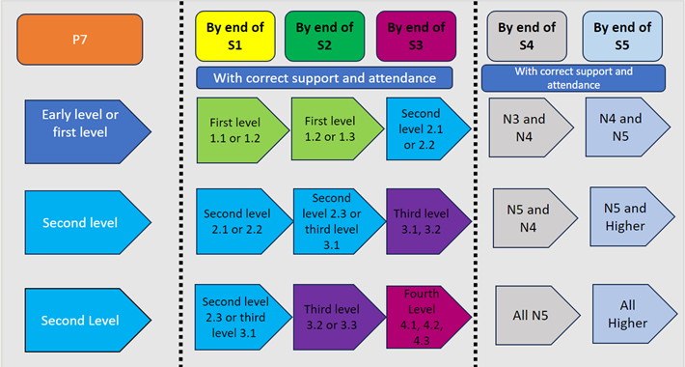
National pathways and progress

Slide 11
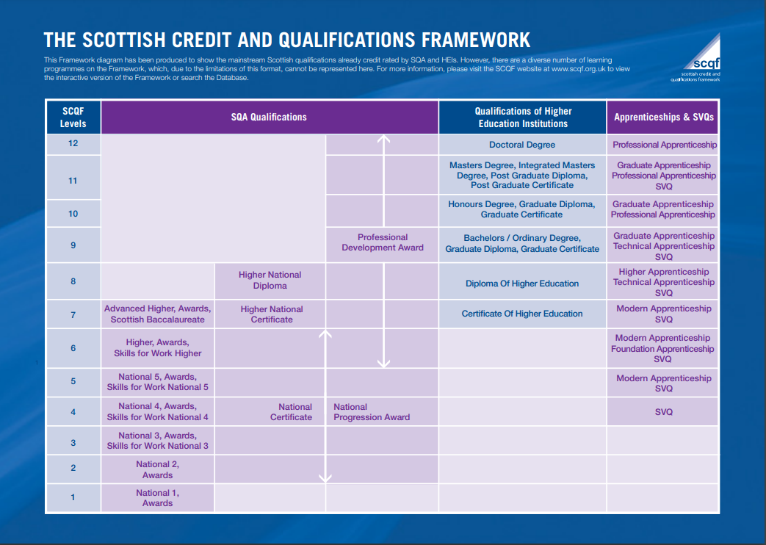

Slide 12
Your role as a parent/carer
Discuss your child's options with them at home.
PTPC will email home a copy of your child's option choices after their meeting.
Contact PTPC or DHT if you would like to discuss further.

Slide 13
Useful links
https://www.myworldofwork.co.uk/

Slide 14
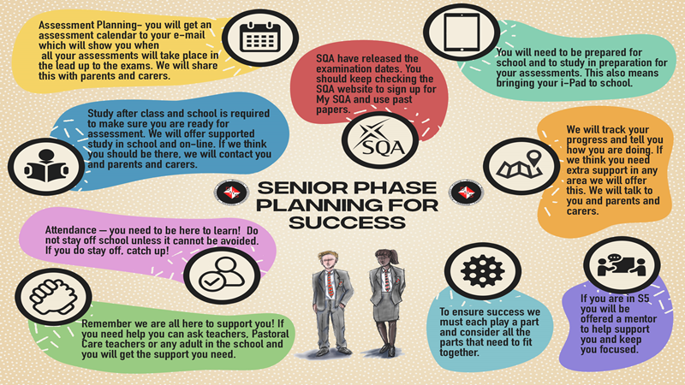

Slide 15
Any questions?

