Slide 1

S3 into S4 options evening
Tuesday 9th December 2025

Slide 2

Message from the Head Teacher
The work here at DHS is excellent in terms of supporting learners into positive destinations and developing young people who will successfully contribute to society.
Ambition is one of our School Values and we work very hard to ensure that all young people have ambition for their future.
We work to ensure the highest level of achievement and attainment for all learners.
We work with partners and universities to support learners into the next stage of their lives.
We are extremely proud of the young people who leave DHS and of their success after leaving school.

Slide 3
Overview of this evening
Purpose of S3 options and S4 curriculum
Timeline for S4 options
Pathways into S5
Supporting young people in their option choices

Slide 4
Our aim
Moving into the Senior Phase we are working to prepare our young people for the world outside of school and the opportunities that await.
Equipping them with Skills for Learning Life and Work to enable them to progress to sustained, positive destinations.
These sustained positive destinations change the lives of our young people for the better and positively impact them allowing for a successful future

Slide 5
S3 vs S4 – what’s the difference?
S1 – S3 – Broad General Education – Developing skills and building underlying knowledge and interest across the curricular areas.
S4-S6 - QUALIFICATIONS
Our aim is that as many young people as possible attain at least 5 qualifications in S4.

Slide 6
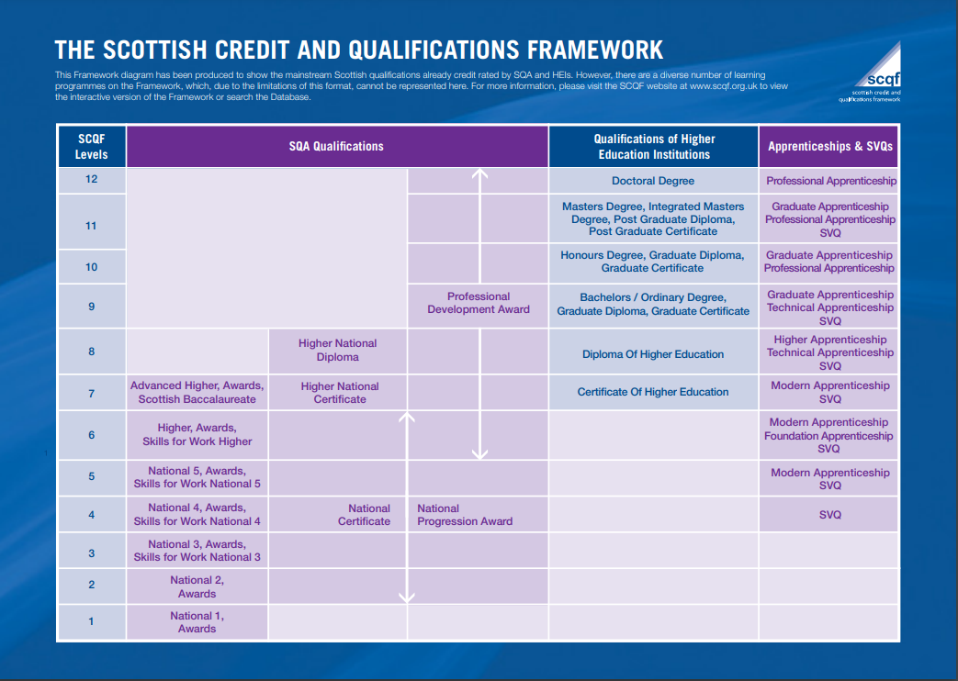

Slide 7



The S4 curriculum
In S3 young people have studied 8 subjects, including English and Maths, alongside PSE and PE.
Young people will then take forward 7 of these subjects into S4. These will be their National Qualifications that they will study at National 3-5 level.
Pupils will be encouraged to take forward their strongest subjects into S4.

Slide 8
The S4 curriculum at DHS
Subject | Number of periods
English | 5
Maths /Maths Apps | 5
Choice subject 1-5 | 4
Core PE | 2
PSE | 1

Slide 9
What can young people expect
Appropriate pace and challenge
Some double periods
Increased workload
Homework
Deadlines
Assessment
Prelims Dec 2026
SQA Exam diet - May 2027

Slide 10


Slide 11
Timeline for S4 options
4th December S3 reports and tracking data issued
12th – 21st January course choice interviews with PTPC
Pupils begin to follow their new timetable during June 2026.

Slide 12
How do I support my child with their options choices?
Consider your child’s recent tracking levels. Which subjects are their strongest? These are the subjects they are most likely to achieve best in.
What subjects does your child enjoy studying within school?
Does your child have any career aspirations yet?

Slide 13
Tracking levels explained
Level 3 – Expected level S2 – S3 | Level 4 – Exceeding level in S3
3.1= SOME of the benchmarks they have experienced from their learning at level 3 | 4.1= SOME of the benchmarks they have experienced from their learning at level 4
3.2 = MOST of the benchmarks they have experienced from their learning level 3 | 4.2 = MOST of the benchmarks they have experienced from their learning level 4
3.3= ALMOST ALL of the benchmarks they have experienced from their learning at level 3 | 4.3= ALMOST ALL of the benchmarks they have experienced from their learning at level 4
Learners who have achieved level 3 by the end of S3 are likely to be presented for National 5 at the end of S4.

Slide 14
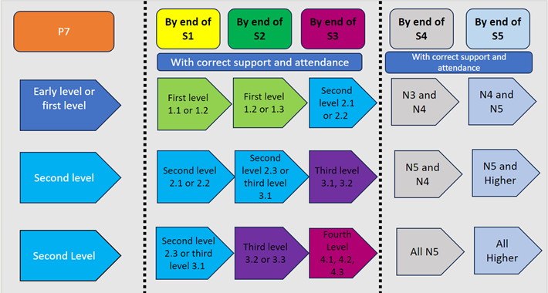
National pathways and progress

Slide 15
Your role as a parent/carer
Discuss your child's options with them at home.
PTPC will email home a copy of your child's option choices after their meeting.
Contact PTPC or DHT if you would like to discuss further.

Slide 16
Any questions?

