Slide 1

S2 Parents options evening
Tuesday 25th November 2025

Slide 2

Message from the Head Teacher
The work here at DHS is excellent in terms of supporting learners into positive destinations and developing young people who will successfully contribute to society.
Ambition is one of our School Values and we work very hard to ensure that all young people have ambition for their future.
We work to ensure the highest level of achievement and attainment for all learners.
We work with partners and universities to support learners into the next stage of their lives.
We are extremely proud of the young people who leave DHS and of their success after leaving school.

Slide 3
Overview of this evening
Purpose of S3 options and S3 curriculum
Timeline for S3 options
S3 into S4 moving into Senior Phase
Supporting young people in their option choices

Slide 4
Curriculum for Excellence Principles of Curriculum Design
Challenge and Enjoyment
Breadth
Progression
Depth
Personalisation and Choice
Coherence
Relevance

Slide 5

The S3 curriculum
In S1 and S2, our young people experience a broad curriculum across all subject areas.
For S3, young people study 8 subjects (including English and Maths) from a range of curricular areas. They choose 6 of these . They will also study core subjects such as PSE and PE.
They then progress in these subjects throughout S3 and take 7 of these forward into S4 to study at Senior Phase level

Slide 6
Timeline for S3 options
W/B 24th November young people will discuss S3 options during PSE lessons.
W/B 1st and 8th December, young people will choose their subjects during interviews with PTPC.
Pupils begin to follow their new timetable during May 2026.

Slide 7
How do I support my child with their options choices?
Consider your child’s recent tracking levels. Which subjects are their strongest? These are the subjects they are most likely to achieve best in.
What subjects does your child enjoy studying within school?
Does your child have any career aspirations yet?

Slide 8
Tracking levels explained
Level 2 – Usually between P7-S2 | Level 3 – Expected level S2 – S3 | Level 4 – Exceeding level in S3
2.1 = SOME of the benchmarks they have experienced from their learning at level 2 | 3.1= SOME of the benchmarks they have experienced from their learning at level 3 | 4.1= SOME of the benchmarks they have experienced from their learning at level 4
2.2 = MOST of the benchmarks they have experienced from their learning level 2 | 3.2 = MOST of the benchmarks they have experienced from their learning level 3 | 4.2 = MOST of the benchmarks they have experienced from their learning level 4
2.3 = ALMOST ALL of the benchmarks they have experienced from their learning at level 2 | 3.3= ALMOST ALL of the benchmarks they have experienced from their learning at level 3 | 4.3= ALMOST ALL of the benchmarks they have experienced from their learning at level 4
It is likely that learners who have achieved level 2.3 and above by this stage of S2 will be able to progress to National 5 level in these subject areas during S4.
Those achieving less than 2.3 at this stage are more likely to be presented for National ¾.

Slide 9
Example tracking letter
Subject | Level |  | Subject | Level
Business | 2.1 |  | Art | 3.1
English | 2.2 |  | Drama | 1.3
Modern Languages BGE | 2.1 |  | Home Economics | 2.2
RE | 2.1 |  | Music | 2.3
Social Subjects | 3.2 |  | Physical Education | 2.3
Mathematics | 3.1 |  | Technological Studies | 2.3
Science | 2.2

Slide 10
Example tracking letter
Subject | Level |  | Subject | Level
Business | 1.1 |  | Art | 2.2
English | 1.2 |  | Drama
Modern Languages BGE | 2.3 |  | Home Economics | 1.1
RE | 1.3 |  | Music | 2.1
Social Subjects | 2.2 |  | Physical Education | 1.2
Mathematics | 2.2 |  | Technological Studies | 2.2
Science | 2.1

Slide 11
Example tracking letter
Subject | Level |  | Subject | Level
Business | 2.2 |  | Art | 3.1
English | 2.2 |  | Drama | 1.2
Modern Languages BGE | 2.2 |  | Home Economics | 2.3
RE | 2.1 |  | Music | 2.3
Social Subjects | 3.1 |  | Physical Education | 3.3
Mathematics | 3.1 |  | Technological Studies | 2.2
Science | 2.1

Slide 12
S3 Options Form
You must now select one subject from each column below.
You have to select at least one of each from Social Studies (blue), Science (pink), Technology (green) and Creative (red).
Your pastoral care teacher will use your tracking to help identify your strongest subjects from each of these areas.
You then pick you're two other strongest subjects from the remaining columns.
D | E | F | G | H | I
Geography | Biology | Art | Business Management | Art | Administration
History | Chemistry | Music | Graphic Communication | Music | Hospitality
Modern Studies | Physics | Drama | Design & Manufacture | Drama | Practical Woodwork
Biology | Geography | Administration | Hospitality | Administration | Art
Chemistry | History | Practical Woodwork | Art | Business Management | Music
Physics | Modern Studies | Hospitality | Music | Design & Manufacture | Biology
Environmental Science | RE Studies | History | Chemistry | PE Studies | PE Studies
 |  | Dance | PE Studies | French | Spanish

Slide 13
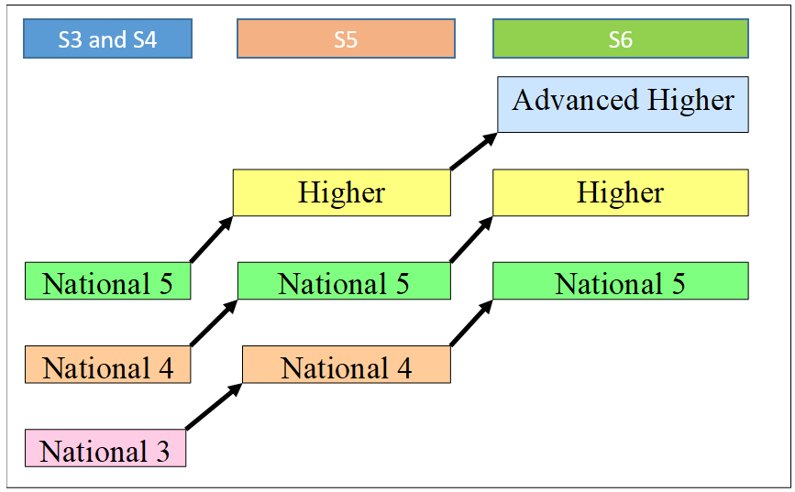
National pathways and progress

Slide 14
Your role as a parent/carer
Discuss your childs options with them at home.
PTPC will email home a copy of your childs option choices after their meeting.
Contact PTPC or DHT if you would like to discuss further.

Slide 15
Any questions?

