Slide 1
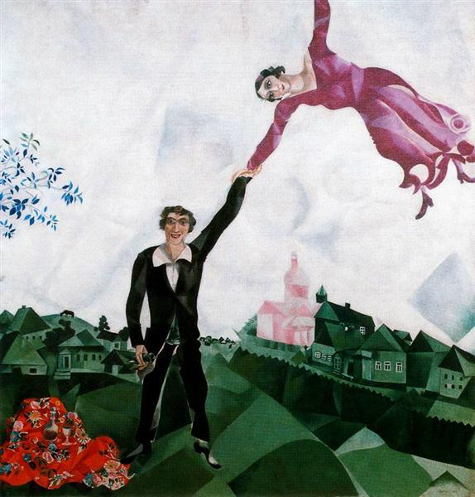
Language Portraits after Marc Chagall

Slide 2
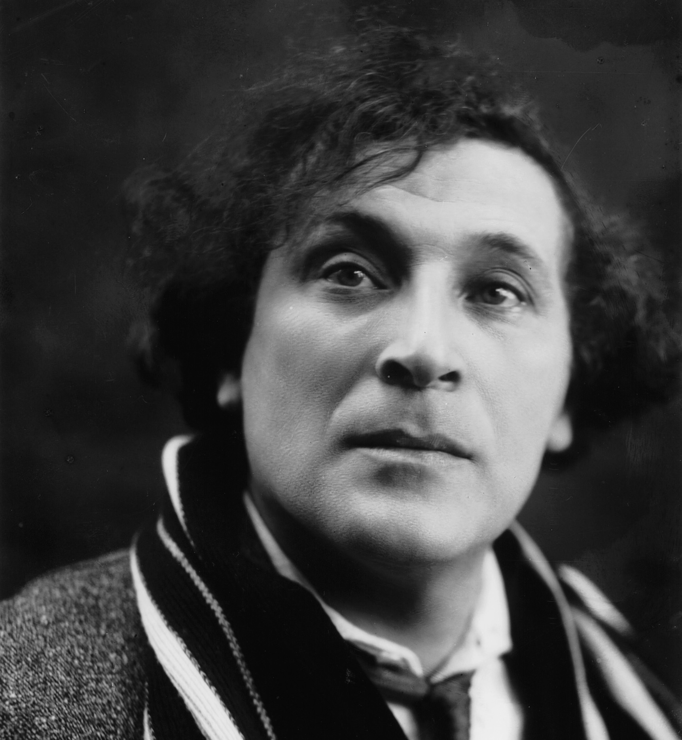
Marc Chagall
Marc Zakharovich Chagall (Moish Zakharovich Shagal) was born on 6 July 1887 in Vitebsk (then part of the Russian Empire) and died on 28 March 1985 in Paris.

Slide 3
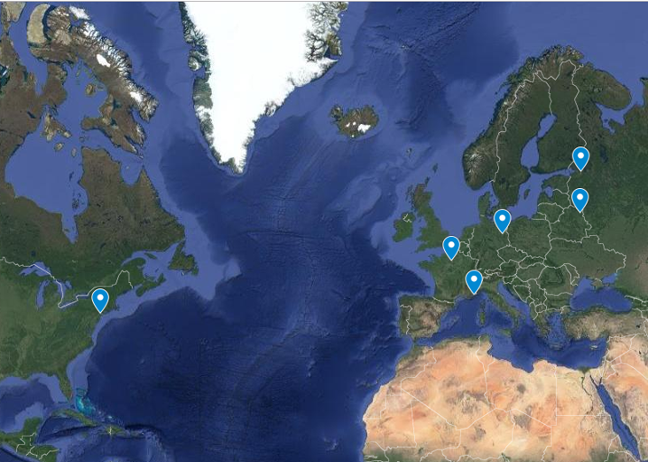
Marc Chagall – Language Biography
Hebrew
Aramaic
Russian
Marc Chagall grew up in Vitebsk in a Hasidic family. He spoke Yiddish at home and as a young boy learned to read and write Hebrew (with elements of Aramaic).
He entered Russian school at the age of 13, had difficulties learning Russian and did not do well academically at school. Eventually Russian became his dominant language. In 1906 he moved to Saint Petersburg to study.
In 1911 he first moved to Paris where he learned French ‘on the fly; according to witnesses, he spoke it fluently, though he always retained his Russian Yiddish accent’ (Lvovich).
In 1915 he married Bella (Berta Rozenfeld) and they moved to Saint Petersburg where in 1916 their daughter Ida was born. In 1918 they returned to Vitebsk but in 1922 emigrated to Lithuania, then to Germany, finally, in 1924 they moved to Paris.
In 1941 they fled to New York but Chagall never learned English. In 1944 Bella died and in 1948 he returned to Europe . He died in Paris in 1985.
Yiddish
Lithuanian?
French
English?
German?

Slide 4
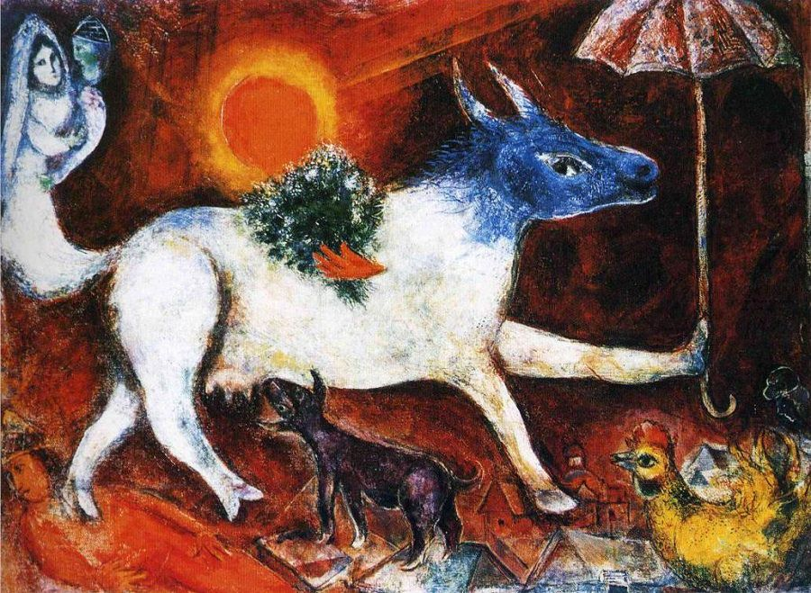
Idioms are word combinations that have a different figurative meaning than the literal meanings of each word or phrase.
Marc Chagall often literalized idioms in his paintings – he painted images that reflected the literal meaning of the words.

Slide 5
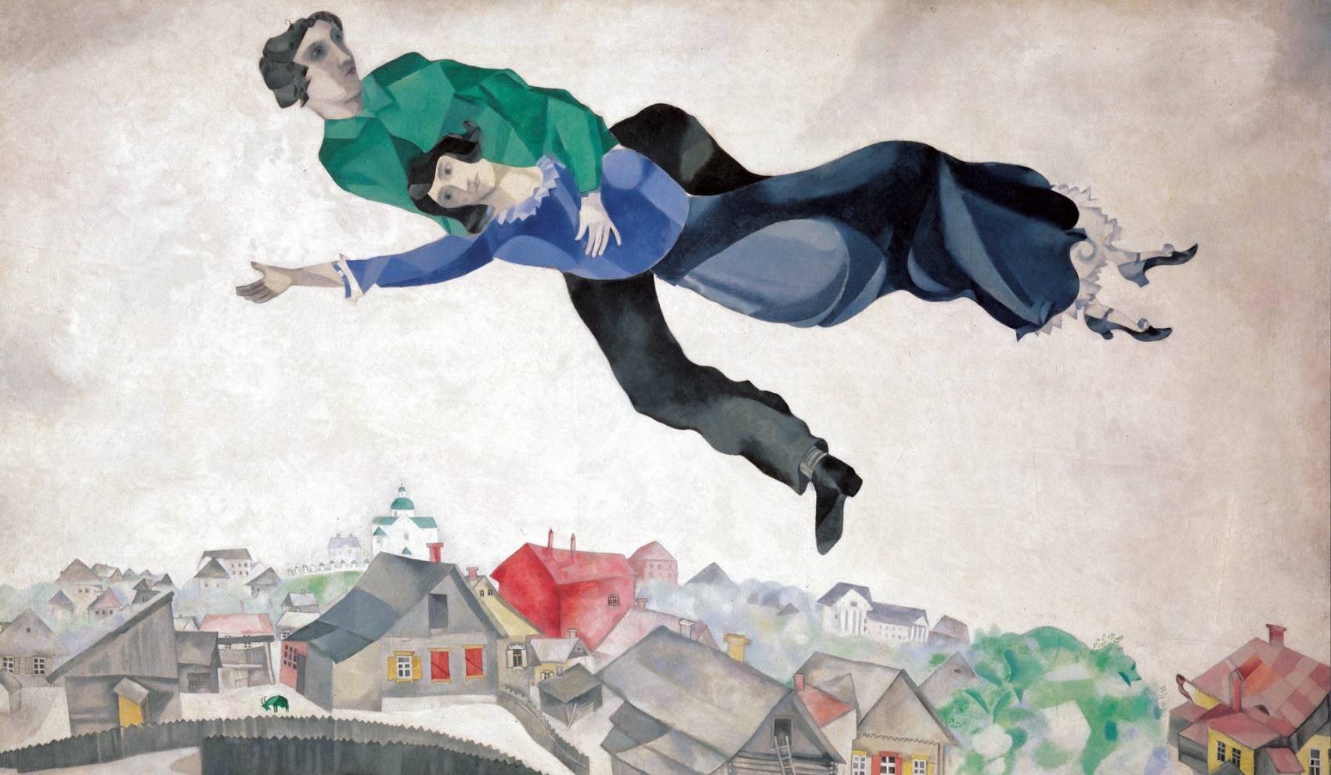
Marc Chagall: Over the town (2013)
“The word luftmensch / literally ‘man of the air’ denotes in Yiddish an individual overly involved in intellectual pursuits
Chagall, ever the dreamer—himself was the luftmensch he depicted.

Slide 6
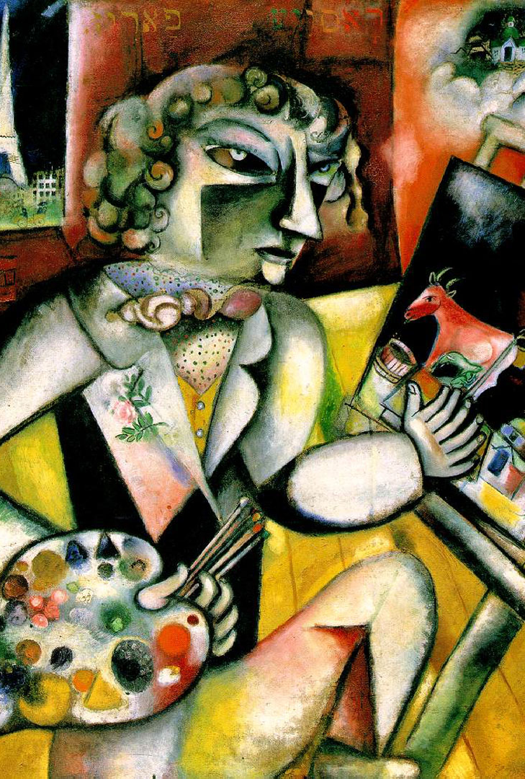
Marc Chagall: Self -portrait with seven fingers (1912-13)
In this portrait Chagall depicted another idiom: mit ale zibn finger / ‘doing something with all seven fingers’ meaning - doing one’s best, investing in the work one’s whole being.

Slide 7
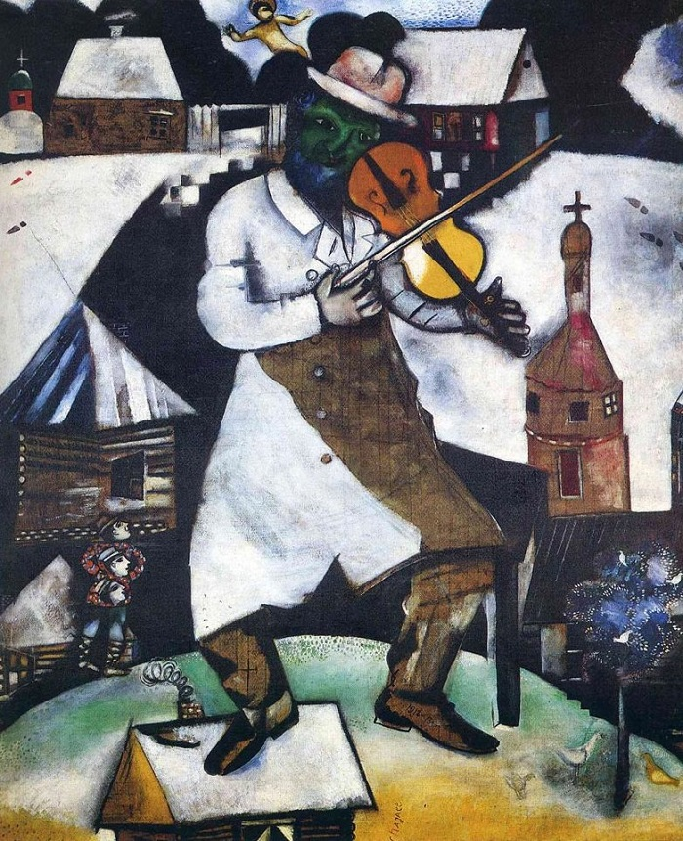
Marc Chagall: The Fiddler (1913)
A saying: Meshugener, arop fun dakh, literally means: ‘lunatic, get off the roof’
The meaning of it is that someone is a lunatic in a positive sense – a creative genius.

Slide 8
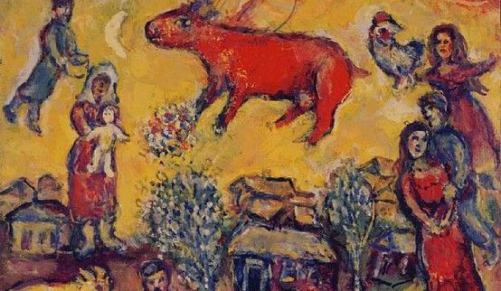
Marc Chagall: Red Cow in the Yellow Sky (1965)
Yiddish: a ku iz gefloygn ibern dakh un geleygt an ey/ a cow flew over the roof and laid an egg - is usually said to a person who imagines unreal, impossible, fantastic things.

Slide 9
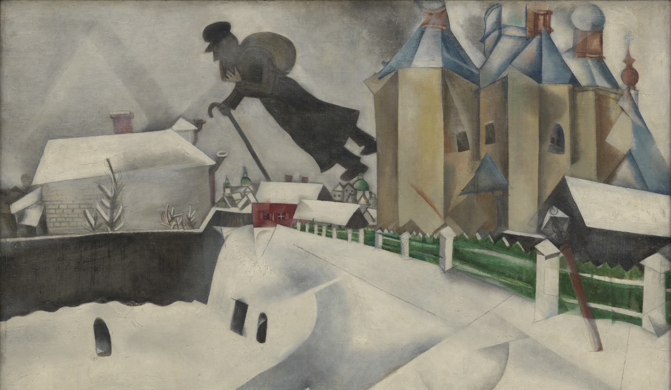
Marc Chagall: Over Vitebsk (1915-20)
Here Chagall literalized another Yiddish idiom: er geyt iber di hayzer, meaning “goes over the houses/from house to house,” i.e. is a beggar, showing a Jew with a sack on his back.

Slide 10
Marc Chagall: Paris par la fenêtre (1913)
In Russian one often calls a kiska/ ‘kitten’ a dear person - so some critics consider that the cat with a human face symbolises Bella.
Yiddish bashiremt / ‘covered with an umbrella’ – means protected by the destiny and here Chagall painted the umbrella as a parachute in the colours of French flag.

Slide 11
In hot water - Be in trouble
In the same boat - Be in the same situation
Out of the blue - With no warning
Piece of cake - Something very easy
Read between the lines - Find the hidden meaning
The icing on the cake - Something additional that turns good into great
Fell on deaf ears - People wouldn't listen to something
Get cold feet - Be nervous
I'm all ears - You have my full attention
A bull in a china shop - Someone who is very clumsy
Cry crocodile tears - To pretend to be upset
Put a bug in his ear - Make a suggestion
Raining cats and dogs - It is raining very hard
Stir a hornet's nest - To cause a lot of trouble
The world is your oyster - You can achieve whatever/go wherever you want
When pigs fly - To say something is impossible
All examples from:https://examples.yourdictionary.com/idioms-for-kids.html
Idioms are word combinations that have a different figurative meaning than the literal meanings of each word or phrase.
English Idioms:

Slide 12
“think of blue almonds” (myśleć o niebieskich migdałach) - daydream
“tell it straight from the bridge” (mówić prosto z mostu) - speak bluntly/ spill the beans
“fell from the Christmas tree/ from the moon” (urwać się z choinki/ spaść z księżyca) – be uninformed
“run where the pepper grows” (uciekać gdzie pieprz rośnie) or “where the devil says goodnight” (gdzie diabeł mówi dobranoc) – run like hell
„promise pears on a willow” (obiecywać gruszki na wierzbie) – promise the world
tell you to “stuff yourself with hay” (wypchać się sianem) - tell you to get lost
“It’s not my circus, not my monkeys” (to nie mój cyrk, nie moje małpy) – it’s not my problem.
Polish idioms:

Slide 13
From Polish translator Kinga Skorupska:
The idiom: Słoń nastąpił ci na ucho? Literal translation: “Did an elephant stomp on your ear?” What it means: “You have no ear for music.” Other languages this idiom exists in: Our translators tell us that in Croatian, there’s also a connection made between elephants and musical ability in the phrase, “You sing like an elephant farted in your ear (Pjevaš kao da ti je slon prdnuo u uho.).” But in the Latvian version, it’s a bear who stomps on your ear.
The idiom: Bułka z masłem. Literal translation: “It’s a roll with butter.” What it means: “It’s really easy.”
The idiom: Z choinki się urwałaś? Literal translation: “Did you fall from a Christmas tree?” What it means: “You are not well informed, and it shows.”

Slide 14
Urdu idioms:
The idiom: گل کھال وا gull khilana Literal translation: To blossom a flower. What it means: “to create problem”
The idiom: گووا ے ر تا taaray gin-naa Literal translation: To count the stars What it means: “to wake in night”
The idiom: ا پہ ں و ر وگا ا angaroon pe lautna Literal translation: To walk on burning coals What it means: “To be in serious trouble”

Slide 15
Czech idioms:
The idiom: Padají trakaře ("it's raining wheelbarrows") Meaning: it’s raining a lot
The idiom: Bouře ve sklenici vody. (A storm in a glass of water) Meaning: a small event that has been exaggerated out of proportion
The idiom: Lepší vrabec v hrsti nežli holub na střeše (Better a sparrow in the hand than a pigeon on the roof). Meaning:a small thing you have for sure is better than hoping for a big thing

Slide 16
Arabic idioms:
The idiom: Odrob el haddid wa howa hami / اضرب الحديد وهو حامي Literal meaning: Hit the iron while it’s hot. Actual meaning: Don’t postpone the issue; do not procrastinate.
The idiom: Eid wahda matsa’afsh / يد واحدة ماتسقفش Literal meaning: One hand doesn’t clap. Actual meaning: if something is to work, cooperation from all parties is necessary, usually said to encourage teamwork.
The idiom: لبس لي فيها ناقة ولا جمل / laisa lii fiiha naqa wa la jamal. Literal meaning: I don’t have a camel in the caravan. Actual meaning: this matter doesn’t concern me.
Example (translated): “If Tom didn’t have a camel in the caravan, he would rarely pay any attention to the matter.”.

Slide 17
Thai idioms:
หนีเสือปะจระเข้ (Nee seua, pa jarakay ) Literal meaning: “Escape the tiger only to meet a crocodile”. Actual meaning: When you get out of one problem but find yourself in a worse situation.
รู้อย่างเป็ด (roo yang bpet) Literal meaning: “To know in the manner of a duck”. Actual meaning: to be familiar with many things but a master of none.

Slide 18
Hindi idioms
The idiom:मक्खियाँ मारना [muhk-khih-yahn mahr-nah Literal translation: “to kill flies” What it means: “'to do nothing', sitting idle”
The idiom: आसमान सिर पर उठाना [ahs-mahn sihr puhr uthah-nah] Literal translation: “to keep the sky on your head” What it means: “to make a lot of noise', but its literal translation says ”
The idiom: उल्लू बनाना [uhlloo buh-nah-nah] Literal translation: “to make someone an owl” What it means: It means 'to prank someone, playing a practical joke on someone”
The idiom: हवा से बातें करना [huh-vah sey bah-teyn kuhr-nah] Literal translation: “'to talk with air” What it means: 'to run/walk very fast'. It's similar to saying 'Run like the wind' in English, but can also be used for other occasions when you are travelling fast like riding a motorcycle or driving a car
The idiom: अँगुली पर नचाना [uhn-gu-lee puhr nuh-chah-nah] Literal translation : 'to dance on one's (the person who makes the other do what he/she wants) finger’. It means 'to make some one do exactly what you want'

Slide 19
From German translator Johanna Pichler:
The idiom: Tomaten auf den Augen haben. Literal translation: “You have tomatoes on your eyes.” What it means: “You are not seeing what everyone else can see.” It refers to real objects, though — not abstract meanings.
The idiom: Ich verstehe nur Bahnhof. Literal translation: “I only understand the train station.” What it means: “I don’t understand a thing about what that person is saying.’”
The idiom: Die Katze im Sack kaufen. Literal translation: “To buy a cat in a sack.” What it means: That a buyer purchased something without inspecting it first.
Other languages this idiom exists in: We hear from translators that this is an idiom in Swedish, Polish, Latvian and Norwegian. In English, the phrase is “buying a pig in poke,” but English speakers do also “let the cat out of the bag,” which means to reveal something that’s supposed to be secret.

Slide 20
From Swedish translator Matti Jääro:
The idiom: Det är ingen ko på isen Literal translation: “There’s no cow on the ice.” What it means: “There’s no need to worry. We also use ‘Det är ingen fara på taket,’ or ‘There’s no danger on the roof,’ to mean the same thing.”
The idiom: Att glida in på en räkmacka Literal translation: “To slide in on a shrimp sandwich.” What it means: “It refers to somebody who didn’t have to work to get where they are.”
The idiom: Det föll mellan stolarna Literal translation: “It fell between chairs.” What it means: “It’s an excuse you use when two people were supposed to do it, but nobody did. It has evolved into the slightly ironic phrase, ‘It fell between the chair,’ which you use when you want to say,‘Yeah, I know I was supposed to do it but I forgot.’”

Slide 21
From Latvian translator Ilze Garda and Kristaps Kadiķis:
The idiom: Pūst pīlītes. Literal translation: “To blow little ducks.” What it means: “It means to talk nonsense or to lie.” Other language connections: In Croatian, when someone is obviously lying to someone, you say that they are “throwing cream into their eyes (bacati kajmak u oči).”
The idiom: Ej bekot. Literal translation: “‘Go pick mushrooms,’ or, more specifically, ‘Go pick boletes!'” What it means: “Go away and/or leave me alone.”

Slide 22
From French translator Patrick Brault:
The idiom: Avaler des couleuvres. Literal translation: “To swallow grass snakes.” What it means: “It means being so insulted that you’re not able to reply.”
The idiom: Sauter du coq à l’âne. Literal translation: “To jump from the cock to the donkey.” What it means: “It means to keep changing topics without logic in a conversation.”
The idiom: Se regarder en chiens de faïence. Literal translation: “To look at each other like earthenware dogs.” What it means: “Basically, to look at each other coldly, with distrust.”
The idiom: Les carottes sont cuites! Literal translation: “The carrots are cooked!” What it means: “The situation can’t be changed.” Other language connections: It’s bit like the phrase, “It’s no use crying over spilt milk,” in English.

Slide 23
From Russian translator Aliaksandr Autayeu:
The idiom: Галопом по Европам Literal translation: “Galloping across Europe.” What it means: “To do something hastily, haphazardly.”
The idiom: На воре и шапка горит Literal translation: “The thief has a burning hat.” What it means: “He has an uneasy conscience that betrays itself.”
The idiom: Хоть кол на голове теши Literal translation: “You can sharpen with an ax on top of this head.” What it means: “He’s a very stubborn person.”
The idiom: брать/взять себя в руки Literal translation: “To take oneself in one’s hands.” What it means: It means to get control of your emotions or actions (often after being very upset) Other languages this idiom exists in: Translators tell us that there is a German version of this idiom too: “Sich zusammenreißen,” which translates literally as “to tear oneself together.” And in Polish, the same idea is expressed by the phrase, “we take ourselves into our fist (wziąć się w garść).”

Slide 24
From Portuguese translators Gustavo Rocha and Leonardo Silva:
The idiom: Quem não se comunica se trumbica Literal translation: “He who doesn’t communicate, gets his fingers burnt.” What it means: “He who doesn’t communicate gets into trouble.”’
The idiom: Quem não tem cão caça com gato Literal translation: “He who doesn’t have a dog hunts with a cat.” What it means: “You make the most of what you’ve got.” Basically, you do what you need to do, with what the resources you have.
The idiom: Empurrar com a barriga Literal translation: “To push something with your belly.” What it means: “To keep postponing an important chore.”
The idiom: Pagar o pato Literal translation: “Pay the duck.” What it means: “To take the blame for something you did not do.”

Slide 25
From Japanese translators Yasushi Aoki and Emi Kamiya:
The idiom: 猫をかぶる Literal translation: “To wear a cat on one’s head.” What it means: “You’re hiding your claws and pretending to be a nice, harmless person.”
The idiom: 猫の手も借りたい Literal translation: “Willing to borrow a cat’s paws.”* What it means: “You’re so busy that you’re willing to take help from anyone.”
The idiom: 猫の額 Literal translation: “Cat’s forehead.” What it means: “A tiny space. Often, you use it when you’re speaking humbly about land that you own.”
The idiom: 猫舌 Literal translation: “Cat tongue.” What it means: “Needing to wait until hot food cools to eat it.”

Slide 26
From Kazakh translator Askhat Yerkimbay:
The idiom: Сенің арқаңда күн көріп жүрмін Literal translation: “I see the sun on your back.” What it means: “Thank you for being you. I am alive because of your help.”

Slide 27
From Croatian translator Ivan Stamenkovic:
The idiom: Doće maca na vratanca Literal translation: “The pussy cat will come to the tiny door.” What it means: “Essentially, ‘What goes around comes around.’”
The idiom: Da vidimo čija majka crnu vunu prede Literal translation: “We see whose mother is spinning black wool.” What it means: The oddball member of the family who does not fall in line with the others; the worst member of the family
The idiom: Muda Labudova Literal translation: “Balls of a swan.” What it means: “It means something that’s impossible.”
The idiom: Mi o vuku Literal translation: “To talk about the wolf.” What it means: “to be talking about someone, who then will appear. Other language connections: In Polish, “O wilku mowa” is the equivalent.

Slide 28
From Tamil translator Tharique Azeez:
The idiom: தலை முழுகுதல் (Thalai Muzhuguthal) Literal translation: “To take a dip or pour water over someone’s head.” What it means: “To cut off a relationship.”
The idiom: தண்ணீர் காட்டுதல் (Thanneer Kaattuthal) Literal translation: “Showing water to someone.” What it means: “It means to be someone’s nemesis.”

Slide 29
From Dutch translator Valerie Boor:
The idiom: Iets met de Franse slag doen Literal translation: “Doing something with the French whiplash.” What it means: doing something hastily.
The idiom: Iets voor een appel en een ei kopen Literal translation: “Buying something for an apple and an egg.” What it means: you bought it very cheaply. Other language connections: Spanish translator Camille Martínez points out out that when something is expensive in English, you pay two body parts for it (“it cost me an arm and a leg”), whereas in Spanish you only pay one — either a kidney (“me costó un riñón”) or an eye (“me costó un ojo de la cara”).

Slide 30
From Korean translator Jeong Kinser:
The idiom: 똥 묻은 개가 겨 묻은 개 나무란다 Literal translation: “A dog with feces scolds a dog with husks of grain.” What it means: One should not talk down to one of higher social standing, when one has nothing to back it up with
The idiom: 오십보 백보 Literal translation: “50 steps are similar to 100 steps.” What it means: Meaning: the two alternatives are equivalent or indifferent
Example (translated): “I can take the bus or the subway to get home; during rush hour 50 steps are similar to 100 steps.”

Slide 31
From Serbian by Sanja Pejovic
1. KAD NA VRBI RODI GROŽDJE (When weeping willow tree bears grapes). Means: Never.
2. BOGU IZA LEDJA (Behind God’s back). Means: Very far away or in a godforsaken place.
3. U LAŽI SU KRATKE NOGE (A lie has short legs). Means: A lie will be quickly revealed.
4. PAO S MARSA (Fell down from Mars). Meaning: Hasn’t got a clue.
5. PROSTO K’O PASUL (As simple as beans). Meaning: Very easy.
6. KOŠTALO GA K’O SVETOG PETRA KAJGANA (It cost as much as St Peter paid for his scrambled eggs). Meaning: Very expensive.
All the translators’ examples are from: https://blog.ted.com/40-idioms-that-cant-be-translated-literally

Slide 32
Now, it’s your turn!

Slide 33
Marc Chagall: Paris par la fenêtre (1913)
Annotating excercise

Slide 34
Instructions
Look at the painting provided - Marc Chagall: Paris par la fenêtre (1913). Can you see any starange things happening there? Use sticky notes to explain what you think they may mean.
Browse through the idioms provided. Consider their literal and actual meaning.
Select two idioms (each idiom must be from a different language) and think how you can combine them in one painting. Think about the composition, how the elements will look together and about the message they will convey.
Cut the idioms out place them next to the piece of paper and paint your painting.
Once the paint is dry use glue to stick the cut out words onto the page so they are part of the artwork. Feel free to cut out each word separately and spread them as you like.

Slide 35
Bibliography:
Lvovich, Natasha, "Translingual Identity and Art: Marc Chagall's Stride Through the Gate of Janus" (2015). CUNY Academic Works. https://academicworks.cuny.edu/kb_pubs/149
Netography:
https://examples.yourdictionary.com/idioms-for-kids.html
https://blog.ted.com/40-idioms-that-cant-be-translated-literally
http://www.inthisplayground.com/portfolio/fotoplay-at-princeton/

