Slide 1
Solfa Hand signs

Slide 2
What are solfa hand signs?
Hand signs provide a helpful visual representation of the different pitches (notes) used in a song.
They help by:
• Attaching a simple visual reference to each pitch
• Visually demonstrating the relationship between pitches in terms of higher and lower

Slide 3
do
Every pitch of the musical scale is given a solfa name (a singing name).
Click on the ball to hear them.
ti
la
so
fa
Simply sing the singing names using the same pitches made by the piano. Click the ball again to try this.
Note: “do” is pronounced like “dough”, not “doo”.
mi
re
do

Slide 4
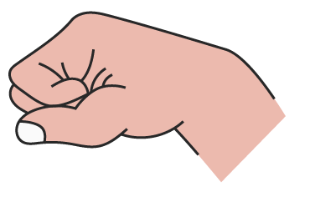
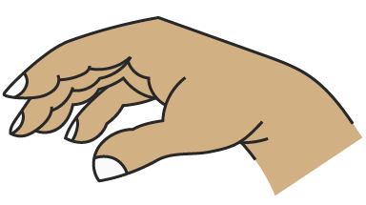
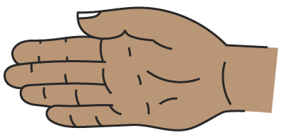
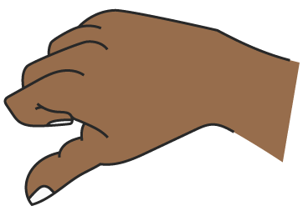
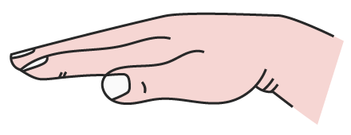
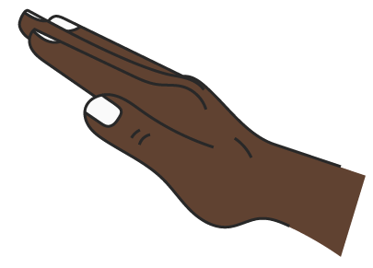
do
As we sing each singing name, we also make the following hand signs in front of our body.
It is important to show the pitches physically going up and down. Low “do” should be around your belly button, “mi” at chest height, “so” at eye level and high “do” just above your head.
ti
la
so
fa
mi
re
do
Adapted from: VanderGraaf, Z. (n.d.) What is a Kodaly Hand Sign Ladder? [Online]. Available at https://dynamicmusicroom.com/kodaly-hand-sign-ladder/ (Accessed 20/12/21).

Slide 5
Top tips for clear hand signs
• To show consecutive sounds all at the same pitch, gently bounce your hand away from your body to show each individual sound.
• Make sure your different hand signs are shown at different heights. “So” is higher pitched than “mi” and this is reinforced by signing “so” physically higher up than “mi”.

