Slide 1
Analysis Questions – Textual Analysis
Exam Prep
Some general points about analysis questions:
The questions posed will always give some sort of focus for the analysis, e.g. ‘Explain how the writer uses word choice to express his contempt for …’
Analysis should be detailed and specific to the given context and question focus. Generic analysis will not address the demands of specific tasks.

Slide 2
Analysis Questions – Textual Analysis
Exam Prep
Some general points about analysis questions:
Equally, simply stating which technique has been used will score nothing at Higher level.

Slide 3
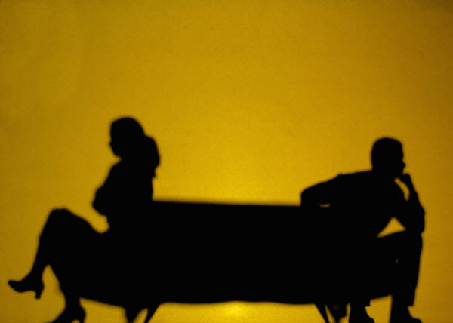

Textual Analysis – Exam Prep
Focus on – Imagery (1)
Simile: A comparison of two things using ‘like’ or ‘as’, e.g. ‘she turned as white as a sheet’.
Metaphor: A comparison of two things by saying that one thing is the other, e.g. ‘she was a shadow of her former self’.
Personification: When an inanimate object is given human qualities, e.g. ‘the wind howled around her’.

Slide 4
Textual Analysis – Exam Prep
Focus on – Imagery (2)
In order to analyse imagery, you need to ask yourself the following question, which then becomes the basic structure for your answer (see table below):
What is being compared to what and why?
Identify technique | The writer uses [metaphor/simile/personification] to …
What? | compare …
What? | with …
Why? (must link to focus of question) | which shows …

Slide 5
Textual Analysis – Exam Prep
Focus on – Imagery (3)
Modelled response
‘It was a good tree by the sea-loch, with many cones and much sunshine; it was homely too with rests among its topmost branches as comfortable as chairs.’ (p. 7)
Question: Explain how Jenkins uses imagery in the opening paragraph of his novel to create the impression of the forest as an idyllic setting.

Slide 6
Textual Analysis – Exam Prep
Focus on – Imagery (4)
Modelled response
‘It was a good tree by the sea-loch, with many cones and much sunshine; it was homely too with rests among its topmost branches as comfortable as chairs.’ (p. 7)
Question: Explain how Jenkins uses imagery in the opening paragraph of his novel to create the impression of the forest as an idyllic setting.
Identify technique | Jenkins uses the simile ‘as comfortable as chairs’ to
What? | compare the branches of the tree
What? | with a comfortable chair
Why? (must link to focus of question) | which creates an idyllic setting as it suggests that those who work in the tree feel at one with nature as though they were in their own home and the overall initial impression of the setting is therefore a positive one

Slide 7
Textual Analysis – Exam Prep
Focus on – Imagery (5)
Modelled response
Unsatisfactory responses
The writer uses a simile to create an idyllic setting | X 0 credit awarded for merely identifying a technique and repeating the question
The writer uses a simile to help you get a better picture in your head of what it is like | X A commonly used, generic response to imagery questions which could apply to any example and therefore scores 0
The writer compares the branches to chairs, which suggests they are comfy | X No specific reference to the focus of the question nor to which technique of imagery has been employed by the writer

Slide 8
Textual Analysis – Exam Prep
Focus on – Imagery (6)
Your
response
You must now answer the following questions, using the model answer to help guide you.
All you have to do is apply the same process to different quotations (all of which are examples of imagery)

Slide 9
Textual Analysis – Exam Prep
Focus on – Imagery (7)
Your
response
‘thrilling as a pipe lament across the water, daylight announced it must go’ (p. 8)
Question: Explain how Jenkins uses imagery in the opening paragraph of his novel to create the impression of the forest as an idyllic setting.

Slide 10
Textual Analysis – Exam Prep
Focus on – Imagery (9)
Your
response
‘Dusk like a breathing drifted in among the trees’ (p. 8)
Question: Explain how Jenkins uses imagery in the opening paragraph of his novel to create the impression of the forest as an idyllic setting.

Slide 11
Textual Analysis – Exam Prep
Focus on – Imagery (10)
Your
response
‘all the magnificent sombre harmonies of decay, became indistinguishable’ (p. 8)
Question: Explain how Jenkins uses imagery in the opening paragraph of his novel to create the impression of the forest as an idyllic setting.

Slide 12
Textual Analysis – Exam Prep
Focus on – Imagery (11)
Your
response
‘The scent of the tree seemed to strengthen with the darkness, until Calum fancied he was resting in the heart of an enormous flower’ (p. 9)
Question: Explain how Jenkins uses imagery in the opening paragraph of his novel to create the impression of the forest as an idyllic setting.

Slide 13
Textual Analysis – Exam Prep
Focus on – Word choice (1)
You will need to be able to analyse the choice of vocabulary made by the author and its
impact on meaning.
As with questions on imagery, responses to questions on word choice should be specific to the given focus of the question.

Slide 14
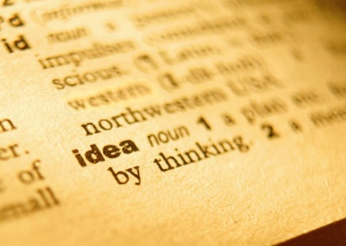
Textual Analysis – Exam Prep
Focus on – Word choice (2)
In order to answer word choice questions, learners need to understand two basic principles of semiotics. The analysis of word choice essentially becomes one of denotation vs connotation:
Denotation:
the literal meaning of a word, its basic definition.
Connotation:
an idea or feeling which a word invokes in addition to its literal or primary meaning.
.

Slide 15
Textual Analysis – Exam Prep
Focus on – Word choice (3)
In order to understand the idea of denotation vs connotation, you can try making up tables like the ones below, where words with the same basic meaning are compared.
For the two examples given, the focus is the degree of comfort suggested by the words used to describe the temperature.

Slide 16
Textual Analysis – Exam Prep
Focus on – Word choice (4)
Word choice example | Denotation | Connotation
Chilly | Cold | Suggests a mild discomfort
Freezing | Cold | Suggests increased discomfort and possible danger
Perishing | Cold | Hypothermic coldness that can cause death; extreme discomfort

Slide 17
Textual Analysis – Exam Prep
Focus on – Word choice (5)
Word choice example | Denotation | Connotation
Warm | Hot | A pleasant, comfortable heat
Boiling | Hot | Heat that causes discomfort such as sweating and airlessness
Blistering | Hot | Heat that can harm and cause the skin to break; extreme discomfort

Slide 18
Textual Analysis – Exam Prep
Focus on – Word choice (6)
You can make up you own tabulated examples with a focus on an increased degree of intensity using denotations such as good, bad, raining, sunny, happy, sad, angry etc.
As with imagery, there is a question that you can ask yourself which then frames the structure of your response:
What word has the writer chosen, what word could they have used instead and what impact does the writer’s choice have on understanding, impact, emotion etc.?

Slide 19
Textual Analysis – Exam Prep
Focus on – Word choice (7)
What word? | The writer’s choice of [quotation] …
What alternative? | to show …
What does it add? (must link to focus of question) | has connotations of …, which suggests/show/increases the reader’s understanding of …

Slide 20
Textual Analysis – Exam Prep
Focus on – Word choice (8)
Modelled
response
‘But now the wood was invaded and defiled’ (p. 18)
Question: Explain how Jenkins uses word choice to show the strength of Duror’s feeling at the brothers’ presence in the forest.
What word? | Jenkins’ uses the word ‘defiled’
What alternative? | to show that Duror does not like the brothers being in the forest
What does it add? (must link to focus of question) | ‘defiled’ has connotations of a perversion of something innocent and pure, and shows that Duror feels that the damage done by the brothers’ presence in the woods is irreversible, which is an extreme view

Slide 21
Textual Analysis – Exam Prep
Focus on – Word choice (9)
Modelled
response
Unsatisfactory Responses
The writer uses word choice when he writes ‘defiled’ | X Quotation only = 0 credit
The writer shows that Duror doesn’t like the brothers and finds them disgusting | X No quotation therefore analysis is unfocused and discussion of connotations not possible
The writer’s word choice of ‘defiled’ helps you get a better impression of how strong Duror’s feelings towards the brothers are | X Generic analysis of any example of word choice and therefore 0 credit; also, just repeats the question

Slide 22
Textual Analysis – Exam Prep
Focus on – Word choice (10)
Your
response
You must now answer the following questions, using the model answer to help guide you.
All you have to do is apply the same process to different quotations (all of which are examples of word choice)

Slide 23
Textual Analysis – Exam Prep
Focus on – Word choice (11)
Your
response
The following questions all contain further examples of word choice from the opening chapter of the novel that show the strength of Duror’s feelings towards the brothers (same focus as worked example) and which you must now work through using the above structure:

Slide 24
Textual Analysis – Exam Prep
Focus on – Word choice (12)
Your
response
No one else found their presence obnoxious’ (p. 12)
Question:
Explain how Jenkins uses word choice to show the strength of Duror’s feeling at the brothers’ presence in the forest.

Slide 25
Textual Analysis – Exam Prep
Focus on – Word choice (13)
Your
response
‘Duror was alone in his obsession’ (p. 12)
Question:
Explain how Jenkins uses word choice to show the strength of Duror’s feeling at the brothers’ presence in the forest.

Slide 27
Textual Analysis – Exam Prep
Focus on – Word choice (14)
Your
response
‘an accumulated horror, which the arrival of these cone-gatherers seemed at last about to let loose’
(p. 13)
Question:
Explain how Jenkins uses word choice to show the strength of Duror’s feeling at the brothers’ presence in the forest.

Slide 28
Textual Analysis – Exam Prep
Focus on – Word choice (15)
Your
response
‘he felt he was leaving behind him in that hut something unresolved, which would never cease to torment him’
(p. 22)
Question:
Explain how Jenkins uses word choice to show the strength of Duror’s feeling at the brothers’ presence in the forest.

