Slide 1
The Cone-Gatherers
By Edward, Rebekah, Samantha and Ellie

Slide 2
The Order of Social Class
Lady Runcie-Campbell
Rodderick & Sheila
Tulloch
Duror
Graham
Neil
Calum

Slide 3
Lady Runcie-Campbell
High class
Q-“She was the mistress of this estate: if respect and honour were due to her on that account, they must be earned; the accidental possession of greater material wealth was not sufficient” Page 146.
A- this shows that Lady Runcie-Campbell is at the top of the class order because she owns the estate that the cone gatherers work on.
Q- “Of the mansion behind its private fence of giant silver firs” Page -1
A- this gives connotations of luxury and wealth and the word “private” suggests others such as the cone-gatherers/poor people are not allowed within this boundary. “Fence” is also a symbol that there is a real division between rich and poor and finally “giant” gives connotations of this division being huge.
Beach Hut Scene

Slide 4
Roderick and Sheila
Q- “Roderick is unlike his mum. He likes the cone gatherers - “It is one of the very big trees at the end of the park; a silver fir” Page - 163
A- Roderick chooses the climb a tree which is symbolic of the huge barrier between classes. He wishes to join the cone gatherers and pick cones – he aligns himself with the “green abundant future” of the new wood, not the barren past or the anguished present. However he also wants the cone gatherers to get back in favour with LRC, he hopes that if they help him she will let them stay.
Q-“We carried dogs in the car”
A- Roderick’s innocence is shown in the way that he has not grasped the differences between social classes. The incident with the car foreshadows a larger social conflict later when Roderick will believe again that his mother acts unreasonably towards the cone gatherers.

Slide 5
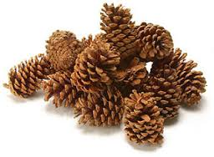
Tulloch
Lower class
Q- “As Mr Tulloch walked through the wood to visit the cone-gatherers”
A- This shows that Tulloch is slightly above the cone-gatherers in social class as he is still accepted by LRC however he sees himself as equal with them and he wants to show them that he sees them as equals

Slide 6
Duror
Lower class
Q-“Duror took an ill turn,’ she explained sharply. ‘I think, Duror,’ she said, turning to him, the quicker we get you home the better”
A-This shows Duror’s class as Lady Runcie Campbell is helping him when he is ill because if it was Calum who took an ill turn, Lady Runcie Campbell would definitely not support him.

Slide 7
Graham
Lower class
Q-“Graham glanced at the deer and keeper. Which beast, your ladyship? He wanted to ask” Page - 71
A- This shows that because he wanted to ask LRC this but chose not to, emphasises that he is below LRC in the class order but also above Duror.

Slide 8
Neil
Lowest class
Q- “He gazed at the great house with calm. Yet bitter intentness” Page -1
A- The word “gazed” shows that Neil is in a trance over how beautiful the house is however the words “bitter intentness” contrasts with this because it emphasises that Neil knows that he will never be that high in the class order and he’s not that happy with it.

Slide 9
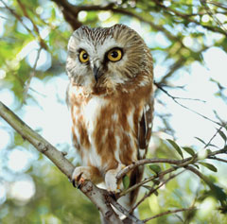
Calum
Lowest class
Q-“His left knee visible through a hole rubbed in his trousers” Page-2
A- this shows that Calum is the lowest in the order of class as he is unable to wear appropriate clothes as he does not have the money. It also shows how labour intensive Calum’s work is because he has managed to rub a hole into his trousers.
Q- “He kept chuckling to them” Page-2
A- This emphasises Calum’s innocence and child like qualities as he is laughing at the birds when they land on his head and shoulder. This emphasises why Calum is at the bottom of the class order as he acts as a child.

