Slide 1
FACULTY OF TECHNOLOGIES
THE DEPARTMENT FOR WORK

Slide 2
“All our dreams can come true, if we have the courage to pursue them.”
–Walt Disney

Slide 3
ADMINISTRATION & IT
Develop IT skills and use technologies to get a job

Slide 4
ADMINISTRATION & IT
LEARN SKILLS THAT EMPLOYERS WANT
LEARN ABOUT MOST COMMON SOFTWARE PACKAGES
LEARN HOW TO COMMUNICATE WITH THE PUBLIC
BE EMPLOYABLE

Slide 5
BUSINESS MANAGEMENT
Learn and develop awareness of ways in which society relies on business

Slide 6
BUSINESS MANAGEMENT
LEARN SKILLS TO SUCCEED IN LIFE
LEARN ABOUT BUSINESS PRINCIPLES
DEVELOP EMPLOYABILITY SKILLS
BE EMPLOYABLE

Slide 7
COMPUTING SCIENCE
Develop a range of computing and computational thinking skills

Slide 8
COMPUTING SCIENCE
SHAPE THE WORLD IN WHICH WE LIVE
UNDERSTAND COMPUTATIONAL PROCESSES
COMPUTERS ARE USED IN EVERYTHING
BE EMPLOYABLE

Slide 9
COMPUTER GAMES DEVELOPMENT
Learn how to produce high quality, innovative and exciting games

Slide 10
COMPUTER GAMES DEVELOPMENT
LEARN HOW TO MAKE COMPUTER GAMES
LEARN ABOUT GRAPHICS
LEARN ABOUT CODING
BE EMPLOYABLE

Slide 11
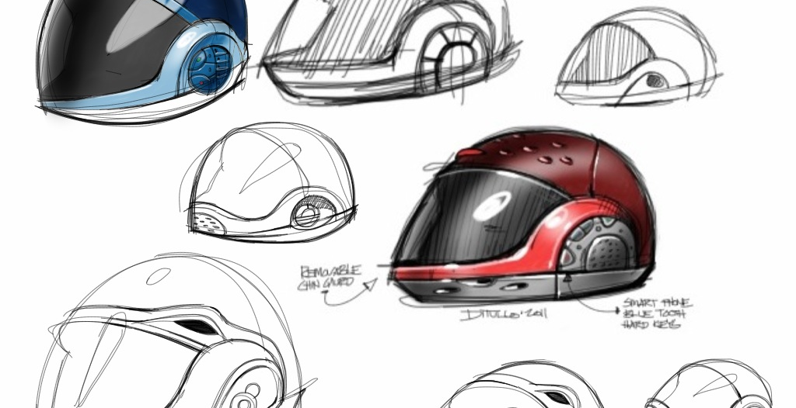
DESIGN AND MANUFACTURE
A broad and practical experience in product design and manufacture

Slide 12
DESIGN AND MANUFACTURE
ENHANCE YOUR CREATIVE AND PRACTICAL SKILLS
UNDERSTAND MANUFACTURING PROCESSES
USE YOUR IMAGINATION, CREATIVITY, LOGICAL THINKING TO APPLY PRACTICAL SKILLS
BE EMPLOYABLE

Slide 13
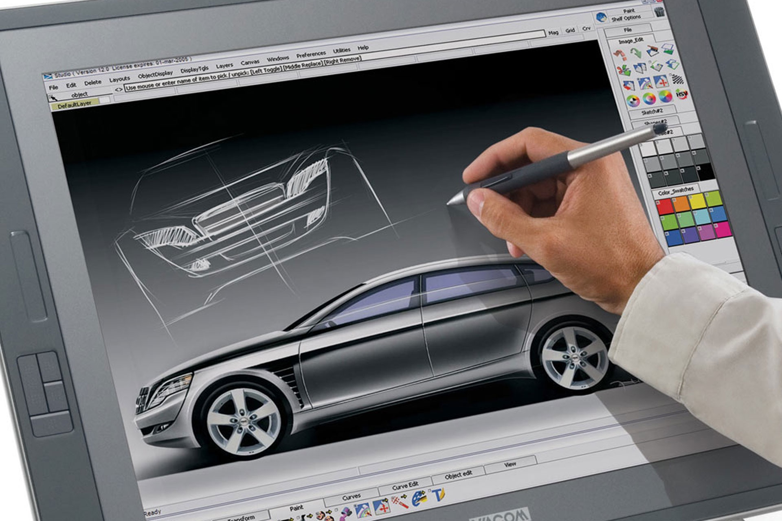
GRAPHIC COMMUNICATION
Develop skills in graphic communication techniques

Slide 14
GRAPHIC COMMUNICATION
DEVELOP SKILLS IN GRAPHIC COMMUNICATION TECHNIQUES
LEARN TO DEVELOP AND COMMUNICATE IDEAS GRAPHICALLY
ENGAGE WITH TECHNOLOGIES
BE EMPLOYABLE

Slide 15
JOIN US IN TECHNOLOGIES AND FIND YOUR PERFECT JOB!

