Slide 1
Higher: Factors Impacting on Performance- Physical - Tactics
Bellahouston Academy

Slide 2
Tactics
Tactics are a GAME PLAN that a team or a player uses to help them gain an advantage over their opponents.
A tactic should work to YOUR STRENGTHS and take advantage of your OPPONENTS WEAKNESSES

Slide 3
Your Strengths
A good tactician will play to their strengths.
For example: In football if a team has a prolific goal scorer who is excellent in the air, your tactic may be to put high crosses into the box, to create more GOAL SCORING OPPORTUNITES
In basketball if you have a very tall centre you may try to play a high, lobbed pass into them as they can shoot over the top over their marker.

Slide 4
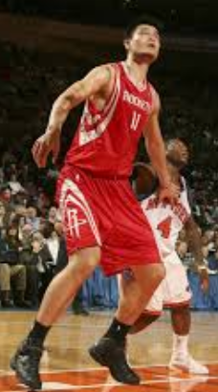
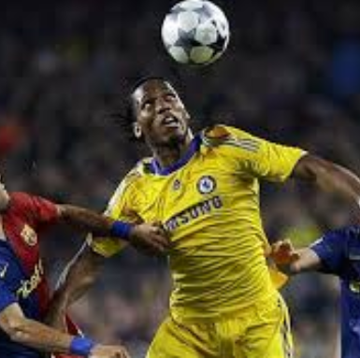
Strengths

Slide 5
Strength- Task
In pairs, choose a sport and one strength that you have in this sport.
In your jotters- Name a sport and your strengths in this sport. Describe a tactic you could use to play to this strength.

Slide 6
Opponent’s Weaknesses
It is equally as important to consider your opponents weaknesses when choosing your tactic.
In football if your opponents strikers are slow you may choose to play a high back line
In basketball if your opponents are weak outside shooters, you may choose to play a zone to force outside shots.

Slide 7
Opponents Weaknesses
In pairs pick a sport and a possible weakness that you opponents may have.
In your jotters your should describe this weakness and how you could take advantage of it.

Slide 8
Width in Attack
Width in attack is a very useful tactic in sports such as rugby, hockey and football.
It helps a team to progress up the pitch using the space out wide.
In football it gives teams the chance to cross the ball into the box to create goal scoring opportunities.

Slide 9
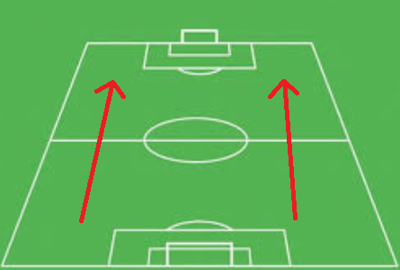

Slide 10
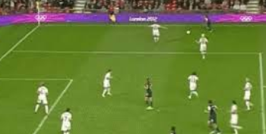
Width in Attack
Because my team has 2 VERY QUICK WINGERS, we used the tactic WIDTH IN ATTACK. This lets our QUICK wingers RUN PAST opponents to get into OPEN SPACE. They then have more TIME to play an ACCURATE cross into the box which gives us a GOAL SCORING OPPORTUNITY

Slide 11
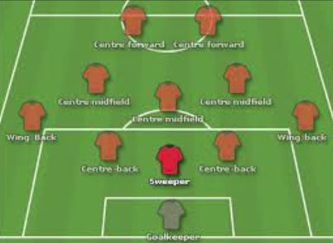
Depth in Defence
Depth in Defence is a tactic used in invasion games such as football to prevent teams from gaining goal scoring opportunities.
Teams may use a “SWEEPER” whose job is to sit behind the other defenders and clear away any danger.

Slide 12
Depth in Defence
Depth in Defence is a good tactic as it can limit your opponents ability to penetrate your defence and limits them to out side shots which are less accurate.
My team used a SWEEPER as a tactic in football. This tactic is good as the sweeper was able to clear away any long crosses and prevented one on ones with the goalkeeper. This forced my opponent into making outside shots which are less accurate.

Slide 13
Zone Defence
Another defensive tactic that teams can use to try and prevent their opponents from scoring is a zone defence.
Although used in many sports it is particularly effective in basketball.
The most common types of zone are a 2-3 and a 2-1-2 zone.

Slide 14
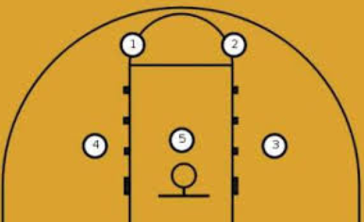
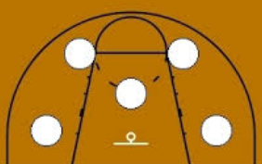
Zone Defence- Basketball
The main advantage of a zone defence is that it “should” prevent easy drives towards the basket.
A good zone will force outside shots which are generally less accurate

Slide 15
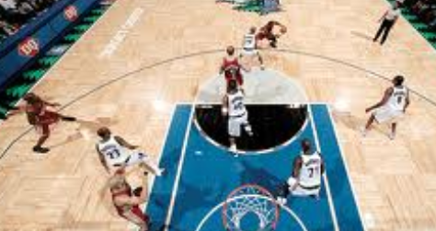
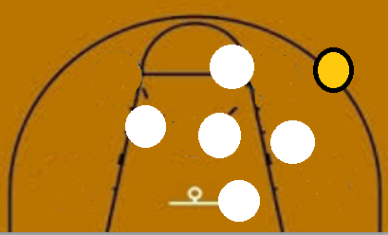
Zone Defence
Rather than marking an opposing player, in a zone defence each player marks an area.
They keep their shape and move around as the ball moves.

Slide 16
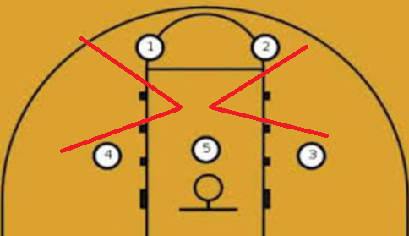
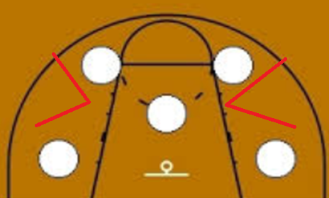
Zone Defence- Weaknesses
There are areas in each zone that are weak to penetration from attackers.
Attackers may expose these weak points to gain access to the basket

Slide 17
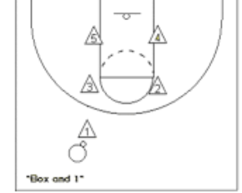
Zone Defence- Weaknesses
A zone is less effective against an excellent outside shooter.
If this happens
teams could play
a box and 1 were
1 defender leaves
the zone and man
marks the good
shooter.

Slide 18
Offense- Fast Break
A fast break is a counter attacking tactic used in basketball to score a basket before the opposition have set up their defence.
It is very effective against a zone defence as the other team do not get time to go into their positions. Which means players have more time and can shoot uncontested shots.
It is very tiring and can become predictable if it is over used. Good Speed and CRE are required.

Slide 19
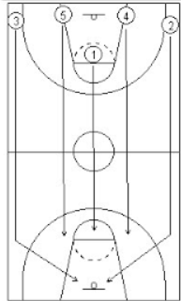
Fast Break
The tall centre (5) or Power Forward (4) rebounds the ball.
They outlet pass to the fast, point guard (1)
The PG dribbles the ball up the middle of the court
The Small Forward (3) and Shooting Guard (4) FILL THE LANES and run up the side of the court.
The PF and C also run up the court to give support.
This gives the PG lots of attacking options.

Slide 20
Summary
Tactics are a GAME PLAN or STRATEGY teams USE to help them WIN.
Tactics will play to a TEAMS STRENGTHS and take ADVANTAGE of an OPPONENTS WEAKNESS
Width in Attack, Depth in Defence, Fast Break and Zone Defence are all examples of tactics.
Each tactic has different advantages and disadvantages that must be considered before using them.

