Slide 1
Higher: Factors Impacting on Performance- Social
Bellahouston Academy

Slide 2
Social Factors
Social factors covers a wide variety of terms such as;
Team work
Etiquette
Environmental Issues (Audience, facilities etc.)

Slide 3
Social- Gathering Information
There are many ways to gather information on social factors;
Questionnaire
Self Appraisal
Team feedback
Environmental Checklist

Slide 4
Feedback
Feedback can either be INTERNAL or EXTERNAL and comes in many forms;
Written- (Self evaluations, observation schedules)
Verbal- (Teacher, Coach, Partner)
Visual- (Video recordings)
Kinaesthetic- (You can feel how well you are performing)

Slide 5
Social- Data Gathering
Because data gathering for social involves a lot of feedback, the reliability and validity of each methods relies on the honesty and experience of the observer.
Because my teacher is experienced, honest and understands the test criteria, the results were valid and accurate.

Slide 6
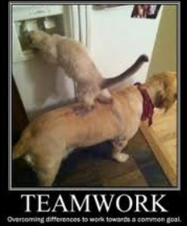
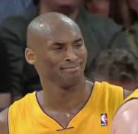
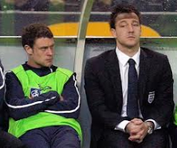
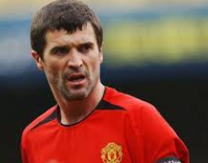
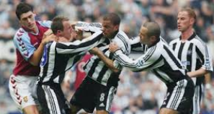
Social- Team Work
The ability to work well in a team is a vital skill in all aspects of life.
Many players are fantastic individual players but they do not get on well with their team
Task: Can you name a player like this?

Slide 7
Social- Team Work
Poor teamwork can have negative impacts on your performance such as;
You may make the wrong decision about passing or shooting if you do not like your team mate
Your manager may choose not to play you because you upset the team dynamics
You are less likely to enjoy your sport which may reduce your motivation to succeed.

Slide 8
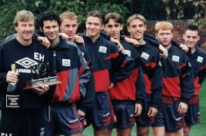
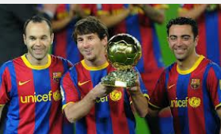
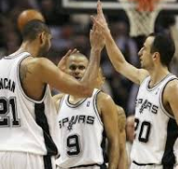
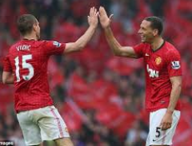
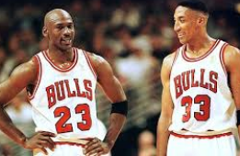
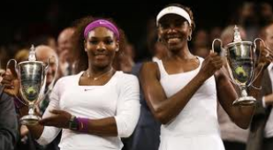
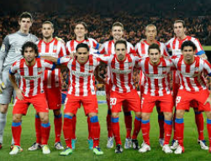
Team Work Makes the Dream Work
Good team work can help to turn a average team into world beaters.
Can you name any teams or players within a team who work really well together?

Slide 9
Team Work
The ability to work well with your team mates has many advantages;
You will know each team mates strengths and weaknesses well, this will help with your decision making.
As I knew that my team mate was very good with his head, I played a high cross into the box instead of a low one.

Slide 10
Social- Team Work
You will know how best to motivate other players and they will understand how to motivate you.
You will work harder for your team because you don’t want to let them down.

Slide 11
Social- Etiquette
Etiquette is a fancy word for sportsmanship
Showing good etiquette in a game is an UNWRITTEN RULE
This means that you cannot be punished for not obeying the rule, but it is bad manners and un-sportsman like to do so.

Slide 12
Social- Etiquette
Task: Name as many examples of etiquette as you can.
Shaking hands before/ after the game
Picking you opponent up if they fall after a tackle
Thanking the officials after the match
Being polite to the officials
Congratulating your opponent if they beat you
Apologising for a lucky net shot in tennis
In rugby, 3 cheers for the other team after the match

Slide 13
Social- Etiquette
Showing etiquette is very important in all activities
It creates a friendly playing environment
It helps to promote good behaviours and attitudes

Slide 14
Social- Environment
Environmental factors can have either a positive or negative effect on performance.
A lack of available facilities will influence performance as you will be unable to train as often
If you are playing outdoors and it is windy, this could affect your performance and you may need to change you game plan.
Because it was windy outside I decided to play the ball along the ground as often as I could. This meant that I was more accurate with my passing as the wind was not knocking the ball off course as often.

Slide 15
Social- Environment
Playing in front of an audience is another social factor which can have either a positive or negative effect on performance.
If an audience is supporting you, you may feel more motivated, happy and this may help you to perform your skills more effectively
You may step up your performance in front of an audience.

Slide 16
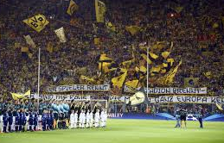
Social- Environment
However for some people playing in front of an audience is a negative factor
A hostile audience may put you off your game and demotivate you
You may feel nervous and this could lead to you making bad decisions
You may find it difficult to concentrate due to the noise levels
The pressure may cause you to try too hard and make silly mistakes

Slide 17
Social- Environment
Class Discussion:
Has anyone ever played/performed in front of an audience.
When/ Where was it?
How did it make you feel
What impact did it have on your performance.

