Slide 1
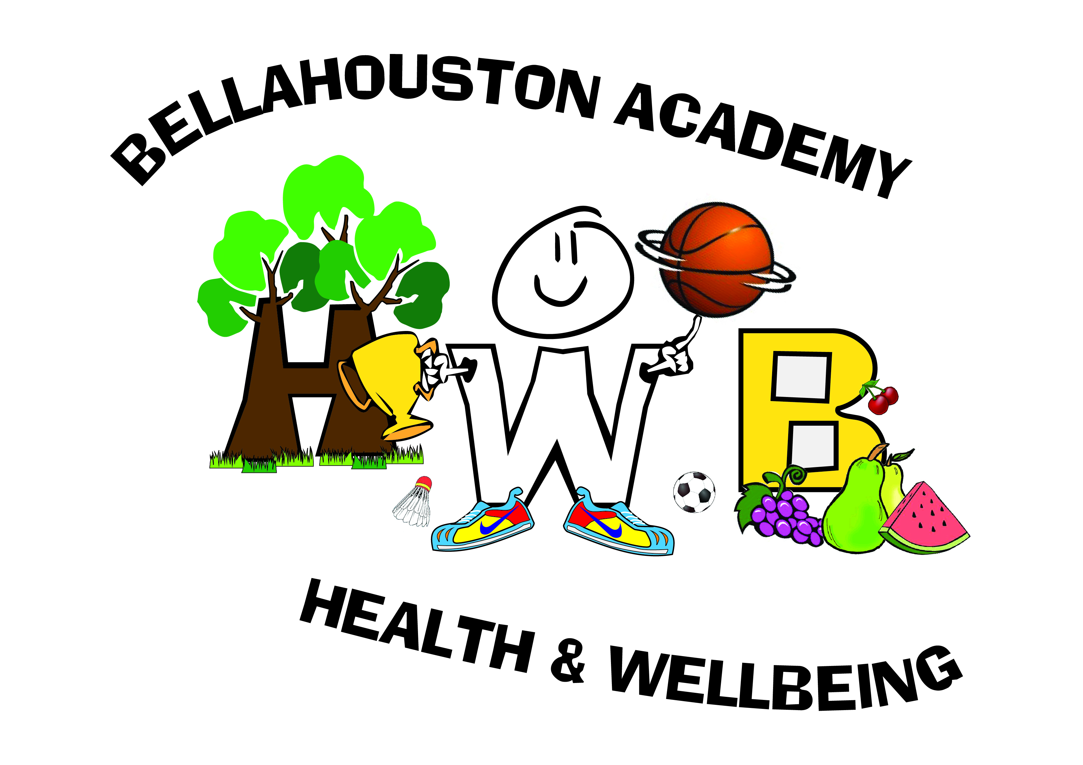
Higher : Factors Impacting on Performance- Physical
Bellahouston Academy

Slide 2
Factors Impacting on Performance
The are main factors which can impact your performance.
To remember these we use the acronym M.E.S.P.
M-Mental
E- Emotional
S- Social
P- Physical

Slide 3
Physical
The physical factor can be broken down into 3 sub factors. Within these 3 sub factors are many other factors. These are;
Physical fitness
Skill fitness
Tactical Fitness

Slide 4
Physical Fitness
Question: Name 6 different types of physical fitness.
C.R.E (Cardio Respiratory Endurance)
Strength
Speed
Flexibility
Power
Muscular Endurance

Slide 5
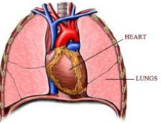
C.R.E.- Definitions
Cardio Respiratory Endurance is the ability of the heart and lungs to provide oxygen to the working muscles over a long period of time.

Slide 6
C.R.E.- Gathering Information
Name: Multi Stage Fitness Test (Bleep Test)
Description: Cones will be set out 20 metres apart. You must run between the cones in time with the bleeps from a CD player. You keep running in time with the bleeps until you cannot continue or you miss two bleeps in a row.

Slide 8
C.R.E. –Gathering Information
Advantages of the Multi Stage Fitness Test:
The test is standardised and is a permanent record which means everyone in the world does the same test. This lets you compare your results with:
National Averages- You can use your results to see how you compare to others people of the same age and gender. This shows you if it is a strength or weakness. You can also compare you results with;
Your Previous Results- In the future you will be able to look back on these results. This will show you how much you have improved which can help with motivation!

Slide 9
C.R.E.- Gathering Information
More advantages of the Multi Stage Fitness Test:
It is easy to complete, because you don’t have a lot of specialist equipment.
It is a recognised test which means it is VALID
It is an appropriate way of finding out your levels of C.R.E.
It helps you to create your training program.

Slide 10
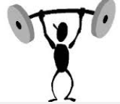
Strength- Definition
Strength is the greatest force that can be applied against an person or object.
There are 2 different types of strength;
Static: This is the ability to hold or push against an object e.g. a scrum in rugby or a shoulder tackle in football.
Explosive: Actions such as putting a shot require a dynamic release of strength.

Slide 11
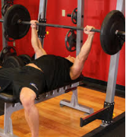
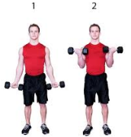
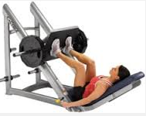
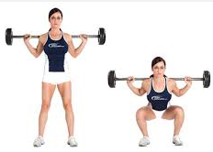
Strength- Gathering Information
Name: One Rep Max
Description: Your one rep max is the heaviest weight that you can lift only once. Which lift you attempt depends on what muscle area you wish to test.

Slide 12
Strength- Gathering Information
Advantages of the 1 rep max.
It is easy to complete
It is a permanent record (This means you can compare your results with previous attempts which is good for motivation and tracking progress)

Slide 13
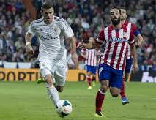
Speed- Definition
Speed is the ability for the whole body or a part of the body to move from A to B in a short period of time.
There are two types of speed;
Limb Speed: This is the ability of the arms or legs to complete an action quickly e.g. overhead clear in badminton.
Whole Body Speed: This is the ability for someone to run quickly e.g. 100m Sprint

Slide 14
Speed- Gathering Information
Name: 30m Running Start Sprint Test
Description. Cones are set out at the start line, 30 metres from the start line and 60 metres from the start line. You run from the start to the 30 metre line then sprint at your maximum speed for 30 metres until the 60 metre line. Your time is recorded over the 30 metres.

Slide 15
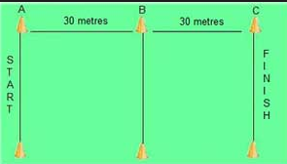

Slide 16
Speed- Gathering Information
Advantages of the 30 Metre Running Start Sprint Test.
As it has a running start the test is more accurate because it takes away reaction time and reduces the effect of acceleration on the time.
Like the Multi Stage Fitness Test it is standardised and can be compared to national averages, your class and previous results.

Slide 17
Speed- Gathering Information
More advantages of the 30 Metre Running Start Sprint test:
It is easy to complete, because you don’t have a lot of specialist equipment.
It is a recognised test which means it is VALID
It is an appropriate way of finding out your levels of speed.
It helps you to create your training program.

Slide 18
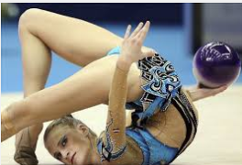
Flexibility- Definition
Flexibility is the range of movement around a joint.

Slide 19
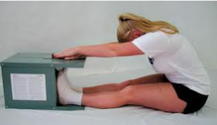
Flexibility- Gathering Information
Name: Sit and Reach
Description: Using a sit and reach box you sit down on the floor and put your feet against the box. You then reach forward and push a marker as far along the box as you can without bending your knees. Your result is the furthest point on the box that you can reach.

Slide 20
Flexibility- Gathering Information
Advantages of the Sit and reach Test.
Standardised
Permanent Record
Easy to Complete

Slide 21
Flexibility- Gathering Information
More advantages of the Sit and Reach Test:
It is easy to complete, because you don’t have a lot of specialist equipment.
It is a recognised test which means it is VALID
It is an appropriate way of finding out your levels of flexibility.
It helps you to create your training program.

Slide 22
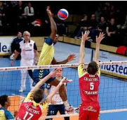
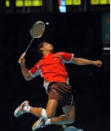
Power- Definition
Power is the combination of speed and strength.
Power = Speed X Strength

Slide 23
Power in Action
Watch this clip and remember that a basketball rim is 10ft high and Nate Robinson is only 5ft 9.
http://www.youtube.com/watch?v=n3WJJYpE988

Slide 24
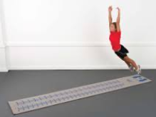
Power- Gathering Information
Name: Standing Broad Jump
Description: Using a standing broad jump mat you stand at the start line and jump with two feet as far as possible. Your score is taken from the back of your heel.

Slide 25
Power- Gathering Information
Advantages of the Standing Broad Jump;
Standardised
Permanent Record
Easy to Complete

Slide 26
Power- Gathering Information
More advantages of the Standing Broad Jump:
It is a recognised test which means it is VALID
It is an appropriate way of finding out your levels of power.
It helps you to create your training program.

Slide 27
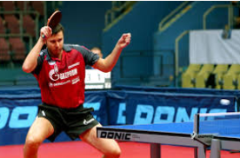
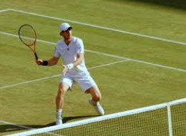
Muscular Endurance- Definition
Muscular Endurance is the ability of a muscle or a group of muscles to be able to repeat an action or set of actions over a long period of time.

Slide 28
Muscular Endurance- Gathering Information
There are several tests for muscular endurance, depending on which muscle group requires testing. An example of a muscular endurance test is;
Name: 30 Second Press Up Test.
Description: You have 30 seconds to complete as many press ups as you can. You partner counts and records the final number.

Slide 29
Muscular Endurance- Gathering Information
Advantages of the 1 Minute Press Up Test;
It is easy to complete, because you don’t have a lot of specialist equipment.
It is a recognised test which means it is VALID
It is an appropriate way of finding out your levels of muscular endurance in your arms.
It helps you to create your training program.

Slide 30
Methods of Training
In order to improve in a fitness area we must train.
The type of training that we complete depends on the factor that we are trying to improve.

Slide 31
Methods of Training- CRE
The main way to train CRE is to use FARTLEK training.
Fartlek is a Swedish method of CRE training and involves VARIED PACE RUNNING
This means that you jog, walk and sprint.
A Fartlek session should last between 20 and 30 minutes.

Slide 32
Training Zone
When doing any CRE training it is important to work within your training zone for the majority of the session.
Your training zone for CRE is between 60 and 80% of your maximum heart rate.
You maximum heart rate is 220 – your age

Slide 33
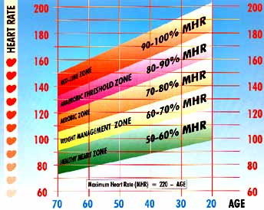

Slide 35
Advantages of Fartlek
It is varied pace, just like many sports including football and basketball where you run at different paces.
This means it is GAME LIKE!
It is easy to do and doesn’t require any equipment
It is a very effective method of increasing CRE.

Slide 36
Training CRE-Effects on the Body
There are many, many benefits to improving CRE.
1. Heart becomes bigger and more effective! This makes it easier for the heart to pump blood around the body.
So it can do the same job in fewer beats which means it takes longer to tire.

Slide 37
Training CRE-Effects on the Body
2. The lungs will become bigger and more effective. This means that they can take in more oxygen with fewer breaths
3. Your resting heart rate will decrease. The average person has a resting heart rate of 70BPM but this can drop to as low as 30BPM for elite athletes. A lower resting heart rate means it will take longer for elite athletes to reach their maximum, so they can perform at a higher level for longer!

Slide 38
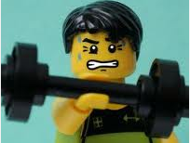
Methods of Training- Strength
Method: Weight Training
Description: To improve strength through weight training you should lift heavy weights (about 70-80% of 1 rep max) for a low number of reps (3-5)
So if your 1 rep max bench press is 100kg you should complete 3 sets of 5 reps at 80kg.

Slide 39
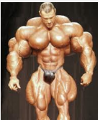
Training Strength- Effects on the Body
Your muscle mass will increase
You will become stronger
This will mean your weight will increase (muscle weights roughly 2x fat). If you become too heavy it can have a negative effect on your speed and agility

Slide 40
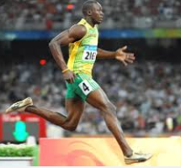
Methods of Training- Speed
Name: Interval Training
Method: Interval training works on a 4:1 Work to Rest Ratio.
I.e. Sprint for 10 seconds then rest for 40. Complete this 5 times.

Slide 41
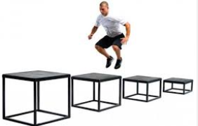
Methods of Training- Power
Name: Plyometric
Method: Plyometric training involves lots of fast actions such as 1 or 2 legged box jumps. This helps to build fast twitch muscle fibres which help to generate power.

Slide 42
Plyometric
Watch this clip to see some plyometric training!
http://www.youtube.com/watch?v=ppM1Ad-zd0o

Slide 43
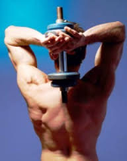
Methods of Training- Muscular Endurance
Weight Training
This is similar to strength training however you will lift light weight (30-40% of maximum) for a high number of repetitions.
If your 1 rep max chest press is 100kg you will lift 30kg for 3 sets of 20 reps.

Slide 44
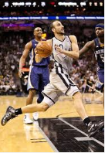
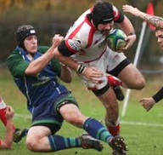
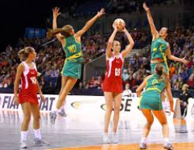
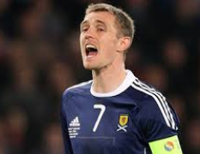
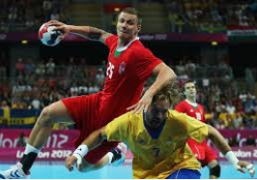
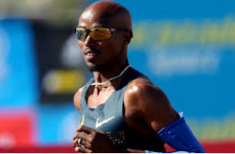
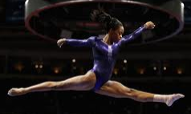
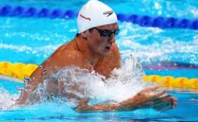
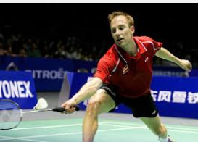
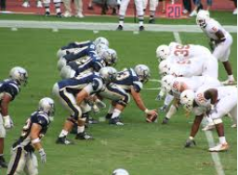
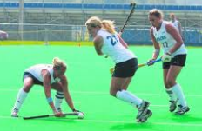
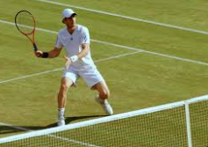
How does CRE impact performance
Task: Name 5 activities which require a good level of CRE.

Slide 45
How does CRE impact performance
We already know the impact that CRE has on our bodies, now lets look at how it can impact your performance in an activity.
It is important to remember that because CRE is endurance, the benefits of good CRE come into effect in the latter stages of a match.
Towards the end of the game… in the last 10 minutes of the match… in the final set…

Slide 46
How does CRE impact performance
What impact does CRE have on your performance in football?
Towards the end of the match I can still…
Make runs forward and attack the opposition.
Keep up with attackers and stop them going past me
Maintain a high skill level (shoot + pass accurately)

Slide 47
How does CRE impact performance
Other examples include;
I can avoid the effects of fatigue towards the end of the match.
I can maintain a high level of concentration for the full match
I won’t become tired which helps prevent me from making mistakes towards the end of the match.

Slide 48
How does CRE impact performance
Task: Answer the following questions in your jotter.
What is the best test for CRE? (1)
Describe this test (4)
Name 2 effects that CRE has on your body. (2)
Describe 2 benefits of good CRE on your performance in football. (2)

Slide 49
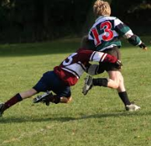
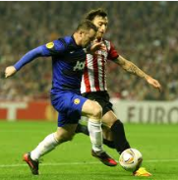
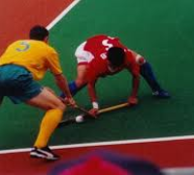
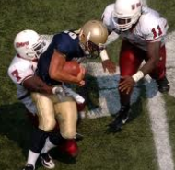
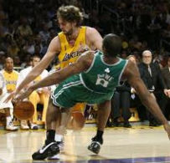
How does strength impact performance?
Task: Name 5 activities that require a high level of strength.

Slide 50
How does strength impact performance?
Strength is very beneficial in activities such as hockey, football and rugby when tackling.
Having strength in rugby will allow you to make a secure tackle which brings your opponent to the ground and prevents them from scoring a try.
Because I am strong I can use my shoulder to keep my opponent away from the ball in football. This makes it harder for them to win possession.

Slide 51
How does strength impact performance?
Task: Answer the following questions in your jotter.
What is the name of the test for strength (1)
Describe how you gathered information (tested) your strength (2)
Explain why strength is important in your activity (2)

Slide 52
Strength in Action
Watch this clip of American Football players using their strength to their advantage.
http://www.youtube.com/watch?v=VhmMU6afIHo

Slide 53
How does speed impact your performance?
You should now be able to identify activities where different factors are important.
Task: Name an activity and a situation where whole body speed impacts your performance (2).
E.g. In basketball having good whole body speed allows me to get away from my marker to receive a pass in space which is easier to score.

Slide 54
Speed in Action
Watch this clip of Gareth Bale to see speed in action!
http://www.youtube.com/watch?v=SJtW25DcSFk

Slide 55
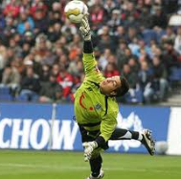
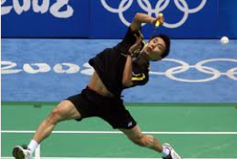
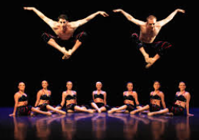
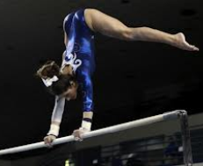
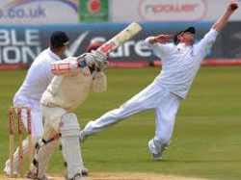
How does flexibility impact your performance?
Name 5 activities where flexibility impacts your performance.

Slide 56
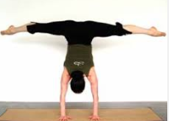
How does flexibility impact your performance?
Having good flexibility is obviously a benefit in aesthetic activities such as dance and gymnastics.
However it is also a benefit in sports such as football, basketball etc.
Flexibility allows you to reach further which mean you can… return more shuttles… catch more balls… save more shots…

Slide 57
Flexibility in Action
Watch this short clip for some examples of flexibility in football
http://www.youtube.com/watch?v=oEUiKTtR5SM

Slide 58
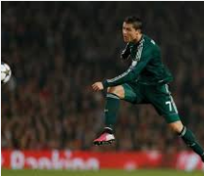
How does power impact your performance?
You know that power is the combination of…
Strength and…
Speed!
Task: Explain how power can impact your performance in 2 different activities (4)

Slide 59
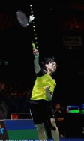
How does power impact your performance?
Having a powerful smash in badminton makes it more difficult for my opponent to return the shot and puts them under more pressure.
Having a powerful spike in volleyball makes it more difficult for my opponent to return the shot and puts them under more pressure.
Having a powerful strike in football makes it more difficult the goalkeeper to return save and means I score more goals.
Having a powerful take off on my vault in gymnastics means I can generate more height which helps me to perform my routine.

Slide 60
Power in Action!
See the advantages of a powerful smash in badminton in this clips!
http://www.youtube.com/watch?v=sKC1Depuf6Q

Slide 61
How does muscular endurance impact your performance
Task: Explain 1 positive and 1 negative effect that muscular endurance can have on your performance in an activity of your choice (2)
Good muscular endurance means that I can still perform a powerful and accurate smash towards the end of the match
Poor muscular endurance will prevent me from being able to serve effectively in the last set of tennis. This means my opponent can play a more attacking shot on my serves.

Slide 62
Stages of Skill Development
Cognitive Stage
During the cognitive stage you begin to find out exactly what is involved in the skill you are learning.
You begin to break the skill down into Preparation, Action and Recovery and make an attempt at learning each stage.
At this stage mistakes are common and lots of feedback is required.

Slide 63
Stages of Skill Development
Associative Stage
During the associative stage you combine the subroutines of the skill.
The performer's ability and experience will determine the practice time required.
Repeated practice will allow the performer to become more consistent in the skill and make fewer errors.

Slide 64
Stages of Skill Development
Autonomous Stage
During the autonomous stage you are able to perform the skill naturally and without conscious thought.
Errors are not likely at this stage, the skill is performed with flair, control and accuracy.

Slide 65
Practice Methods for skill development
Here are some methods you can use to develop skills at the Cognitive Stage of skill development.
Gradual Build-up
Shadow Practice
Solo Practice
Whole – Part – Whole

Slide 66
Gradual Build-up
Involves performing the skill by making the practice more demanding.
For example learning the spike in volleyball can be developed by making the practice more demanding.
Task: Give an example using this method of practice that you could use to improve a specific skill in an activity of your choice.
Hints: Cause / Effect / Impact

Slide 67
Shadow Practice
Involves rehearsing the movement required for the action.
The performer is getting used to the movement and can perform it in slow motion to 'groove' the technique.
Task: Give an example using this method of practice that you could use to improve a specific skill in an activity of your choice.
Hints: Cause / Effect / Impact

Slide 68
Solo Practice
Performing a skill or practice on your own to help reinforce the movement or routine.
Task: Give an example using this method of practice that you could use to improve a specific skill in an activity of your choice.
Hints: Cause / Effect / Impact

Slide 69
Practice Methods for skill development
Here are some methods you can use to develop skills at the Associative Stage of skill development.
Repetition and Drills
Feeder / Isolated Practice
Opposed / Un-opposed

Slide 70
Repetition and Drills
Training exercises (drills) that repeat a particular skill over and over (note: repetition can be used with all types of practice).
The intention is to make the skill more natural and automatic.
This method eliminates the distraction of the game and other skills.
Be careful of fatigue and boredom.
Combination drills link more than one skill together in a repeated sequence.
Task: Give an example using this method of practice that you could use to improve a specific skill in an activity of your choice.
Hints: Cause / Effect / Impact

Slide 71
Feeder / Isolated Practice
Involves a helper to repeatedly play a ball/shuttle into a particular area on the court/pitch, to allow a performer to practice a particular skill.
Enables performer to concentrate on one specific technique at a time.
Will improve preparation, action and recovery.
Task: Give an example using this method of practice that you could use to improve a specific skill in an activity of your choice.
Hints: Cause / Effect / Impact

Slide 72
Opposed / Un-opposed
Involves altering the level of opposition.
A netball practice may begin with no defender
Then introduce a passive defender (limited involvement)
Finally an active defender (fully involved).
Task: Give an example using this method of practice that you could use to improve a specific skill in an activity of your choice.
Hints: Cause / Effect / Impact

Slide 73
Practice Methods for skill development
Here are some methods you can use to develop skills at the Autonomous Stage of skill development.
Pressure Training
Conditioned Games / Small Sided Games

Slide 74
Pressure Training
Once a skill has been practiced and the basic movements and criteria established, different types of demands (pressure) can be added to further improve the skill.
For example the speed at which the movements have to be repeated, the physical demands of the skill or the level of opposition.
Task: Give an example using this method of practice that you could use to improve a specific skill in an activity of your choice.
Hints: Cause / Effect / Impact

Slide 75
Conditioned Games / Small Sided Games
In order to improve a skill the normal rules of a game can be changed so that the skill being learned occurs more often or has greater importance.
For example to encourage the tip in volleyball the middle to back of the court could be eliminated.
Small sided games involves making the number of players playing the game less.
This will encourage more individual skill involvement, easier decision-making and more specific coach feedback.
Task: Give an example using this method of practice that you could use to improve a specific skill in an activity of your choice.
Hints: Cause / Effect / Impact

