Slide 1
Higher: Factors Impacting on Performance- Mental
Bellahouston Academy

Slide 2
Mental Factors
Mental factors can have either a positive or a negative impact on performance.
The mental factors that we will be focussing on are;
LEVEL OF AROUSAL
MENTAL TOUGHNESS
DECISION MAKING
CONCENTRATION

Slide 3
Gathering Information
There are many ways to gather information on mental factors, depending on which aspect you would like to test.
One method is the “Athletes “How Tough Are You” MENTAL TOUGHNESS QUESTIONNAIRE”

Slide 4
Gathering Data
The questionnaire is available below
https://www.competitivedge.com/athletes-%E2%80%9Chow-tough-are-you%E2%80%9D-0
This data then needs to be analysed to assess the performers “mental toughness”

Slide 5
Approaches to Develop Performance
There are many different techniques to help with mental factors, depending on which factor is the weakness.
Breathing Techniques can help to lower a performers level of arousal if it is too high.
Listening to music can either help to motivate or to calm someone down and lower their level of arousal

Slide 6
Approaches to Develop Performance
Mental Imagery- This can help to improve mental toughness as it prepares the performer for events which may occur. This can also improve concentration and reduce stress or anxiety. It also helps with decision making.
Self- Talk- Talking to yourself in a positive manner can help to motivate as well as reduce anxiety and stress.

Slide 7
Approaches to Develop Performance
Coaches Feedback- This can help to overcome a variety of mental factors. It can be used to motivate or to lower stress.
Feedback can also assist with decision making as it ensures performers know when they have made a mistake so they do not repeat it.
It can help to focus a performer which improves concentration.

Slide 8
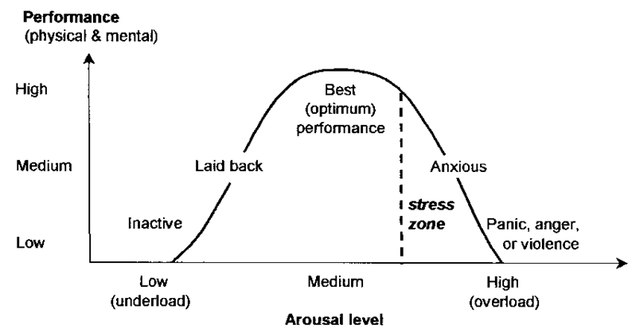
Level of Arousal
Level of Arousal is the level of nervousness, boredom, stress that you feel before/during a sporting event.

Slide 9
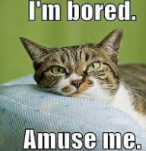
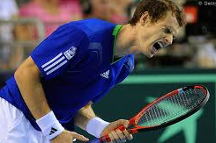
Level of Arousal
If your level of arousal is too low you will be unmotivated and bored. This will have a negative effect on performance.
If your level of arousal is too high you may be anxious, panicky and make poor decisions.

Slide 10
Level of Arousal
The OPTIMUM LEVEL OF AROUSAL is somewhere in the middle of the scale.
When someone is performing at the optimum level of arousal they will be calm but motivated.
Someone who is performing at their optimum level is often said to be “IN THE ZONE”

Slide 11
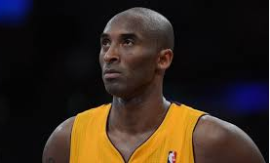
Watch this
http://www.youtube.com/watch?v=wl49zc8g3DY
Has there every been a time when you have been in the zone!

Slide 12
Mental Toughness
Mental Toughness is the ability to overcome set backs.
Being mentally tough helps a performer to keep performing to their highest level even if they concede a goal or a decision goes against them.
If you are not mentally tough you may lose motivation, or start to make bad decisions.

Slide 13
Mental Toughness
Players who are mentally tough have the ability to motivate themselves to overcome obstacles.
https://www.youtube.com/watch?v=r_yO2_mjP34
How many players and teams would have given up at 3-0?
Gerrard, Alonso and Dudek all showed incredible mental toughness.

Slide 14
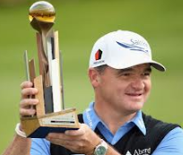
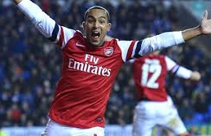
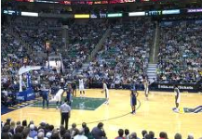
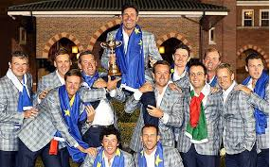
Mental Toughness
Task: Can you name another occasion when a player/ team has shown mental toughness?
Paul Lawrie came from 10 shots down to win British Open.
Arsenal came from 4 nil down to beat reading 7-5 in an incredible league cup tip
Utah Jazz came from 36 points down to beat the Denver Nuggets.
Team Europe down 10-6 on final day, managed to retain Ryder Cup

Slide 15
Decision Making
The ability to make good decision, quickly, whilst under pressure is a vital skill for any player.
I knew that my team mate was very fast so I decided to play a long ball over the top because I knew he would catch it.
My opponent played a overhead clear but did not return to base quickly so I decided to play a disguised drop shot.

Slide 16
Decision Making
I was put under pressure by my opponent as she was marking me tightly. This caused me to make silly mistakes and pass the ball out of the court.
My opponent was much taller than me and was rushing in to block my shot, I decided instead to fake a shot and then drive to the basket.

Slide 17
Decision Making
https://www.youtube.com/watch?v=0OVr1VfRJiY
Manu Ginobili had less than a second to make his mind up. He has a defender in front of him blocking his path to the basket. He decides to jump to the side away from the defender. That shot won Argentina a gold medal in the 2004 Olympic Games

Slide 18
Task: Scenarios
Read the following scenario and describe and explain any potential decisions that you should make.
Football. You are a centre midfielder. Your team team is losing by 2 goals to nil. There are 15 minutes left in the game. You have one very fast striker and the other is 6 foot 3. What kind of decisions may you make and why.

Slide 19
Scenario- Possible Answers
I decided to play a long ball from midfield to the very tall and strong striker. This allowed him to play the ball off to our faster sticker which gave us more goal scoring opportunities.
I decided to take the ball up the wing. This allowed me to play a ball into the box towards the tall striker.

Slide 20
Concentration
Concentration is vital in all sports. It is the ability to block out any distractions and focus only on the match.
A momentary loss of concentration can be the difference between winning and losing.
https://www.youtube.com/watch?v=TbeloXcLfbw

Slide 21
Concentration
Chris Webber has a loss of concentration and calls for a timeout. As his coach has used all of the time outs this is a technical foul. This gave the other team two free throws and ultimately cost them the state championship.

Slide 22
Concentration
Losing concentration in a match can lead to;
Poor decisions
Missed opportunities
Avoidable mistakes
Goal scoring opportunities for opponents

Slide 23
Concentration Test
Here is quick test to see how good your attention is.
Can you count the number of passes made by the team in white!
https://www.youtube.com/watch?v=vJG698U2Mvo

