Slide 1
Higher: Factors Impacting on Performance- Emotional
Bellahouston Academy

Slide 2
Emotional Factors
Emotional factors can impact your performance in a negative or a positive way.
Examples of emotional factors include;
Anger
Happy
Sad
Fear

Slide 3
Gathering Information
Questionnaires can be used to identify emotional factors that effect performance.
An example of these is the Profile of Mood Status
The POMS test asks performers to indicate how they have been feeling. They can select “not at all”, “a little”, “moderately”, “quite a lot” or “extremely” to indicate how they feel.

Slide 4
Profile of Mood Status
The Profile of Mood Status can be completed here;
http://brianmac.co.uk/poms.htm

Slide 5
Emotions- Coping Mechanisms
Emotional factors are very personal and as such everyone will need to find their own way of coping. Some examples of coping strategies include;
Breathing Techniques
Counting to 10
Positive Self Talk
Meditation
Mental Imagery

Slide 6
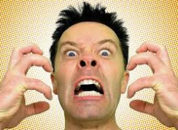
Anger
Being angry during a performance can have several impacts on your performance;
You may become abusive to the officials or others in your team. This can result in you being disciplined.
You could commit a bad foul which results in being sent off.
You may be distracted and not perform to your best
You may make bad decisions which prevent your team from scoring or causes them to concede a goal.

Slide 7
Anger in action!
Watch this clip to see how anger can effect a performance.
http://www.youtube.com/watch?v=zAjWi663kXc
How did Zidanes’ anger affect his performance
http://www.youtube.com/watch?v=wcWNsS6wEps
Controlled anger can have a positive influence on performance
http://www.youtube.com/watch?v=tUFR_W1lRVE

Slide 8
Task
Tell you partner about a time when you got angry.
Discuss what made you angry, what impact it had on you and how you dealt with the anger
This can be at any time but it is preferable if it was during a sporting event
Your partner will then tell the class

Slide 9
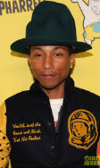
Happiness
Happiness will usually have a positive impact on your performance.
Feeling happy may help you to relax and concentrate
If you are enjoying the activity you will try harder.
You are more likely to show good etiquette and you will be friendlier to your team mates.

Slide 10
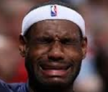
Sad
Being sad will usually have negative impacts on your performance.
If you are sad due to events outside of the game you may be distracted and make silly mistakes.
You will be less interested in the outcome of the game and may put in less effort.

Slide 11
Sadness in Action!
Being sad can create a positive impact on your performance;
Watch this clip;
http://www.youtube.com/watch?v=1k2uD-P3Z3Y
How did sadness impact Michael Jordan’s performance.

Slide 12
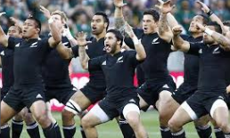
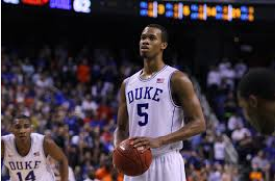
Fear
Fear will usually have a negative impact on performance;
Fear produces negative thoughts which can impact your confidence
A fear of failure may mean you do not fully commit to the game
You may be distracted by your fear of playing in front of a crowd… this may cause you to make bad decisions.

Slide 13
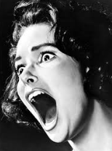
Fear
Class discussion:
Has anyone ever had the opportunity to over come their fear.
What was it and how did you do it?

