Slide 1
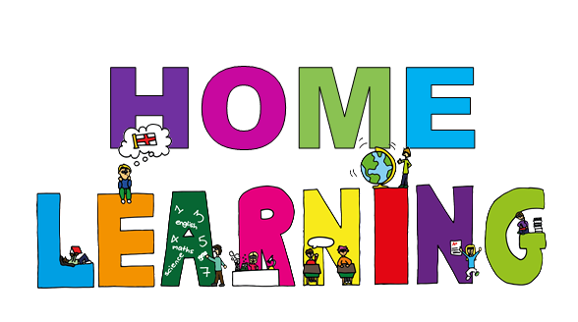
Primary 7a
Miss Farmer

Slide 2
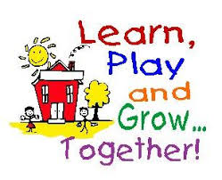
The next few slides provide you with some grids and challenges that you can complete throughout the school closures. Take your time and have fun with these. You could send a photo or ask an adult at home to tweet something you are proud of!
1. Creativity Grid
2. Stay active ideas
3 and 4. P.E challenge Grids
5. Lego (if you enjoy playing with lego you might like these activities).
6. STEM challenge grid

Slide 3
I will upload literacy and maths activities every week.
Remember to break your learning into chunks and stay active.

Slide 4
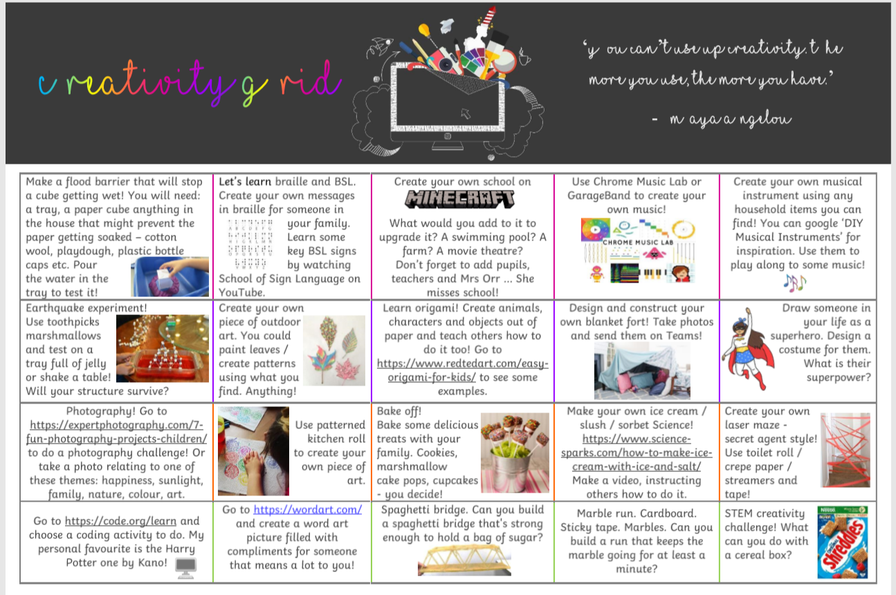

Slide 5
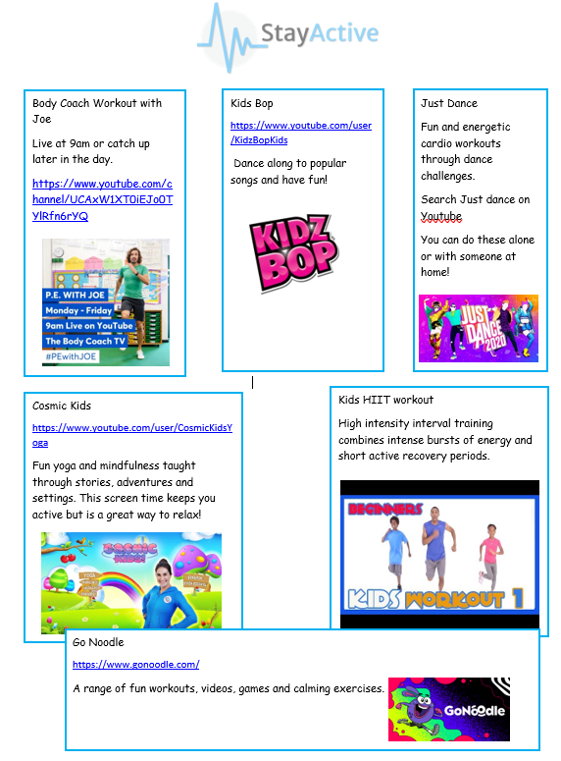

Slide 7
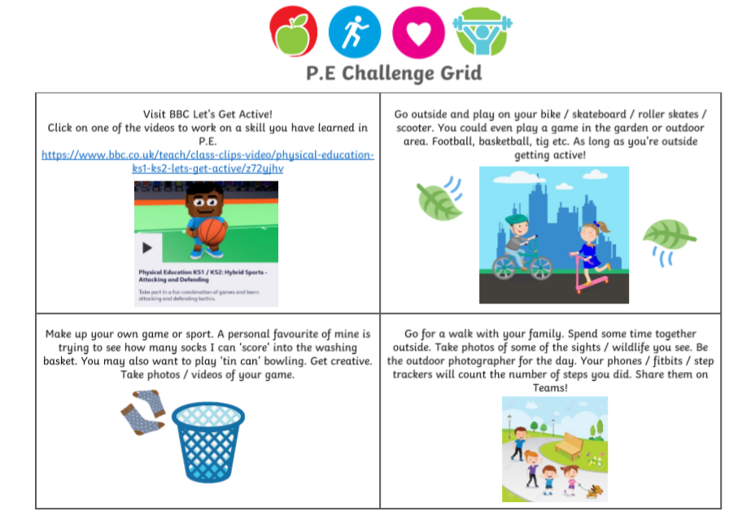

Slide 8
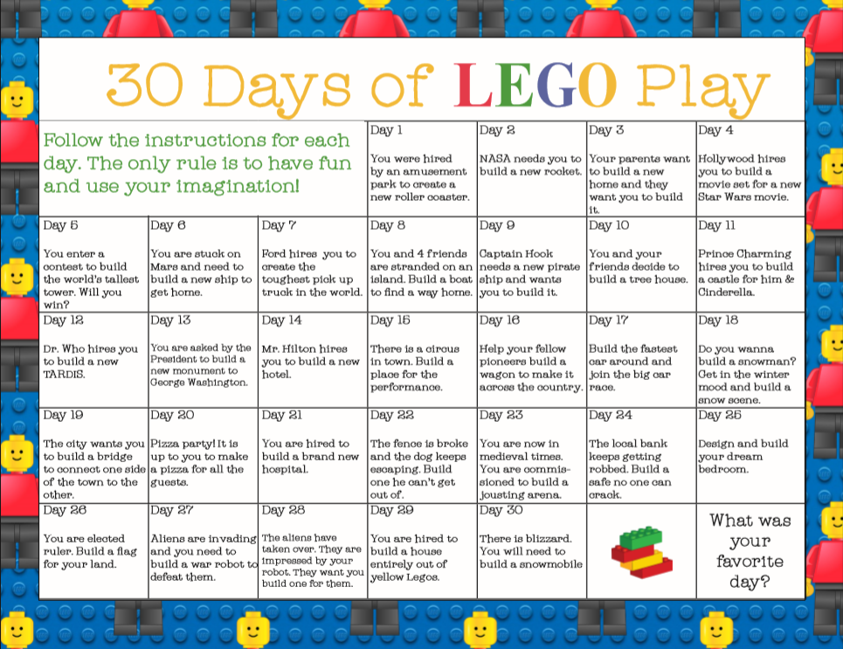

Slide 11
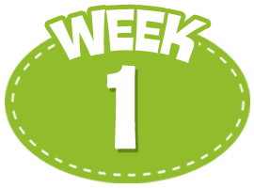
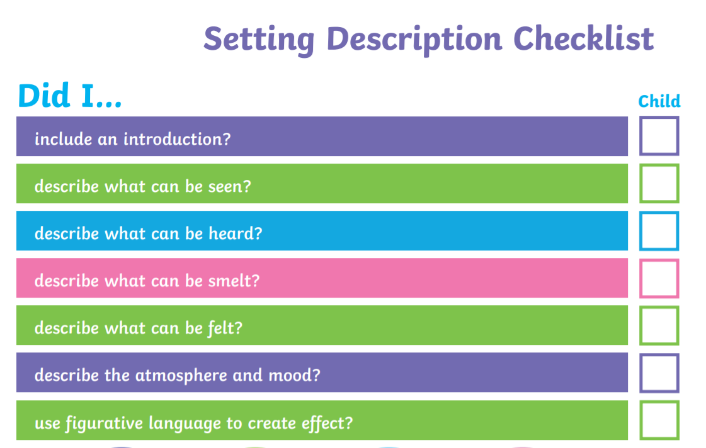
W.B 20th April 2020
Literacy
Spelling
- Select any 3 activities from the spelling menu on slide 13 to practise your words.
The words are related to science and the list is on the next slide.
Reading
Try to complete 2 activities from the reading bingo grid.
Space Explorer Comprehension (slides 16-19)
3. Writing
Think about your reading passage. Create a character profile for an alien or space explorer.
Describe the setting of space….you could draw a picture to help the reader visualise the setting
4. Newsround Challenge
Practice taking notes.
Watch Newsround, write a heading for each story that they cover and try to include as many details about the different stories by taking notes. Turn your notes into an interesting poster for the days news.
Use your talking and listening skills
Can you perform a short presentation to somebody else in your house about one of the stories? You could even try to use your iPad and film yourself as a news anchor. Try using Green Screen.

Slide 12
W.B 20th April 2020
Maths
Addition and Subtraction – slide 20-21
Multiplication and Division – slide 22-23
Time – slide 24

Slide 13
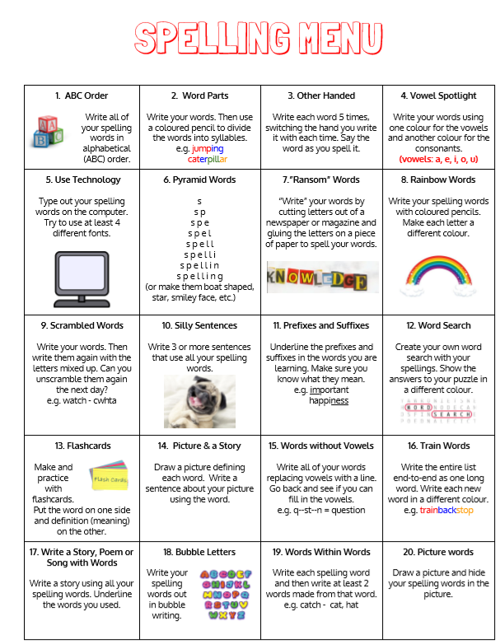
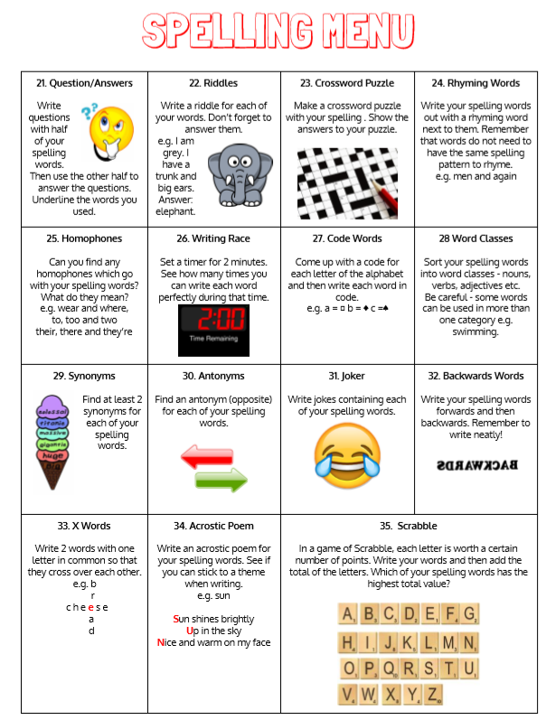

Slide 14
READ I NG
1. A newspaper article about an important or current news story. | 2. A persuasive leaflet or article. | 3. A detective story. | 4. A story by an author you have never read before. | 5. A biography or autobiography of someone you find inspirational.
6. A book by your favourite author. | 7. A story set in the future. | 8. A non-fiction book about a subject you don’t know much about. | 9. A book which is the sequel to an earlier book. | 10. A picture book.
11. A story involving animals. | 12. A comic. | 13. A book by a Children’s Laureate. | 14. A book about science. | 15. A myth or legend.
16. A book which has been made into a film. | 17. A poem. | 18. A book you loved when you were younger. | 19. A story set in the past. | 20. A fairy tale.
21. A book recommended by a friend. | 22. A funny book. | 23. An adventure story. | 24. A non-fiction book about something you are interested in. | 25. A book that someone in your family liked when they were a child.
B
INGO

Slide 15
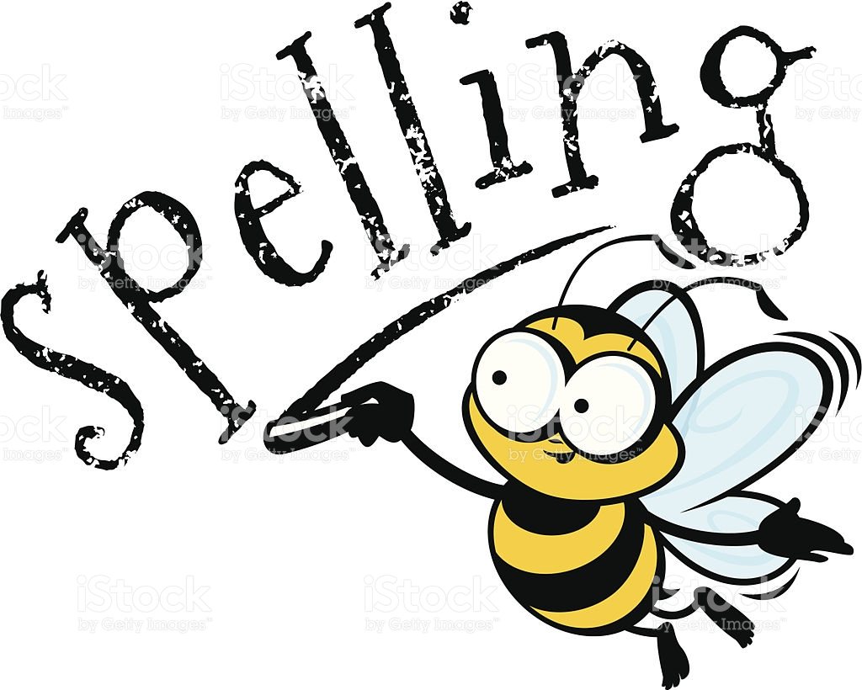
This week's spelling words:
Science Theme
alkaline
combustion
condensation
evaporation
amphibian
frequency
function
laboratory
liquid
mammal
nutrient
organism
oxygen
respiration
thermometer

Slide 16
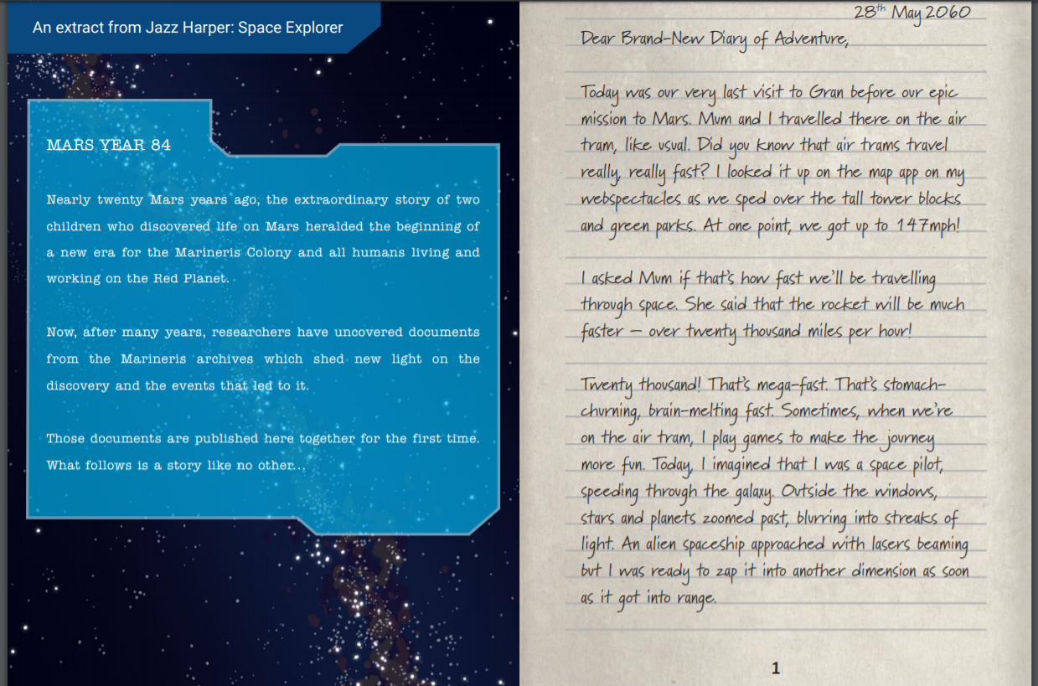

Slide 17
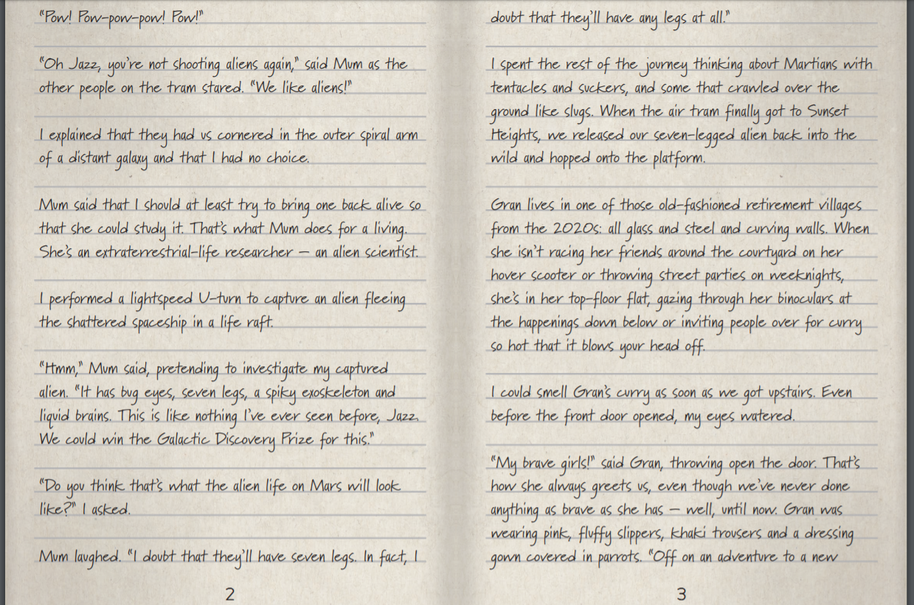

Slide 18
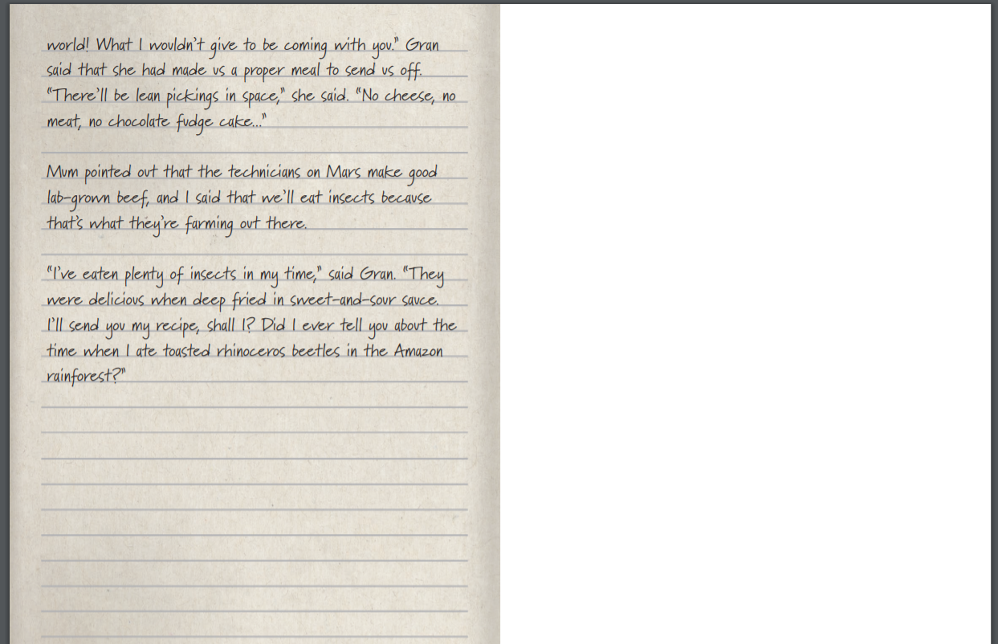

Slide 19
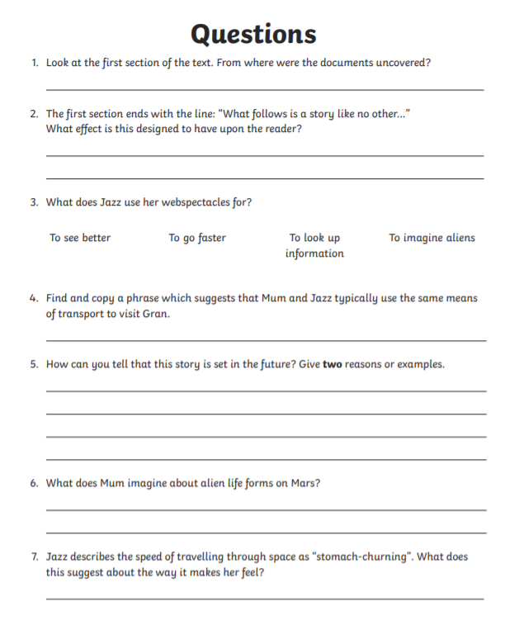
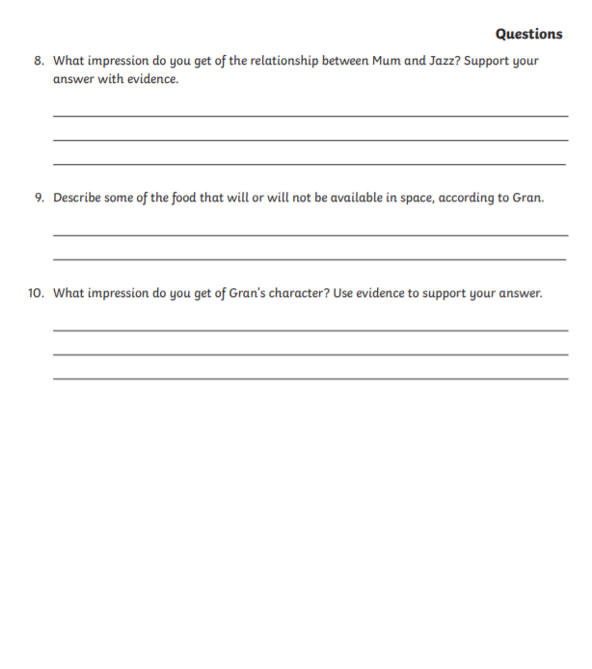

Slide 20
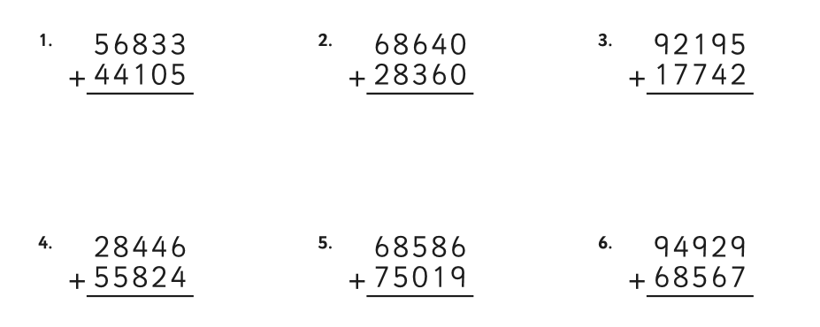
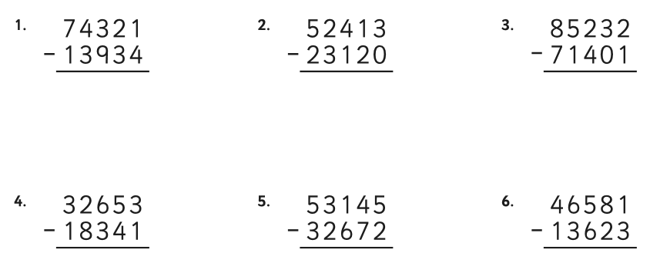
Addition
Subtraction

Slide 21
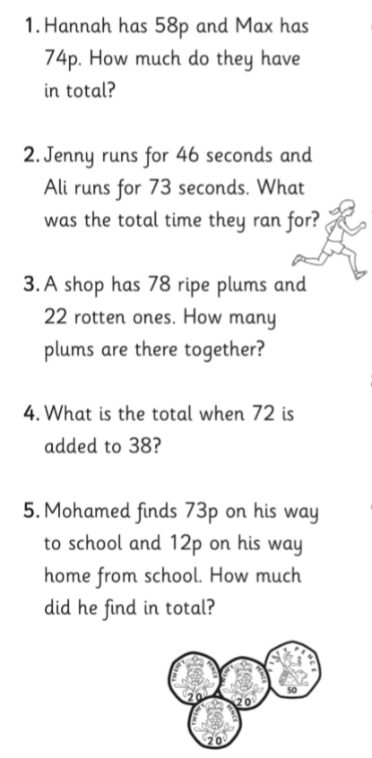
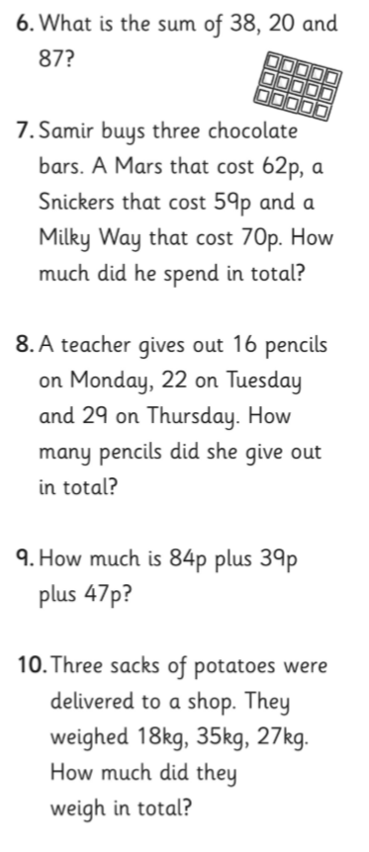
Try to do these questions in your head.

Slide 22
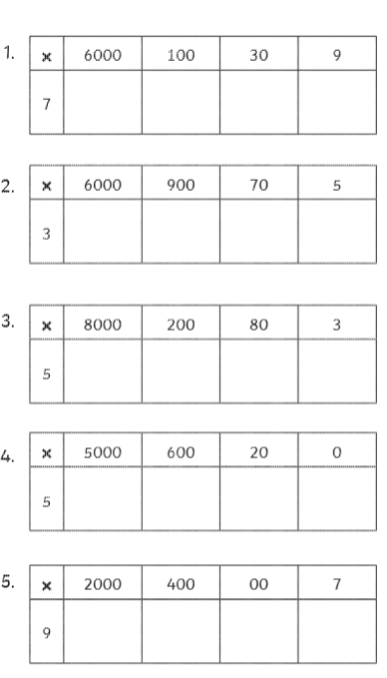
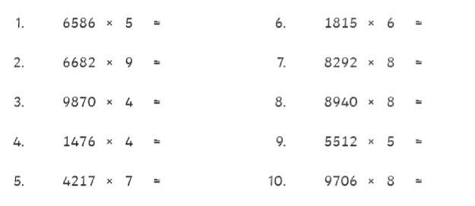
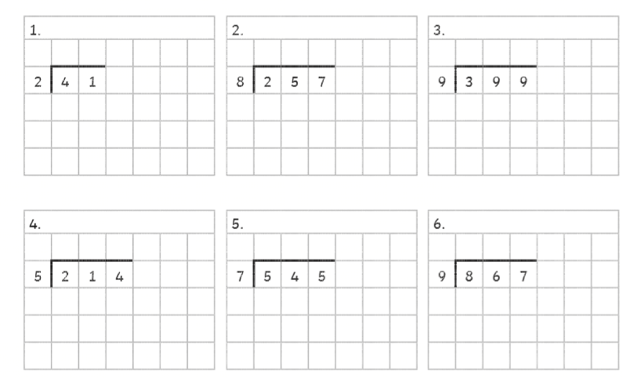
6139x7
6975x3
8283x5
Play games on TopMarks to help with your timetables and keep your speed up.

Slide 23
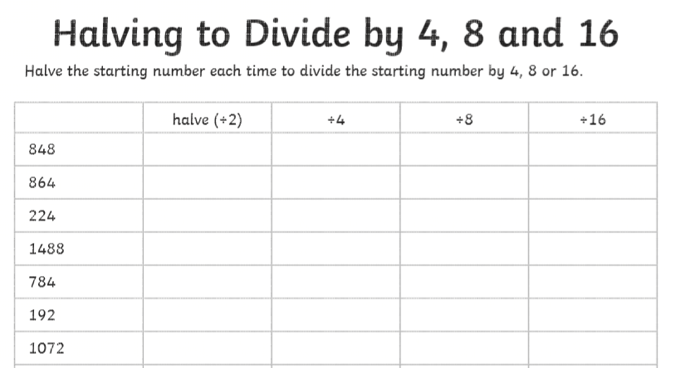
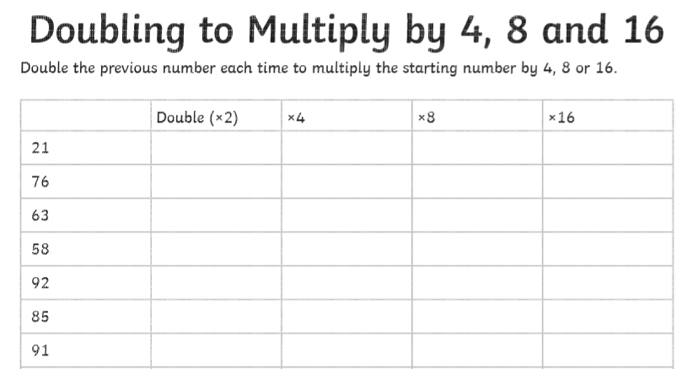

Slide 24
