Slide 1
How does this logo make you feel?
Identify the colours normally in this logo.
Describe how the company tries to be different from its competitors.
Notes:
4 minute task
Answers
1. Personal preference
2. Red and Gold
3. Customer Service, Store layout, Staff Uniforms, Unique Selling Point (USP) in its products
Provoke discussion around how McDonalds looks and feels in other countries. It is mainly the same standard you as customers would expect, however the products are slightly different due to geographical needs and tastes. Explain that this is all down to their Corporate Culture and company objectives.

Slide 2
¿Cómo te hace sentir este logo?
Identifique los colores normalmente en este logotipo.
Describa cómo la empresa trata de ser diferente de sus competidores.
Notes:
4 minute task
Answers
1. Personal preference
2. Red and Gold
3. Customer Service, Store layout, Staff Uniforms, Unique Selling Point (USP) in its products
Provoke discussion around how McDonalds looks and feels in other countries. It is mainly the same standard you as customers would expect, however the products are slightly different due to geographical needs and tastes. Explain that this is all down to their Corporate Culture and company objectives.

Slide 3
S2 – CORPORATE TRAINING
TCH 3-01a I can explore and use the features of a range of digital technologies, integrated software and online resources to determine the most appropriate to solve problems.
Uses the most appropriate applications and software tools to capture and modify text, images, sound and video to present and collaborate.
Demonstrates an understanding of file handling for example, uploading, downloading, sharing and permission setting, for example within Glow or other platforms.
TCH 4-01a I can select and use digital technologies to access, select relevant information and solve real world problems.
Consistently use a range of devices and digital software and application and services to share, create, collaborate effectively and publish digital content online.
Notes:
Introduce the new topic and LI & SC

Slide 4
Learning Intentions
I will investigate the meaning behind Corporate Culture
I will discuss the benefits of having a strong Corporate Culture
Success Criteria
I can describe the terms Corporate Culture and Mission Statement
I can communicate my thoughts feelings
I have developed my investigative and communication skills
Notes:
Lesson One – LI & SC

Slide 5
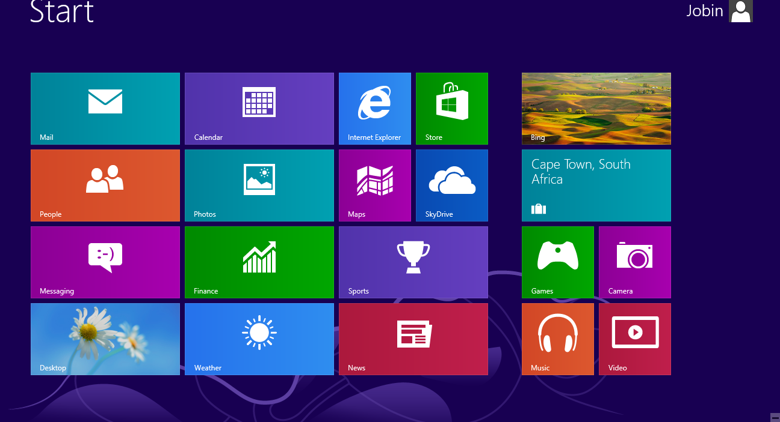
Corporate Culture
Notes:
Advise employee they should be taking notes as they may be asked questions on this area later.
1. Click on Internet Explorer to see definition of Corporate Culture ** This is important for their homework – therefore pupils should note this in their jotter ** (http://www.bbc.co.uk/bitesize/higher/business_management/business_enterprise/internal_organisation/revision/5/)
Click on Video icon to see clip of main aims of the business through their logo – no need to watch the full video. (6 mins 32 secs) (https://www.youtube.com/watch?v=UKc271fj2ok&app=desktop)
3. Click on the Game icon to play We’re on a Mission. (http://www.businessed.co.uk/index.php/home/activities/gcse-activities/gcse-activities-topic - business-objectives)

Slide 6
Corporate Culture
Mission Statements
Uniforms
Logos
Colours
Store Layouts
Beliefs
Vision
Objective
Direction
Inform Stakeholders
Notes:
RECAP:
Corporate Culture (Uniforms, Logos, Colours, Layouts, Beliefs)
Mission Statements
IF TIME PERMITS PLAY THE FOLLOWING GAME:
Mission Statements:
1. “To organize the world’s information and make it universally accessible and useful.”
2. “To make all athletes better through passion, design and the relentless pursuit of innovation.”
3. “To inspire and nurture the human spirit – one person, one cup and one neighborhood at a time.”
4. “To give everyone the power to create and share ideas and information instantly, without barriers.”
5. “To refresh the world… To inspire moments of optimism and happiness… To create value and make a difference.”
6. “To build the web’s most convenient, secure, cost-effective payment solution.”
7. “To provide our fans, communities and partners the highest quality sports and entertainment in the world, and to do so in a way that is consistent with our values.”
8. “To utilize the power of Moore’s Law to bring smart, connected devices to every person on earth.”
9. “To save people money so they can live better.”
10. “To accelerate the world’s transition to sustainable energy.”
11. “To provide the best gear for our athletes and the modern day explorer, support the preservation of the outdoors, and inspire a global movement of exploration.”
12. “To be the world’s favorite destination for discovering great value and unique selection.”
13. “To inspire and develop the builders of tomorrow.”
14. “To prevent and alleviate human suffering in the face of emergencies by mobilizing the power of volunteers and the generosity of donors.”
15. “To give everyone a voice and show them the world.”
ANSWERS
1. Google
2. Under Armour
3. Starbucks
4. Twitter
5. Coca-Cola
6. PayPal
7. Intel
8. NFL
9. Walmart
10. Tesla
11. Northface
12. eBay
13. LEGO
14. American Red Cross
15. YouTube

Slide 7
Evaluate the Lesson
You have 280 characters, create a mission statement for Media City Ltd.

Slide 8
Give me 5…
ways a business could demonstrate its corporate culture.
Click anywhere to start!
Notes:
30 seconds for pupils to answer starter question on whiteboards.
Answers:
Logo
Uniform
Beliefs
Colours
Store Layouts

Slide 9
Learning Intentions
I will continue to explore Corporate Identity
I will select appropriate software to demonstrate businesses Corporate Identity
Success Criteria
I can transfer my knowledge of corporate culture/identity into a practical setting
I can utilise my prior knowledge and research to create a brand board
I have developed my creativity and IT skills
Notes:
Lesson Two – LI & SC

Slide 10
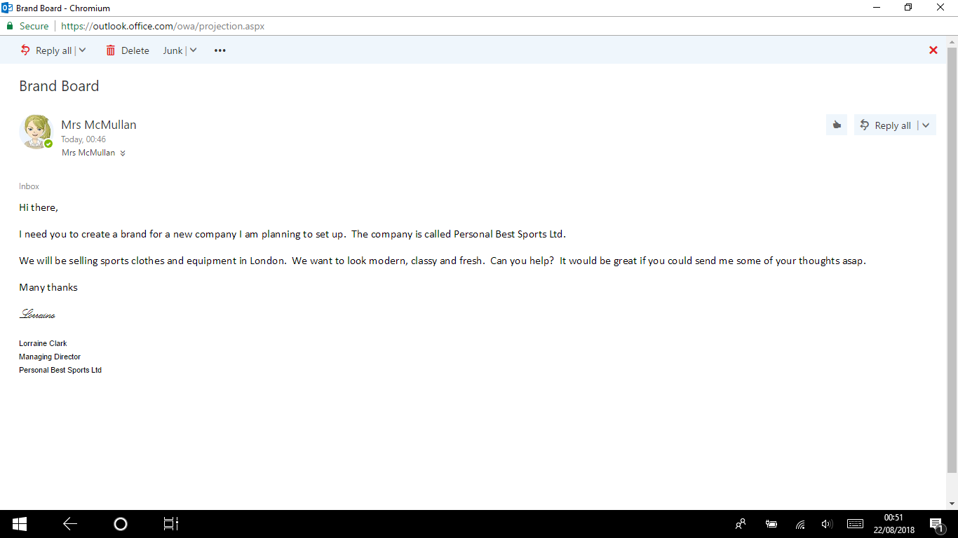
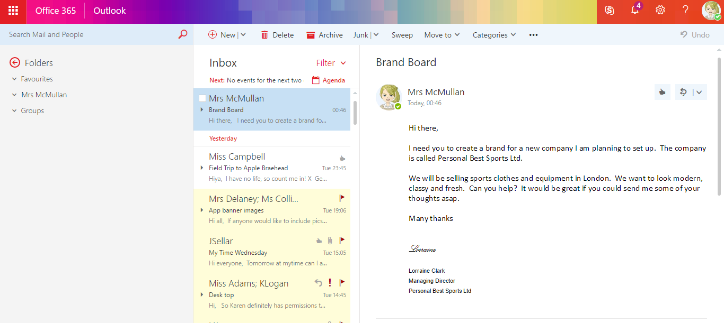
Lorraine Clark
Lorraine Clark
Notes:
You have received an email from a customer asking you to create a corporate identity for their company Personal Best Sports Ltd. You have been asked to create a brand board for this company. First you need to understand what a brand board is, therefore watch the video on the next slide to evaluate what you need to do.
Pupils should save this in their Managing Finance Folder.

Slide 11
Notes:
You tube; Branding Your Personal Brand / Creative Business | Build a Strong, Cohesive Brand Identity
(https://www.youtube.com/watch?v=0YmIQKgry_E) 6 minutes and 37 secs.
As pupils watch this they should take notes in their jotter;
Brainstorming
Mood Board for Brand
Create a colour palate (2/3 colours)
Brand board – colours, images, patterns, graphics etc

Slide 12
Lorraine Clark
Lorraine Clark
Notes:
Pupils should open the Corporate Training Pupil Folder and complete their interpretation of a Brand Board for Personal Best Sports Ltd.
Pupils should then save this in their My Documents - Corporate Training Folder.

Slide 13
HOMEWORK DUE: NEXT TRAINING SESSION
Notes:
Mission Possible Homework – due for next lesson.
Go over command words and expectations. Inform employees that this will be graded at level 3 (Q1) and level 4 (Q2, 3).

Slide 14
Evaluate the Lesson with an Emoji
Notes:
Draw and emoji on your whiteboard to self evaluate your understanding of todays lesson.

Slide 15
Identify the colours normally in this logo
How does this company enhance creativity?
Notes:
Answers (4 minute task)
1. Blue, Red, Yellow and Green
2. Through their values and environment, they invest in their employees to ensure they get the best out of them – a key feature for any business.

Slide 16
Learning Intentions
I will continue to explore Corporate Culture
I will use digital software to create and publish digital content
Success Criteria
I can transfer my knowledge of corporate culture/identity into a practical setting
I can utilise my prior knowledge to create a professional display/ poster
I have developed my creativity and IT skills
Notes:
Lesson Three – LI & SC

Slide 17
HOMEWORK DEADLINE
Notes:
Mission Possible Homework – now due – collect in – to be teacher marked and returned with feedback for next lesson.

Slide 18
Display/ Poster
Requirements
2 Fonts
2 Styles
2 Sizes
2 Colours
2 Graphics
Border
Display/ Poster
Requirements
2 Fonts
2 Styles
2 Sizes
2 Colours
2 Graphics
Border
Notes:
PLEASE ALLOW 30/35 minutes for this task – this is a level 4 task
Teachers should talk around the requirements of creating a professional Display/ Poster
Pupils should use their brand board to continue the corporate image identified through into their poster/display.
Should pupils complete this task – extension material can be given in the form of Desk Top Publishing Book – task 7 onwards.
There is no plenary in this lesson – due to time restrictions.

Slide 19
Give me 5…
requirements for a professional poster.
Click anywhere to start!
Notes:
30 seconds for pupils to answer starter question on whiteboards.
Answers:
2 Fonts
2 Styles
2 Sizes
2 Colours
2 Graphics
Border

Slide 20
Learning Intentions
I will continue to explore Corporate Culture
I will use digital software to create and publish digital content
Success Criteria
I can transfer my knowledge of corporate culture/identity into a practical setting
I can utilise my prior knowledge to create a professional business card
I have developed my creativity and IT skills
Notes:
Lesson Four – LI & SC

Slide 21
Display/ Poster
Requirements
2 Fonts
2 Styles
2 Sizes
2 Colours
2 Graphics
Border
Display/ Poster
Requirements
2 Fonts
2 Styles
2 Sizes
2 Colours
2 Graphics
Border
Notes:
PUPILS CREATED THIS IN THEIR PRIOR LESSON – PUPILS SHOULD NOW PEER ASSESS.

Slide 22
Peer Assessment – Overall Presentation
Spelling
Corporate Feel – modern, classy, fresh
Layout/Full use of page
No heading beside: address, website, slogan
Correct dates to be inserted
Peer Assessment
Spelling
Corporate Feel – modern, classy, fresh
Layout/Full use of page
No heading beside: address, website, slogan
Correct dates to be inserted
Notes:
PUPILS SHOULD NOW PEER ASSESS.
Spelling
Corporate Feel – modern, classy, fresh
Layout/Full use of page
No heading beside: address, website, slogan
Correct dates to be inserted

Slide 23
Notes:
IF TIME PERMITS – Show video of how Google promotes its Corporate Culture through its Head Quarters, then click on the phone to access a Kahoot on Corporate Culture and requirements for a professional presentation.
You tube; Google Office (inside)
(https://www.youtube.com/watch?v=W4Glzoslt1w) 1 minutes and 34 secs.
https://play.kahoot.it/#/k/fc57ca4d-ee46-479a-a0f4-613e6034e22b
Play in classic mode
Username: gw10mcmullanlisajoy@glow.sch.uk

Slide 24
Give me 5…
reasons why a diary (electronic or paper based) is useful.
Click anywhere to start!
Notes:
30 seconds for pupils to answer starter question on whiteboards.
Answers:
Don’t miss appointments
Can plan better
Can edit without making a mess
Can be more productive
Can provide better information to customers/clients (better reputation)
Setting up routine recurring appointments
Getting reminders, minutes, hours or even a day before an event
Searching for appointments
Alerting the user to a double booking
Sharing the diary with others and viewing their diaries
Scheduling meetings
Provision of a task/to do list.

Slide 25
Learning Intentions
I will use my Digital literacy skills to establish an online communication tool while exploring the advantages and disadvantages of communicating electronically.
Success Criteria
I can communicate and print professional and relevant data.
Notes:
Lesson four/five

Slide 26
Communication

Slide 27
EDIARY - TASK 1
First week in February:
Monday – 9.00 am to 10.00 am Meeting with Mrs Lorraine Clark to discuss Poster Design and Brand Board. Meeting at the Conference Centre.
Wednesday – all day – Conference about new digital products available. SECC.
Friday – 12.00 – 2.00 pm Lunch with Jon Douglas to discuss possibility of new website. Equestrian Centre – Bishopton.
Print weekly view for this week

Slide 28
EDIARY - TASK 2
Second week in March:
Tuesday – 2.00 pm – 3.00 pm Meeting with Mr Bingham to discuss new website. Meeting to be held at Head Office.
Thursday – 3.00 pm – 5.00 pm Visit to Edinburgh Office.
Friday – all day – Trip to Aberdeen to inspect the new billboards in the city centre. Meet with Miss Allison.
Print weekly view for this week

Slide 29
EDIARY - TASK 3
First week in April:
Monday– 5.00 pm – 6.00 pm Meeting with Mrs Brown to discuss new design trainees. Meeting to be held in own office.
Tuesday – 3.00 pm – 5.00 pm Interview new trainees.
Thursday/Friday – all day – Trip to London to meet Managing Director of Websites around the world.
Print weekly view for this week

Slide 30
Evaluate the Lesson
You have 280 characters, Outline the benefits of an ediary.

Slide 31
Log straight onto computer…
ASSESSMENT TIME
Click anywhere to start!
Notes:
ISSUE ASSESSMENT

Slide 32
Learning Intentions
I will use my Digital literacy skills to establish an online communication tool while exploring the advantages and disadvantages of communicating electronically.
Success Criteria
I can communicate and print professional and relevant data.
Notes:
Lesson four/five

Slide 33
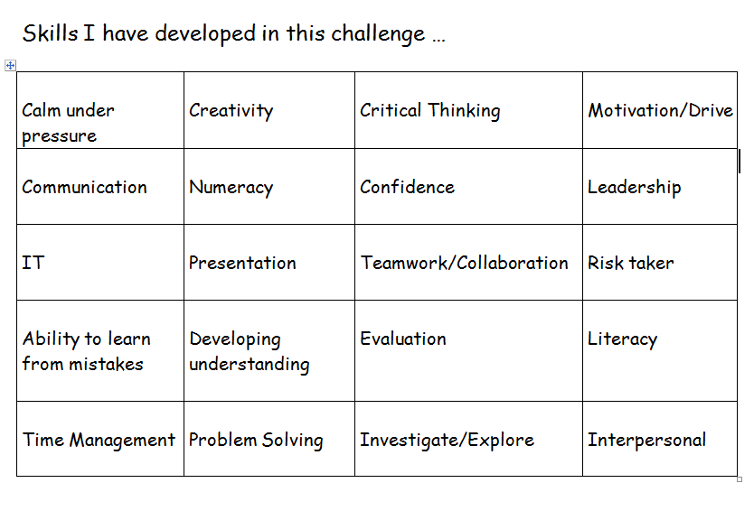
Self Evaluation Time

