Slide 1
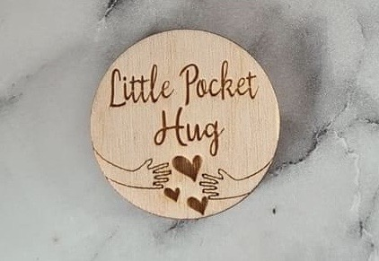
LI: I am learning about the power of my thoughts
Health and Wellbeing

Slide 2
Success Criteria
I understand that everyone experiences a mixture of emotions.
I know that my thoughts can impact the way I feel.
I know that I can try to manage my emotions by reminding myself to focus on the positive things in my life.

Slide 3
Our thoughts can play a big role on how we feel.
If we allow ourselves to concentrate on negativity, worry, fear
and doubt, then we can start to feel really down.
If we concentrate on the positives, maybe we can change our mindset and our mood. We might manage to change the way we feel.
I like this image as it is suggesting that if we focus on love
then love with flourish.
What would happen if we keep focusing on all the things we are
worried about?
They will flourish and take over our thoughts.

Slide 4
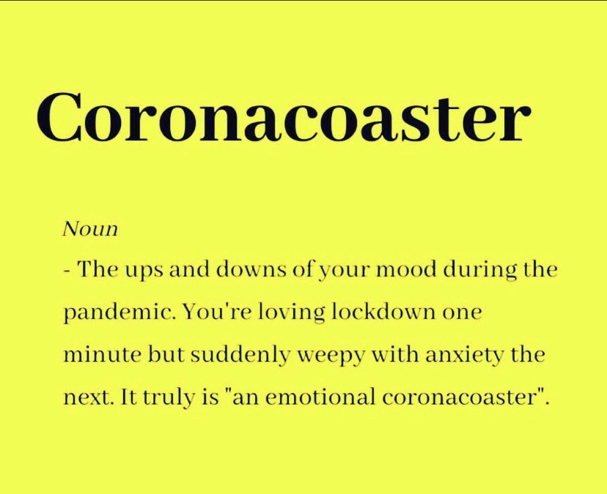
We are going to take a look at some quotes that deliver a positive message.
These quotes might help you to remember that it is ok to feel a mixture of emotions especially during difficult times. It is ok to have days or moments when you feel a bit down but we need to be able to pick ourselves up as well.
I saw this and thought on one hand it was quite funny because it is a play on the saying ‘Rollercoaster of Emotions’ but on the other hand it is quite accurate.

Slide 7
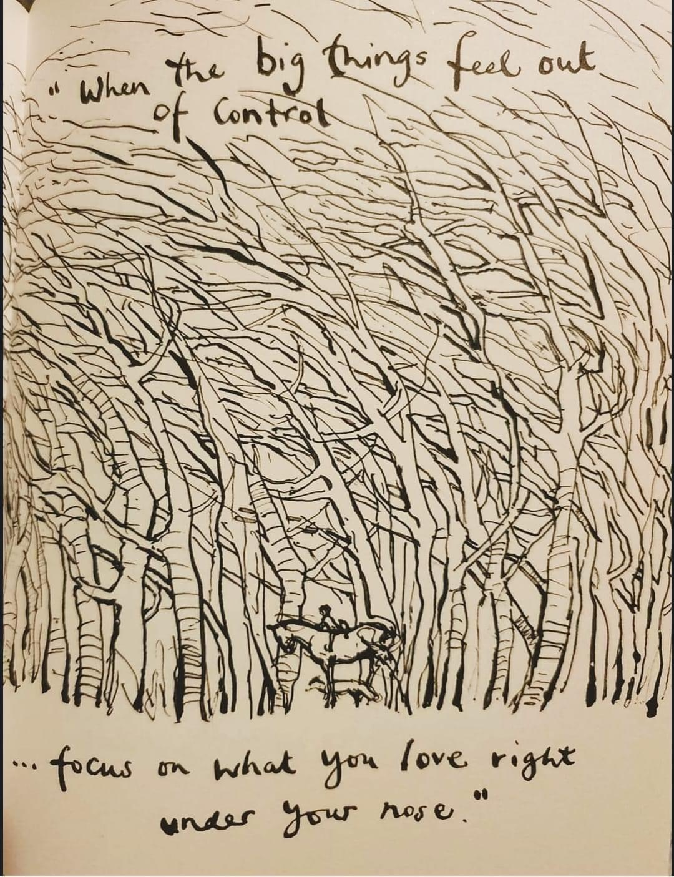

Slide 8
This is one of my favourites.

Slide 9
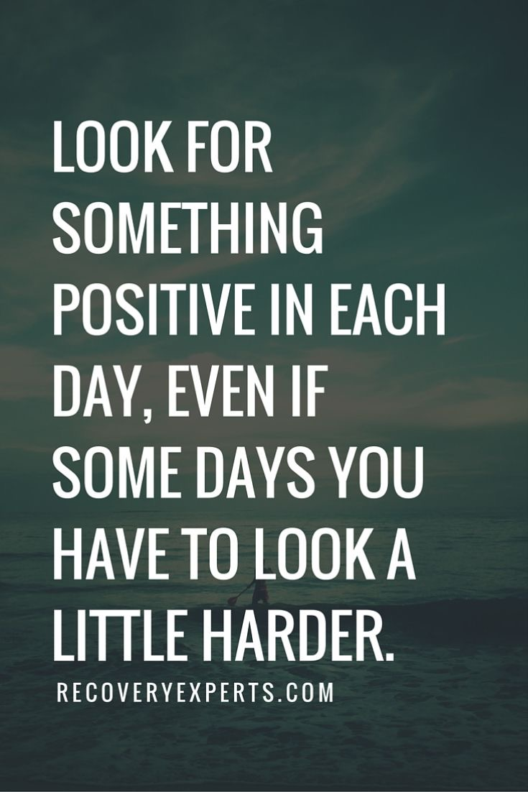

Slide 10
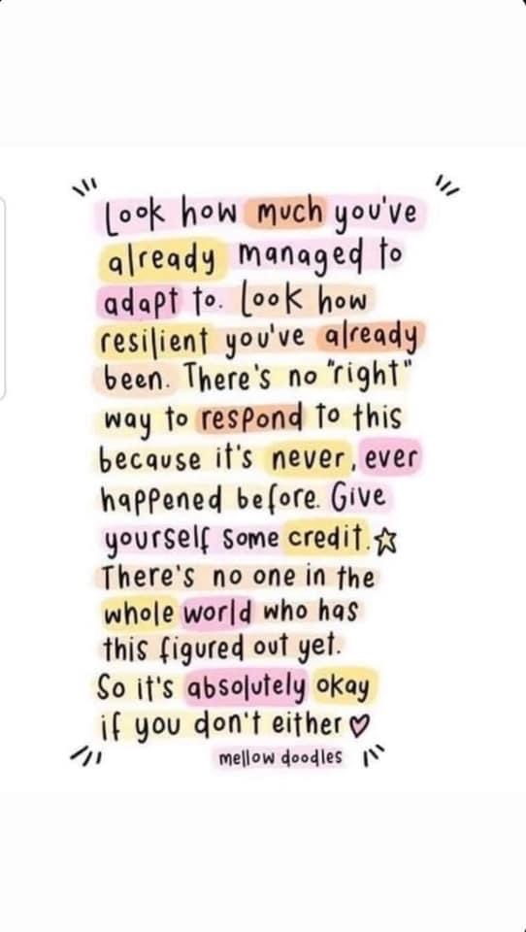

Slide 13
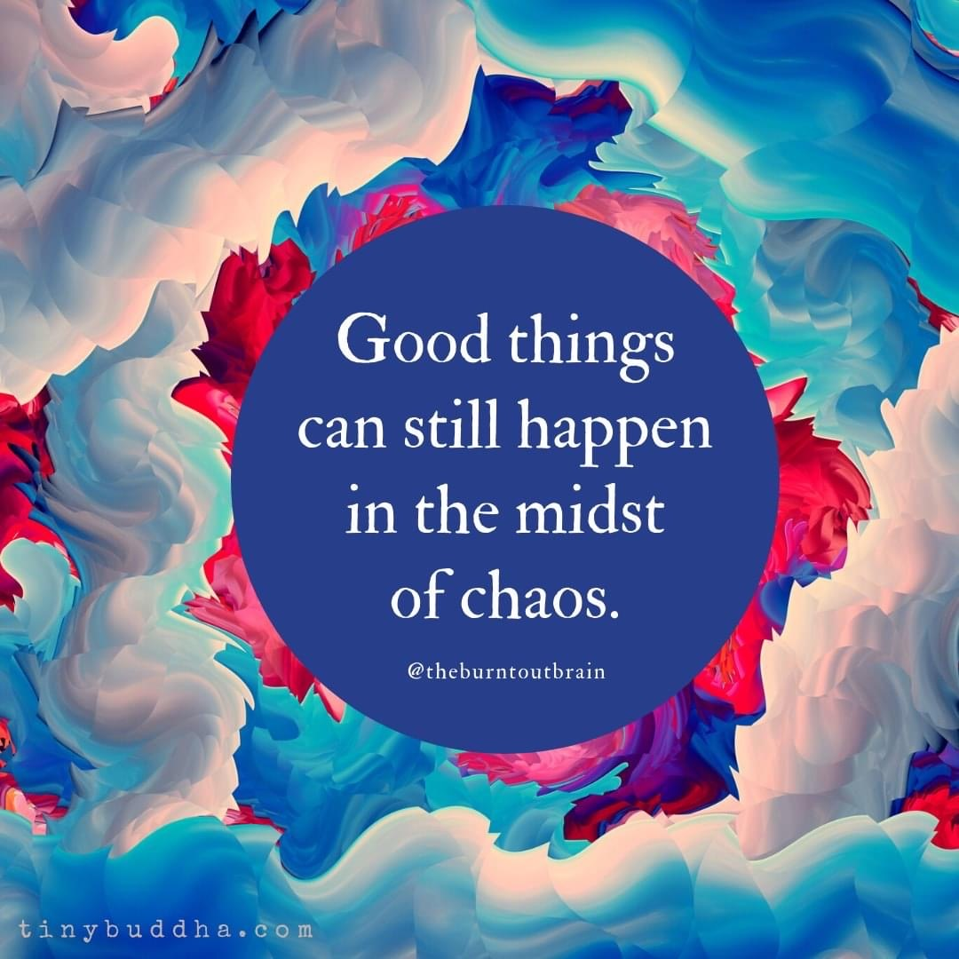

Slide 14
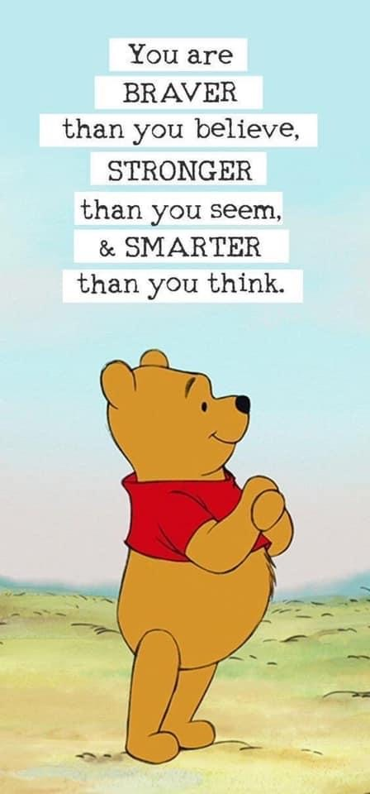

Slide 15
TASK
Even if you don’t feel you need it, a positive message can really make a difference to someone else.
Use the quotes we have just looked at to inspire you to create your own motivational message. I will put them all together and we can use these to remind ourselves to look for the positives when the negative thoughts try to take over.
You can create this however you like: digital or like a poster. You can include pictures, make it colourful and vibrant, think about fonts etc.

