Slide 1
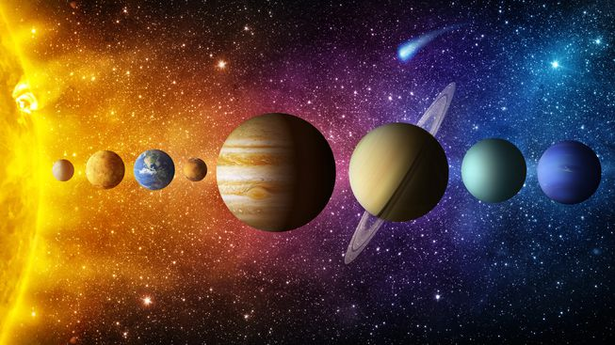
Space
The solar system, by mansoor

Slide 2
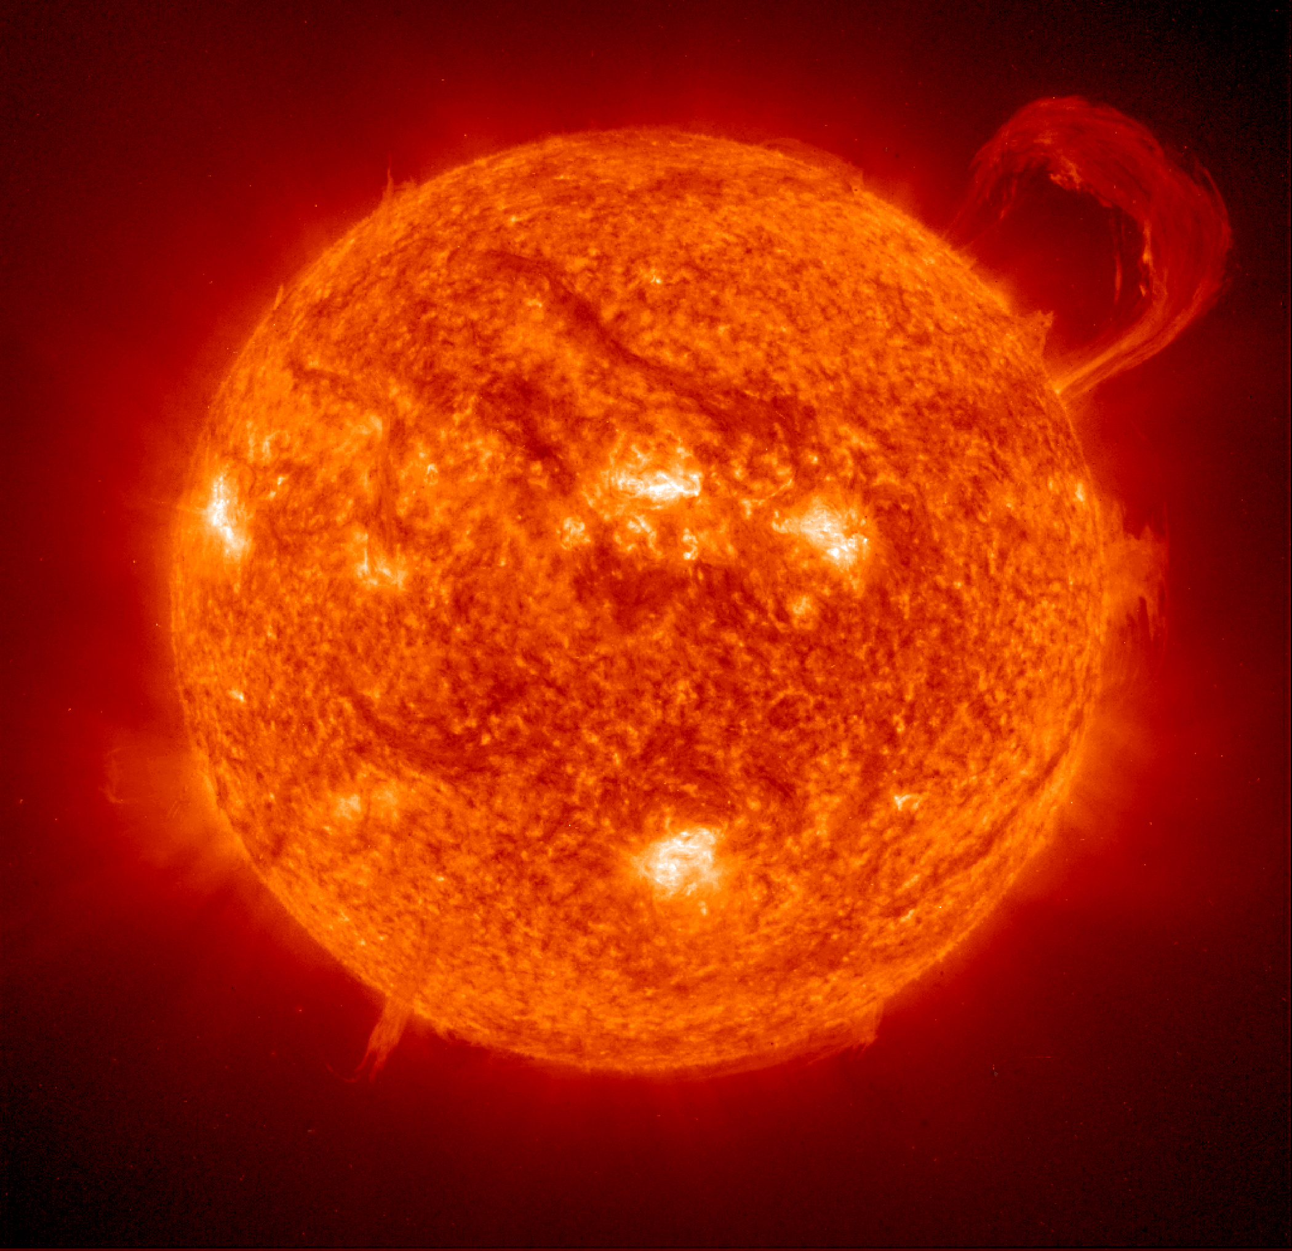
The sun
The sun is not a sphere of fire but it is a sphere of gas. The gas combine creating heat, which then supports life here on earth.
It releases these huge beams of radiation that are called solar flares. These cut power on some places and turn electrical devices dangerous for a short amount of time.
Scientists think that the sun will turn 10 times bigger in 5 billion years and destroy mercury, venus and earth.

Slide 3
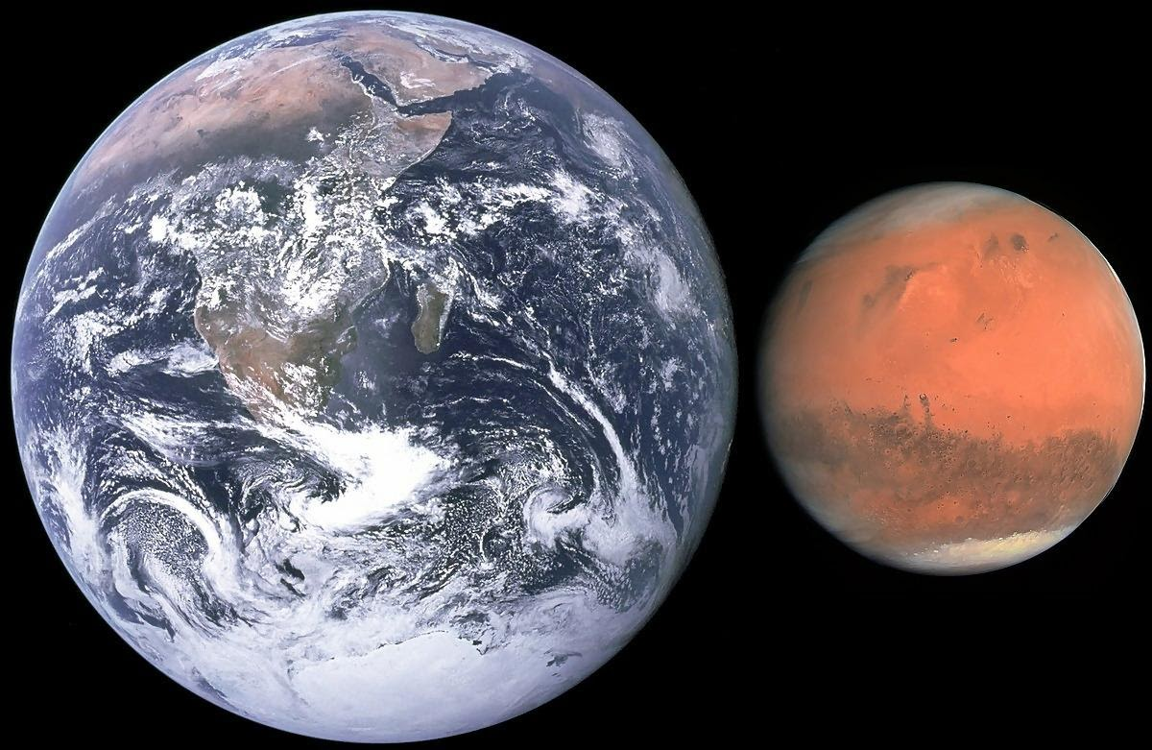
The inner planets
These planets are mercury, venus, earth and mars.
They are all made out of rocks and all sorts of other minerals.
Mercury is very hot at day but is very cold at night.
Venus is the hottest planet and has the most volcanic activity.
Earth is the only life supporting planet in the solar system.
Mars is the only planet that could have humans on it in the future.

Slide 4
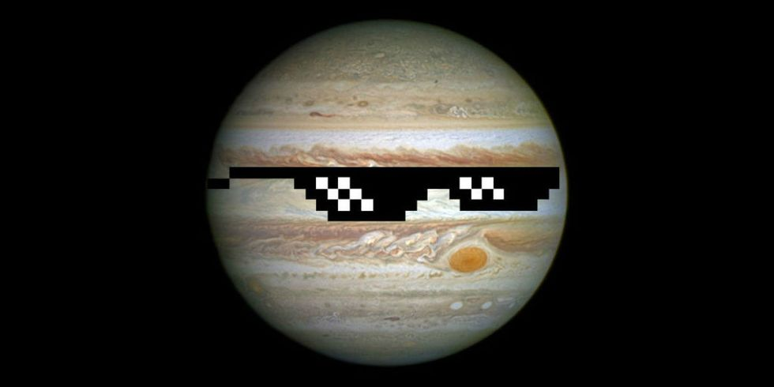
Gas giants
The gas giants are jupiter, Saturn, uranus and neptune.
Jupiter is the largest planet and if it was just a bit larger it could have been a star!
Saturn is one of the planets that have rings and scientists think that saturn has rings because its moons collided and turned into rubble.
Uranus is the coldest planet and it is the only planet that spins sideways.
Neptune is the windiest planet in the solar system, surprisingly its windier than scotland.

Slide 5
Thanks for listening
Any questions?

