Slide 1
Notes:
Teacher Note - Please check the content in this link, including any comments, is suitable for your educational environment before showing. Twinkl accepts no responsibility for the content of third-party websites.

Slide 2
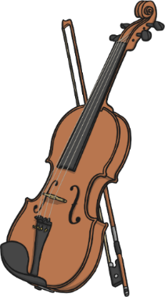
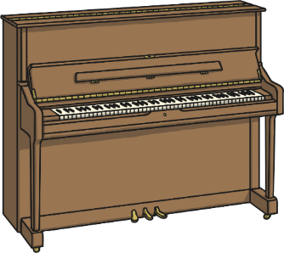
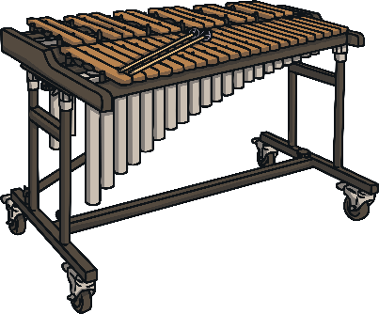
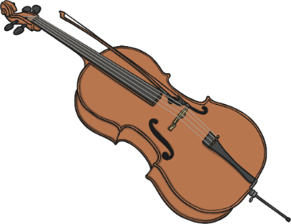
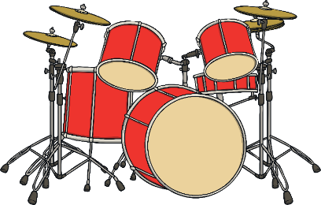
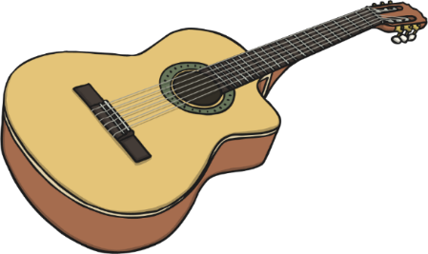
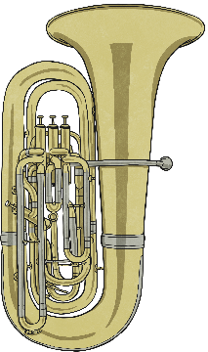
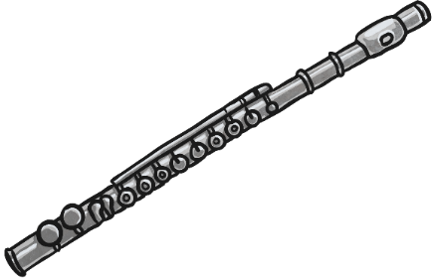
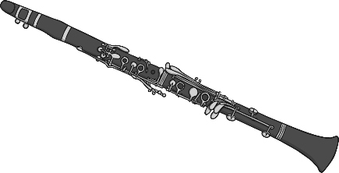
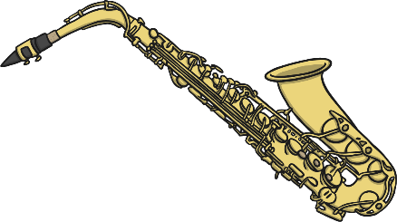
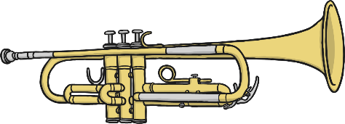
Click an instrument to watch a video:
percussion
strings
piano
xylophone
cello
violin
guitar
drums
woodwind
brass
flute
tuba
clarinet
trumpet
saxophone
Notes:
Teacher Note - Please check the content in this link, including any comments, is suitable for your educational environment before showing. Twinkl accepts no responsibility for the content of third-party websites.

Slide 3
back
Notes:
Teacher Note - Please check the content in this link, including any comments, is suitable for your educational environment before showing. Twinkl accepts no responsibility for the content of third-party websites.

Slide 4
back
Notes:
Teacher Note - Please check the content in this link, including any comments, is suitable for your educational environment before showing. Twinkl accepts no responsibility for the content of third-party websites.

Slide 5
back
Notes:
Teacher Note - Please check the content in this link, including any comments, is suitable for your educational environment before showing. Twinkl accepts no responsibility for the content of third-party websites.

Slide 6
back
Notes:
Teacher Note - Please check the content in this link, including any comments, is suitable for your educational environment before showing. Twinkl accepts no responsibility for the content of third-party websites.

Slide 7
back
Notes:
Teacher Note - Please check the content in this link, including any comments, is suitable for your educational environment before showing. Twinkl accepts no responsibility for the content of third-party websites.

Slide 8
back
Notes:
Teacher Note - Please check the content in this link, including any comments, is suitable for your educational environment before showing. Twinkl accepts no responsibility for the content of third-party websites.

Slide 9
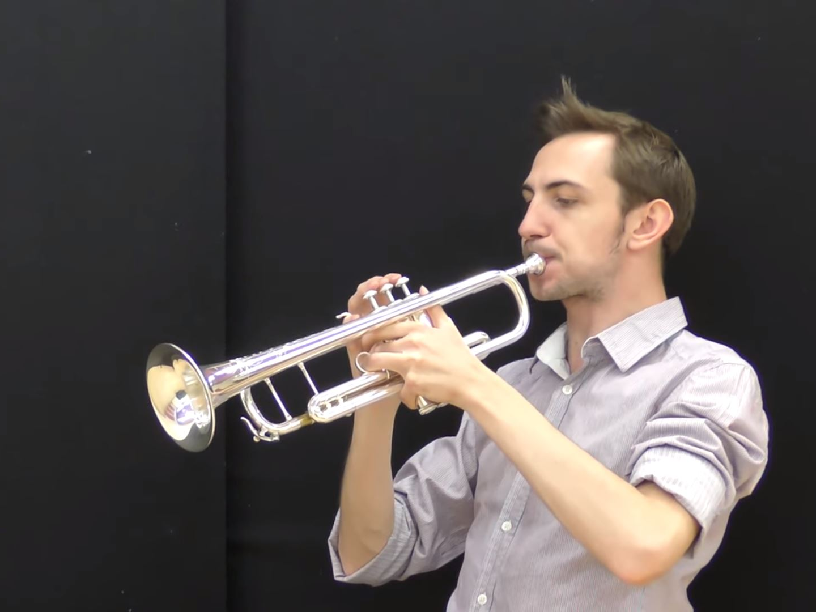
back
Notes:
Teacher Note - Please check the content in this link, including any comments, is suitable for your educational environment before showing. Twinkl accepts no responsibility for the content of third-party websites.

Slide 10
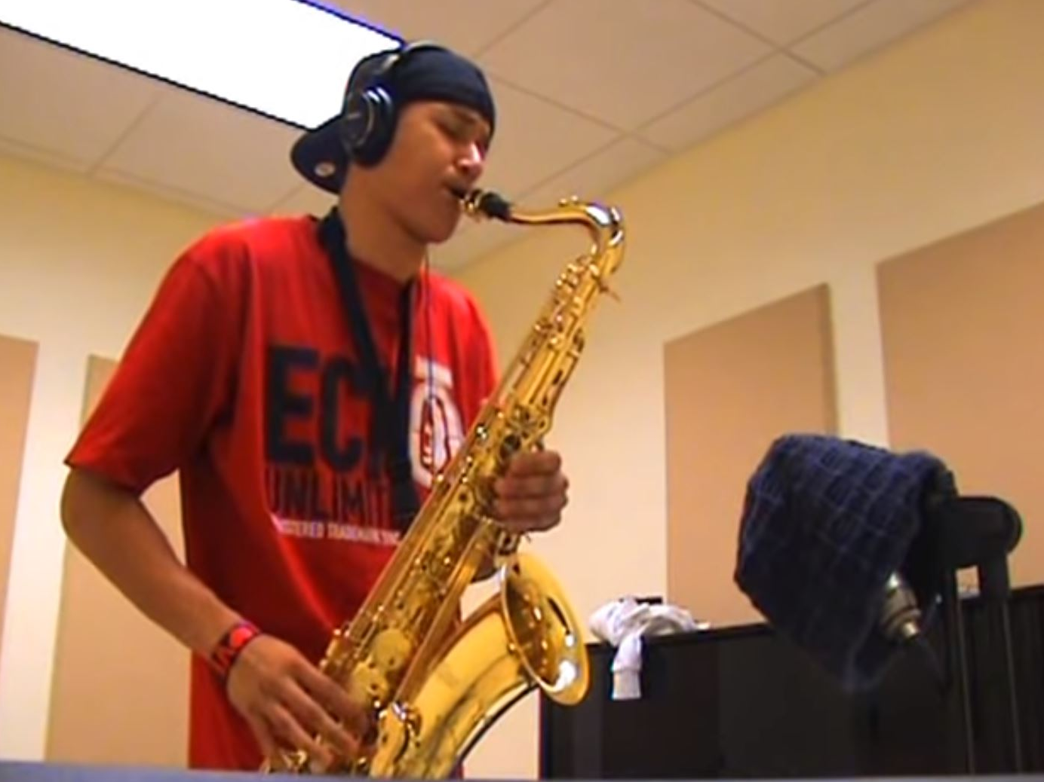
back
Notes:
Teacher Note - Please check the content in this link, including any comments, is suitable for your educational environment before showing. Twinkl accepts no responsibility for the content of third-party websites.

Slide 11
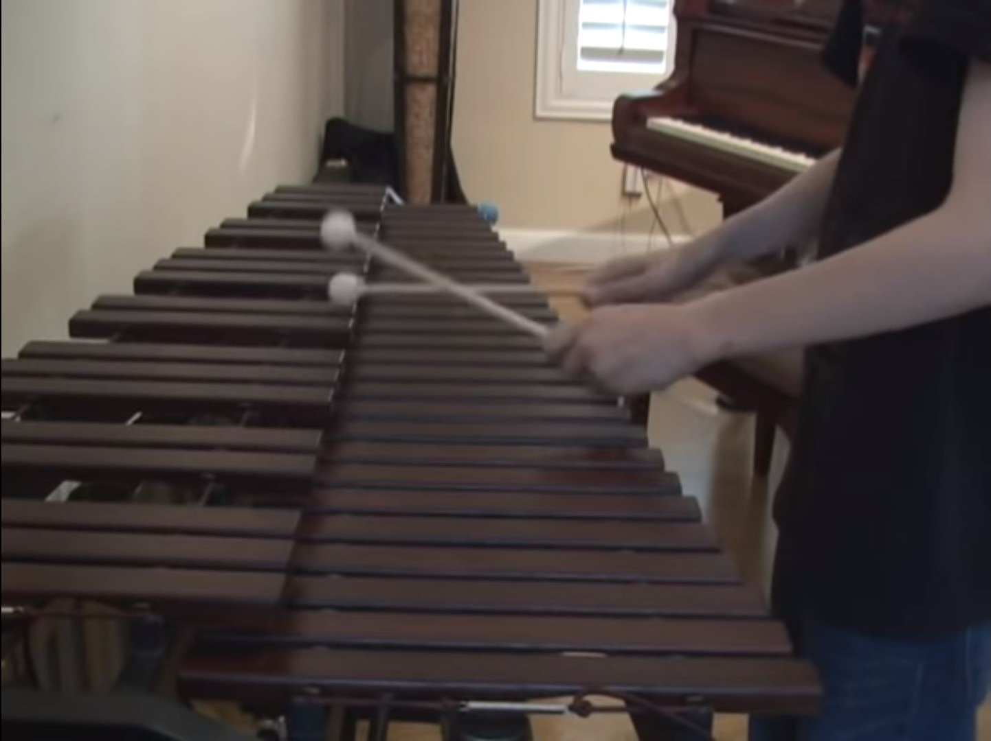
back
Notes:
Teacher Note - Please check the content in this link, including any comments, is suitable for your educational environment before showing. Twinkl accepts no responsibility for the content of third-party websites.

Slide 12
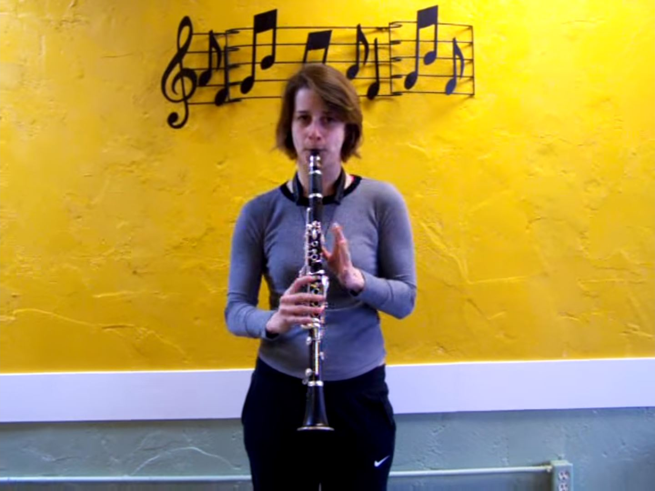
back
Notes:
Teacher Note - Please check the content in this link, including any comments, is suitable for your educational environment before showing. Twinkl accepts no responsibility for the content of third-party websites.

Slide 13
back
Notes:
Teacher Note - Please check the content in this link, including any comments, is suitable for your educational environment before showing. Twinkl accepts no responsibility for the content of third-party websites.

Slide 14
What's your favourite musical instrument? Can you play an instrument? What type of music do you listen to?
Notes:
Teacher Note - Please check the content in this link, including any comments, is suitable for your educational environment before showing. Twinkl accepts no responsibility for the content of third-party websites.

Slide 15
Notes:
Teacher Note - Please check the content in this link, including any comments, is suitable for your educational environment before showing. Twinkl accepts no responsibility for the content of third-party websites.

