Slide 1
Roddy Campbell
School Careers Adviser
Notes:
Personalise slide...
Introduce yourself to class and explain your role within the school as Careers Adviser
Brief introduction to SDS
Explain why you are here in relation to title of group work.

Slide 2
General Overview
Skills Development Scotland Structure
School Career Coach
Work Coach
Post-School Career Coach
Personal Advisers
My World of Work
Generating ideas
Subject Choice Tools
Careers A-Z
Parent/Teacher zone
Job/Course search
Positive Destinations
- Follow-up
Notes:
Personalise slide...
Introduce yourself to class and explain your role within the school as Careers Adviser
Brief introduction to SDS
Explain why you are here in relation to title of group work.

Slide 3
Where Waid school leavers go next...

Slide 4
Support in The Waid Academy
Strong relationship with Staff/Pupils
Presence at Parents/Pathways Evenings
Attend school meetings for pupil updates
Supporting guidance with subject choice
Drop-in Service at school
CV/Job & MA search support – skills & strengths
University/College/MA/Employment - applications
Labour Market Information
Career counselling
Notes:
Personalise slide...
Introduce yourself to class and explain your role within the school as Careers Adviser
Brief introduction to SDS
Explain why you are here in relation to title of group work.

Slide 5
3 Stages of Research: Key Websites
CAREERS RESEARCH – Job profiles
- My World of Work: Careers A-Z, subject choice tools
www.myworldofwork.co.uk
COURSE RESEARCH – All university courses in the UK
- UCAS
www.ucas.com
GRADUATE OPPORTUNITIES
- Prospects – using your degree, graduate jobs, post-graduate opportunities
www.prospects.ac.uk
- Specific Universities, Colleges, Modern Apprenticeships, Employment opportunities - online

Slide 6
FE vs. HE
National 4/5 qualifications
NC/NQ
Highers/Adv Highers
HNC/HND/Degree
Notes:
Emphasise average requirements required for each. N4/5’s for NC/NQ, 1 or 2 highers for HNC/D and 4 or 5 highers (often from one sitting) for uni
Where you can study (degrees at college too) and relationship between quals.
Stress progression.

Slide 7
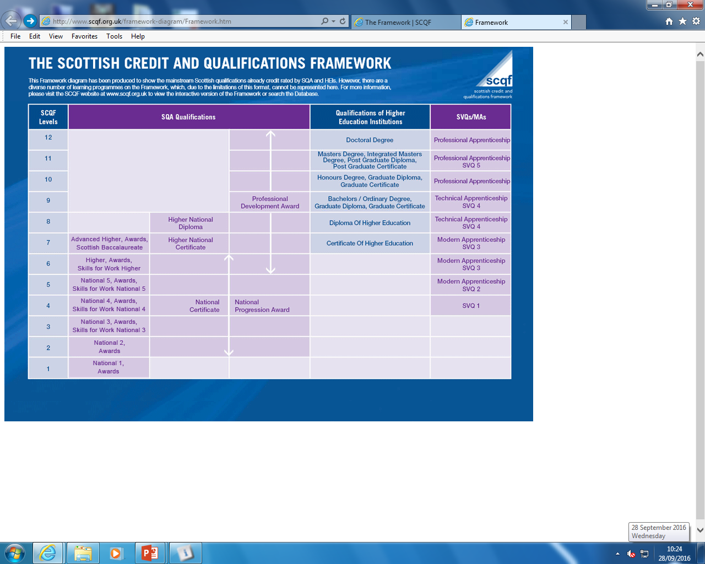
Notes:
Emphasise average requirements required for each. N4/5’s for NC/NQ, 1 or 2 highers for HNC/D and 4 or 5 highers (often from one sitting) for uni
Where you can study (degrees at college too) and relationship between quals.
Stress progression.

Slide 8
Have a look on My World of Work – myworldofwork.co.uk
Notes:
Talk to the group about our website My World of Work – myworldofwork.co.uk - and the fact that they will use it to progress through school and beyond.

Slide 9
Roddy Campbell
roddy.campbell@sds.co.uk
07595674201
Notes:
Reminder of what we have done today...

