Slide 1
Learning IN OUR SCHOOL
Pupil Voice about HGIOS

Slide 2
Our Challenge…
We were challenged to look at our school website and research, review and rewrite.
There was lots of information there about our school. The only problem was, most of it had been written by adults! This was a great opportunity to share what we think about our school and what we want to share
The following slides have some of our writing which tells you more about our school from us – the children.
P1 – The Playground
P2 – In the classroom
P3 and P4 – The dinnerhall and school routines like lunch, break and outdoor learning.
P5-7 have been looking at our webpage and have been revisiting and redrafting that!
https://blogs.glowscotland.org.uk/fi/tulliallanps/

Slide 3
p1 - Playground
What do we think about our playground?

Slide 4
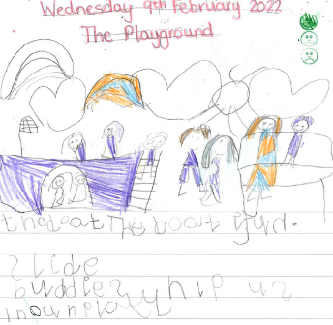
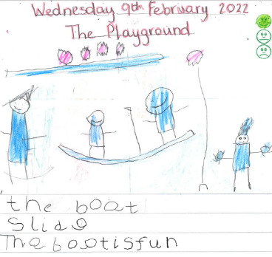
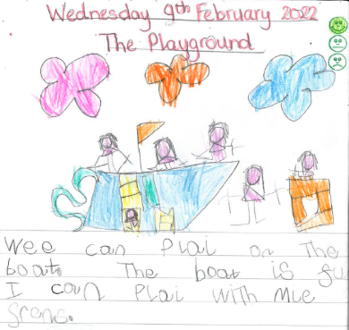
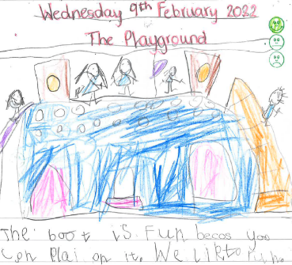
In P1 we think the playground is an amazing place to explore new things, play with our friends, have lots of exercise and fun. We wanted to share all the things we like about our playground.
We like the boat because you can play on it with your friends

Slide 5
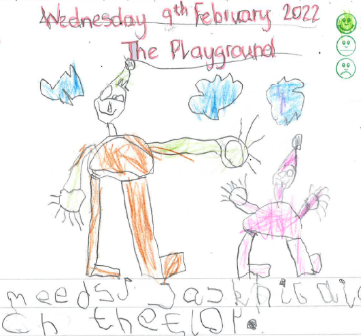
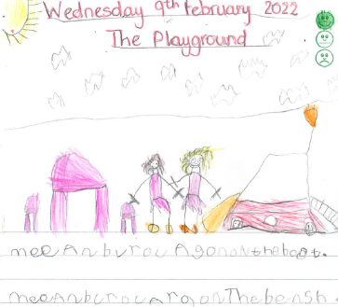
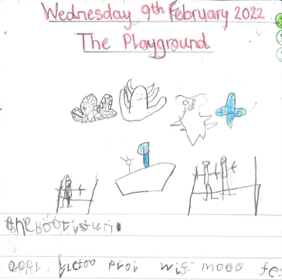
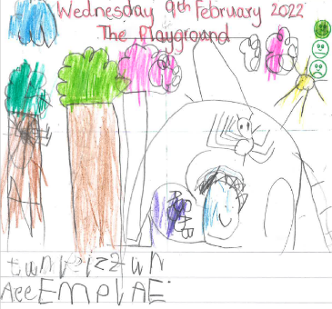
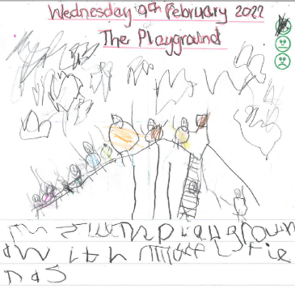
Boat
Buddies

Slide 6
Learning IN THE p1/2 CLASSROOM
What do we think about our classroom?

Slide 7
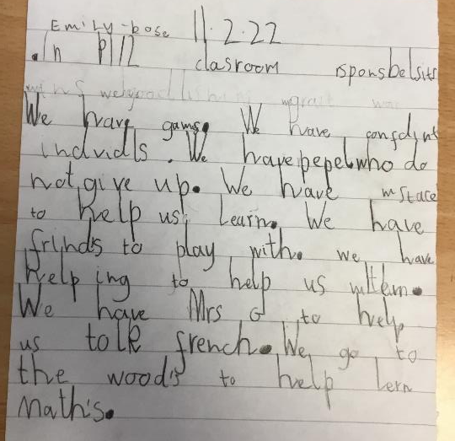
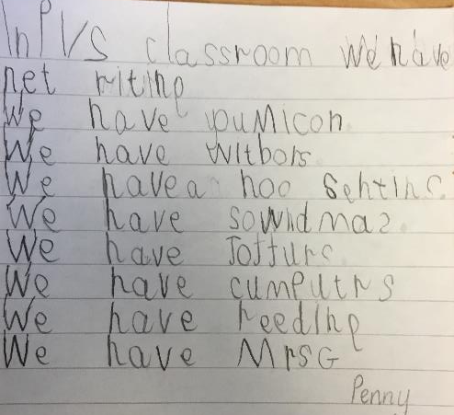
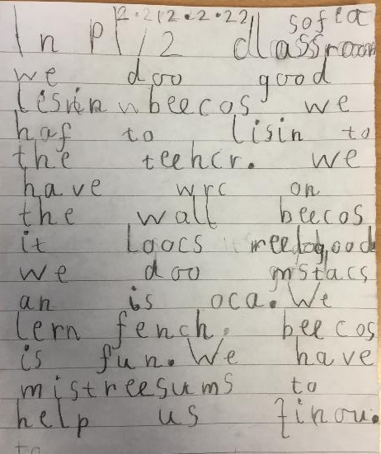
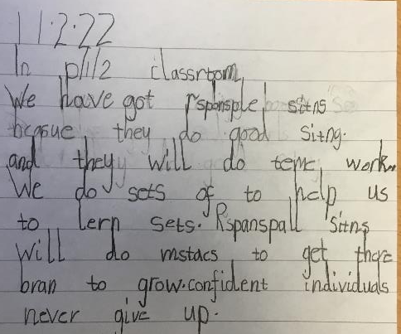
Primary 1/2 and Primary 2 is an exciting place to learn new things. We want to share all the things about what learning looks like in our classroom.

Slide 8
Learning IN THE p2 CLASSROOM
What do we think about our classroom?

Slide 9
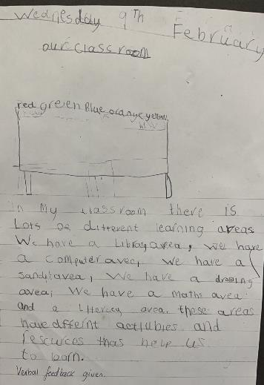
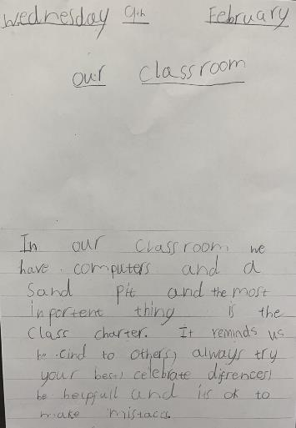

Slide 10
P3 - Dinnerhall
What do we think about our dinnerhall?

Slide 11
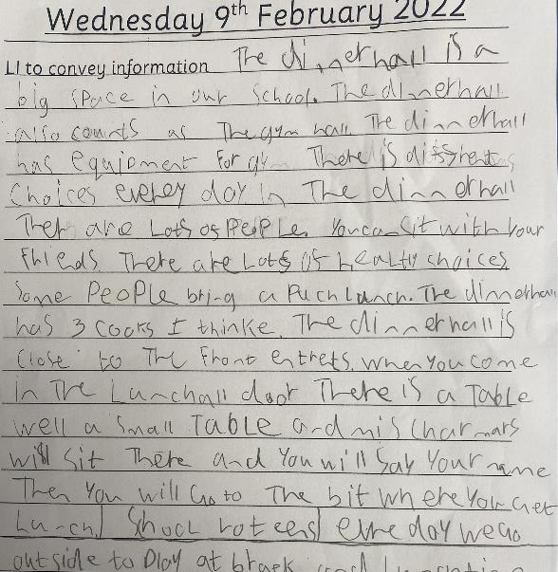
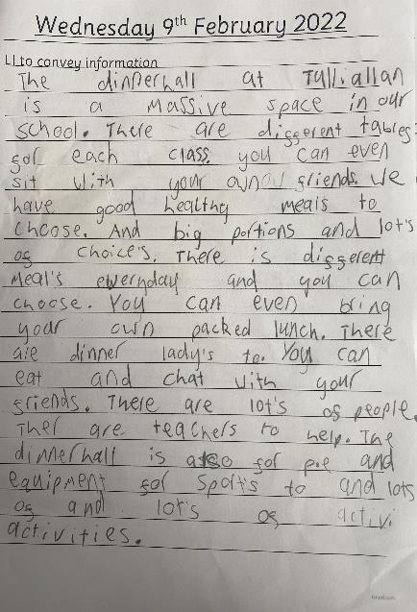
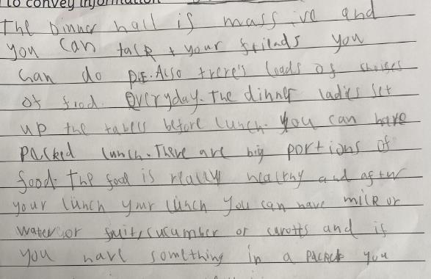
In Primary 3 we think our routines are super important and help us reach our full potential.
-----------------------------
We think our dinnerhall is great place to learn how to eat a balanced diet, practice our fine motor skills and is a great place to enjoy our lunch.

Slide 12
