Slide 1


Slide 2
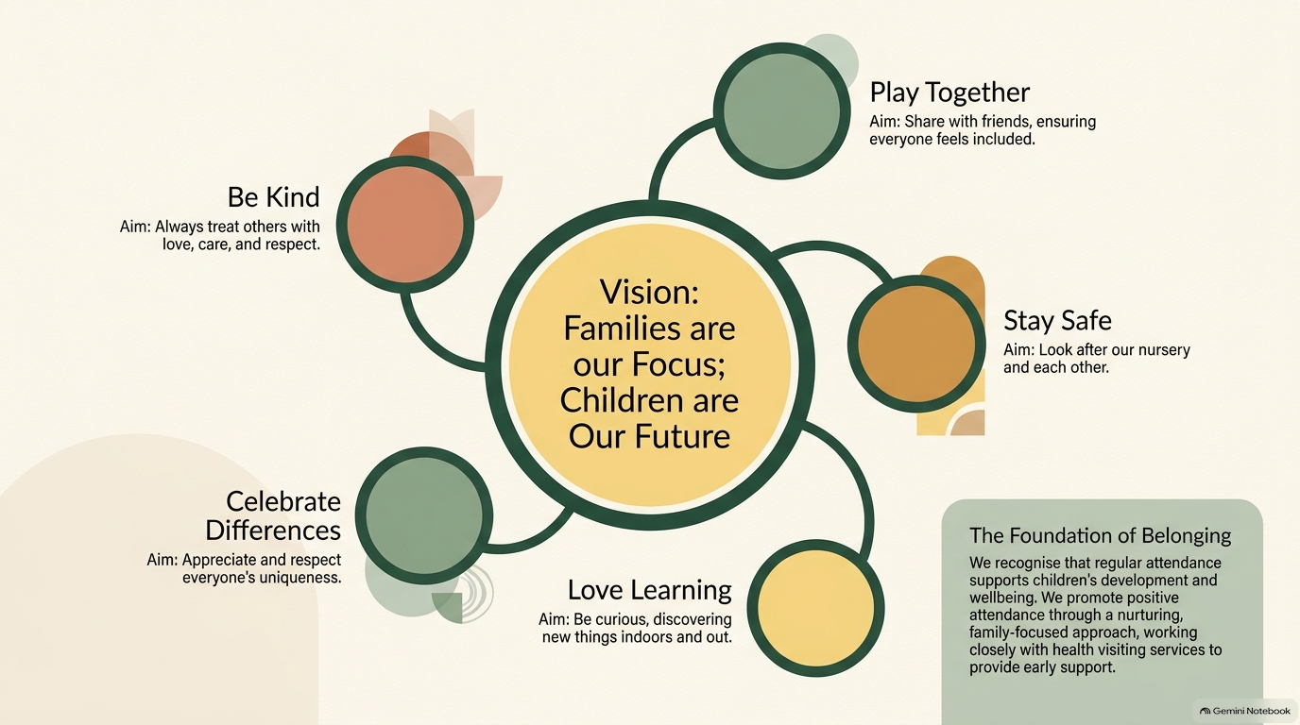

Slide 3
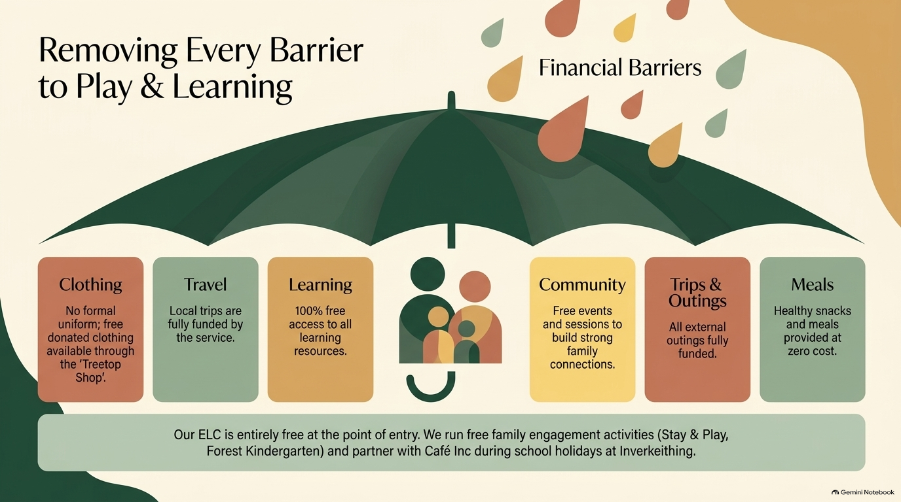

Slide 4
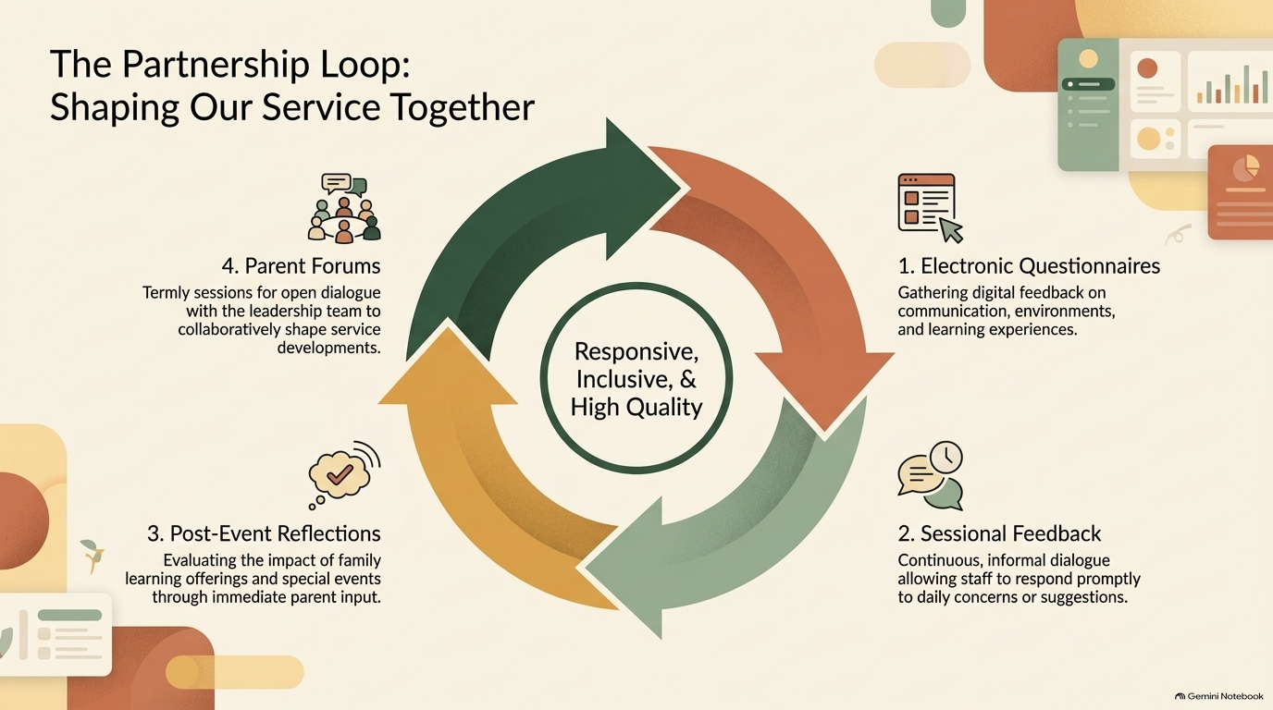

Slide 5
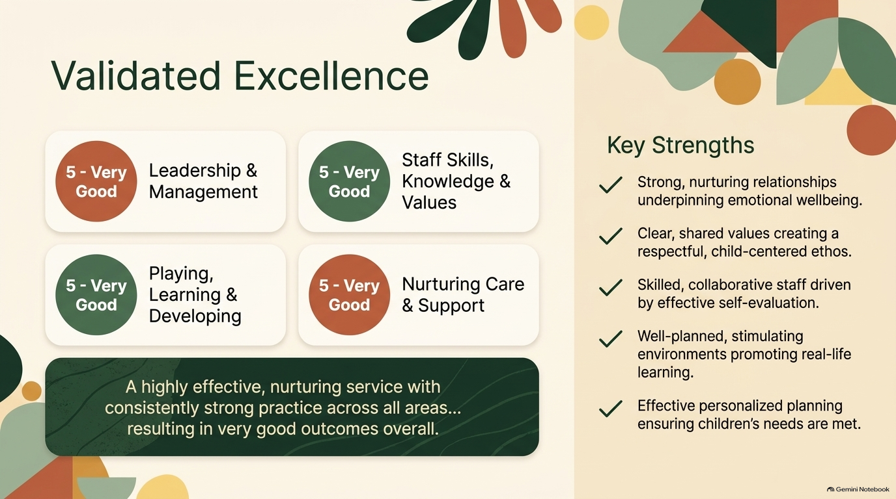
Validated Gradings
Effective personalised planning ensuring children’s needs are met.

Slide 6
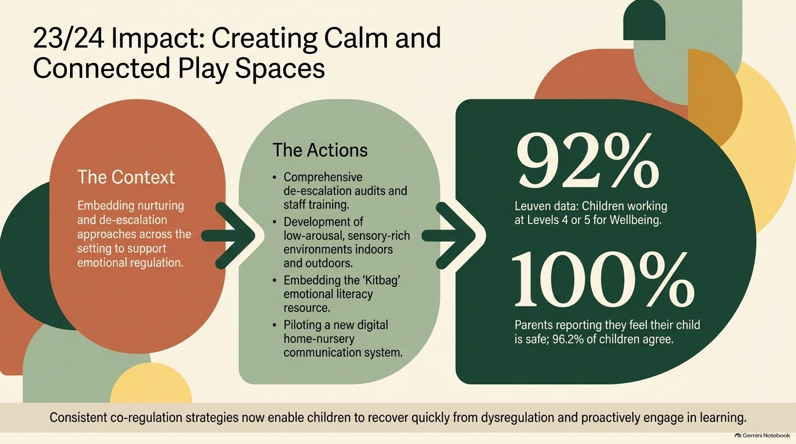
25-26
Of total respondents:

Slide 7

25-26

Slide 8
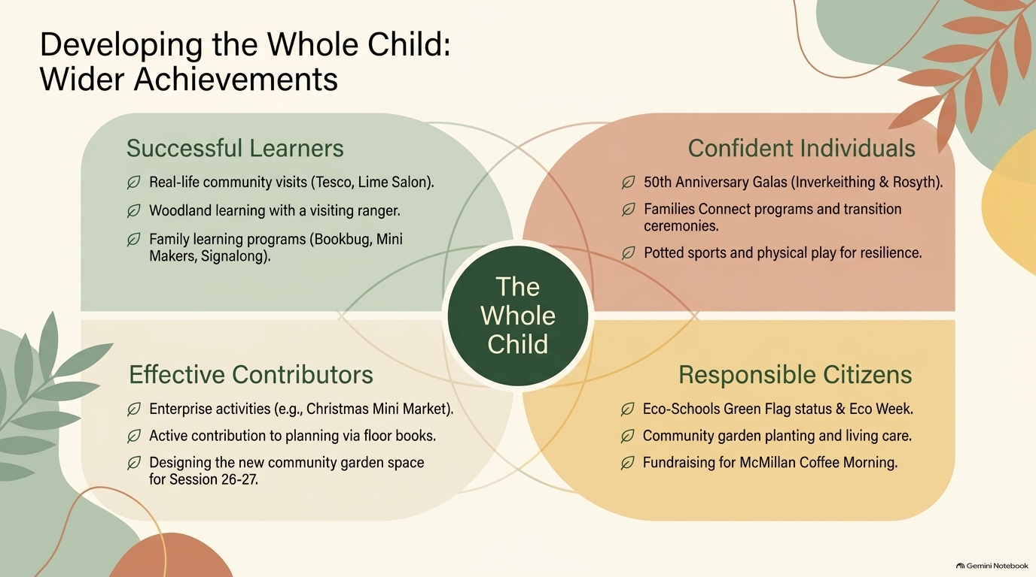

Slide 9

What Next?
Over the course of session 26-27 we will have 2 focussed priorities.

Slide 10
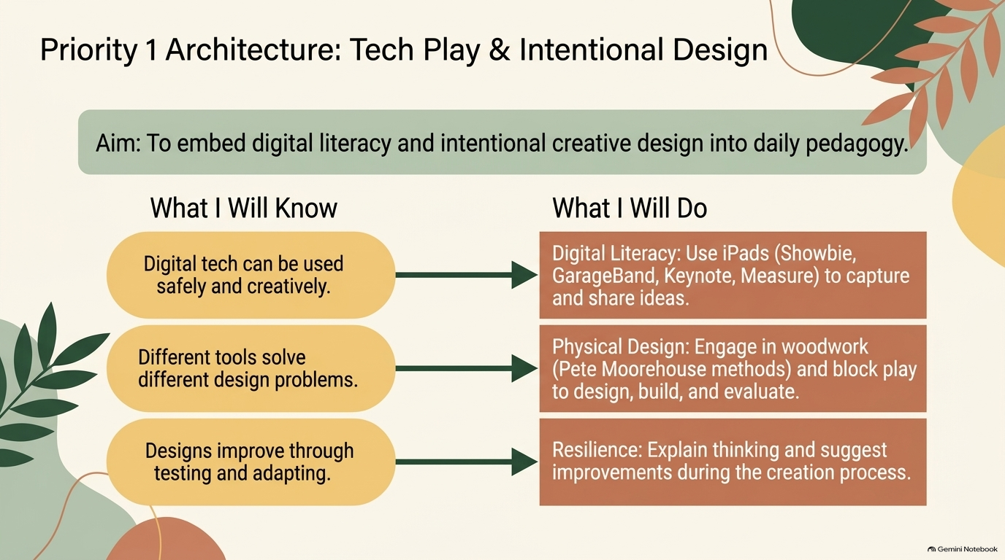


Slide 11
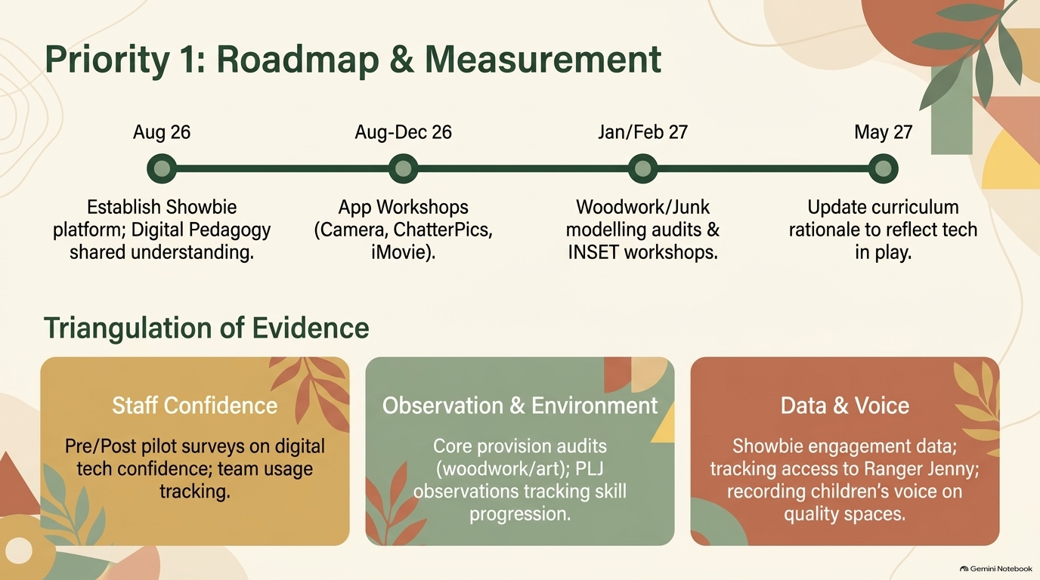

Slide 12
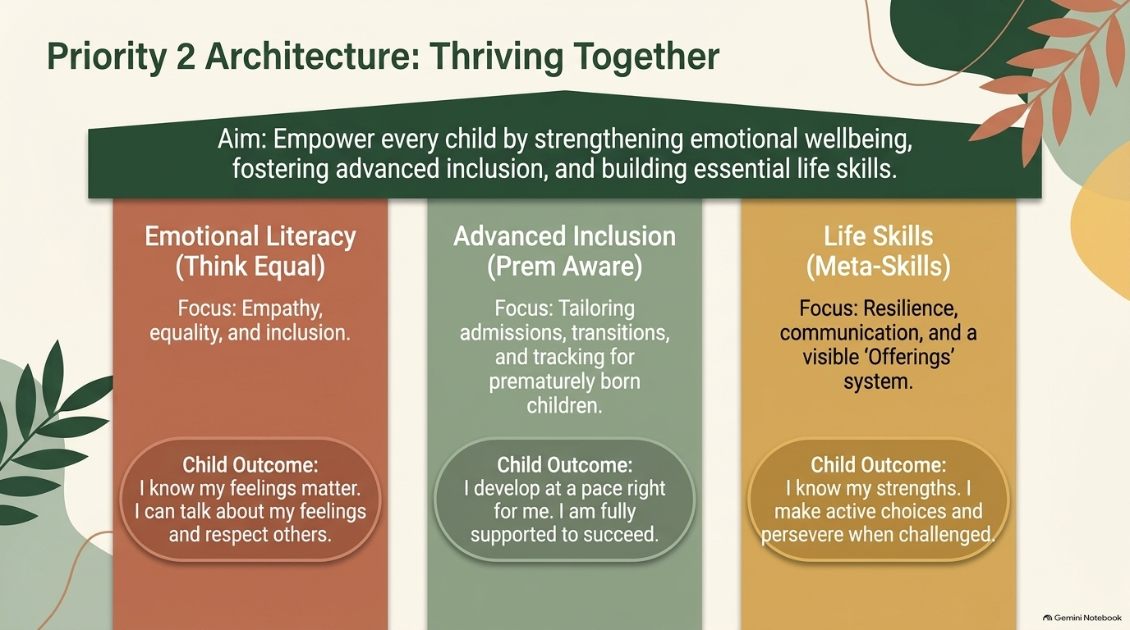


Slide 13
