Slide 1
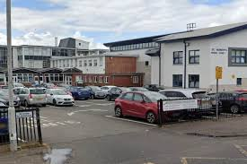
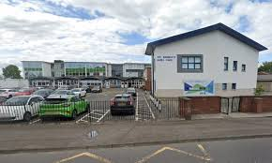
Introduction to S1
at St Andrew’s High School

Slide 2

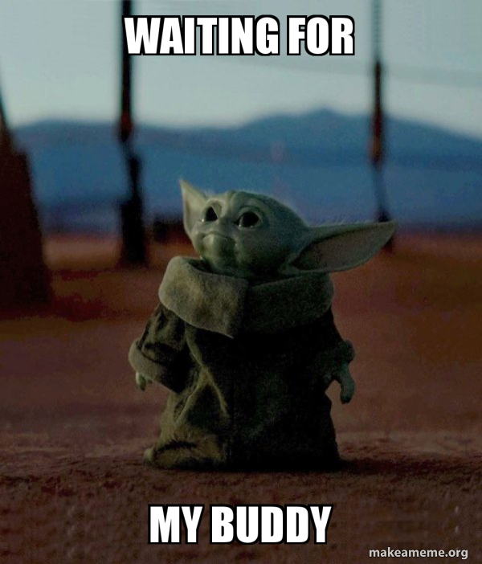
Things you told us you enjoyed…
Your buddies
You will have buddies when you come up after the holidays. They will help you find your way around for the first few weeks.
The seniors are always available to help if you need something.

Slide 3

Things you told us you enjoyed…
Getting to try different subjects
You will have lots of opportunities to do more of the subjects you enjoyed. The feedback you gave said you liked Home Economics, RE, Woodwork, PE, Science, English, Maths & Art.
These are subjects that you will be able to do more of.

Slide 4
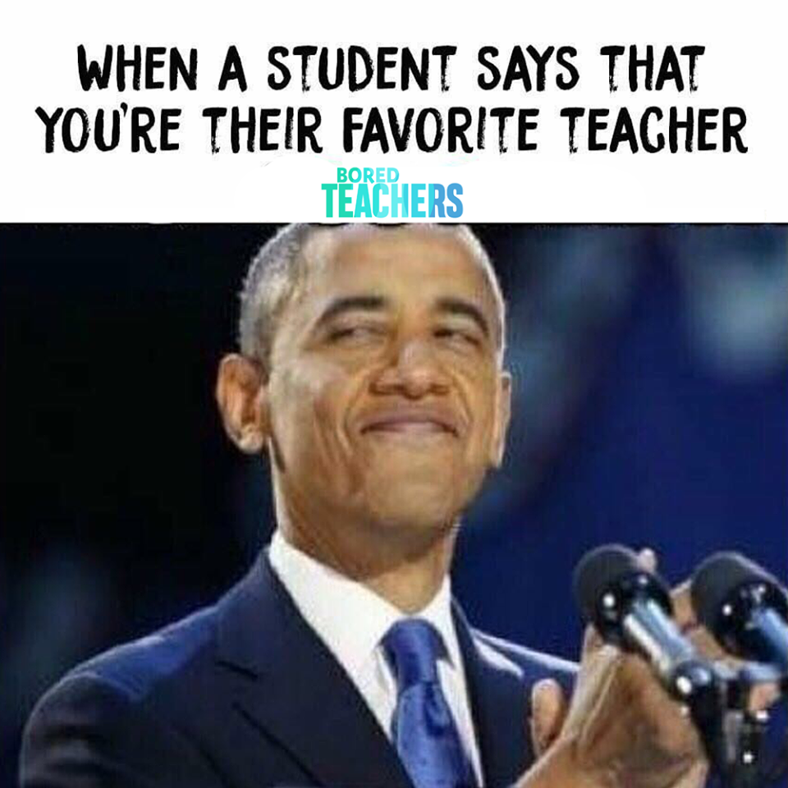
Things you told us you enjoyed…
Meeting new teachers
Your teachers were very pleased with your visit. Feeback from teachers was that you listened well, tried your best and were a credit to your school.

Slide 5
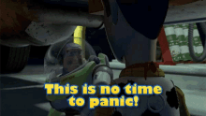
Things you told us you are worried about…
Buses/Getting lost/Being late/Movement around the school
Your bus pass will be sent to you during the summer holidays. There will be seniors on your bus. Your guidance teacher (Mrs Logie) and your Year Head (Mrs Ward) will be waiting for you in the bus park.
Buddies will be assigned to your class to help you find your way around. Teachers know you are learning your way. If you get lost or worried ask a senior or a teacher…they are here to help you. Don’t panic!

Slide 6

Things you told us you are worried about…
Bullying
Your Guidance Teacher (Mrs Logie) is always available to speak to. You can either drop into the Guidance Base or book an appointment to speak to Mrs Logie if she is teaching at that time.
Bullying is not tolerated at St Andrew’s High School. It is against the values and ethos of the school. If you feel bullied or see bullying, you let Mrs Logie know.
Your buddies will also be there to support you with this.

Slide 7
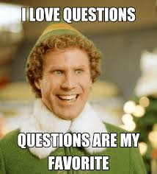
Things you wanted to ask…
Is there a hockey/football/basketball team?
Your parent/carer will receive an email towards the end of the summer holidays. It will have a list of all extra-curricular clubs and who runs them.
We update this every year as some teachers leave, new clubs start etc.
There are lots of extra-curricular activities available and there will be plenty of clubs for you to join.

Slide 8
Things you wanted to ask…
If I get lost will someone find me?
Yes!
First years have been coming up to St Andrew's for a long time. We look after them.
If you do lose your way, find the nearest teacher or senior. If there are no teachers in corridors knock on the nearest door. Every single teacher in the school will help you if you get lost.

Slide 9
Things you wanted to ask…
What are the rules at lunchtime?
You cannot leave the school grounds. You cannot go to Asda, Greggs or anywhere else outside of the school. We have a big outdoor space with lots of benches in the school grounds, you can use this space, but you cannot leave the school.
You can pay by cash or card at the tills.
You can also pre-order your lunch.

Slide 10
Things you wanted to ask…
When do we get our timetables?
On your first day back, you report to the assembly hall. You will be given your timetable.
Your class will be largely the same as the group you were in during your visit. There might be a few very slight changes.

Slide 11
Things you wanted to ask…
What are the rules with school uniform?
They are very simple. Black trousers/skirt, white shirt/poloshirt, black shoes, black jumper/cardigan or school jumper and a school tie.
No hoodies. No coloured shoes. Nothing that isn't in the uniform.
School is preparing you for work. Lots of jobs require a uniform. There is also health and safety reasons why you can't wear hoodies. (woodwork machinery)

Slide 12
Things you wanted to ask…
Can you get study support?
Yes. Teachers want to help you learn. If you need a bit of support, ask.
Different subjects run different study support programmes and homework clubs. You will get all this information when you come up after the holidays.
Support is always there!

Slide 13
Things you wanted to ask…
How hard are exams?
It depends on how much work you put in. If you work hard, you will find them easier.
There is lots of support for things like assessments/exams. If you are struggling and worried about sitting a test, speak to your Guidance Teacher or Mr Mitchell (Head of Pupil Support), they can help you.

Slide 14
Things you wanted to ask…
When was St Andrew's built?
The school was opened in 1959.
Since then, there has been new bits added to the school, so some bits are much newer.

Slide 15
Things you wanted to ask…
What are the rules about mobile phones?
You cannot use your phone in class.
You can use your phone at break and lunch time.
You are allowed your phone into school with you but you must keep it in your bag during class time.
You will be getting an IPad after the holidays, so there will not be a reason to use phones in class.

Slide 16
If you have any other questions...
Mrs Logie always has time to answer questions...
Your parents/carers can phone or email the school if anything comes up before or during the holidays.
Or, your primary school can get in contact if you have questions.
Mrs Logie's job is to help and support you. If you need anything or have any other questions, she is always happy to answer them.
Everyone at St Andrew's is looking forward to the new S1's coming up. We are all really excited for you to be part of our school.

Slide 17
Key people for you...
Mrs Logie
PT Guidance for S1's
Miss Ward
Depute & Year Head of S1&S6
Mr Mitchell
Head of Pupil Support
Pupil Support Officers
Mrs Kelly, Mrs Lister and Mrs Murray
We will see you in August. Enjoy your summer holidays!

