Slide 1
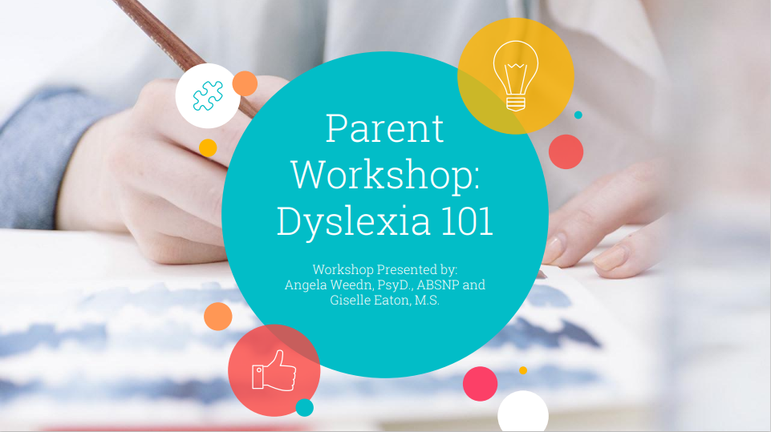
Natalie Rooney – Support for Learning Teacher

Slide 3
Reading Smoothly
Decoding (sounding out words)
Spelling
Recognising Common Sight Words
Rhyming
Solving word problems in maths
Understanding what they read.
Learning a new language.

Slide 4
How are Children Assessed for Dyslexia?
Class teacher gathers observations.
Referral to SFL Teacher
Contextual Assessment Process Begins
Learning strengths and difficulties are identified.
Pupil is identified as Dyslexic or not. There is no grey area.

Slide 5
Supporting a Dyslexic Pupil
Audio books - Audible
Use technology – Dictate in Word, Immersive reader.
Colour Overlays for reading.
Access to common word banks.
Extra time
Multi-sensory approach to letter recognition.
Memory games
Work on remembering birthday, days of the week and months of the year.

Slide 6
Supporting a Dyslexic Pupil
Our Dyslexia Heroes in school are responsible for helping all children in school who may have a difficulty with literacy. Here are some of their suggestions to help your child at home:

Slide 8
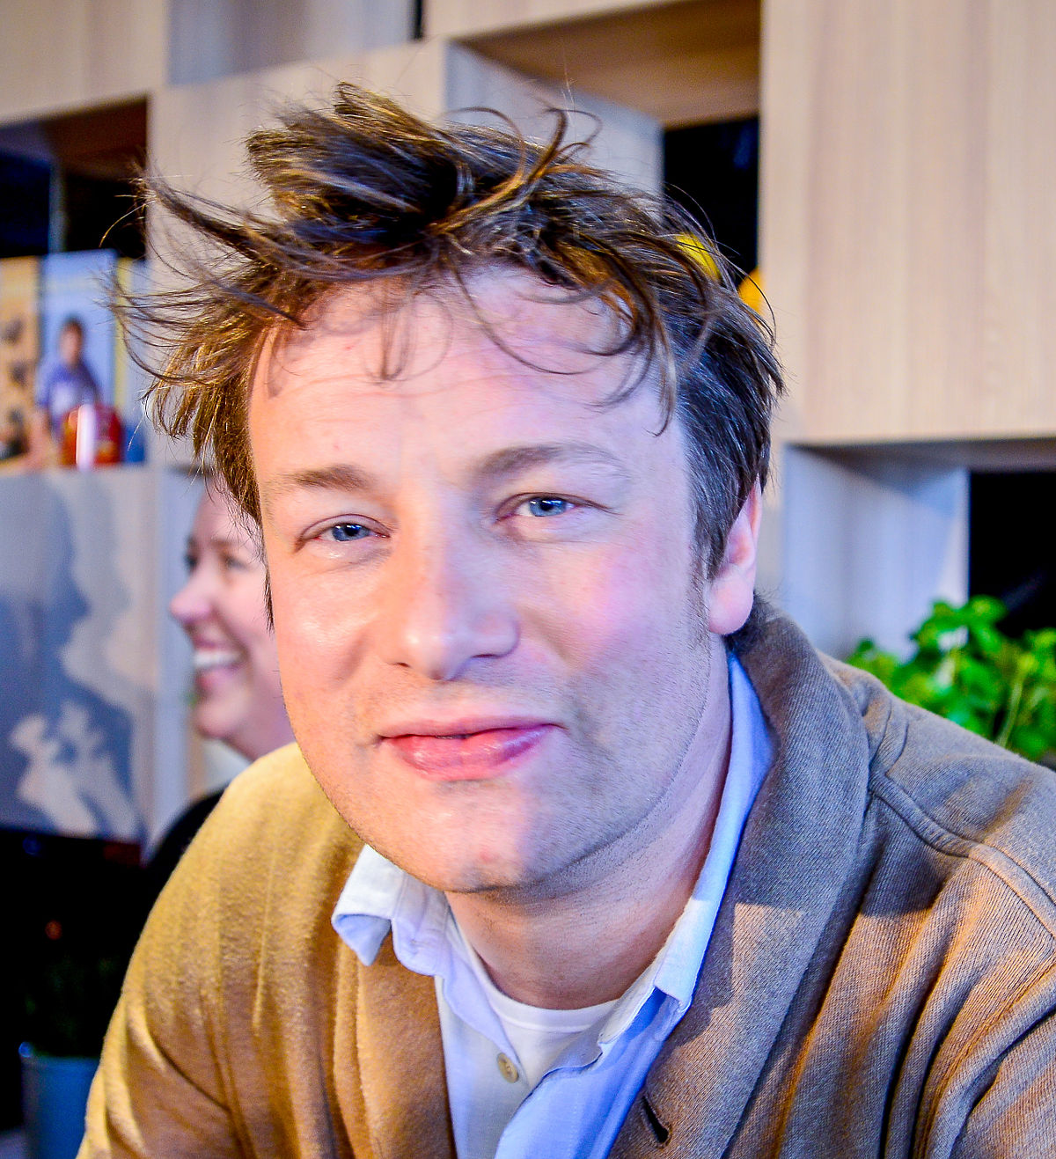
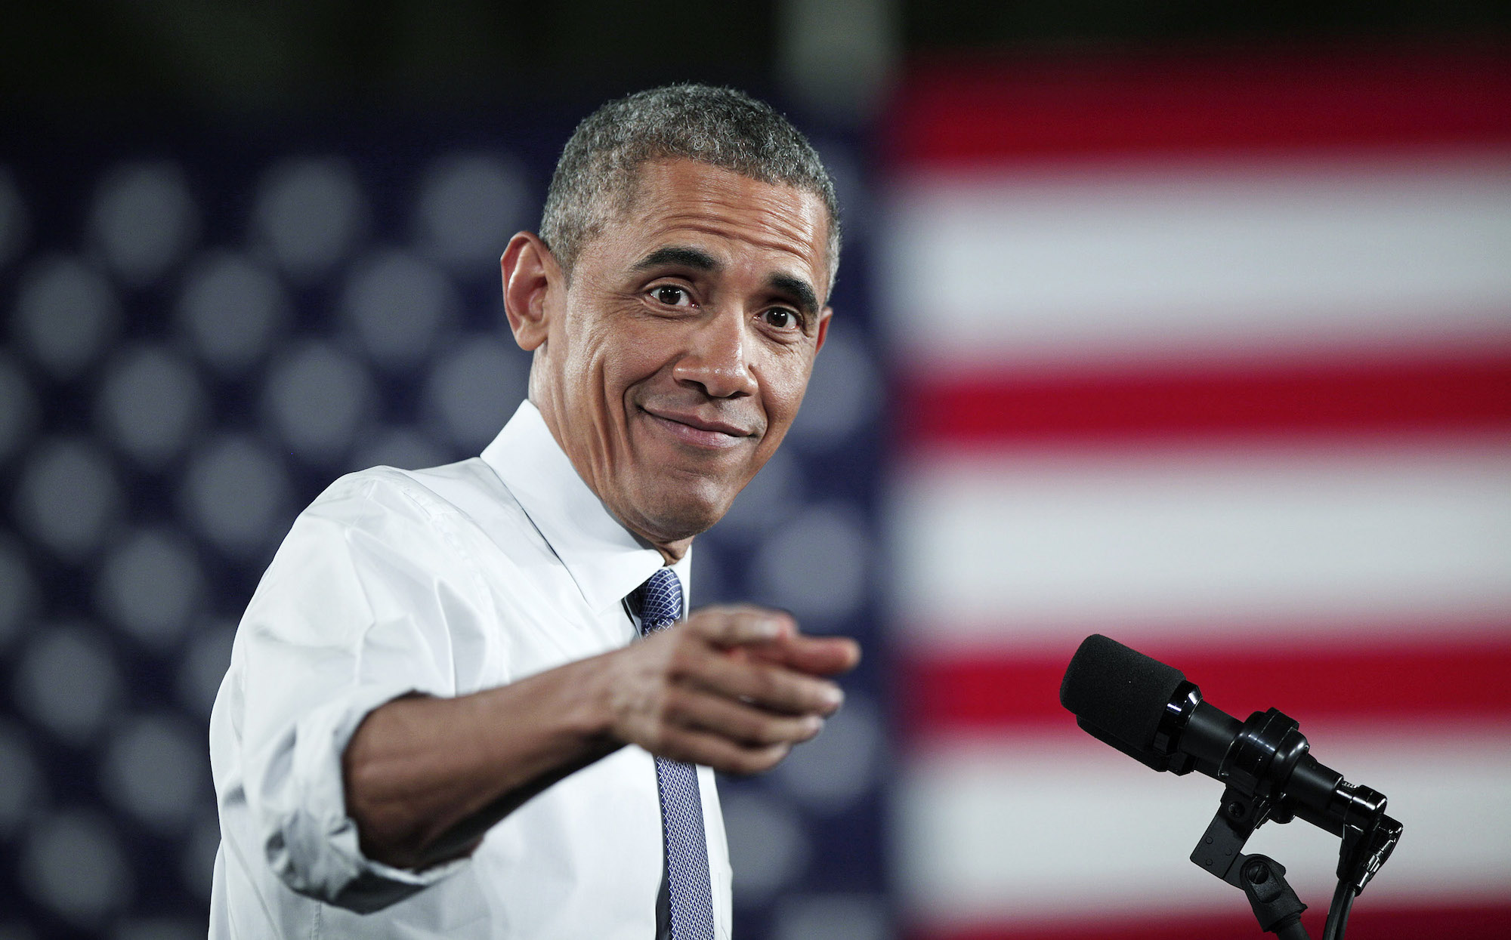
Dyslexic Strengths
Creative
Observant
Big picture thinkers
High levels of empathy
Able to think in 3D
This Photo by Unknown Author is licensed under CC BY-SA-NC

