Slide 1


Welcome to our school Parent / Carers Open Morning led by Bella and Darcie Baird House
UNCRC Article 3 – Anyone making decisions that affect young people should make young peoples interests a high priority.
Article 28 – You have the right to an education.
Article 29 – Education should teach you to respect other people and the environment.

Slide 2
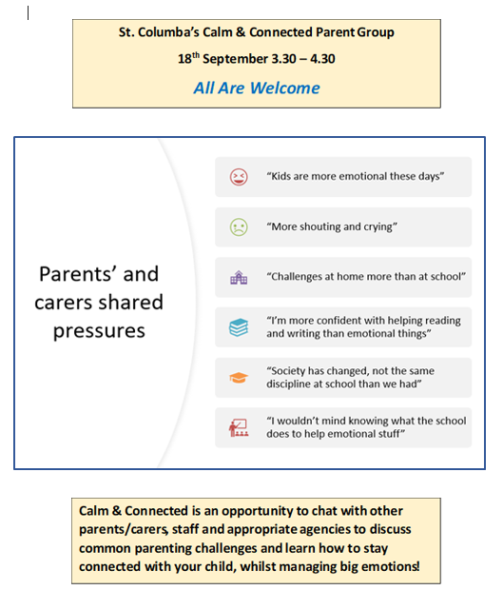
Calm and Connected

Slide 3
Questions often discussed….
How can I get my child to go for a haircut?
Why does my child run around the house when they get home from school?
What do the teachers do to support my child?
I find bedtime really tricky; what is it like for you?
Does it matter if my child just eats plain pasta?
They are reluctant to eat fruit and veg!

Slide 4
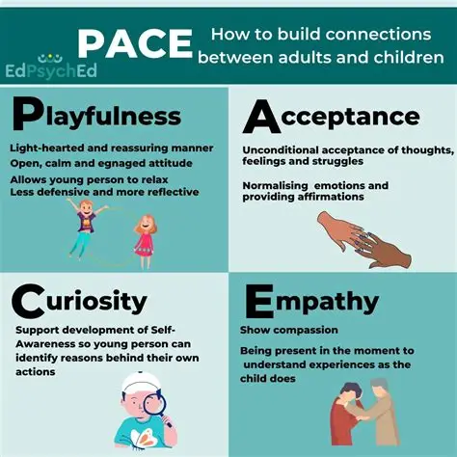

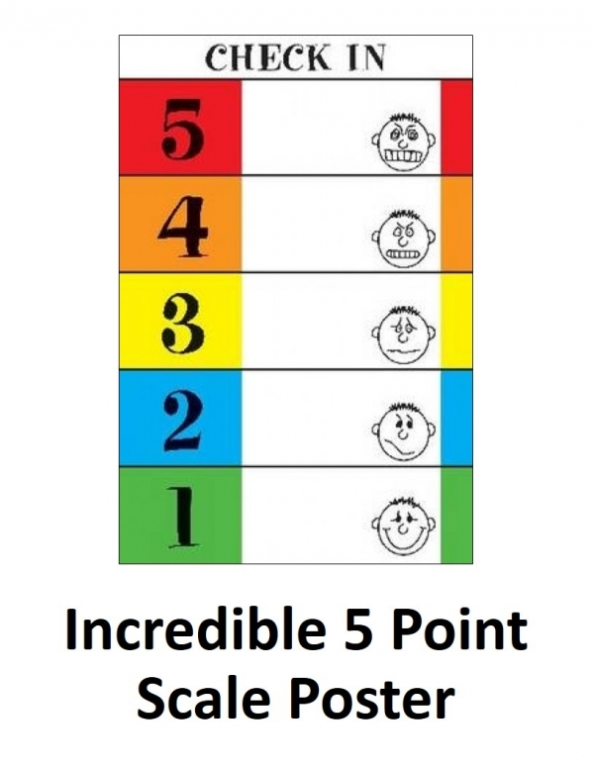

Information discussed….
Engage
don’t
Enrage!
What do we mean by restorative approaches?

Slide 5

We’d welcome any suggestions for our next meeting and look forward to seeing you there!

Slide 6
School Improvement Plan 2025/26
At St Columba’s we want all our students to be happy and successful in everything they do. We listen to the views of our pupils, and we listen to the views of our parents & carers. We are AMBITIOUS to do well in 2025-26. These are the school priorities in the improvement plan for this year.
To improve the pupils knowledge of numeracy
To use digital technology to support children’s learning
3. To improve our new reporting system called Progress

Slide 7

Monitoring social media
We BELIEVE social media can be a good thing. The school uses FACEBOOK to share images of activities carried out by pupils during the school day. All parents have access to Seesaw, and staff regularly post information about what we have been learning.
We ask that everyone is responsible on line. Please talk to your children how to behave on line. Remember don’t share passwords or your mobile numbers to anyone you don’t know.
We don’t want anything bad said online coming into school upsetting children and disrupting their learning time.

Slide 8
FACT – Frankies Active, Campaigners Team
We have a road safety team in our school, made up of pupils and Mrs Scott. Our job is to ensure that pupils are being safe on the streets, crossing roads and making sure cars don’t stop on zig zag lines and use traffic lights responsibly. We have the COURAGE to speak to the parents/ carers in our school and members of our community to adhere the highway code. Thus making Cupar a safer place for all.
We need your help. We ask, that if you need to park your cars in neighbouring streets that you don’t block drive ways and be respectful to our neighbours

Slide 9
House keeping - Soft shoes and labelling clothes
Please ensure you label your child’s clothing, shoes, accessories including pencil cases and lunch boxes. Each year we have “tonnes of stuff” piling up in our lost and found boxes. If we have no name, we can’t return the item to the owner, and eventually they will be disposed of.

Slide 10
Thank you for listening! Do you have any questions?

