Slide 1

Rights Respecting Schools
St Columbas Primary School

Slide 2
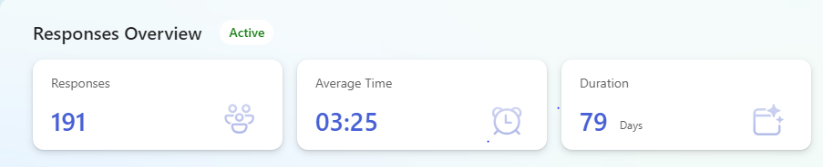
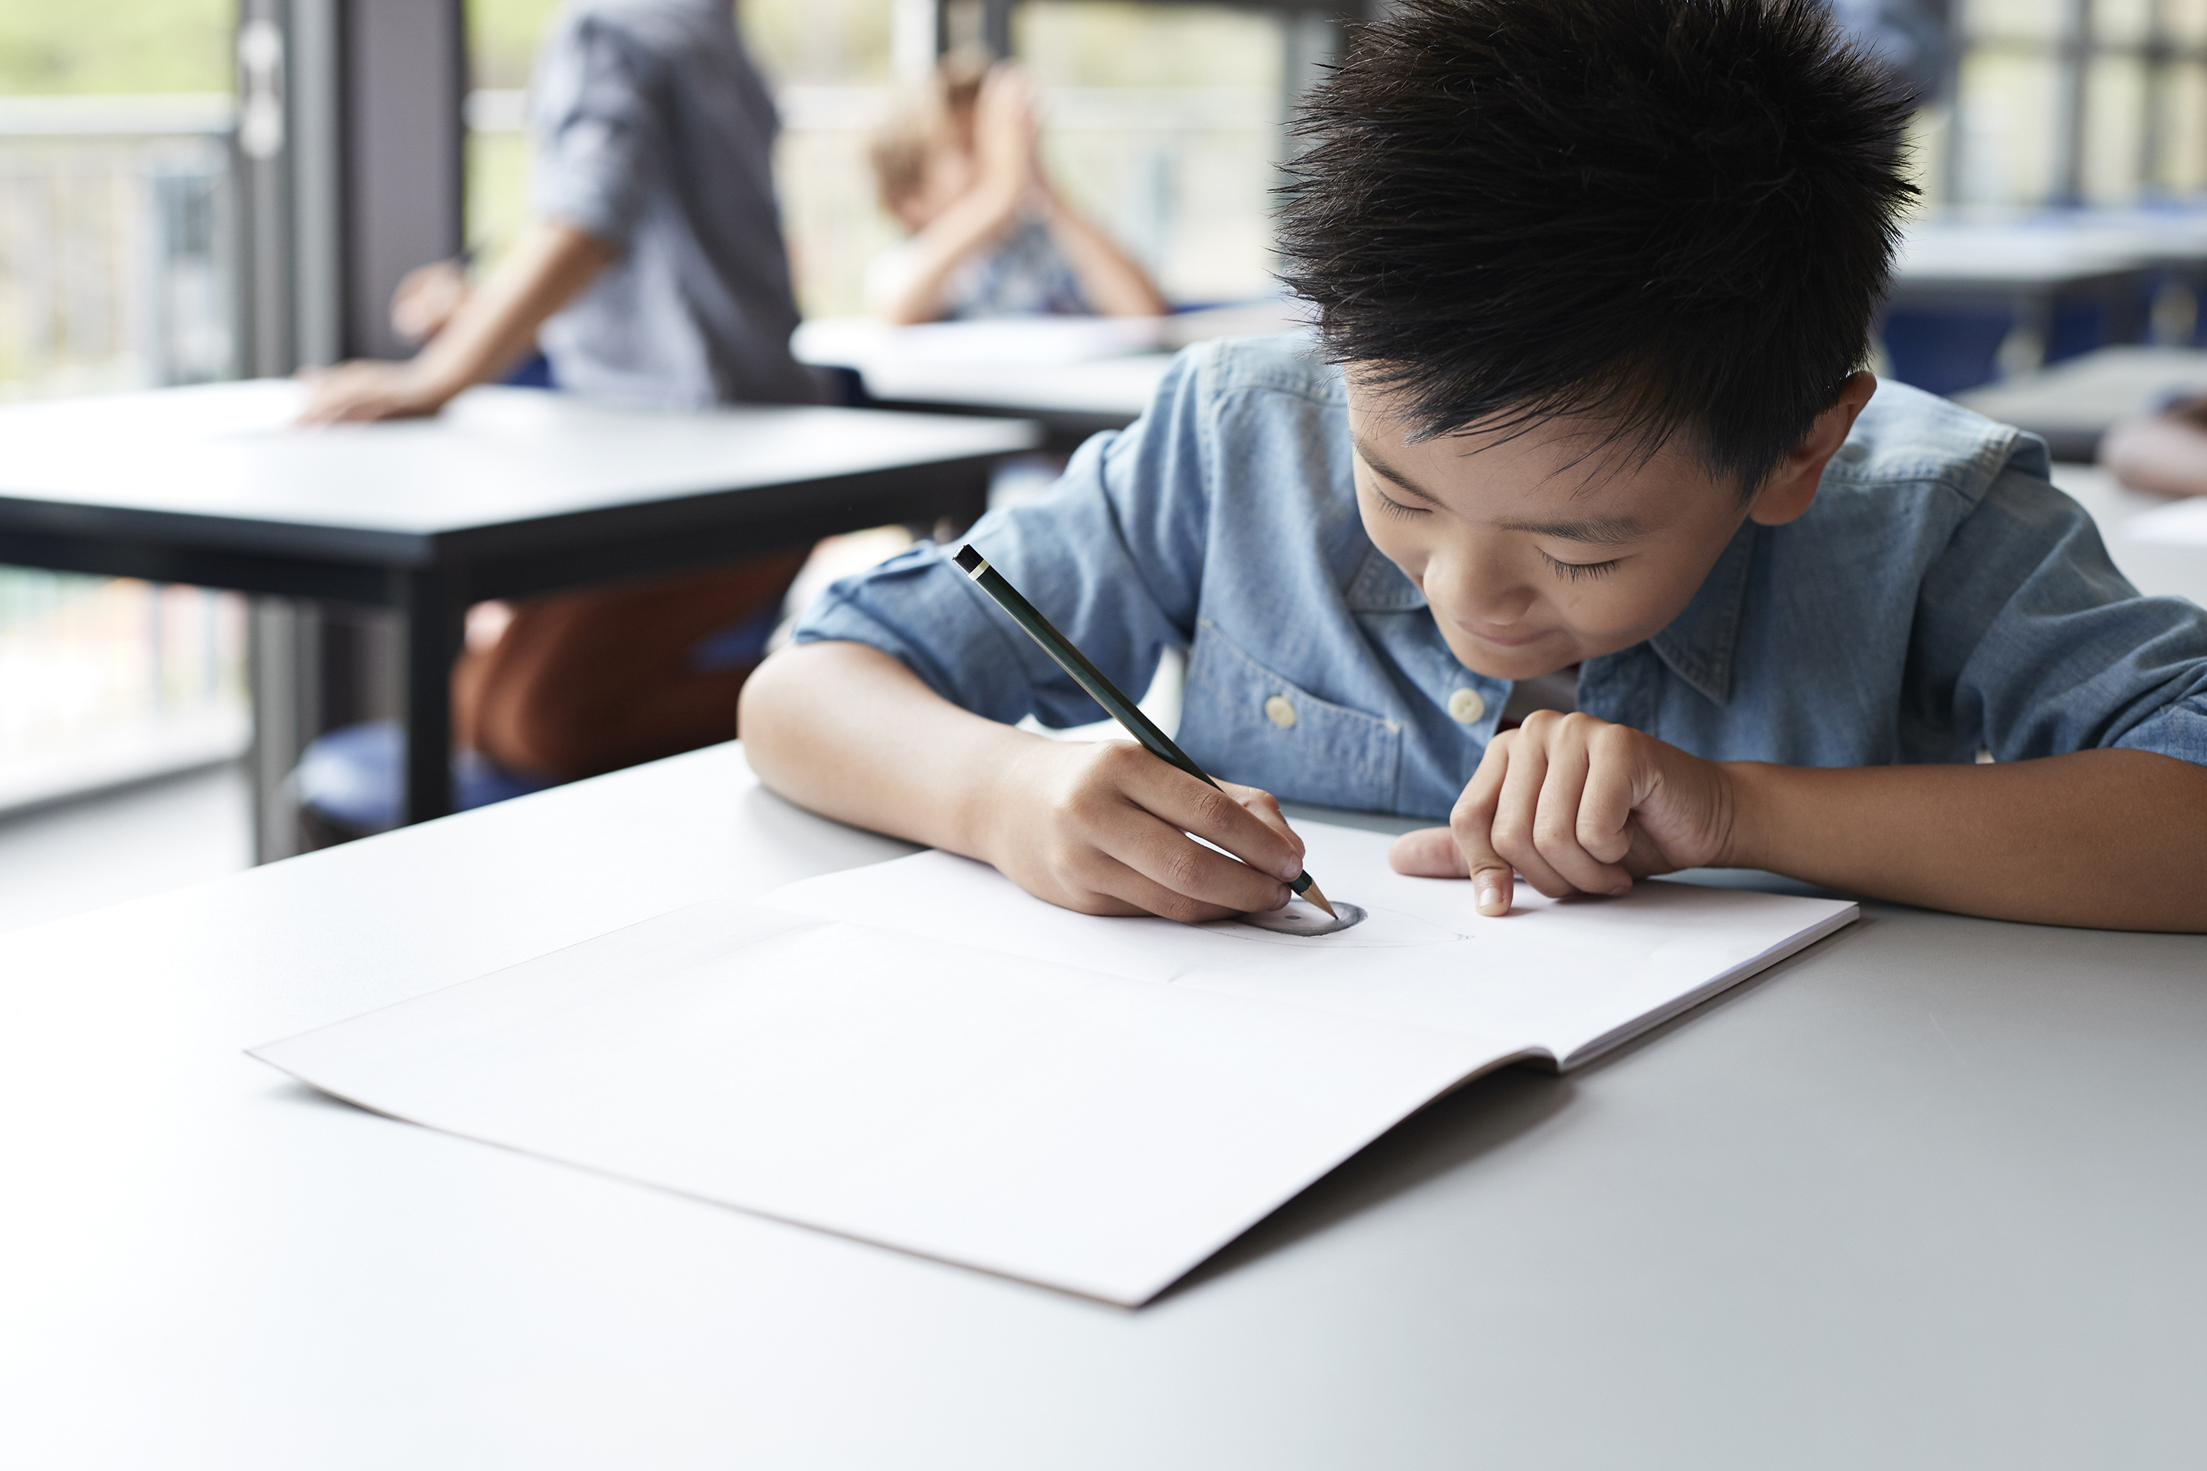
Pupil Responses

Slide 3
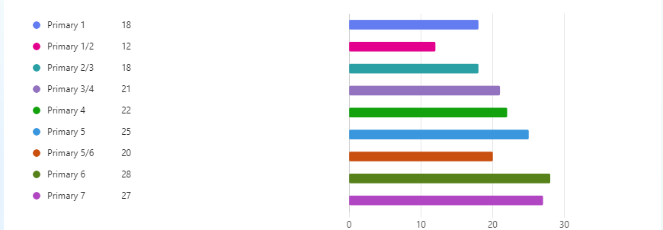
Pupil Class Responses

Slide 4
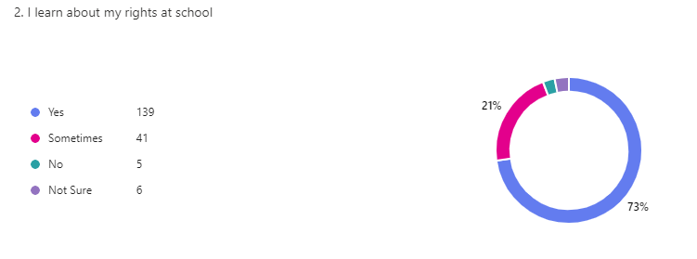
I learn my rights at school

Slide 5

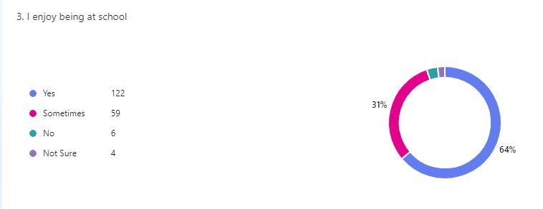
I enjoy being at school

Slide 6
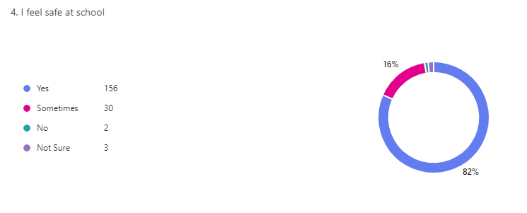
4. I feel safe at school

Slide 7
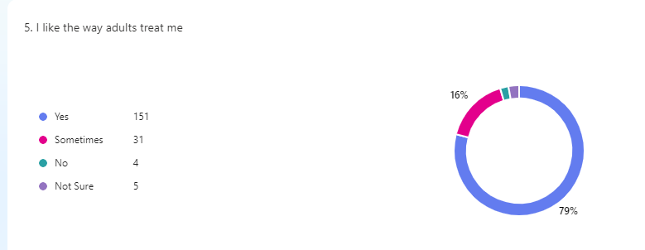
I like the way adults treats me

Slide 8
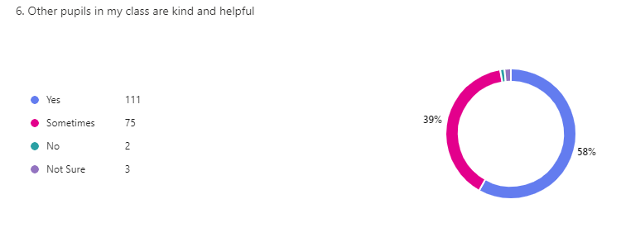
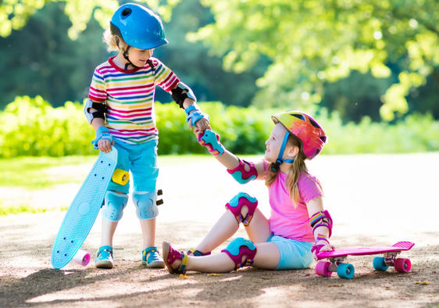
Other pupils in my class are kind and helpful

Slide 9
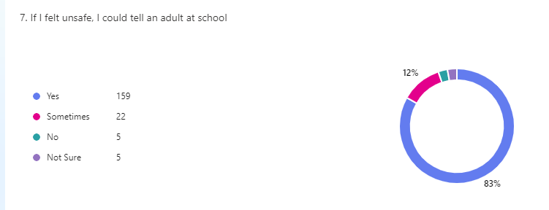
If I felt unsafe, I could tell an adult at school

Slide 10
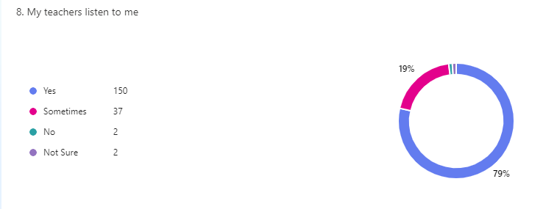
My Teachers Listen To Me

Slide 11
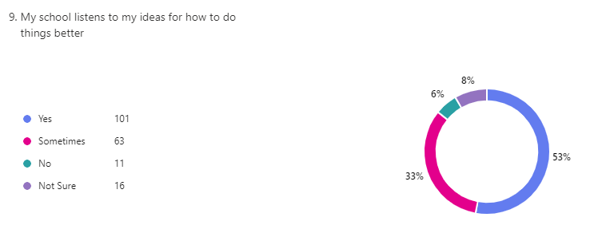
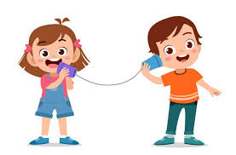
My school listens to my ideas

Slide 12
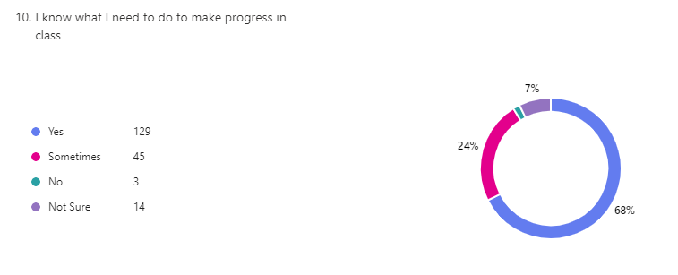
I know what I need to do to make progress in class

Slide 13
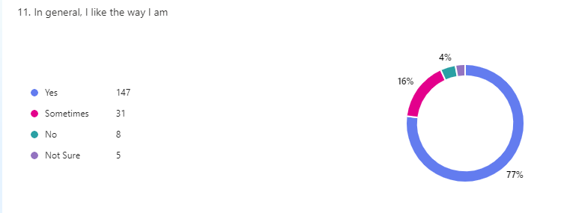
In general, I like the way I am

Slide 14
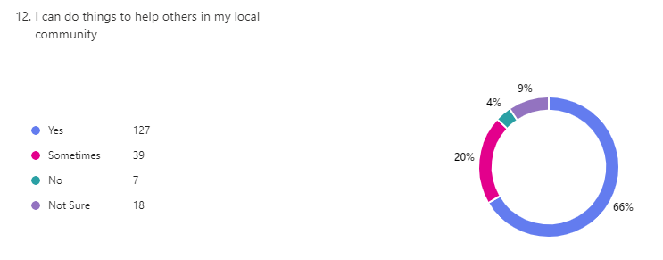

I can do things to help others in my local community

Slide 15
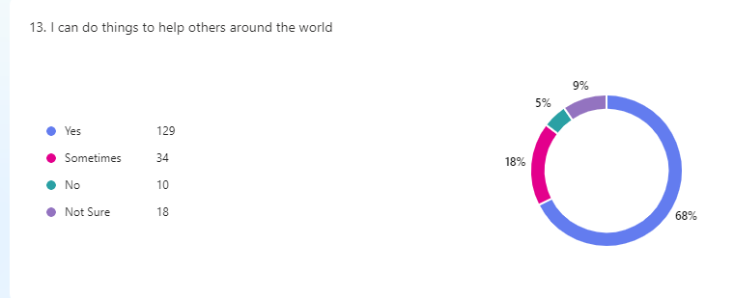
I can do things to help others around the world

Slide 16
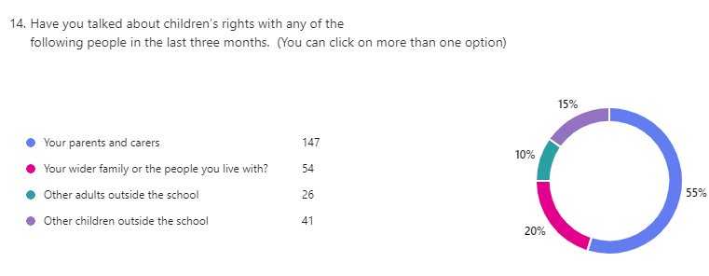
14.Have you talked about children’s rights with any of the following people in the last three months.

Slide 17
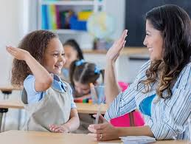
Staff Responses

Slide 18
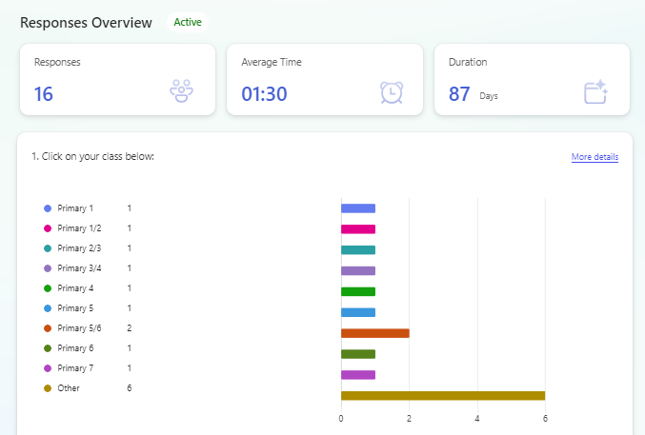
Staff Responses

Slide 19
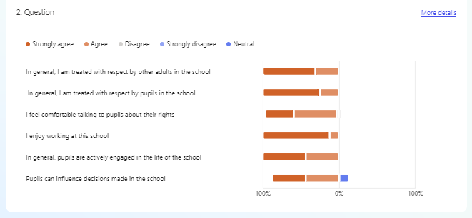

Slide 20
Staff replies
“I have worked in St Columba's for 17 years and its a great respectful school.”
The children are involved in some discussions through questionnaires/competitions and some are in specific meetings but collectively I would say they are currently not influencing decisions made in the school.

