Slide 1
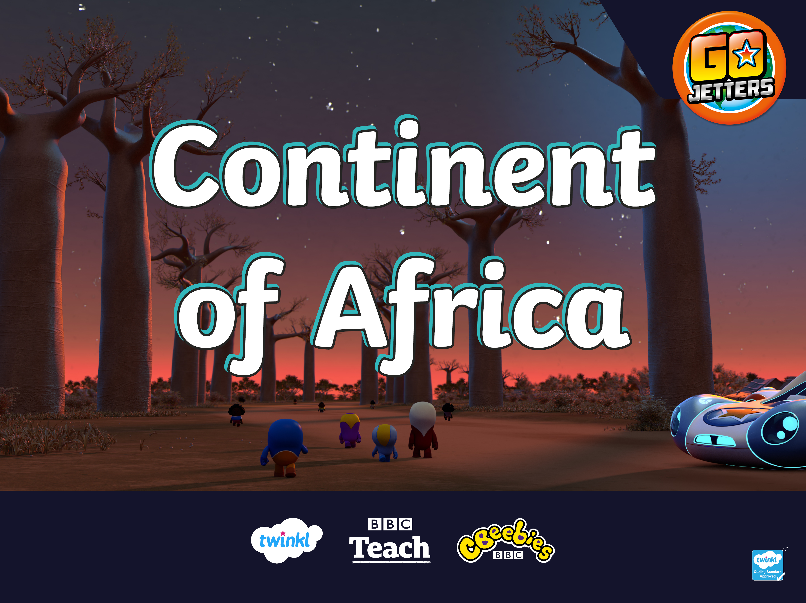

Slide 2
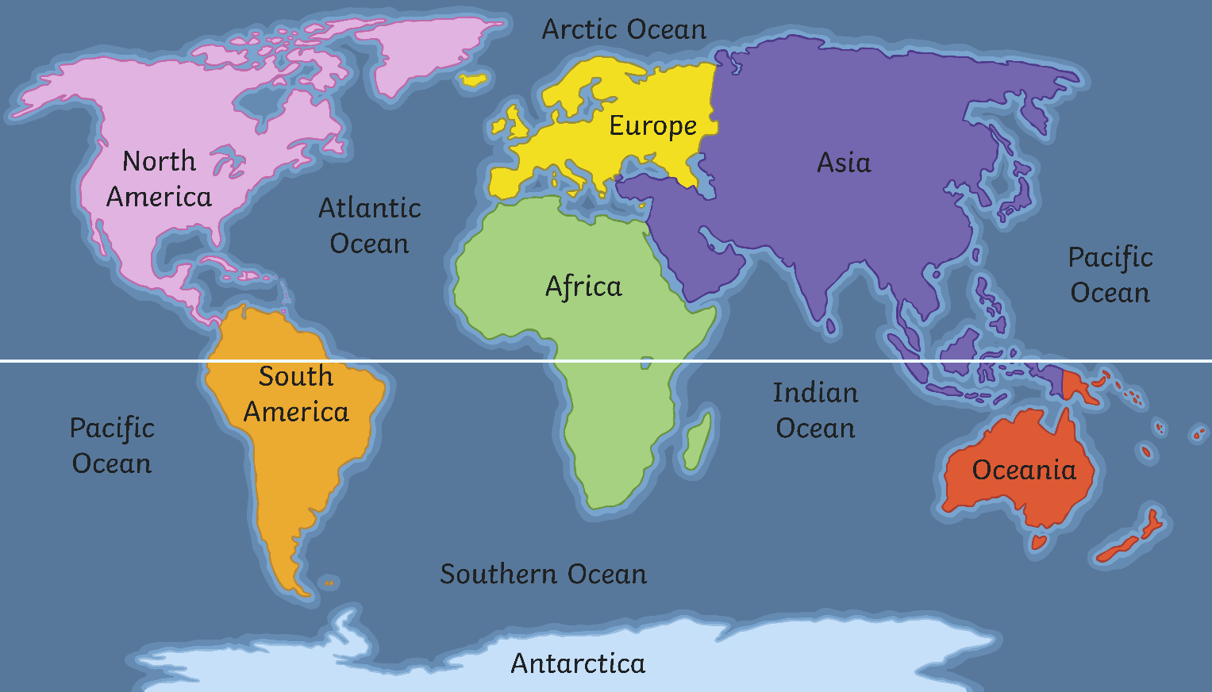
What Is a Continent?
Here are the seven continents of Planet Earth. A continent is a massive piece of land that is often separated from other areas of land by water or another feature such as mountains.
Equator

Slide 3
Continents
Ha ha! I’ve taken letters away from the names of these continents.
I don’t think you’ll be able to guess what they are!

Slide 4
Continents
S_u_h A_e_i_a
South America
_o_t_ _m_r_c_
North America
A_r_c_
Africa
E_r_p_
Europe
A_i_
Asia
O_e_n_a
Oceania

Slide 5
Africa
Here is a map which shows the countries that are in the continent of Africa. Geographic!

Slide 6

Africa
How many African countries can you remember the names of? With your partner, see how many you can think of in one minute.
Start Timer
59
58
57
56
55
54
53
52
51
50
49
48
47
46
45
44
43
42
41
40
39
38
37
36
35
34
33
32
31
30
29
28
27
26
25
24
23
22
21
20
19
18
17
16
15
14
13
12
11
10
9
8
7
6
5
4
3
2
1
0
60

Slide 7
What Is Africa?
Look at these pictures. Which are of Africa and which aren’t?

Slide 8
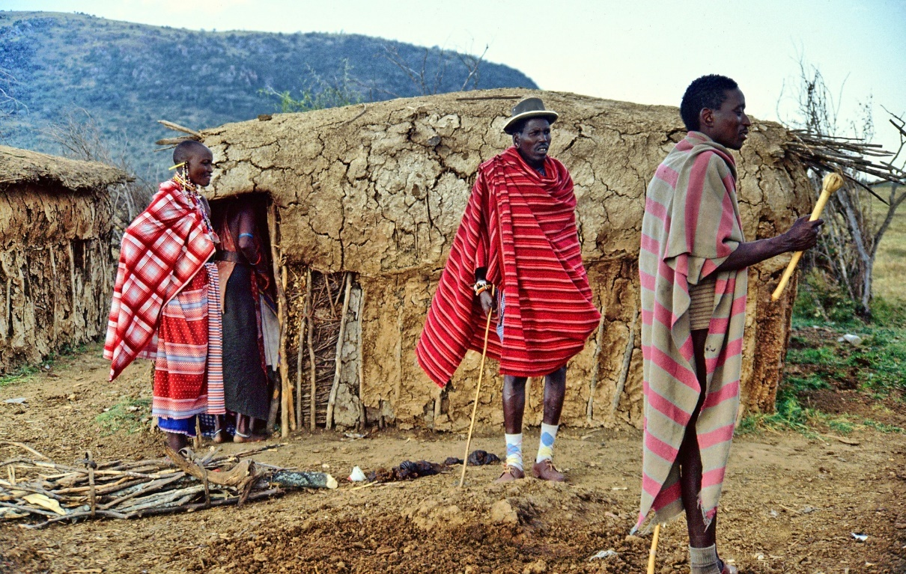
What Is Africa?

Slide 9
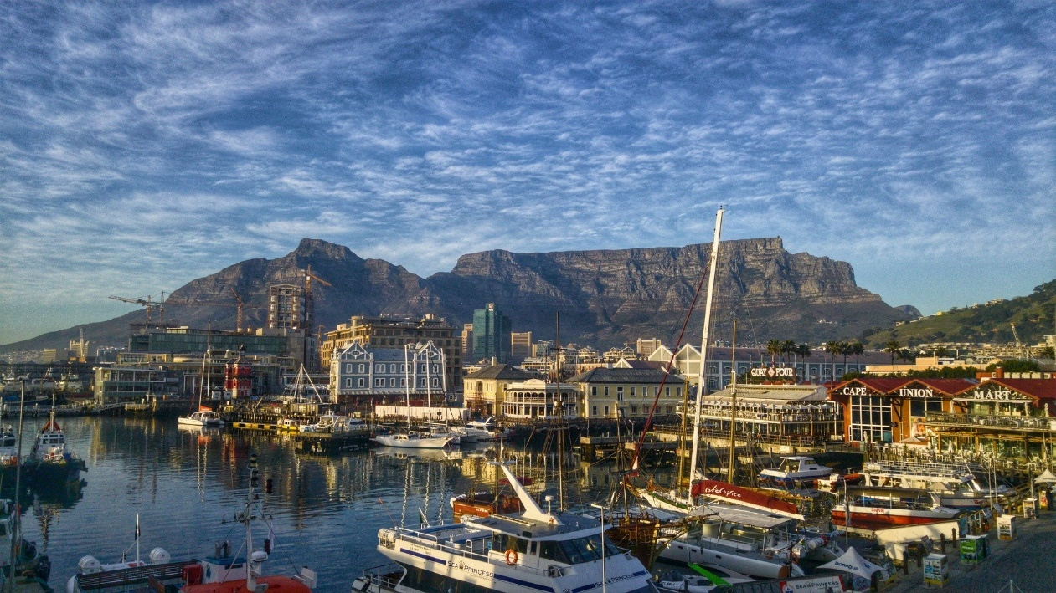
What Is Africa?

Slide 10
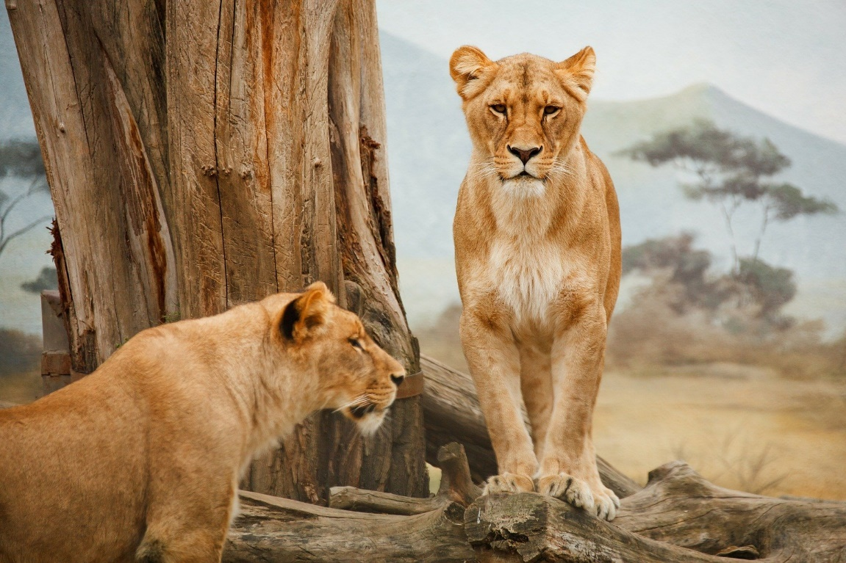
What Is Africa?

Slide 11
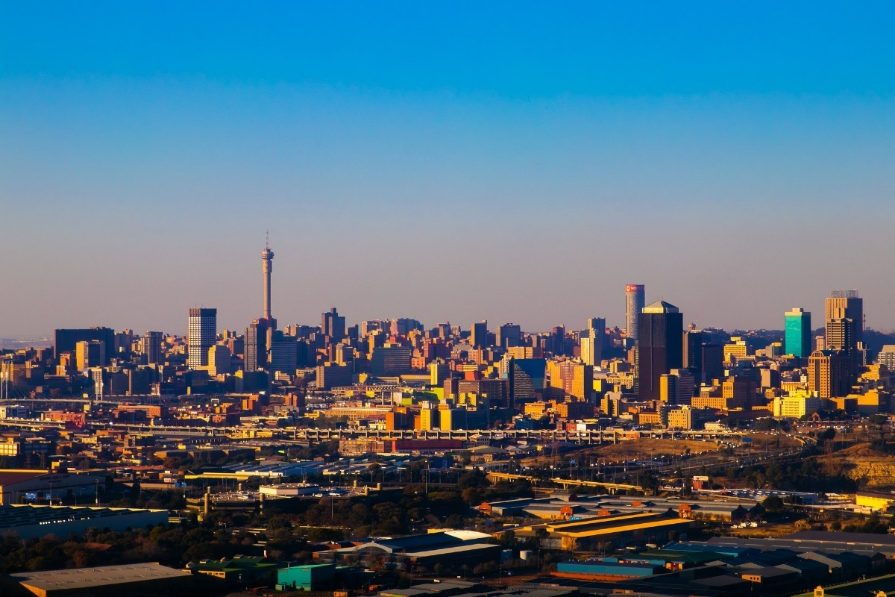
What Is Africa?

Slide 12
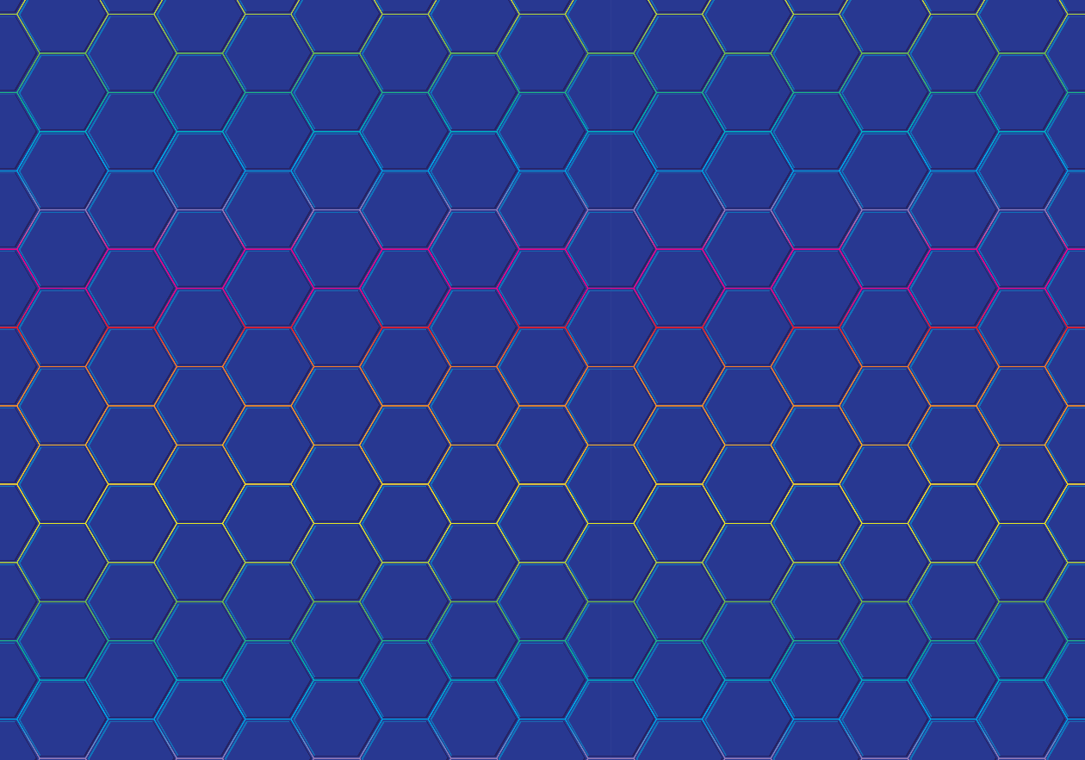
What Is Africa?
Did you work it out? They are all pictures
of Africa.
Let’s travel to Africa to find
out more about this amazing continent. To the Vroomster!

Slide 13
Africa
Today, we are going to be learning about the continent of Africa. Tell your partner anything you already know about Africa.
Here’s Ubercorn with some Funky Facts.

Slide 14
What Is a Landmark?
Can you remember what a landmark is?

Slide 15
What Is a Landmark?
A landmark is something that stands out in an area. It could be a building, a bridge, a lake or river, a sculpture or something else. These places might be special because of their age or their size.

Slide 16
What Is a Landmark?
A landmark makes a place recognisable. This means you could look at a picture of a landmark and know straight away where it is.

Slide 17
Famous Landmarks
Do you recognise any of these famous landmarks from around the world?

Slide 18
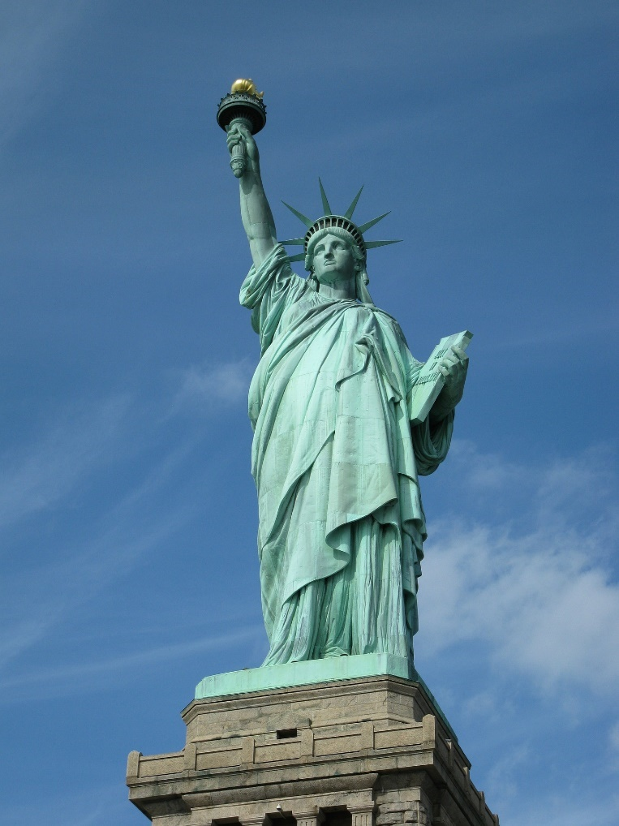
Famous Landmarks
Statue of Liberty, USA

Slide 19
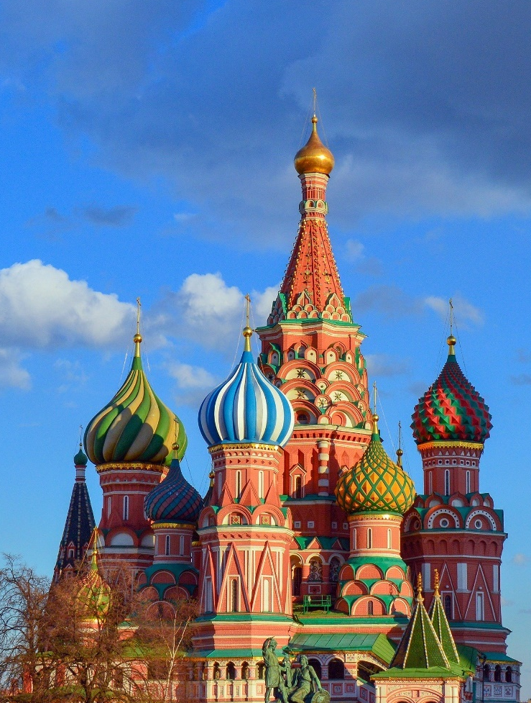
Famous Landmarks
St Basil’s Cathedral, Russia

Slide 20
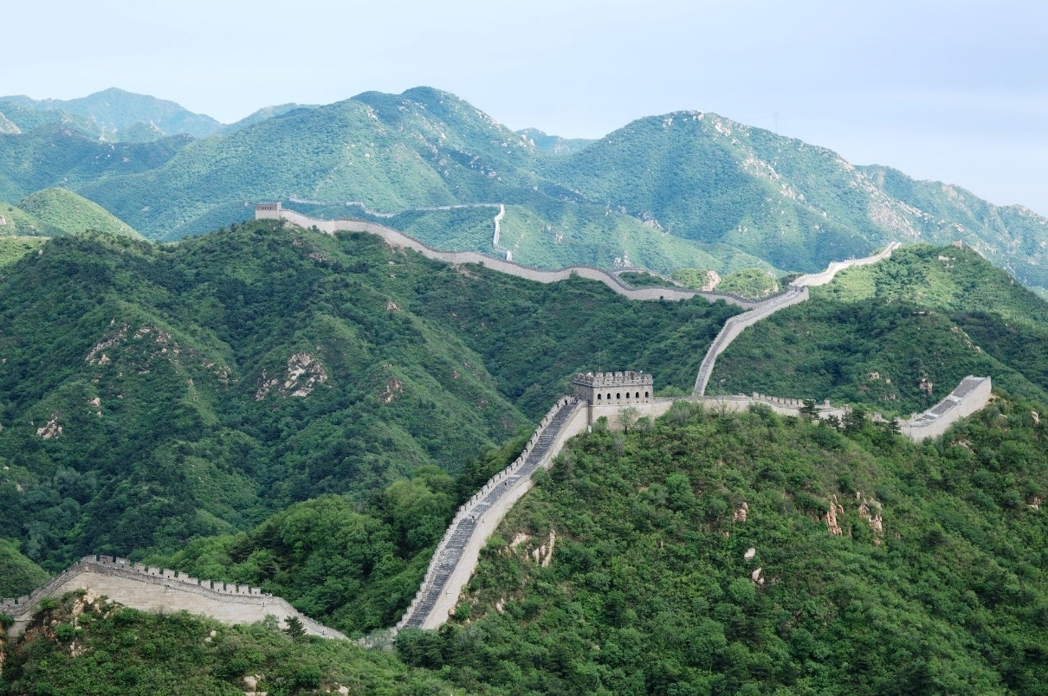
Famous Landmarks
The Great Wall, China

Slide 21
The Sahara Desert
Now let's look at landmarks in Africa!
A desert is place that has less than 25cm of rain a year. Deserts don’t have to be hot – there are deserts in very cold places too. The Sahara Desert is in northern Africa. It is the largest hot desert in the world and stretches across 11 different countries.

Slide 22
Maasai Mara
This is the Maasai Mara in Kenya. It is named after the Maasai, a group of people who have lived in the region for many hundreds of years. Here is Ubercorn with some Funky Facts.

Slide 23
Timgad Ruins
The Timgad ruins are what is left of a Roman city built almost two thousand years ago. The ruins are in Algeria in North Africa. In the photo, you can see
the Trajan Arch.

Slide 24
Pyramids of Giza
Some of Africa’s most famous landmarks are the pyramids of Giza in Egypt. Ubercorn is here to tell us more about it.

Slide 25
Victoria Falls
Victoria Falls is on the Zambezi river, along the border of two countries, Zambia and Zimbabwe. It is one of the world’s largest waterfalls. The noise of the water is so loud that it can be heard from almost 40 kilometres away! This is why the falls are known locally as ‘Mosi-oa-Tunya’ which
means ‘the smoke that thunders’.

Slide 26
Table Mountain
Table Mountain is an unusual mountain in South Africa.
Let’s find out more from Ubercorn’s Funky Facts.

Slide 27
El-Tabia Mosque
The El-Tabia mosque is in Egypt. A mosque is where Muslim people go to worship. The mosque has two tall towers called minarets. Every day, a special call to tell Muslims it is time to pray is given from a minaret.

Slide 28
Landmarks Quiz
How much have you learnt about African landmarks?
It’s time to find out!

Slide 29
Landmarks Quiz
1. What is a landmark?
a. A patch of dirt on some land.
b. Something that stands out in an area.
c. A sign on a map.

Slide 30
Landmarks Quiz
2. Which of these is not a country in Africa?
a. Egypt
b. Zambia
c. England

Slide 31
Landmarks Quiz
3. What is the name of the desert we have learnt about?
a. The Sahara Desert
b. The Landmark Desert
c. The Africa Desert

Slide 32
Landmarks Quiz
4. What shape are the special buildings in Egypt that Ubercorn told us about?
a. Pyramid
b. Cuboid
c. Sphere

Slide 33
Landmarks Quiz
5. What is unusual about the mountain in South Africa that Ubercorn took us to?
a. It is the tallest mountain in the world.
b. It is impossible to climb.
c. It is shaped like a table.

Slide 34


