Slide 2
Guess the Word
I’ve tricked those No Jetters! I’ve taken away letters from this word.
I’m sure you won’t be able to guess what it is!
C_n_i_e_t

Slide 3
Guess the Word
I’ve tricked those No Jetters! I’ve taken away letters from this word.
I’m sure you won’t be able to guess what it is!
Continent

Slide 4
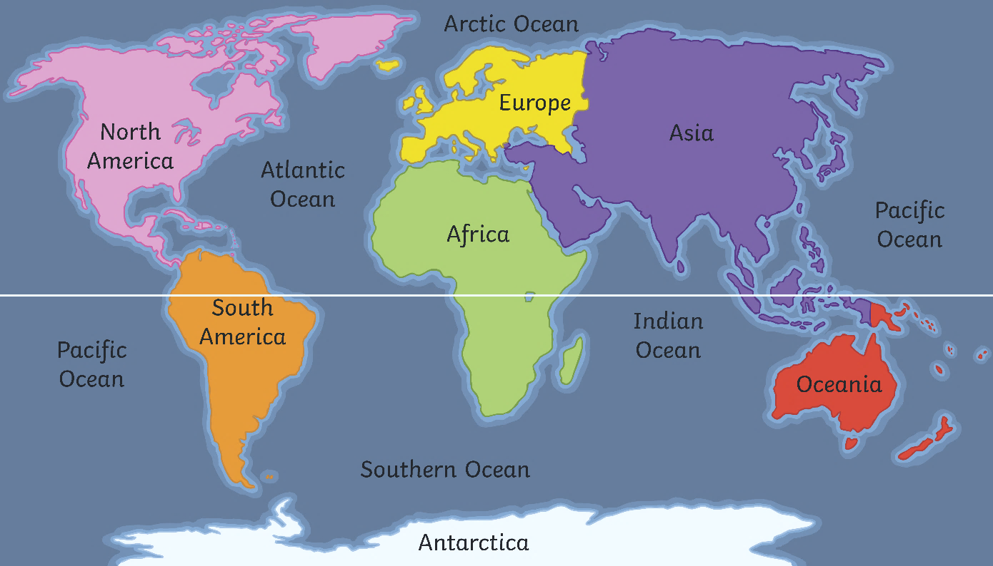
Continents
Great job, Go Jet Cadets!
You weren’t tricked by Grandmaster Glitch. A continent is a large piece of land often separated from other land by things like water or mountains. Earth has seven continents.
Equator

Slide 5
Antarctica
Equator
Can you find the continent of Antarctica on the map?
On lots of maps and globes, Antarctica is white. Why do you think that is?

Slide 6
Hot and Cold Places
Have you ever visited somewhere really hot?

Slide 7
Hot and Cold Places
How about somewhere really cold?

Slide 8
Hot and Cold Places
What did you wear? What did you do there?
Where do you like being best, somewhere hot or somewhere cold?

Slide 9
Hot and Cold Places
Lots of places are hot during the summer and cold during the winter.
Can you name any hot or cold places?

Slide 10
Hot and Cold Places
Geographic! Some places are cold all of the time. These places are at the top and bottom of the Earth. Other places are hot nearly all the time. These places are in the middle of the Earth.
Equator

Slide 11
Hot and Cold Places
The middle of the Earth is called the Equator. Most places at the Equator are very warm. However, if a location near the Equator is on very high ground, like on a mountain top, then it might still be cold.

Slide 12
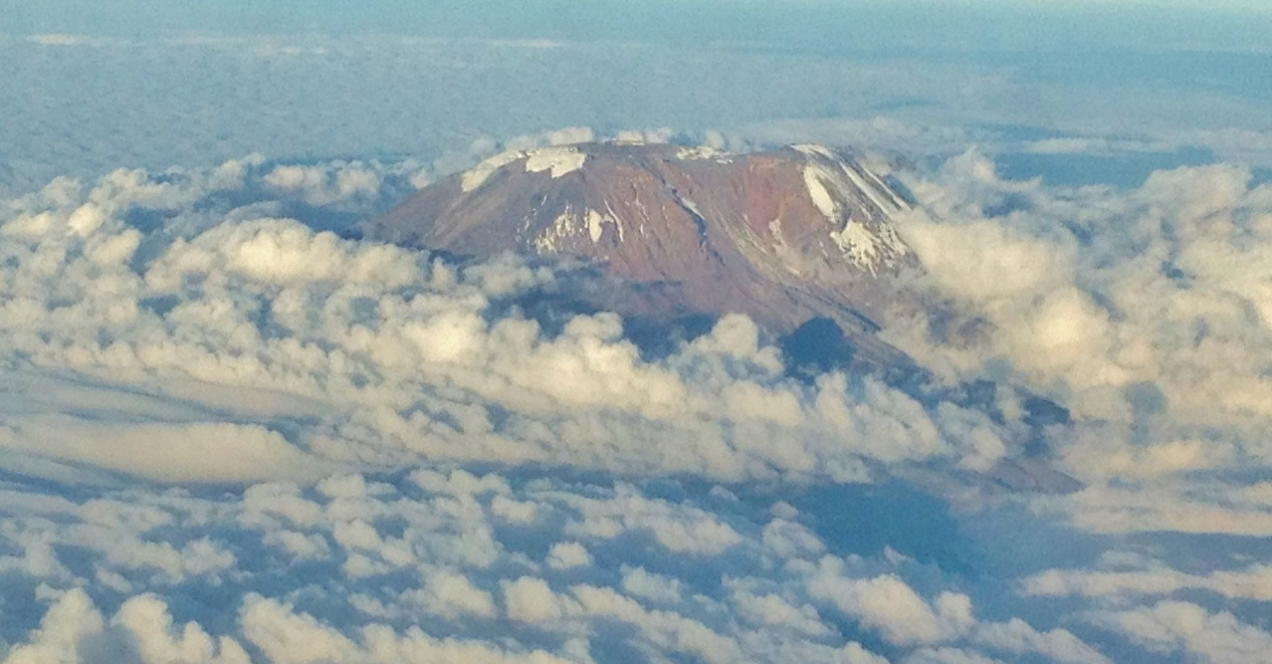
Hot and Cold Places
This is Mount Kilimanjaro in Tanzania in Africa. Can you see the snow on it?

Slide 13
North and South
north
west
east
south
This is a compass and it explains the direction things are in. Today, we are going to be thinking about north and south.

Slide 14
Hemisphere
A sphere is a 3D shape like a ball. A hemisphere is half a ball shape. Earth is split into two hemispheres, the northern hemisphere and southern hemisphere.
Northern Hemisphere
Southern Hemisphere

Slide 15
North Pole and South Pole
You may have heard of these places: the North and South Pole. The North Pole is in the northern hemisphere. The South Pole is in the southern hemisphere.
Equator

Slide 16
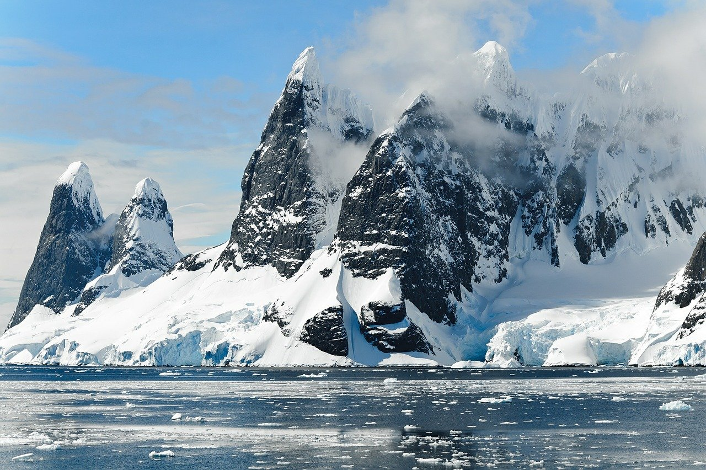
North Pole and South Pole
The areas around both the North and South Poles are sometimes called polar regions.
The North Pole is in an area called the Arctic. The Arctic is an area of frozen ocean.
The South Pole is in an area called the Antarctic or Antarctica. Antarctica is an area of frozen land.
Both places are very cold all the time.

Slide 17
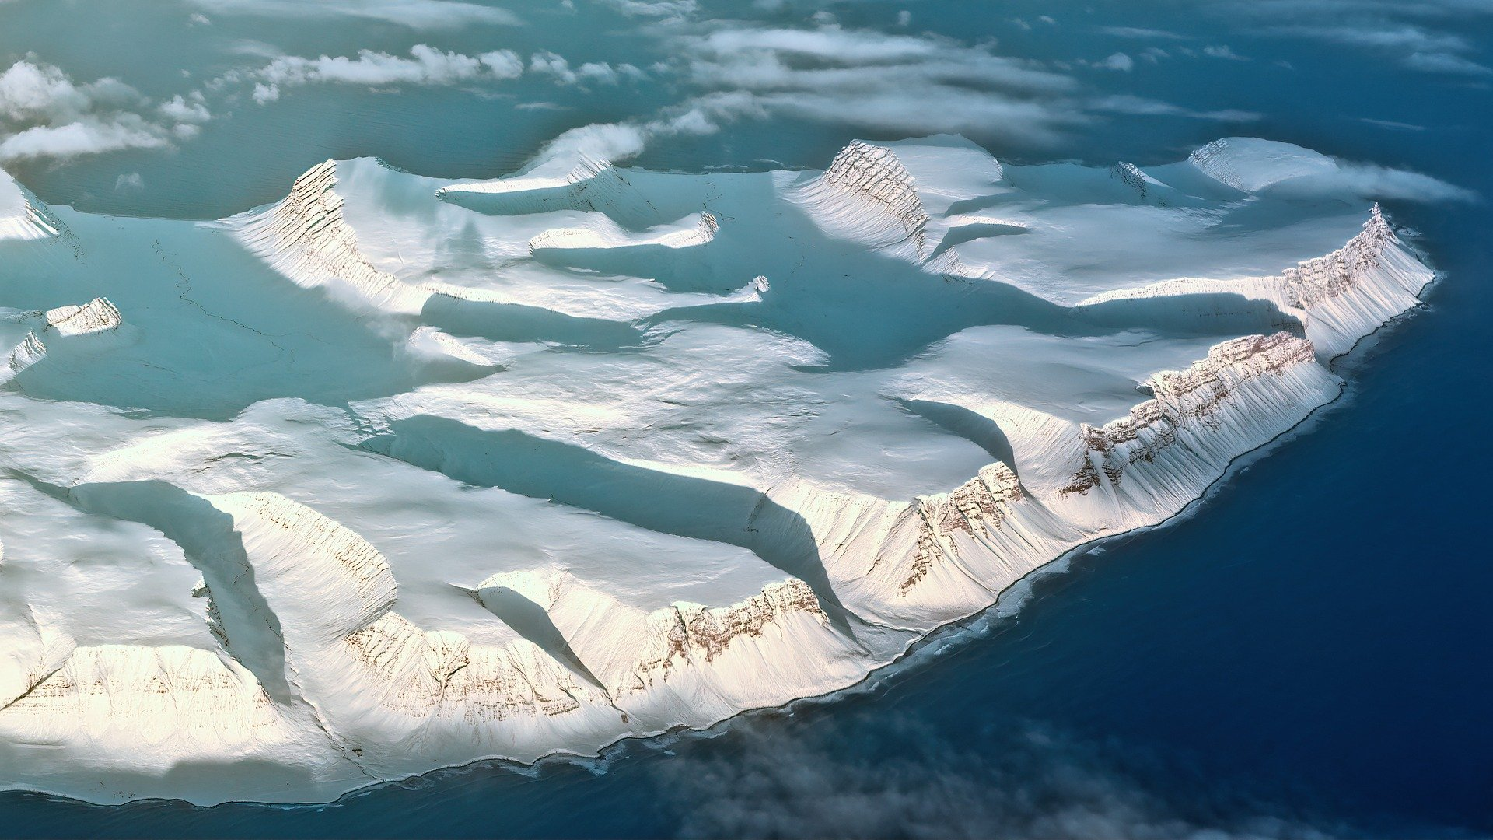
Glaciers
Ubercorn’s ready with his funky facts to tell us lots more about Antarctica.

Slide 18
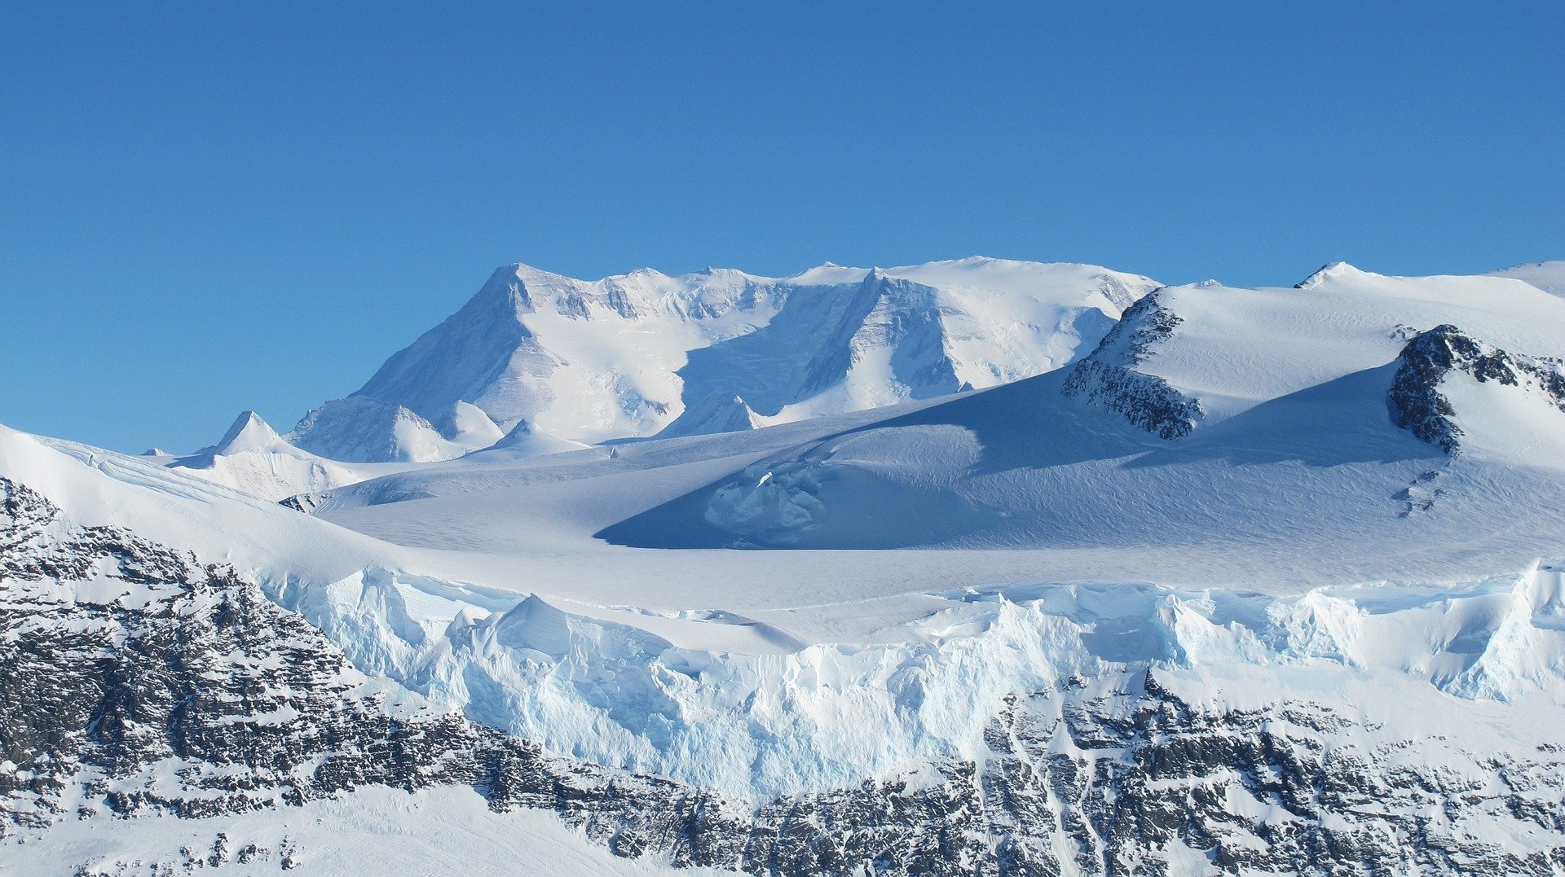
South Pole
Here is Ubercorn with his funky facts about the South Pole and some famous explorers.

Slide 19
Here are some more of my funky facts about special places in Antarctica.

Slide 20
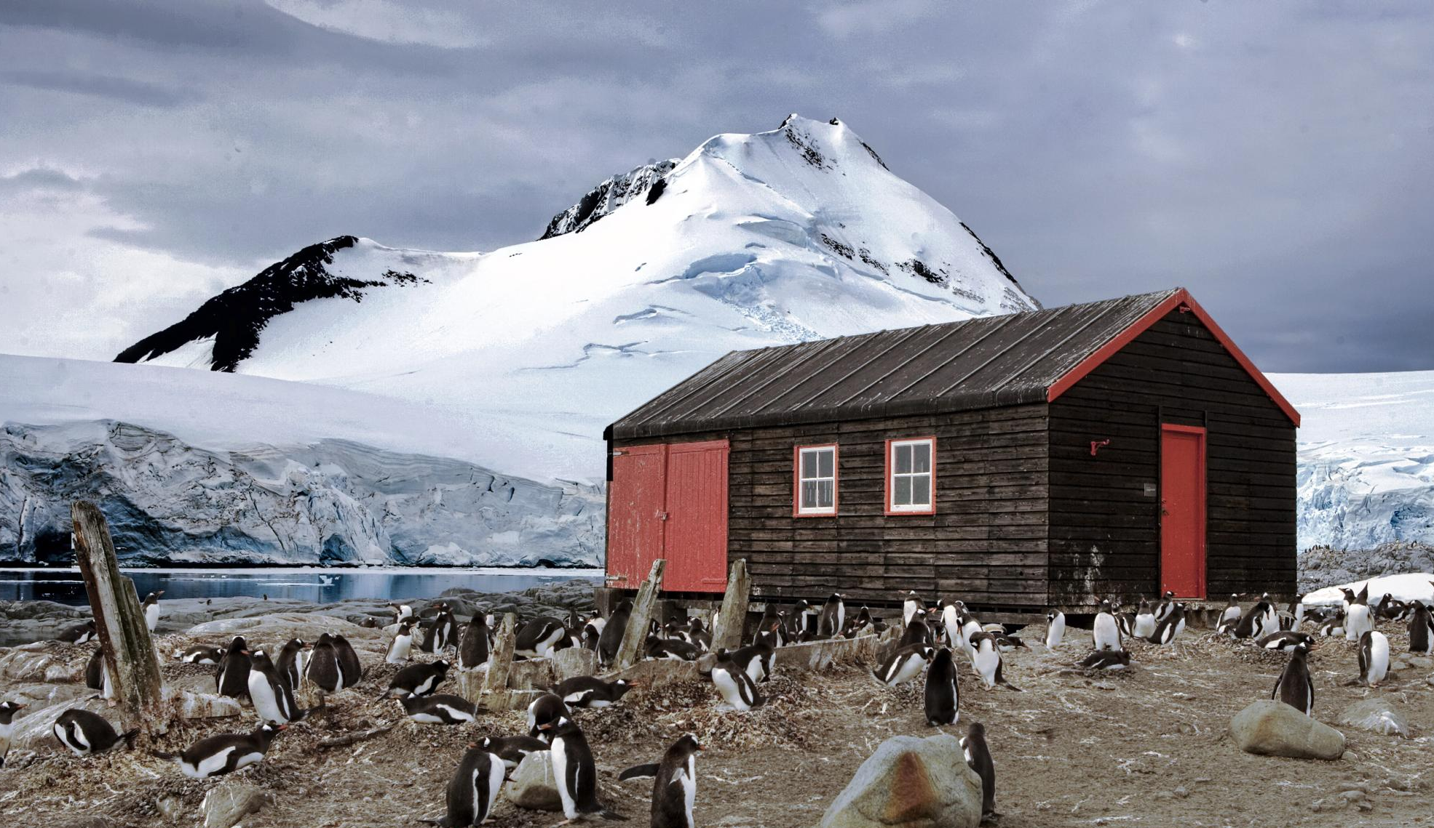
Port Lockroy
This is Port Lockroy base. It is a museum full of interesting things from Antarctica. Tourists can even send a postcard from it!
“penguin post office” by Christopher Michel is licensed under CC BY 2.0

Slide 21
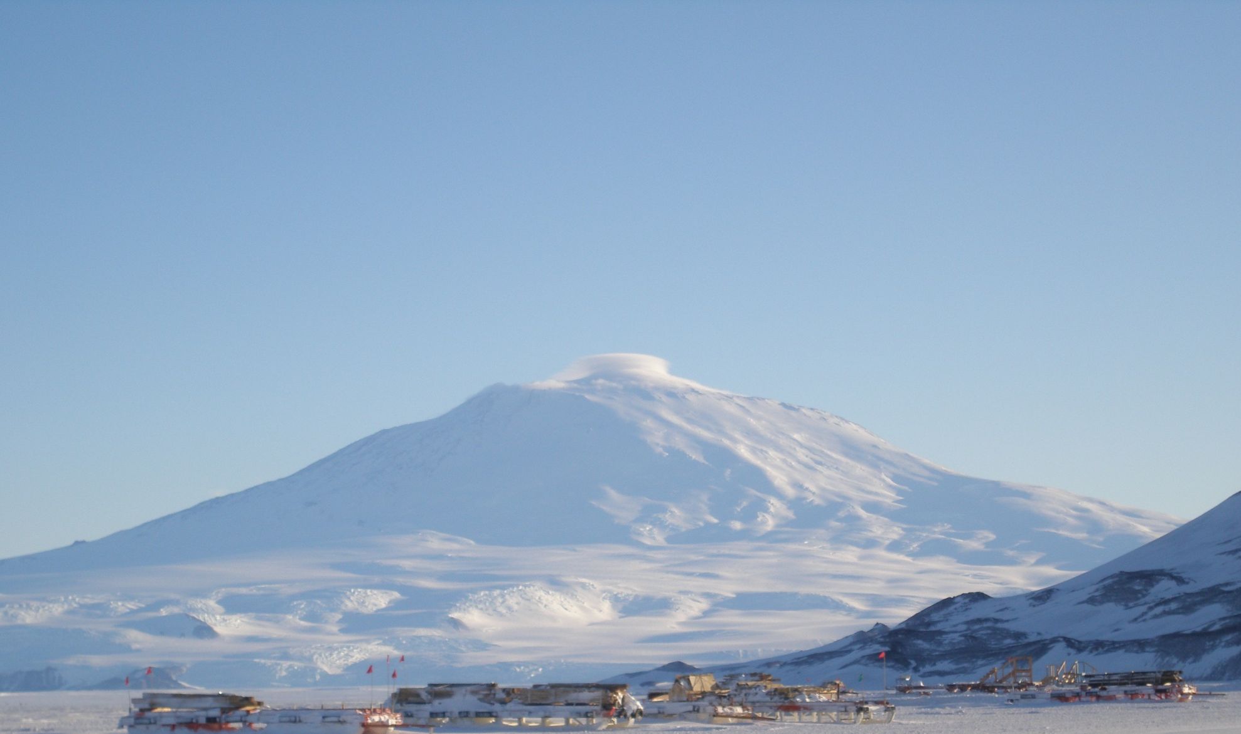
Mount Erebus
This is Mount Erebus. It is an active volcano, which means that it can still erupt.
Mount Erebus last erupted in 2011.
“Mount Erebus - from the sea ice” by Alan Light is licensed under CC BY 2.0

Slide 22
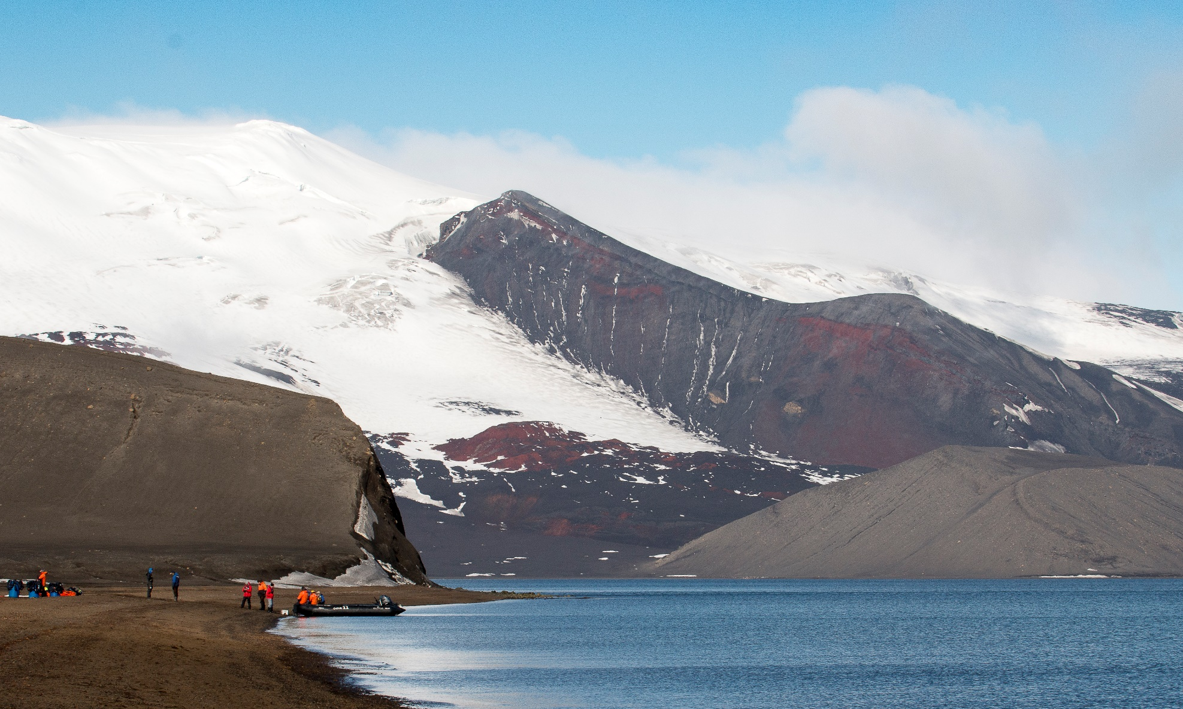
Deception Island
There are research bases on Deception Island where scientists carry out experiments. Tourists also visit the island.
“Deception Island Telefon Bay” by Gary Bembridge is licensed under CC BY 2.0

Slide 23
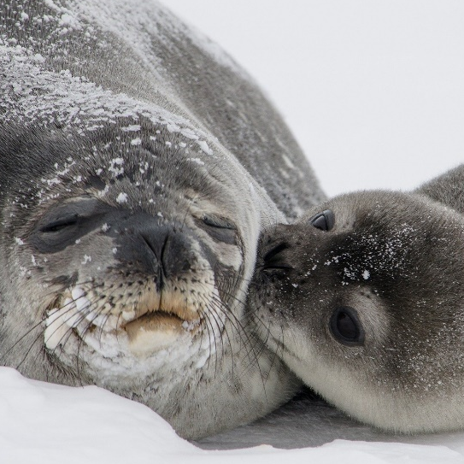
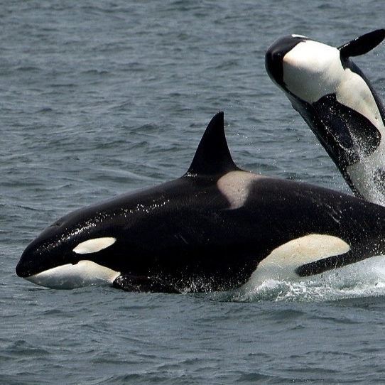
Animals From Antarctica
Although it’s freezing in Antarctica, lots of animals live there. Here are some of them.
emperor penguin
seal
orca
Can you create your own funky facts about them and other animals that live in Antarctica?

Slide 24
To the Vroomster!
Would you like to visit the South Pole? If you went there on the Vroomster, what do you think you would need to take?

