Slide 1
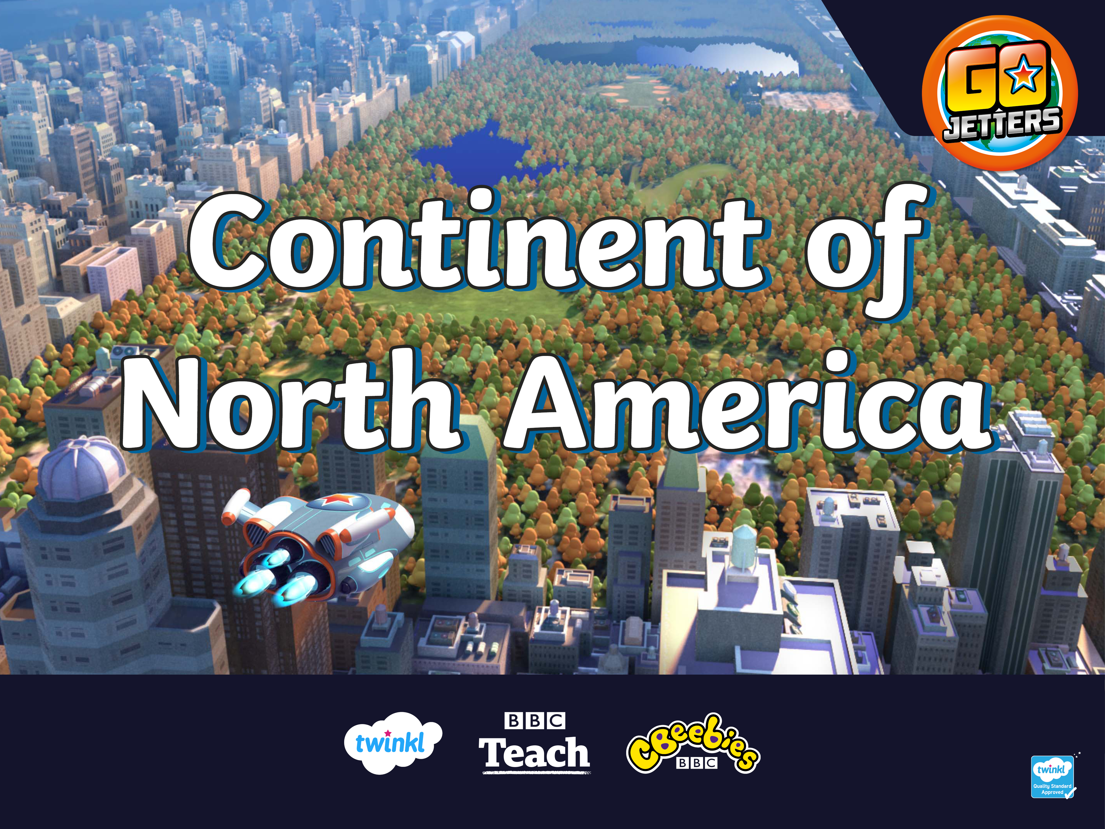

Slide 2
What Is a Continent?
Here are the seven continents of Planet Earth. A continent is a massive piece of land that is often separated from other areas of land by water, or another feature, such as mountains.
Europe
North America
Asia
Africa
South America
Oceania
Antarctica

Slide 3
Continent Conundrum
Not cool! Grandmaster Glitch has muddled up the map.
Can you fix it?
Oceania
Europe
Africa
South America
Asia
Antarctica
Fix That Glitch
North America

Slide 4
Continent Conundrum
Not cool! Grandmaster Glitch has muddled up the map.
Can you fix it?
Europe
North America
Asia
Africa
South America
Oceania
Fix That Glitch
Antarctica

Slide 5
North America
North America
This is the continent of North America.
It is joined to the continent of South America by a narrow strip of land.
South America

Slide 6
North America

Slide 7
North America
There are many countries that make up North America. Let's have a closer look.

Slide 8
North America

Slide 9
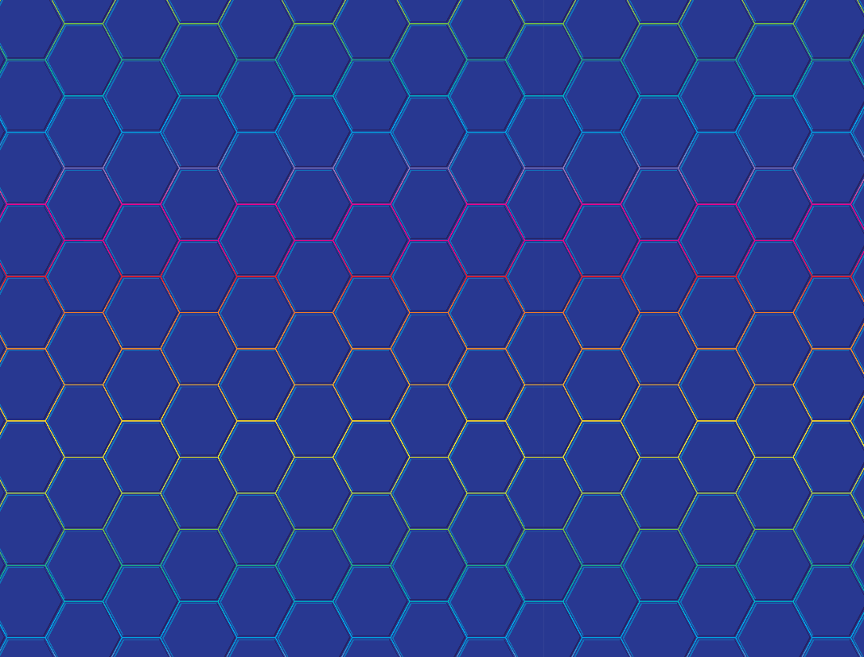
North America
How many countries on the continent of North America can you remember in one minute? Tell your partner.
Start Timer
59
58
57
56
55
54
53
52
51
50
49
48
47
46
45
44
43
42
41
40
39
38
37
36
35
34
33
32
31
30
29
28
27
26
25
24
23
22
21
20
19
18
17
16
15
14
13
12
11
10
9
8
7
6
5
4
3
2
1
0
60

Slide 10
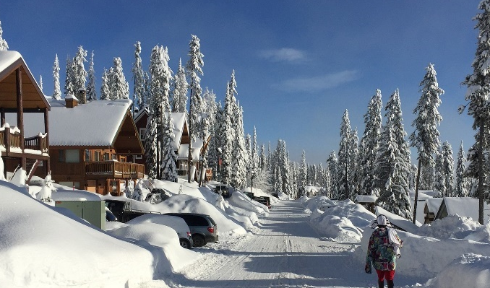
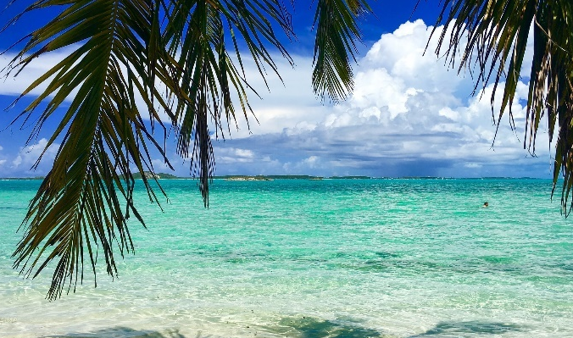
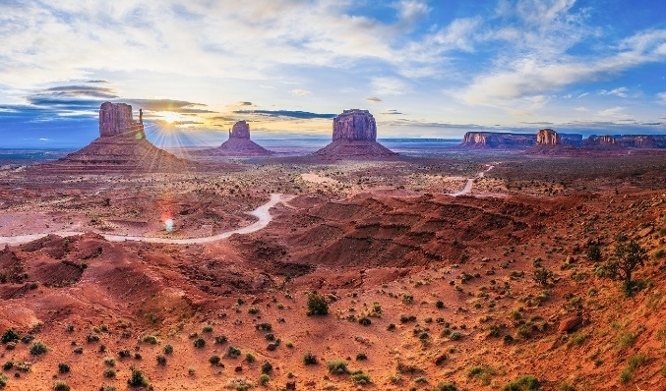
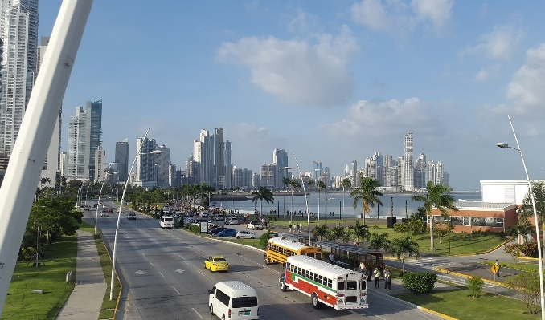
North America
Look at these pictures. Which are images of North America?

Slide 11
North America
Did you work it out? They all are! North America is a huge continent and has a variety of landscapes.
British Columbia, Canada
Bahamas
Panama City, Panama
Monument Valley, USA

Slide 12
What Is a Landmark?
Can you remember what a landmark is?
A landmark is something that stands out in an area. For example, it could be a building, a bridge, a lake, a river or a sculpture. It might be special because of its age or size.
A landmark makes a place recognisable. This means you could look at a picture of a landmark and know straight away where it is.

Slide 13
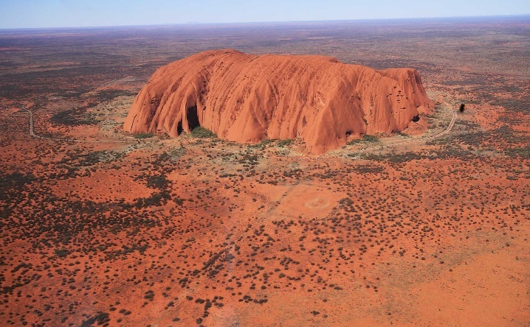
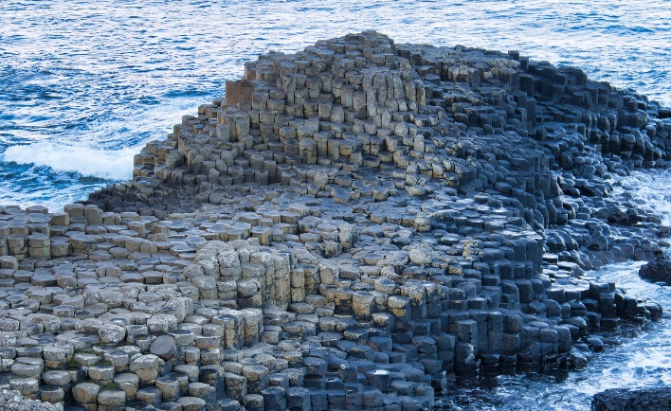
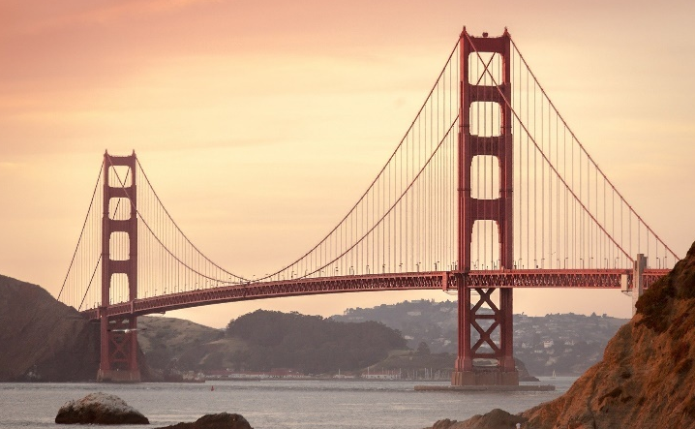
Famous Landmarks
Do you recognise any of these famous landmarks from around the world?
Uluru, Australia
The Golden Gate Bridge, USA
Giant’s Causeway, UK

Slide 14
Now, let's explore the continent of North America! To the Vroomster!

Slide 15

USA
America, or United States of America (USA), is split into states. You’ll see 50 stars on the American flag, one for each state. The country’s capital city is Washington DC.

Slide 16
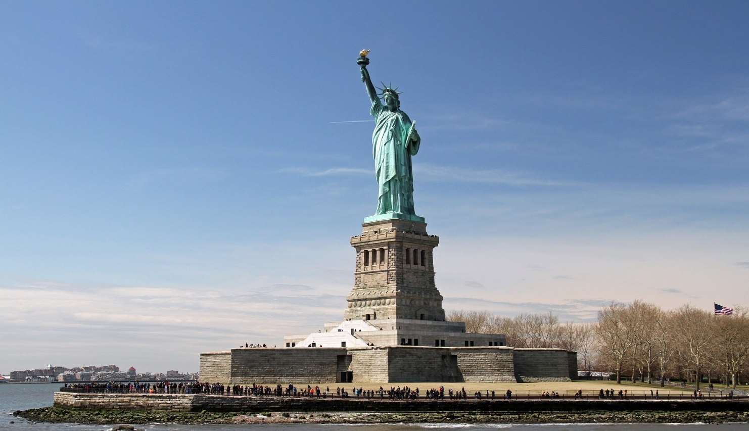
Statue of Liberty
This is the Statue of Liberty in New York, USA. Liberty means ‘freedom’. Listen to Ubercorn’s Funky Facts about the statue that is sometimes called ‘Lady Liberty’!

Slide 17
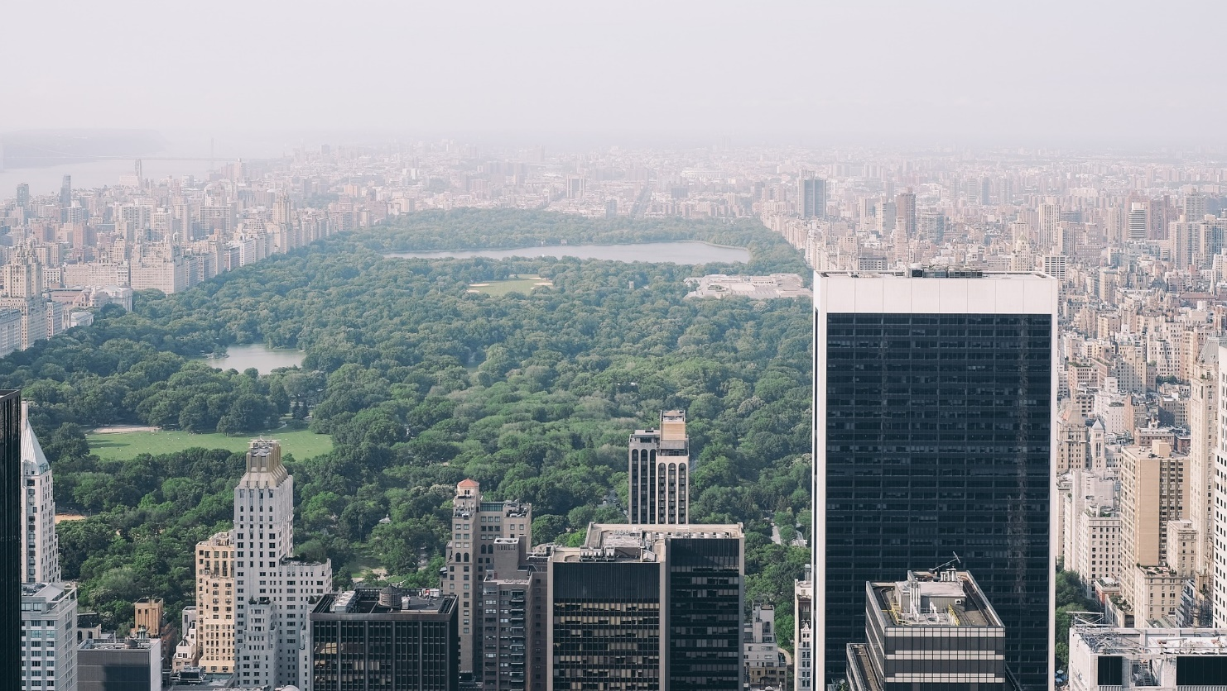
Central Park
Another famous New York landmark is Central Park. Here’s Ubercorn (with a bit of help from Foz and Kyan) to tell us all about it.

Slide 18
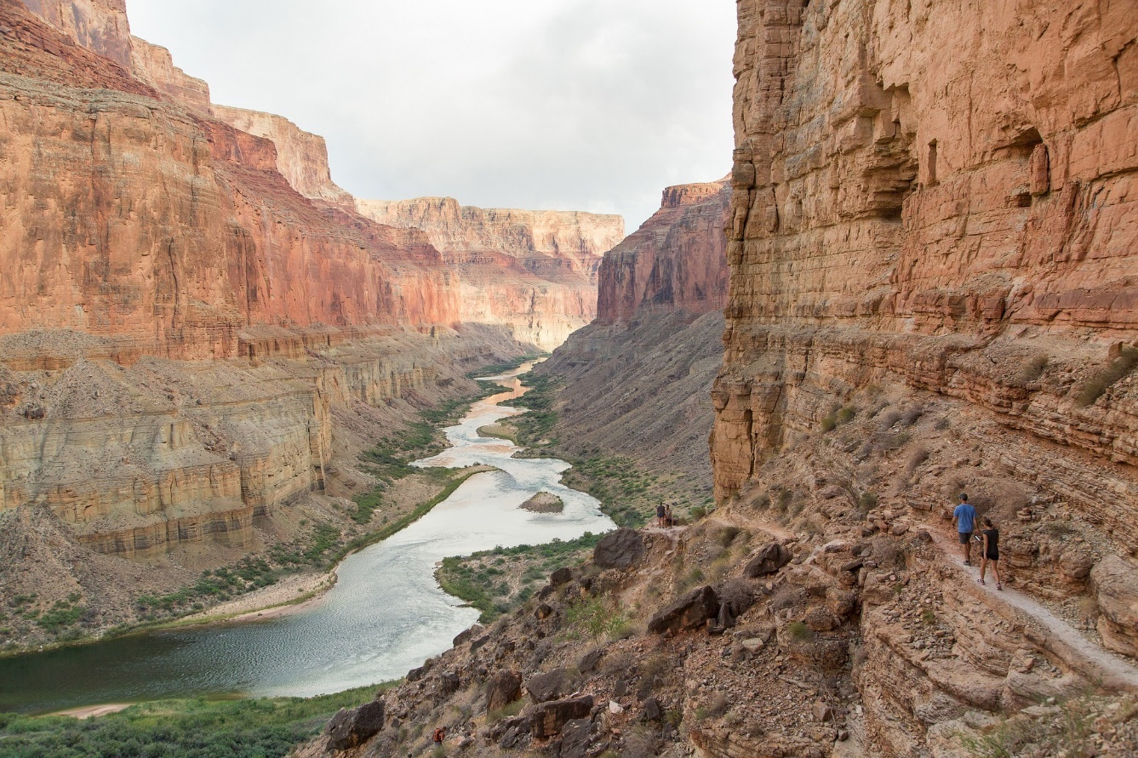
Grand Canyon
Right across the other side of the USA, you’ll find the Grand Canyon in Arizona. Here is Ubercorn with the Funky Facts.

Slide 19
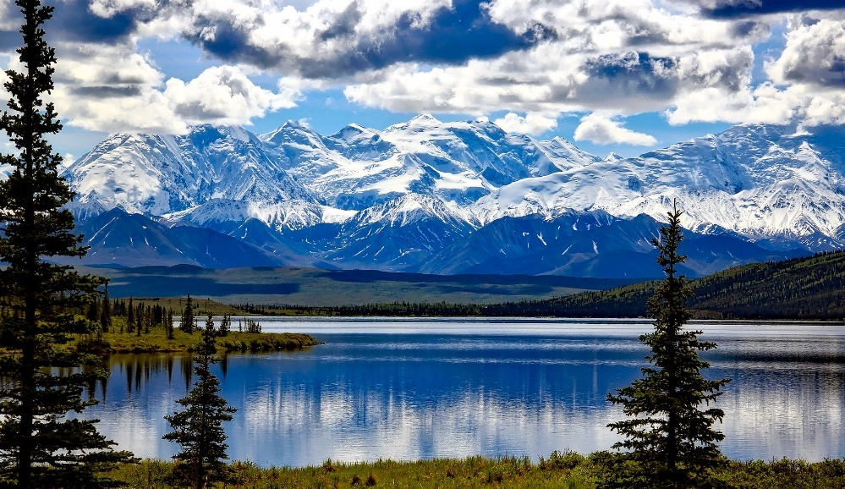
Alaska
Although Alaska isn’t within or next door to USA, it is one of the American states!
This is Denali National Park and Preserve in Alaska.

Slide 20
Canada
Canada is the second largest country in the world! Canada has two official languages: English and French.

Slide 21
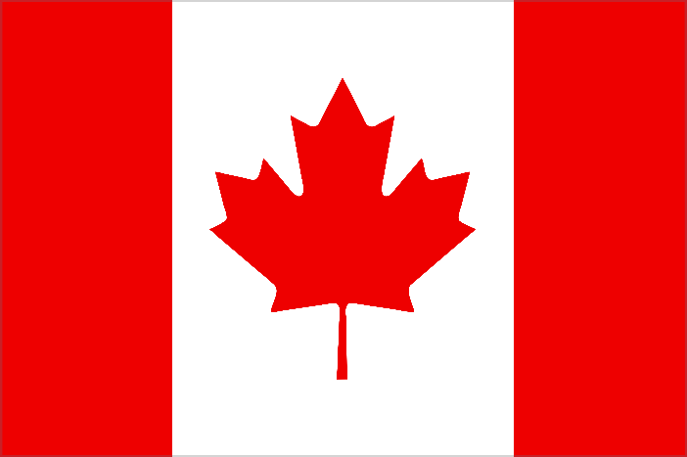
Canada
The maple leaf on Canada’s flag is the
country’s national symbol because it is
a distinctive feature of Canada’s nature.
Toronto is the most populated city in Canada with over 5 million people!

Slide 22
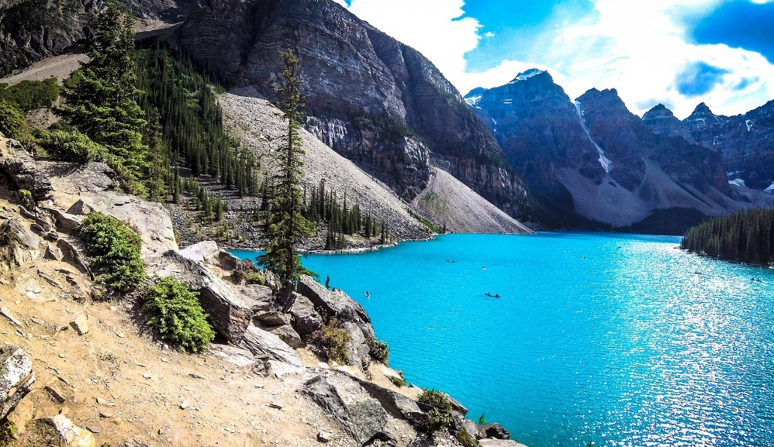
Banff National Park
Moraine Lake
Canada’s oldest national park is in Alberta, in the Rocky Mountains. People come here to visit the beautiful scenery including Moraine Lake, Lake Louise and Mount Norquay.
Tourists enjoy skiing, kayaking, cycling and hiking here.

Slide 23
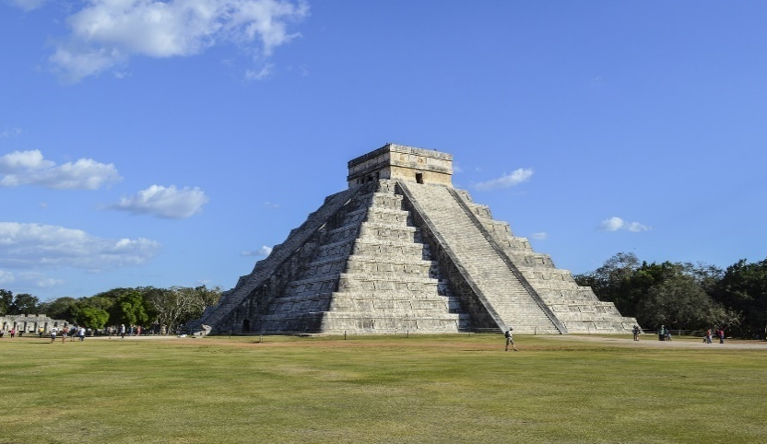
Mexico
Chichen Itza was a large city built by the Maya people. The ancient Maya were a civilisation that lived long ago in parts of North America. This landmark is one of the world’s most visited archaeological sites. It is over 1,000 years old.
El Castillo is the name given to the large pyramid temple there which has many steps on each side of the building.

Slide 24
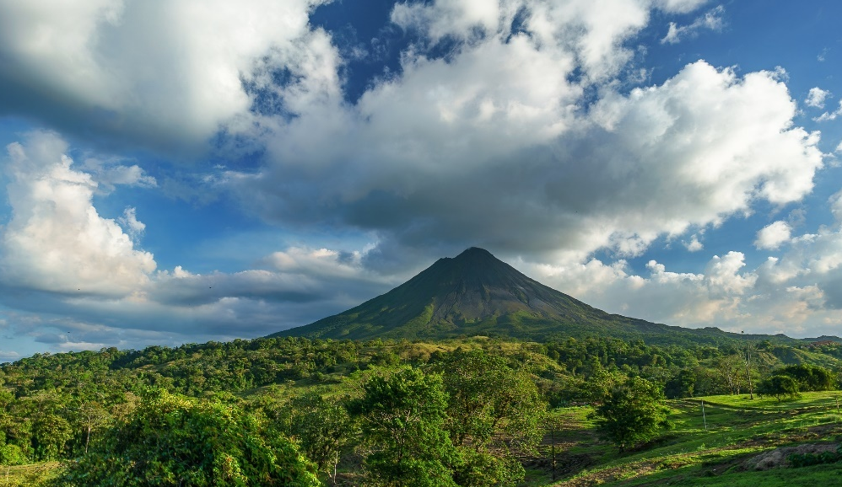
Costa Rica
From the Vroomster, I can see Arenal Volcano. It is cone shaped and over 1,600 metres high. Its crater is 140 metres wide and is believed to have been one of the most active volcanoes in the world. It was dormant for hundreds of years until it erupted in 1968, destroying a nearby town. Since 2010, it has been dormant.

Slide 25
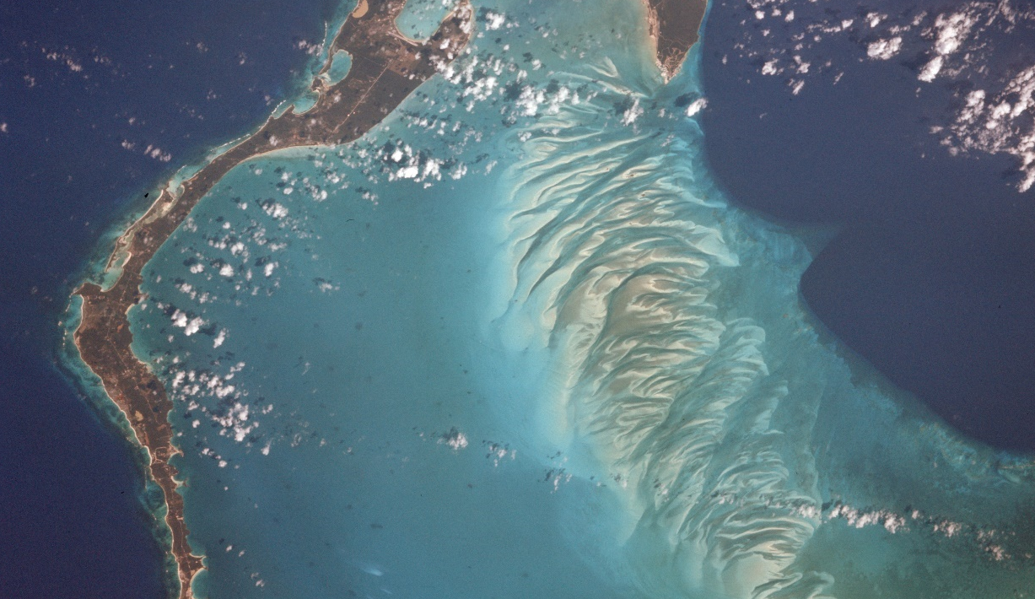
Bahamas
The Bahamas is made up of 700 islands.
Eleuthera is one of these islands and there you’ll find the Glass Window Bridge. Travelling over this bridge gives incredible views of the Atlantic Ocean on one side and the Bight of Eleuthera on the other. The two bodies of water are separated by a thin strip of rock where the bridge has been built.

Slide 26
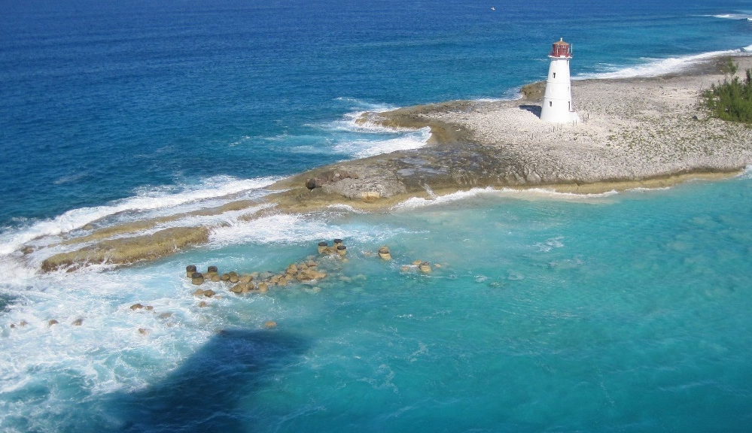
Bahamas
The Bahamas is an archipelago which means an area where there’s a large collection of islands closely grouped together.

Slide 27
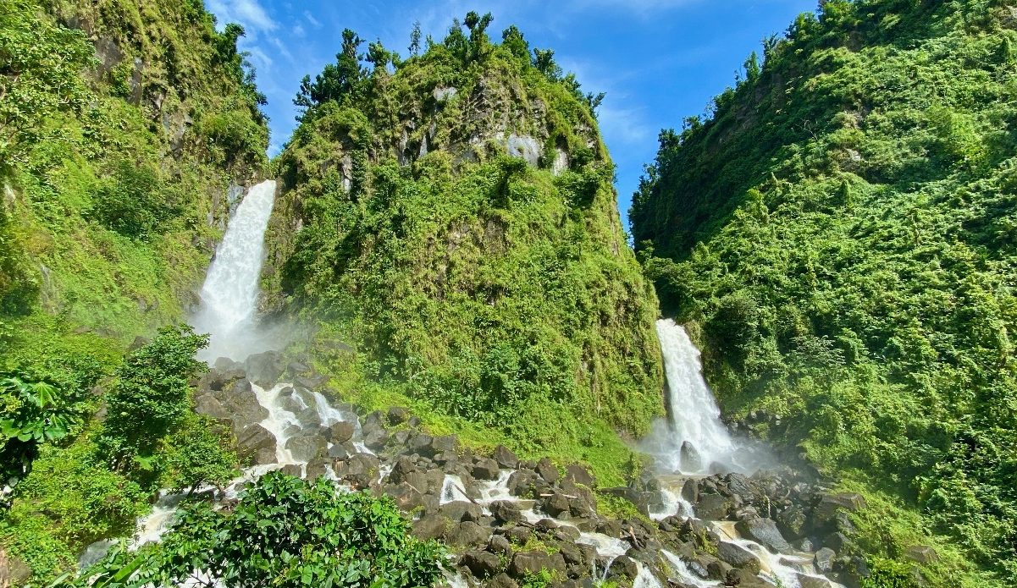
Dominica
On the small island of Dominica, you’ll find the Father Falls and the Mother Falls – which make up Trafalgar Falls. Father Falls is around 85 metres high and Mother Falls is about 40 metres high. Awesome!

Slide 28
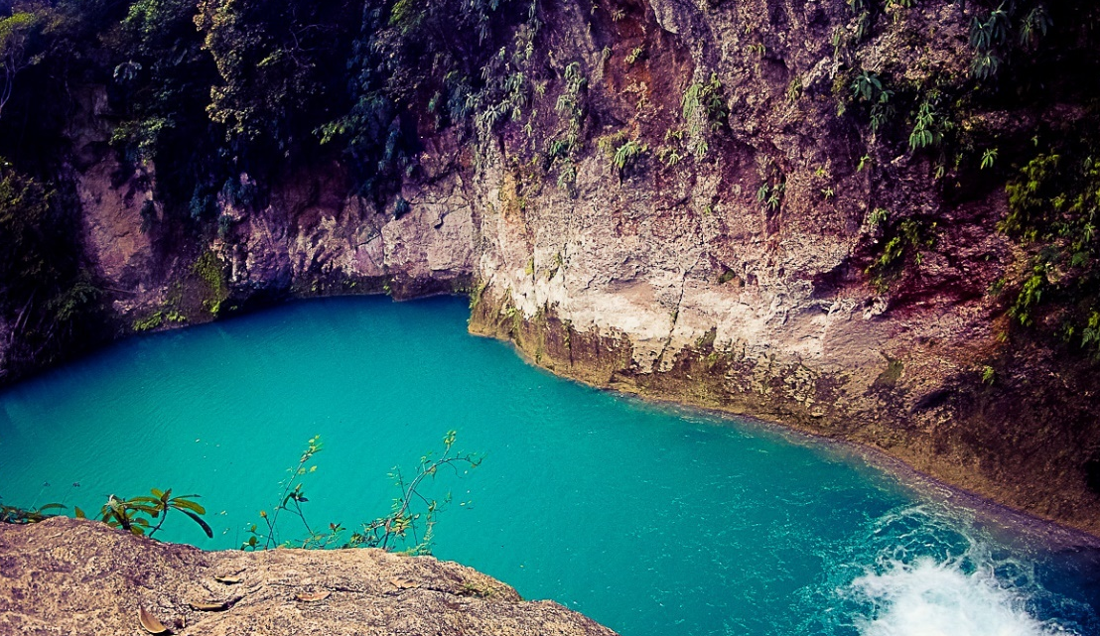
Haiti
On the island of Haiti, you’ll find three blue pools linked by waterfalls. They are known as Bassin Bleu, Bassin Clair, and Bassin Palmiste.
“BB_web-14” by HOPE Art is licensed under CC BY 2.0

Slide 29
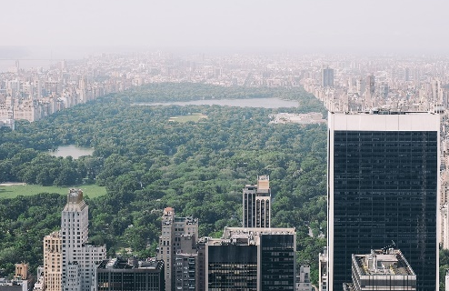




North America Quiz
Link up the picture, its name and location.
The Glass Window Bridge
Chichen Itza
Arenal Volcano
Banff National Park
Central Park
USA
Bahamas
Mexico
Canada
Costa Rica

Slide 30
North America Quiz
Link up the picture, its name and location.
The Glass Window Bridge
Chichen Itza
Arenal Volcano
Banff National Park
Central Park
USA
Bahamas
Mexico
Canada
Costa Rica

Slide 31
