Slide 1
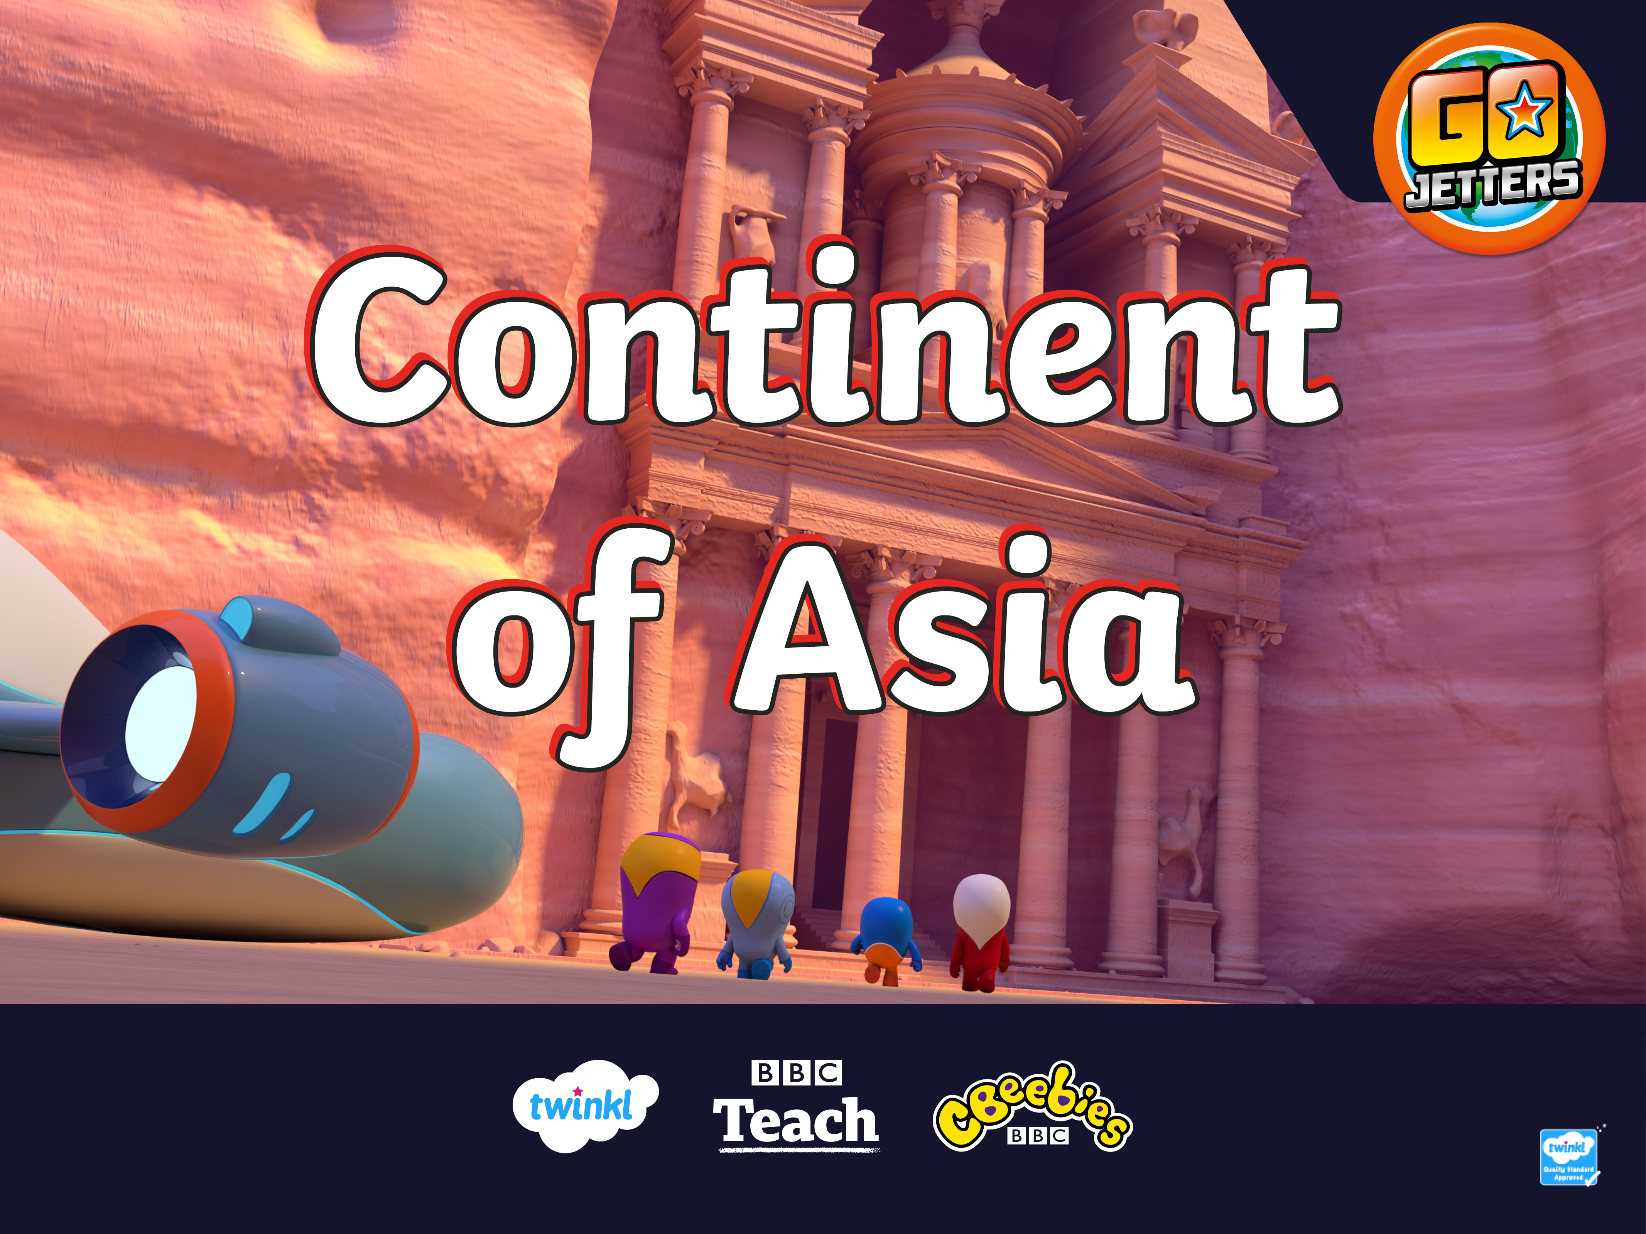

Slide 2
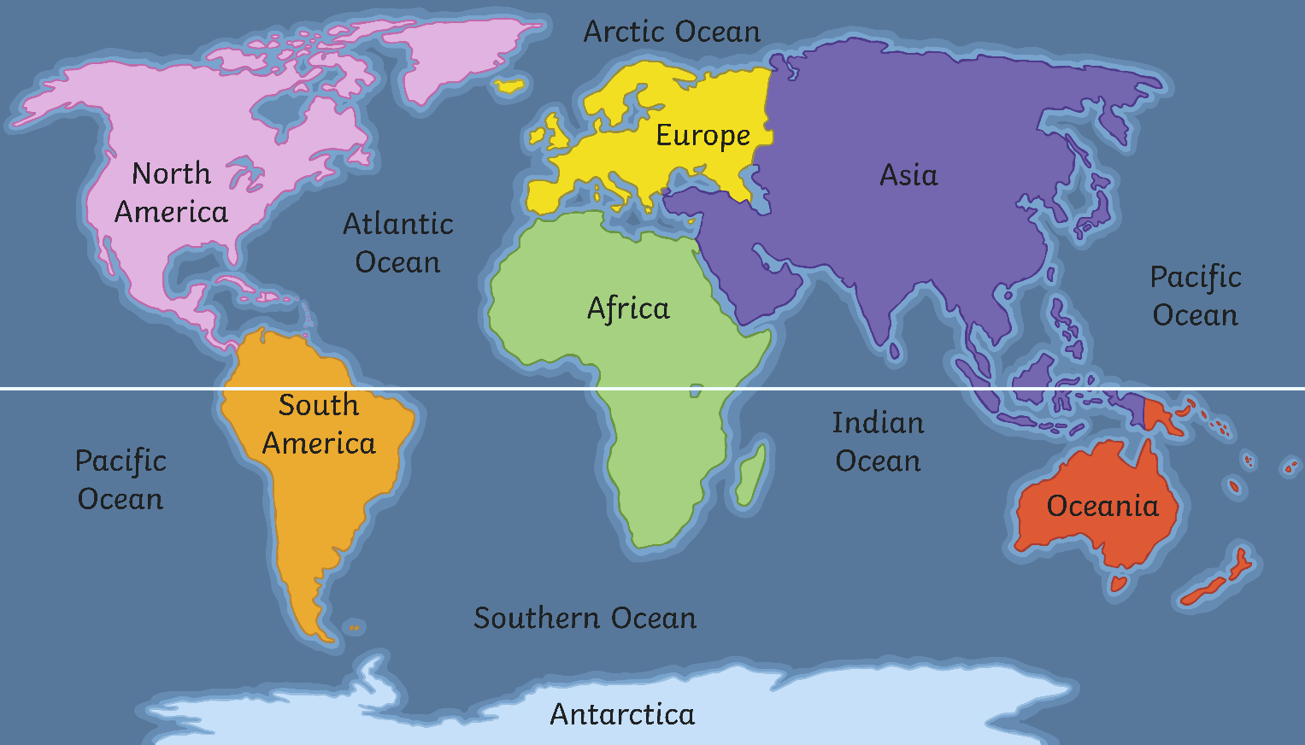
What Is a Continent?
Here are the seven continents of Planet Earth. A continent is a massive piece of land that is often separated from other areas of land by water or another feature such as mountains.
Equator

Slide 3
Asia
Here is a map which shows the countries that are in the continent of Asia.

Slide 4
Asia
Today, we are going to be learning about the continent of Asia.

Slide 5
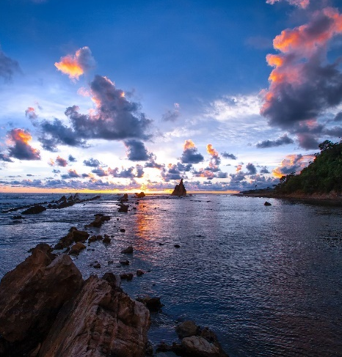
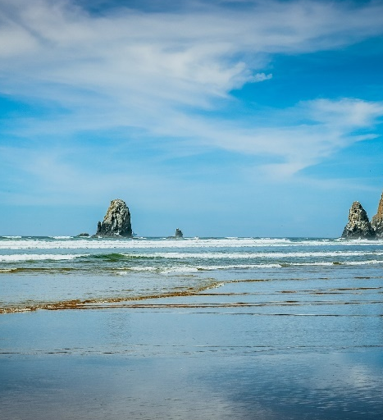
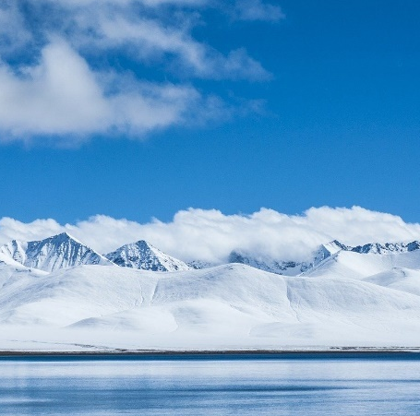
Asia
Funky Fact 3:
Asia is separated from the continent of Europe by a land border and edged by three oceans: the Indian Ocean to the south, the Pacific Ocean to the east and the Arctic Ocean to the north.

Slide 6
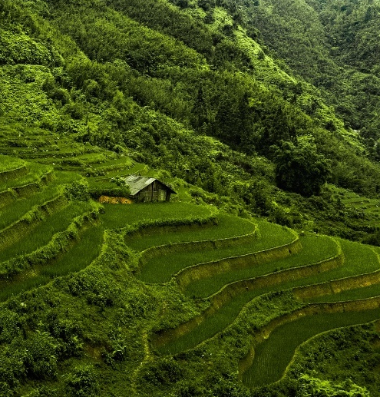
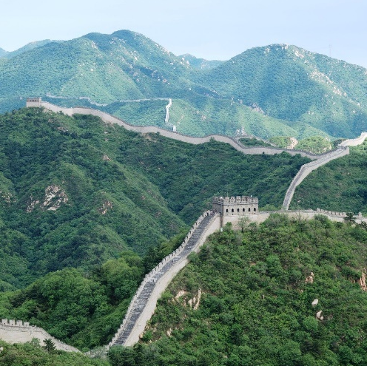
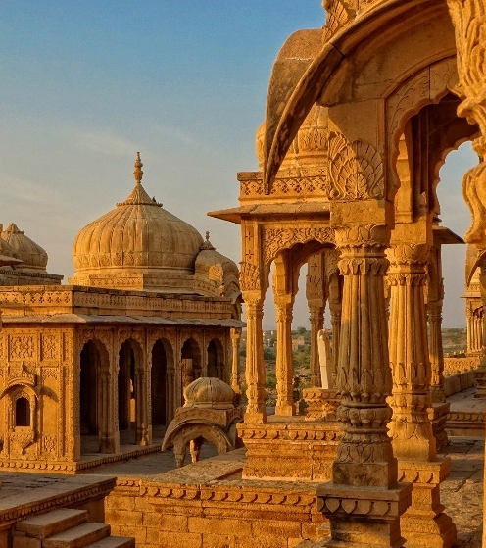
Asia
Funky Fact 2:
Asia is made up of 48 countries. Some of these countries include China, India, Thailand, Vietnam and Malaysia.

Slide 7
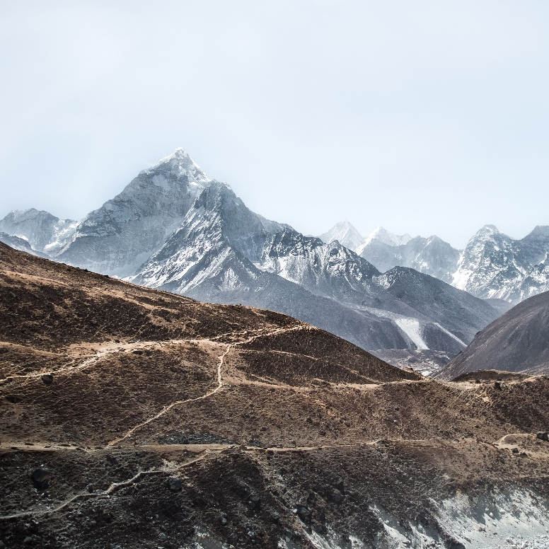
Asia
Funky Fact 1:
The highest peak in Asia is Mount Everest.

Slide 8

Asia
Did you know that the Tibetan name for Mount Everest is Chomolungma?

Slide 9
What Is a Landmark?
Can you remember what a landmark is?

Slide 10
What Is a Landmark?
A landmark is something that stands out in an area. It could be a building, a bridge, a lake or river, a sculpture or something else. These places might be special because of their age or their size.
A landmark makes a place recognisable. This means you could look at a picture of a landmark and know straight away where it is.

Slide 11
What Is a Landmark?
Do you recognise any of these famous landmarks from around the world?

Slide 12
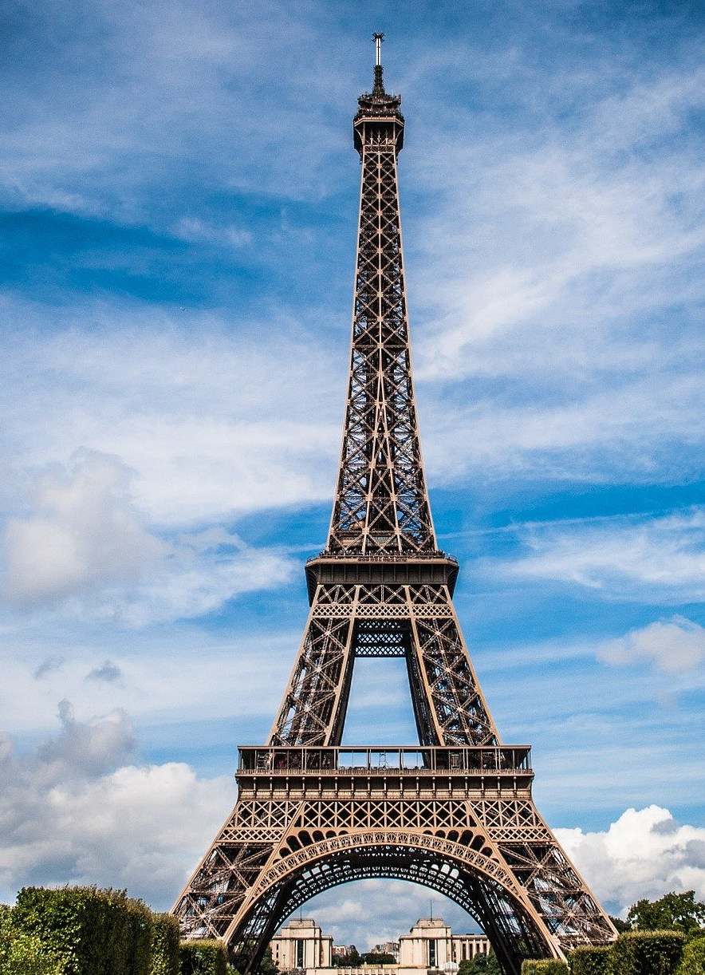
What Is a Landmark?
The Eiffel Tower, France

Slide 13
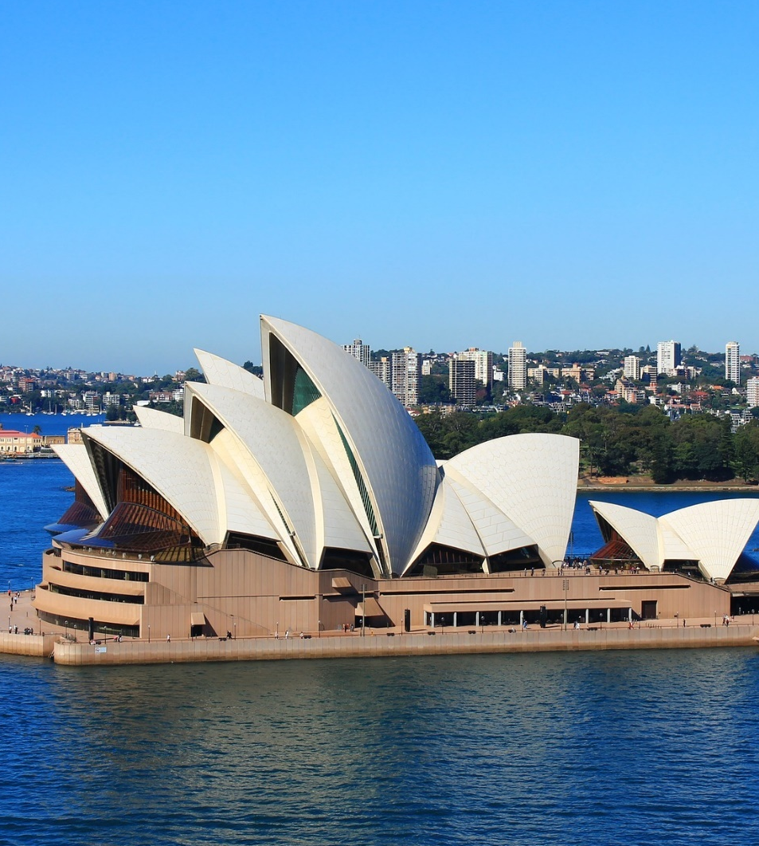
What Is a Landmark?
Sydney Opera House, Australia

Slide 14
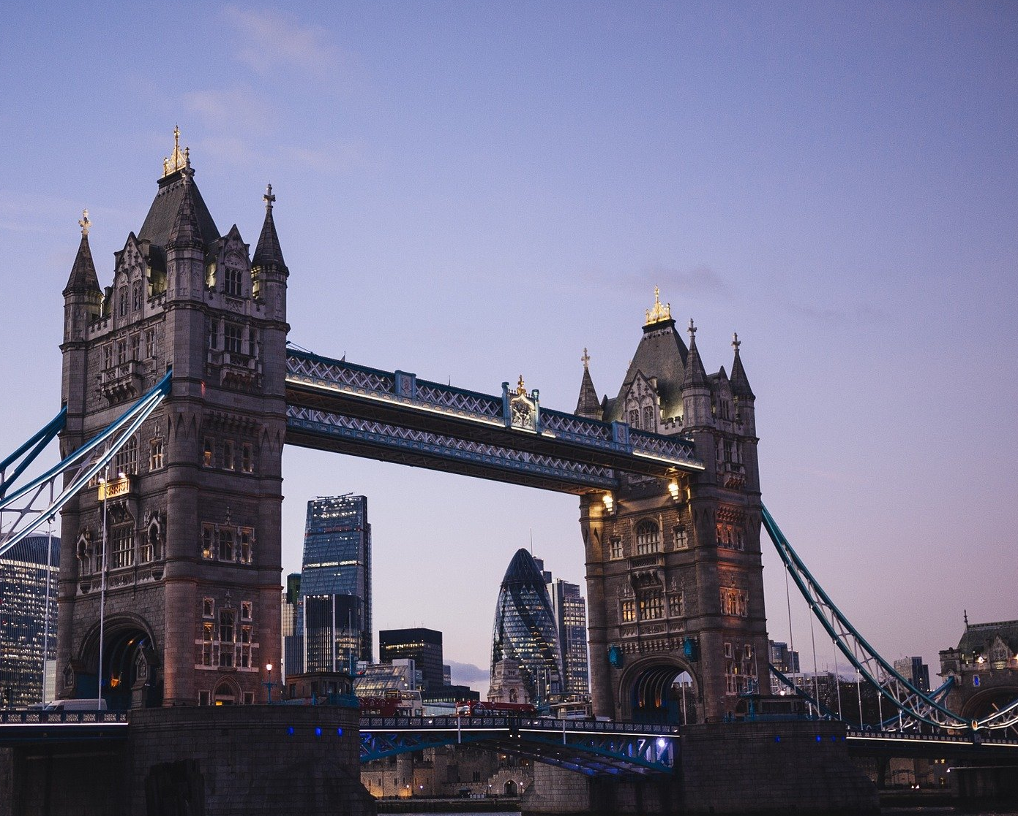
What Is a Landmark?
Tower Bridge, UK

Slide 15
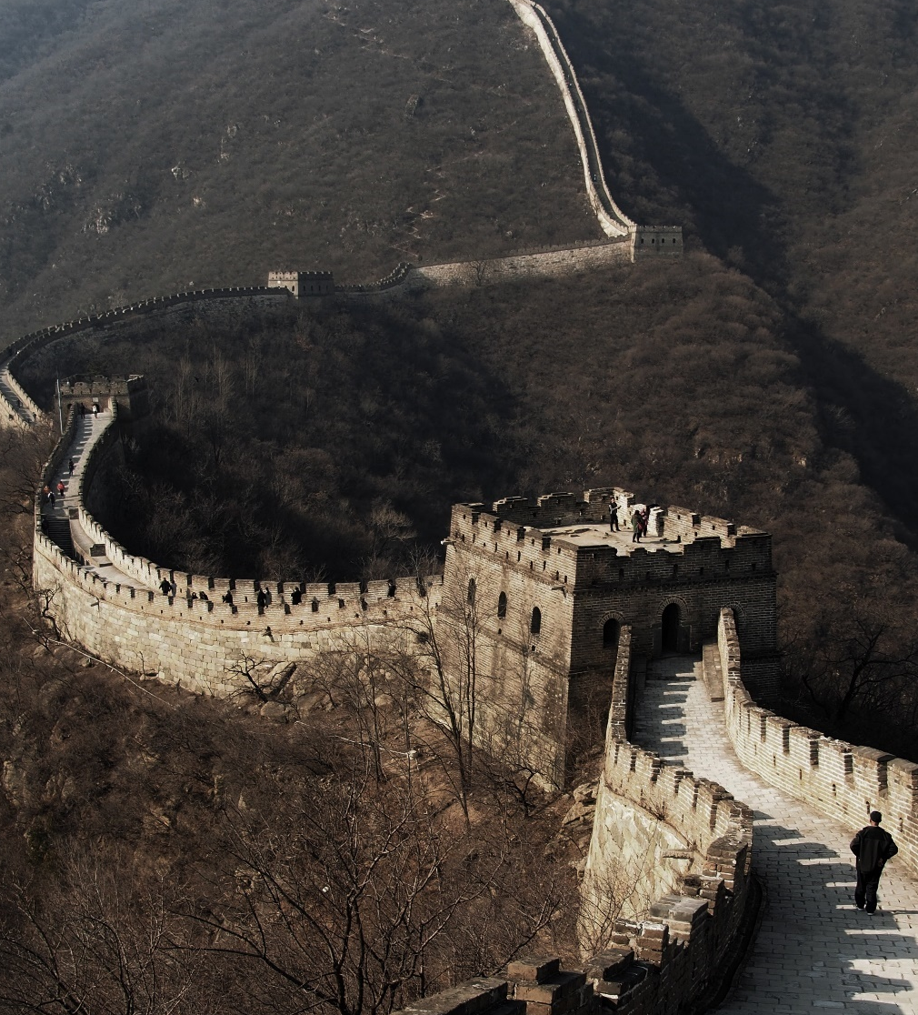
The Great Wall of China
Now, let's explore the continent of Asia! This is the Great Wall of China, which is in China.
Here is Ubercorn with some funky facts.

Slide 16
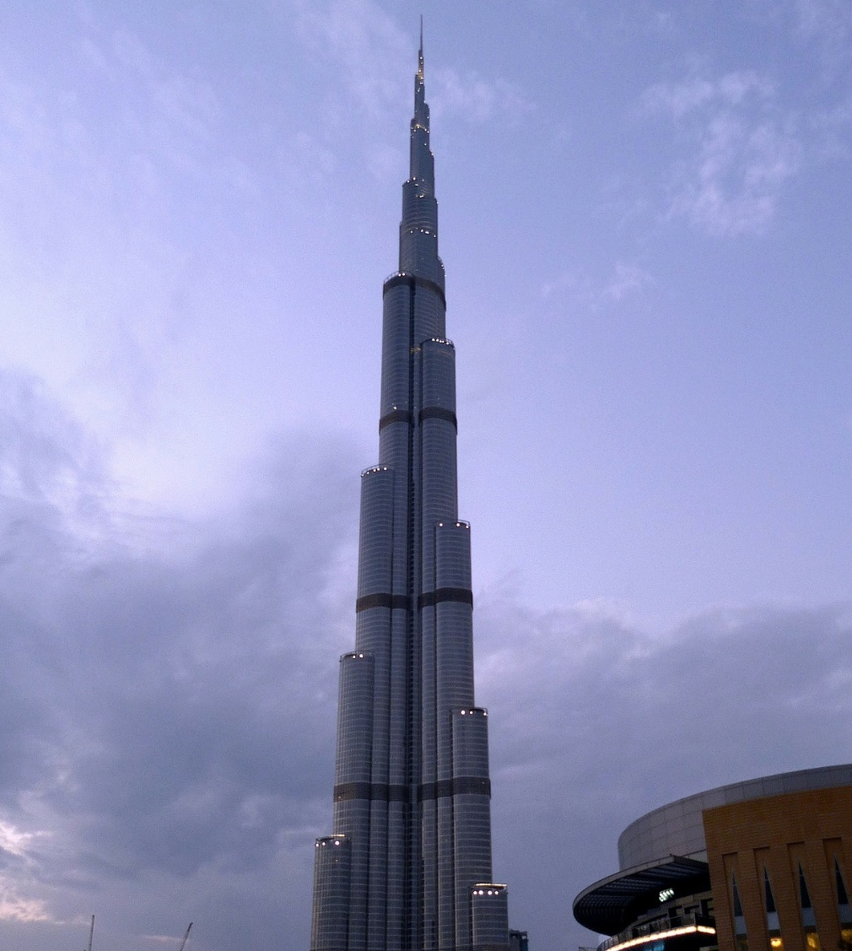
Burj Khalifa, Dubai
I love a tall building and Burj Khalifa is the tallest man-made structure in the world! It is 828 metres tall. It is also known as the Jewel of Dubai.

Slide 17
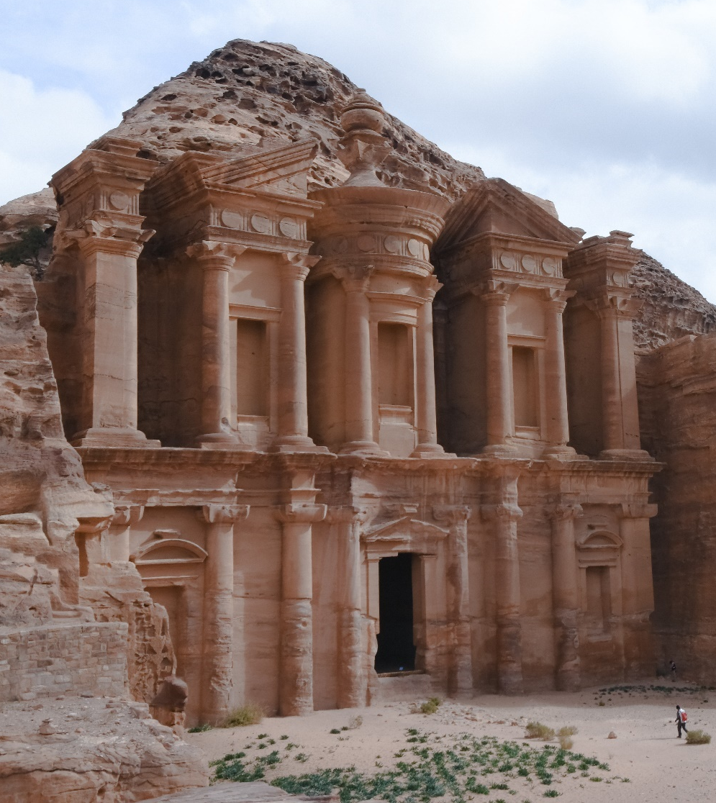
Petra, Jordan
Petra is in Jordan. It is carved into rock.
Here is Ubercorn to tell us more about it.

Slide 18
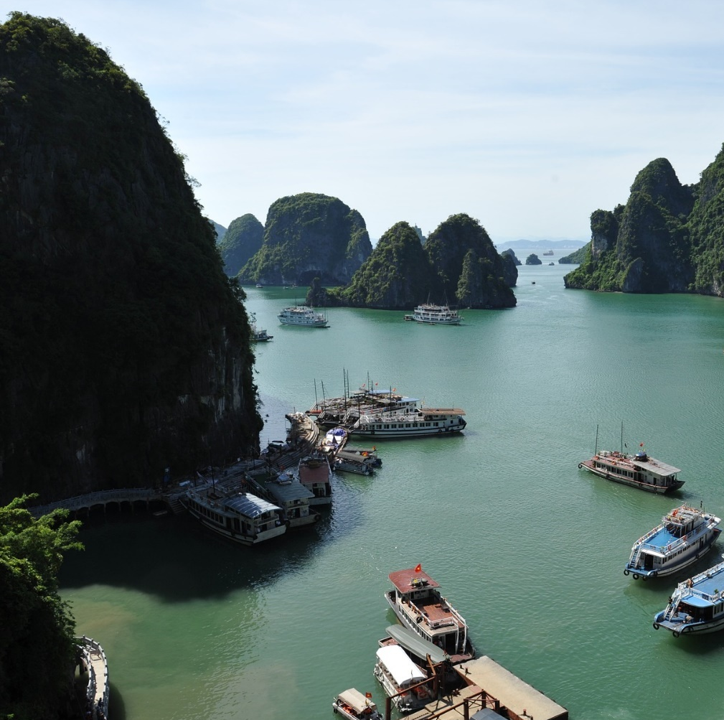
Ha Long Bay, Vietnam
Look at Ha Long Bay in Vietnam. It is a beautiful bay with many islands and cliffs made from limestone and covered in different types of plants. The wind and waves have made these unusual looking islands over many years. Souvenir selfie!

Slide 19
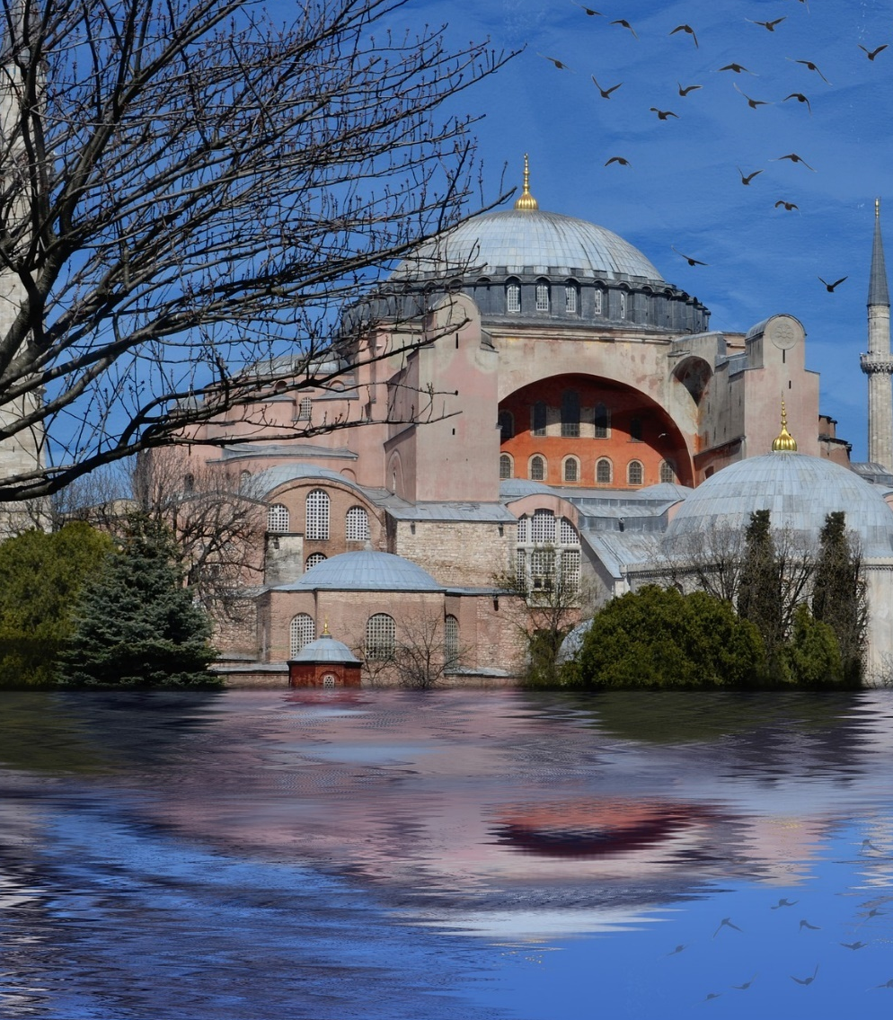
Hagia Sophia Museum, Turkey
The Hagia Sophia Museum was originally built as a church, then it became a mosque and now it is a museum. When it was first built, the church was the biggest in the world for over a thousand years and it took 11 thousand people to build it!

Slide 20
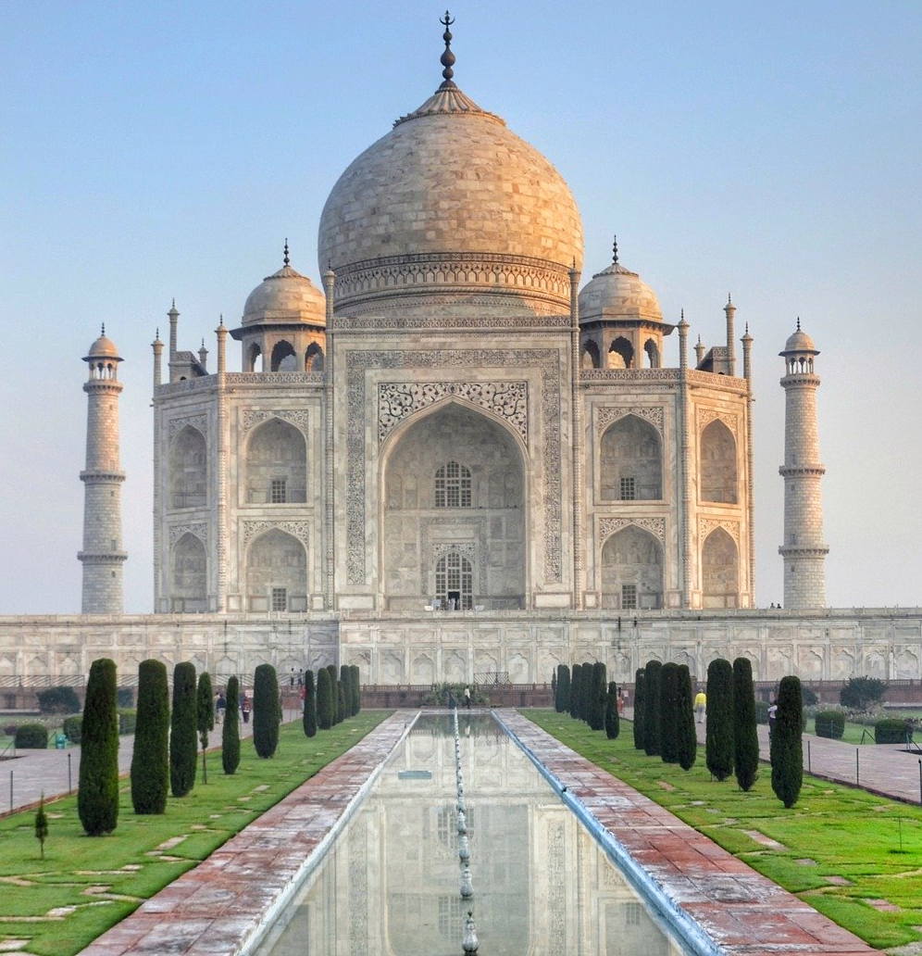
The Taj Mahal, India
The Taj Mahal is made of white marble and was built in memory of the Mughal Emperor Shah Jahan’s wife. It took 16 years to build and is over 300 years old!
What a building!

Slide 21
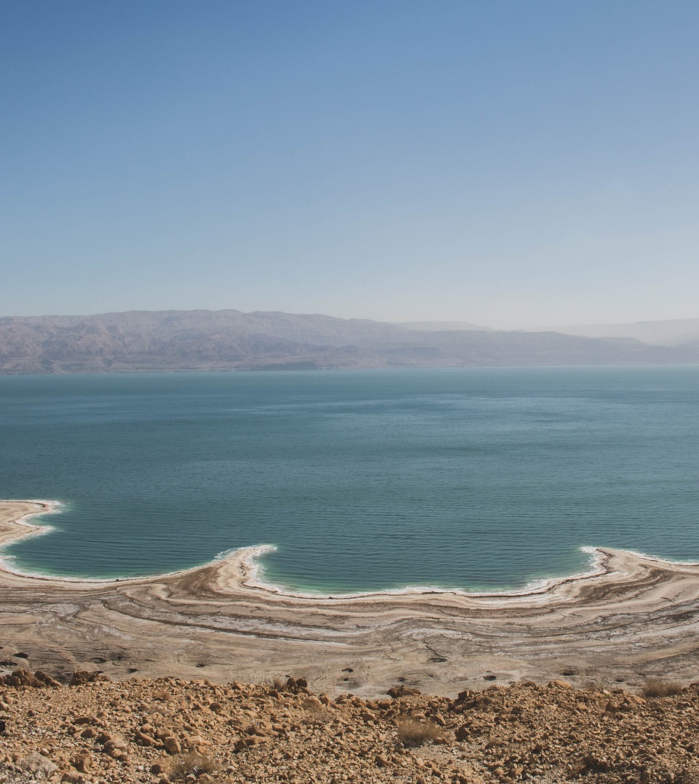
Dead Sea
The Dead Sea is actually a lake in Asia.
Let’s find out more from Ubercorn’s top three funky facts.

Slide 22
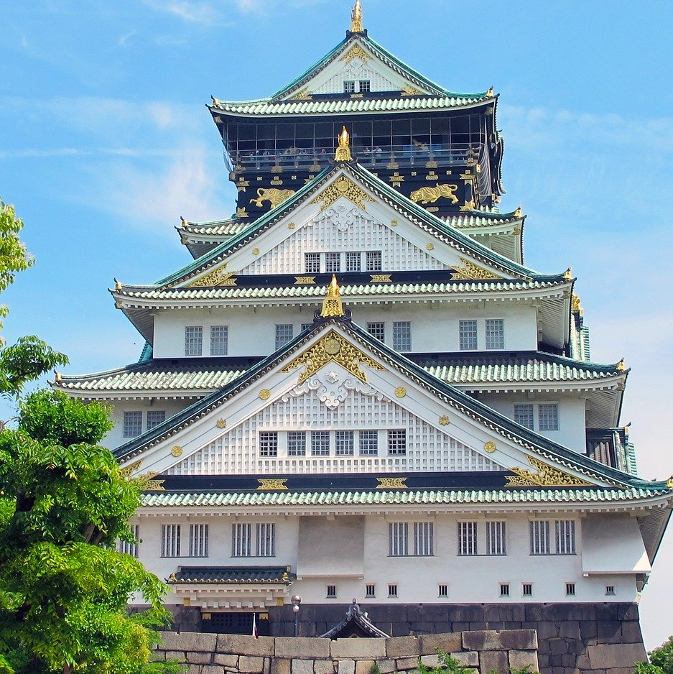
Osaka Castle, Japan
In 1583, the beautiful Osaka Castle was built where a special temple had once been, but it burnt down during a war 16 years later. It was rebuilt but it has been struck by lightning and burnt down again since then!

Slide 23
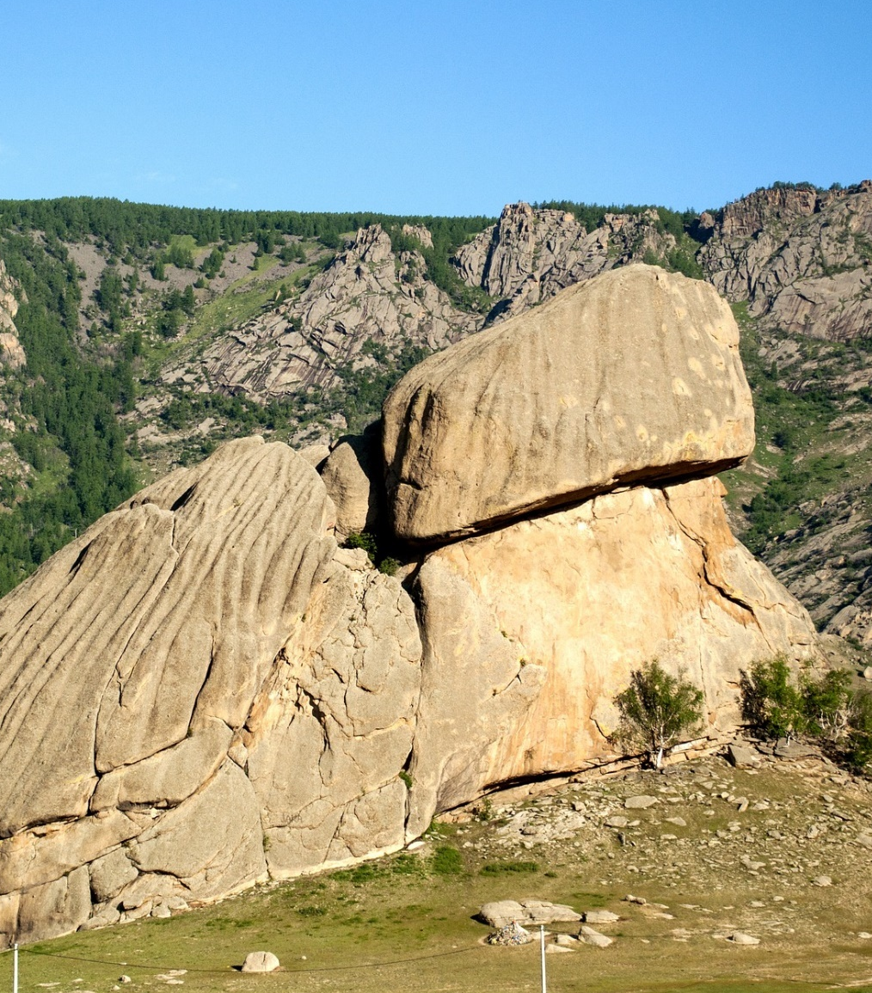
Turtle Rock, Mongolia
Turtle Rock in Mongolia is also known as Melkhi Khad. It is formed from granite and is 24 metres high. That’s almost the same height of 6 double decker buses! It is called Turtle Rock because its shape reminds people of a turtle. Awesome!

Slide 24
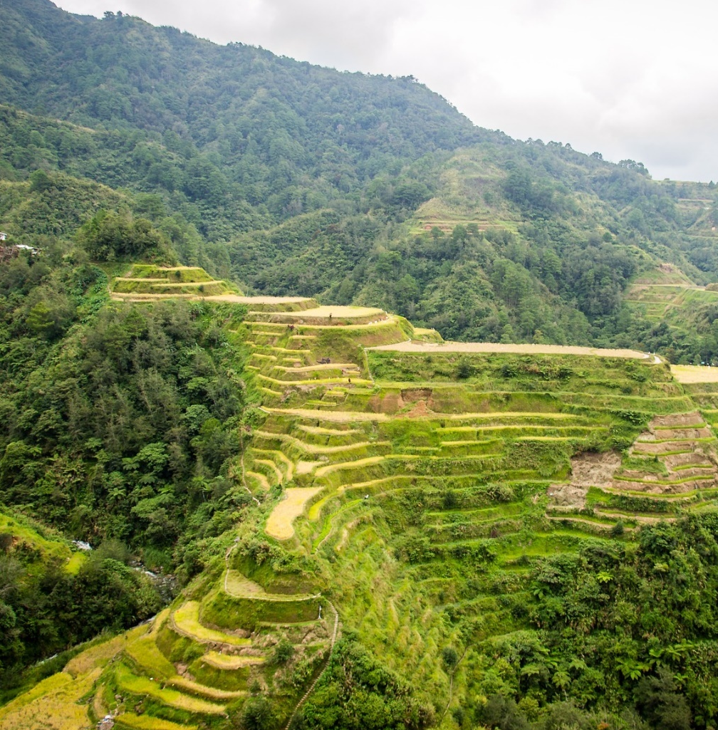
Banaue Rice Terraces, Philippines
The Banaue Rice Terraces were created by people, by hand, over 2000 years ago. They were made so that rice could be grown on them and the people could sell the rice to passing traders.

Slide 25
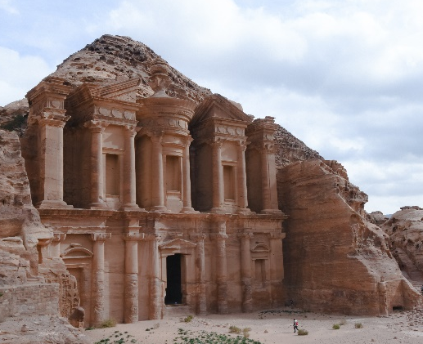

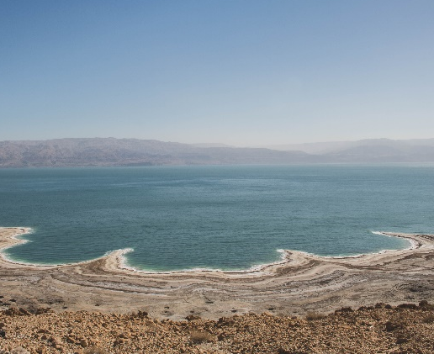
What Can You Remember?
Look at these pictures. Can you remember three funky facts about these places in Asia?

Slide 26


