Slide 1

Using Exit Tasks to Gauge Pupil Understanding
Linking Exit Tasks to Success Criteria

Slide 2
Learning Intentions
Understand the purpose of exit tasks in formative assessment
Explore how to link exit tasks to lesson success criteria
Discover digital tools for creating exit tasks using iPads
Create and share an example exit task

Slide 3
What Are Exit Tasks?
Short activities completed at the end of a lesson
Help gauge pupil understanding of key concepts
Provide feedback for both teacher and learner
Can be written, verbal, visual, or digital

Slide 4
Why Use Exit Tasks?
Encourage reflection and metacognition
Identify misconceptions early
Inform next steps in planning
Promote pupil voice and ownership

Slide 5
Linking to Success Criteria
Example Success Criteria:
"I can describe three functions of the circulatory system."
Linked Exit Task:
"List two functions of the circulatory system you now understand."
✅ Keep it specific
✅ Use pupil-friendly language
✅ Match the format to the learning

Slide 6
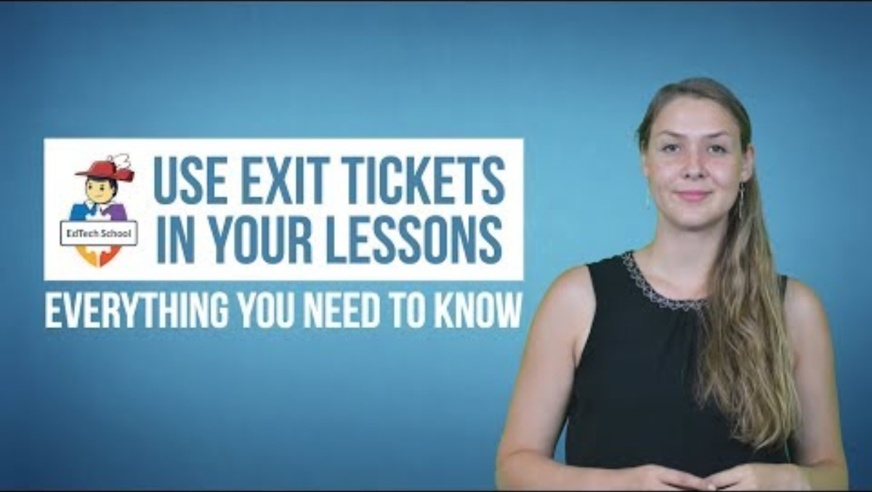
“Quick and Easy Ways to Use Exit Tickets in the Classroom”

Slide 7
Digital Tools for Exit Tasks (iPad-Friendly)
Tools | Feature | Link
ZIPLET | Quick Questions no log on | Ziplet.com
Socrative | MCQs, short answers | Home - Socrative | Socrative
Poll Everywhere | Live polls, word clouds | Engage your audience | Poll Everywhere
BookWidgets | 60+ exit ticket templates | BookWidgets - The perfect content creation tool for teachers in the classroom
Jotform AI | Auto-generates exit quizzes | Free Online Form Builder & Form Creator for 2025 | Jotform

Slide 8
Try It Out!
Create a digital exit task linked to this success criteria:
"I can explain the impact of climate change on biodiversity."
Use one of the tools above and share with a partner.

Slide 9
Share & Reflect
What did you create?
How does it link to the success criteria?
What might pupils find engaging or challenging

Slide 10
Be Cautious with Emotion-Based Exit Tasks
🚫 Not All Exit Tasks Measure Understanding
While emojis or mood check-ins can be useful for wellbeing, they don’t assess learning.
Examples to be cautious of:
“How do you feel about today’s lesson?” 😐🙂😃
“Rate your confidence from 1–5” without context
Emoji-only responses with no explanation

Slide 11
Why this matters:
Emotional responses can be misleading
Pupils may feel confident but misunderstand key concepts
Doesn’t provide actionable feedback for teaching
✅ Better Alternative: Pair emotional check-ins with knowledge-based prompts, e.g.
"How confident are you in explaining [topic]? Write one sentence to show your understanding."

Slide 12
Further Reading & Resources
📚 Recommended Books
20 Formative Assessment Strategies That Work by Kate Wolfe Maxlow & Karen L. Sanzo — Chapter on using exit tickets effectively [taylorfrancis.com]
Exit Tickets: Gathering Evidence to Guide Next Steps (DistillED guide by Jamie Clark, 2025) — practical strategies for alignment with success criteria [newsletter...eclark.com]
The Exit Ticket: A Snapshot of Student Learning (Land‑Grant Press, 2024) — overview of design and implementation in diverse contexts [lgpress.clemson.edu]

Slide 13
🌐 Online Articles & Templates
“24 Exit Ticket Ideas and Examples for Immediate Feedback” – practical prompts and alignment tips [weareteachers.com]
“How To Use Exit Tickets As Assessment For Learning” – free templates and step‑by‑step guidance [thirdspace...arning.com]
“Let’s STOP and THINK about Exit Tickets” – reframing and timing strategies to deepen learning [middleweb.com]
Reading Rockets: Exit Slips – classroom-ready prompt examples and downloadable templates [readingrockets.org]
🔗 Useful Links
Land‑Grant Press guide: “The Exit Ticket: a snapshot…” [lgpress.clemson.edu]
DistillED guide: “Exit Tickets: Gathering Evidence…” [newsletter...eclark.com]

Slide 14
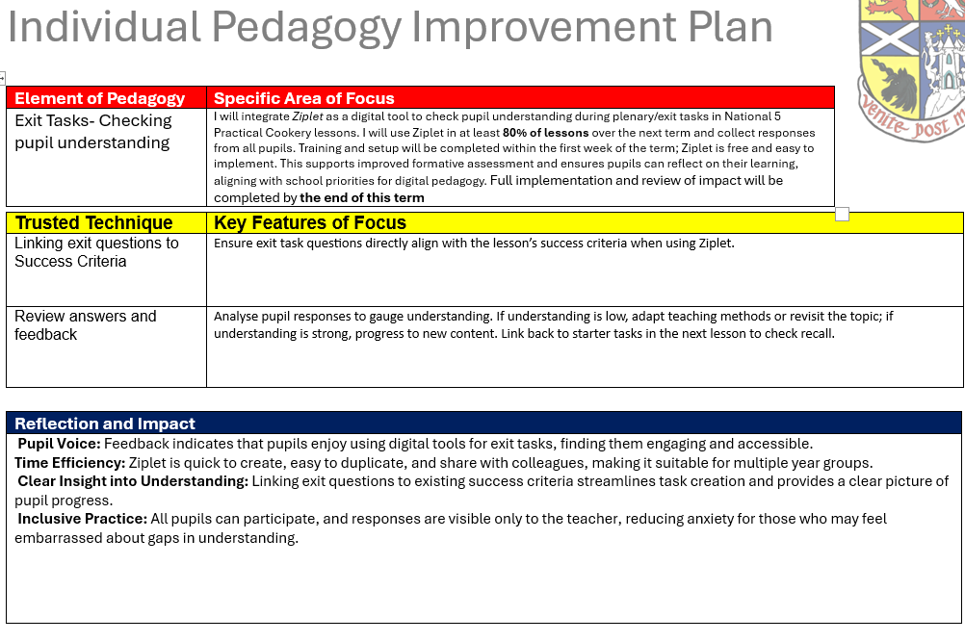
My IPIP

Slide 15
Takeaway & Next Steps
✅ Choose one tool to trial next week
✅ Plan one lesson with a linked exit task
✅ Share your experience at the next department meeting

