Slide 1
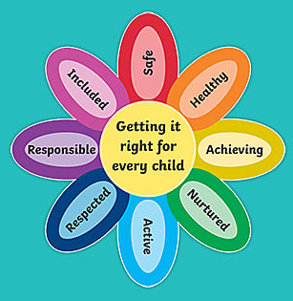

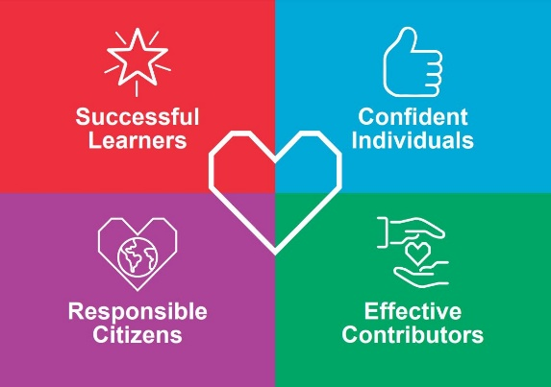
Individual Pedagogy Improvement Plan
Robert Gordon – Home Economics Teacher
‘How can Retrieval Practice improve outcomes for learners?’

Slide 2
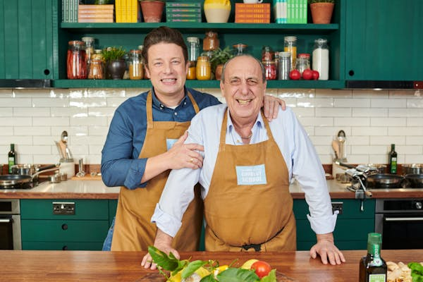
We are learning to...
…increase awareness around different retrieval practice techniques.
…understand the 9 Scottish dietary goals using some retrieval techniques.
I will be able to...
…successfully use ‘cops and robbers’ and ‘misconception’ retrieval practice tasks.
…explain the 9 Scottish dietary goals to a peer.

Slide 3
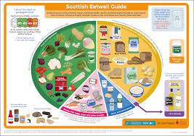

Revised Dietary Goals of Scotland (RDGS)
The Scottish dietary goals, revised in 2016, aim to improve the overall health of the nation. In Scotland ill health is on the rise and much of this is down to the poor diet we eat.
There are 9 goals, and these are:
eat more fruit and vegetables,
eat more fibre,
eat less overall calories,
eat less saturated and total fat,
eat no more that 6g of salt per day,
eat no more than 70g red meat per person/day,
eat more oily fishes (S.M.A.S.H),
eat less sugar,
maintain starchy carbohydrate intake at 50% of total energy.

Slide 4
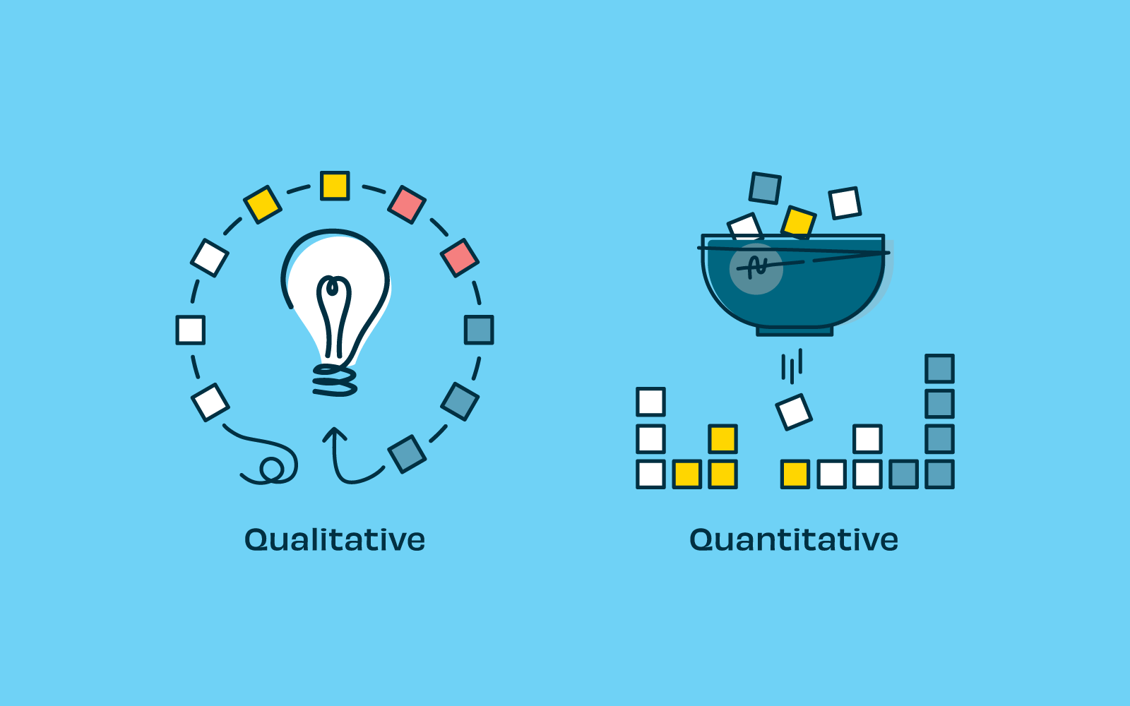
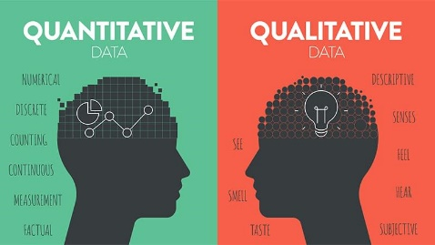
Individual Pedagogy Improvement Plan
Element of Pedagogy – Teaching and Learning Strategies
Specific Focus – Retrieval Practice with BGE and Senior Phase Classes.
Trusted Technique 1) Misconceptions Retrieval
Key Features of Focus 1) The teacher writes a collection of misconceptions based on previous classroom experiences or from classwork. These can be points that pupils often get wrong, find confusing or aren’t necessarily true. Pupils must then rewrite, correct or improve the original statement.

Slide 5
Individual Pedagogy Improvement Plan
Element of Pedagogy – Teaching and Learning Strategies
Specific Focus – Retrieval Practice with BGE and Senior Phase Classes.
Trusted Technique 2) Cops and Robbers Retrieval
Key Features of Focus 2) The ‘Cops’ column is for pupils to write as much as they can from memory about a specific topic or material in a set time. After this pupils must complete the ‘Robbers’ column, where everyone should get out of their seats and swap/share/steal ideas or information from their peers.

Slide 6
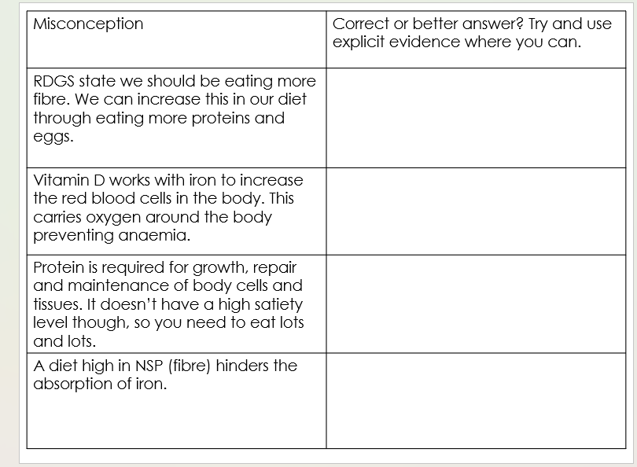
Technique 1 – Misconceptions – Example of use in class…
N5 HFT – Food for Health Unit

Slide 7
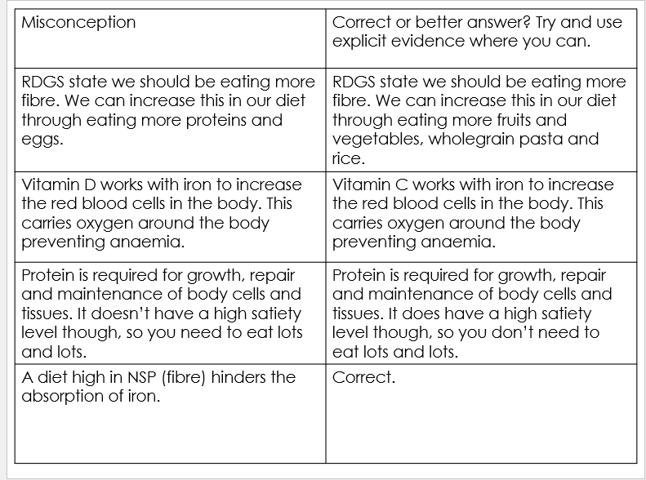
Technique 1 – Misconceptions – Example of use in class…
N5 HFT – Food for Health Unit

Slide 8
Misconceptions | Correct or better answer?
The Scottish dietary goals state we should… …maintain our fibre intake at 50% total energy.
The Scottish dietary goals state we should… …eat less saturated and total fats.
The Scottish dietary goals state we should… …eat more fish such as Salmon, Mackerel, Alpaca, Cod and Haddock.
The Scottish dietary goals revised in 2019 aim to improve the overall health of the nation. There are 6 or 7 goals and they aim to tell the public to eat less of all the tasty things.

Slide 9
Misconceptions | Correct or better answer?
The Scottish dietary goals state we should… …maintain our fibre intake at 50% total energy. | The Scottish dietary goals state we should… …maintain our starchy carbohydrate intake at 50% total energy.
The Scottish dietary goals state we should… …eat less saturated and total fats. | Correct
The Scottish dietary goals state we should… …eat more fish such as Salmon, Mackerel, Alpaca, Cod and Haddock. | The Scottish dietary goals state we should… …eat more oily fish such as Salmon, Mackerel Anchovies, Sardines and Herring.
The Scottish dietary goals revised in 2019 aim to improve the overall health of the nation. There are 6 or 7 goals, and they aim to tell the public to eat less of all the tasty things. | The Scottish dietary goals revised in 2016 aim to improve the overall health of the nation. There are 9 different goals, and they aim to tell the public achievable targets to improve our health.

Slide 10
Revised Dietary Goals of Scotland (RDGS)
The Scottish dietary goals, revised in 2016, aim to improve the overall health of the nation. In Scotland ill health is on the rise and much of this is down to the poor diet we eat.
There are 9 goals, and these are:
eat more fruit and vegetables,
eat more fibre,
eat less overall calories,
eat less saturated and total fat,
eat no more that 6g of salt per day,
eat no more than 70g red meat per person/day,
eat more oily fishes (S.M.A.S.H),
eat less sugar,
maintain starchy carbohydrate intake at 50% of total energy.

Slide 11
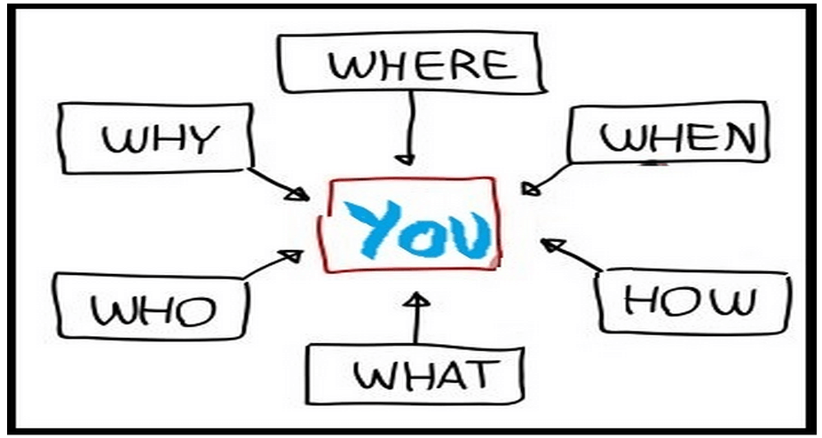

Context -
Why did I choose this focus for my IPIP?
“Before you start something new, review the old” Kirschner (2017)
Evidence based research suggests retrieval practice improves confidence in pupil understanding as well as identifying gaps in their knowledge.
Due to being an active learning process, it makes pupils think and make connections with previously taught knowledge. Should be a closed book strategy.

Slide 12

Context -
Where does Retrieval fit into my Lesson?
Updated learning standard - STAAR
Share, Transition, Activate, Assess, Review
Transition through use of a retrieval starter task – ‘cops and robbers’ or ‘misconceptions’.
Assessing through use of a retrieval task -
Using Achieve – quizzes or set a test.
Past papers – course reports.
Links with flipped learning and placing pupils in the heart of their own learning. Brain dumps/mind maps at the start of a topic or flashcards at the end.

Slide 13
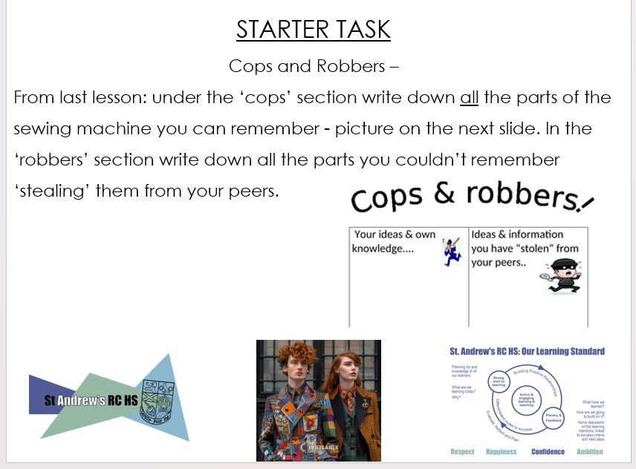
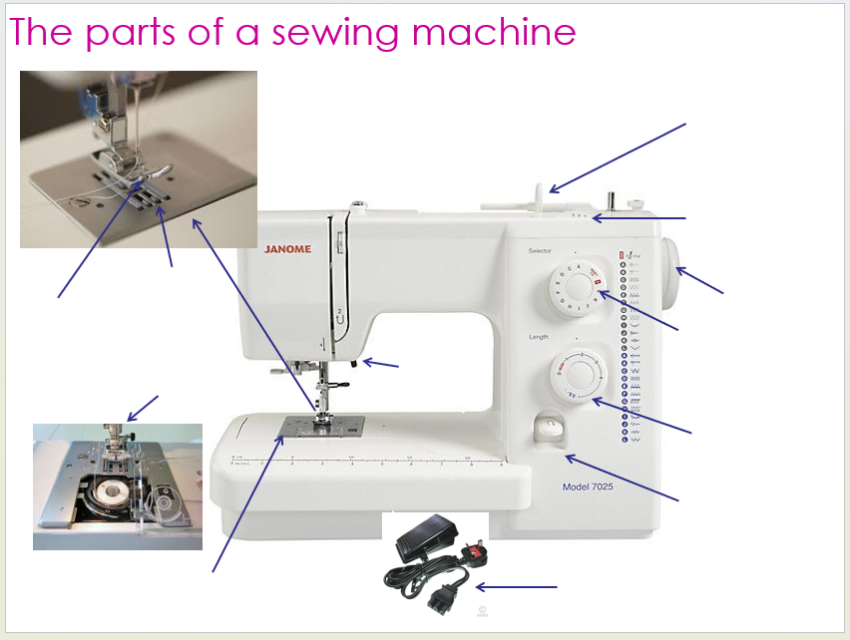
Technique 2 – Cops and Robbers – Example of use in class…
S2 BGE Fashion and Textiles Lesson

Slide 14

Cops – Your own ideas and knowledge… | Robbers – ideas and knowledge you have stolen from your peers…

Slide 15
Revised Dietary Goals of Scotland (RDGS)
The Scottish dietary goals, revised in 2016, aim to improve the overall health of the nation. In Scotland ill health is on the rise and much of this is down to the poor diet we eat.
There are 9 goals, and these are:
eat more fruit and vegetables,
eat more fibre,
eat less overall calories,
eat less saturated and total fat,
eat no more that 6g of salt per day,
eat no more than 70g red meat per person/day,
eat more oily fishes (S.M.A.S.H),
eat less sugar,
maintain starchy carbohydrate intake at 50% of total energy.

Slide 16
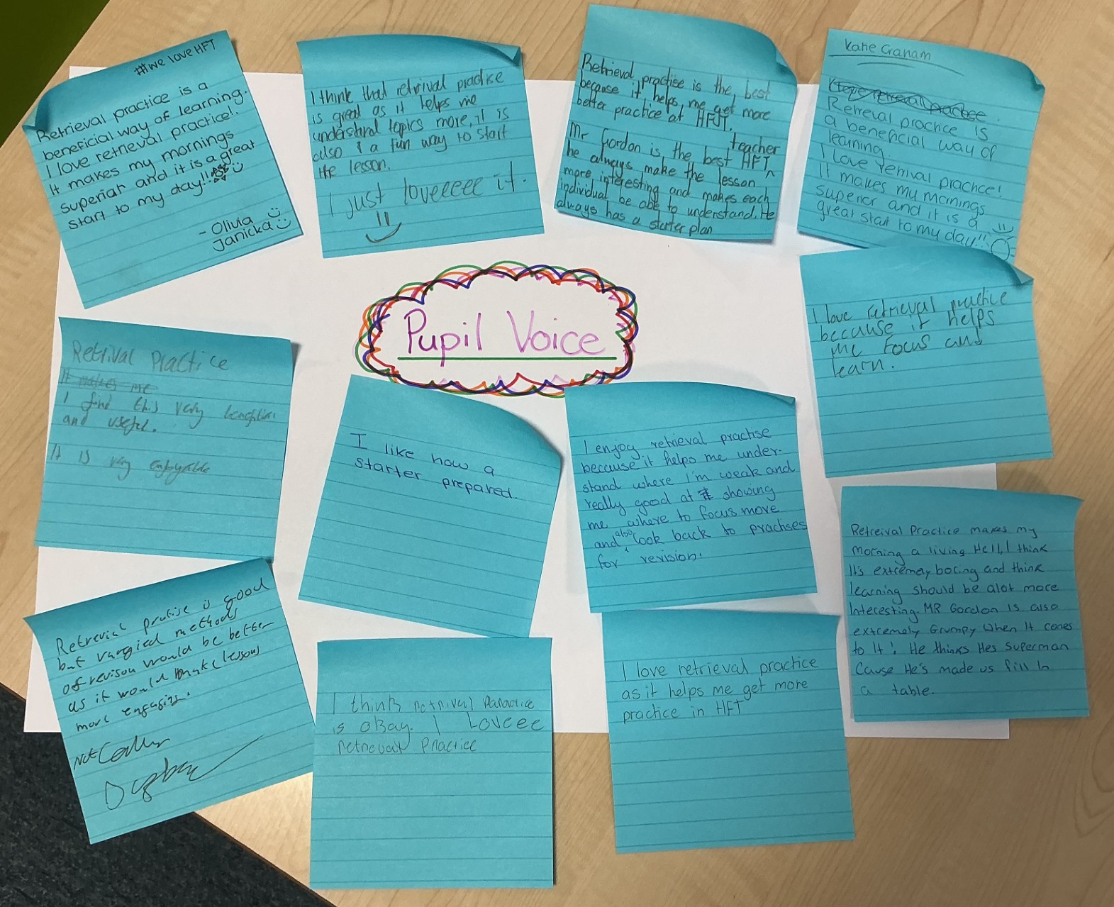
“Retrieval practice is the best because it helps me get better at practice of HFT.”
Findings – Pupil Voice
“I love retrieval practice because it helps me focus and learn.”
“…is a beneficial way of learning… it is a great start to the day”

Slide 17

Individual Pedagogy Improvement Plan
Element of Pedagogy – Teaching and Learning Strategies
Specific Focus – Retrieval Practice with BGE and Senior Phase Classes.
Reflection and Impact
Pupil Reaction – pupil voice suggests pupils enjoy using retrieval practice in lessons.
I find it easy to use and it doesn’t require hours and hours of preparation time to create resources.
Increased learner conversations, clarification of points raised, encouragement of peer dialogue and predictions of an outcome.
It ensures all can be involved. By its very nature it is a differentiated resource (scaffolding or ‘stealing’).

Slide 18
Plenary – Reflection on LI & SC:
We are learning to...
…increase awareness around different retrieval practice techniques.
…understand the 9 Scottish dietary goals using some retrieval techniques.
I will be able to...
…successfully use ‘cops and robbers’ and ‘misconception’ retrieval practice tasks.
…explain the 9 Scottish dietary goals to a peer.

Slide 19
Plenary:
Reflecting on this session, are these resources you could use in your classroom?
Is there a lesson where you could use these techniques easily?

Slide 20


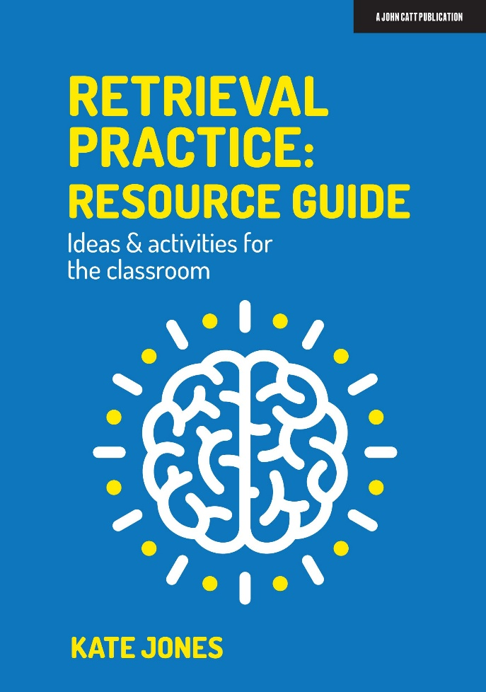


References and Useful Books -
Understanding and Using Educational Theories – Aubrey, K., Riley, A. (2019)
Retrieval Practice: Resource Guide, Ideas and Activities for the Classroom – Jones, K (2021)
Essential Teaching Skills – Kyriacou C (2018)

