Slide 1
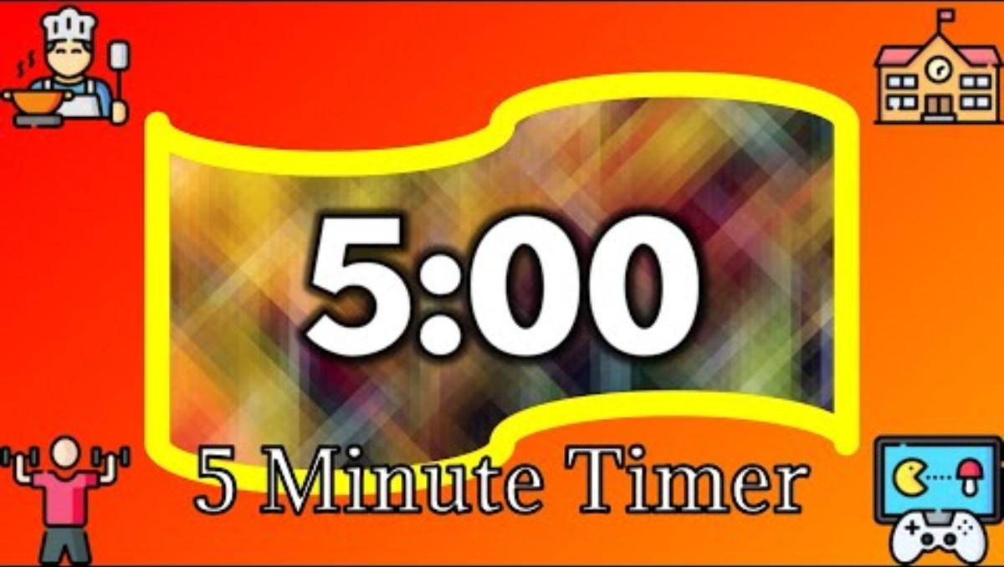
WHAT DOES A STRONG START TO LEARNING LOOK LIKE IN MY CLASSROOM?

Slide 2
Being organised and prepared for the lesson
WHAT DOES A STRONG START TO LEARNING LOOK LIKE IN MY CLASSROOM?
Sharing the learning intentions and the purpose of learning
Establishing routines and practicing those routines
Short review of previous learning
Meeting and greeting pupils at the door
Pupils put their mobile phones in the tray
An appropriate and effective starter task with clear instructions

Slide 3
A Strong Start to Learning
Lewis Matthews

Slide 4
The purpose of today’s session
This short, interactive session focuses on how to establish a strong start to learning.
We will explore some practical strategies to create a positive, purposeful learning environment from the moment learners enter the classroom.
You are going to reflect on your current practice, discuss examples of effective classroom routines, and leave with actionable ideas to implement in your practice.

Slide 5

ENTRY
RETRIEVAL
TRANSITION
CIRCULATION
FEEDBACK

Slide 6

Begin a lesson with a short review of previous learning.
“The review of previous learning can help us recall words, concepts, and procedures effortlessly and automatically when we need this material to solve problems or to understand new material.”

Slide 7
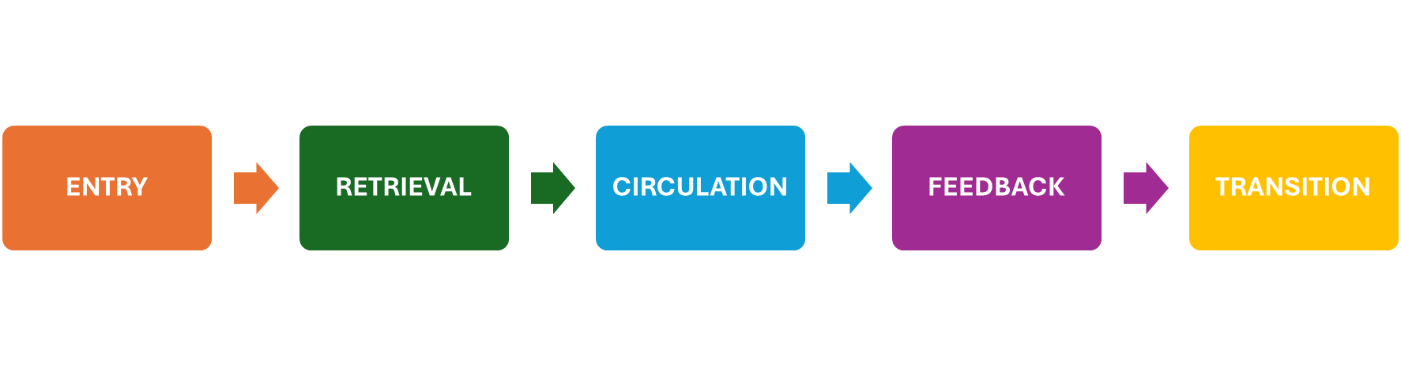
Think of a lesson that you recently delivered
Apply the framework to the start of the lesson
Share with the rest of your group

Slide 8
Challenge questions
ENTRY | How did you greet learners? Was the starter task visible as learners entered the classroom?
RETRIEVAL | How did you include retrieval/prior learning in the starter task?
CIRCULATION | Do you circulate the classroom as learners are completing the starter task?
FEEDBACK | How did you give feedback to learners? How did you question learners?
TRANSISTION | How did you share the learning intentions? Were the learning intentions visible or verbally shared with learners?

Slide 9
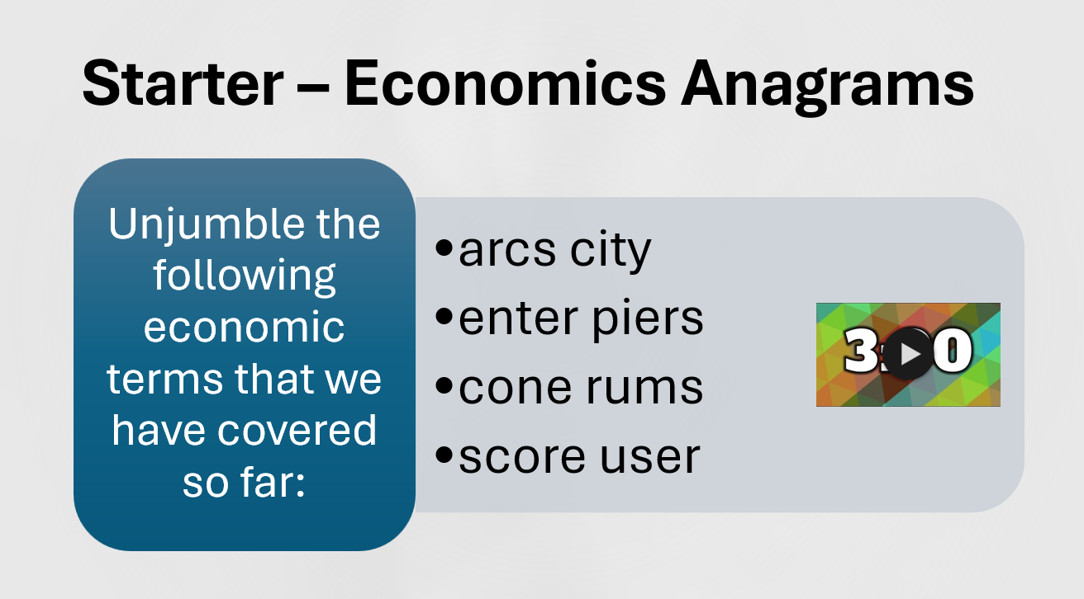
S2 ICT

Slide 10
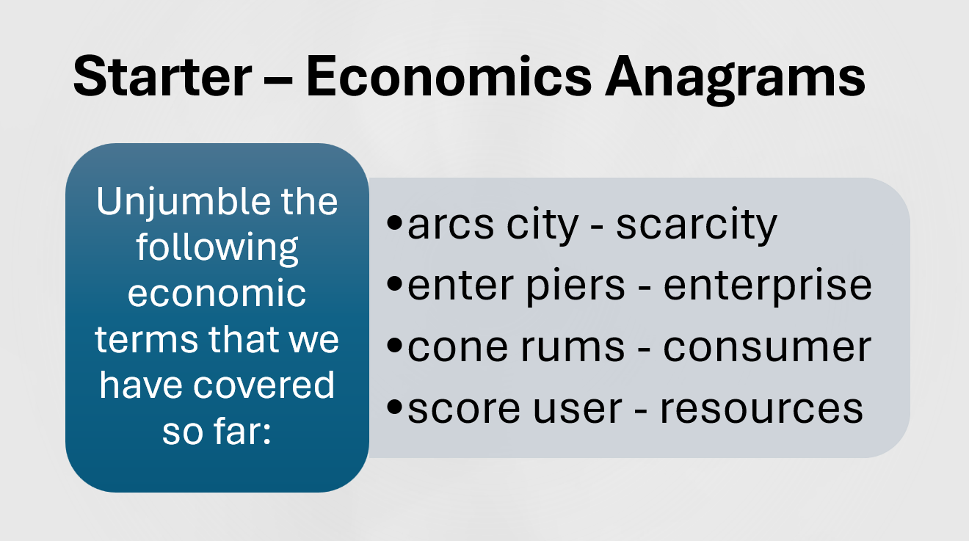
S2 ICT

Slide 11
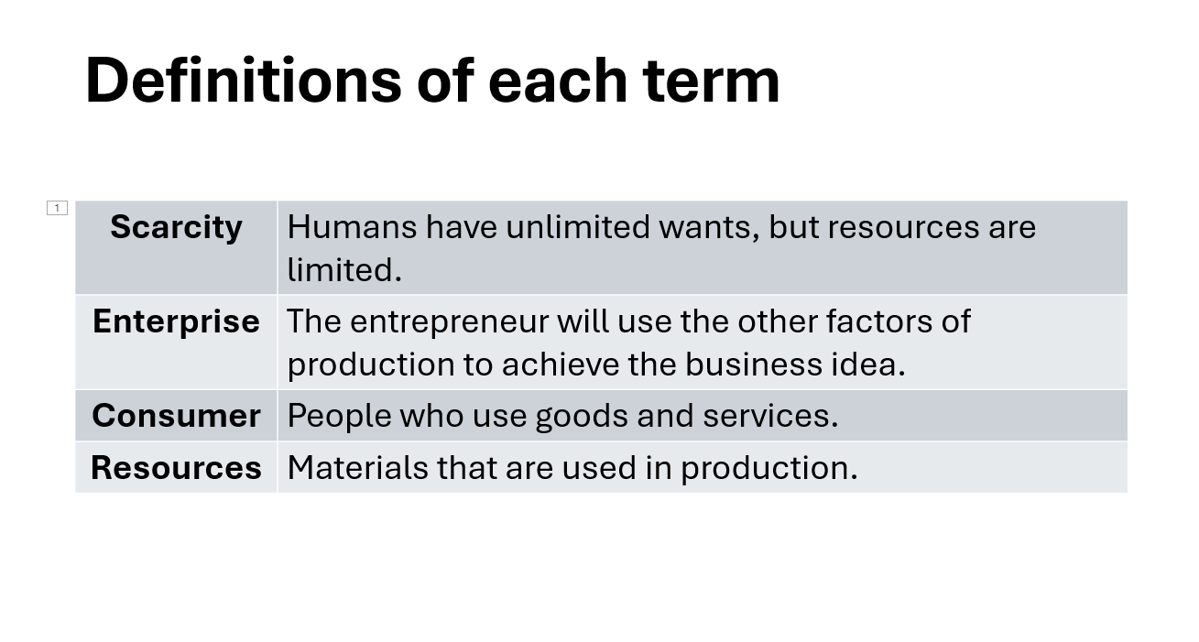
S2 ICT

Slide 12
ENTRY | Meeting and greeting pupils at the door Mobile phones in the tray Starter task is visible to pupils as they enter with clear instructions Reinforces high expectations
RETRIEVAL | Timer starts Learners completing the starter task which is focused on recalling key terms and concepts
CIRCULATION | Register is completed Checking learners are on task Appropriate praise to learners
FEEDBACK | Timer stops Questioning learners about the key terms
TRANSITION | Sharing the learning intentions with the learners Sharing the purpose of the learning that is going to take place

Slide 13
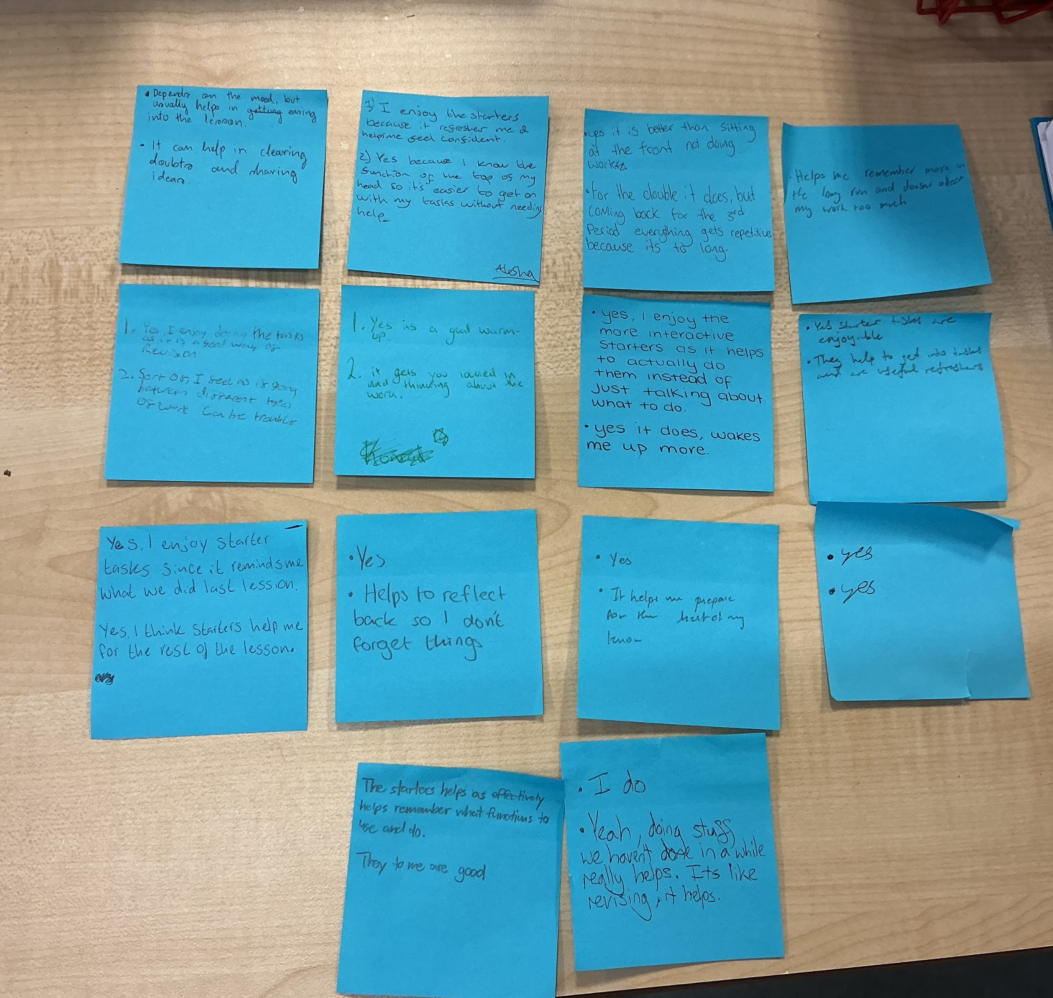
Pupil Voice
Do you enjoy starter tasks like this?
Do you feel a strong start to learning helps you for the rest of the lesson?

Slide 14
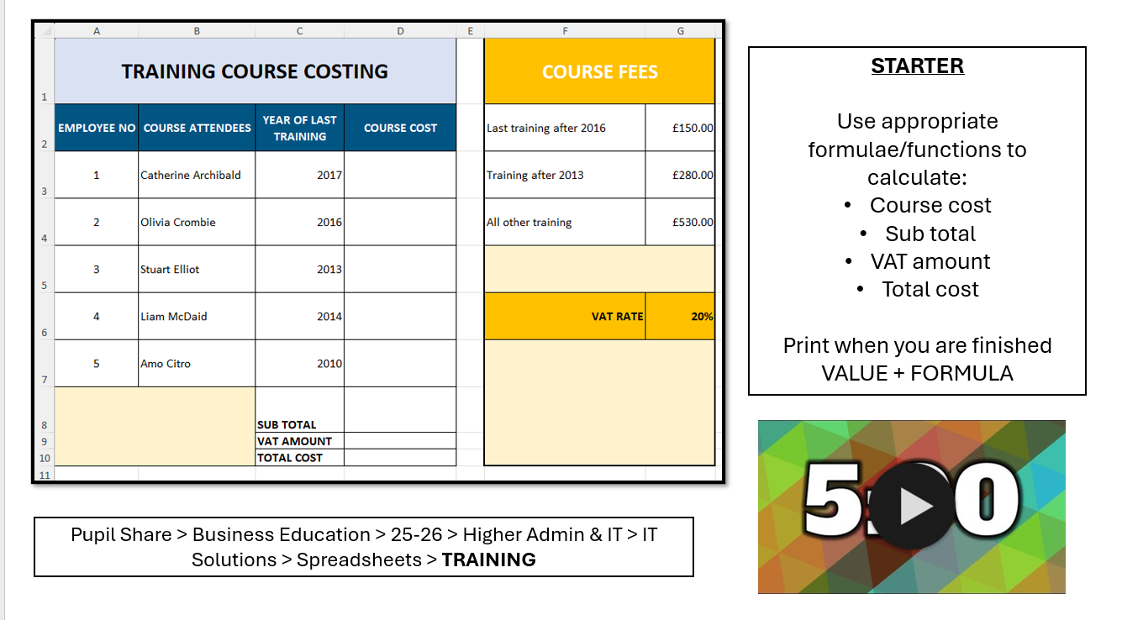
Higher Admin & IT

Slide 15
Learner responses
Do you enjoy starter tasks like this?
Do you feel a strong start to learning helps you for the rest of the lesson?
“I enjoy the starters because it is a refresher and helps me feel confident”
“Depends on the mood, but it helps in easing into the lesson”
“Yes, I enjoy doing the tasks, it is a good way of revision”
“The starters helps as effectively helps remember what functions to use”
“Reminds me of what we did last lesson”
“I enjoy more interactive starters as it helps to actually do them instead of just talking about what to do”
“It gets you locked in and thinking about the work”
“Helps to reflect back so I don’t forget things”
“Helps me remember more in the long run”
“Are useful refreshers”
“It can help in clearing doubt and sharing ideas”
“Doing stuff we haven’t done in a while really helps”
“Yes, it does, it wakes me up more”

Slide 16
Recap of today’s session
What are the 5 stages to a strong start to learning?
ENTRY
RETRIEVAL
TRANSITION
CIRCULATION
FEEDBACK

Slide 17
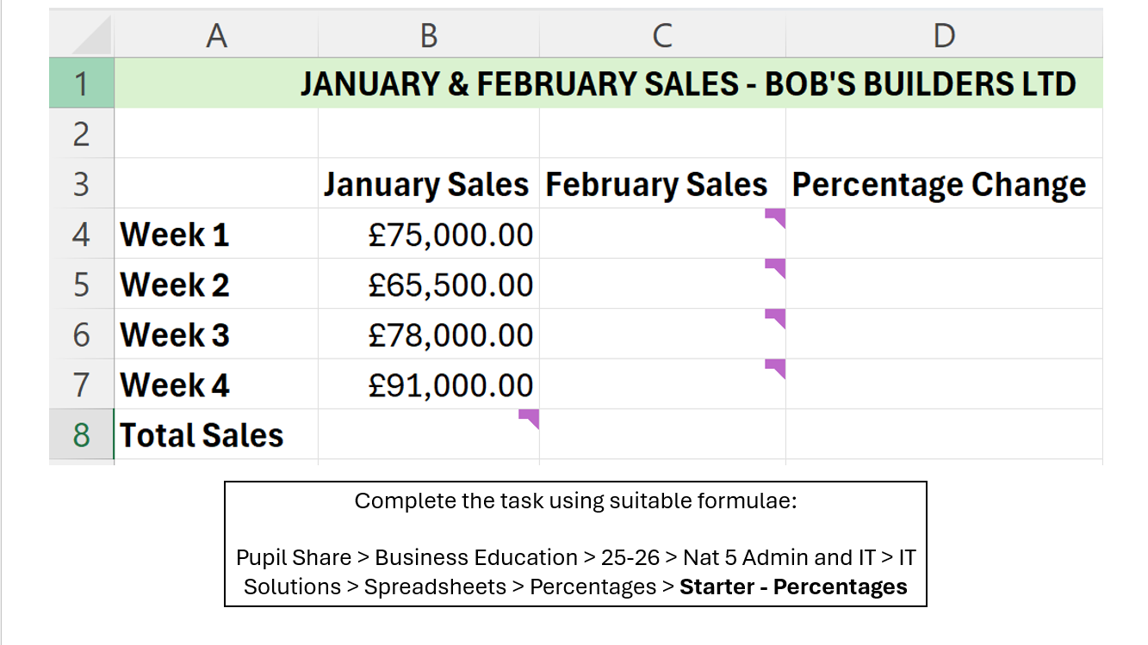
N5 Admin

Slide 18
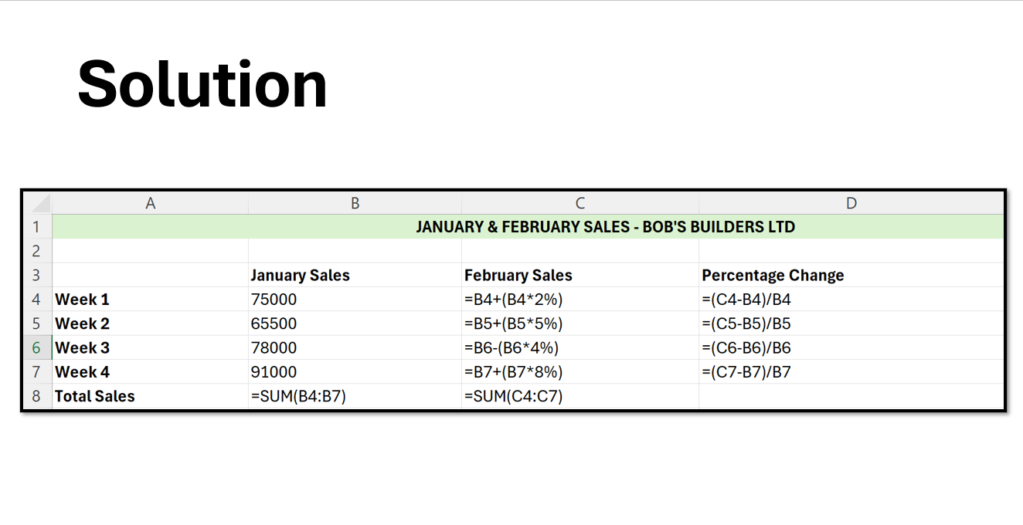
N5 Admin

Slide 19
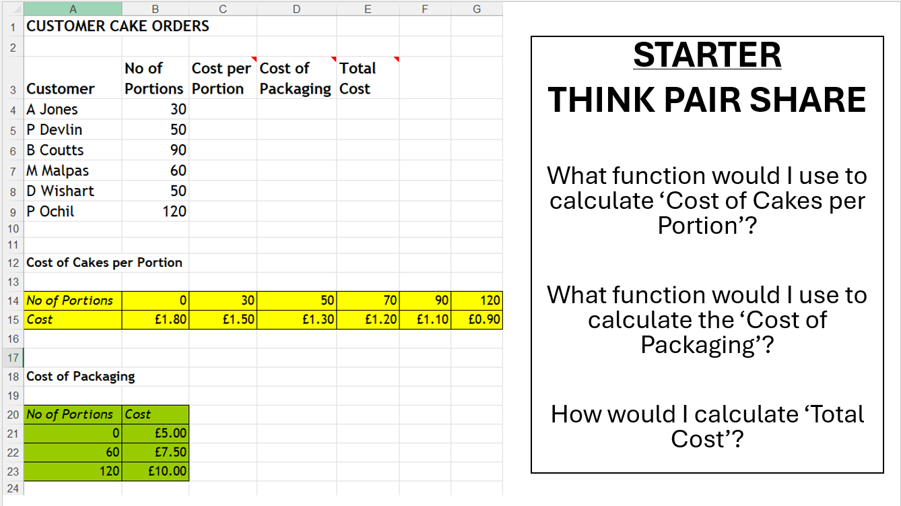
Higher Admin

Slide 20
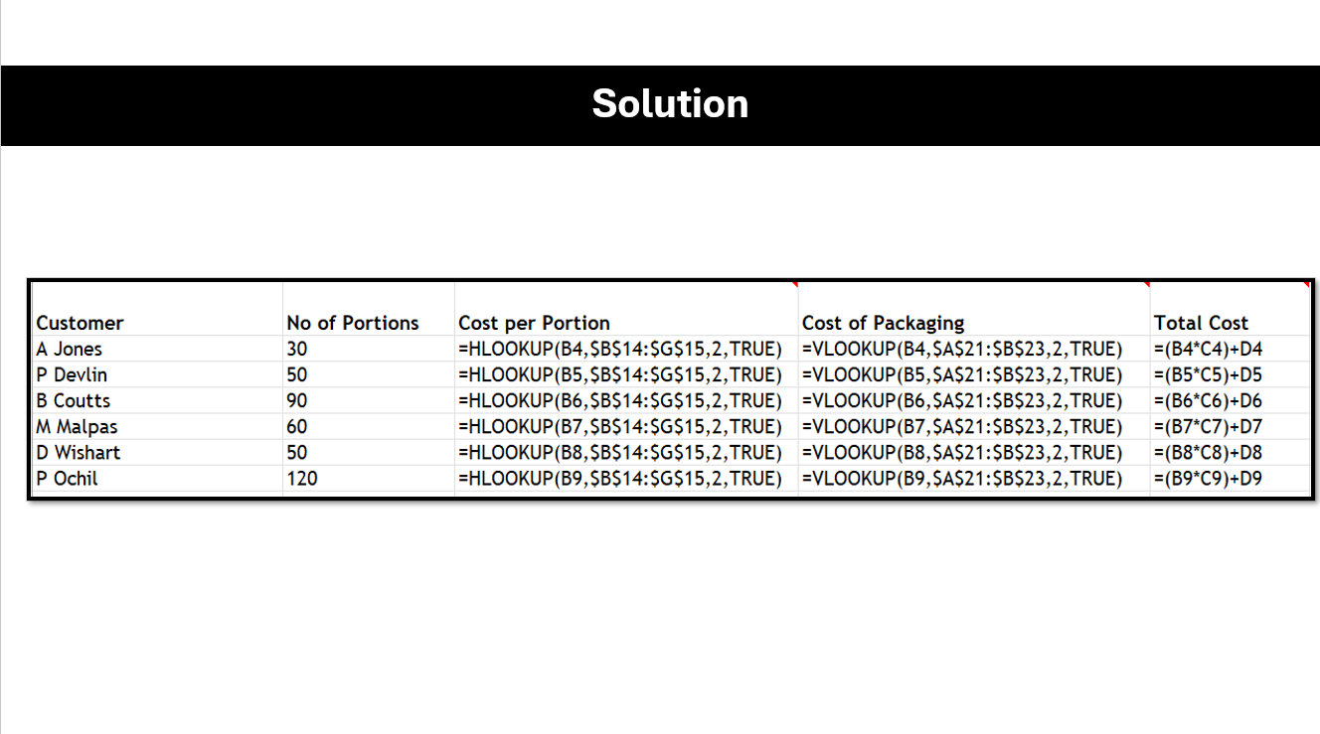
Higher Admin

