Slide 1
Flip Learning Method

Slide 2
What is it?
When Have I Used it?
The flipped learning method (or flipped classroom) is an instructional strategy that reverses the traditional learning environment. Instead of introducing new content during class time, students first explore the material outside of class, typically through videos, readings, or other resources. Then, class time is used for active learning—such as discussions, problem-solving, group work, or applying concepts with teacher guidance.
Woodmill HS
During the winter lockdown
Was part of my probationer enquiry
National Climate Change
Forfar Academy
Had access to Ipads made it easier to use
S3 Population

Slide 3
How is it Used?
Choose the Topic:
Select a lesson or concept that would benefit from deeper in-class exploration—something that students often struggle with or that lends itself to discussion and application.
2. Create Pre-Class Materials
Provide students with resources to learn the basics before class. These could include:
Short video lectures (recorded by you or sourced online)
Readings or interactive presentations
Podcasts or infographics
Quizzes to check understanding
Make sure the materials are: Clear and engaging
Accessible (consider subtitles, mobile-friendly formats)Not too long (ideally 5–15 minutes)

Slide 4
3. Design Active In-Class Activities
Use class time for:
Group discussions
Problem-solving tasks
Role plays or simulations
Peer teaching
feedback
The goal is to apply and deepen understanding, not just repeat content.
4. Assess and Reflect:
Use formative assessment (e.g., exit tickets, mini-quizzes, peer feedback)
Reflect with students on what worked and what didn’t
Adjust materials and activities based on feedback

Slide 5
Pupil Voice- S1 Rainforests
‘I liked doing it on my own’
‘The discussion was fun’
‘I don’t like to talk in front of people so the quiz was better’
‘I didn’t like doing all the work on my own, I prefer when miss Wilson tells me stuff’

Slide 6
My Examples
Flipped Learning Plan: Birth Rate and Death Rate in a Developing Country:
Week 1: Introduction to Population Change
Pre-Class Tasks:
Watch a short video on global population trends (e.g. BBC Bitesize or YouTube).
Read a summary of key terms: birth rate, death rate, natural increase.
In-Class Activities:
Quiz on key terms.
Group discussion: Why do population rates vary globally?
Learning Intention:
I am learning to understand the key terms and global patterns related to population change, including birth rate, death rate, and natural increase.
Success Criteria:
I can define birth rate, death rate, and natural increase using correct geographical terminology.
I can describe global patterns of population change using maps and data.
I can compare population trends between developing and developed countries.
I can contribute to a class discussion about why population rates vary around the world.

Slide 7
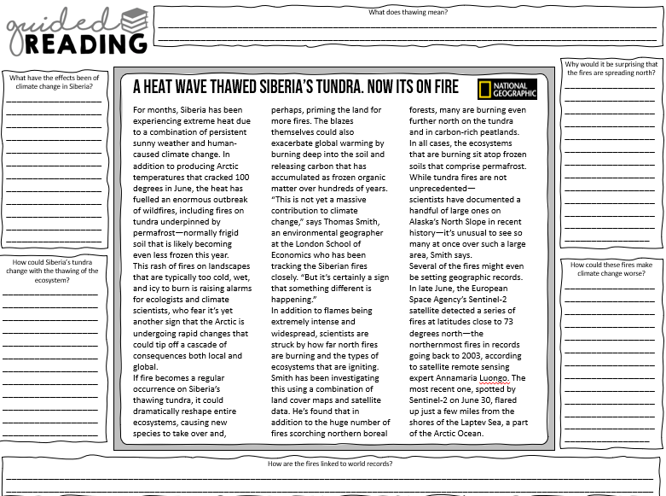
Try it!- The Effects of Climate Change
Learning Intention- To be able to understand the social, economic, and environmental effects of climate change globally and locally, and how these impacts affect people and places.
Success Criteria-
I can Identify at least three global and two local effects of climate change.
I can Categorize effects into social, economic, and environmental groups.
I can Explain how climate change impacts people and the environment using a case study.
I can Answer an exam-style question with relevant examples.
https://www.bbc.co.uk/bitesize/guides/z432pv4/revision/2
https://www.bbc.co.uk/bitesize/guides/z432pv4/revision/5
https://www.internetgeography.net/topics/what-are-the-effects-of-climate-change/

Slide 8
Quiz
1.
Which of the following is NOT an effect of climate change?
Rising sea levels
Increased frequency of extreme weather events
Decrease in global temperatures
Melting glaciers

Slide 9
2.
Which region is most vulnerable to sea-level rise?
Himalayas
Bangladesh
Sahara Desert
Andes Mountains

Slide 10
3.
Name two social effects of climate change.

Slide 11
4.
Match the effect to the category:
Loss of biodiversity
Increased insurance costs
Coastal erosion
Categories: Social / Economic / Environmental

Slide 12
5.
True or False
Climate change only affects developing countries.

Slide 13
6.
Which greenhouse gas is most associated with climate change?
Oxygen
Carbon dioxide
Nitrogen
Helium

Slide 14
7.
Explain why extreme weather events are becoming more frequent due to climate change.

Slide 15
8.
Describe the effects of climate change on people and the environment. (6 marks)

Slide 16
9.
Which of these is an economic effect of climate change in the UK?
Ski resorts closing in Scotland
Increased tropical diseases
Sea-level rise affecting 80 million people globally
Coral reef bleaching

Slide 17
10.
Name two environmental effects of climate change.

Slide 18
11.
Which of these is a potential benefit of climate change in the UK?
Increased flooding
Longer growing season for crops
More frequent droughts
Loss of biodiversity

Slide 19
12.
Which disease is expected to increase due to climate change?
Cholera
Malaria
Influenza
Tuberculosis

